Slide 1
AjaxScope & Doloto: Towards Optimizing Client-side Web 2.0 App Performance
Ben Livshits
livshits@microsoft.com
Microsoft Research
(joint work with Emre Kıcıman)

Slide 2
Motivation
Improve applications we use daily
Take research ideas and techniques from
Compilers and program analysis
Distributed systems
Networking
Web 2.0 apps: a natural choice
Tons of new AJAX apps being developed: bleeding edge
Ability to influence things: new AJAX frameworks
Two projects
AjaxScope: instrumentation platform for AJAX-based Web apps
Doloto: dynamic code loading for faster Web 2.0 apps

Slide 3
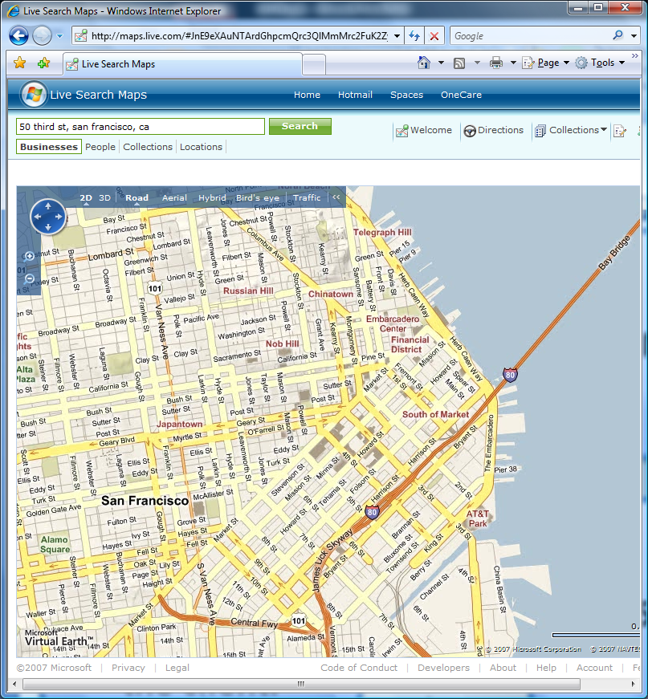
A Web 2.0 Application
Talks to >14 backend services
(traffic, images,
search, directions, ads, …)
~ 1 MB code
70,000+ lines of JavaScript code downloaded to client
2,855 Functions
Notes:
Update the map

Slide 4
Web 1.0 → Web 2.0
Server-side
computation
Static HTML
Client-side
rendering

Slide 5
Web 1.0 → Web 2.0
Server-side
computation
JavaScript
+ DHTML
Complex distributed apps
Static HTML
Client-side
computation
Client-side
rendering

Slide 6
Outline
Web 2.0 Apps
AjaxScope Platform
AjaxScope Policies:
Adaptive performance profiling
Debugging: finding memory leaks
Doloto: Code Splitting & Download Latency
Conclusions

Slide 7
AjaxScope Approach
Goal: Detailed visibility into app behavior in the client
Approach: On-the-fly rewriting to add instrumentation
Key Enabler: Instant re-deployability of web apps

Slide 8
AjaxScope Proxy
Rewritten
Web Page
Rewriting Engine
Web
Page
JS
Parser
Instrumentation #1
Logs
Log
Collector
Pluggable policies
Controls rewriting based on incoming logs
Platform support for adaptive and distributed instrumentation
Instrumentation #2

Slide 9
Monitoring Goals
Performance Optimization
Performance profiling (no browser changes required)
String optimization; cache placement; …
Code splitting and joining, data prefetching
Debugging
Report function arguments, app state, errors
Memory leak checking
Statistical debugging
Test
Code coverage
A/B tests
Operations
Measure RPC network latencies
What features are being used / discovered?

Slide 10
Server-side Deployment
Logs
Logs
Users

Slide 11
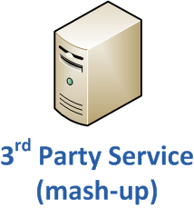
Our Prototype (Client-side)
Researcher/
Developer
Logs

Slide 12
Why “On-the-fly” Rewriting
Service has tight control over code running at client
Clients always download new version
Cache-ability controlled by service
Enables dynamic instrumentation
Use to reduce performance overhead
Adaptive instrumentation
Distributed Instrumentation

Slide 13
Outline
Web Apps
AjaxScope Platform
AjaxScope Policies
Adaptive performance profiling
Debugging: finding memory leaks
Doloto: Code Splitting & Download Latency
Conclusions

Slide 14
Experimental Setup
Profile 90 web sites’ “startup”, client-side AjaxScope
+ 6 more JS-heavy news & game sites
+ 78 sites randomly chosen, weighted by popularity
 | Site | Code Size (kB) | # of Functions | Exec Time (ms)
Maps | maps.google.com | 295 | 1,935 | 530
 | maps.live.com | 924 | 2,855 | 190
Portals | msn.com | 124 | 592 | 300
 | yahoo.com | 278 | 1,097 | 670
 | google.com/ig | 135 | 960 | 190
 | protopages.com | 599 | 1,862 | 13,780

Slide 15
Observe, Analyze, Update Code
Auto-drill-down performance profiling
Iteratively add logging only where needed
<script>
FastFunc1();
FastFunc2();
SlowFunc();
</script>
…
function SlowFunc() {
// drill-down continues
}
<script>
LogTime();
FastFunc1();
LogTime();
FastFunc2();
LogTime();
SlowFunc();
LogTime();
</script>
<script>
LogTime();
FastFunc1();
FastFunc2();
SlowFunc();
LogTime();
</script>
If it’s slow
Found it!

Slide 16
Expt: Adaptative Perf Profiling
Average 30% reduction in
CPU Overhead
95% Average Reduction
in Logging Bandwidth
Notes:
Reduced code “bloat” Avg 3 instr points instead of 89 to capture startup
# of instrumentation points drops from median=89 to 3; mean=129 to 3.7
20% reduction in mean execution overhead
79% reduction in mean logging BW (300KB to 64KB);
95% reduction in median logging BW (92KB to 4KB);

Slide 17
Monitoring for JS Memory Leaks
Memory leaks: major problem for complex apps in older browsers
Caused by circular references across DOM + JavaScript memory heaps
Not a big deal for Web 1.0, but matter for long-running apps
DOM
object
JavaScript
object

Slide 18
Example: CNN.com
var pipelineContainers = document.getElementById("cnnPipelineModule").
getElementsByTagName("div");
...
for (var i=0; i<pipelineContainers.length; i++){
var pipelineContainer = pipelineContainers[i];
if(pipelineContainer.id.substr(0,9) == "plineCntr") {
pipelineContainer.onmouseover = function () {CNN_changeBackground(this,1); return false;}
}
}
First, get DOM elements
Then, set their event handlers to a new function
Notes:
found circular references in google.com/ig , yahoo.com, chi.lexigame.com, cnn.com
Ben: bold all of this, highlight using colors.
Have a picture of circular reference, that comes out of this…

Slide 19
Example: CNN.com
var pipelineContainers = document.getElementById("cnnPipelineModule").
getElementsByTagName("div");
...
for (var i=0; i<pipelineContainers.length; i++){
var pipelineContainer = pipelineContainers[i];
if(pipelineContainer.id.substr(0,9) == "plineCntr") {
pipelineContainer.onmouseover = function () {CNN_changeBackground(this,1); return false;}
}
}
JavaScript
object
DOM
object
function closure references pipelineContainer
Notes:
found circular references in google.com/ig , yahoo.com, chi.lexigame.com, cnn.com
Ben: bold all of this, highlight using colors.
Have a picture of circular reference, that comes out of this…

Slide 20
Checking for Memory Leaks
Check all object assignments for potential cycles
a.b = c;
a.b = c
TraverseHeapAndCheckForCycles(c, a);
Distribute expensive traversals across users
Each user gets random N% of checks
Controls per-user overhead
Notes:
How can I explain memory leaks more succinctly?
Do I need 4 slides?
(probably spent 10min between 19 and slide 22)
Ben: for this slide, simplify, move it to after the example -> and use “a.b = c” as the statement…

Slide 21
Expt: Distributing Expensive Tests
Baseline
Allows fine-grained control over per-user overhead
Trade-off detection time

Slide 22
Outline
Web Apps
AjaxScope Platform
AjaxScope Policies:
Adaptive performance profiling
Debugging: finding memory leaks
Doloto: Download Latency & Code Splitting
Conclusions

Slide 23
Doloto: Code Splitting and Loading
Client-side code is used to reduce latency and improve user experience
Takes a while to transfer code to the client
Idea behind Doloto:
Start with a small piece of code on the client
Transfer code on demand or
When the bandwidth becomes available
Leads to better responsiveness

Slide 24
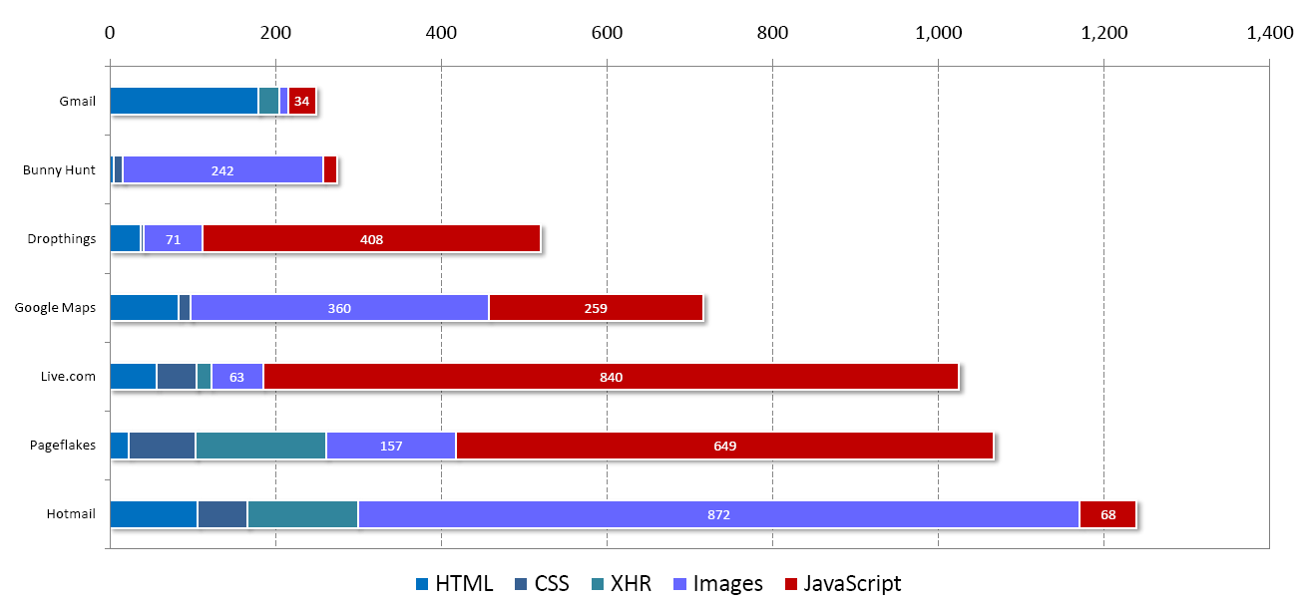
Web 2.0 Application Code
Gmail
Tons and tons of JavaScript code
Bunny Hunt
Drop Things
Google Maps
Live.Com
Pageflakes
Hotmail

Slide 25
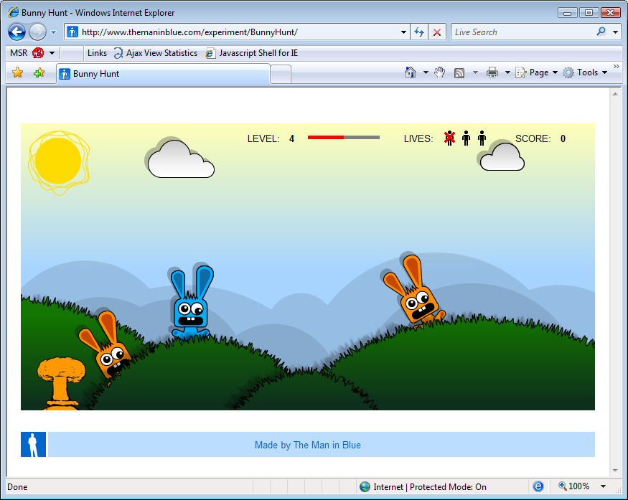
All-at-once Loading: Bunny Hunt
It’s an arcade game
Explicitly download all resources before starting the game
Images, CSS, JS
16KB JavaScript
272KB total
Notes:
55sec (56k modem)
10sec (802.11b)
2.3sec (cable modem)

Slide 26
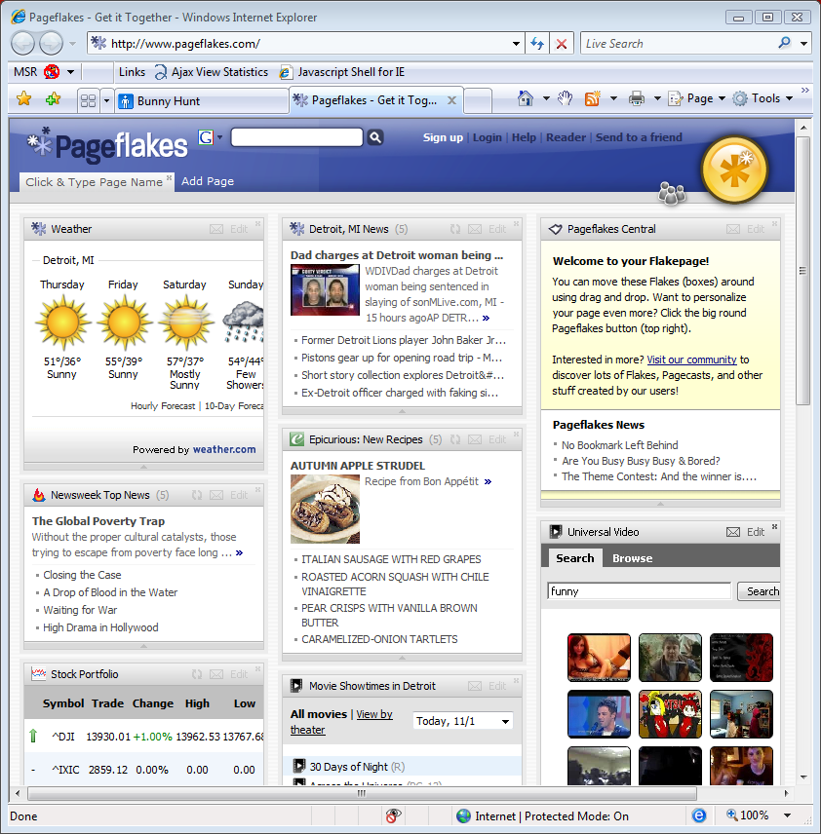
Dynamic Loading: PageFlakes
Mash-up gadget/portal page
>1MB total download (including 640kb JavaScript)
Initial page loads quickly
First loads only small code stub
Rest loaded in the background
Notes:
Another portal (dropthings) loads 400kB of JS but much slower…

Slide 27
Dynamic Loading: Let Everyone Do It
Problem: this is hard to do well manually!
Mechanism itself is simple:
E.g., var myFunc = eval(xmlhttp.responseText)
Or dojo.require(“dojo.widget.*”)
But, have to architect app for splitting
Componentize by expected execution time…
Hard to maintain code splits as app & workload changes
Goal: perform automatic code splitting

Slide 28
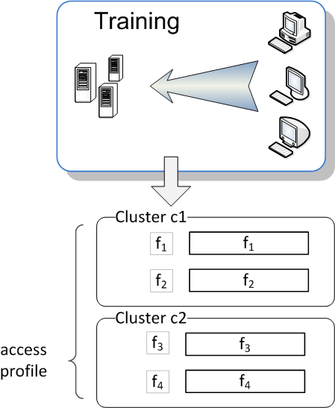
Automated Splitting (1)
1. Capture function-level workloads of app
Cluster functions that are called together
could also be done w/static analysis; except for ‘eval’
Learn what functions are likely to be called when
workload dependent

Slide 29
Automated Splitting (2)
2. Automatically rewrite code for split
Replace unloaded functions with a stub
Use language tricks to allow fine-grained splits
Support closures, optimize runtime cost
var g = 10;
function f1(){
var x=g+1;
…
return …;
}

Slide 30
Automated Splitting (2)
2. Automatically rewrite code for split
Replace unloaded functions with a stub
Use language tricks to allow fine-grained splits
Support closures, optimize runtime cost
var g=10;
var real_f1;
function f1() {
if(!real_f1){
var code=load(“f1”);
real_f1=this.eval(code);
f1 = real_f1;
}
return real_f1.apply(this,
arguments);
}
var g = 10;
function f1(){
var x=g+1;
…
return …;
}

Slide 31
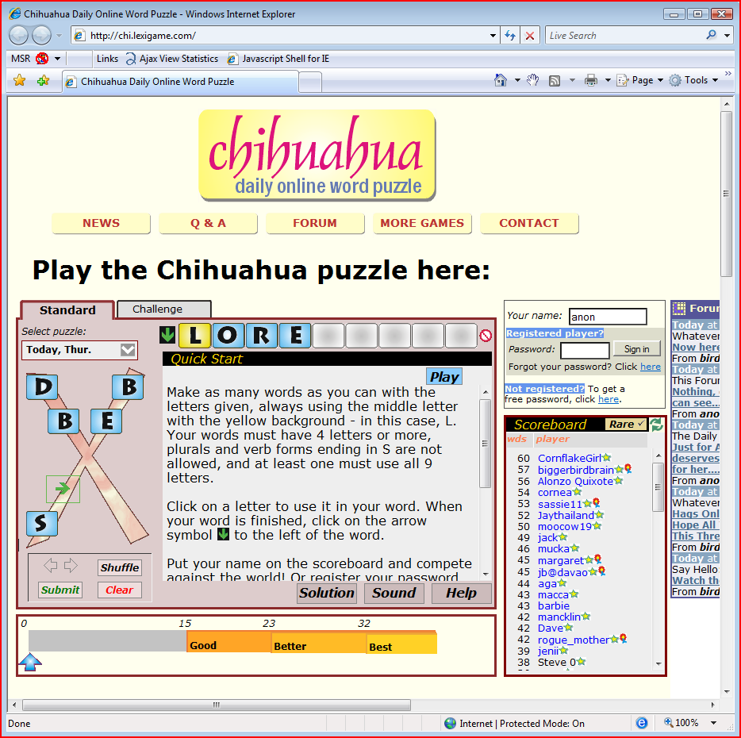
Small End-to-end Test-case
Word puzzle
http://chi.lexigame.com
107kb JavaScript
212kb total
By default, loads all at startup
Reduced to 88kb (18%) JavaScript initial download
Rest downloaded in background / on-demand

Slide 32
Next Steps
Testing on larger applications:
Apply static analysis to avoid injecting all stubs
Adapt code splits to changing workloads
Web App | Total JS Size | % of functions used on load | # of code bytes used on load
Dropthings | 480kB | 26% | 44kB
Google Maps | 643kB | 28% | 98kB
Live.com | 840kB | 18% | 496kB
Pageflakes | 904kB | 10% | 421kB

Slide 33
Doloto Demo (sort of)

Slide 34
Questions?
Download AjaxScope/Ajax View prototype:
http://research.microsoft.com/projects/ajaxview/

