Slide 1
A Couple of Ways to Skin an Internet-Scale Cat
Jim Webber
http://jim.webber.name

Slide 2
Roadmap
A little Swedish
Some home truths
  About Web Services and the Web
Implementing Workflows
  The Starbuck’s example
Q&A

Slide 3
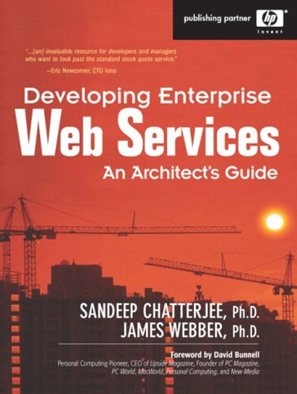
Jag heter Jim und kommer du England
I like Web Services
  I am a MESTian at heart
I like the Web
  But I have sympathies that lie with the RESTafarians
I wrote this book, about WS-*

Slide 4
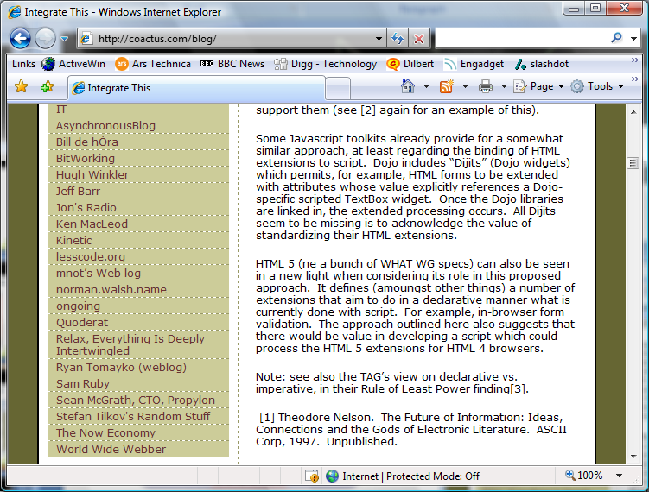
Jag heter Jim und kommer du England
I like Web Services
  I am a MESTian at heart
I like the Web
  But I have sympathies that lie with the RESTafarians
I am “similarly minded”
Mark Baker’s consulting company, Coactus
That’s me

Slide 5
What is a Web Service?
A Web Service is a system which exposes a message oriented-interface whose messages are in SOAP format
  SOAP is the lowest point in the WS stack
A Web Service is just a technical mechanism for hosting a business process

Slide 6
A Web Services Application
Example: ServiceA sends ServiceB a MessageX. ServiceB responds with a MessageY or a MessageZ depending on the content of the MessageX it received.

Slide 7
Typical SOA with Web Services

Slide 8
Services Support Protocols

Slide 9
Engineered or Loose Coupling

Slide 10

Web Services are Evil?
I hate WSDL. I wanna kick it squarely in the nuts!
Two things:
  WSDL
    It’s an XML IDL for RPC
    Therefore ill-suited for Internet scale
  All the superfluous WS-* standards and politics
    Too many dumb WS-KitchenSink standards
      Not everything needs to be an OASIS standard!
    Too many useful tools spent too long in standards wars
      3 transactions specs? Anyone heard of consistency???
Toolkits hide messaging model, provide leaky abstractions over a distributed system
Photo: Comedy Central

Slide 11
SSDL Embraces Messages
WSDL is limited to request-response interactions
  Can theoretically augment with BPEL for conversations
  In practice tool support is limited, approach is verbose and complex
SOAP Service Description Language (SSDL) is better!
  All messages are SOAP + WS-Addressing over arbitrary transports specified by URI
  Metadata describes conversation state machine for 1...N services
    It does what WS-Choreography does too!
  Tool support: http://soya.sourceforge.net

Slide 12

Why Web Services Rock My World
could
Good Web Services/SOA are message-oriented
  TCP/IP is message-oriented and has scaled really well!
  SOAP Service Description Language provides message-oriented metadata for services
    WSDL must die, die, die!
Business processes tend to be message-oriented
  Easy to map workflows onto
Loose coupling by default
End-to-end processing model
  Defined by SOAP, not WSDL!
Composable model
  You can ignore all the dumb stuff in the WS-* stack
    Except WSDL because the toolkits embrace it ☹
Photo: Comedy Central

Slide 13
Web Abuse
Tunnelling is all a bunch of tree-hugging hippy crap!
Two lo-fi approaches to
“Web” integration
  URI tunnelling
  POX
Both models treat HTTP as a transport
  More or less
Yet some of the Web jihadists don’t see this
Both of these approaches overlay the Web with their own (weak) models...
Photo: Comedy Central

Slide 14
Web Tunnelling
Remember: SOAP + WS-Addressing is transport neutral
Web Services tunnel SOAP over HTTP
  Using the Web as a transport only
  Ignoring many of the features for robustness the Web has built in
Lots of Web people doing the same!
  URI tunnelling, POX approaches are the most popular styles on today’s Web
  Worse than SOAP!
    Less metadata!
But they claim to be “lightweight” and RESTful

Slide 15
URI Tunnelling Pattern
Web servers understand URIs
URIs have structure
Methods have signatures
Can match URI structure to method signature
E.g.
  http://example.com/addNumbers?p1=10&p2=11
  int addNumbers(int i, int j) { return i + j; }

Slide 16
URI Tunnelling Strengths
Very easy to understand
Great for simple procedure-calls
Simple to code
  Do it with the servlet API, HttpListener, IHttpHandler, Rails controllers, whatever!
Interoperable
  It’s just URIs!

Slide 17
URI Tunnelling Weaknesses
It’s brittle RPC!
Tight coupling, no metadata
  No typing or “return values” specified in the URI
Not robust – have to handle failure cases manually
No metadata support
  Construct the URIs yourself, map them to the function manually
You can use GET (but also POST)
  OK for functions, but contrary to the Web for functions with side-affects

Slide 18
POX Pattern
Web servers understand how to process requests with bodies
  Because they understand forms
And how to respond with a body
  Because that’s how the Web works
POX uses XML in the HTTP request and response to move a call stack between client and server

Slide 19
POX Strengths
Simplicity – just use HTTP POST and XML
Re-use existing infrastructure and libraries
Interoperable
  It’s just XML and HTTP POST
Can use complex data structures
  By representing them in XML

Slide 20
POX Weaknesses
Client and server must collude on XML payload
  Tightly coupled approach
No metadata support
  Unless you’re using a POX toolkit that supports WSDL with HTTP binding (like WCF)
Does not use Web for robustness
Does not use SOAP + WS-* for robustness

Slide 21

RPC is Commonplace Today
To err is human, to really mess things up you need a computer
To really, really mess things up you need a distributed system
  “A Note on Distributed Computing”
Bad Web Services and Web integration
have much in common
  It’s RPC!
  With latencies and nasty partial failure characteristics

Slide 22
</rant>

Slide 23
Web Fundamentals
To embrace the Web, we need to understand how it works
  Which means understanding RFC 2616 to a degree
The Web is a distributed hypermedia model
  It doesn’t try to hide that distribution from you!
Our challenge:
  Figure out the mapping between our problem domain and the underlying Web platform

Slide 24
Web History
Started as a distributed hypermedia platform
  CERN, Berners-Lee, 1990
Revolutionised hypermedia
  Imagine emailing someone a hypermedia deck nowadays!
Architecture of the Web largely fortuitous
  W3C and others have since retrofitted/captured the Web’s architectural characteristics

Slide 25
The REST Architectural Style
Fielding captured his interpretation of the WWW architecture in his 2000 thesis
  REpresentational State Transfer (REST)
Since then the Web community has been working on ways to make distributed systems behave more like the Web
  Championed by some very vocal people!

Slide 26
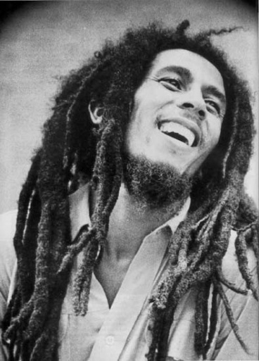

RESTafarians?
Bob Marley
Photo by PanAfrican.tv
Mark Baker,
Photo by Paul Downey

Slide 27
Web Characteristics
Scalable
Fault-tolerant
Recoverable
Secure
Loosely coupled
Precisely the same characteristics we want in business software systems!

Slide 28
Scalability
Web is truly Internet-scale
  Uniform interface
    HTTP defines a standard interface for all actors on the Web
    Replication and caching is baked into this model
      Caches have the same interface as real resources!
  Stateless model
    Supports horizontal scaling

Slide 29
Fault Tolerant
The Web supports a stateless model
  All information required to process a request must be present in that request
    Sessions are still available, but must be handled in a Web-consistent manner
Statelessness also means easy replication
  One Web server is replaceable with another
  Easy fail-over, horizontal scaling

Slide 30
Recoverable
The Web places emphasis on repeatable information retrieval
  In failure cases, can safely repeat GET on resources
HTTP verbs plus rich error handling help to remove guesswork from recovery
  HTTP statuses tell you what happened!

Slide 31
Secure
HTTPs is a mature technology
  Based on SSL for secure point-to-point information retrieval
Isn’t sympathetic to Web architecture
  Can’t cache!
But $billions transacted through HTTPs everyday

Slide 32
Loosely Coupled
Adding a Web site to the WWW does not affect any other existing sites
All Web actors support the same, uniform interface
  Easy to plumb new caches, proxies, servers, resources, etc into the Web

Slide 33
Tenets for Web-based Services
Resource-based
  Rather than service-oriented
Addressability
  Interesting things should have names
Statelessness
  No stateful conversations with a resource
Representations
  Resources can be serialised into representations
Links
  Resources
Uniform Interface
  No plumbing surprises!

Slide 34
Resources
A resource is something “interesting” in your system
Can be anything
  Spreadsheet (or one of its cells)
  Blog posting
  Printer
  Winning lottery numbers
  A transaction
  Others?
Making your system Web-friendly increases its surface area
  You expose many resources, rather than fewer endpoints

Slide 35
Resource Representations
We deal with representations of resources
  Not the resources themselves
    “Pass-by-value” semantics
  Representation can be in any format
    Any media type
Each resource has one or more representations
  Representations like JSON or XML are good for Web-based services
Each resource implements the uniform HTTP interface
Resources have names and addresses (URIs)

Slide 36
Resource Architecture
Consumer
(Web Client)
Uniform Interface
(Web Server)
Logical Resources
Resource Representation
(e.g. XML document)
Physical Resources

Slide 37
URIs
See URI Templates later...
Resource URIs should be descriptive, predictable?
  http://spreadsheet/cells/a2,a9
  http://jim.webber.name/2007/06.aspx
    Convey some ideas about how the underlying resources are arranged
    Can infer http://spreadsheet/cells/b0,b10 and http://jim.webber.name/2005/05.aspx for example
URIs should be opaque?
  http://tinyurl.com/6
  TimBL says “opque URIs are cool”
    Convey no semantics, can’t infer anything from them
      Can’t introduce coupling

Slide 38
URI Templates, in brief
Use URI templates to make your resource structure easy to understand – transparent!
For Amazon S3 (storage service) it’s easy:
  http://s3.amazon.com/{bucket-name}/{object-name}
Bucket1
Bucket2
Object2
Object1
Object1
Object3
Object2

Slide 39
URI Templates in Action
Once you can reason about a URI, you can apply the standard HTTP techniques to it
  Because of the uniform interface
You have metadata for each resource
  OPTIONS, HEAD
  Which yield permitted verbs and resource representations
Can program against this easily using Web client libraries and regular expressions

Slide 40
Links
Connectedness is good in Web-based systems
Resource representations can contain other URIs
  Resources contain links (or URI templates) to other resources
Links act as state transitions
  Think of resources as states in a state machine
  And links as state transitions
Application (conversation) state is captured in terms of these states
  Server state is captured in the resources themselves, and their underlying data stores

Slide 41
The HTTP Verbs
Retrieve a representation of a resource: GET
Get metadata about an existing resource: HEAD
Create a new resource: PUT to a new URI,
or POST to an existing URI
Modify an existing resource: PUT to an
existing URI
Delete an existing resource: DELETE
See which of the verbs the resource
understands: OPTIONS
Decreasing likelihood of being understood by a Web server today

Slide 42
GET Semantics
GET retrieves the representation of a resource
Should be idempotent
  Shared understanding of GET semantics
  Don’t violate that understanding!

Slide 43
POST Semantics
POST creates a new resource
But the server decides on that resource’s URI
Common human Web example: posting to a blog
  Server decides URI of posting and any comments made on that post
Programmatic Web example: creating a new employee record
  And subsequently adding to it

Slide 44
POST Request
Verb, path, and HTTP version
POST / HTTP/1.1
Content-Type: text/xml
Host: localhost:8888
Content-Length: ....
Connection: Keep-Alive
<buy>
<symbol>ABCD</symbol>
<price>27.39</price>
</buy>
Content type (XML)
Content (again XML)

Slide 45
POST Response
201 CREATED
Location: /orders/jwebber/ABCD/2007-07-08-13-50-53

Slide 46
PUT Semantics
PUT creates a new resource but the client decides on the URI
  Providing the server logic allows it
Also used to update existing resources by overwriting them in-place
Don’t use POST here
  Because PUT is idempotent!

Slide 47
PUT Request
PUT /orders/jwebber/ABCD/2007-07-08-13-50-53 HTTP/1.1
Content-Type: text/xml
Host: localhost:8888
Content-Length: ....
Connection: Keep-Alive
<buy>
<symbol>ABCD</symbol>
<price>27.44</price>
</buy>
Verb, path and HTTP version
Updated content
(higher buy price)

Slide 48
PUT Response
200 OK
Location: /orders/jwebber/ABCD/2007-07-080-13:50:53
Content-Type: application/xml
<nyse:priceUpdated .../>
Minimalist response might contain only status and location

Slide 49
DELETE Semantics
This is important for decoupling implementation details from resources
Stop the resource from being accessible
  Logical delete, not necessarily physical
Request
  DELETE /user/jwebber HTTP 1.1
  Host: example.org
Response
  200 OK
  Content-Type: application/xml
  <admin:userDeleted>
  jwebber
  </admin:userDeleted>

Slide 50
HEAD Semantics
HEAD is like GET, except it only retrieves metadata
Request
  HEAD /user/jwebber HTTP 1.1
  Host: example.org
Response
  200 OK
  Content-Type: application/xml
  Last-Modified: 2007-07-08T15:00:34Z
  ETag: aabd653b-65d0-74da-bc63-4bca-ba3ef3f50432
Useful for caching, performance

Slide 51
OPTIONS Semantics
Asks which methods are supported by a resource
  Easy to spot read-only resources for example
Request
  OPTIONS /user/jwebber HTTP 1.1
  Host: example.org
Response
  200 OK
  Allowed: GET,HEAD,POST
You can only read and add to this resource

Slide 52
HTTP Status Codes
The HTTP status codes provide metadata about the state of resources
They are part of what makes the Web a rich platform for building distributed systems
They cover five broad categories
  1xx - Metadata
  2xx – Everything’s fine
  3xx – Redirection
  4xx – Client did something wrong
  5xx – Server did a bad thing
There are a handful of these codes that we need to know in more detail

Slide 53
Common Status Codes
100 – Continue
200 – OK
201 – Created
301 – Moved Permanently
303 – See Other
304 – Not Modified
400 – Bad Request
401 – Unauthorised
403 – Forbidden
404 – Not Found
405 – Method Not Allowed
500 – Internal Server Error

Slide 54
HTTP Headers
Headers provide metadata to assist processing
  Identify resource representation format (media type), length of payload, supported verbs, etc
HTTP defines a wealth of these
  And like status codes they are our building blocks for robust service implementations

Slide 55
Some Useful Headers
Authorization
  Contains credentials (basic, digest, WSSE, etc)
  Extensible
Content-Type
  The resource representation form
    E.g. application/xml, application/xhtml+xml
ETag/If-None-Match
  Opaque identifier – think “checksum” for resource representations
  Used for conditional GET
If-Modified-Since/Last-Modified
  Used for conditional GET too
Location
  Used to flag the location of a created/moved resource
  In combination with:
    201 Created, 301 Moved Permanently, 302 Found, 307 Temporary Redirect, 300 Multiple Choices, 303 See Other
WWW-Authenticate
  Used with 401 status
    Tells client what authentication is needed

Slide 56
We have a comprehensive model for distributed computing…
… but we still need a way of programming it.

Slide 57
Describing Contracts with Links
The value of the Web is its “linked-ness”
  Links on a Web page constitute a contract/API for page traversals
The same is true of the programmatic Web
Use Links to describe state transitions in programmatic Web services
  By navigating resources (aka application state)

Slide 58
Links as APIs
<confirm xmlns="...">
<link rel="payment" href="https://pay"
type="application/xml"/>
<link rel="postpone" href="https://wishlist"
type="application/xml"/>
</confirm>
Following a link causes an action to occur
This is the start of a state machine!
Links lead to other resources which also have links
Can make this stronger with semantics
  Microformats

Slide 59
Links are State Transitions
Select
Confirm
Pay
Ship
Wishlist

Slide 60
Microformats
Microformats are an example of little “s” semantics
Innovation at the edges of the Web
  Not by some central design authority (e.g. W3C)
Started by embedding machine-processable elements in Web pages
  E.g. Calendar information, contact information, etc
  Using existing HTML features like class, rel, etc

Slide 61
Microformats and Resources
Use Microformats to structure resources where formats exist
  I.e. Use hCard for contacts, hCalendar for data
Create your own formats (sparingly) in other places
  Annotating links is a good start
  <link rel="withdraw.cash" .../>
  <link rel="service.post" type="application/x.atom+xml" href="{post-uri}" title="some title">
The rel attribute describes the semantics of the referred resource

Slide 62
“Subjunctive Programming”
With changing contracts embedded as part of a resource, we can’t be too imperative anymore
Think “subjunctive”
Code for Web integration by thinking “what if” rather than “if then”
  The Web is declarative!

Slide 63
We have a framework!
The Web gives us a processing and metadata model
  Verbs and status codes
  Headers
Gives us metadata contracts or Web “APIs”
  URI Templates
  Links
Strengthened with semantics
  Little “s”

Slide 64
Workflow
How does a typical enterprise workflow look when it’s implemented in a Web-friendly way?
Let’s take Starbuck’s as an example, the happy path is:
  Make selection
    Add any specialities
  Pay
  Wait for a while
  Collect drink

Slide 65
Workflow and MOM
With Web Services we exchange messages with the service
Resource state is hidden from view
Conversation state is all we know
  Advertise it with SSDL, BPEL
Uniform interface, roles defined by SOAP
  No “operations”

Slide 66
Web-friendly Workflow
What happens if workflow stages are modelled as resources?
And state transitions are modelled as hyperlinks or URI templates?
And events modelled by traversing links and changing resource states?
Answer: we get Web-friendly workflow
  With all the quality of service provided by the Web

Slide 67
Placing an Order
Place your order by POSTing it to a well-known URI
  http://example.starbucks.com/order
Client
Starbuck’s Service

Slide 68
Placing an Order: On the Wire
Request
POST /order HTTP 1.1
Host: starbucks.example.com
Content-Type: application/xml
Content-Length: ...
<order xmlns="urn:starbucks">
<drink>latte</drink>
</order>
Response
201 Created
Location: http://starbucks.example.com/order?1234
Content-Type: application/xml
Content-Length: ...
<order xmlns="urn:starbucks">
<drink>latte</drink>
<link rel="payment" href="https://starbucks.example.com/payment/order?1234"
type="application/xml"/>
</order>
If we have a (private) microformat, this can become a neat API!
A link! Is this the start of an API?

Slide 69
Whoops! A mistake
I like my coffee to taste like coffee!
I need another shot of espresso
  What are my OPTIONS?
Request
OPTIONS /order?1234 HTTP 1.1
Host: starbucks.example.com
Response
Allow: GET, PUT
Phew! I can update my order

Slide 70
Look Before You Leap
See if the resource has changed since you submitted your order
  If you’re fast your drink hasn’t been prepared yet
Request
PUT /order?1234 HTTP 1.1
Host: starbucks.example.com
Expect: 100-Continue
Response
200 OK
I can still PUT this resource, for now

Slide 71
Amending an Order
Add specialities to you order via PUT
  Starbucks needs 2 shots!
Client
Starbuck’s Service

Slide 72
Amending an Order: On the Wire
Request
PUT /order?1234 HTTP 1.1
Host: starbucks.example.com
Content-Type: application/xml
Content-Length: ...
<order xmlns="urn:starbucks">
<drink>latte</drink>
<additions>shot</additions>
<link rel="payment" href="https://starbucks.example.com/payment/order?1234"
type="application/xml"/>
</order>
Response
200 OK
Location: http://starbucks.example.com/order?1234
Content-Type: application/xml
Content-Length: ...
<order xmlns="urn:starbucks">
<drink>latte</drink>
<additions>shot</additions>
<link rel="payment" href="https://starbucks.example.com/payment/order?1234"
type="application/xml"/>
</order>

Slide 73
Statelessness
Remember interactions with resources are stateless
The resource “forgets” about you while you’re not directly interacting with it
Which means race conditions are possible
Use If-Unmodified-Since to make sure
You’ll get a 412 – Precondition Failed if you lost the race
  But you’ll avoid potentially putting the resource into some inconsistent state

Slide 74
Warning: Don’t be Slow!
Can only make changes until someone actually makes your drink
  Resources can change without your intervention
Request
PUT /order?1234 HTTP 1.1
Host: starbucks.example.com
...
Response
409 - Conflict
Too slow! Someone else has changed the state of my order
Request
OPTIONS /order?1234 HTTP 1.1
Host: starbucks.example.com
Response
Allow: GET

Slide 75
Order Confirmation
Check your order status by GETing it
Client
Starbuck’s Service

Slide 76
Order Confirmation: On the Wire
Request
GET /order?1234 HTTP 1.1
Host: starbucks.example.com
Content-Type: application/xml
Content-Length: ...
Response
200 OK
Location: http://starbucks.example.com/order?1234
Content-Type: application/xml
Content-Length: ...
<order xmlns="urn:starbucks">
<drink>latte</drink>
<additions>shot</additions>
<link rel="payment" href="https://starbucks.example.com/order?1234"
type="application/xml"/>
</order>
Are they trying to tell me something?

Slide 77
Order Payment
POST your payment to the order resource
  https://starbucks.example.com/order?1234
Client
Starbuck’s Service
New resource!
https://starbucks.example.com/payment/order?1234
Notes:
This could be better with POST and the Starbucks knows the URI template for PUT
Let the client only use the Links in the resources to interact with the service

Slide 78
How did I know to POST?
The client knew the URI to POST to from the link
Verified with OPTIONS
  Just in case you were in any doubt ☺
Request
OPTIONS /payment/order?1234 HTTP 1.1
Host: starbucks.example.com
Response
Allow: POST

Slide 79
Order Payment: On the Wire
Request
POST /order?1234 HTTP 1.1
Host: starbucks.example.com
Content-Type: application/xml
Content-Length: ...
<payment xmlns="urn:starbucks">
<cardNo>123456789</cardNo>
<expires>07/07</expires>
<name>John Citizen</name>
<amount>4.00</amount>
</payment>
Response
201 Created
Location: https://starbucks.example.com/payment/order?1234
Content-Type: application/xml
Content-Length: ...
<payment xmlns="urn:starbucks">
<cardNo>123456789</cardNo>
<expires>07/07</expires>
<name>John Citizen</name>
<amount>4.00</amount>
</payment>

Slide 80
Check that you’ve paid
Request
GET /order?1234 HTTP 1.1
Host: starbucks.example.com
Content-Type: application/xml
Content-Length: ...
Response
200 OK
Content-Type: application/xml
Content-Length: ...
<order xmlns="urn:starbucks">
<drink>latte</drink>
<additions>shot</additions>
</order>
My “API” has changed, because I’ve paid enough now

Slide 81
What Happened Behind the Scenes?
Starbucks can use the same resources!
Plus some private resources of their own
  Master list of coffees to be prepared
Authenticate to provide security on some resources
  E.g. only Starbuck’s are allowed to view payments

Slide 82
Master Coffee List
/orders URI for all orders, only accepts GET
  Anyone can use it, but it is only useful for Starbuck’s
  It’s not identified in any of our public APIs anywhere, but the back-end systems know the URI
Request
GET /orders HTTP 1.1
Host: starbucks.example.com
Response
200 OK
Content-Type: application/xml
Content-Length: ...
<?xml version="1.0" ?>
<feed xmlns="http://www.w3.org/2005/Atom">
<title>Coffees to make</title>
<link rel="alternate" href="http://example.starbucks.com/order.atom"/>
<updated>2007-07-10T09:18:43Z</updated>
<author><name>Johnny Barrista</name></author>
<id>urn:starkbucks:45ftis90</id>
<entry>
<link rel="alternate" type="application/xml" href="http://starbucks.example.com/order?1234"/>
<id>urn:starbucks:a3tfpfz3</id>
</entry>
...
</feed>
Atom feed!

Slide 83
Payment
Only Starbucks systems can access the record of payments
  Using the URI template: http://.../payment/order?{order_id}
We can use HTTP authorisation to enforce this
Request
GET /payment/order?1234 HTTP 1.1
Host: starbucks.example.com
Response
401 Unauthorized
WWW-Authenticate: Digest realm="starbucks.example.com",
qop="auth", nonce="ab656...",
opaque="b6a9..."
Request
GET /payment/order?1234 HTTP 1.1
Host: starbucks.example.com
Authorization: Digest username="jw"
realm="starbucks.example.com“
nonce="..."
uri="payment/order?1234"
qop=auth
nc=00000001
cnonce="..."
reponse="..."
opaque="..."
Response
200 OK
Content-Type: application/xml
Content-Length: ...
<payment xmlns="urn:starbucks">
<cardNo>123456789</cardNo>
<expires>07/07</expires>
<name>John Citizen</name>
<amount>4.00</amount>
</payment>

Slide 84
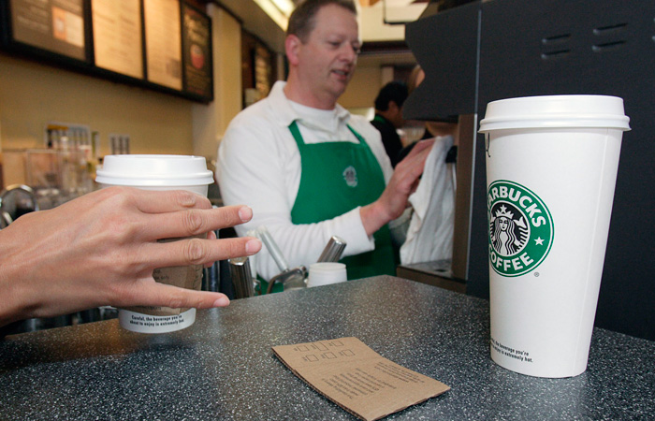
Finally drink your coffee..
Source: http://images.businessweek.com/ss/06/07/top_brands/image/starbucks.jpg

Slide 85
What did we learn from Starbuck’s?
HTTP has a header/status combination for every occasion
APIs are expressed in terms of links, and links are great!
  APP-esque APIs
APIs can also be constructed with URI templates and inference
XML is fine, but we could also use formats like APP, JSON or even default to XHTML as a sensible middle ground
State machines (defined by links) are important
  Just as in Web Services…

Slide 86
Summary
Both the Web and Web Services suffer from poor patterns and practices, awful tooling
Both platforms are about externalising state machines when done well
  Conversation state machines for Web Services
  Hypermedia state machines for Web
WS-* is bloated, but most of it can (should!) be safely ignored
The Web is now starting to feel the love from middleware vendors too – beware!
MEST and REST are both sensible approaches

Slide 87
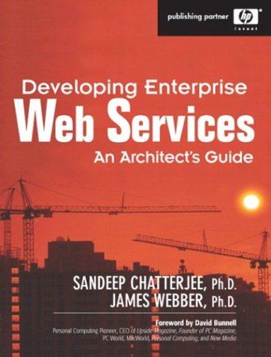
Questions?
Developing Web-based Services
(working title)
Jim Webber
Savas Parastatidis
Ian Robinson
Coming 2008…
Blog:
http://jim.webber.name

