Slide 1
Introduction to Silverlight 1.1
Mark Smith
marksm@develop.com
www.julmar.com/blogs/mark

Slide 2
Importance [online capabilities]
Software is moving away from the desktop toward the web
web apps are convenient
for publisher and users...
...however, users like the
rich UX of the desktop
vs.

Slide 3
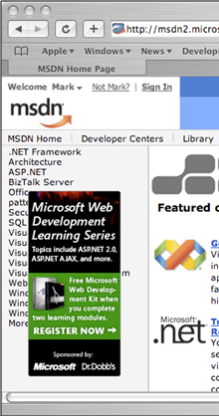
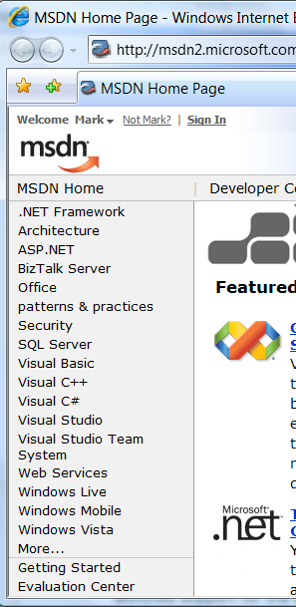
Importance [HTML limitations]
HTML is inherently a document technology
difficult to provide the rich, dynamic experience people desire on every platform
dynamic rollover ad pops up over text in this
browser
vs.

Slide 4
What is Silverlight? [browser plug-in]
Silverlight is a cross-platform, cross-browser technology
packaged as a light-weight browser plug-in
IE6/IE7 - Windows
.cab
Firefox – Windows
OSX
Linux
.xpi
Safari - OSX
.dmg

Slide 5
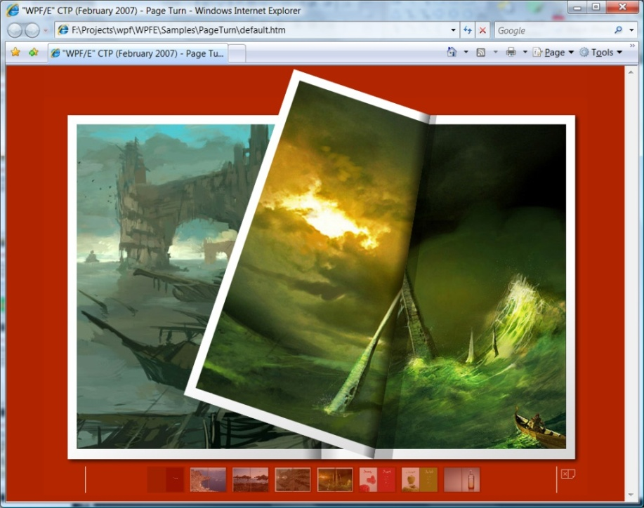
Core scenarios [RIA]
Silverlight helps you build rich internet applications (RIA)
includes support for videos, overlays and animations
supports on-screen overlays
… and full screen video
animations provides page "flip" experience

Slide 6
Positioning Silverlight
Silverlight provides "close to desktop" experience
balance of rich content across multiple platforms
richer UI experience
.XBAP and WPF
Silverlight
AJAX
broader reach
HTML + ASP.NET

Slide 7
That sounds a lot like Adobe Flash!
Silverlight is very similar in capability to Flash
but oriented towards the Microsoft developer
uses the tools and languages MS developers are used to
 | Flash | Silverlight
Supported Platforms | Mac OSX, Windows, Linux, PDA and handheld | Mac OSX (10.4.8+), Windows, Linux (planned)
Packaging | .SWF (binary) | .XAML, .HTML, can be server-generated
Programming | ActionScript 3.0, Flex | Javascript, C#, VB.NET, IronPython, etc.
Tools | Adobe Flash MX or Flex2 | Anything generating XAML/HTML/JScript
Plug-in size | ~1MB | ~ 4MB
Media support | H.263, On2 VP6 | HD-VC1 WMV, WMA, MP3
Notes:
To be technically accurate, Silverlight does not support Linux directly, but Microsoft has instead decided to support the MoonLight project which is a Silverlight adaption based on the Mono project and owned by Novell. For more information on the Linux plug-in, check out http://www.mono-project.com/Moonlight

Slide 8
Silverlight Timeline
SL 1.0 beta SL 1.1 alpha
SL 1.0 release, SL 1.1 refresh
VS.NET 2008
SL 1.1 release
April 2007
September 2007
November 2007
Summer/Fall 2008

Slide 9
Silverlight 1.0
Initial release implements base feature set
XAML based visual layout (subset of WPF)
2D vector graphics
audio/video codecs and media player element
animations
JSON/POX web service client support
downloader control for background fetches
Behavior is written in Javascript
plug-in interprets the XAML and hooks up event handlers
provides easy transition for typical web developer
Provides solid RIA technology for media-centric experience
but nothing extraordinary that Flash cannot compete with

Slide 10
Silverlight 1.1
Builds on 1.0 base and extends it to support .NET
subset of desktop CLR included in browser plug-in
allows logic to be written in C#, VB.NET, etc.
CoreCLR includes GC, JIT, and base framework classes
System.Xml
System.Collections
LINQ
Threading
HTTP proxy support
more forthcoming in future drops ..
Requires Visual Studio 2008 and .NET 3.5

Slide 11
Demo
Enough talking already! Let's code something!

Slide 12
Summary: why does Silverlight 1.1 matter?
Use Silverlight to improve your applications
no need to learn entirely different technology like Flash
web developers use
Silverlight to provide
a richer UX than HTML
desktop developers use
Silverlight to put a limited
version of their app online
WPF

