Slide 1
Evolution of the PayPal API Platform
Enabling the future of Money
QCon San Francisco 2014
Deepak Nadig, Head of API Platform Engineering
Notes:
PayPal founded 15+ years ago. Money transfer between 2 PDA devices. VC beamed money from a Palm Pilot. In 1999, email based payments. And then Merchants checkout online. PayPal has grown phenomenally.
Outline:
The PayPal Context
PayPal API Evolution (Until REST)
PayPal Complexity
What got us here …
From 2012 to Target
API Platform
API Platform Qualities
Getting to Target
Maturity Model
Architecture
Successes
Summary

Slide 2
PAYPAL CONTEXT
157 million active digital wallets
203 markets and 100 currencies
Serves 2M+ third-party developers
2013: Total Payment Volume was $180 billion
Q3 2014
  Total Payment Volume was $56.6 Billion, $7118 / second
  Growing 29% YoY
  $12 Billion in mobile payments volume (20% of total)
  895 million transactions, 9.7 million payments / day
2014: >1 Billion Mobile Transactions
25% cross border trade
In a globally dynamic environment
300+ features per quarter
We roll 100,000+ lines of code every two weeks

Slide 3

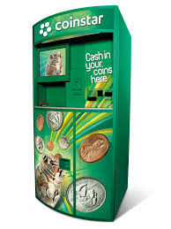

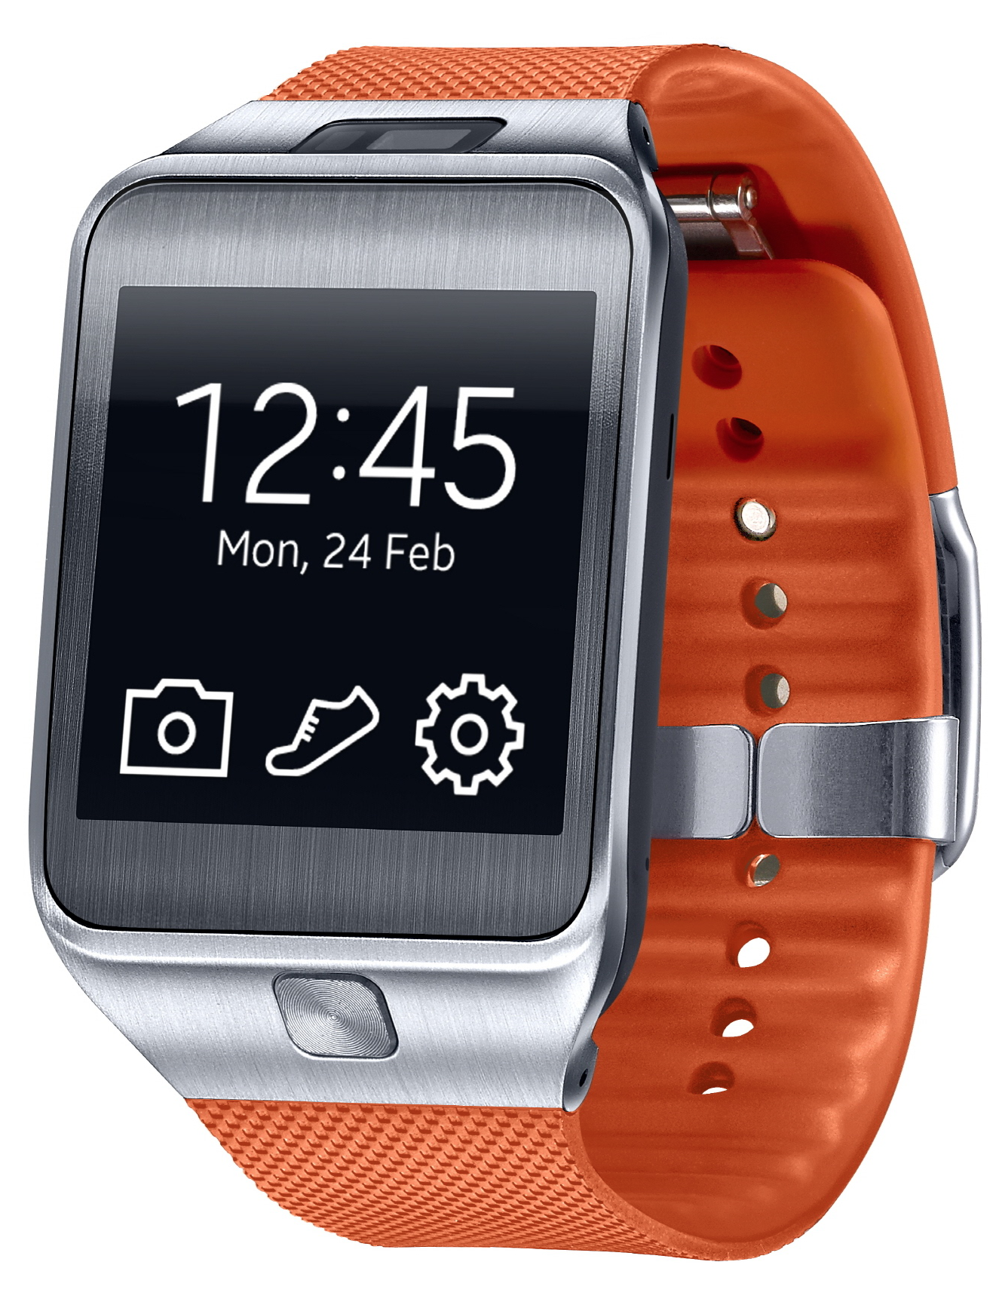

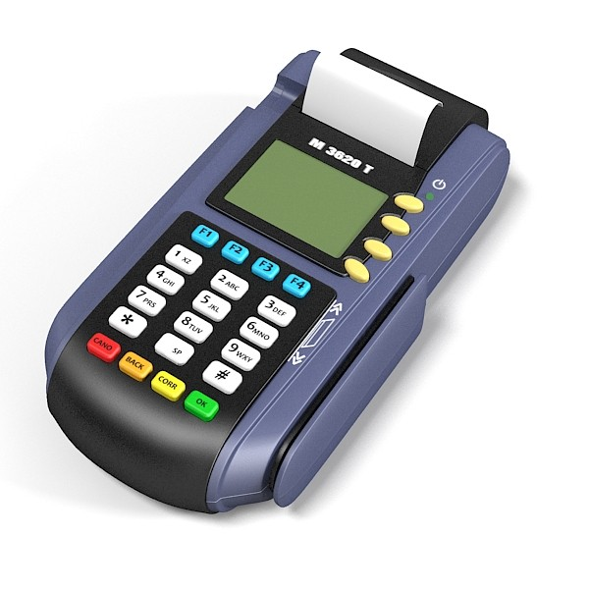
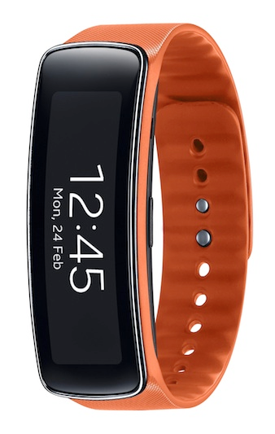



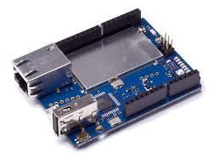
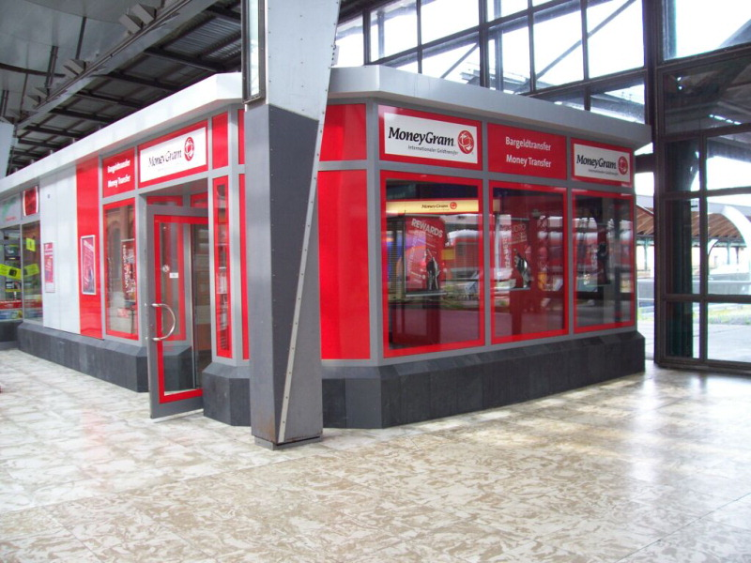
PAYPAL EXTERNAL API EVOLUTION
2001 Instant Payment Notification
2004 Transaction, Mass Pay API
2005 Direct Payment API, Express Checkout
2007 Payment APIs (NVP)
PayPal External API
2009 Adaptive APIs (SOAP/XML, NV, JSON)
PayPal Capabilities
2013 Payment APIs (REST)
Notes:
1 – Online checkout
2 – Offline checkout
3 – Checkout anywhere
4 – Frictionless payments
5 – Mobile payments – Checkout or P2P
6 – Gaming and payments
7 – TV payments
8 – Managing money; Physical/Digital bridge
9 – Wearables
10 – Hobbyists

Slide 4
API PLATFORM CHALLENGES (2012)
External API Platform
Multiple developer portals
Overlapping, inconsistent APIs
Learn from large documents
Complex sign-up process
Incomplete, unreliable Sandbox
Internal SOA
Discovery through tribal knowledge
Overlapping, inconsistent APIs
Integrating with an API took weeks
Tight coupling; monoliths
Proprietary standards & technology
Notes:
Most common SOA anti-patterns
You start bottom up (without spending time with developers)

Slide 5

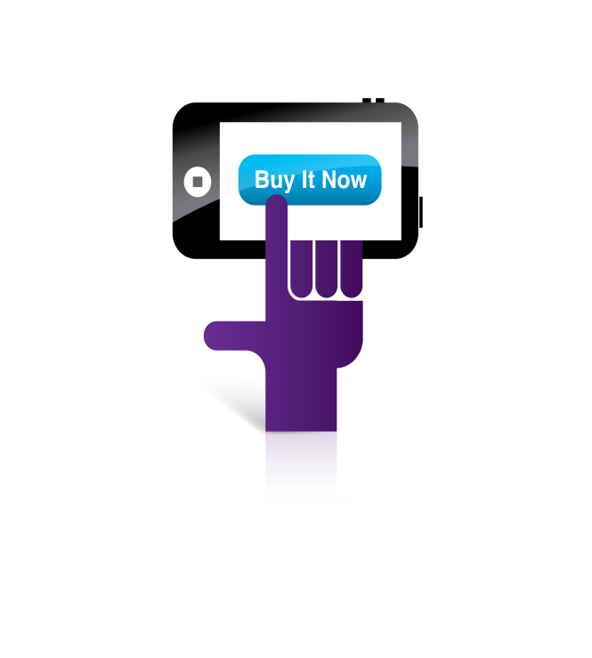
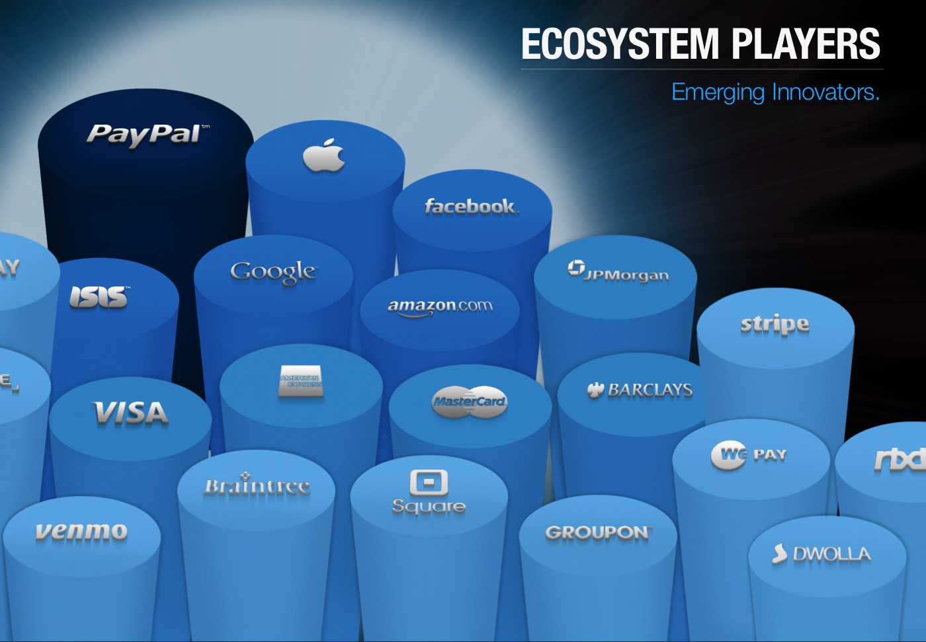

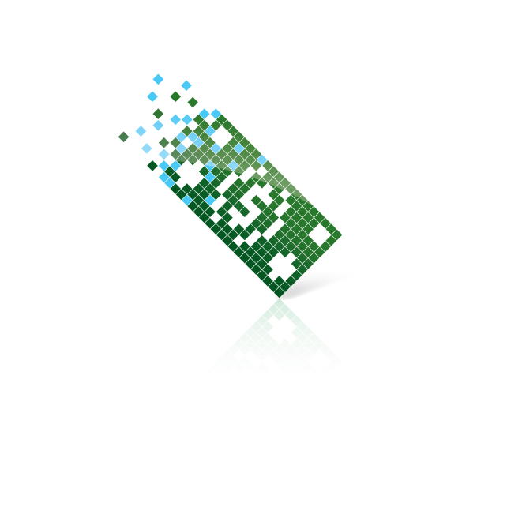

WHAT GOT US HERE WON’T TAKE US THERE
Mobile
Local
Limits
reached
Performance
High
growth
Digital
Social
Kickoff
Time
Notes:
Different quality attributes are important at different stages of a company

Slide 6
API PLATFORM – 2012 TO TARGET STATE
API Definition
Internal or External
Universal
API Discovery
Painful
Developer Portal
API Design
Project specific
API as a Product
Architecture
Tightly coupled SOA
Loosely coupled SOA
Technology
Proprietary
Standards based
Integration
Expensive
TTFHW¹ < x min
(1) Time to First Hello World – Time to make a simple call/application
Notes:
Loosely coupled SOA
Bounded contexts using namespaces
Shared nothing

Slide 7
PAYPAL API PLATFORM
Portfolio of APIs
aligned by business capabilities,
realized by isolated and encapsulated services,
that can be used by internal and external developers
to develop applications and integrations
quickly and cost effectively

Slide 8
API PLATFORM QUALITIES
API First
Work back from the use cases
API Design Standards
API as a Product
API portfolio
Aligned by capabilities
Working back from the customer
Developer Experience
Easy to learn, integrate, diagnose
Time To First Hello World
API Quality Attributes
Response-time
Availability
Service Architecture
Encapsulated, Isolated
Craftsmanship

Slide 9
GUIDING TOWARDS TARGET STATE
Define the Target State
Define shared goals and measure progress
Facilitate change across the company
Notes:
Changing mindset of 13000 employees

Slide 10
TARGET STATE - RUN-TIME ARCHITECTURE
PayPal Applications
(Wallet, POS)
2nd-party Applications
(eBay, Braintree)
3nd-party Mobile Applications
(Uber, PhotoCard)
3nd-party Server Applications
(Online websites)
Experience
APIs
Batch
APIs
PayPal Web Applications
API Facade
Protocol conversion
OAuth, CORS
Routing
Orchestration
Batch
Processing
External
Events
Capability
APIs
Payments
Instruments
Customer
Invoicing
Webhooks
Credit
Risk
Compliance
Disputes
Event Bus
(*) Out of
data center
Notes:
3 Primary integration or interaction styles
Request/Response
Notifications
Batch
REST
Service granularity is a little more predictable and customer driven
Events are also APIs of a different nature. Managing portfolio of events is similar to managing portfolio of APIs

Slide 11
SHARED GOALS & MEASURING PROGRESS
Maturity Level | Maturity Level Name | Characteristics (Design, Functional, Operational)
Level 1 | Exists | All services (classic & new)
Level 2 | Functional | Complies with API standards, fully tested, basic documentation
Level 3 | Core | API aligned with product structure, complete developer experience
Level 4 | Performant | Complies with SLO (Service Level Objectives)
Level 5 | Ideal | Fully encapsulated, isolated, meets all design and implementation principles
Shared goals for completing at least 75% of platform at Maturity Level 3+
Reported across functions and leaders
Notes:
5 - Bounded contexts/Namespaces

Slide 12
FACILITATING CHANGE
Educate & evangelize target architecture & standards
Make it valuable to conform. Make deviations very expensive
Partition using API Product Structure & ‘bounded contexts’
Report progress of each API Product & organization
Make early adopters your evangelists. Celebrate success!

Slide 13
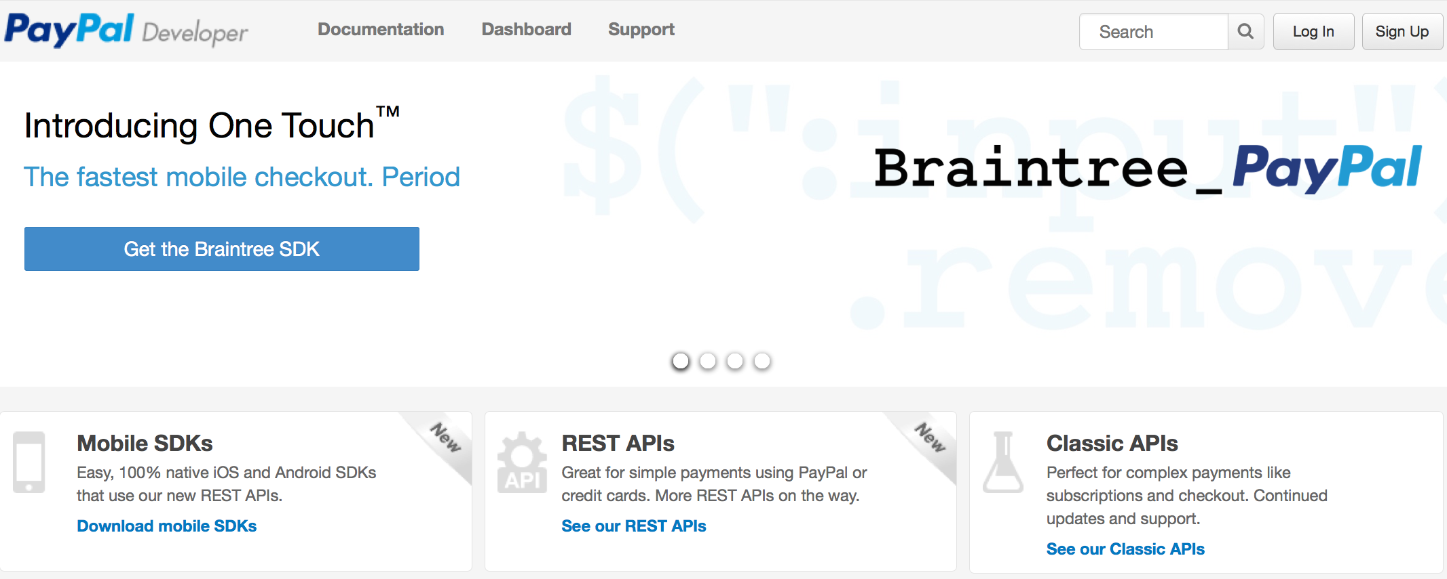
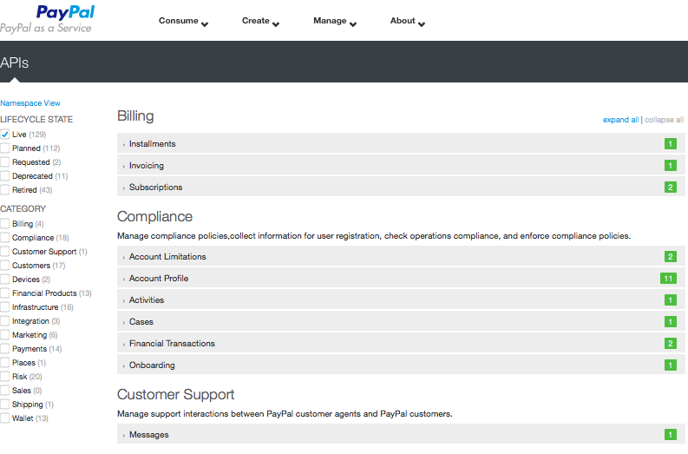
API PLATFORM EVOLUTION – THE JOURNEY
2012
INITIATED
President buy-in
Company mandate
Seed organization
Right people
2013
EXTERNAL
Launched externally
Initiated internally
Early adopters
2014
EXPANSION
Complete majority
Educate, evangelize
Recognize success
2015
RETIRE LEGACY
Retire & migrate
Transition to norm
2016
NORM

Slide 14
EVOLUTION IS MORE THAN TECHNOLOGY
Technology/Product
REST/OAuth
API Orchestration w/ Groovy
GDD⁽¹⁾ based tools/Genio
People
API Design team
API Product owners
Developer advocates
Developer
Process
Hackathons
Developer experience
Company-wide program
(1) Google Discovery Document

Slide 15
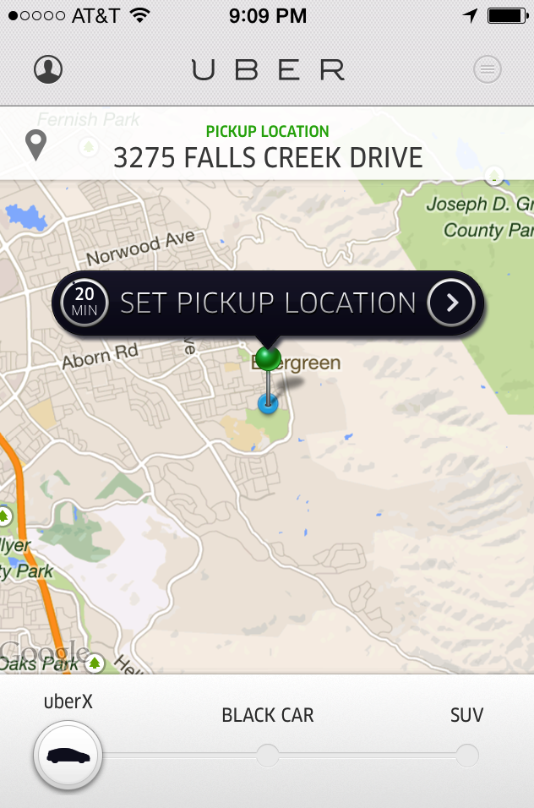
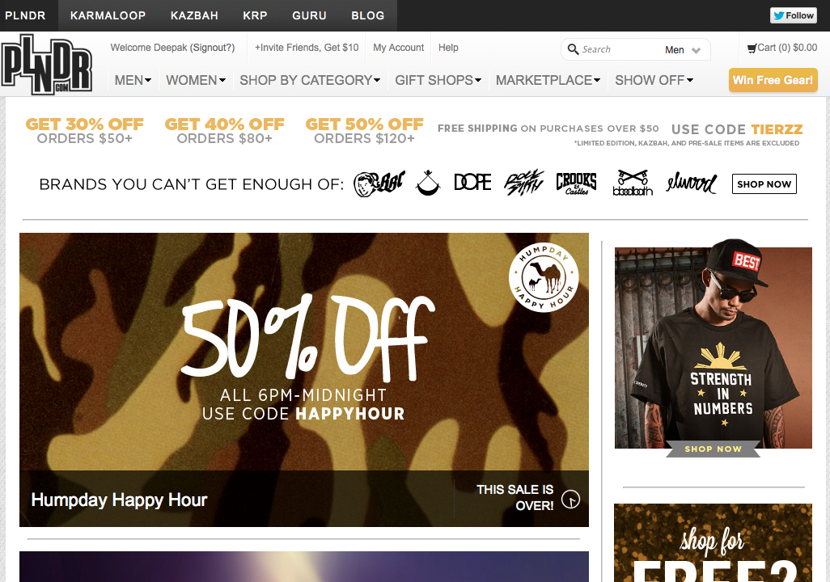

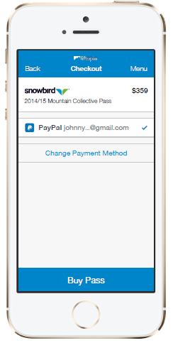
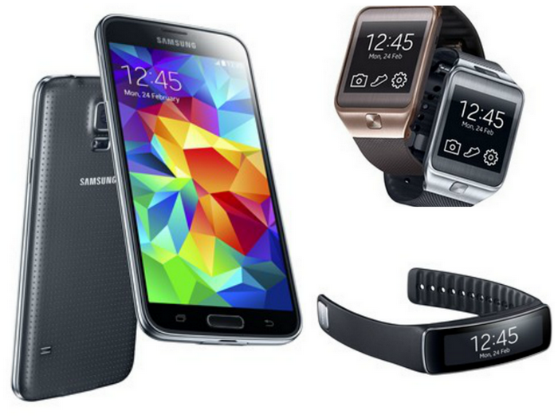
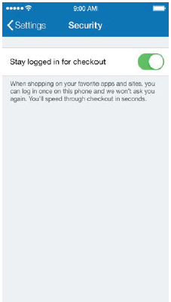
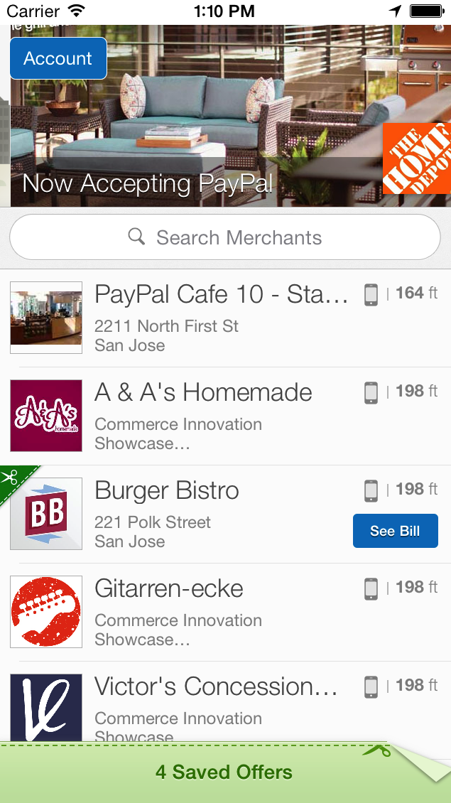
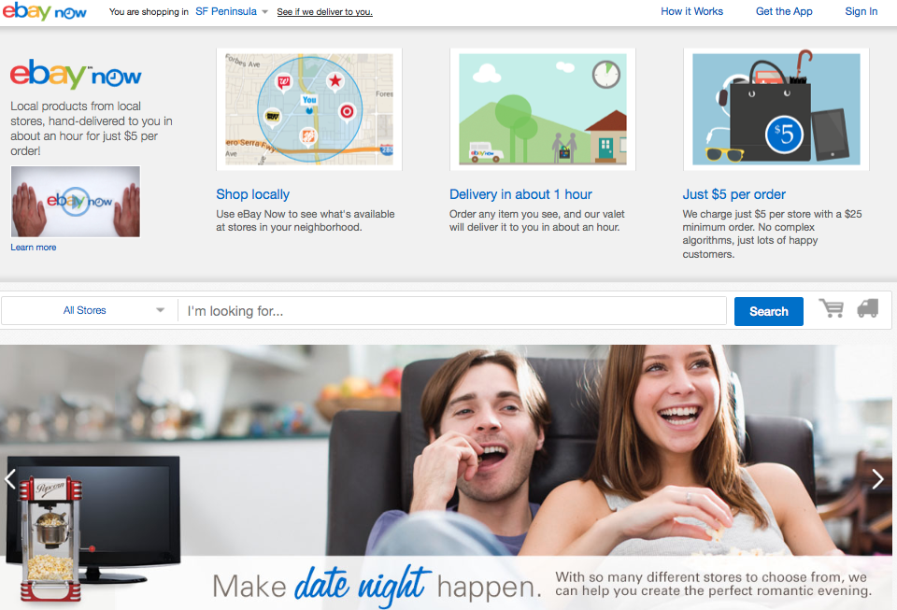
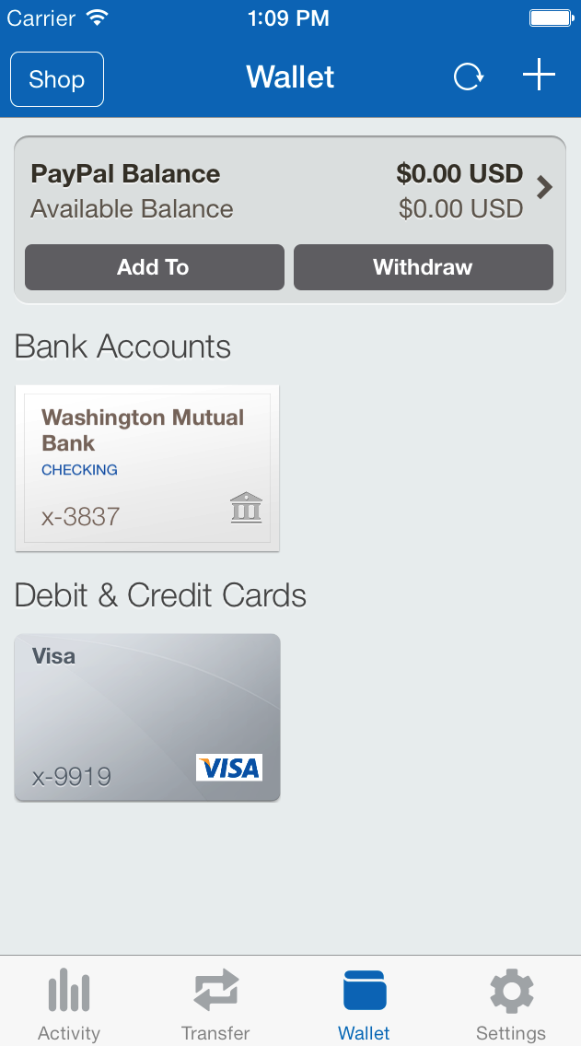
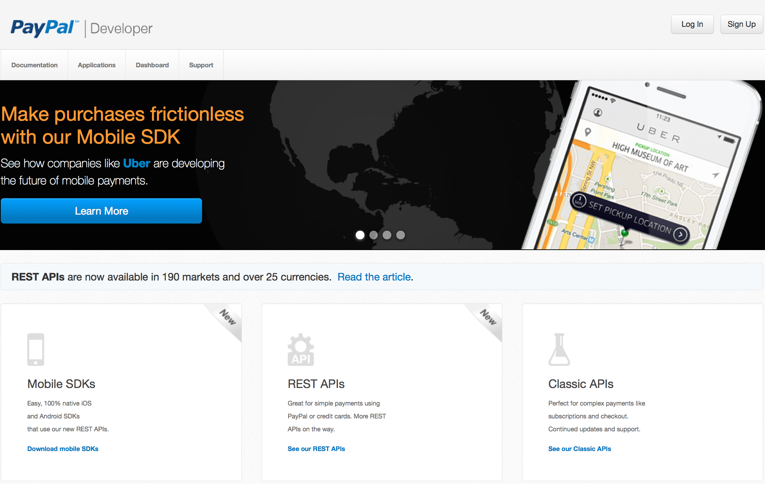
CUSTOMERS OF THE API PLATFORM
Customer Application: PayPal Web Application
APIs: /v1/apis/applications
Customer Application: PayPal Mobile Application
APIs: /v1/oauth2/token, /v1/wallet/{user-id}/financial-instruments
Customer Application: eBay Web Page
APIs: /v1/oauth2/token, /v1/vault/token
Customer Application: Third-party Web Application
APIs: /v1/oauth2/tokens, /v1/payments/payment
Customer Application: Third-party Mobile Application (based on mSDK)
APIs: /v1/oauth2/token, /v1/payments/payment
Customer Application: PayPal Touch
APIs: /v1/oauth2/tokens, /v1/payments
Customer Application: Samsung Wallet (Samsung Galaxy S5, Gear 2, Gear Fit)
APIs: /v1/oauth2/tokens, /v1/wallet/activities

Slide 16
TO CLOSE
PayPal API Platform has been redesigned to support new needs
Plan to evolve the complete Architecture Business Cycle
Define target; goals and metrics; manage change
Educate, evangelize … repeat
Flexibility may be the most under-rated quality attribute!

Slide 17
Thank you
@deepak_nadig

