Slide 1
Dmitriy Setrakyan
GridGain In-Memory Data Fabric:
Ultimate Speed and Scale for Transactions and Analytics
www.gridgain.com
#gridgain
Founder & EVP Engineering
@dsetrakyan

Slide 2
Agenda
Evolution of In-Memory Computing
GridGain In-Memory Data Fabric
Distributed Cluster & Compute
Coding Example
Distributed Data Grid
Coding Examples
Distributed Streaming & CEP
Plug-n-Play Hadoop Accelerator

Slide 3
What is In-Memory Computing?
High Performance & Low Latencies
Faster than Disk and Flash
Cost Effective
Distributed or Not
Caching, Streaming, Computations
Data Querying – SQL or Unstructured
Volatile and Persistent
OLAP and OLTP Use Cases
Notes:
Data Centers are moving to all RAM datacenters $30/MB vs 1 cents per MB
RAM costs less than disk over a period 3 years, less cooling, less space, less electricity
5000 to 1m faster than disk

Slide 4
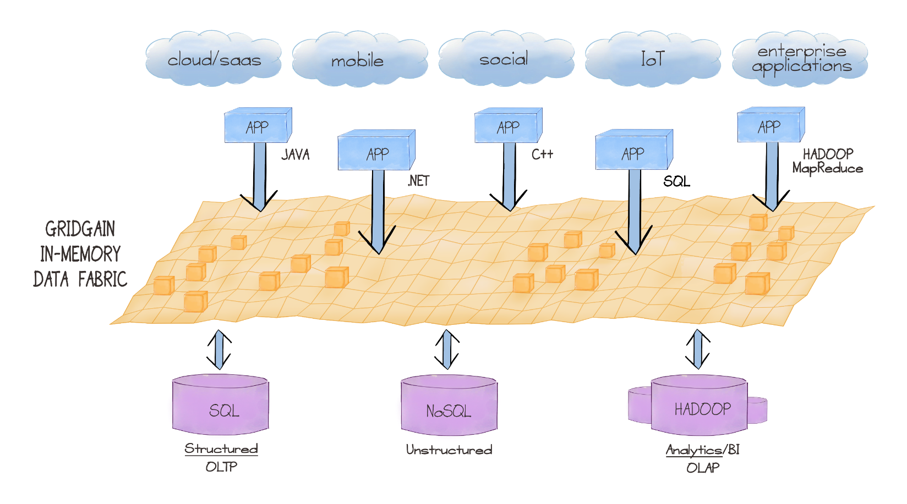
Evolution of In-Memory Computing
Streaming
Data Grid
Hadoop
Acceleration
Clustering & Compute Grid
Database IM options
Hadoop accelerators
Streaming
BI accelerators
In-Memory Data Grids
IMDBs
Distributed
Caching
Caching

Slide 5
Existing Market is Fragmented
Company | Product | Proprietary/ Open Source | Characterization
Oracle | In-Memory Option for Oracle Database | Proprietary | Cost Option
Oracle | Times Ten | Proprietary | Point Solution IMDB
Oracle | Coherence | Proprietary | Point Solution IMDG
SAP | Hana | Proprietary | Point Solution - IMDB
Microsoft | SQL Server 2014 | Proprietary | Feature Upgrade
DataBricks | Apache Spark | Open Source | Point Solution - Hadoop
VoltDB | VoltDB | Open Source | Point Solution – IMDB
Aerospike | Aerospike | Open Source | Point Solution – NoSQL DB
IBM | DB2 with BLU Acceleration | Proprietary | Feature Upgrade
Software AG | Terracotta | Open Source | Point Solution - IMDG
Hazelcast | Hazelcast | Open Source | Point Solution - IMDG
Notes:
Let me tell you about the market that we simplified
In that world having complexity and disparity is not strategic

Slide 6
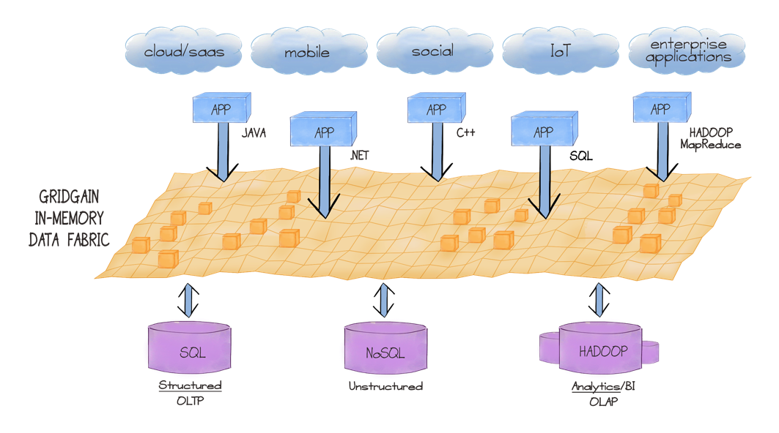
GridGain In-Memory Data Fabric: Strategic Approach to IMC
Supports all Apps
Open Source – Apache 2.0
Apache Project - Ignite
Simple Java APIs
1 JAR Dependency
High Performance & Scale
Automatic Fault Tolerance
Management/Monitoring
Runs on Commodity Hardware
Streaming
Data Grid
Hadoop
Acceleration
Clustering & Compute Grid
Supports existing & new data sources
No need to rip & replace
© 2014 GridGain Systems, Inc.

Slide 7
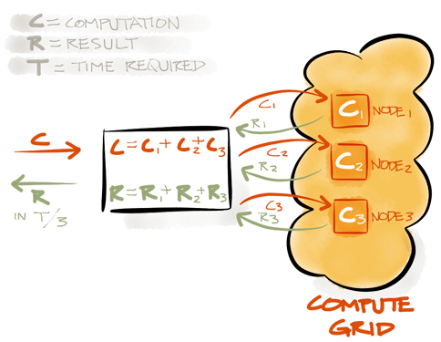
Clustering & Compute
Direct API for MapReduce
Direct API for Fork/Join
Zero Deployment
Cron-like Task Scheduling
State Checkpoints
Early and Late Load Balancing
Automatic Failover
Full Cluster Management
Pluggable SPI Design

Slide 8
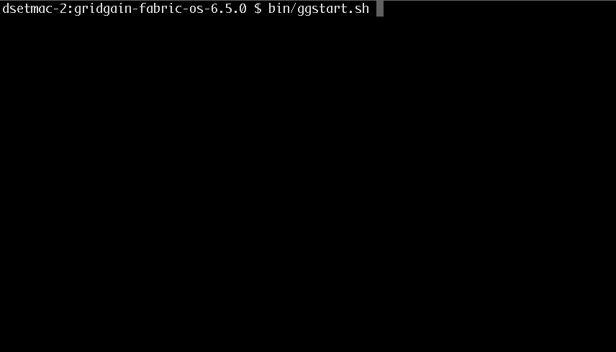
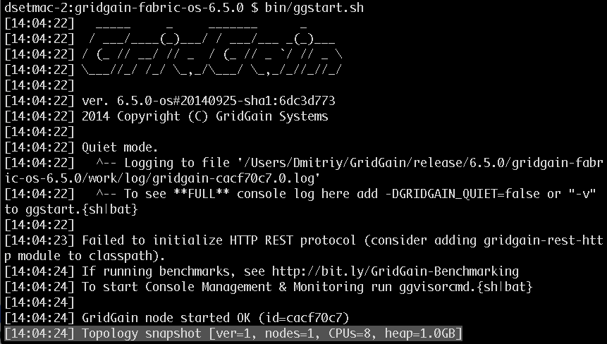
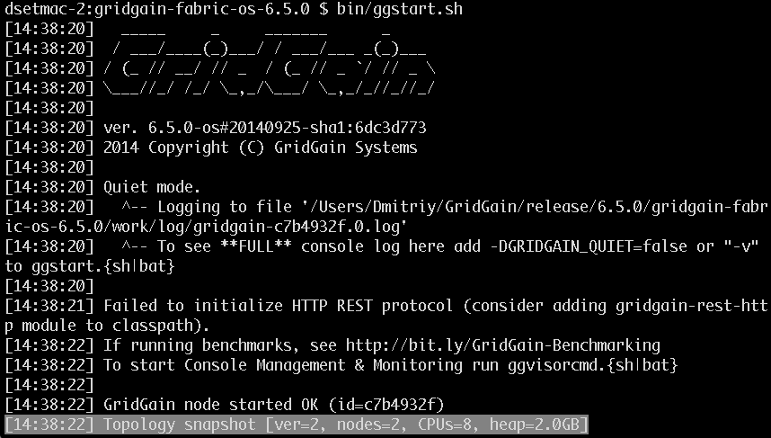
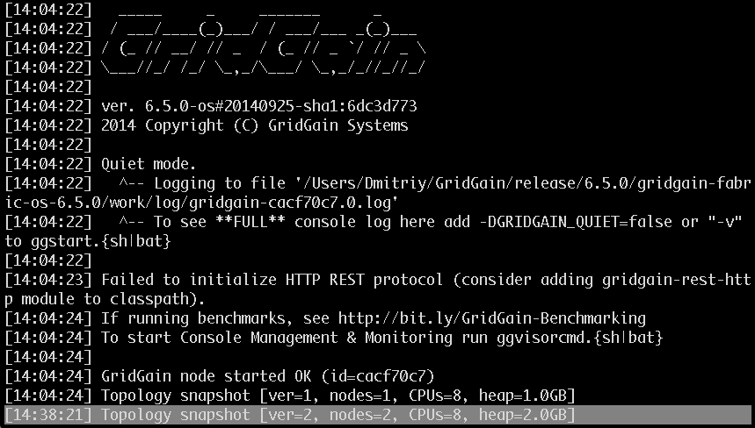
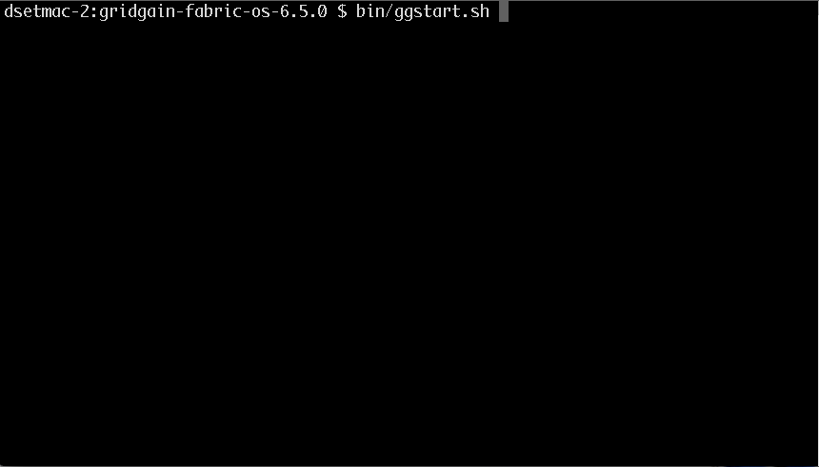
Automatic Cluster Discovery

Slide 9
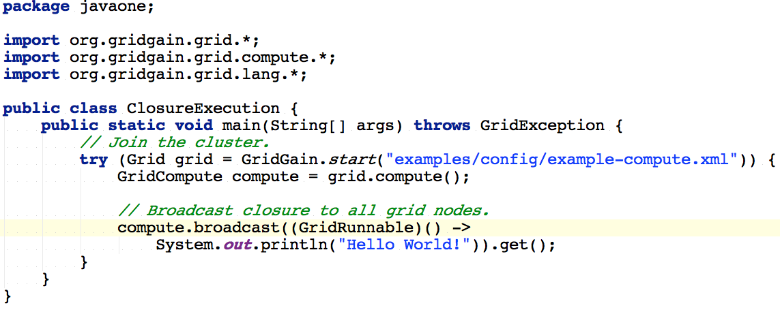
Closure Execution

Slide 10
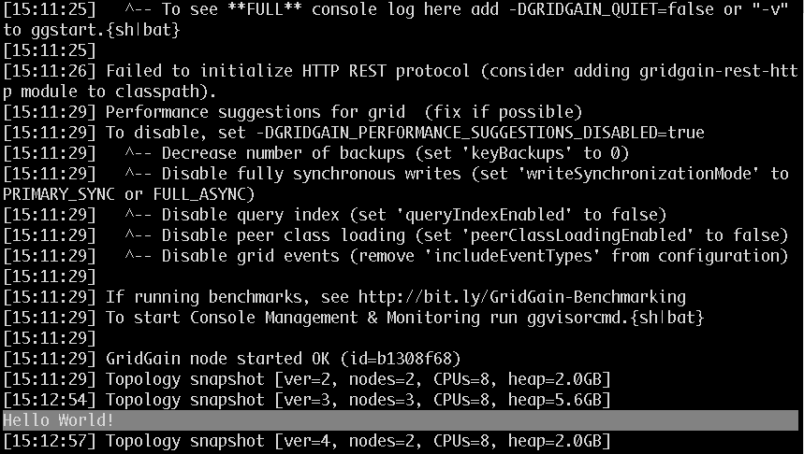
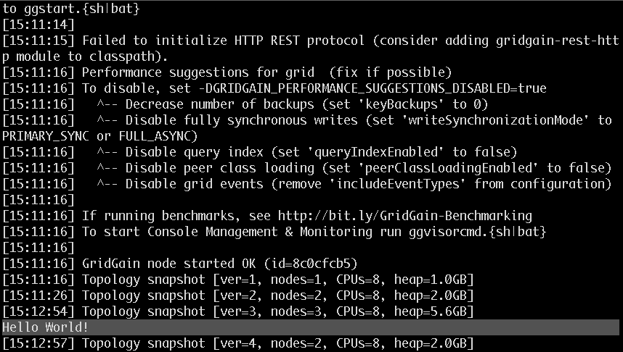
Closure Execution

Slide 11
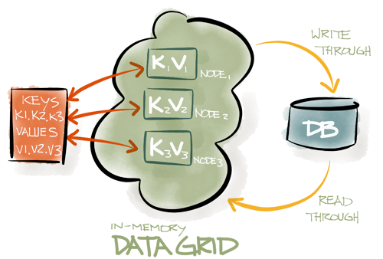
In-Memory Caching and Data Grid
Distributed In-Memory Key-Value Store
Replicated and Partitioned
TBs of data, of any type
On-Heap and Off-Heap Storage
Backup Replicas / Automatic Failover
Distributed ACID Transactions
SQL queries and JDBC driver
Collocation of Compute and Data

Slide 12
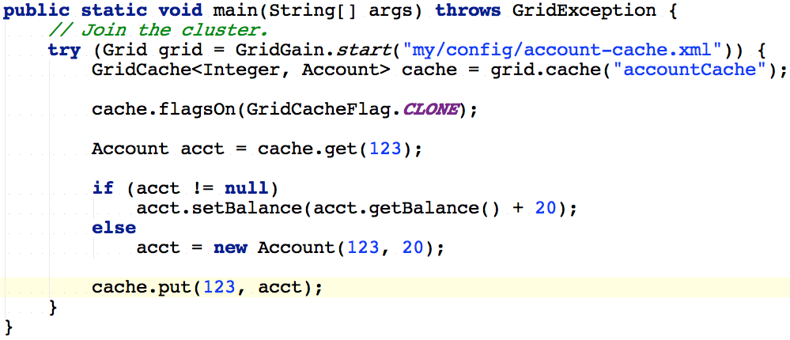
Cache Operations

Slide 13
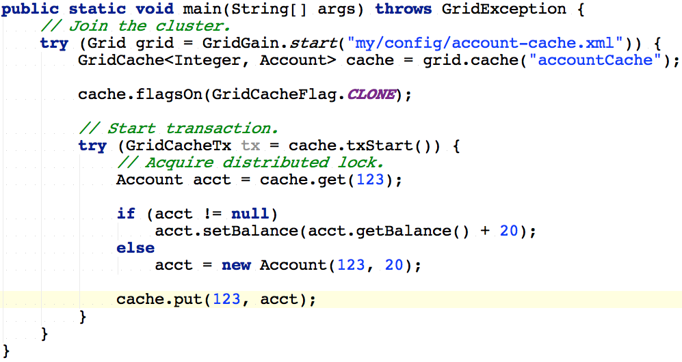
Cache Transaction

Slide 14
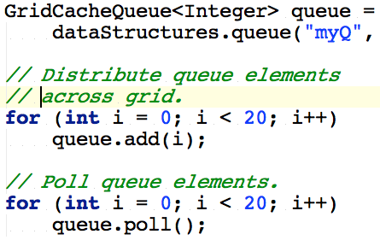
Distributed Data Structures
Distributed Map (cache)
Distributed Set
Distributed Queue
CountDownLatch
AtomicLong
AtomicSequence
AtomicReference
Distributed ExecutorService

Slide 15
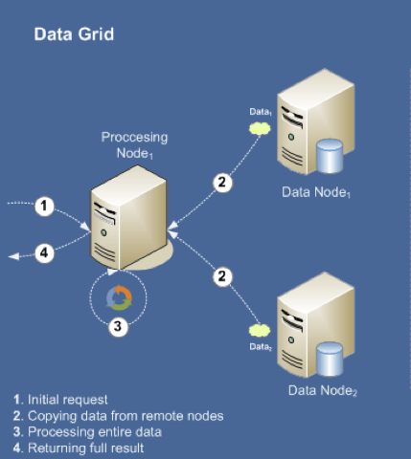
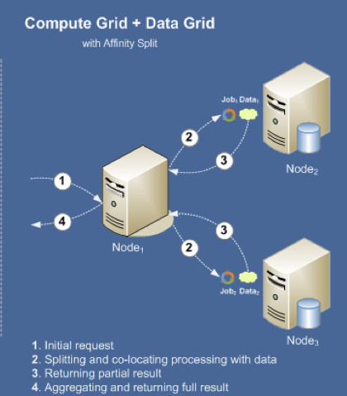
Client-Server vs Affinity Colocation
Client-Server
Affinity Colocation

Slide 16
In-Memory Streaming & CEP
Streaming Data Never Ends
Branching Pipelines
CEP Sliding Windows
Real Time Indexing
Real Time Querying
At Least Once Guarantee

Slide 17
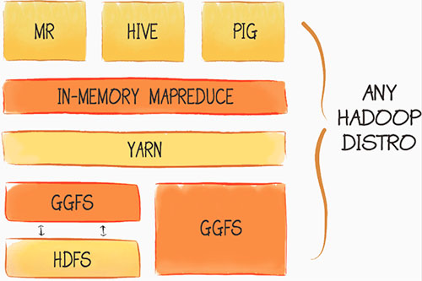
Plug-n-Play Hadoop Accelerator
Up to 100x Acceleration
In-Memory Native MapReduce
In-Process Data Colocation
Eager Push Scheduling
GGFS In-Memory File System
Pure In-Memory
Write-Through to HDFS
Read-Through from HDFS
Sync and Async Persistence

Slide 18
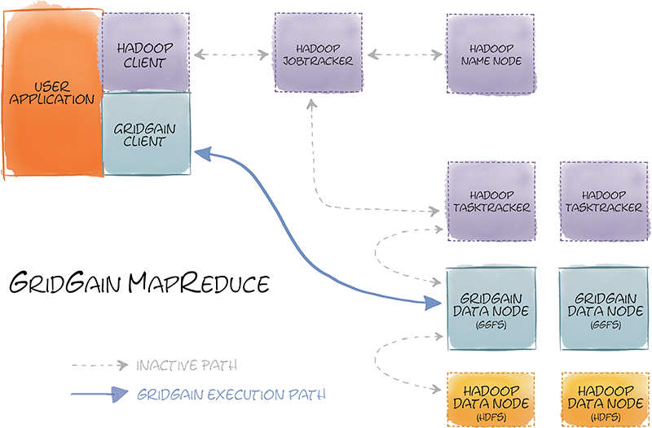
In-Memory Native MapReduce
In-Memory Native MapReduce
Zero Code Change
Use existing MR code
Use existing Hive queries
No Name Node
No Network Noise
In-Process Data Colocation
Eager Push Scheduling

Slide 19
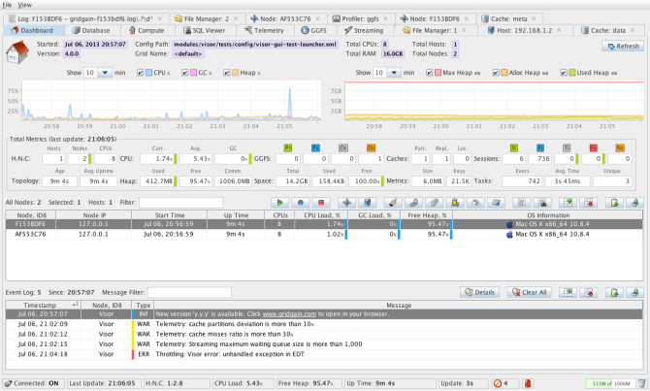
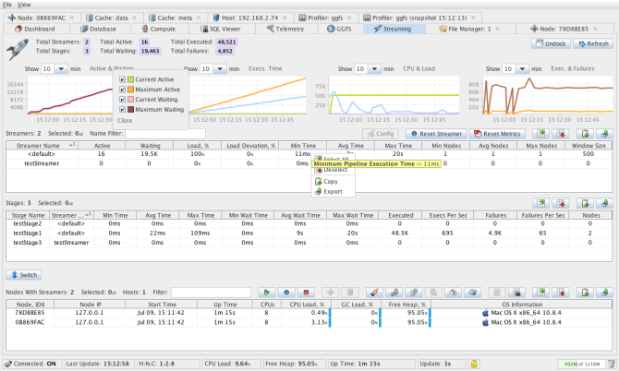
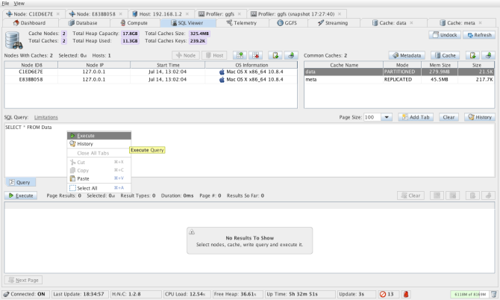
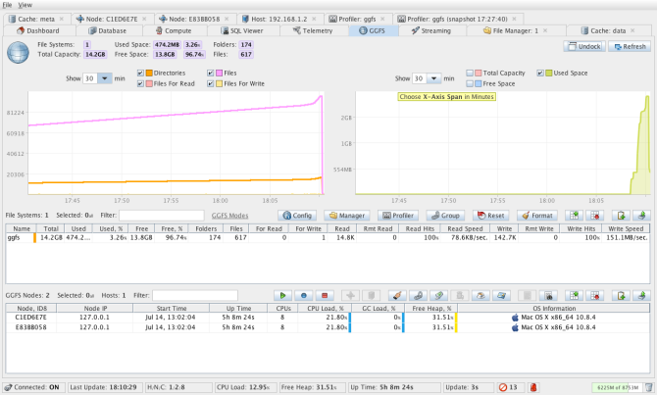
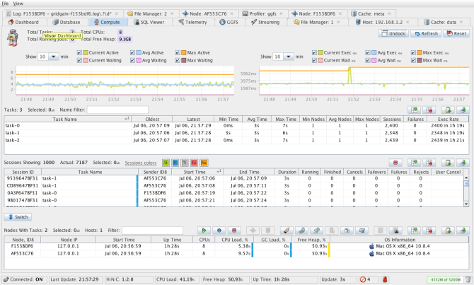
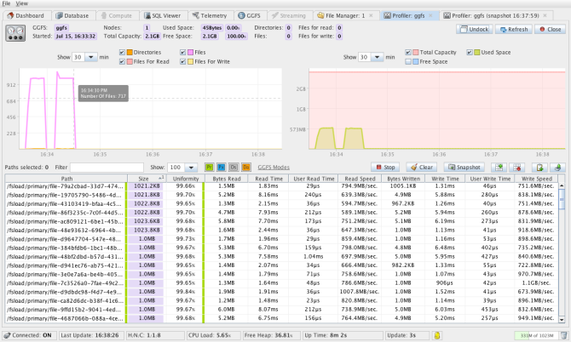
DevOps Management and Monitoring
Notes:
- In-Memory

Slide 20
Thank You
www.gridgain.com
#gridgain @dsetrakyan

