Slide 1
Big Data and the Intersection of IT and IoT

Slide 2
About me
Hans Jespersen
hans.jespersen@solacesystems.com
https://www.linkedin.com/in/hansjespersen
https://github.com/hjespers

Slide 3
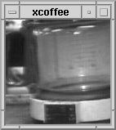
First Things on the Internet
“The camera was installed on a local network in 1991 using a video capture card on an
Acorn Archimedes computer. Employing the X Window System protocol”
"The camera was connected to the Internet in November 1993 by Daniel Gordon
and Martyn Johnson. It therefore became visible to any Internet user and grew into
a popular landmark of the early web.”
Source http://en.wikipedia.org/wiki/Trojan_Room_coffee_pot

Slide 4
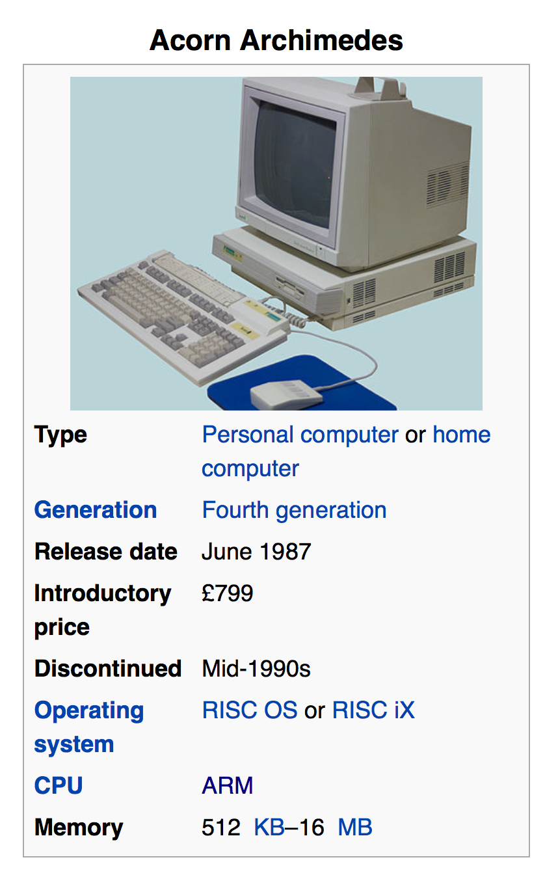
= Acorn RISC Machine

Slide 5
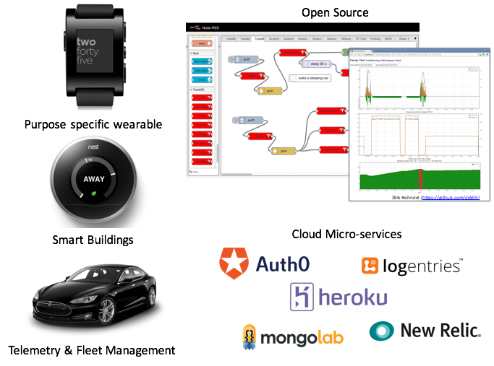
Some of my favorite things

Slide 6
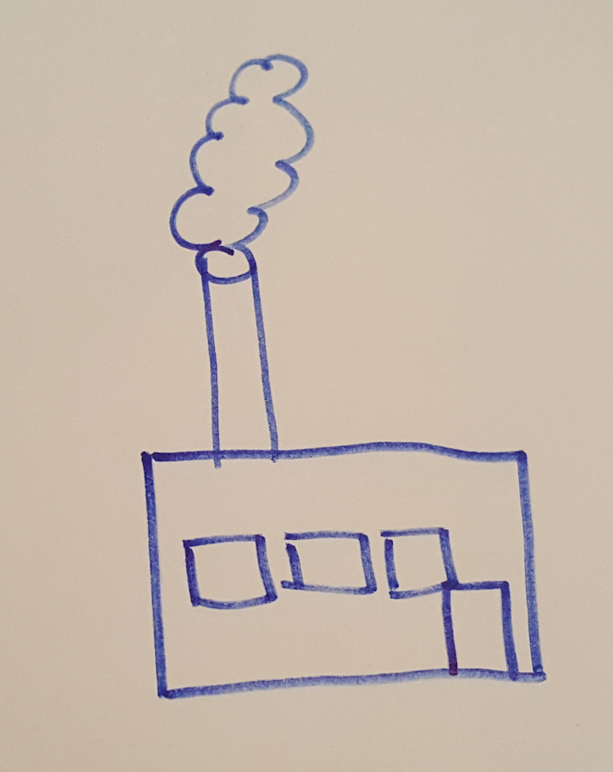
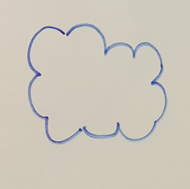
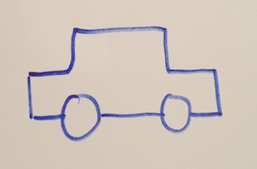
Thing
Internet
Data Center

Slide 7
If only it were that simple

Slide 8
REST
long poll
SSE
websocket
MQTT
+WS +TLS
COAP
+DTLS
XMPP, DDS, AMQP, WebRTC, HTTP/2…

Slide 9
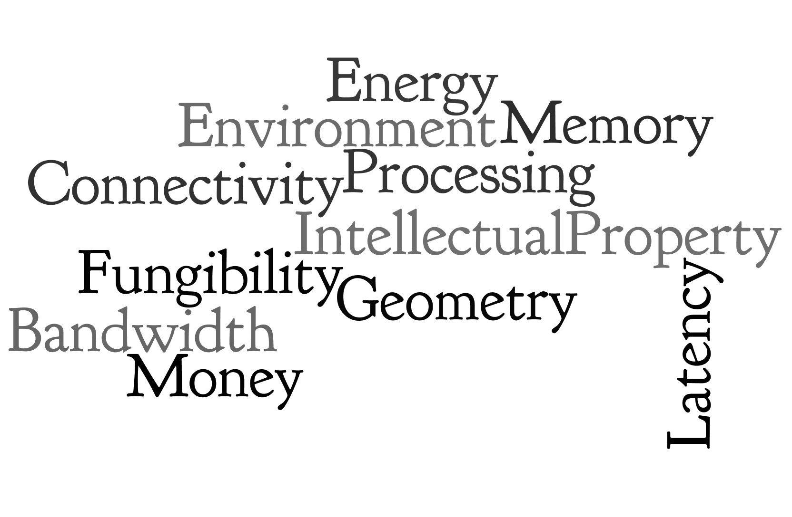
Top 11 IoT Architectural Contraints

Slide 10
Split-brained Things

Slide 11
The IIoT Car
Door Locks
Ignition
Airbag
e-Brakes
CAN Bus
Drive-by-Wire
Parking Sensor
Mirror
Headlights
LIN Bus
Sunroof
Backup Camera
Seat
Motor/Heater
HVAC
Tire Pressure Sensor
Emissions
ODBII
Port
Autopilot

Slide 12
The Consumer IoT Car
Dashboard
Head-end
Unit
Audio Port
3G/4G
A/V Wiring Harness
Console
Navigation
Yelp
USB
Port
Automotive Ethernet
Audio
Voice Control
Pandora
Text to Speech
Bluetooth
Seatback
Display
Slacker
WiFi/
Hotspot

Slide 13
Connected Car User Experience
Mothership
Big Data & Analytics
APIs
Data
OTA
Firmware
Updates
VPN
Bluetooth
Slacker
TuneIn Radio
Google Maps
Navigation
Browser
App SDK?
3rd Party (really?)

Slide 14
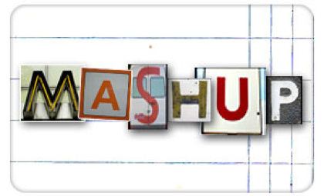
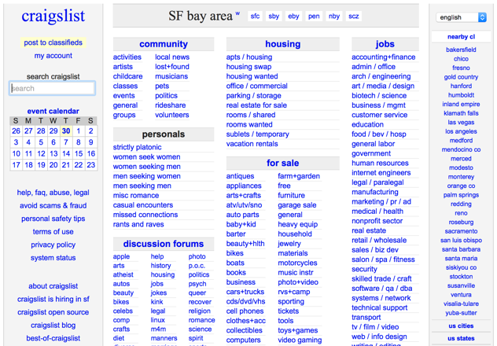
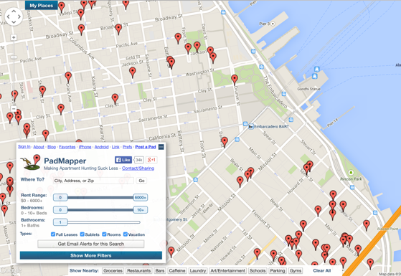
We need more open IoT
less central control

Slide 15
Split-brained Data Centers

Slide 16
Split-brained Data Center
DMZ
IoT
Private Cloud
Legacy
Big Data

Slide 17
IoT Specific Infrastructure
Device Registry
Device Security
Device Connectivity
Device LifeCycle Management
IoT Data Validation & Management
IoT Data Routing Rules
IoT SLA Monitoring
IoT Usage Metering & Billing

Slide 18
Cloud Infrastructure

Slide 20
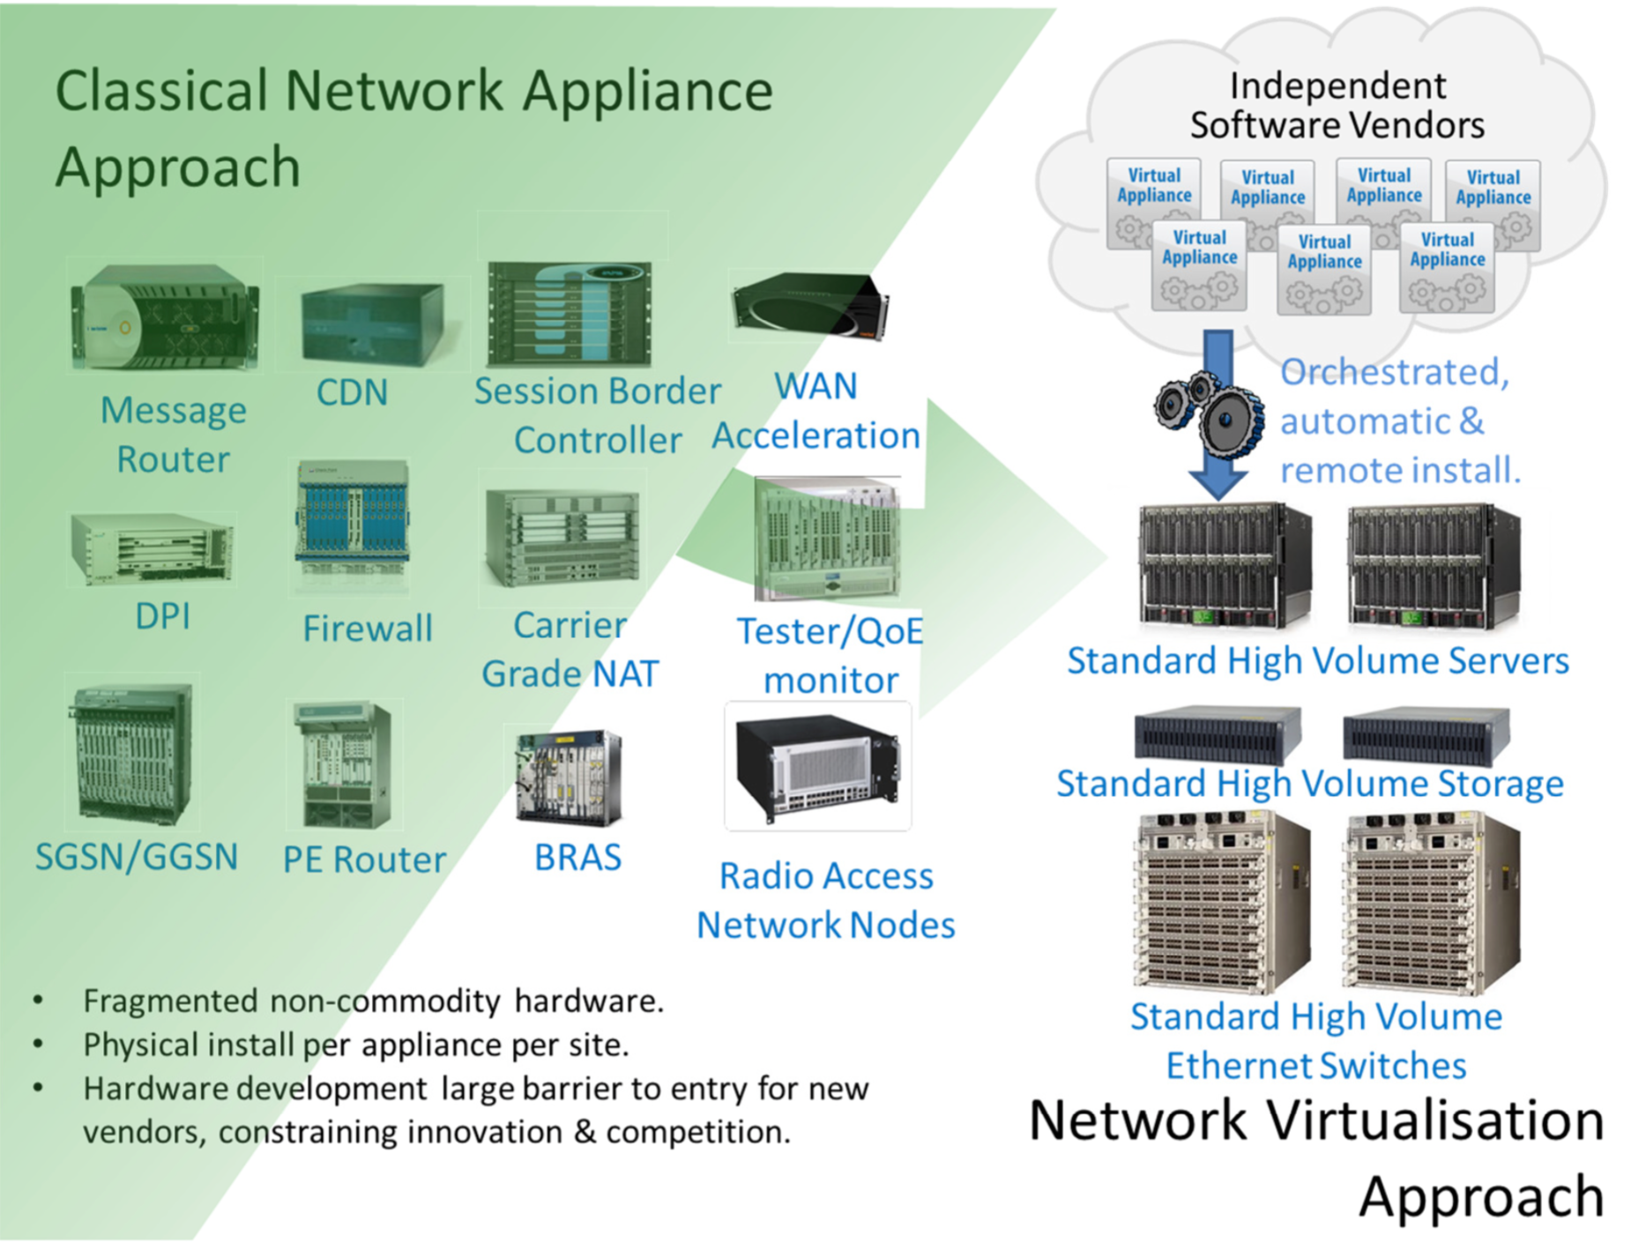
Legacy Infrastructure
Mainframes
Web Servers
App Servers
SOA/ ESB / BPM
SSO & Identity Mgmt.
Monitoring & Management

Slide 22
IoT Data Ingestion-as-a-Service
Alt. Storage
IoT
Specific
Infrastructure
Remote
(DR/B2B)
In-Memory
IoT
Comms
Server
Telemetry
Capture (Queue)
Ingestion
Pipeline
Processing
Data
Lake
Thing
Security
Infrastructure
Legacy
Batch Analytics
Streaming
Analytics

Slide 23
Thing
Internet
Data Center

Slide 24
Thing
Internet
Data Center

Slide 25
Areas of continued innovation
OTA Containers & Microcontroller Microservices
Distributed control planes and policy management
Machine learning

Slide 26
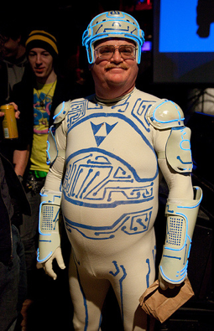
What a long strange trip it’s been

