Slide 1
HTTP/2 and a faster Web
What it is, what it does and what does it mean

Slide 2
Omer Shapira
Engineering Manager Traffic Infrastructure
@rhynolite
Notes:
About me:

Slide 3
Content Slides
LinkedIn Presentation Template

Slide 4
Agenda
What to expect before beers
LinkedIn
Bandwidth vs. Latency
Challenges with HTTP/1
What is HTTP/2
How the game changes
How LinkedIn adopts HTTP/2
Notes:
We are currently limited in scope of our

Slide 5
Speed matters
Who we are and what we do
Social network for business
Founded in 2002
300M+ users
200 countries
Users first
Notes:
We are currently limited in scope of our

Slide 6
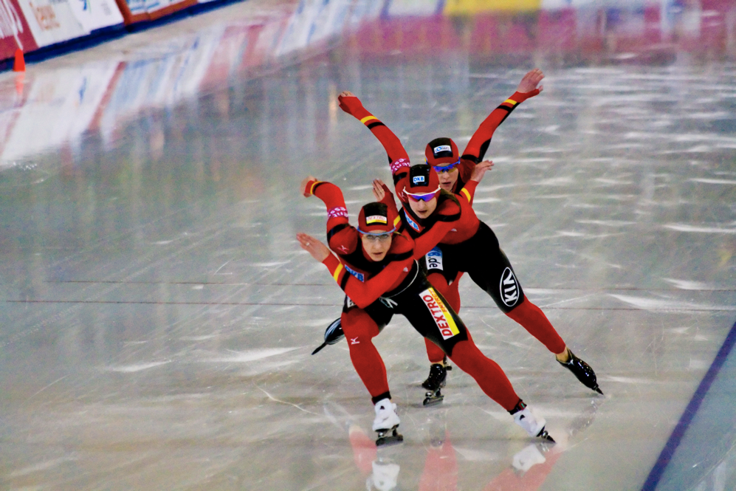
Let’s talk about speed
What’s speed, anyway?
How do we measure the Internet speed?
Trains vs. cars
Bandwidth vs. latency
Notes:
Most of the time is being spent by the person reading the newspaper, spilling the coffee on the newspaper, answering the phone or yelling on children to start behaving themselves.

Slide 7
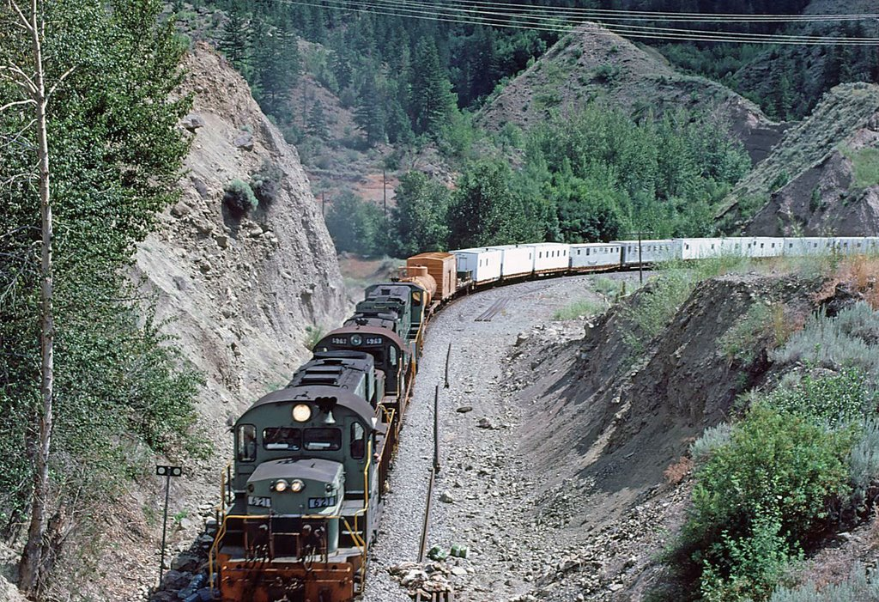
Let’s talk about bandwidth
One bazzillion MBps for $4.99 a month + VAT
Bandwidth is analogous to number of cars on a train
Adding bandwidth is expensive – but simple
Typically sold as “speed”
Matters for streaming
Bandwidth does not matter that much for web or mobile
Notes:
Most of the time is being spent by the person reading the newspaper, spilling the coffee on the newspaper, answering the phone or yelling on children to start behaving themselves.

Slide 8
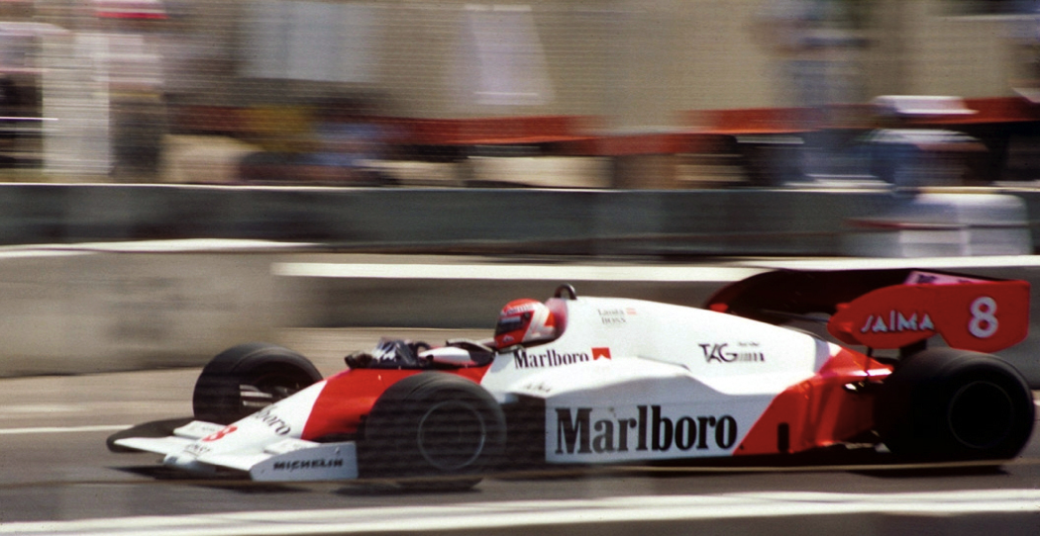
Let’s talk about latency
Latency: time it takes for the server to receive and process request for a page object
Shorten the pipe
Or move faster
Speed of light is a hard limit
Decreasing latency is hard and sometimes impossible
Notes:
Most of the time is being spent by the person reading the newspaper, spilling the coffee on the newspaper, answering the phone or yelling on children to start behaving themselves.

Slide 9
Important latency limits
No one will advertise latency
100ms – user perceives as instantaneous.
1s – is about the upper limit of human flow of thought. User loses the feeling direct feedback.
10s – upper limit of attention. Feedback is important, and the chance of context switch is high.
Source: Nielsen Norman Group
Notes:
Most of the time is being spent by the person reading the newspaper, spilling the coffee on the newspaper, answering the phone or yelling on children to start behaving themselves.

Slide 10
Reality check
Signal latency in vacuum and in fiber
Route | Distance (km) | Time in vacuum (ms) | Time in fiber (ms) | TCP handshake in fiber (ms)
NYC to SF | 4148 | 14 | 21 | 63
NYC to London | 5585 | 19 | 28 | 84
NYC to Sydney | 15993 | 53 | 80 | 240
Source: High Performance Browser Networking
Notes:
Most of the time is being spent by the person reading the newspaper, spilling the coffee on the newspaper, answering the phone or yelling on children to start behaving themselves.

Slide 11
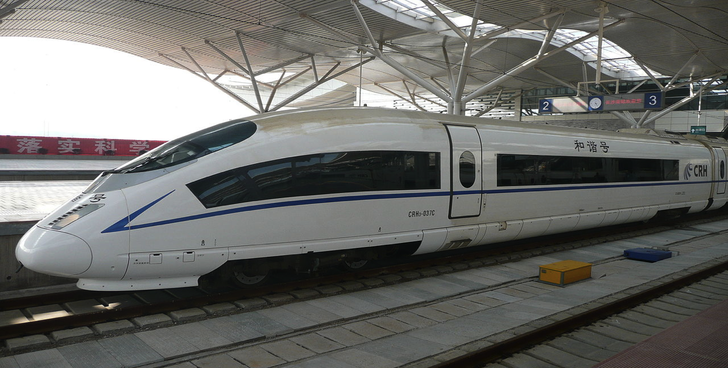
Fast Internet
Short latencies, high bandwidth, opportunities
Low latency
High bandwidth
…
PROFIT!
Notes:
Most of the time is being spent by the person reading the newspaper, spilling the coffee on the newspaper, answering the phone or yelling on children to start behaving themselves.

Slide 12
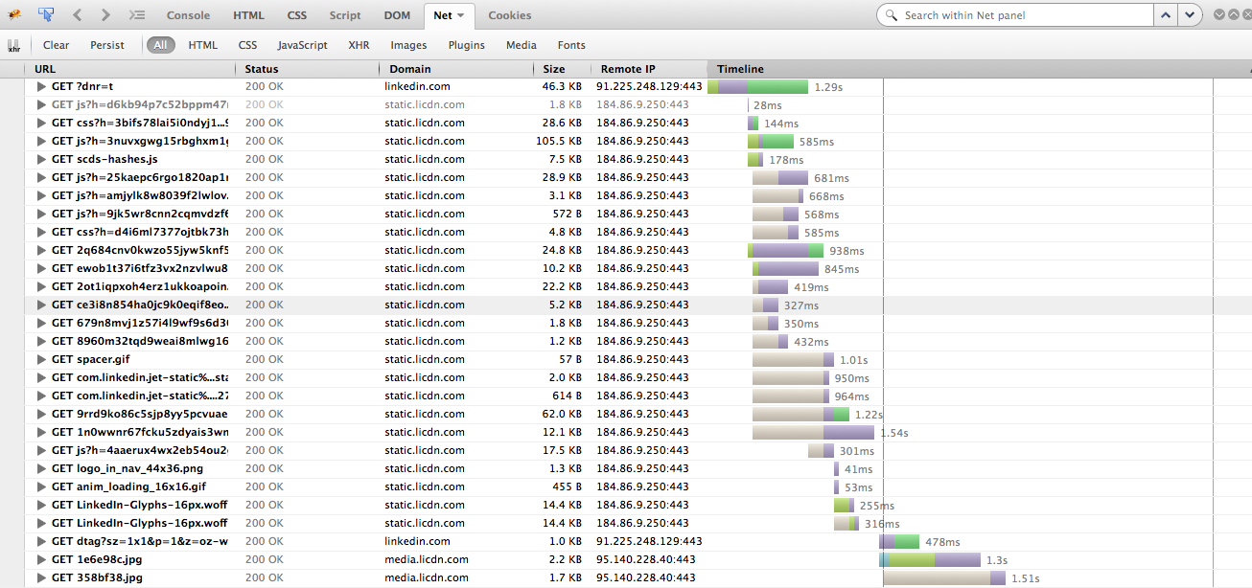
In reality
Not all latencies are the same
Network latency
DNS resolution
SSL/TLS negotiation
Last mile latency typically adds 40ms
Browser latency
DOM/CSSOM latency
Render tree construction
Blocking wait for connection
Notes:
Most of the time is being spent by the person reading the newspaper, spilling the coffee on the newspaper, answering the phone or yelling on children to start behaving themselves.

Slide 13
Browser latency: what’s up there?
No rendering until the tree grows
Source: Critical Rendering Path
Notes:
Most of the time is being spent by the person reading the newspaper, spilling the coffee on the newspaper, answering the phone or yelling on children to start behaving themselves.
Render tree is constructed from DOM and CSSOM
Then rendering starts
DNS resolution
SSL/TLS negotiation
Last mile latency typically adds 40ms
Browser latency
DOM/CSSOM latency
Blocking wait for connection

Slide 14
HTTP/1 challenges
Things to consider during migration

Slide 15
Let’s talk about HTTP
Long latencies, low bandwidth, lots of client time
Mimics interactions between a person and a newspaper
Reading a page takes time.
Transferring text is easy
Single browser window
Notes:
Most of the time is being spent by the person reading the newspaper, spilling the coffee on the newspaper, answering the phone or yelling on children to start behaving themselves.

Slide 16
Hyper TEXT transfer protocol
In reality we mostly transfer images
Notes:
Most of the time is being spent by the person reading the newspaper, spilling the coffee on the newspaper, answering the phone or yelling on children to start behaving themselves.

Slide 17
Challenges with HTTP
The protocol is getting obsolete

Slide 18
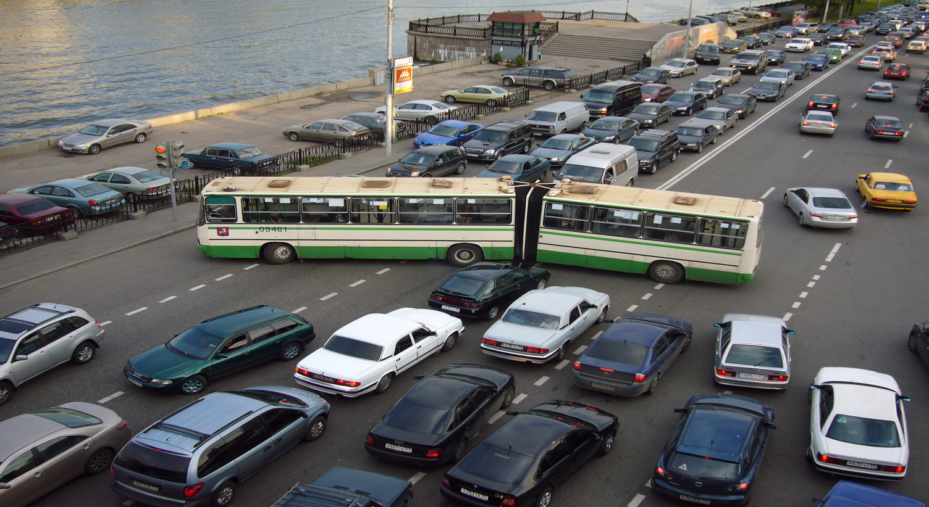
Challenges with HTTP
Congestion Control
Notes:
Connections start slow to avoid router congestions
HTTP/1.1 has “Keep-Alive” option…
But connections will timeout during inactivity, causing new connections to start slowly again

Slide 19
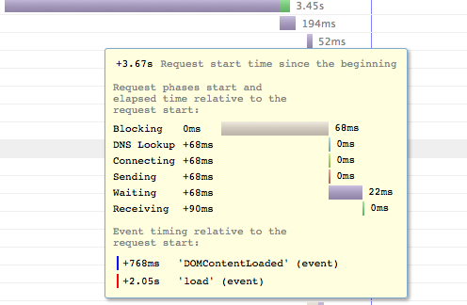
Challenges with HTTP
6 requests in flight, the rest wait…
Once all threads are used,
the browser blocks the next request…
Notes:
Domain sharding – browser opens 6 connections per origin

Slide 20
Domain sharding to the rescue?
6 requests per shard
Shard1.static.company.com
…
ShardX.static.company.com
X times the connections
BUT
X times the SSL negotiation
X times nascent connections
X times “half closed” connections…
Notes:
Domain sharding – browser opens 6 connections per origin.

Slide 21
Challenges with HTTP
Head of line latency
Content is not requested until the base page is parsed
Head of line latency
Notes:
Under HTTP/1.1, browser has to parse the page to get more URLs
This includes building DOM, CSSOM, executing JavaScript…
Browser latency has to happen, but HTTP constrains us to follow the sequential model

Slide 22
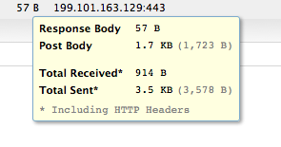
Challenges with HTTP
Headers are never compressed
Headers are transmitted with every request
But some of the headers need to be only transferred once
Accepts-Encoding
Headers are never compressed
Can add extra hop
Server sent 914 bytes to
transfer 57 bytes of response.
This is 15x overhead
Notes:
Header compression

Slide 23
HTTP/2 approach
A new perspective

Slide 24
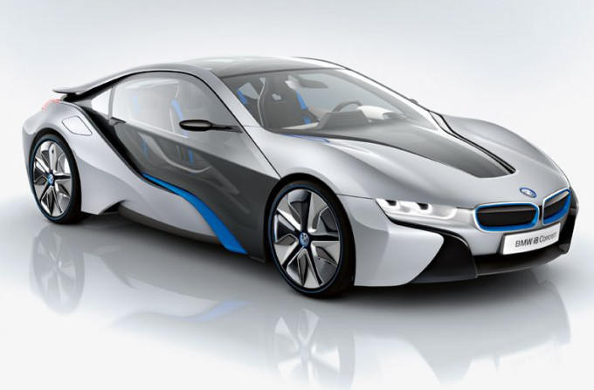
SPDY – a new beginning
Foundations for HTTP/2

Slide 25
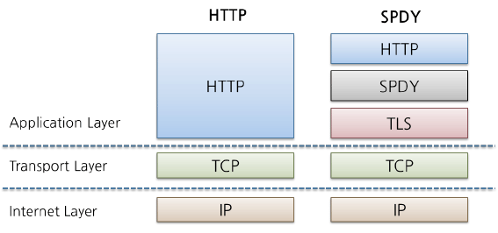
Overview of HTTP/2
Drop in replacement, transparent for webdevs and SWEs
Starts with NPN negotiation (optionally with HTTP upgrade)
If both server and browser support SPDY, they switch to SPDY

Slide 26
Overview of HTTP/2
Multiplexing instead of thread pools/domain sharding
Single connection is maintained between browser and server
Congestion window grows, increasing utilization of the network
Unlimited resources in flight – browser is not blocked
Notes:
----- Meeting Notes (9/22/14 16:28) -----
Packet loss will be much more painful in SPDY. 3% (Leif Hedstrom)
ATT public data - packet loss.
Custom congestion control. Perhaps different algorithm. TCP cubic will keep me stable for longer.

Slide 27
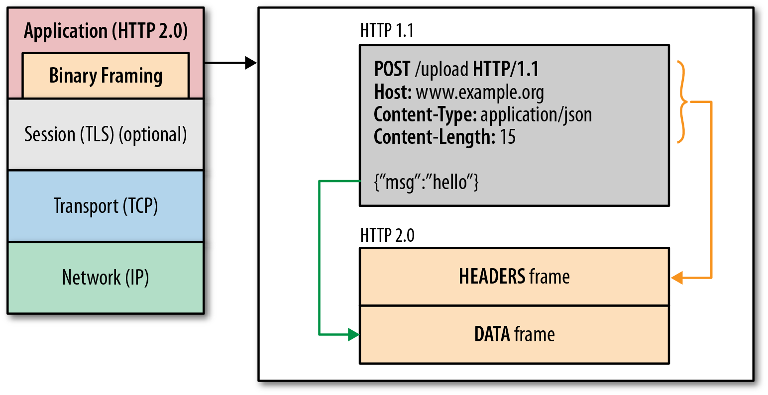
Overview of HTTP/2
Based on SSL/TLS
Negotiated over SSL (NPN/ALPN) or as HTTP upgrade
Transport layer security (always in SPDY, optional in HTTP/2)
Compression (including headers)
Notes:
----- Meeting Notes (9/22/14 16:28) -----
Not always negotiated through upgrade. The problem with upgrade is the extra RTT for request and response. byte sniffing, upgrade header. over SSL - NPN. SSL price has been already paid.
----- Meeting Notes (9/22/14 16:31) -----
HTTP/2.0 does allow clients talking SPDY.

Slide 28
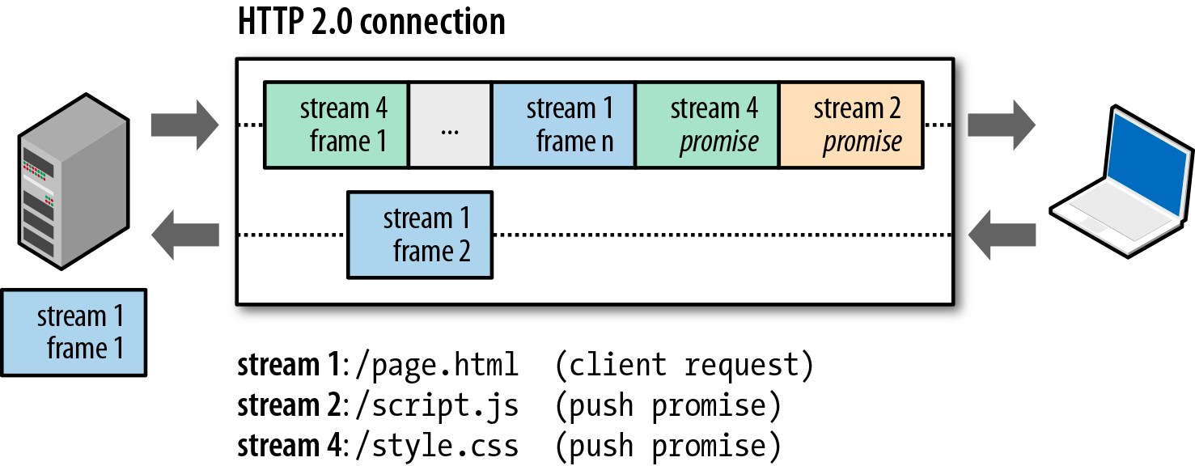
Overview of HTTP/2
Server push
Server can speculatively push resources to client before base page has been parsed
Resources can be reused between pages through the browser cache.

Slide 29
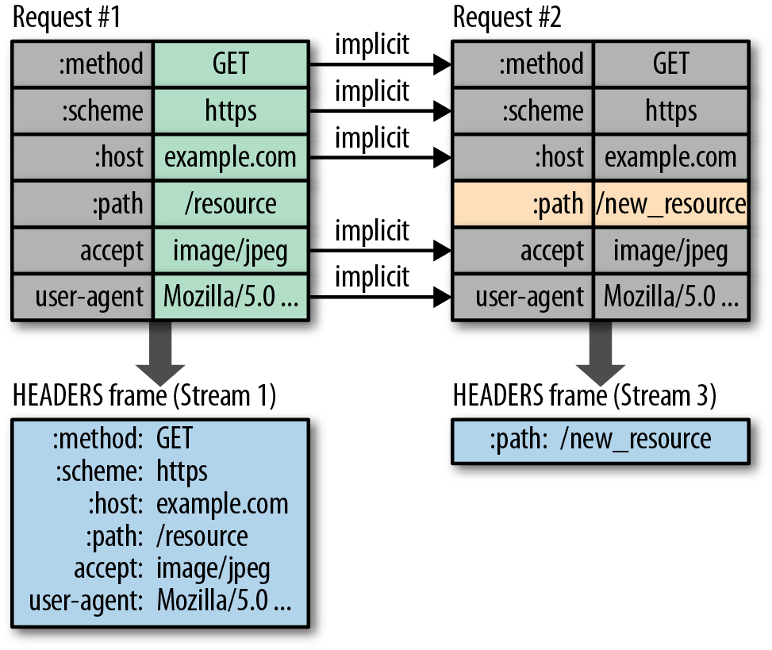
Overview of HTTP/2
Header elimination and compression
Explicit headers are eliminated
Headers are further compressed
Notes:
----- Meeting Notes (9/22/14 16:40) -----
User Agent
Host
Accept-Encoding

Slide 30
HTTP/2 changes the game
Things to consider during migration

Slide 31
It is (mostly) here
Chrome, Firefox, IE with Safari to follow
chrome –enable-spdy4
IE 11
Firefox 34
Safari…

Slide 32
HTTP/1 best practices…
Chrome, Firefox, IE with Safari to follow
Domain sharding
Inlining
Spriting

Slide 33
Domain sharding – slows HTTP/2 down
Chrome, Firefox, IE with Safari to follow
Domain sharding
Breaks HTTP/2 prioritization etc
Requires multiple SSL/TLS handshake
Nascent connections break TCP flow control
We are looking for a single connection per domain
Tip: use altName to map multiple domains to same SSL certificate
Single HTTP/2 connection, multiple connections for HTTP/1
Notes:
Domain sharding does not work, at least not out of the box

Slide 34
Inlining – wastes bandwidth
Chrome, Firefox, IE with Safari to follow
Inlining != DRY
Instead of inlining resources, modularize codebase and utilize Server Push
SP places object into browser cache
Tombstone records to invalidate cache

Slide 35
Control head-of-line latency
Chrome, Firefox, IE with Safari to follow
Recall browser latency graph
DOM and CSOM are required for rendering
Prioritize JS and CSS over images
Notes:
Domain sharding does not work, at least not out of the box

Slide 36
New challenges
HTTP/2 simplifies delivery, opens new challenges
Transition from HTTP/1 to HTTP/2
Innovation possibilities
Hybrid models

Slide 37
Putting SPDY to work at LinkedIn
So what?

Slide 38
Anatomy of a page
One base page and tons of static content
Base page
Static Content
Notes:
----- Meeting Notes (9/22/14 16:40) -----
Majority of the page weight are coming from the CDN.
Base page is coming from the PoP.
The key is the static content.

Slide 39
LinkedIn network stack
Or rather non-planar graph
Notes:
----- Meeting Notes (9/22/14 16:40) -----
Majority of the page weight are coming from the CDN.
Base page is coming from the PoP.
The key is the static content.

Slide 40
CDNs
Blazing fast, ubiquitous and not flexible
Distribute the content around the globe
Make the web pretty fast by shortening the pipes

Slide 41
There is a CDN edge near you

Slide 42
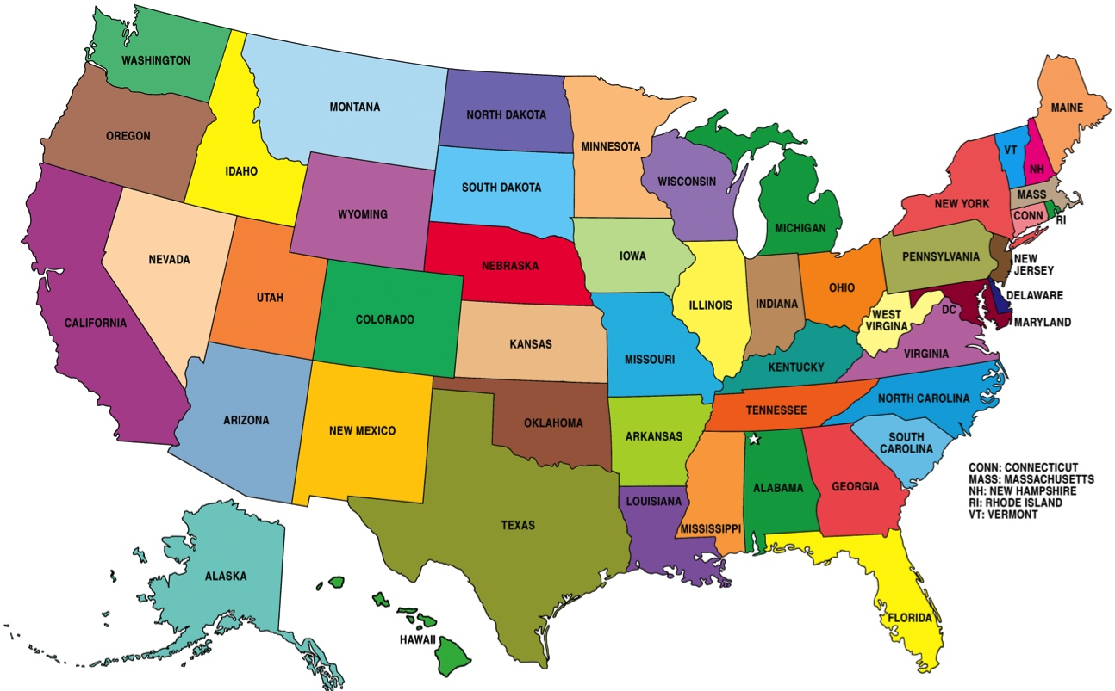
Can we beat CDNs locally?
Let’s use science to experiment!
Notes:
----- Meeting Notes (9/22/14 16:40) -----
Still going through t

Slide 43
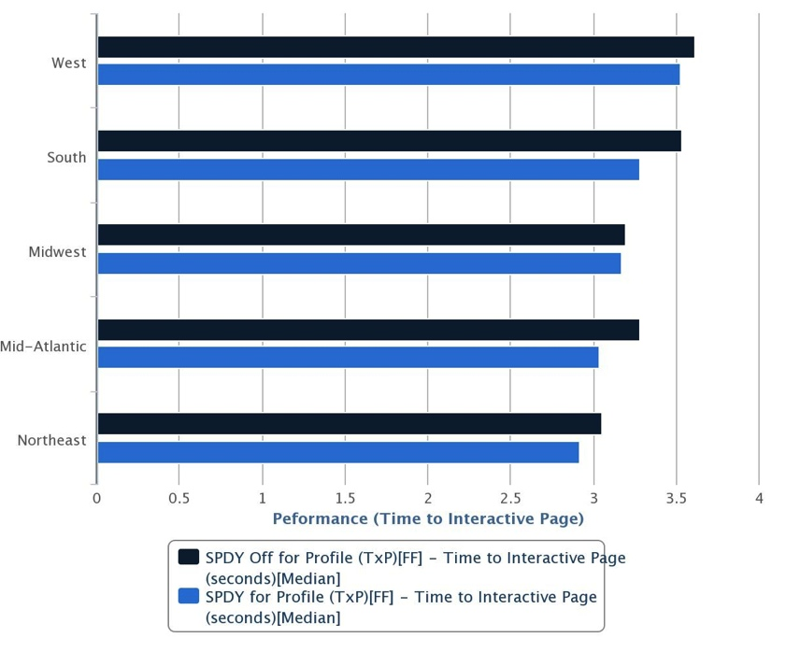
Comparing SPDY with CDN - results
Results
Benefits of SPDY increased with for regions close to the PoP
Profile page is better across the board
Homepage is better for regions closer to ECH
Notes:
----- Meeting Notes (9/22/14 16:40) -----
Just static content.

Slide 44
LinkedIn network stack
Overly simplified
Notes:
----- Meeting Notes (9/22/14 16:40) -----
Majority of the page weight are coming from the CDN.
Base page is coming from the PoP.
The key is the static content.

Slide 45
LinkedIn network stack
Pushing the CDN aside
Notes:
----- Meeting Notes (9/22/14 16:40) -----
Majority of the page weight are coming from the CDN.
Base page is coming from the PoP.
The key is the static content.

Slide 46
Static content vs. base pages – round 2

Slide 47
Combining HTTP/2 with CDNs
Deploy HTTP/2 stacks around the globe

Slide 48
Bottom line
HTTP/2 makes web faster; so do CDNs
Modern CDNs do pretty good job accelerating HTTP
HTTP/2 accelerates web content delivery further
Serving static content through HTTP/2 accelerates LinkedIn page
In the long run, CDNs will support HTTP/2. This will make the web faster for everybody.

Slide 49
Questions

Slide 50
We are hiring

