Slide 1
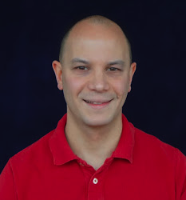
Daniel
My Three Ex’s: A Data Science Approach for Applied Machine Learning

Slide 2
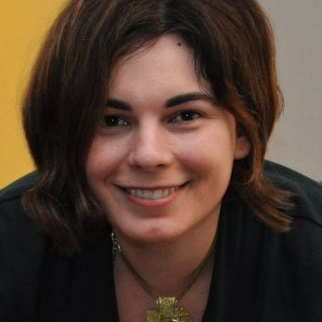
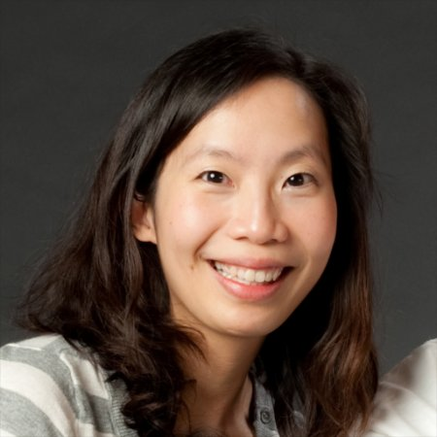
Dedicated to 3 of my favorite ex co-workers.

Slide 3
First, a disclosure.
This isn’t a talk about machine learning.
It’s a talk about applying machine learning.
What’s the difference?

Slide 4
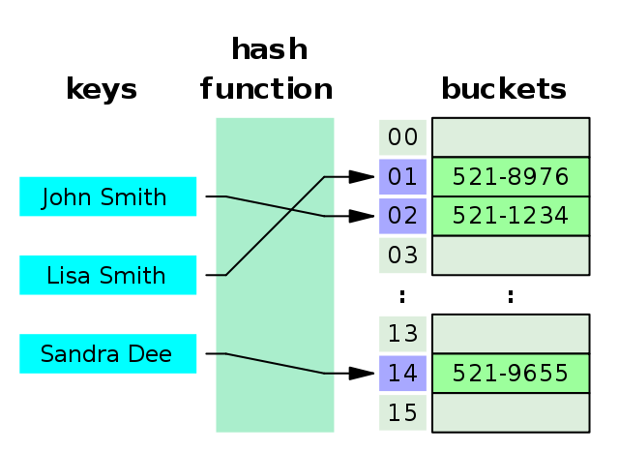
Let’s talk about something else for a moment.
Hash Tables

Slide 5
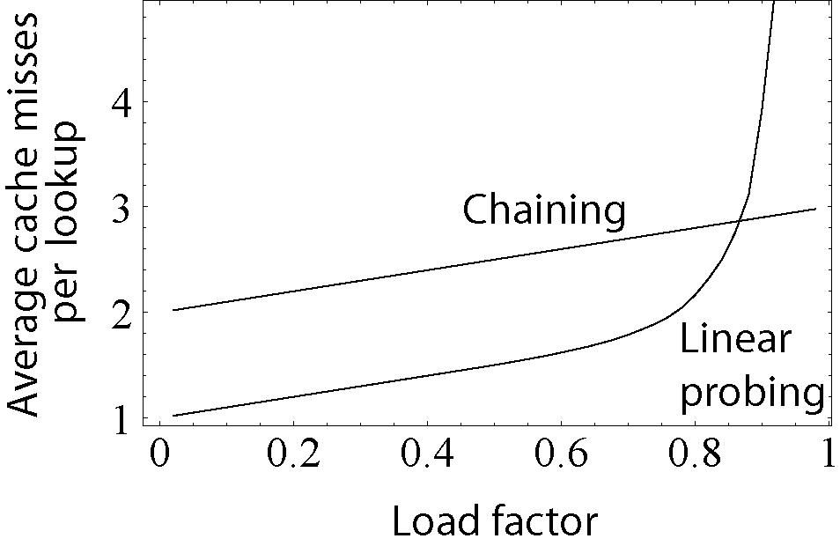
What you (need to) know about hash tables.
Theory
Application
Class HashMap<K,V>
java.lang.Object
java.util.AbstractMap<K,V>
java.util.HashMap<K,V>
Type Parameters:
K - the type of keys maintained by this map
V - the type of mapped values
All Implemented Interfaces:
Serializable, Cloneable, Map<K,V>

Slide 6
Now let’s get back to machine learning!

Slide 7
Please allow me to introduce my three ex’s.
Express.
Explain.
Experiment.

Slide 8
Embrace the data science mindset.
Express
Understand your utility and inputs.
Explain
Understand your models and metrics.
Experiment
Optimize for the speed of learning.

Slide 9
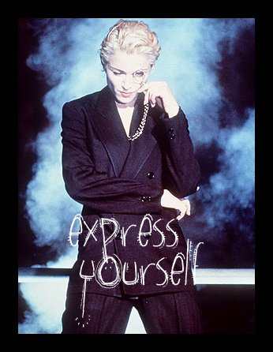
Express.

Slide 10
How to train your machine learning model.
Define your objective function.
Collect training data.
Build models.
Profit!

Slide 11
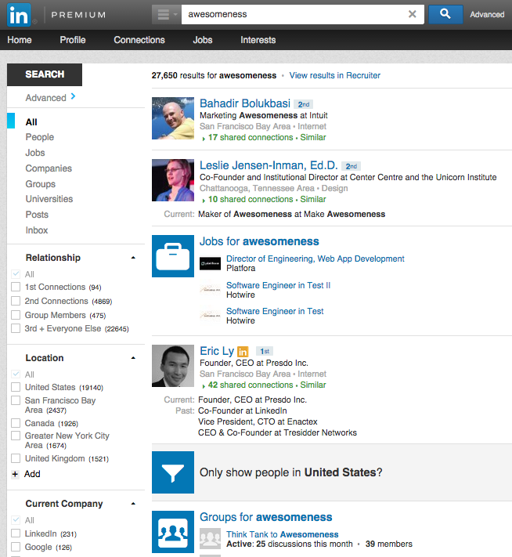
You can only improve what you measure.
Clicks?
Actions?
Outcomes?

Slide 12
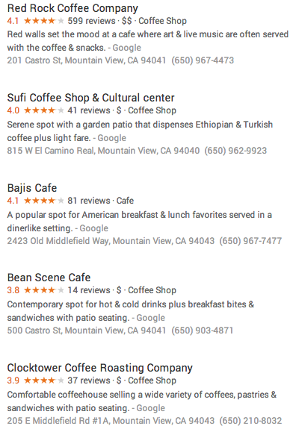
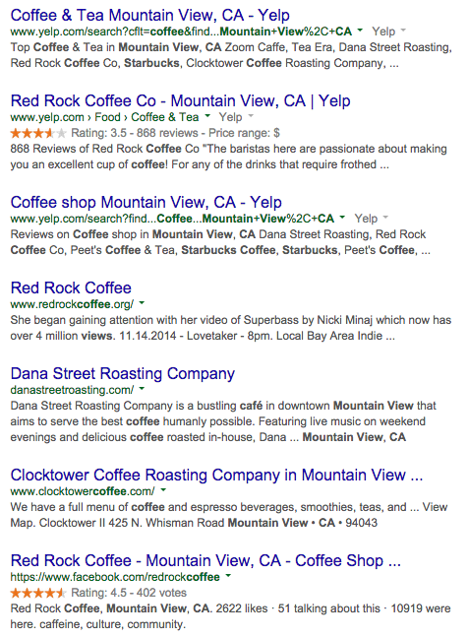
Be careful how you define precision…

Slide 13
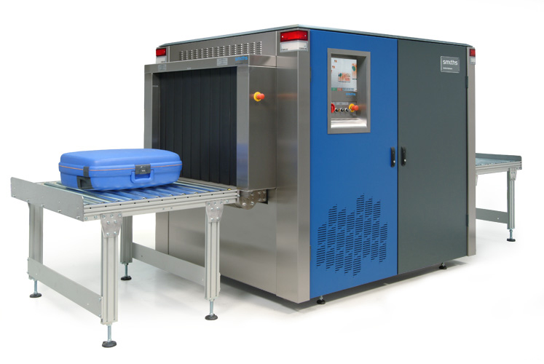
Account for non-uniform inputs and costs.

Slide 14
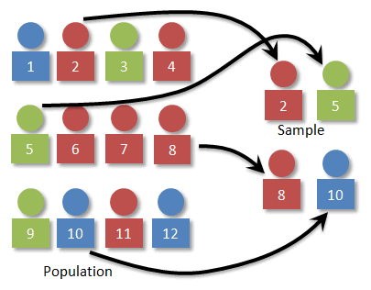
Stratified sampling is your friend.

Slide 15
An example of segmenting models.
Searcher: Recruiter
Query: Person Name
Searcher: Job Seeker
Query: Person Name
Searcher: Recruiter
Query: Job Title
Searcher: Job Seeker
Query: Job Title

Slide 16
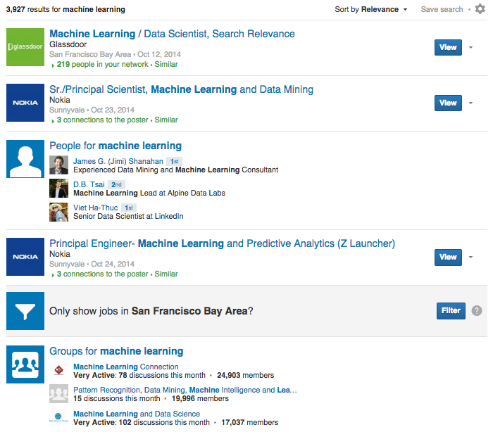
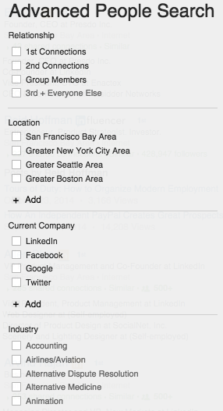
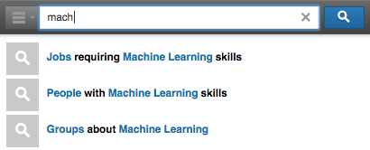
Express yourself in your feature vectors.

Slide 17
Express: Summary.
Choose an objective function that models utility.
Be careful how you define precision.
Account for non-uniform inputs and costs.
Stratified sampling is your friend.
Express yourself in your feature vectors.

Slide 18
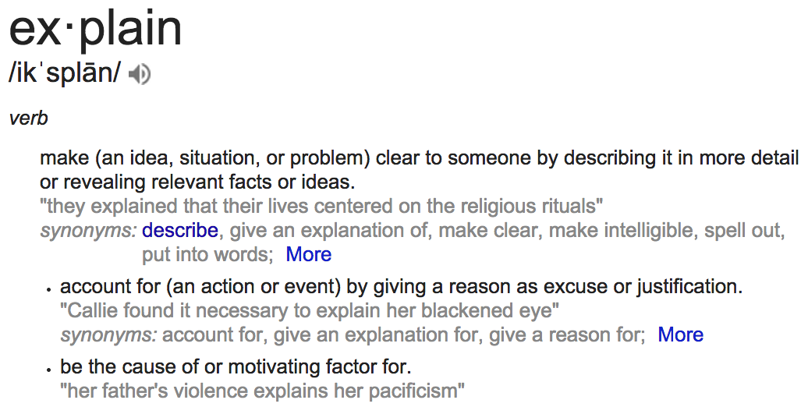
Explain.

Slide 19
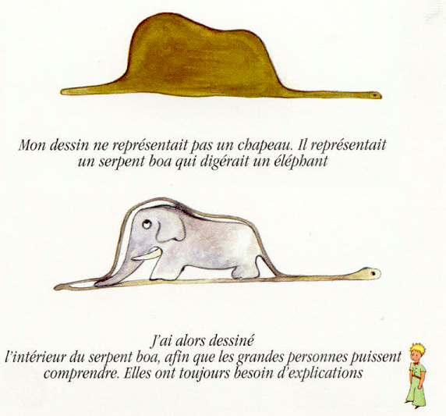
With apologies to the little prince.

Slide 20
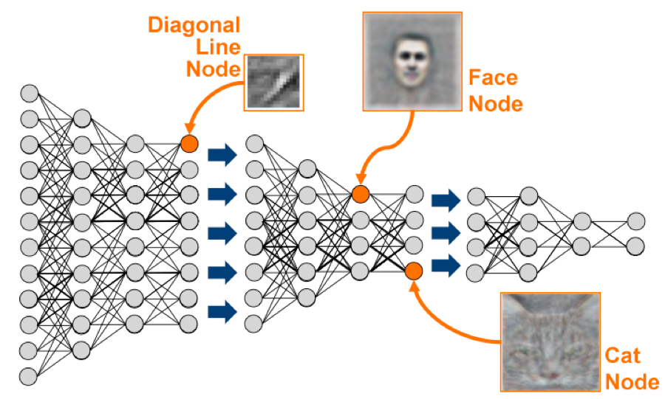
Everyone is talking about Deep Learning.

Slide 21
But accuracy isn’t everything.

Slide 22
Explainable models, explainable features.
Less is more when it comes to explainability.
Algorithms can protect you from overfitting, but they can’t protect you from the biases you introduce.
Introspection into your models and features makes it easier for you and others to debug them.
Especially if you don’t completely trust your objective function or the representativeness of your training data.

Slide 23
Linear regression? Decision trees?
Linear regression and decision trees favor explainability over accuracy, compared to more sophisticated models.
But size matters. If you have too many features or too deep a decision tree, you lose explainability.
You can always upgrade to a more sophisticated model when you trust your objective function and training data.
Build a machine learning model is an iterative process. Optimize for the speed of your own learning.

Slide 24
Explain: Summary.
Accuracy isn’t everything.
Less is more when it comes to explainability.
Don’t knock linear models and decision trees!
Start with simple models, then upgrade.

Slide 25
Experiment.

Slide 26
Why experiments matter.
“You have to kiss a lot of frogs to find one prince. So how can you find your prince faster?
By finding more frogs and kissing them faster and faster.”
-- Mike Moran

Slide 27
Life in the age of big data.
Yesterday
Today
Experiments are expensive,
choose hypotheses wisely.
Experiments are cheap,
do as many as you can!

Slide 28
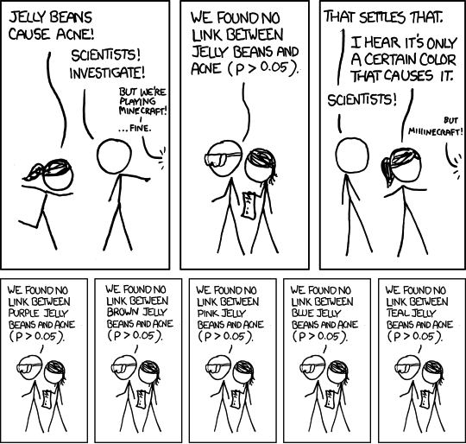
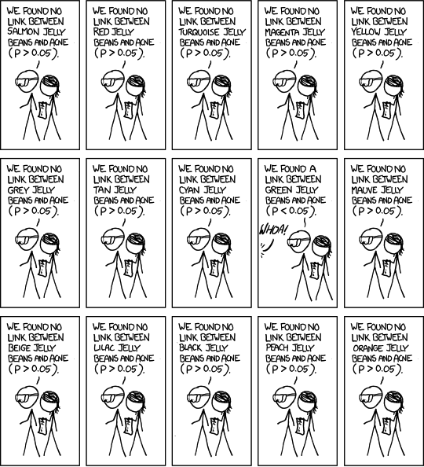
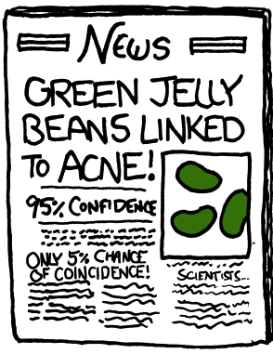
So should we just test everything?

Slide 29
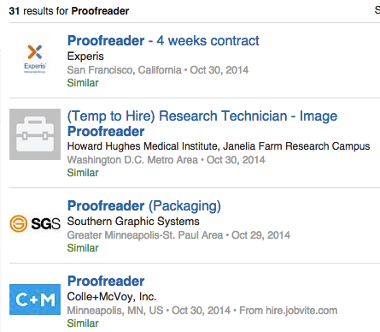
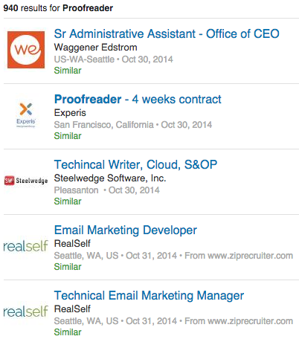
Optimize for the speed of learning.
vs

Slide 30
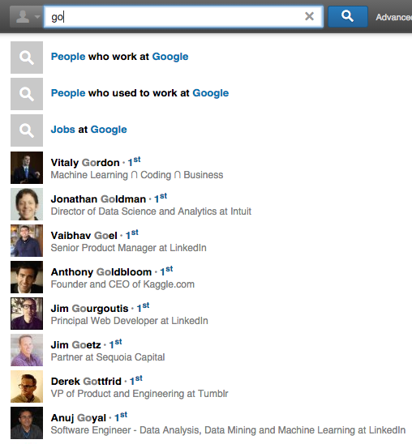
Be disciplined: test one variable at a time.
Autocomplete
Entity Tagging
Vertical Intent
# of Suggestions
Suggestion Order
Language
Query Construction
Ranking Model
Notes:
Suggestions
Graphmail

Slide 31
Experiment: Summary.
Kiss lots of frogs: experiments are cheap.
But test in good faith – don’t just flip coins.
Optimize for the speed of learning.
Be disciplined: test one variable at a time.

Slide 32
Bringing it all together.
Express
Understand your utility and inputs.
Explain
Understand your models and metrics.
Experiment
Optimize for the speed of learning.

Slide 33
Daniel Tunkelang
dtunkelang@linkedin.com
https://linkedin.com/in/dtunkelang

