Slide 1
Building Reactive Services using Functional Programming
Rachel Reese
@rachelreese | github: rachelreese | rachelree.se
Notes:
Hi I’m Rachel Reese! I’m going to speak today on Reactive services. And by that I mean services that adhere to the guidelines laid down in the reactive manifesto.

Slide 2
Reactive manifesto
New!
Responsive
Message-driven
Resilient
Elastic
Notes:
Have you all seen the newest Reactive Manifesto? Update Sept 16!
Today’s modern applications should be:
And we’ll go into what they mean by that..

Slide 3
Responsive
Responsive
The system responds in a timely manner if at all possible. Responsiveness is the cornerstone of usability and utility, but more than that, responsiveness means that problems may be detected quickly and dealt with effectively. Responsive systems focus on providing rapid and consistent response times, establishing reliable upper bounds so they deliver a consistent quality of service. This consistent behavior in turn simplifies error handling, builds end user confidence, and encourages further interaction.

Slide 4
Events
Notes:
Almost every program has to handle events, whether it’s clicks in the user interface or listening to sockets in a server. Events are really just a reaction to a change of state.

Slide 5
Events in F#
Immutable
Composable
First-class
Implement IObservable
Notes:
Immutable: So they don’t change from under us. Concurrency of any form is wicked difficult with mutability.
IObservable: Events are values of type IEvent<'T>. They inherit from IObservable<'T> which is used by other libraries such as Reactive Extensions (Rx). → because of this, they implement IDisposable, helping prevent memory leaks.
First-class: Events are values. we can pass them around as inputs, parameters, outputs. We can filter & transform them.
Composable: Not only can we filter & transform, but we can compose all the operations in the event module.

Slide 6
First class! Composable!
Notes:
The F# community loves |> so much we designed our logo around it!

Slide 7
Event combinators
Add
Choose
Filter
Map
Merge
Pairwise
Partition
Scan
Split
Notes:
These functions are called combinators. We can also create our own.
Basically, we can turn a series of events into an Event Stream which handles like an IEnumerable. Our code looks like we’re programming against sequences.
What to do with the received data VS How to react with the received data
5-7 mins

Slide 8
Demo
Demo
Composing and transforming events

Slide 9
Async workflows
An application of F#’s computation expression syntax.
Notes:
We’ll discuss computation expressions in a min.

Slide 10
Computation expressions
A single syntactic mechanism which gives a nice syntax for multiple abstract computation types.
Monads, yes
But also:
Applicative functors
Monoids
Additive monads*
Computations constructed using monad transformers*
Notes:
computation expression is a mechanism that enables implementation and execution of a controlled series of expressions as an evaluation of steps.
If you don’t know anything about functional programming, tune out now. ;) This doesn’t affect in any way how easy these concepts are to implement.
As long as we define the bind and return operations for the monad, the monadic laws will hold, and you won’t have to resort to explicit use of combinators.
Lots of people think computation expressions are ONLY monads.
Yes, these are just monads, but they are monads with additional required structure.

Slide 11
Async vs. concurrent vs. parallel
Asynchronous
Concurrent
Parallel
Non-blocking, specifically in reference to I/O operations (not necessarily parallel, can be sequential).
Multiple operations happening at the same time (not necessarily in parallel).
Multiple operations processed simultaneously.

Slide 12
Async workflows
Reads similarly to classic, linear synchronous code
Easy to convert
Easy to understand and reason about.

Slide 13
Consider classic synchronous code

Slide 14
Async workflow
Notes:
Free to write synchronous code to prototype, then convert to async later.

Slide 15
Async workflow
Notes:
In a rec loop.
Also have do! And return! syntax.
Async.Sleep
<|
10-15 mins.

Slide 16
Demo
Demo
Async workflows

Slide 17
Message-driven
Message-driven
Reactive Systems rely on asynchronous message-passing to establish a boundary between components that ensures loose coupling, isolation, location transparency, and provides the means to delegate errors as messages. Employing explicit message-passing enables load management, elasticity, and flow control by shaping and monitoring the message queues in the system and applying back-pressure when necessary. Location transparent messaging as a means of communication makes it possible for the management of failure to work with the same constructs and semantics across a cluster or within a single host. Non-blocking communication allows recipients to only consume resources while active, leading to less system overhead.

Slide 18
The actor model
An actor is an independent computational entity which contains a queue, and receives and processes messages.
The actor model is a model of concurrent computation using actors which is characterized by dynamic creation of actors, inclusion of actor addresses in messages, and interaction only through direct asynchronous message passing with no restriction on message arrival order.
Notes:
* One actor is no actor. They come in systems. Carl Hewitt.

Slide 19
F# Agents
Actor = Agent = MailboxProcessor
Notes:
use async workflows.
The important thing here is that there IS a path from any actor to any other.
One of my fave recent uses (not super relevant to this talk) – I built a stock charting iOS app using F# & Xamarin which uses agents to keep the UI & chart responsive.

Slide 20
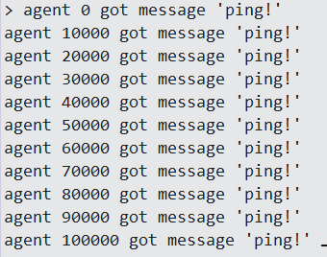
Agents: basic syntax
Notes:
Can create thousands. Not threads!!

Slide 21
Getting replies from an agent
Notes:
This app repeats text put into it.
Tremendously real world.

Slide 22
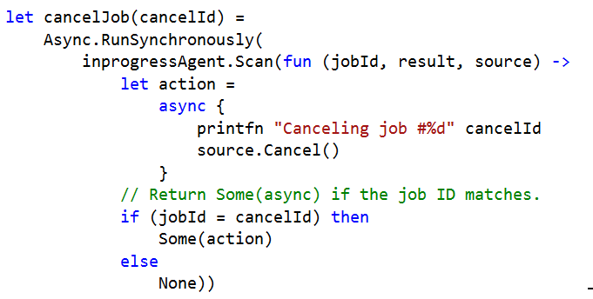
Scanning an agent’s queue
Notes:
This app spins up a few jobs. You can cancel them.

Slide 23
One major difference from Erlang
F# agents do not work across process boundaries, only within the same process.
Enter Cricket (previously FSharp.Actor)
Notes:
In many cases, just using F# MBP is totally appropriate.

Slide 24
Cricket

Slide 25
Cricket remoting

Slide 26
Cricket
Notes:
Actor internals are the same here as non-remoting.
30-35 mins.

Slide 27
Demo
Demo
Agents, Scanner, Cricket

Slide 28
Resilient
Resilient
The system stays responsive in the face of failure. This applies not only to highly-available, mission critical systems — any system that is not resilient will be unresponsive after a failure. Resilience is achieved by replication, containment, isolation and delegation. Failures are contained within each component, isolating components from each other and thereby ensuring that parts of the system can fail and recover without compromising the system as a whole. Recovery of each component is delegated to another (external) component and high-availability is ensured by replication where necessary. The client of a component is not burdened with handling its failures.

Slide 29
Error handling
Tasks that are run using Async.RunSynchronously report failures back to the controlling thread as an exception. Use Async.Catch or try/catch to handle.
Async.StartWithContinuations has an exception continuation.
Supervisor pattern.

Slide 30
Async.Catch
Notes:
Best for async workflows.

Slide 31
Async.StartWithContinuations
Getting replies from an agent

Slide 32
Async.StartWithContinuations
Scanning an agent

Slide 33
Supervisors

Slide 34
Supervisors
Notes:
Continuous scan of the error inbox looking for errors of a certain type.
40-45 mins.

Slide 35
Demo
Demo
Error handling with supervisors and Async.StartWithContinuations

Slide 36
Elastic
Elastic
The system stays responsive under varying workload. Reactive Systems can react to changes in the input rate by increasing or decreasing the resources allocated to service these inputs. This implies designs that have no contention points or central bottlenecks, resulting in the ability to shard or replicate components and distribute inputs among them. Reactive Systems support predictive, as well as Reactive, scaling algorithms by providing relevant live performance measures. They achieve elasticity in a cost-effective way on commodity hardware and software platforms.

Slide 37
Scaling agents on demand
Notes:
<string*string> is type annotation.
Also comment on let rec vs while true difference.
Using same simple example.
45-50 mins.

Slide 38
Demo
Demo
Scaling agents on demand

Slide 39
More resources
https://github.com/DCFsharp/ConcurrencyInFsharp
http://fsprojects.github.io/FSharp.Control.Reactive/
https://github.com/fsprojects/Cricket
http://tomasp.net/blog/csharp-async-gotchas.aspx/

Slide 40
Building Reactive Services using Functional Programming
Rachel Reese
@rachelreese | github: rachelreese | rachelree.se
Notes:
Reactive services: i.e., based on the reactive manifesto.

