Slide 1
Scalable Microservices at Netflix. Challenges and Tools of the Trade
Sudhir Tonse
Manager, Cloud Platform Engineering – Netflix
@stonse

Slide 2
Who am I?
Sudhir Tonse - Manager, Cloud Platform Engineering – Netflix
Contributed to many NetflixOSS components (Archaius, Ribbon …)
Been through many production outages ☺
@stonse

Slide 3
Agenda
Netflix – background and evolution
Monolithic Apps
Characteristics
What are Microservices?
Microservices
Why?
Challenges
Best practices
Tools of the trade
InterProcess Communication
Takeaways

Slide 4
Netflix - Evolution

Slide 5
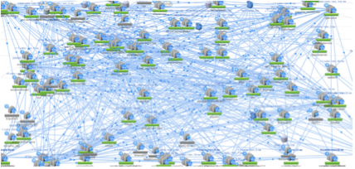
Netflix - Evolution
Old DataCenter (2008)
Everything in one WebApp (.war)
AWS Cloud (~2010)
100s of Fine Grained Services

Slide 6
Netflix Scale
~ 1/3 of the peak Internet traffic a day
~50M subscribers
~2 Billion Edge API Requests/Day
>500 MicroServices
~30 Engineering Teams (owning many microservices)

Slide 7
Monolithic Apps

Slide 8
Monolithic App

Slide 9
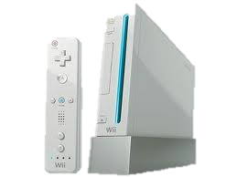
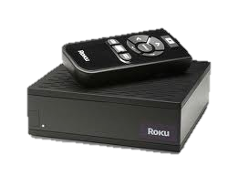
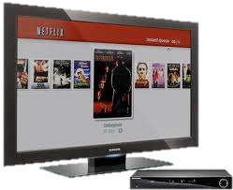
Monolithic Architecture
Load Balancer
Monolithic App
Account Component
Catalog
Component
Database
Recommendation
Component
Customer Service
Component

Slide 10
Characteristics
Large Codebase
Many Components, no clear ownership
Long deployment cycles

Slide 11
Pros
Single codebase
Easy to develop/debug/deploy
Good IDE support
Easy to scale horizontally (but can only scale in an “un-differentiated” manner)
A Central Ops team can efficiently handle

Slide 12
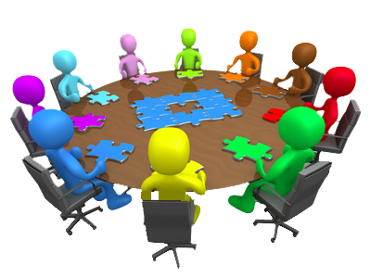
Monolithic App – Evolution
As codebase increases …
Tends to increase “tight coupling” between components
Just like the cars of a train
All components have to be coded in the same language

Slide 14
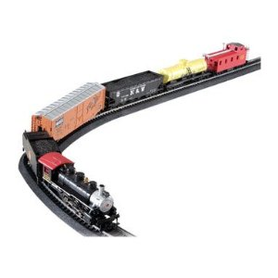
Evolution of a Monolithic App
Shopping Cart
User Accounts
Product Catalog
Customer Service

Slide 15
Monolithic App - Scaling
Scaling is “undifferentiated”
Cant scale “Product Catalog” differently from “Customer Service”

Slide 16
Availability

Slide 17
Availability
A single missing “;” brought down the Netflix website for many hours (~2008)

Slide 18
Monolithic Apps – Failure & Availability

Slide 19
MicroServices
You Think??

Slide 20
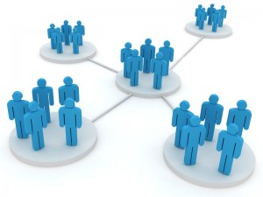
Tipping Point
&
&
Organizational Growth
Disverse Functionality
Bottleneck in
Monolithic stack

Slide 21
What are MicroServices?

Slide 22
Not about …
Team size
Lines of code
Number of API/EndPoints
MicroService
MegaService

Slide 23
Characteristics
Many smaller (fine grained), clearly scoped services
Single Responsibility Principle
Domain Driven Development
Bounded Context
Independently Managed
Clear ownership for each service
Typically need/adopt the “DevOps” model
Attribution: Adrian Cockroft, Martin Fowler …

Slide 24
Composability– unix philosophy
Write programs that do one thing and do it well.
Write programs to work together.
tr 'A-Z' 'a-z' < doc.txt | tr -cs 'a-z' '\n' | sort | uniq | comm -23 - /usr/share/dict/words
Program to print misspelt words in doc.txt

Slide 25
Monolithic App (Various Components linked together)
Comparing Monolithic to MicroServices

Slide 26
MicroServices – separate single purpose services

Slide 27
Monolithic Architecture (Revisiting)
Load Balancer
Monolithic App
Account Component
Catalog
Component
Database
Recommendation
Component
Customer Service
Component

Slide 28
Microservices Architecture
Load Balancer
API Gateway
Catalog DB
Account Service
Catalog
Service
Customer DB
Recommendation
Service
Customer Service
Service

Slide 29
Concept -> Service Dependency Graph
Service X
Service L
Your App/Service
Service Y
Service M
Service Z

Slide 30
MicroServices - Why?

Slide 31
Why?
Faster and simpler deployments and rollbacks
Independent Speed of Delivery (by different teams)
Right framework/tool/language for each domain
Recommendation component using Python?, Catalog Service in Java ..
Greater Resiliency
Fault Isolation
Better Availability
If architected right ☺

Slide 32
MicroServices - Challenges

Slide 33
Challenges
Can lead to chaos if not designed right …

Slide 34
Overall Complexity
Distributed Systems are inherently Complex
N/W Latency, Fault Tolerance, Retry storms ..
Operational Overhead
TIP: Embrace DevOps Model

Slide 35
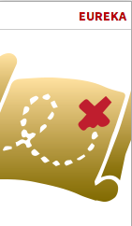
Service Discovery
100s of MicroServices
Need a Service Metadata Registry (Discovery Service)
Registry
Service
(e.g. Netflix Eureka)
Account Service
Catalog
Service
Recommendation
Service
Customer Service
Service
X
Service
Y
Service
Z
Service

Slide 36
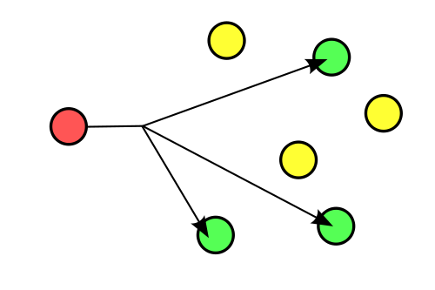
Chattiness (and Fan Out)
~2 Billion Requests per day on Edge Service
Results in ~20 Billion Fan out requests in ~100 MicroServices
1 Request
1 Request
Monolithic App
MicroServices

Slide 37
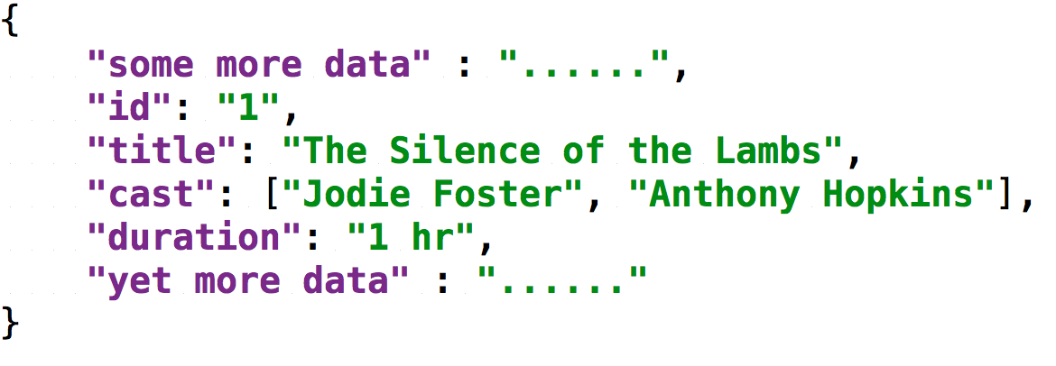
Data Serialization Overhead
Data transformation
getMovies()
getMovie()
getMovieMetadata()
Service A
Service B
Service C
Service D
Cl
ient
B
Cl
ient
C
Cl
ient
D
X
X
Avro
JSON
Xml

Slide 38
Challenges - Summary
Service Discovery
Operational Overhead (100s of services; DevOps model absolutely required)
Distributed Systems are inherently Complex
N/W Latency, Fault Tolerance, Serialization overhead ..
Service Interface Versioning, Mismatches?
Testing (Need the entire ecosystem to test)
Fan out of Requests -> Increases n/w traffic

Slide 39
Best Practices/Tips

Slide 40
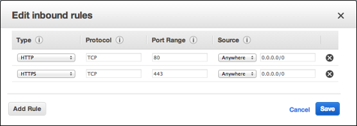
Best Practice -> Isolation/Access
TIP: In AWS, use Security Groups to isolate/restrict access to your MicroServices
http://docs.aws.amazon.com/AWSEC2/latest/UserGuide/using-network-security.html

Slide 41
Best Practice -> Loadbalancers
Choice
Central Loadbalancer? (H/W or S/W)
OR
2. Client based S/W Loadbalancer?

Slide 42
Central (Proxy) Loadbalancer
API Gateway
Customer Service Load Balancer
Account Service Load Balancer
Customer Service
Service 1
Account Service 1
Account Service N
Reco Service
Load Balancer
Customer Service
Service N
Recommendation
Service 1
Recommendation
Service N

Slide 43
Client Loadbalancer
API Gateway
Account Service LB
Recommendation
Service LB
Customer Service
Service LB
Customer Service
Service 1
Account Service 1
Account Service N
Customer Service
Service N
Recommendation
Service 1
Recommendation
Service N

Slide 44
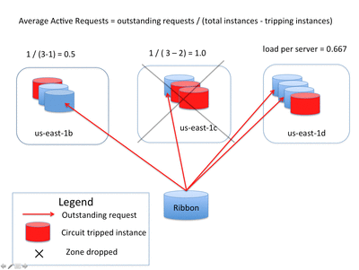
Client based Smart Loadbalancer
Use Ribbon (http://github.com/netflix/ribbon)

Slide 45
Best Practice -> LoadBalancers
TIP: Use Client Side Smart LoadBalancers

Slide 46
Best Practices contd..
Dependency Calls
Guard your dependency calls
Cache your dependency call results
Consider Batching your dependency calls
Increase throughput via Async/ReactiveX patterns

Slide 47
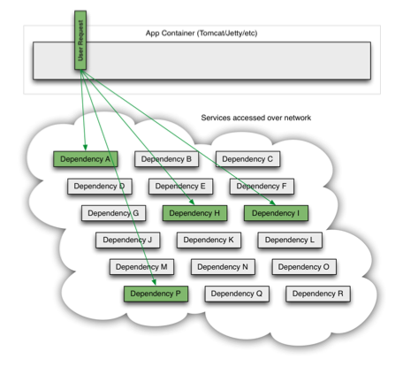
Dependency Resiliency

Slide 48
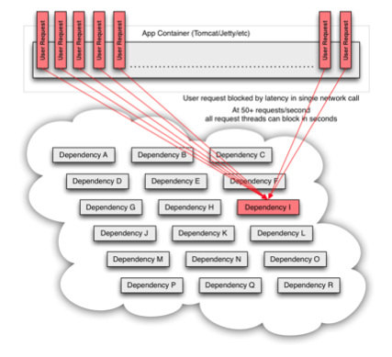
Service Hosed!!
A single “bad” service can still bring your service down

Slide 49
Availability
MicroServices does not automatically mean better Availability
- Unless you have Fault Tolerant Architecture

Slide 50
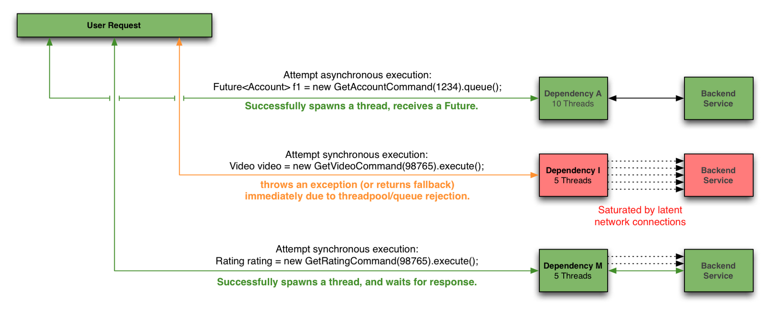
Resiliency/Availability
Circuit Breaker, Retries, Bulk Heading and Fallbacks

Slide 51
Handling Fan Outs

Slide 52
Server Caching
Service X
Your App/Service
Service Y
2. On Cache miss call Service
1. Obtain data from Cache
Service Z
Cache
Cluster
Cache
Cluster
Tip: Config your TTL based on flexibility with data staleness!

Slide 53
Composite (Materialized View) Caching
Service X
Your App/Service
Service Y
2. On Cache miss call Services
1. Obtain data from Cache
Service Z
Cache
Cluster
Fn {A, B, C}
Cache
Cluster

Slide 54
BottleNecks/HotSpots
A/B Test Service
App
Service X
Service Y
Service Z
User Account Service
Every User Req to App translates
to 4 reqs to User Account Service

Slide 55
Tip: Pass data via Headers
A/B Test Service
Usr=XX;
AbCell=103
Usr=XX;
AbCell=103
Usr=XX;
AbCell=103
App
Service X
Service Y
Service Z
User Account Service
Passing data (e.g. user and test cell)
via HTTP Headers reduces dependency
and load on User Account Service

Slide 56
Test Resiliency (of Overall MicroServices)

Slide 57
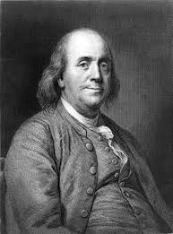
There are only two things certain in life*
Death
Taxes
* Benjamin Franklin

Slide 58
There are only three things certain in life*
Death
Taxes
Outages in Production
* Inspired by Benjamin Franklin

Slide 59
Best Practices contd..
Test Services for Resiliency
Latency/Error tests (via Simian Army)
Dependency Service Unavailability
Network Errors

Slide 60
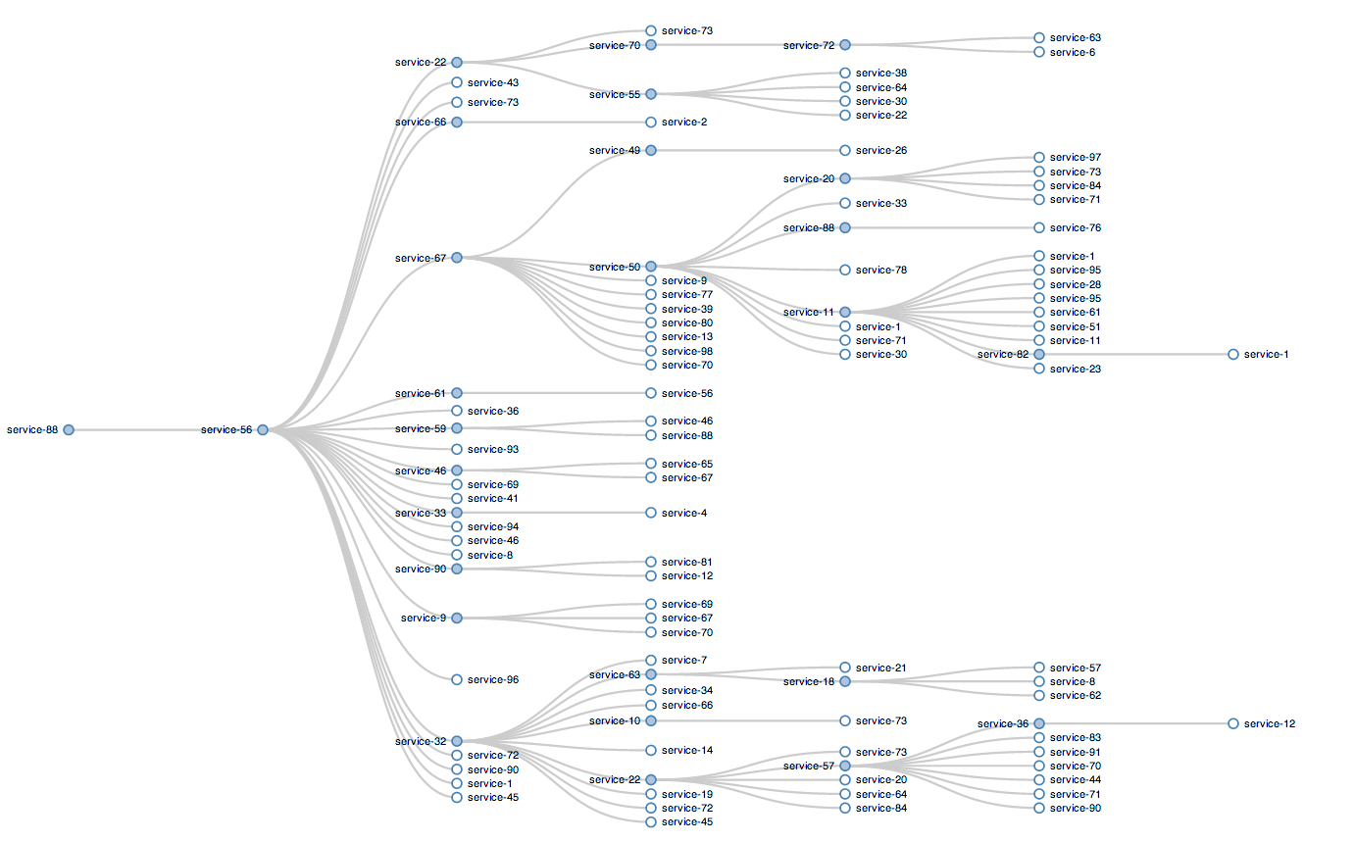
Test Resiliency – to dependencies
Notes:
Startup dependencies hurt us on scale up event
Degrading without knowing is bad

Slide 61
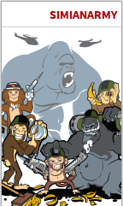
Test Resiliency
Use Simian Army https://github.com/Netflix/SimianArmy

Slide 62
Best Practices - Summary
Isolate your services (Loosely Coupled)
Use Client Side Smart LoadBalancers
Dependency Calls
Guard your dependency calls
Cache your dependency call results
Consider Batching your dependency calls
Increase throughput via Async/ReactiveX patterns
Test Services for Resiliency
Latency/Error tests (via Simian Army)
Dependency Service Unavailability
Network Errors

Slide 63
Tools of the Trade

Slide 64
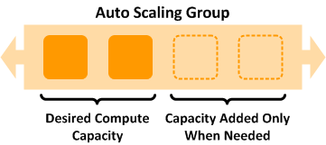
Auto Scaling
Use AWS Auto Scaling Groups to automatically scale your microservices
RPS or CPU/LoadAverage via CloudWatch are typical metrics used to scale
http://docs.aws.amazon.com/AutoScaling/latest/DeveloperGuide/WhatIsAutoScaling.html

Slide 65
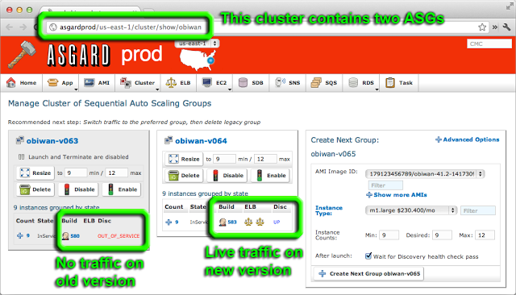
Use Canary, Red/Black pushes
NetflixOSS Asgard helps manage deployments

Slide 66
Service Dependency Visualization

Slide 67
MicroServices at Netflix

Slide 68
Service Dependency Graph
How many dependencies does my service have?
What is the Call Volume on my Service?
Are any Dependency Services running Hot?
What are the Top N Slowest “Business Transactions”?
What are the sample HTTP Requests/Responses that had a 500 Error Code in the last 30 minutes?

Slide 69
Service Dependency Visualization
You
Your Service Dependency Graph

Slide 70
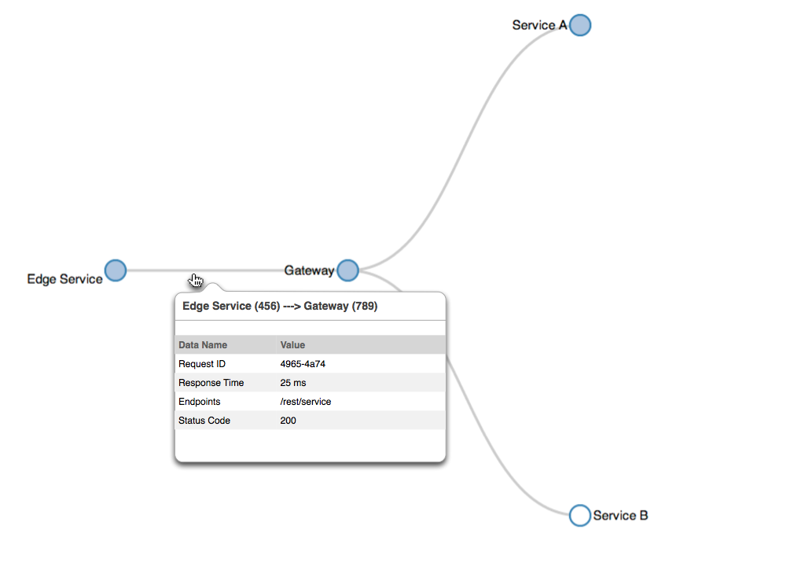
Service Dependency Visualization

Slide 71
Dependency Visualization

Slide 72
Polyglot Ecosystem

Slide 73
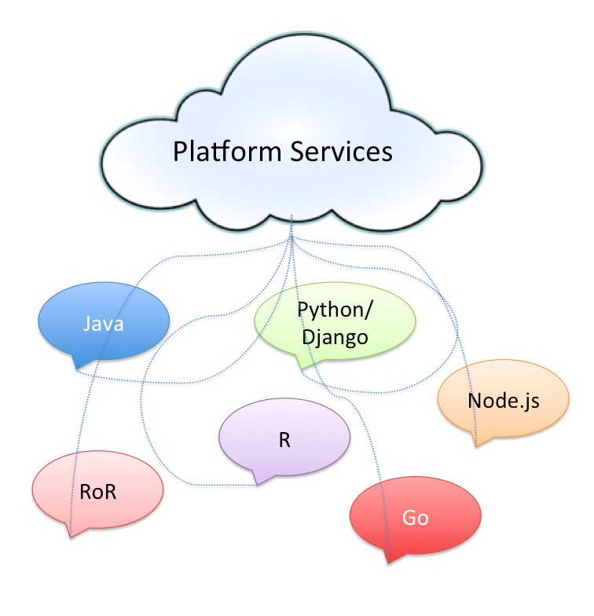
Homogeneity in A Polyglot Ecosystem

Slide 74
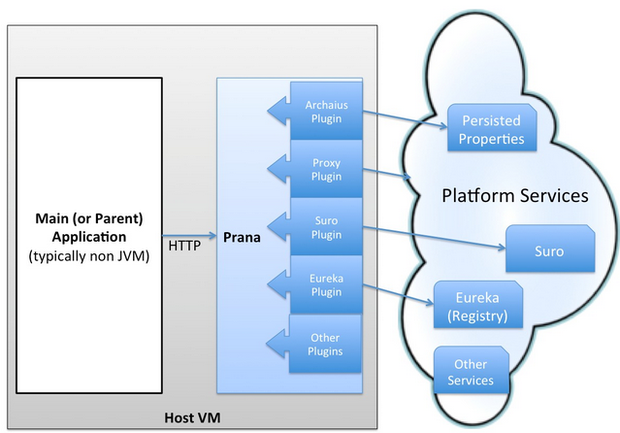
TIP: Use a SideCar
Provides a common homogenous Operational/Infrastructural component for all your non-JVM based MicroServices

Slide 75
Prana Open Sourced!
Just this morning!
http://github.com/netflix/Prana

Slide 76
Inter Process Communication

Slide 77
Netflix IPC Stack (1.0)
Client
Server (Karyon)
Hy
s
t
r
i
x
EVCache
A
p
a
c
h
e
H
T
T
P C
l
i
e
n
t
Ribbon
Apache
Bootstrapping (Governator)
HTTP
Admin Console
Load Balancing
Metrics (Servo)
Tomcat
Eureka Integration
Metrics
(Servo)
Registration
Eureka Integration
Eureka (Service Registry)
Fetch Registry
A Blocking Architecture

Slide 78
Netflix IPC Stack (2.0)
Client (Ribbon 2.0)
Server (Karyon)
HTTP
Ribbon Transport
Ribbon
Bootstrapping (Governator)
UDP
Load Balancing
TCP
Admin Console
WebSockets
RxNetty
Hystrix
RxNet
ty
SSE
Metrics (Servo)
Metrics
(Servo)
Eureka Integration
EVCache
Registration
Eureka Integration
Eureka (Service Registry)
Fetch Registry
A Completely Reactive Architecture

Slide 79
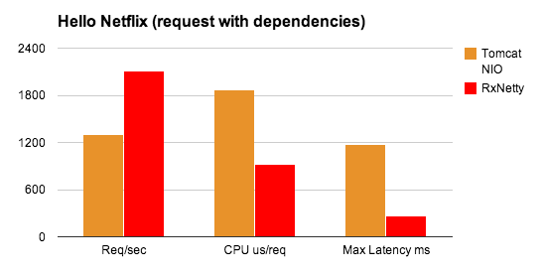
Performance – Throughput
Bounded Thread model (Tomcat) vs Reactive Async (RxNetty)
Details: http://www.meetup.com/Netflix-Open-Source-Platform/events/184153592/

Slide 80
NetflixOSS

Slide 81
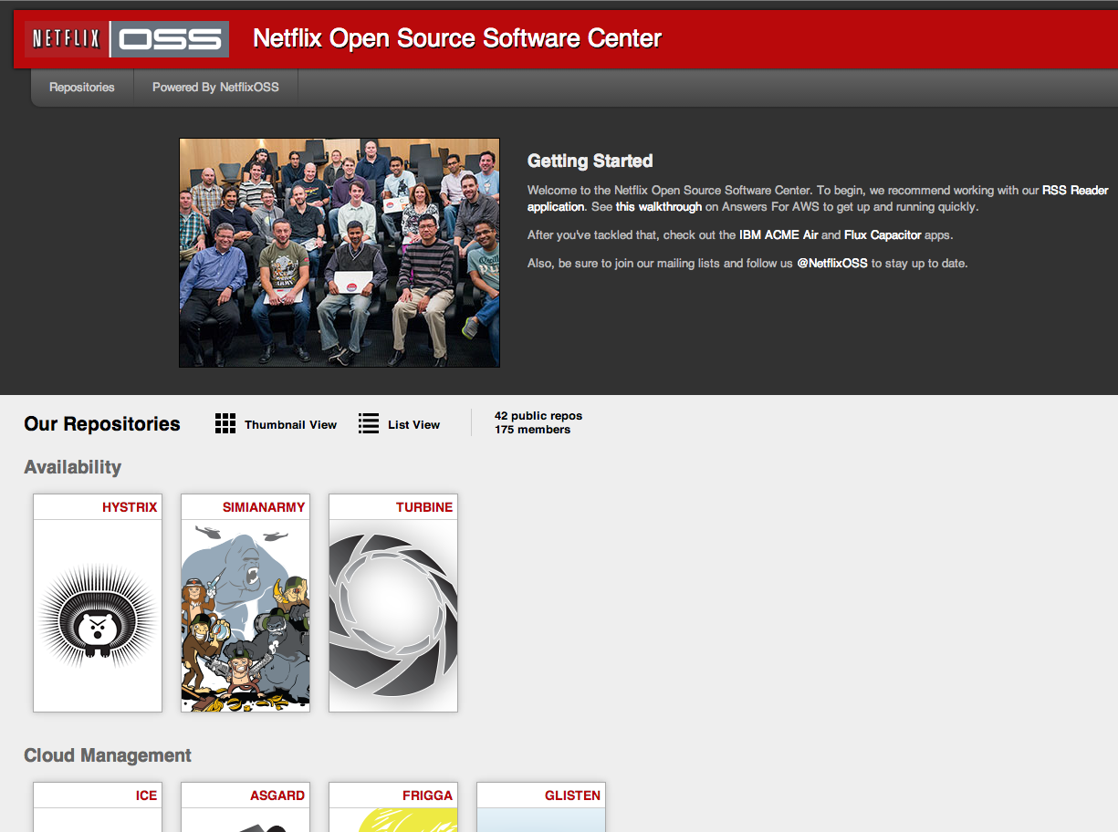
Leverage NetflixOSS
http://netflix.github.co

Slide 82
Eureka – for Service Registry/Discovery
Karyon – for Server (Reactive or threaded/servlet container based)
Ribbon – for IPC Client
And Fault Tolerant Smart LoadBalancer
Hystrix – for Fault Tolerance and Resiliency
Archaius – for distributed/dynamic Properties
Servo – unified Feature rich Metrics/Insight
EVCache – for distributed cache
Curator/Exhibitor – for zookeeper based operations
…

Slide 83
Takeaways

Slide 84
Takeaways
Monolithic apps – good for small organizations
MicroServices – have its challenges, but the benefits are many
Consider adopting when your organization scales
Leverage Best Practices
An Elastic Cloud provides the ideal environment (Auto Scaling etc.)
NetflixOSS has many libraries/samples to aid you

Slide 85
Questions?
@stonse

