Slide 1
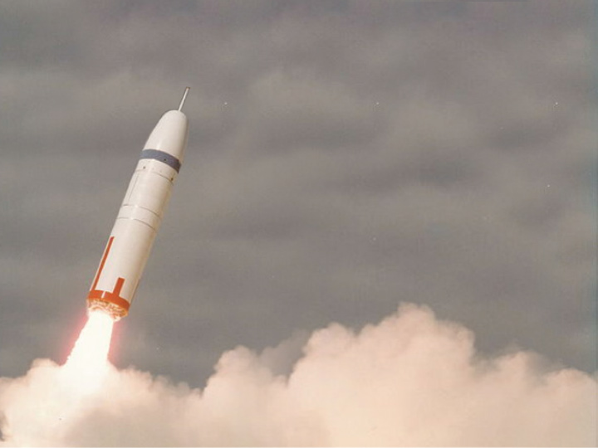
IN-MEMORY + NOSQL + ACID
RESTful Recommendation Engine
using Spring, Aerospike and MongoDB
Peter Milne
Director of Application Engineering
Qcon San Francisco
November 2014
Aerospike aer . o . spike [air-oh- spahyk] noun, 1. tip of a rocket that enhances speed and stability

Slide 2
Sagely Advice
Where is the wisdom we have lost in knowledge? Where is the knowledge we have lost in information?
-T.S.Elliot 1934
Don’t let:
Information oversaturate your Knowledge
Knowledge distract you from Wisdom

Slide 3
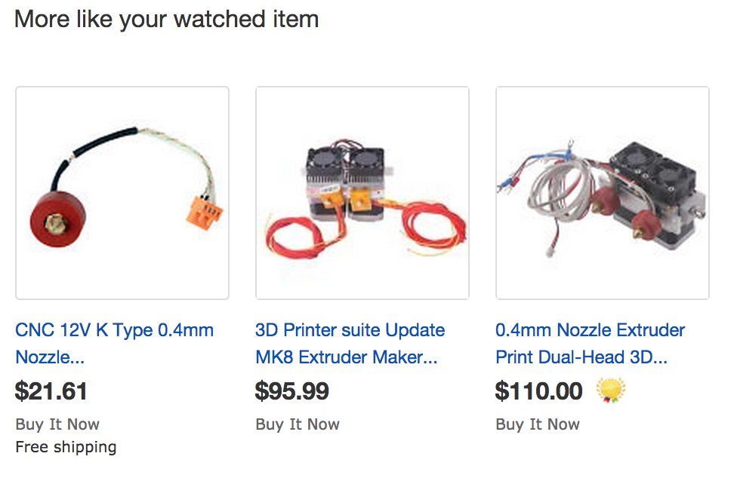
Recommendation Engines
Recommendation engines are used in applications to personalize user experience.
Notes:
For example, e-commerce applications recommend products to a customer that other customers with similar behavior have viewed, enjoyed, or purchased. News applications would use a real-time recommendation engine to provide readers with fresh content, as stories come and go quickly. These application additions improve the user experience, increase sales, and help retain loyal customers.

Slide 4
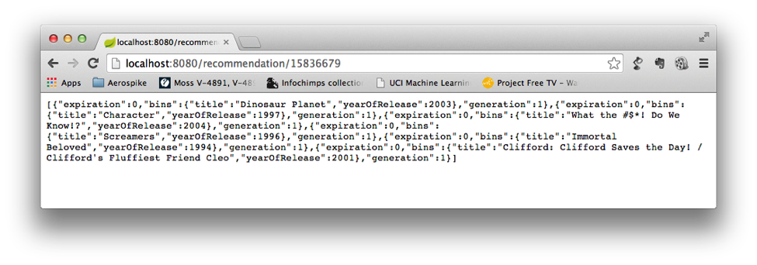
Movie recommendation Engine
Similar to
Hulu, Netflix, YouTube, Daily Motion, etc
Context free
RESTful service
Spring Boot
~100,000 Movies
~800,000 recommendations
Data store
Aerospike
MongoDB

Slide 5
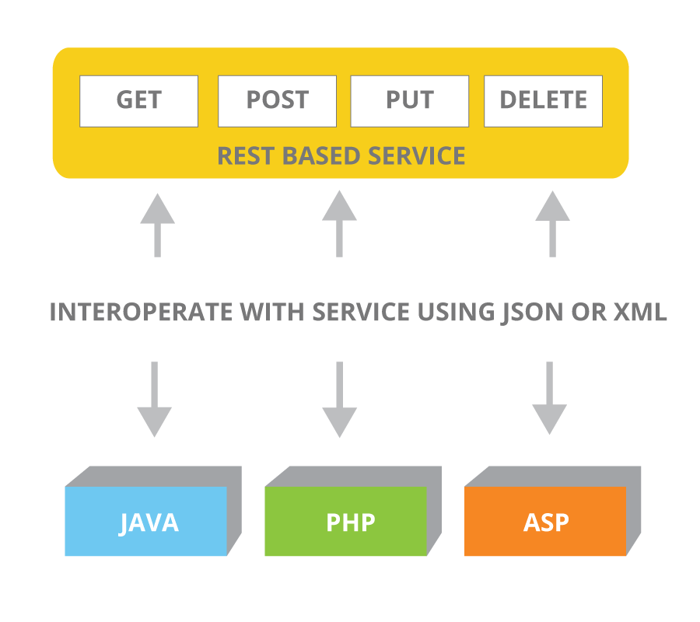
RESTful web services
HTTP based
GET
POST
PUT
DELETE
Payload
XML
JSON
Commonly called “APIs”
“APIs are like … Everybody has one”

Slide 6
Spring Boot
“Spring Boot makes it easy to create stand-alone, production-grade Spring based Applications that can you can just run.”
-- spring.io

Slide 7
MongoDB
NoSQL
Schema less
Data in JSON documents
BSON on server
Seductive programmatic interface
Fashionable JSON
In-memory a.k.a RAM
Fast

Slide 8
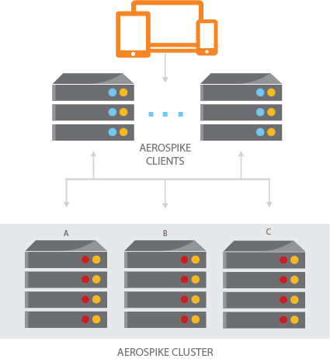
Aerospike
No Hotspots – DHT simplifies data partitioning
Smart Client – 1 hop to data, no load balancers
Shared Nothing Architecture, every node is identical
Single row ACID – synch replication in cluster
Smart Cluster, Zero Touch – auto-failover, rebalancing, rack aware, rolling upgrades
Flash Optimized
Notes:
The Big Picture
Aerospike is a distributed, scalable NoSQL database. It is architected with three key objectives:
To create a flexible, scalable platform that would meet the needs of today’s web-scale applications
To provide the robustness and reliability (ie, ACID) expected from traditional databases.
To provide operational efficiency (minimal manual involvement)
First published in the Proceedings of VLDB (Very Large Databases) in 2011, the Aerospike architecture consists of 3 layers:
The cluster-aware Client Layer includes open source client libraries that implement Aerospike APIs, track nodes and know where data reside in the cluster.
The self-managing Clustering and Data Distribution Layer oversees cluster communications and automates fail-over, replication, cross data center synchronization and intelligent re-balancing and data migration.
The flash-optimized Data Storage Layer reliably stores data in RAM and Flash.
Aerospike scales up and out on commodity servers. 1) Each multi-threaded, multi-core, multi-cpu server is fast 2) Each server scales up to manage up to 16TB of data, with parallel access to up to 20 SSDs 3) Aerospike scales out linearly with each identical server added, to parallel process 100TB+ across the cluster (AppNexus was in production with a 50 node cluster that has now scaled up by increasing SSD capacity per node and reducing node count to 12, in preparation for scaling back up on node counts and SSD capacity ) - see http://www.aerospike.com/wp-content/uploads/2013/12/Aerospike-AppNexus-SSD-Case-Study_Final.pdf
SYNC replication within cluster for immediate consistency, #replicas from 1 to #nodes in cluster, typical deployment has 2 or 3 copies of data; Can support ASYNC within cluster. ASYNC replication across clusters using Cross Data Center Replication (XDR). Writes automatically replicated across one or more locations. Fine grained control - individual sets or namespaces can be replicated across clusters in master/master/slave complex ring and star topologies.

Slide 9
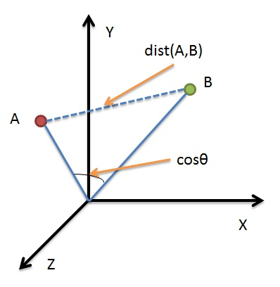
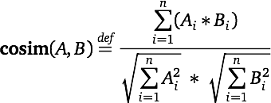
Cosine Similarity
“Cosine similarity is a measure of similarity between two vectors of an inner product space that measures the cosine of the angle between them. …. Cosine similarity is particularly used in positive space, where the outcome is neatly bounded in [0,1].” - Wikipedia

Slide 10
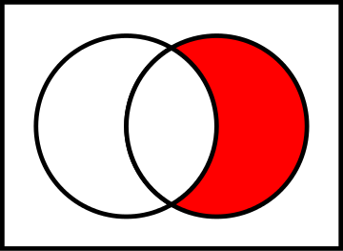
The recommendation algorithm
Jane Doe accesses the application
Retrieve Jane’s User Profile
Retrieve the Movie record for each movie that Jane has watched. For each movie:
Retrieve each of the watched user profiles
See if this profile is similar to Jane’s by giving it a score
Using the user profile with the highest similarity score, recommend the movies in this user profile that Jane has not seen.
A^{c} ∩ B = B \ A
This is a very elementary technique and it is useful only as an illustration, and it does have several flaws
A
B
Relative complement
Notes:
Flaws:
Imagine that Jane has watched Harry Potter. It would be foolish to calculate similarity using the customer profiles who viewed this movie, because a very large number of people watched Harry Potter. If we generalize this idea, it would be that movies with the number of views over a certain threshold should be excluded.
Cosine similarity assumes each element in the vector has the same weight. The elements in our vectors are the movie IDs, but we also have the rating of the movie also. A better similarity algorithm would include both the movie ID and its rating.

Slide 11
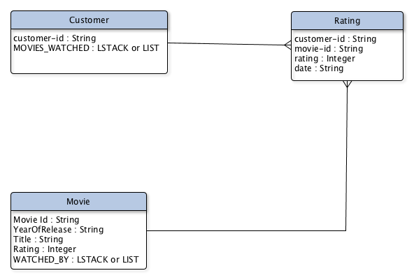
Data model

Slide 12
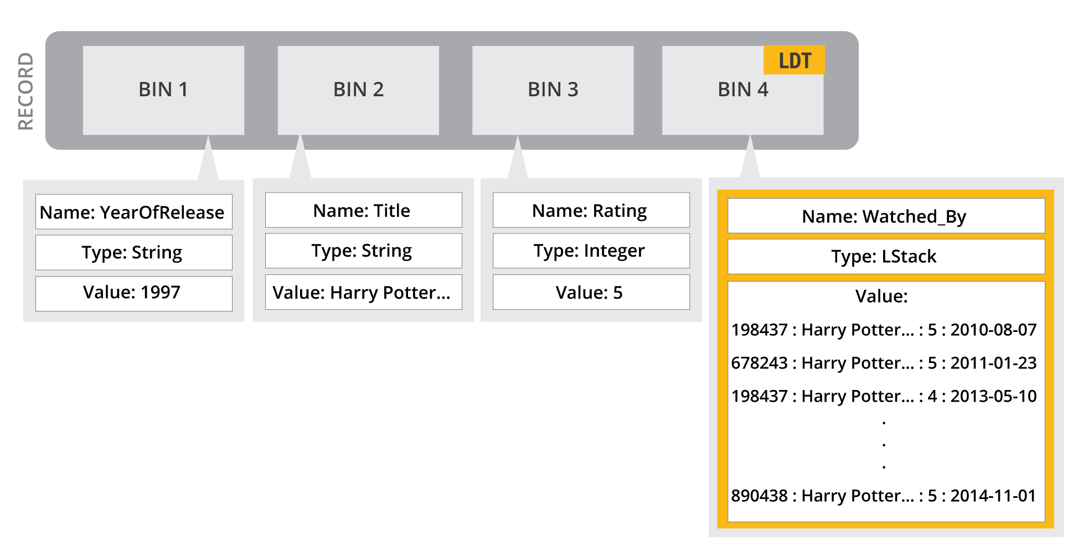
One to Many

Slide 13
The code
RESTful
List of Movies watched
Make a vector

Slide 14
Finding a similar customer
For each movie
For each customer
Watched list
Cosine similarity

Slide 15
Conclusions
MongoDB
Technically seductive programmer interface
Uses JSON ( the current fashion )
Painful to scale – requires lots of servers
Needed a big cluster - Ran out of RAM
Aerospike
Tiny cluster required
Easy to scale
Faster than Mongo
Large Data Type are different to JSON – but good

Slide 16
Books

Slide 17
Resources
GitHub – Recommendation engine example
https://github.com/aerospike/recommendation-engine-example.git
Spring Boot
http://projects.spring.io/spring-boot/
Aerospike
http://www.aerospike.com/
MongoDB
http://www.mongodb.org/

Slide 18
Questions?
peter@aerospike.com
helipilot50
@helipilot50

