Slide 1
LAMBDA ARCHITECTURES IN PRACTICE
Kafka · Hadoop · Storm · Druid
gian merlino
DRUID COMMITTER · SOFTWARE engineer @ Metamarkets

Slide 2
Overview
problem STREAming DATA PIPELINES
challenges No data left behiND
infrastructure The “RAD”-Stack
platform development and OPERATIONS tools

Slide 3
THE PROBLEM

Slide 4
The problem

Slide 5
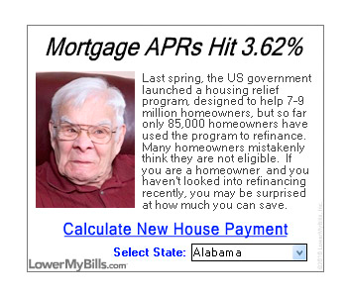
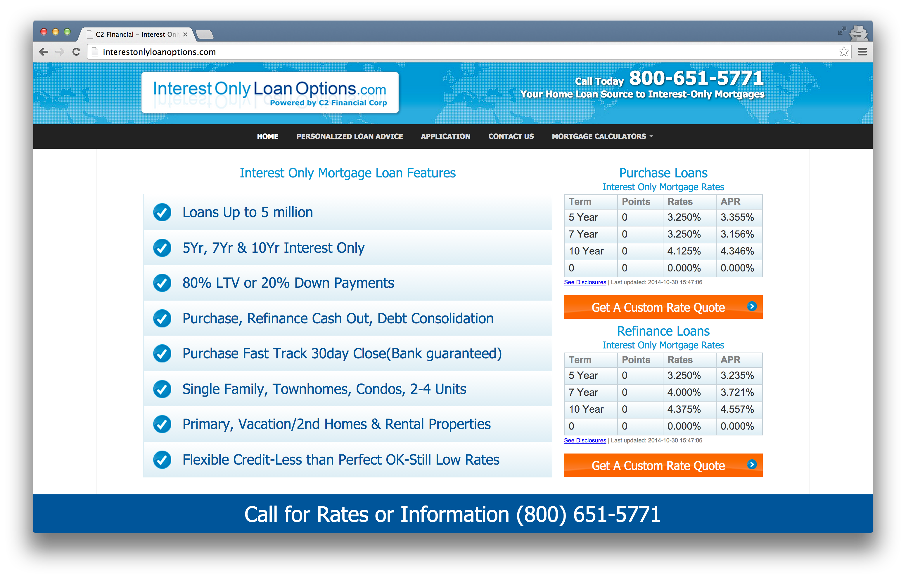
THE PROBLEM

Slide 6
The Problem
Business intelligence for ad-tech
Arbitrary and interactive exploration
Multi-tenancy: thousands of concurrent users
Recency: explore current data, alert on major changes
Efficiency: each event is individually very low-value
Data model: must join impressions with clicks

Slide 7
FINDING a solution
Load all your data into Hadoop. Query it. Done!
Good job guys, let’s go home

Slide 8
HADOOP BENEFITS AND DRAWBACKS
HDFS is a scalable, reliable storage technology
MapReduce is great for data-parallel computation at scale
But Hadoop MapReduce is not optimized for low latency
To optimize queries, we need a query layer
To load data quickly, we need streaming ingestion

Slide 9
FINDING A solution
Hadoop
Streaming data pipeline
Query Layer
Event Streams
Insight

Slide 10
FINDING A solution
Hadoop
Streaming data pipeline
RDBMS
Event Streams
Insight

Slide 11
FINDING A solution
Hadoop
Streaming data pipeline
NoSQL K/V Stores
Event Streams
Insight

Slide 12
FINDING A solution
Hadoop
Streaming data pipeline
Commercial Databases
Event Streams
Insight

Slide 13
FINDING A solution
Hadoop
Streaming data pipeline
Event Streams
Insight

Slide 14
Druid
Druid project started in 2011, open sourced in Oct. 2012
Designed for low latency ingestion and slice-and-dice aggregation
Growing Community
~45 contributors
Used in production at numerous large and small organizations
Cluster vitals
10+ trillion events, 200TB of compressed queryable data
Ingesting over 450,000 events/sec on average
90th/95th/99th percentile queries within 1s/2s/10s

Slide 15
STREAMING data pipelines

Slide 16
TIME SERIES DATA
Unifying feature: some notion of “event timestamp”
Questions are typically also time-oriented
Monitoring: Plot CPU usage over the past 3 days, in 5-min buckets
BI: Which accounts brought in the most revenue this week?
Web analytics: How many unique users today? By OS? By page?

Slide 17
GOALS
Low-latency results
Strong guarantees for historical data

Slide 18
DATA PIPELINE

Slide 19
DATA PIPELINE
Data bus
Decouples data acquisition from processing
Can buffer as many unprocessed messages as you have disk

Slide 20
DATA PIPELINE
Stream processor
Join impressions/clicks
Transform data

Slide 21
DATA PIPELINE

Slide 22
DATA PIPELINE
Store hour-partitioned in S3
Can run Hadoop jobs on it

Slide 23
DATA PIPELINE

Slide 24
λ

Slide 25
definition
Hybrid batch/streaming data pipeline
Batch technologies
Hadoop MapReduce
Spark
Streaming technologies
Storm
Spark Streaming
Samza

Slide 26
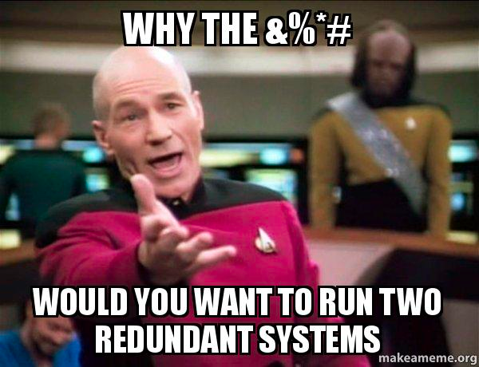
WHY HYBRID?
This sounds insane
Need to develop for both systems
Need to operate both systems
Nobody really wants to do this

Slide 27
WHY HYBRID?
We want low-latency results
We also want strong guarantees for historical data
Many popular streaming systems are still immature
The state of things will improve in the future
…but that doesn’t help you right now

Slide 28
FAULTS
Processor
Processor
Processor
Data
Store

Slide 29
FAULTS
Processor
Processor
Processor
Data
Store

Slide 30
FAULTS
Processor
Processor
Processor

Slide 31
FAULTS
Processor
Processor
Processor

Slide 32
FAULTS
Processor
Processor
Processor

Slide 33
FAULTS
Processor
Processor
:(

Slide 34
FAULTS
Processor
Processor
Processor

Slide 35
FAULTS
Processor
Processor
Processor

Slide 36
FAULTS
Processor
Processor
Processor

Slide 37
FAULTS
Processor
Processor
Processor

Slide 38
COPING WITH FAULTS
“Exactly once” semantics
Transactions
Idempotency
Adding an element to a set
Some kinds of sketches (HyperLogLog)
Doesn’t work well for counters

Slide 39
lATE DATA
Timeline-oriented operations are common in stream processing
Windowed aggregates
top pages per hour
unique users per hour
request counts per minute
Group-by-key of related events
user session analysis
impression/click association

Slide 40
lATE DATA
Similar challenges with both
When can we be sure we have all the data?
Normally, within a minute
Or if a server is slow, a few minutes…
Or if a server is down, a few hours or days…
We don’t want to compromise between data quality and latency

Slide 41
REPROCESSING
Something is broken!
Your data was revised
Or your code had a bug

Slide 42
Why hybrid?
Transactions
Late Data
Reprocessing
*
* Streaming data store, not actually a stream processor

Slide 43
Why hybrid?
Transactions
Late Data
Reprocessing
Globally ordered micro-batches
Internal– yes; external– no
Work in progress
*
Batch– yes;
Streaming– no
* Streaming data store, not actually a stream processor

Slide 44
Why hybrid?
Transactions
Late Data
Reprocessing
Globally ordered micro-batches
Depends on user code
Windows based on received time, not actual time
Internal– yes; external– no
Depends on user code
Work in progress
*
Batch– unlimited; Streaming– windowPeriod
Batch– yes;
Streaming– no
* Streaming data store, not actually a stream processor

Slide 45
Why hybrid?
Transactions
Late Data
Reprocessing
Globally ordered micro-batches
Depends on user code
Rewind with fresh state
Windows based on received time, not actual time
Internal– yes; external– no
Can use non-streaming Spark
Depends on user code
Rewind with fresh state
Work in progress
*
Batch– unlimited; Streaming– windowPeriod
Batch– yes;
Streaming– no
Can use batch ingestion
* Streaming data store, not actually a stream processor

Slide 46
Why not hybrid?
Batch-only?
If ingestion latencies are good enough, that’s great!
Streaming-only?
OK if you have transactions and a way to deal with late data
Current tools do require you to be careful

Slide 47
HYBRID PIPELINE DEVELOPMENT

Slide 48
DEVELOPMENT
Need code to run on two very different systems
Maintaining two codebases is perilous
Productivity loss
Code drift
Difficulty training new developers

Slide 49
PROGRAMMING MODEL
“Query language,” if you prefer
Write once, run… at least twice
Open-source options
Spark + Spark streaming (if you’re in the Spark ecosystem)
Summingbird (key/value aggregation oriented)
Or develop in-house for your use cases
This investment can make sense if you have more pipeline developers than infrastructure developers

Slide 50
PROGRAMMING MODEL
We built “Starfire,” a Scala library for stream transformation
Built around operators
map, flatMap, filter
groupBy, join
lookup
sample
union

Slide 51
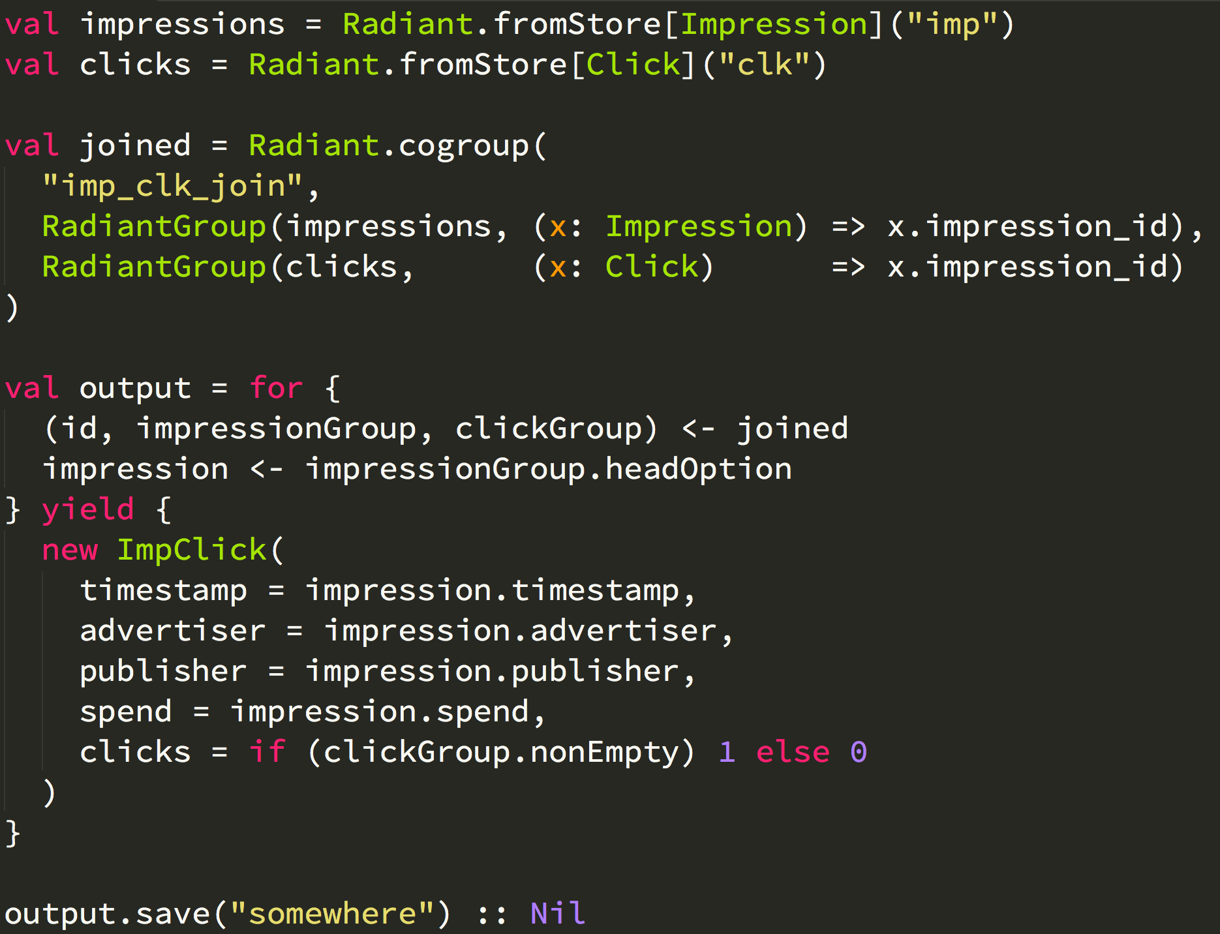
PROGRAMMING MODEL
Load two data streams
Join streams on shared key
Produce combined records
Export data

Slide 52
PROGRAMMING MODEL
Load
Load
Cogroup
FlatMap
Save

Slide 53
EXECUTION
User code generates a system-agnostic computation graph
Drivers optimize and compile the graph for each system
Current drivers:
Local (for unit tests)
Hadoop (using Cascading)
Storm
Samza (beta)

Slide 54
BENEFITS
Hedge your bets around infrastructure
New drivers can run all existing user code
Separate system optimization from code development
Improved grouping engine without any user code changes
We have many more pipeline developers than infrastructure developers
Developer productivity increased
We use Starfire even for batch-only data pipelines

Slide 55
HYBRID PIPELINE OPERATIONS

Slide 56
OPERATIONS
Need to operate two very different systems
Must maintain “no data left behind”
Cornerstones of operations
Tools
Metrics
Alerts

Slide 57
TOOLS
Hadoop job service
Watch S3 for new data from Kafka
Automatically process data after a few hours
Retry failed jobs, alerts on repeated failures

Slide 58
TOOLS
Storm job service
Submit jobs to Nimbus, the Storm scheduler
Monitor for failed jobs
Alert on deployment failures

Slide 59
TOOLS
Backfill tool
Run backfills for particular intervals
Can be used for data changes or algorithm changes
Ensures alignment on Druid segment granularity

Slide 60
TOOLS
Configuration management tool
Control which version of the code should be running
Manage schemas for each pipeline
Manage quotas for each pipeline
Central audit logs for configuration changes

Slide 61
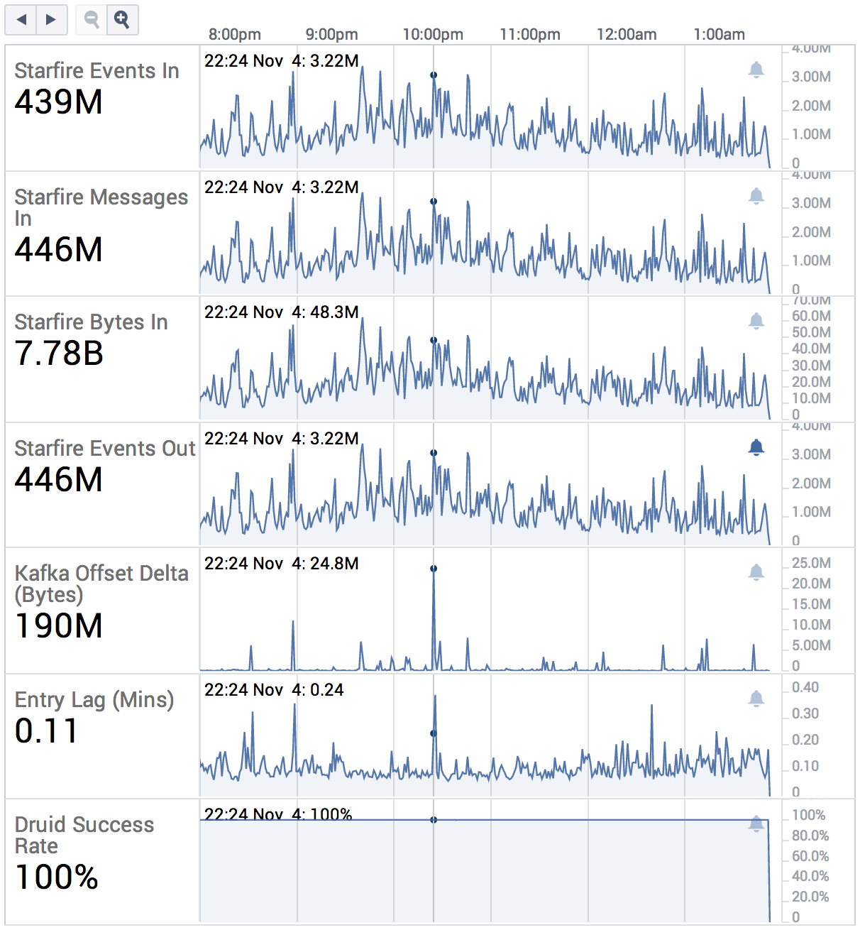
STREAM METRICS

Slide 62
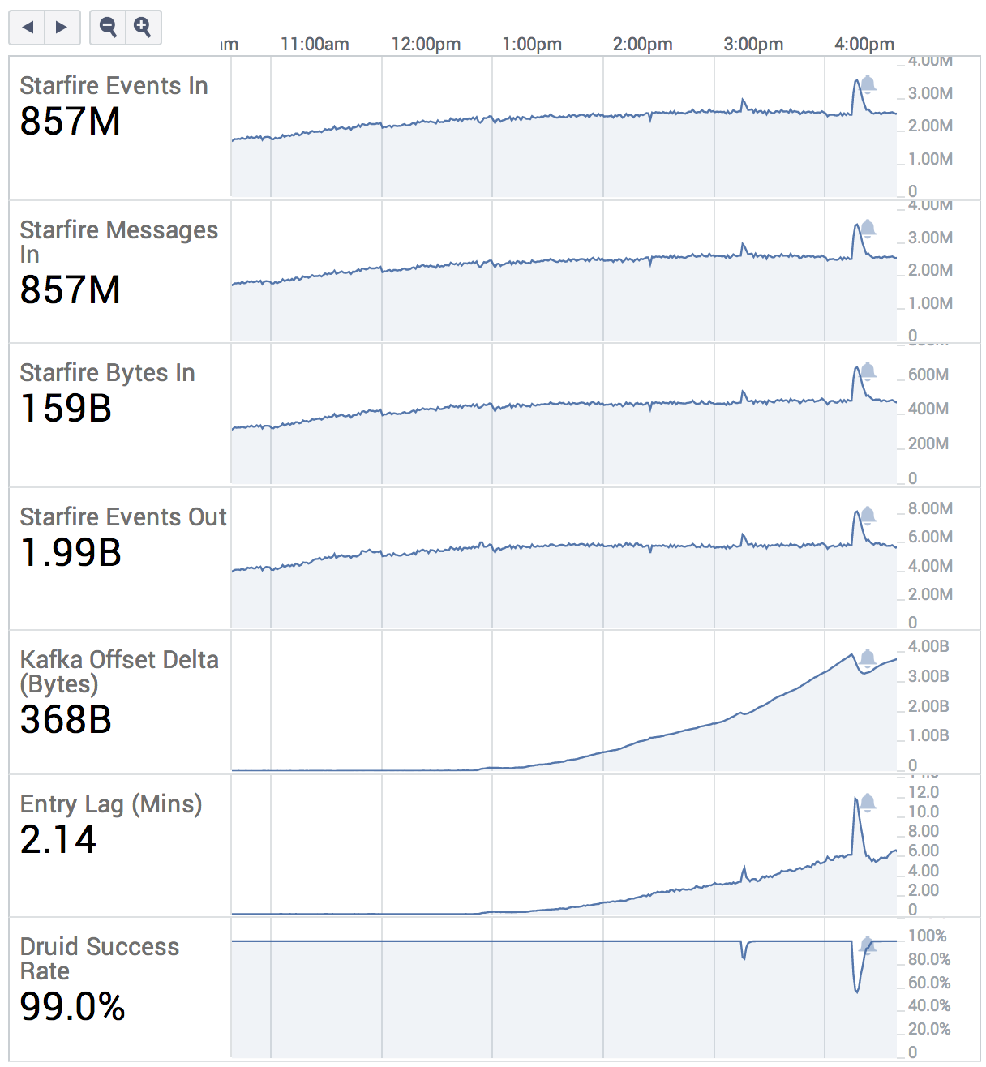
STREAM METRICS

Slide 63
DO TRY THIS AT HOME

Slide 64
CORNERSTONeS
Druid - druid.io - @druidio
Storm - storm.incubator.apache.org - @stormprocessor
Hadoop - hadoop.apache.org
Kafka - kafka.apache.org - @apachekafka

Slide 65
GLUE
storm-kafka
Tranquility
Camus / Secor
Druid Hadoop indexer

Slide 66
TAKE AWAYS
Lambda architectures may not be with us forever
But they solve a real problem: eventually consistent data pipelines using popular open-source technologies
Complexity can be managed with tools and practices

Slide 67
@druidio
@METAMARKETS

