Slide 1
Visit us at Booth #15
Automatically Adapting UI from Desktop to Mobile
Copyright © 2015 Isomorphic Software, All rights reserved.
Notes:
Thanks very much for coming to our session. This talk is about how to Optimize DevOps with a Single Codebase for Web and mobile Applications.
My name is Charles Kendrick, Co founder and CTO of Isomorphic software. I co founded Isomorphic Software about 15 years ago basically because I thought there was a much better way to build powerful web applications.

Slide 2
Approaching mobile as an Enterprise
Things to remember
You are not Facebook
Your users are not teenagers
Vs
Consumer
Enterprise
Goal is engagement for revenue generation
Simple, addictive UI – content focused
Single flagship app
Mostly mobile traffic
Goal is productivity for operational efficiency
Expect sophisticated UI features
Multiple different apps
Mostly desktop use
Notes:
Alot of analysts don't make the enterprise/consumer distinction and end up recommending strategies to enterprise that only make sense for consumer-facing applications. Or, managers in enterprise try to emulate Facebook, LinkedIn, etc. because they "have successful" mobile strategies. But enterprise mobile is a totally different problem, and the solutions are necessarily different.
The CEO is not going to be impressed that you spent $1M on a mobile app and "everybody loves it". The question will be: did it increase productivity?

Slide 3
About Isomorphic Software
Do it right, do it well, do it first
Offer a complete web application dev platform
Make it easy to build powerful enterprise web applications
Notes:
Just a little background Isomorphic Software. As I said earlier, I co founded Isomorphic Software about 15 years ago basically because I thought there was a much better way to build powerful web applications.
So we have actually been doing all this for a long time before AJAX was even called AJAX.
Since then we have had a number of firsts ….
(Phillips semiconductors) Built the first RIA ever (2001). Every UI component was completely generated inside the browser in javascript … years before anyone else
First to deliver an OLAP datacube interface in a browser based on AJAX RIA technology (informatica) – 2003
First to provide an integrated client server framework – java backend, javascript front end with integrated functionality such as the ability to configure client and server behaviors from a single file
First to allow visual application building inside the browser – 2004/05 – 10 years ago

Slide 4
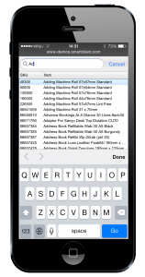
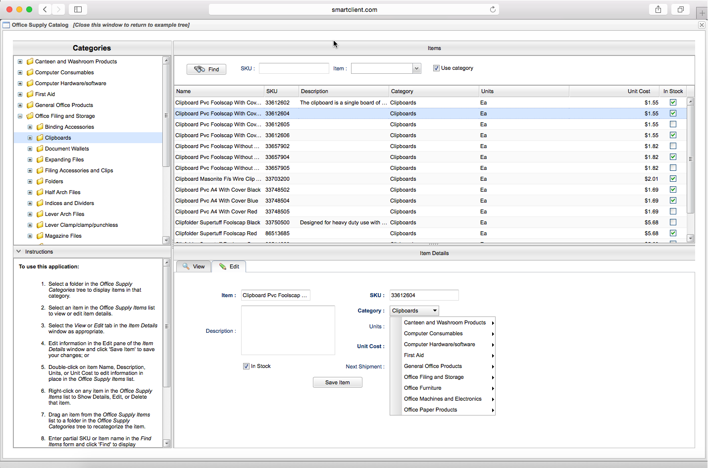
What are the Options?
#1. Use different web technologies for desktop vs mobile apps
Separate, mobile specific framework and component set
Build the app twice
Notes:
The image of two processes is a little miss leading as of course not everything is repeated. There are certainly savings in design, for example.
We at Isomorphic started down this path with SmartGWT.mobile, and decided to relegate it to a niche.

Slide 5
What are the Options?
#2. Build a web app, then native mobile apps per platform
Between web, iOS, Android, build app 3 times
Most organizations will have to ignore Windows Phone, Blackberry, Tizen …
Notes:
There are solutions such as Titanium, which make it so that you don't quite have to build the app 3 times, but more like 2 and a half - once for desktop, then once for mobile with some adjustments per platform

Slide 6
What are the Options?
#3. Use ultralight, mobile-specific technology, even for the desktop version
Desktop applications will lack power and flexibility
Desktop interface may be 70-90% of actual usage
Lightweight is not a good thing when you’re up against heavyweights
Notes:
segue into our ultra-powerful components and appear to be staying on topic rather than drifting into our own marketing –
Talking points:
Mobile support is a must, but "mobile first" just cripples the primary interface.
Users will ask "where's my frozen columns, filter on any column, group by any column, saved search, chart any column, export to Excel, etc?”
Enterprise apps are expected to be very, very powerful and your app will look dated if you can't match these capabilities’

Slide 7
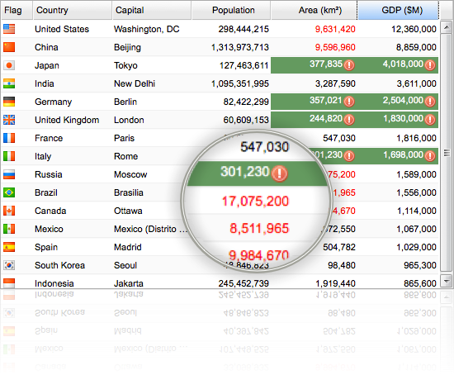
Advanced UI Components (Example)
Freeze, Inline edit, resize
Hiliting, formulas, charts
Filter, order, export
Pivot, ad-hoc analysis
Notes:
One of our customers – Alpha Theory – has over 700 columns in a single grid, providing views, hiliting, ordering, real time updates, formulas, etc.
In the SmartClient platform, we have hundreds of UI components
Work on all browsers
No plugins
Broadest deepest, most advanced set of components available
To give you one example out of hundreds, let’s just take grids. With our grids, you can pivot, export, highlight values based on rules, freeze columns, edit inline, visualize in charts, and so much more. With our grids you get the functionality of excel in a web browser.
You can easily add all those capabilities to your web applications.
Again, grids are just one of hundreds of components.
More importantly for today’s conversation, our components are device-aware, and the layouts that you build with them will respond automatically to the device screen size.

Slide 8
Live Demo
Brief tour of some of the power of a grid.
Notes:
brief tour of some of the power of a grid, like on the fly grouping, filtering, adaptive filtering behavior (huge on mobile).

Slide 9
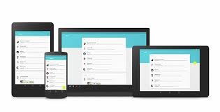
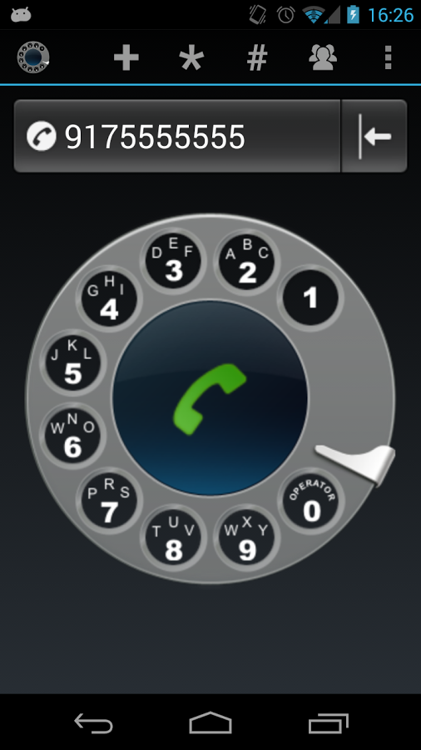
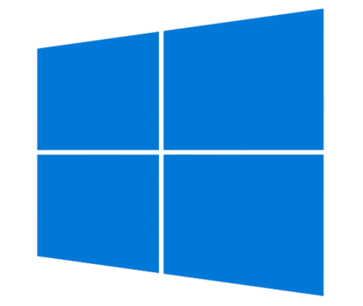
Where are we headed?
There is a better way
Skeuomorphism is dead
Unified web, desktop and mobile design language
Google's "Material Design”
Windows desktop/phone UI converging
Notes:
Develop a single underlying system that allows for a unified experience across platforms and device sizes.
Microsoft clearly trying to do the same with recent Windows refreshes
- there have been missteps, still, many say Google's "Material Design" direction is largely inspired by Microsoft's direction
Conclusion: if it's a positive thing that web and mobile use the same design language, that removes one of the primary reasons people claim they need different implementation technologies for mobile vs web. "Same look? Same tech."

Slide 10
If visual design language is unified …
Why do we need different implementation technologies for mobile versus web?
Same look? Same tech.

Slide 11
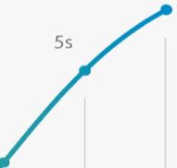
Outdated Performance Perceptions
85x
2007
2015
Notes:
The first iphone was released I June 2007
The iphone 6 was released in Sep 2014
In Just over 7 years, devices are 50x faster
parallel exponential increase in JavaScript performance for desktop and mobile browsers, and point out the two are additive trends.

Slide 12
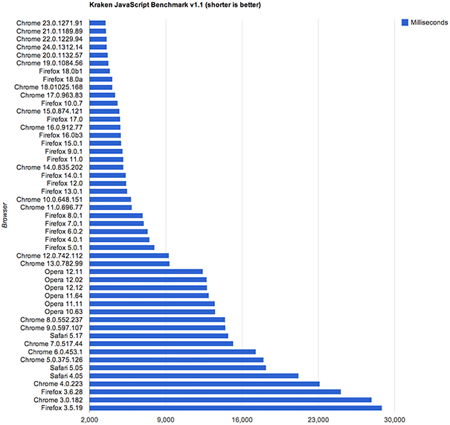
Outdated Performance Perceptions
Kraken Javascript Benchmark (shorter is better)
Milliseconds
Nov 2012
NOW UP TO
30x
FASTER
Jan 2010
2007
Notes:
parallel exponential increase in JavaScript performance for desktop and mobile browsers
the two tredns (device and browser) are additive trends.
IN less than two years, Kraken javascript benchmarks goes from 29,000 to 2000 ms. It is currently around 1000ms, making it approximately 30x faster since 2010

Slide 13
Outdated Performance Perceptions
85 X 30 = 2550
… even with a built in skepticism factor of 10:
2550 / 10 = 255
What used to take 25 secs now takes <0.1 secs
Notes:
parallel exponential increase in JavaScript performance for desktop and mobile browsers
the two tredns (device and browser) are additive trends.
IN less than two years, Kraken javascript benchmarks goes from 29,000 to 2000 ms. It is currently around 1000ms, making it approximately 30x faster since 2010

Slide 14
New Performance Landscape
Worst case scenario for desktop:
IE8
5yr old cheap laptop
DSL line shared between ~30 people
Cheap smartphones much more capable
Mobile browsers much faster than old IE
Standards support enables leaner implementation
CPUs in the ballpark
Network much faster
… we put our mobile-specific framework in a niche

Slide 15
Pricing
How about coding applications once and running them on all devices?
Notes:
Let’s face it, nothing is more inefficient than building the same application twice. There is obviously an alternative and that is to code each application once and run it on all devices.
And also obviously, that is what we are here to talk about.
Sounds like some kind of Nirvana, right? It couldn’t possibly work, right?
So why wouldn’t it work?

Slide 16
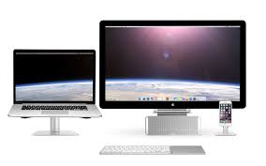
Challenges
Varying screen sizes
Interactivity (e.g. click vs touch)
Look and feel
Responsiveness / performance
Notes:
First, let’s talk about …
User experience challenges.
Obviously our smartphones don’t come with a mouse to point and click. But they do come with cameras, GPS, accelerometers, the ability to make phone calls and more.
So, we need to be able to interact with our applications differently when we access them on our phone.
If you look at the three screens here, this give an indication of the different amounts of real estate we have to deal with on different devices.
Lastly, our smartphone apps need to look a little different from our typical desktop web applications.
So how to we overcome these challenges …

Slide 17
Solution
Responsive layouts
Intelligent auto-fitting
Device-aware components
Adaptive UI
Intelligent data management
Notes:
In the SmartCLient platform that I mentioned earlier, we have a host of functionality that – if for example, you code a desktop web application – will allow it to automatically function on any smartphone device.
Let’s take a dive into this, after which, I will show a live demo

Slide 18
Responsive Layouts
This happens automatically – no additional coding
Notes:
Trying to cram a complex UI with multiple panes onto a smartphone screen creates a usability disaster.
With our solution, when multiple panes don’t fit side-by-side on a device, we automatically split them across pages.
Appropriate navigation controls are provided for each specific device class, and extremely smooth transitions deliver an enterprise grade experience.
Did I mention that no additional coding is needed to deliver this?
Charles: Describe the API and code structures that enable these capabilities.

Slide 19
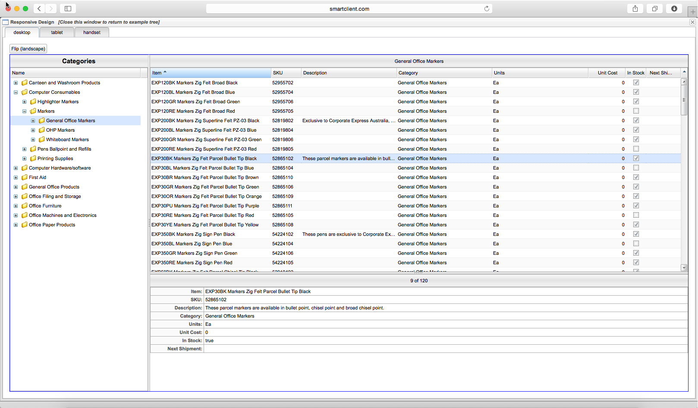
Responsive Layouts
Grid
Tree
Details
Notes:
Trying to cram a complex UI with multiple panes onto a smartphone screen creates a usability disaster.
With our solution, when multiple panes don’t fit side-by-side on a device, we automatically split them across pages.
Appropriate navigation controls are provided for each specific device class, and extremely smooth transitions deliver an enterprise grade experience.
Did I mention that no additional coding is needed to deliver this?
Charles: Describe the API and code structures that enable these capabilities.

Slide 20
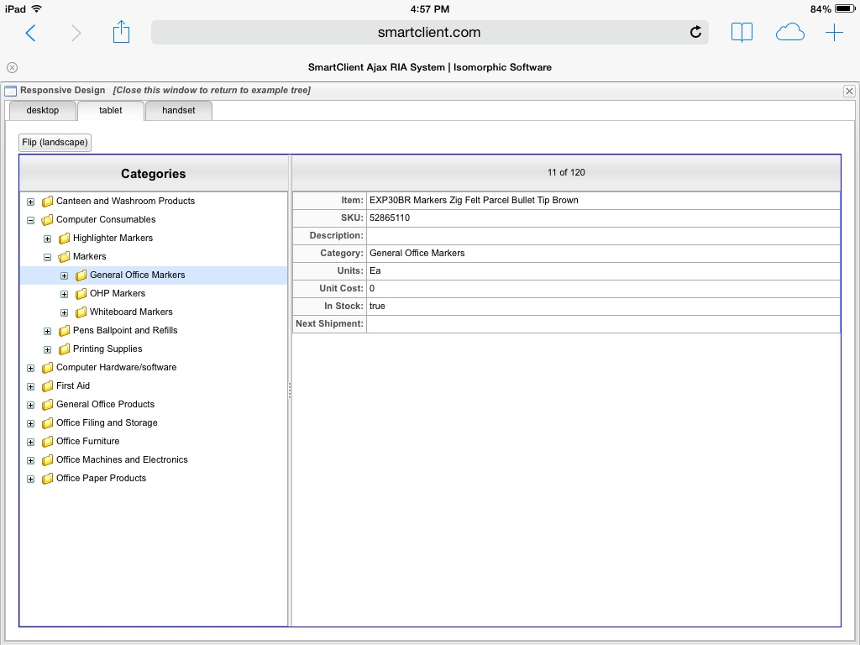
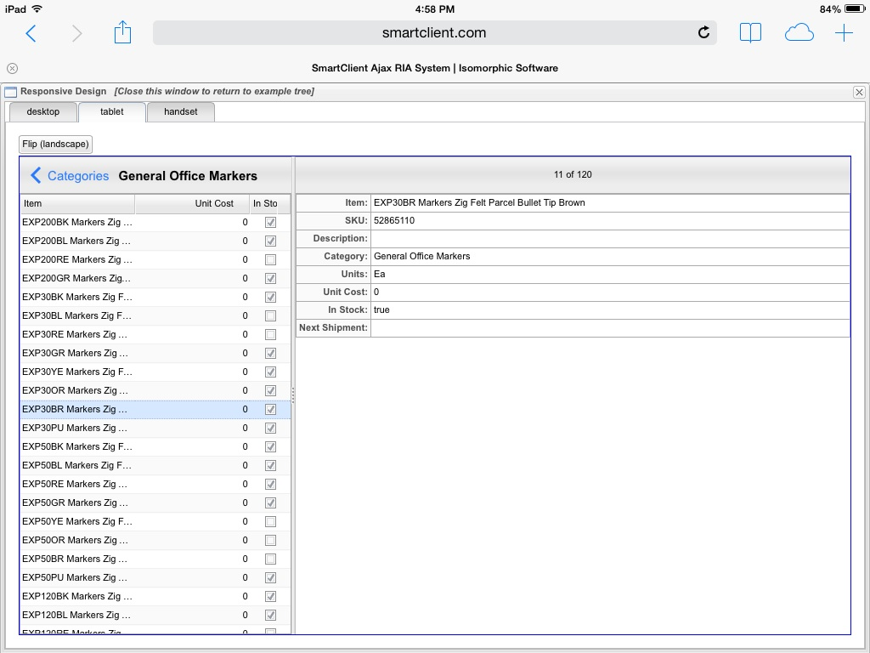
Responsive Layouts
Tree
Details
Grid
Details
Notes:
Trying to cram a complex UI with multiple panes onto a smartphone screen creates a usability disaster.
With our solution, when multiple panes don’t fit side-by-side on a device, we automatically split them across pages.
Appropriate navigation controls are provided for each specific device class, and extremely smooth transitions deliver an enterprise grade experience.
Did I mention that no additional coding is needed to deliver this?
Charles: Describe the API and code structures that enable these capabilities.

Slide 21
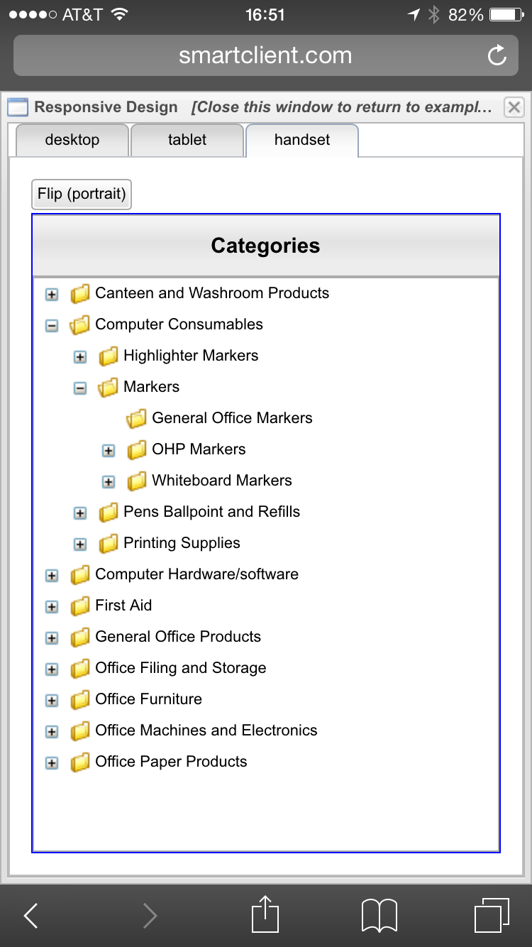
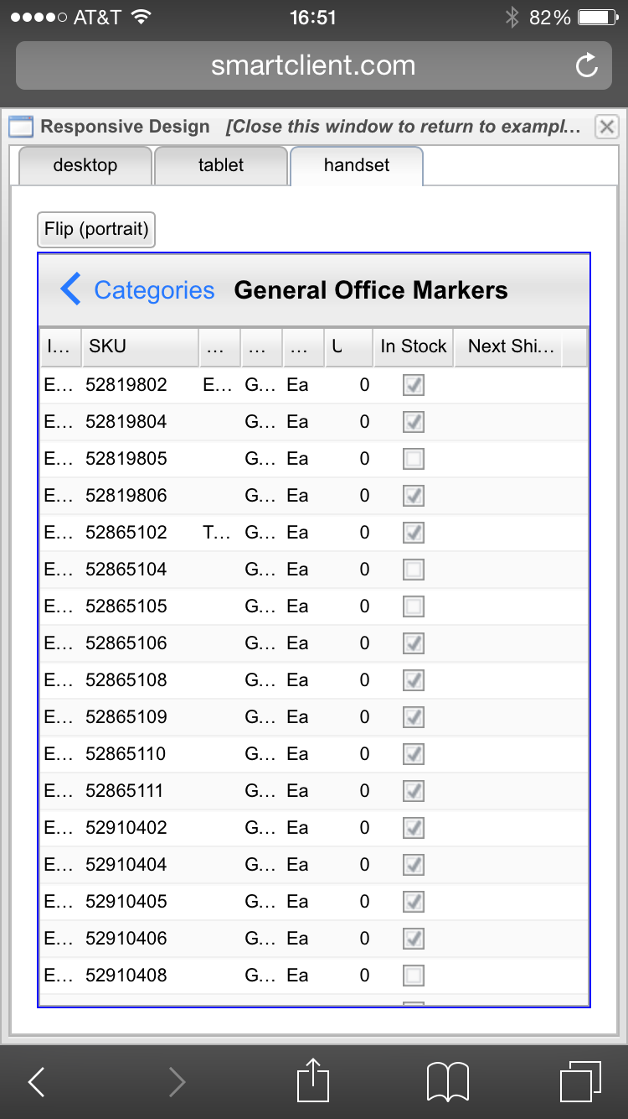
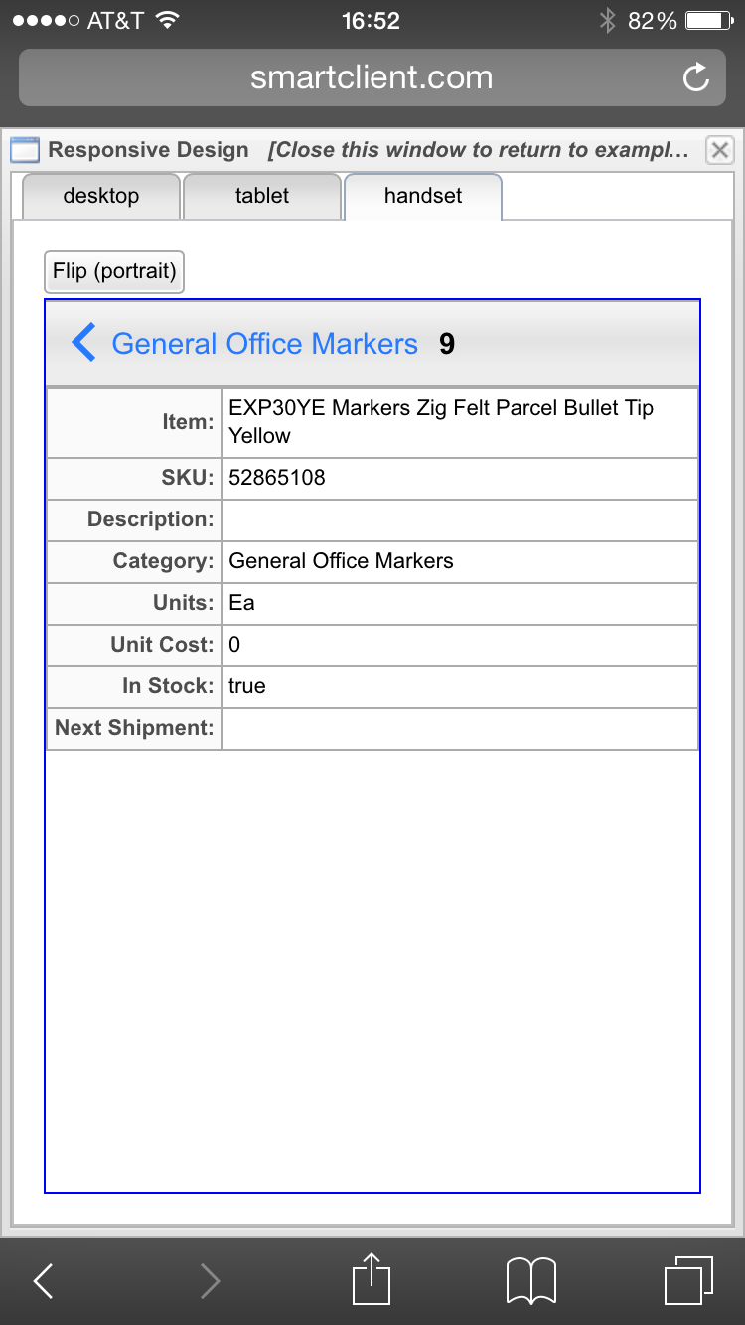
Responsive Layouts
Tree
Grid
Details
Notes:
Trying to cram a complex UI with multiple panes onto a smartphone screen creates a usability disaster.
With our solution, when multiple panes don’t fit side-by-side on a device, we automatically split them across pages.
Appropriate navigation controls are provided for each specific device class, and extremely smooth transitions deliver an enterprise grade experience.
Did I mention that no additional coding is needed to deliver this?
Charles: Describe the API and code structures that enable these capabilities.

Slide 22
Adaptive UI: Filtering & Search
Filters and search fill mobile screen
Appear as popup on desktop
Notes:
Our components automatically adapt to the smaller screen size and different pointing behavior of mobile devices. Components like Combo Boxes, Menus and Dialogs will automatically use the entire screen and offer alternative UI for dismissal and navigation (for example: submenus slide in). Context menus and hovers can be triggered by finger taps or long touches.
Because of these and many other automatic behavior changes for mobile devices, you really can build cross-device applications with a single technology and single codebase
Charles: Describe the API and code structures that enable these capabilities.

Slide 23
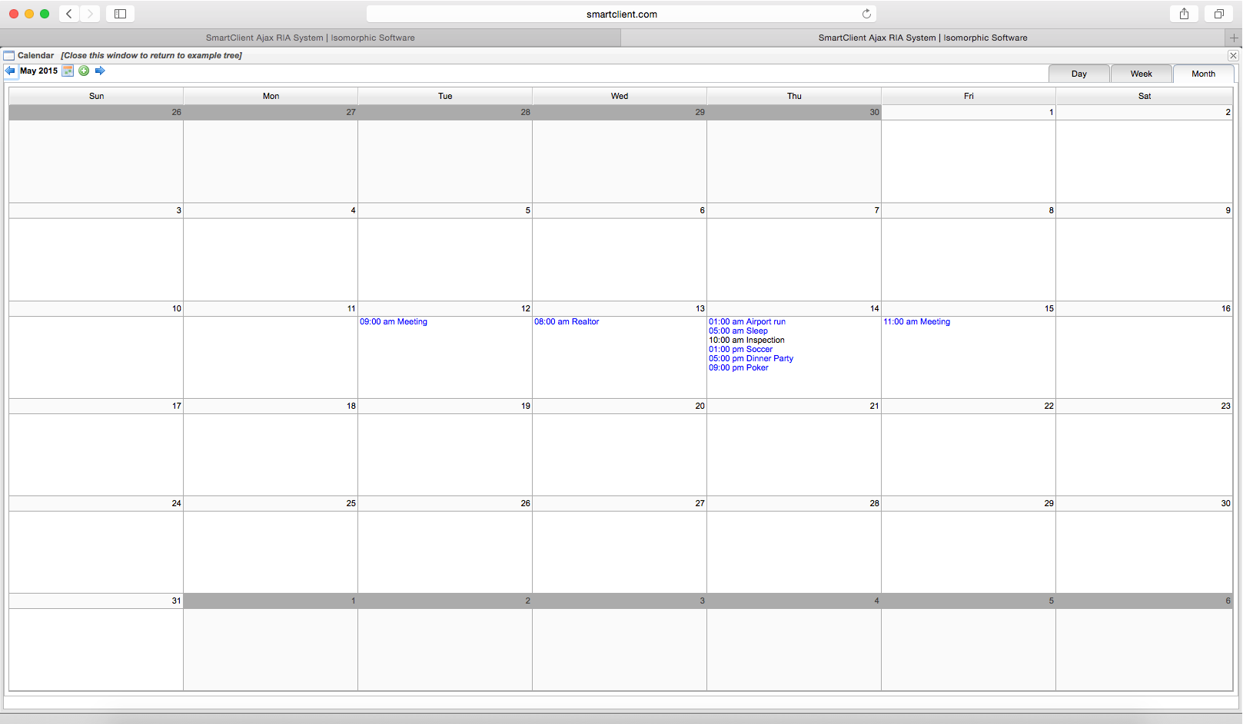
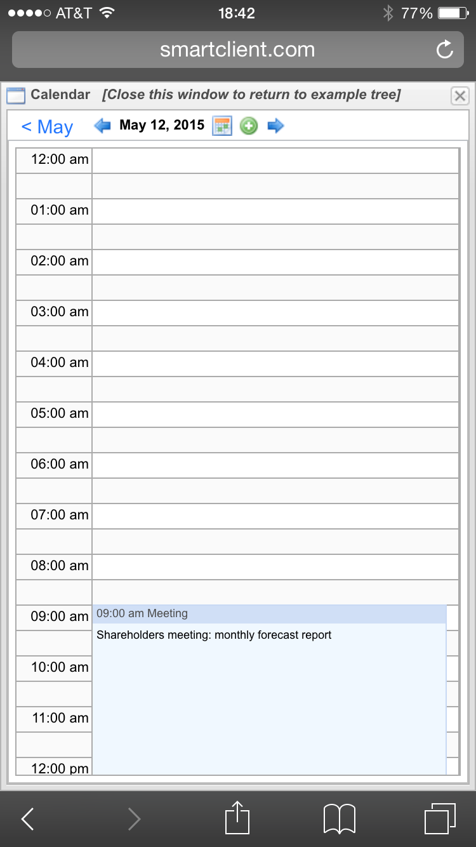
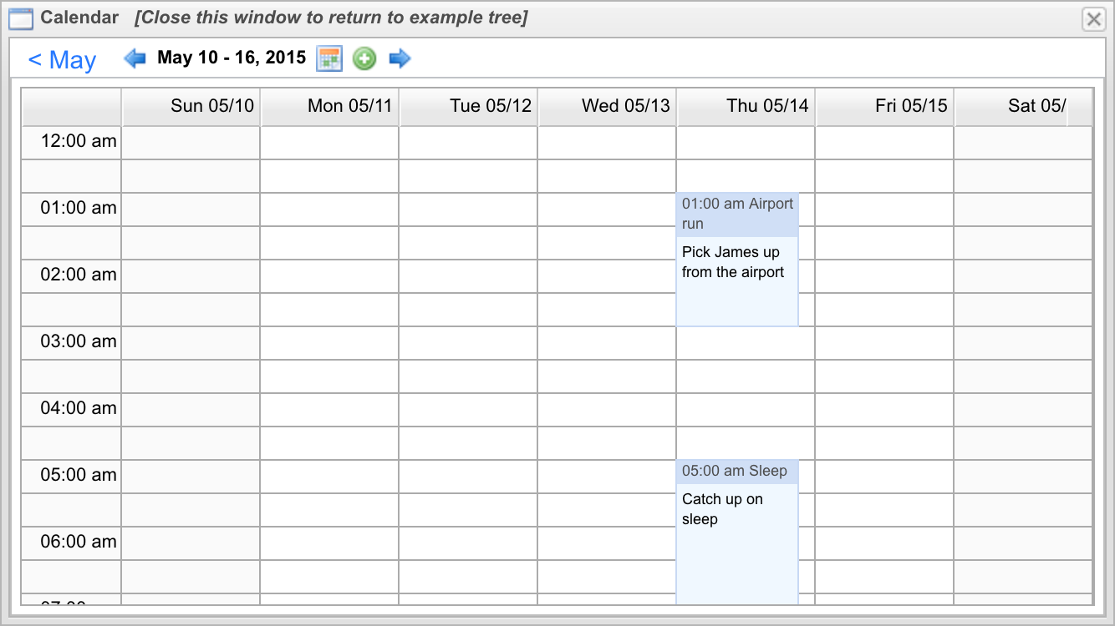
Adaptive UI: Calendar
Desktop: Tabs for Day / Week / Month view
Mobile: Pivot to change view
Notes:
Our components automatically adapt to the smaller screen size and different pointing behavior of mobile devices. Components like Combo Boxes, Menus and Dialogs will automatically use the entire screen and offer alternative UI for dismissal and navigation (for example: submenus slide in). Context menus and hovers can be triggered by finger taps or long touches.
Because of these and many other automatic behavior changes for mobile devices, you really can build cross-device applications with a single technology and single codebase
Charles: Describe the API and code structures that enable these capabilities.

Slide 24
Adaptive UI: Details
Spinner look and feel
Target touch area expanded when items are small
Notes:
Our components automatically adapt to the smaller screen size and different pointing behavior of mobile devices. Components like Combo Boxes, Menus and Dialogs will automatically use the entire screen and offer alternative UI for dismissal and navigation (for example: submenus slide in). Context menus and hovers can be triggered by finger taps or long touches.
Because of these and many other automatic behavior changes for mobile devices, you really can build cross-device applications with a single technology and single codebase
Charles: Describe the API and code structures that enable these capabilities.

Slide 25
Animations: NavBar Example
Subtle, built in animations / transitions
Looks cool + helps users keep sense of place
Clicked button glides in to be the new heading
New buttons fade in to place
Notes:
Our components automatically adapt to the smaller screen size and different pointing behavior of mobile devices. Components like Combo Boxes, Menus and Dialogs will automatically use the entire screen and offer alternative UI for dismissal and navigation (for example: submenus slide in). Context menus and hovers can be triggered by finger taps or long touches.
Because of these and many other automatic behavior changes for mobile devices, you really can build cross-device applications with a single technology and single codebase
Charles: Describe the API and code structures that enable these capabilities.

Slide 26
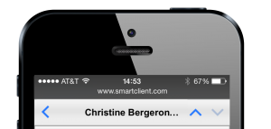
Intelligent Auto-fitting
Pervasive auto-fitting capabilities go way beyond “responsive design”
Works for dynamic data, whose size can’t be anticipated
Notes:
Responsive design” – using CSS tricks to adjust page layout by browser size - is limited
For example, when data length is dynamic
The NavigationBar component features intelligent auto-fitting behavior for the title area, designed to make best use of space for titles that may be based on dynamic data, such as a property of the selected record in a grid.
See here the behaviors with different titles:
"Fa Bai" fits neatly and is centered
“Abe Jacobs" is slightly too long to fit with the navigation buttons, so it is intentionally placed slightly off-center, up to a configurable maximum off-center distance
A longer title like "Izabella Chernyak F.", the title of the left navigation button is hidden (leaving just the left-pointing arrow)
finally, for a very long title like "Christine Bergeron Fewell", the title is clipped and an ellipsis shown
Note that while auto-fitting works regardless of the skin or browser used, the specific titles chosen for this sample may be slightly shorter or longer in different skins or on computers will less fonts installed, and so may trigger the auto-fitting behaviors described above differently.
Charles: Describe the API and code structures that enable these capabilities.

Slide 27
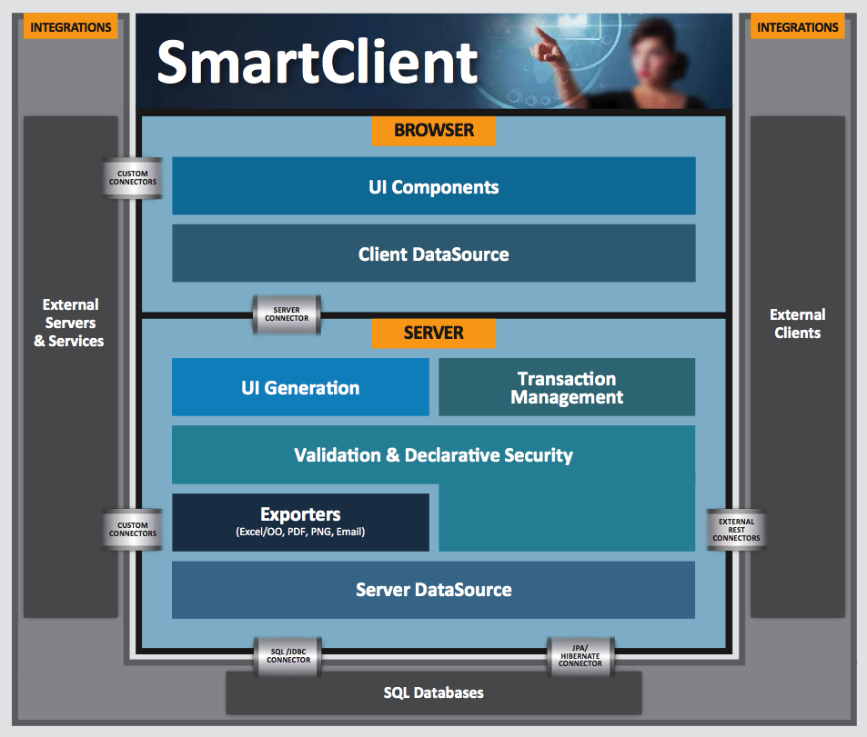
Intelligent Data Management
Data services eliminate redundant server trips
Components have built-in awareness of data operations:
Know when to re-use already-fetched data
Automatically update cached data
Advances in browser technology
Notes:
Responsiveness
You may remember the marketecture diagram from the start of the presentation. Components are just part of our complete platform.
SmartClient's components have built-in awareness of data operations, so they know when already-fetched data can be re-used, and they know how to automatically update cached data. This means snappy performance.
Note also the leap in browser technologies in the past 3-5 years have helped this cause tremendously.

Slide 28
Live Demo
Notes:
Seeing is believing. So, without further adieu, let’s give you a demo and as we go I will describe the API and code structures that enable these capabilities.

Slide 29
Who is using this?
Leveraged across the Fortune 500
to build critical business applications

Slide 30
Last Few Things …
1. Full Featured Free Trial (60 Days)
2. LGPL & Commercial Licenses
3. Write UI in Java or Javascript
4. Learn more at www.SmartClient.com
Notes:
It is being actively and successfully used – in production – by numerous large enterprise applications.
We also have comprehensive documentation, and support, training and consulting if you would like it.
I would like to encourage you to play with and learn more about using a single codebase for all devices. I feel confident this is the way forward.
We offer a 60 day free trial, but we also have an LGPL version.
Does anyone have any questions?
Please visit our website for more details, or feel free to come up after the session and ask questions.
In our marketing, we talk about having a single codebase for all devices as “the key to productivtiy”. So, we have some key shaped thumb drives here which have some additional info loaded up on them. Please feel free to come up and help yourself.
Please also note that we have another session on ? At ?.

Slide 31
Questions?

Slide 32
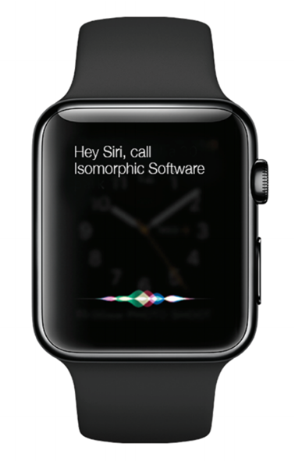
Visit us at Booth #15

Slide 33
Thank you from Isomorphic Software!
www.SmartClient.com
Copyright © 2015 Isomorphic Software, All rights reserved.
Notes:
Thanks very much for coming to our session. This talk is about how to Optimize DevOps with a Single Codebase for Web and mobile Applications.
My name is Charles Kendrick, Co founder and CTO of Isomorphic software.
Copyright © 2014 Isomorphic Software, All rights reserved.

