Slide 1
One click to application awesomeness
“I love the Bitnami guys. They make it dead simple for anybody to run an application in the cloud.”
– Dr. Werner Vogels, vice president and CTO, Amazon

Slide 2
Our (Ongoing) Container Journey
What is Bitnami?
Why Containers?
What is harp?
What have we learned?
What’s Stacksmith?
Blatant Hiring Plug

Slide 3
Bitnami is the easiest way to deploy, run and manage applications & stacks in the cloud (and everywhere else).

Slide 4
More than 120 Bitnami Applications
Developer Tools
Business Apps
Infrastructure
Supported Platforms

Slide 6
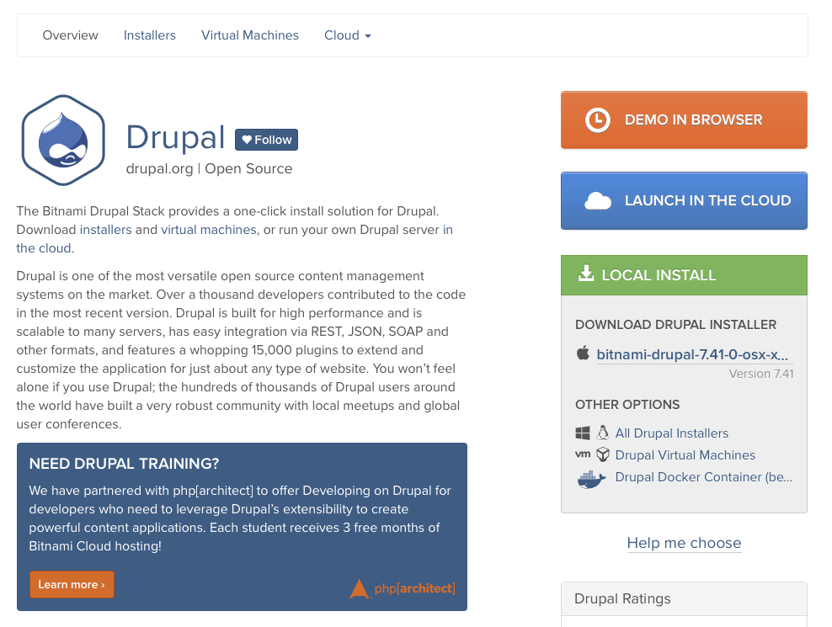
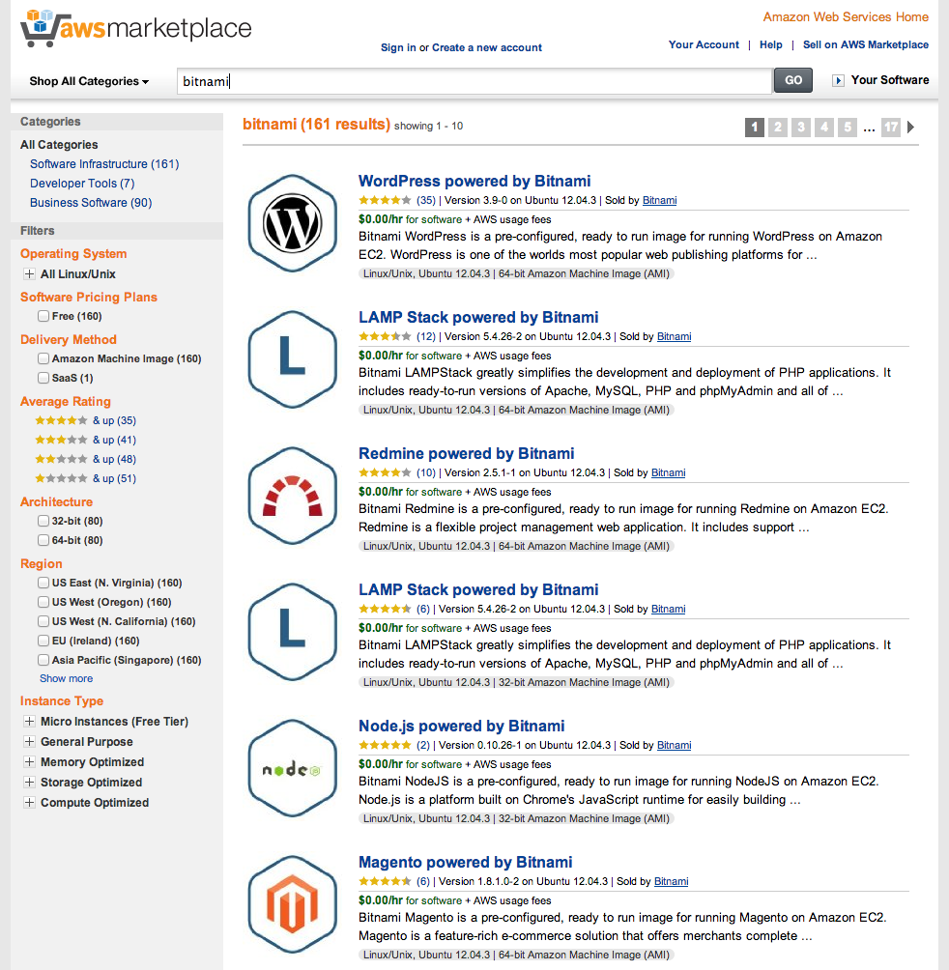
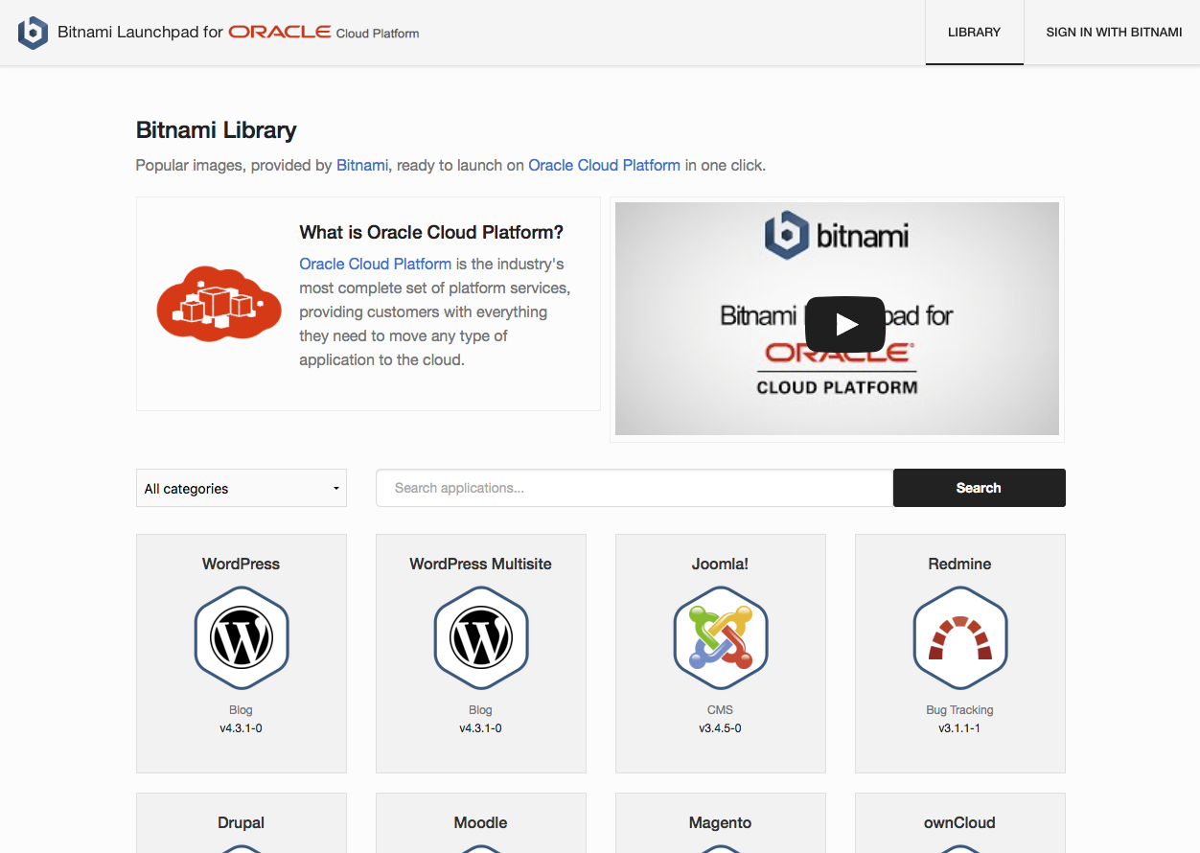
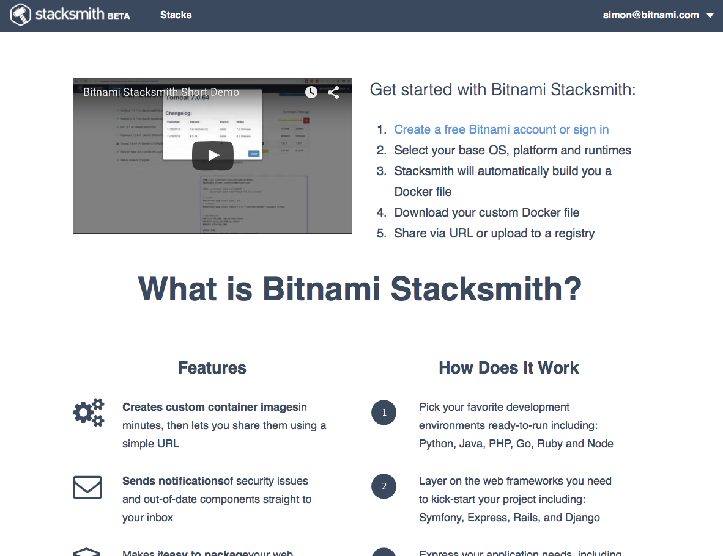
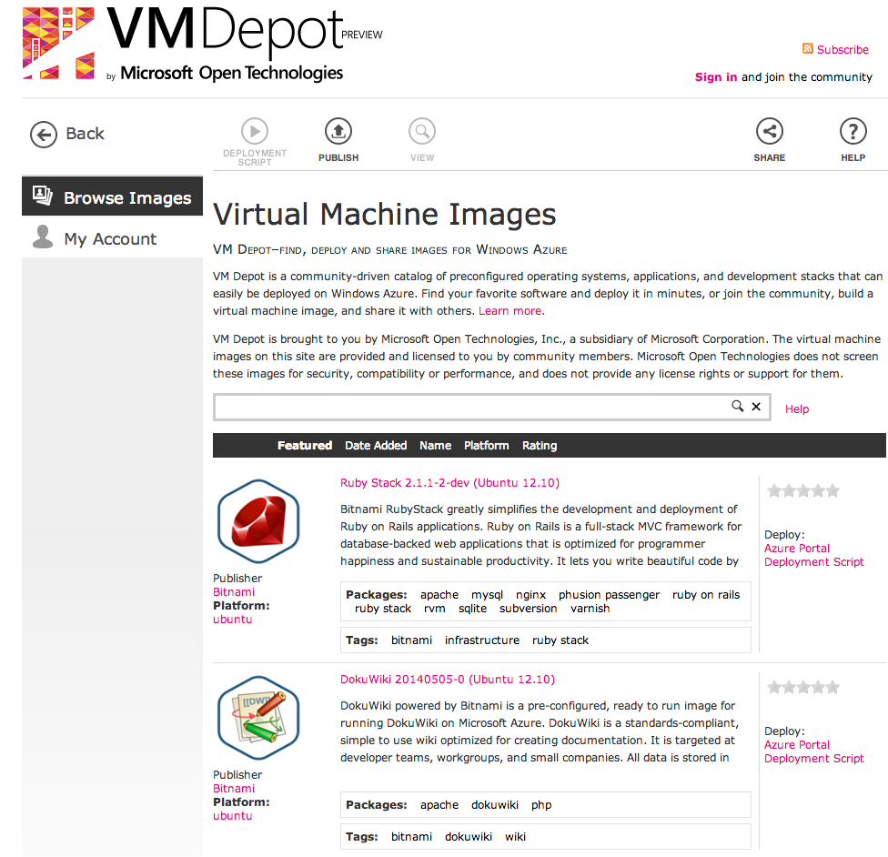
Bitnami.com
Cloud Launch Pads
Cloud Marketplaces

Slide 7
Why Containers?
Notes:
Sep 2014 – marking the start of the great bitnami container movement
Connor and I (joining on the same day) were guinea pigs for a new docker environment
Testing it out for one or two webdev projects to see if it was a viable option
Let’s just say… it wasn’t what it was cracked up to be

Slide 8
v1 aka Doing It All Wrong
Huge *** dockerfile
mysql
ruby runtime
node runtime
redis

Slide 11
v2 aka Doing It Less Wrong
harp

Slide 12
New workflow/mindset was difficult to switch to
How do I install zsh with my fancy prompt?
My tmux configuration isn’t being copied in??
Can you add my SSH keys so I can deploy?
Is emacs installed?

Slide 14
v3 – What we’re doing now
bitnami
containers
*
dinghy
*
* https://github.com/codekitchen/dinghy
*
https://bitnami.com/docker

Slide 15
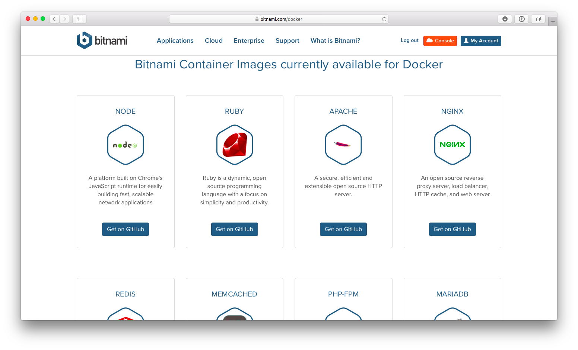

Slide 16
What’s Great?
Containers by default
Setup is trivial, consistent on Mac and Linux laptops
Company doubled in size (mostly engineers)

Slide 17
What’s Next?
Docker-compose & docker exec is awkward
Architectural implications of containers
Update CI system
To share or not to share data services (dev)
Better Secret Sharing

Slide 18
Language Runtimes-as-a-Service

Slide 19
Demo

Slide 20
Summary
What is Bitnami?
Why Containers?
What is harp?
What have we learned?
What’s Stacksmith?
Blatant Hiring Plug

Slide 21
We are Hiring
San Francisco (Mission St.) & Spain (Sevilla)

Slide 23
Questions?

