Slide 1
Designing C#7
The new C#
Where are we headed?
Influence the future
Lucian Wischik
Notes:
Hi! I’m Lucian Wischik, here to talk with you about how we’re designing the next version of C#.
Say, how many of you have worked on C# code in the past six months? Java?
I think this’ll be interesting to you because there’s a lot of cross-fertilization between languages. I hope in this room we’ll have a discussion about language design, hear what you think, have an opportunity to influence future language design.
I work at Microsoft on the C# language design team.

Slide 2
Notes:
Not this Microsoft (from the 90s)

Slide 3
Notes:
Heh. Not this Microsoft either.

Slide 4
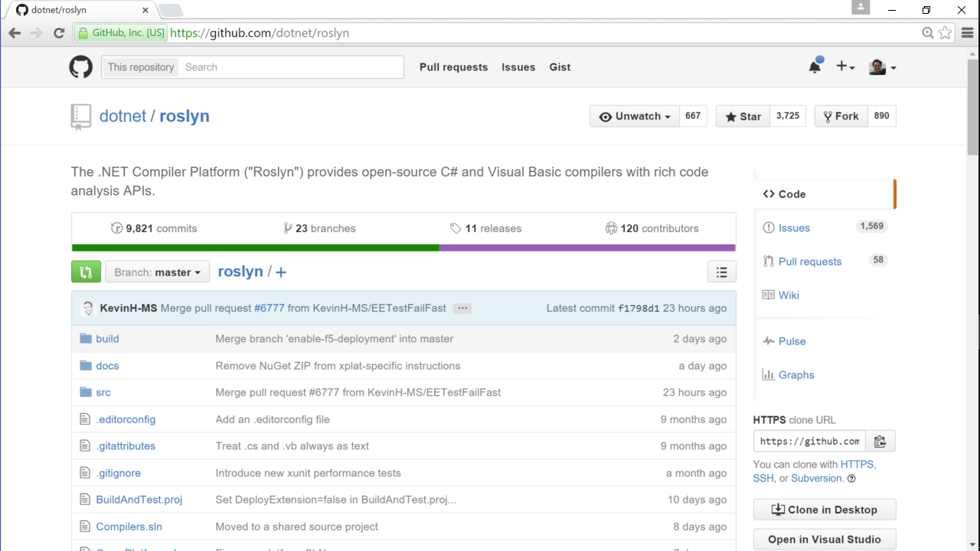
Notes:
I work in this Microsoft. Everyone in our division lives on github, does their day-to-day working life in the open on github, working on a our MIT- and Apache-licensed products.

Slide 5
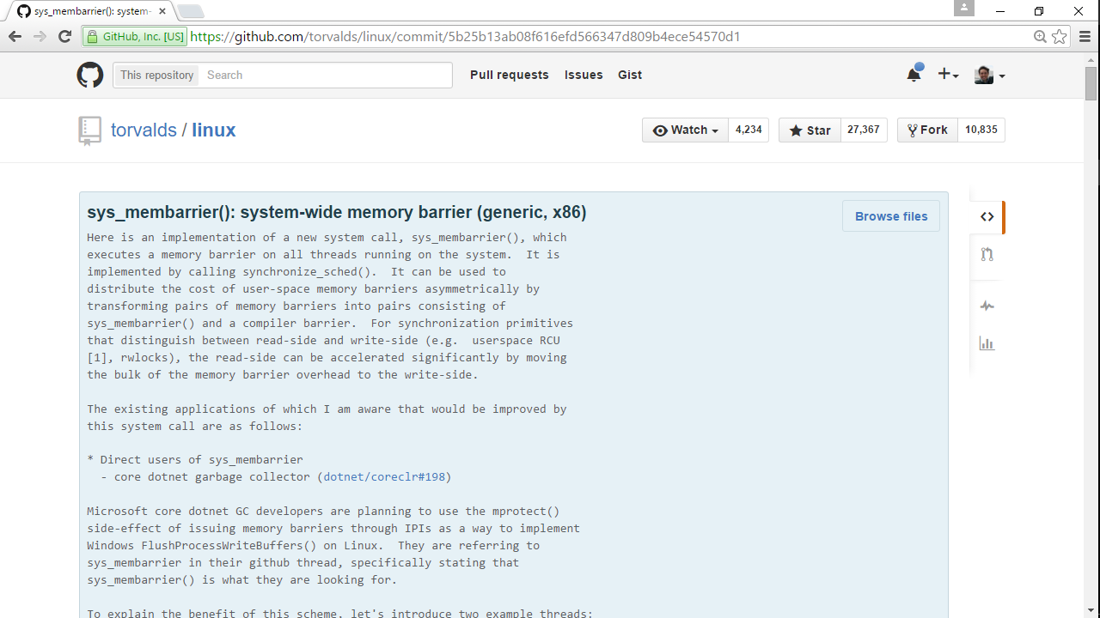
Notes:
It’s this Microsoft. Who’d have thought you’d see this? A commit by Linus himself that supports CoreCLR, part of the C# runtime.

Slide 6
C# is a modern versatile OSS language+service.
It runs on OSX, Linux, Windows, iOS, Android.
It compiles to standalone self-contained native.
You code/build in Sublime, Emacs, VS, on any platform.
Notes:
So let’s make sure we’re on the same page.
C# is a modern versatile OSS language and service.
It generates code that runs on Mac, Linux, Windows, devices. Oh, I should have put FreeBSD there as well.
It compiles to native machine code, to standalone self-contained binaries.
You write your code in your favorite editor, and build it on your favorite platform.
That might be a surprise!
And some of these statements are work-in-progress at the moment.
Let’s see…

Slide 7
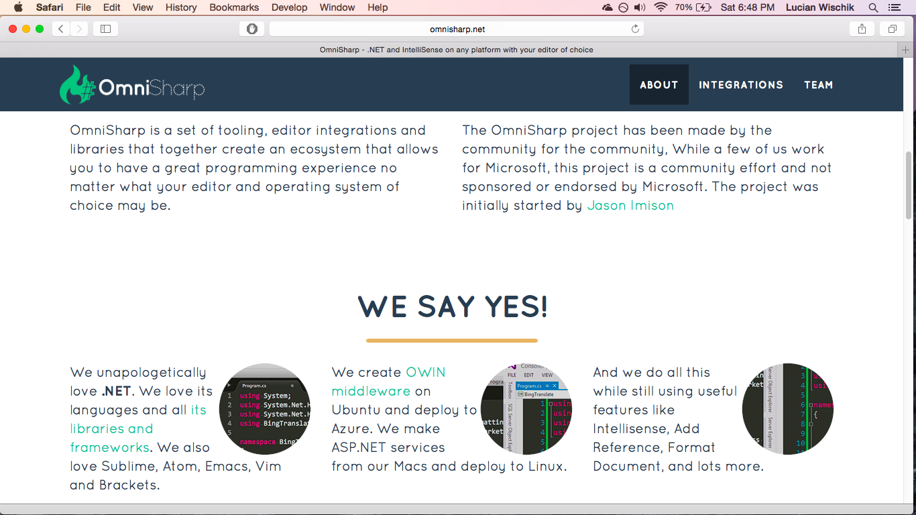
OmniSharp
Notes:
Part of C# is about its developer experience – intellisense, that kind of thing.
I’ll talk about that more.
Omnisharp powers this in a variety of editors like Sublime.

Slide 8
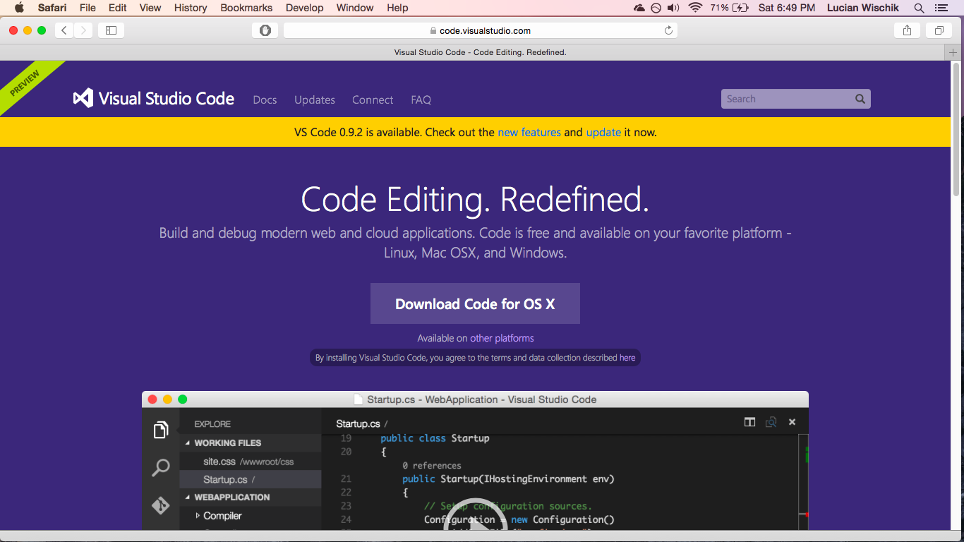
VS Code
Notes:
VS Code is Microsoft’s own free cross-platform code editor.

Slide 9
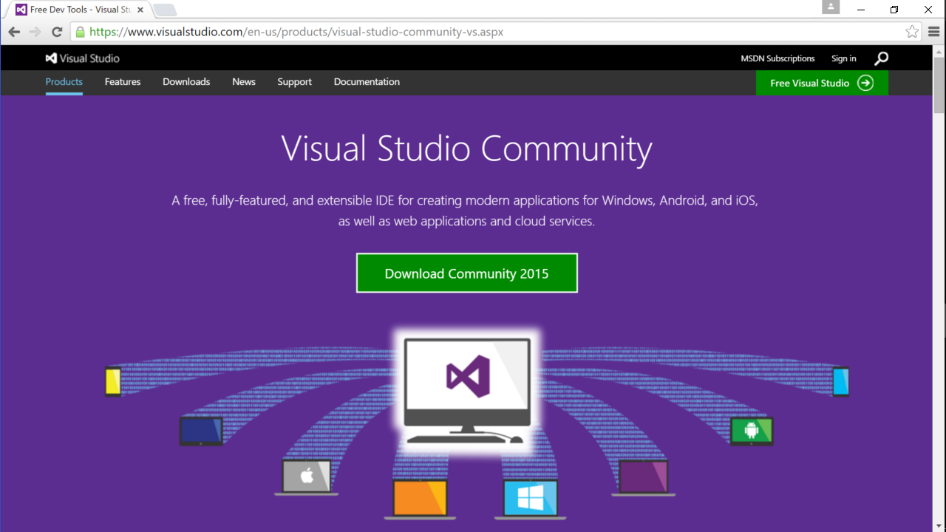
VS Community
Notes:
Visual Studio Community is Microsoft’s free full-fledged IDE, Windows-only.

Slide 10
C# code
Standard library
github.com/dotnet/corefx
Compile → bytecode
github.com/dotnet/roslyn
Keystroke response within 80ms
98th percentile 40ms
VM
github.com/dotnet/coreclr
Compile → Native
Notes:
The C# compiler compiles to bytecode. The compiler’s on github, called “roslyn”.
Actually the C# compiler used to be written in C++, in a codebase that had become kind of unwieldy.
We rewrote it from scratch in C#. Took about 5 years, finished just this summer. We took a page out of functional programming’s book, used immutable data-structures and deterministic transforms, so now it runs faster on multicore and is actually a really fun codebase.
[CLICK]
Why is it called Roslyn? Because the architect of this rewrite was sitting in a small town called Roslyn in Eastern Washington, drinking the local beer also called Roslyn, and I guess the name kind of stuck.
[CLICK]
Anyway, the bytecode runs on a JITing garbage-collecting VM called CoreCLR, and runs on Linux, OSX, FreeBSD, Windows. Xamarin also have a VM for Android.
[CLICK]
Or, you can run the bytecode through a further compiler to native – faster startup time, lower working set, and the OS doesn’t need to have writable+executable pages which is nice for security. Xamarin does this for C# on iOS. We do it so far for C# on Windows 10.
[CLICK]
The VM and native still have garbage collection. What do we do about GC latency? It doesn’t seem to be a problem. Like, the C# compiler itself, every single keystroke it has to generate an immutable syntax tree of the entire program, re-resolve symbols, but typing responsiveness never gets above 80ms and is normally at 40ms, below the threshold of awareness. Although it gets slower depending on how much beer you’ve drunk.

Slide 11
Modern languages in practice: Go, Rust, Swift
The 21st century is 15 years old, and yet mainstream languages are still seemingly stuck in the 1980s. Time for a new crop of languages that tackle the challenges of our time: concurrency and parallelism; state management; security; efficiency
The amazing potential of open source
When dinosaurs roamed the Earth, many of them were .NET developers who all drank from the same water hole supplied by Microsoft. Then the open source comet hit and the OSS explosion began.
Notes:
Were you at yesterday’s “modern languages” track?
[CLICK]
Mainstream languages stuck in the 1980s. Interesting, from my viewpoint Go and Swift are already mainstream languages in their areas.
[CLICK]
And today’s .NET track starts out with the dinosaurs!
I’ll be talking about how C# is and continues to be a modern language in all these areas. First I want to talk about two areas that weren’t listed though – OSS, which is basically table-stakes. Go and Rust are already there. Microsoft came late to the game so we’ve had to be extra open to catch up. And Swift will become OSS in a month or two. And the other area is a rich productive development environment – for the places where developer productivity is a bottleneck, not just runtime perf.

Slide 12
C# is a modern versatile language+service
Notes:
An important part of C# is providing that productive developer experience.

Slide 13
Roslyn is a modern versatile compiler+service
Notes:
Or I should say, the Roslyn compiler and language service provides it.

Slide 14
Notes:
Things like information in tooltips, greyed out redundant code, inline temporary variables, quick-fixes, previews.
Let’s step back. Try an experiment. I’d like you to try this now. Imagine in your head, if I asked you to design a some software for school administration -- students and teachers – what’s in your head? How many of you imagined curly braces and semicolons? And how many imagined inheritance hierarchy? It’s about a higher level of abstraction. Well, some of you do. Part of the Roslyn rewrite was to raise the bar in making these higher level things available to the compiler, to the IDE, to plugins. A modern compiler isn’t just a black box that takes in code and spits out binaries. It’s also a service that lets the IDE query, inspect, reason about the code.

Slide 15
Roslyn reference source
Notes:
Here’s another example. Imagine if you could take your company’s codebase, like here our Roslyn codebase is half a million lines of code. And we use that compiler-as-a-service to dig into it, break it apart, expose it all via a webpage that’s regenerated nightly.
[CLICK]
Like, if I wanted to see how the syntax of an If statement is represented, search for it, and I can click to see where it’s referenced. An If has a condition, an “If” clause, and an optional “Else” clause.
Say, how many of you have coded a compiler, or part of one?
I thought we could do a bit of C# compiler coding here right now, just to get started. Also because it’s exactly how we’re designing the next version of C#.

Slide 16
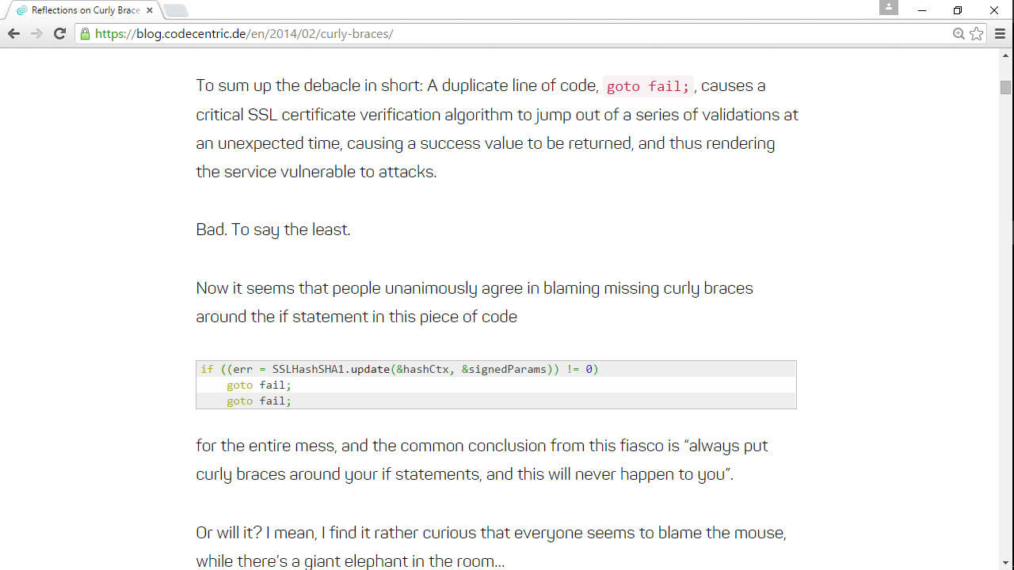
Notes:
I thought we could start with this, last year’s “goto fail” security bug.
People’s knee-jerk response was to blame the coding style, to say you should always have braces on your ifs. It was a wrong response, but let’s go with it for sake of argument.
Let’s modify the C# compiler to error out if you omit the braces.

Slide 17
Notes:
I’ll create a new “Roslyn analyzer”. Analyzers hook into any stage of the compiler pipeline and their role is to produce error messages and quick-fixes. Mine will error out if you miss a brace, so let’s type out those strings. And I’ll make it an error, not a warning.
Analyzers can run upon symbols, after names have been resolved and the compiler’s figured out all your type declarations. But I’ll write one that runs just on syntax trees. On IfStatement syntax trees.
Let’s use the quick-fix to generate a stub for this method.
I don’t want it to throw NotImplementedException.
But actually I’m not sure what I want it to do, so I’ll set a breakpoint here and run.
This’ll launch a new instance of Visual Studio. It’s like Inception. Visual Studios all the way down.
I can debug stuff, see what I’ve got.
That gives me the clue, so I’ll type away. Get out the If statement.
Get the If clause part of it.
This ?. is a null-safe dot operator. Only dots into it if it’s not null. We saw it in Swift and copied it.
I can debug-step through the code I’ve just written, see what it’s done.
If the If clause was a block, inside curly braces, then it’s okay.
Heh heh. My little joke.
Otherwise we’ll report our error message.
Now run it. You can see the error squiggles that our analyzer has produced.
Actually, the punchline is that all of this was needless. The compiler already gave an “unreachable code” error that would have detected goto fail bug, and our knee-jerk analyzer wasn’t even needed.
Actually, that’s not the real punchline. The real punchline is that you saw how C# has democratized a bit of compiler writing. I guess like Java has done with annotation authoring. For C# this analyzer bit is easy for anyone to do, to analyze the syntax and semantics of C# code. Like a team uses it to enforce team coding guidelines, or there are a bunch of libraries that you download from the C# package manager and they come with built-in warnings if you don’t use the APIs right.
What else you saw was coding in the middle of a debug session. I guess you’re used to this if you do Javascript, less so if you do C++. We call it “Edit and Continue”. I guess REPLs are great, Playgrounds are great, and Edit and Continue is also great for some things.

Slide 18
Roslyn is a modern OSS compiler
Notes:
Well that’s the language-service parts, with their low barrier to entry. And the open-source parts?

Slide 19
github/dotnet/roslyn
Notes:
Like I said, our C# compiler is all coded in the open. Fork it on github.
If you clone it
[CLICK]

Slide 20
github/dotnet/roslyn
Notes:
Load it into Visual Studio, here’s where the actual compiler does its compiling stuff. Like, here’s the bit where it lowers If Statements into bytecode.
And I can edit the code, set a breakpoint, and run it, just like I did before.
It takes several minutes to build! And actually it doesn’t quite work yet, because of silly code-signing issues. This will start working in the next Visual Studio update, later this year.

Slide 21
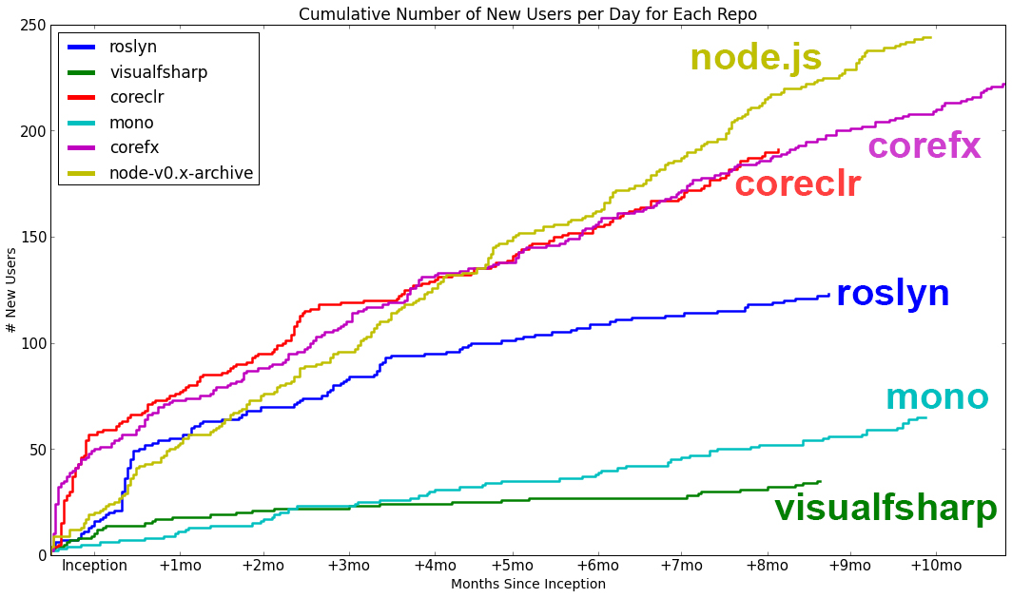
Notes:
We had thought that compiler and JIT and VM stuff would be too esoteric for the community to get involved, but we were wrong.

Slide 22
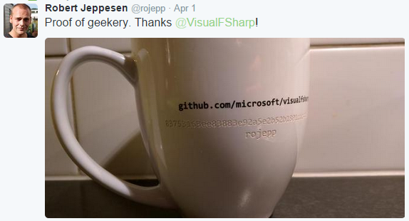
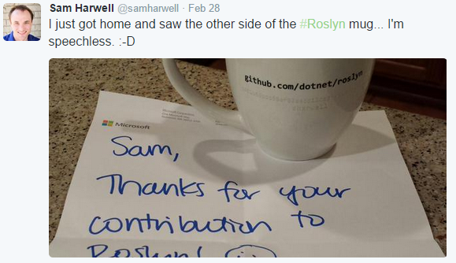
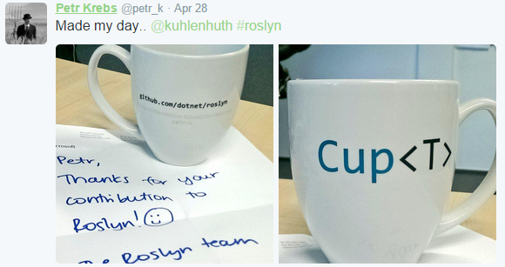
Have fun!
Notes:
And we’ve been having fun with it! For the first year of open-source Roslyn on github, for anyone whose pull-request got accepted, we sent them a Cup<T>. We went down to the workshop to laser-etch the SHA1 of their commit on the back. We didn’t tell folks in advance we were doing this, so people were pretty happy.

Slide 23
C# is a modern OSS language
Notes:
That’s the compiler being open source.
But also the LANGUAGE is open-source. What does that mean?

Slide 24
Notes:
We still have a language design team at Microsoft. We meet four hours a week. We put the meeting notes up on github.
Actually, we were overwhelmed. In a good way. 248 comments form the first set of language notes. And they were all high-quality thoughtful ones.
That’s because everyone has experience and opinions about the language they use!

Slide 25
Notes:
There’s a kind of tension. How to harness all that enthusiasm?

Slide 26
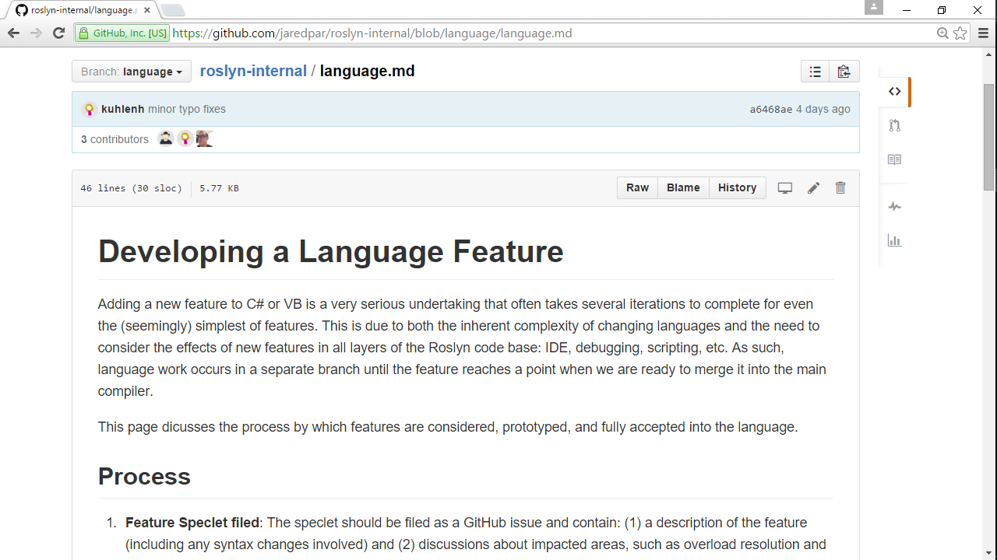
Notes:
We don’t want folks to go off the deep end with massive pull-requests that the language design team thinks are just wrong for the language.
That happened with a few compiler architecture pull-requests that we had to reject.

Slide 27
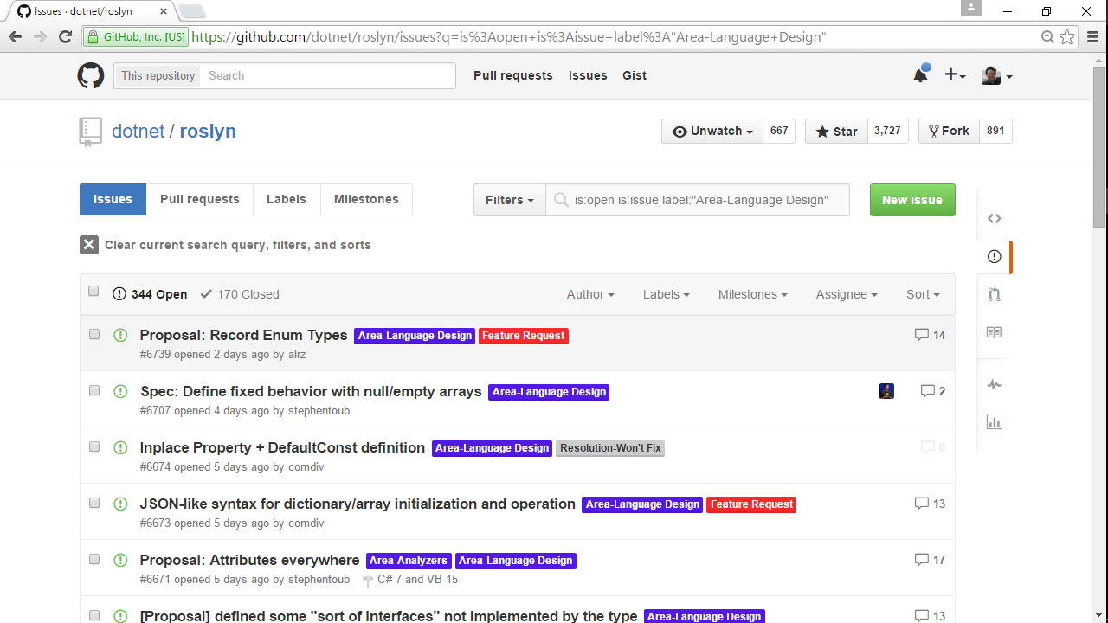
Notes:
I guess can you think of anything that’s better for having been invented in a committee?
Me neither. So it’s individuals who put up proposals on github – members of the public, or folks on the C# language design team, who have passion or insight about their feature. Just like with C++. Maybe do a prototype.

Slide 28
Notes:
It’s still down to the language design team to make sure that the proposals stay true to the kind of C# feel.
So let’s do some language design together! For the rest of this talk, I’ve pulled out three of the proposals for C#7.

Slide 29
C#7 … null safety ??
Notes:
I thought it’d be interesting to start with a language design failure. I’ll talk about three language design things. One failure, one likely success, one meh.

Slide 30
Notes:
Professor Sir Tony Hoare was the guy who invented null references, who invented the crashes you get from following a null reference. He called it his billion-dollar mistake for all the pain he’s wrought.

Slide 31
F#
Swift
C#7 ?
Notes:
Functional languages like F# have been avoiding this problem for years, with what they call “option types”, Some or None.
[CLICK]
Swift took the same functional idea, but somehow made it beautiful, and brought it into the mainstream. I think just the use of ? Did it. So if you have a String, it’s guaranteed not to be null. If you have a String? then it might be null. There are places, especially interop with the huge ObjectiveC legacy, where that kind of care gets too cumbersome, so they added another option String!.
Swift got to do that because it’s a new language from scratch. But if you’re C# or Java you don’t have that luxury. We’ve been exploring a different avenue. We thought, can we avoid the complexity of three string types?
[CLICK]
Look at this. It sees you’re checking for null, so it knows this variable has the potential to be null, and that’s why it knows to warn. It’s using dataflow to figure this out, to understand the meaning of your normal null-checking idioms.
Something that’s interesting here is that null safety isn’t about adding new possibilities to the language. It’s solely about giving warnings or errors on existing code. That sound familiar? Yeah, it’s an analyzer. All of this prototype was implemented as an analyzer, like we saw before.
Actually, what if there were no null-checking idioms in the code, but you still want to opt into the analysis? Here’s where we would like to use the question-mark syntax. But an analyzer can’t change the language, so we did it with an attribute, like a Java annotation.
Part of the philosophy here was to find a sweet spot between valuable and cumbersome. Like, we don’t need to pay back all of Tony Hoare’s billion dollar mistake. If can make the feature really low-overhead, few new concepts, then even if it pays back only five hundred million dollars, it’s probably worth the tradeoff.

Slide 32
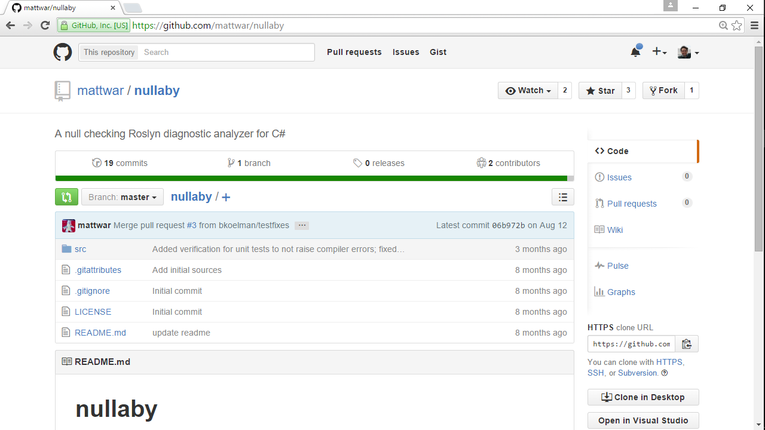
Notes:
The code for this prototype is all on github. We’re facing big challenges mainly around the ecosystem, like what if you use a library that has all this stuff while you’re still on the older C#. Then when you upgrade C#, is your code suddenly going to break?
Personally, this is my top favorite feature, but my expectation of it working out are low. Our next step is for a dev to turn it into a real complete prototype. This feature’s too delicate to predict without seeing it for real.

Slide 33
C#7 … pattern matching
Notes:
How about something more likely? Pattern-matching!

Slide 34
Notes:
This was an interesting article by Ted Neward. He said that ORMs, Object Relational Mappers between database schema and object-oriented classes, he said they’re the Vietnam of computer science.
By that he means we’ve thrown technology after technology at them, but every one has problems, there’s always an impedance mismatch between two very different domains of data, that ORMs are never a clear win.

Slide 35
Person
Student
Teacher
Notes:
So let’s look at this. Say you have a class hierarchy with Person, Student and Teacher.

Slide 36
Person
flickr.com/photos/simononly
Student
Teacher
What if I’m both a student and a teacher?
Notes:
What if I’m both a student and a teacher?
Be quiet, Darth. You’re only a teacher of evil.

Slide 37
Person
virtual ToString()
Speaker
Attendee
Student
Teacher
override ToString()
override ToString()
override ToString()
override ToString()
Notes:
The normal object-oriented way is to stick in a virtual method for each verb you want on that data. It’s all nice an encapsulated.
This is great for extensibility. You can add new kinds of data easily, so long as the set of verbs doesn’t change.

Slide 38
ToString(Person p)
{
Student → …
Teacher → …
Person → …
}
{
"name" : ...
}
{
"name" : ..., "grade" : ...
}
{
"name" : ..., "subject" : ...
}
Render(Person p)
{
Student → …
Teacher → …
Person → …
}
Notes:
But sometimes we’re in a world where the ontology data isn’t what changes, like wire-formats of data over the internet.
[CLICK]
Instead it’s the set of verbs that changes more frequently. Maybe the server needs one set of verbs, and a client needs a different set of verbs.
It’s not the same as Ted’s ORM Vietnam, but this wire impedance mismatch is becoming a key pain point for modern development.
And this is where the functional idioms really come into their own. Where you don’t use encapsulation. And you write methods that can handle the different kinds of data.
But to make this palatable, you need a nice language syntax for writing that kind of method. Which is where pattern-matching comes in.

Slide 39
F#
TypeScript
Notes:
Here’s what functional languages do, like Caml and its derivative F#. They have a match expression, which decomposes the variable “p” into the constituent parts of its three possible types. Like, it might be a student made up of Name and Grade, or a teacher made up of name and subject, or a normal person.
Scala and F# actually take it further with “active patterns”, user-defined decompositions.
[CLICK]
Typescript does it differently. It lets you write in the Javascript idiom, but puts a type system on top of it. So in here, if person p happens to be a Student, then in the If clause this variable “p” actually changes its type, because of type Student. That’s pretty powerful.

Slide 40
C#7 ?
Notes:
Here’s what we’ve got so far in prototype for C#7.
The current idiom is pretty ugly. You declare the variable up-front, then attempt a type-cast with an inline assignment.
We started with something like F#, where the “as” test can declare a variable. It’s not using the same variable like typescript. That seemed a bit too scary. Anyway, this variable “s” is in scope for the “if” clause.
Next step is to put it into a switch statement, cleaner than just a sequence of ifs. We figured we could re-use the existing C# switch keyword since it does pretty much the same thing. Also with a “when” clause. The switch would be a bit more efficient, because the compiler could optimize to just a single typetest against student.
Then we’d likely also want an expression form, like F#. We imagined switch is a statement with statements inside for each case, but match is an expression with expression inside.

Slide 41
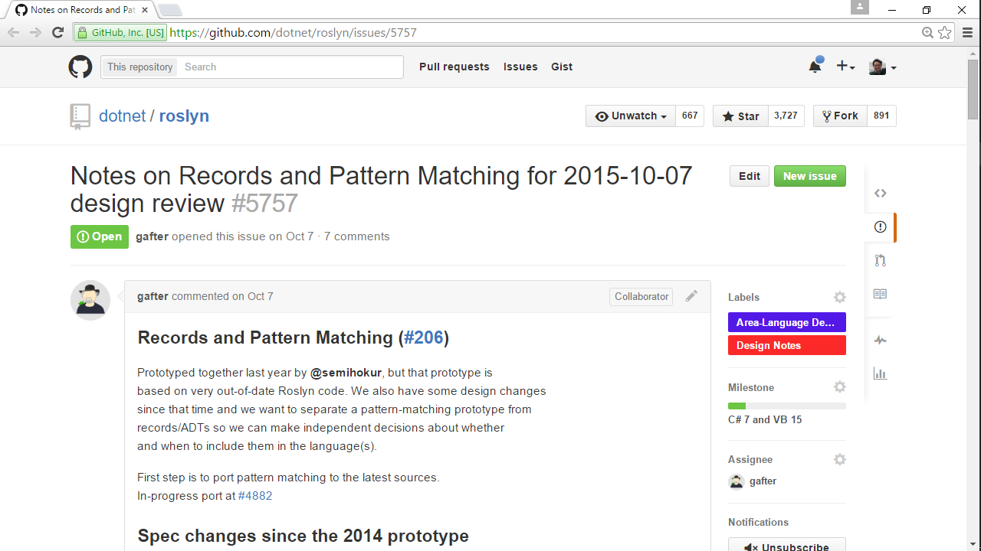
Notes:
There we have it. The proposal’s up on github.

Slide 42
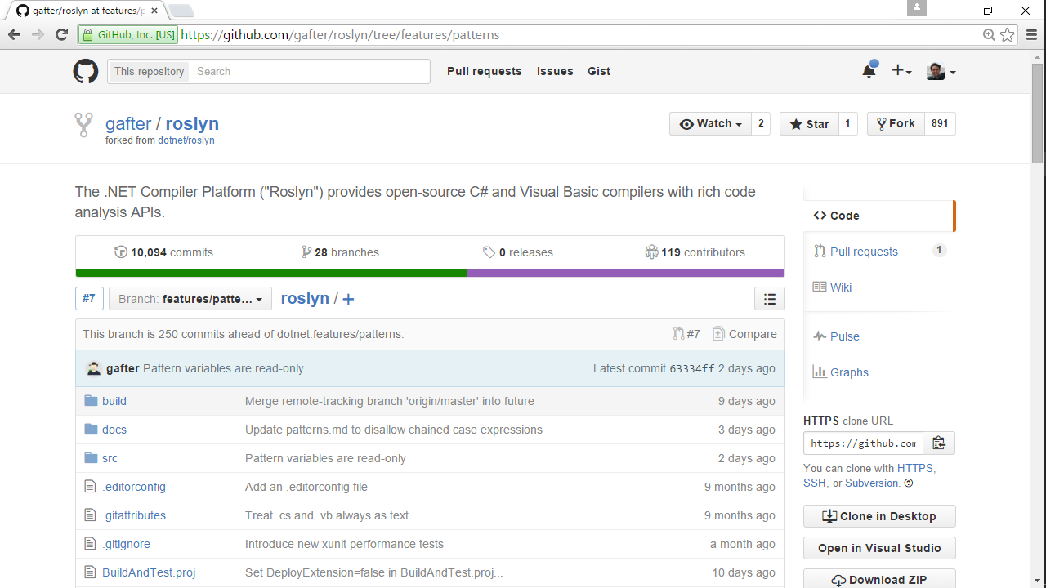
Notes:
This one of course had major new syntax. It couldn’t be done as an analyzer. So it’s in a fork of C#, like I showed you.
What do you think? Me, I’m torn. I like this because it’s so nice from functional programming. But the typescript idea is really compelling.

Slide 43
C#7 … async + concurrency
Notes:
One final area of language design.

Slide 44
Notes:
This was a funny article by Miguel. Callbacks considered harmful. He likes the async/await feature from C#6 because it untangles the spaghetti code you get from callbacks.
Actually he said it stronger. He said “I use async-await because I’m not an animal”.

Slide 45
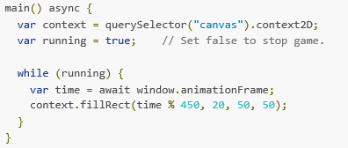
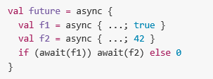
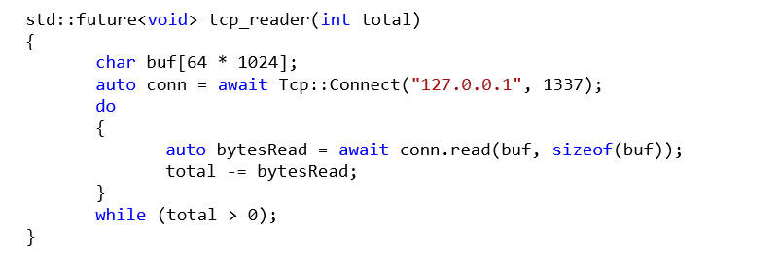
F#
C#
Python
Dart
Scala
Javascript
C++
Notes:
Async was first done in F#. Man I love that language. If everyone coded in a modern functional language like F# or Sala, I swear, the world would have about 60% of its bug defect rate, and more projects would be completed on time, and fewer would fail outright.
[CLICK]
Anyway, we in C# copied it from F#. Funny story. At the time, our management told us in no uncertain terms “no new features”. We had to spend our time fixing bugs. So my manager worked double hours to cover my workload, and I worked double hours to do the work of two developers, and over summer of 2010 I implemented async+await in the C# and VB compilers. Sort of on the sly. My colleague Stephen Toub did all the library implementation, which is a major part of the feature.
The innovation we brought to the table was that F# did async by interpretation, but we did it by a compile-time transformation into a state machine. Much more efficient.
[CLICK]
Python copied it soon after. Their innovation was to unify it with iterators in a beautiful way.
[CLICK]
In Javascript, async-await looks likely for EcmaScript2016 standard.
[CLICK]
And in C++ the async-await feature is in proposal stage. The innovation they’ve brought there, in typical C++ fashion, is a zero overhead implementation. Really slick.
So C# is now a little behind the curve. Still ahead of the languages that don’t have async-await of course. But in C#7 we’re likely to unify await with iterators, a bit like from Python.

Slide 46
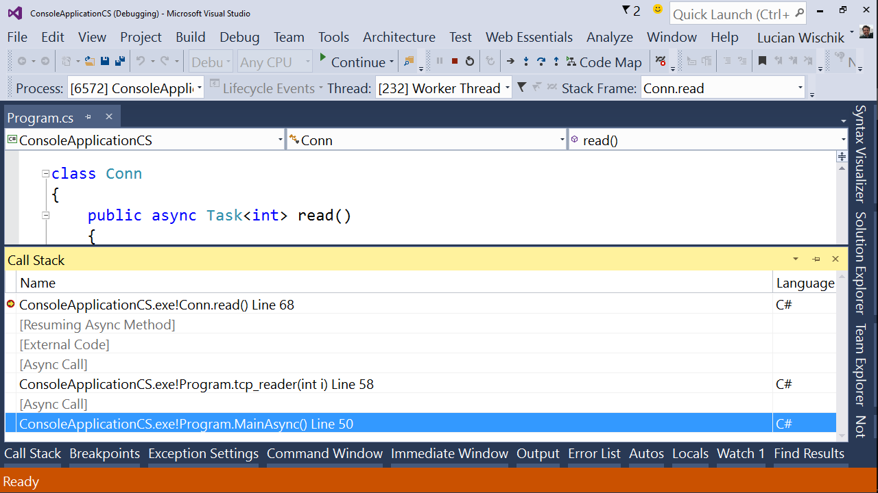
Notes:
One place where VS is ahead of the curve is async debugging.
Things like chrome developer tools, they give you causality callstacks which says where you’ve come from. That can get weird. And the key thing about a callstack, despite it’s name, is that it shows where you’re going to return to. Like, it shows where the next CPU RET instruction will jump back to.
So VS does the same with async callstacks. Shows where the async method will return to. Because, by definition, the place it’ll return is still live, still has a stack frame, still has local variables. It means that async callstacks have zero runtime overhead, and they’re a great debugging tool even on a coredump from a production machine.

Slide 47
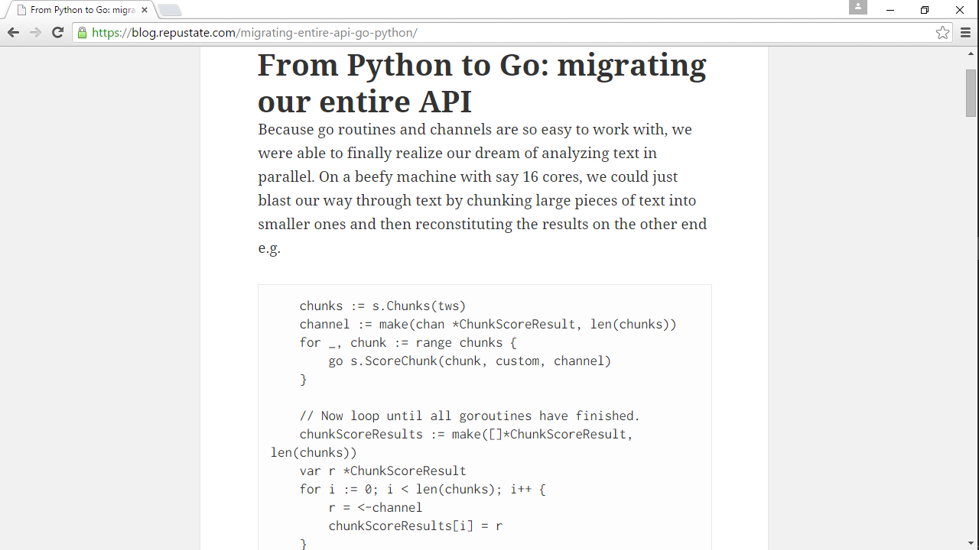
Notes:
This blog post caught my eye recently. A company that migrated from Python to Go, and loved it.
What they liked about it was channels. It helped them parallelize their code, make use of multicore CPUs, so their webservice has lower latency.
I love channels! Did my PhD on them.
Q. What’s even lighter-weight than a go-routine?
A. Nothing!
[CLICK]
I mean, technically, nothing. This is the equivalent in C#. Except, unlike the channels, it avoids allocating its equivalent of a goroutine for every workitem. Only allocates as many as there are threads, and recycles them as they get done.
It uses a higher-level abstraction, “parallelizable lists”, which I guess feels similar to the kind of parallelization that SQL databases will feel free to do for their query executions.
I think the deal is that channels are usually the second-best abstraction for coding most problems, but they’re at least universal. That’s why we heard that Go does more with less. It gets by with just one abstraction, whereas C# has several different abstractions each optimized for a particular scenario.
[CLICK]
Like here, I wrote a fractal that runs in 60ms per frame on my $90 phone from Walmart. How’d it do that? Not with channels. I used C# to program the GPU. That was the best solution in this case.
Well, I think we’re likely to add a Channel API into the C# standard library, but it won’t have the beautiful language syntax like Go has. We’ll see how things work out.

Slide 48
Conclusions
Notes:
And with that,

Slide 49
C# is a modern versatile OSS language+service.
It’s going fun places. Join us for the journey!
lwischik@microsoft.com
@lwischik
Notes:
we’ve come to the end.
I hope you’ve enjoyed seeing this glimpse of the new C#, where it is and we’re it’s going. It’s going fun places. Thanks for coming!

