Slide 1
Lessons in Extreme .NET Performance
Ben Watson
Principal Software Engineer
Shared Platform Group, Application Services Group, Microsoft
Author, Writing High-Performance .NET Code
Notes:
REMINDER: have to get to GC section in 5 minutes!

Slide 2

Notes:
I’ve been at Microsoft since 2008 when this was a thing.
You’ve all heard of this, right?
Is there anybody in this room who used this?
Image from https://sites.google.com/site/cheesemonger32/Screenshot-LiveSearch-MozillaFirefox.png

Slide 3

Notes:
Bing Platform team
Core functionality
Workflow execution
Performance
Educating others about .NET performance

Slide 4

Notes:
* I’ve also taken the hard lessons we learned building Bing and put it in a book
Writing High-Performance .NET Code
http://www.writinghighperf.net

Slide 5
Why Managed Code?
Notes:
In 2015, this feels like a question that doesn’t need to be asked. 5 years ago, this wasn’t really the case, at least at Microsoft, for core platform and system architecture.

Slide 6

Agility
Stability
.NET
Notes:
Fundamental tension in software development: Stability vs. Agility
.NET is how we balance these
Old version of platform was about stability. All unmanaged code.
It took months to get features shipped.
Had to develop their own data pipelines, apps, monitoring. The “platform” was little more than a framework which provided common APIs.
Agility needed to be significantly improved.
Earlier iterations of the platform emphasized stability. Every team was kind of on their own.
3. .NET
This is how we balance the concerns. .NET gives us increased stability while allowing a much faster development pace.
Image courtesy of flickr user harmishhk, https://www.flickr.com/photos/harmishhk/8642273025/

Slide 7
Benefits of .NET
Isolation and safety
Easy testing
Debugging
Code is easy to write*
Notes:
ISOLATION
Search-in-a-box: We knew that one of the things we were going to want to do was run unrelated pieces of code together in the same process, which is inherently risky .NET allows for much easier isolation.
Type safety, memory safety
Because of the built-in metadata and APIS for analyzing IL, we can easily analyze code for patterns we don’t like.
TESTING
Unit tests
Mocks
Tools
Rich ecosystem
DEBUGGING
Built-in metadata!
Can search the heap in a debugger for specific types!
EASE
Easiness to write is a two-edged sword
Rich class library to draw from

Slide 8





GC
JIT
3rd Party Code
People Factors
Notes:
For us, .NET is a strong fortress. It provides the structure we need to achieve both a stable, solid platform, but also move fast in an agile world while remaining safe.
But…there are challenges, enemies we have to face, if you will… (CLICK)
I’m going to use these guys to explain them.
(They’re a little bit goofy, so we should be able to defeat them)
First of all, notice what’s not up there: Stuff like ASP.Net, XAML, GUI performance.
This isn’t going to be about specific technologies, but the core principles of .NET.
What people most commonly lack is an understanding of the basic constructs of .NET.

Slide 9

Garbage Collection
Stops your program DEAD
Notes:
(TIME: @ -45 Minutes)
The first big villain is garbage collection.
STORY: This was the first thing we had to deal with head-on. In many ways we still are. It’s a topic you will always have to deal with.

Slide 10

The Threat
Notes:
We can’t afford expensive GCs in the middle of queries.
We track things like 99th percentile latency.
We want availability above 99.99% (four 9s)

Slide 11
It’s very easy to build a system that spends an extraordinary amount of time in GC.
This is not inherent to the CLR!
Notes:
Unfortunately, most people seem to fall into the lazy way of coding in C#, which does typically involve a ton of memory allocations an inefficient API code.

Slide 12
It is impossible to build a low-latency, high-performance server without taking GC into account from the beginning.

Slide 13
It is a myth that you can’t control the GC – you do so by controlling allocations.

Slide 14
You need to understand the inner workings of the GC, just like you would any memory allocator.
Notes:
* Reminder: We are talking about high-performance systems here. This isn’t regular software!

Slide 15
Generational GC in 30 seconds
Notes:
A quick summary of GC behavior.
(NEXT SLIDE)

Slide 16
Notes:
Heap is divided into generations, 0 - 2.
Memory is usually allocated at the end of gen0.
Allocation is FAST—barely more than a pointer increment.
A GC is triggered when gen0 fills up (there are other criteria too)
In each GC, all the objects are promoted to the next generation, until gen2, where they stay until they’re collected.
A GC is for a specific generation and those below it. A gen0 GC is cheap because it only scans a portion of the heap.
The one you want to avoid at all costs is a gen2 GC, or full GC—the entire heap has to be scanned.
During a GC, depending on your settings, the entire process will be paused for 10s to hundreds of milliseconds.
Memory that no longer has any references to it is cleaned up. That’s how you kill an object.
Allocations >85K are on their own heap and considered part of gen2.

Slide 17
Lessons Learned

Slide 18
The One Rule:
Objects must die in a gen0 GC
- or –
They must live forever in gen2.
Notes:
This is one of the most important things to learn. If you learn NOTHING else, remember this one.
This is how the GC is designed.
The point of this is to avoid promotion.
STORY: We once had a component that had to serialize XML, and we built up a set of XElements. We thought we’d be efficient and delay serialization until the last second to save time in the query.
Oops: this caused the XElements to be promoted to gen1, and sometimes gen2.
This caused more time in GC.
Better to just serialize as soon as possible into pooled buffers, and let the XElement objects be collected.

Slide 19
You will usually want to optimize for as little memory allocation as possible.
Notes:
* This almost goes without saying. The less you allocate, the less work the GC will have to do.
* One reason why this may not apply is with anything pooled—that memory lives forever, so while the initial allocation is potentially large, the net effect will be less overall allocation.

Slide 20
The cost of a GC is proportional to the number of surviving objects.
Notes:
This is vitally important. If you allocate a million objects, but their references go out of scope before the GC, they contribute NOTHING to the cost of that GC.
There is an important exception to this:
If you are allocating so much memory so fast that you hit the segment limit. At that point, you are guaranteed a GC.
STORY: This has actually happened to us. We started hitting upwards of 600 MB/sec in allocations. That guarantees some significant time spent in GC. There are no simple tricks here other than reducing the allocation rate.

Slide 21
Consider pooling for objects with a long or unknown lifetime.
Notes:
Pros:
Save time in gen0/1 GCs
There is no further promotion.
It cuts your allocation rate and time spent in GC.
Risks to this strategy:
Gen2 will become very large (bigger working set)
Gen2 collections may become very long – you might have to mitigate this with other strategies (e.g., stopping processing)
More gen2 objects will have references to newer objects, causing gen0 and gen1 GCs to take a little longer.

Slide 22
Pool everything in the large object heap.
Notes:
True, if you find yourself allocating on the LOH regularly.
All LOH allocations are in gen2 automatically, so more of them will guarantee an expensive gen 2 GC.
More important when background GC is enabled because LOH allocations can block during some phases of background GC.

Slide 23
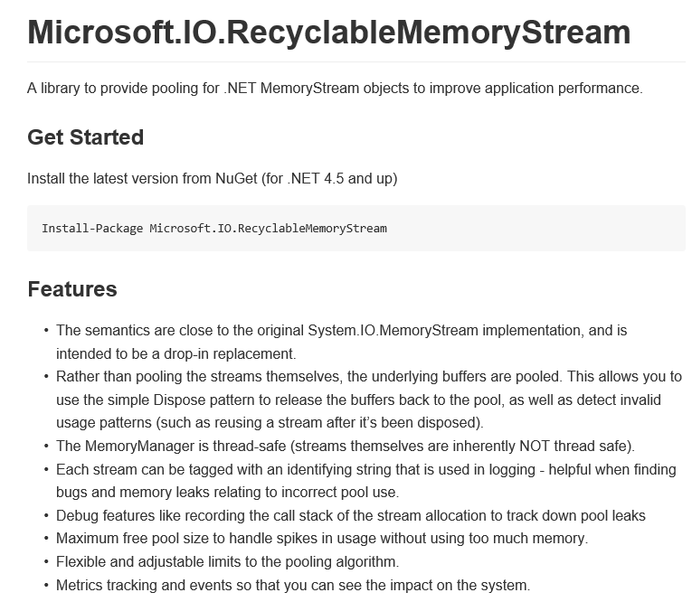
github.com/Microsoft/Microsoft.IO.RecyclableMemoryStream
Notes:
We took all of these lessons and put them together into a class that we needed for one of the most common, memory-intensive operations we do at our layer: serialization.
RecyclableMemoryStream is the result and it’s been made available on GitHub.

Slide 24
GC work never stops
Notes:
In summary,
STORY: When first started, > 10% in GC. Now regularly < 1%.
Not a significant factor in most of our queries.
We count the number of gen2 GCs we have per hour. Our eventual goal is to get this down to counting them per day.

Slide 25

Just In Time Compilation
Just in time to SLOW YOU DOWN
Notes:
(TIME: -30 minutes)
30-second summary
C# code gets translated to an intermediate language with a very simple stack-based syntax.
At runtime, the CLR will translate this code, on-the-fly, into the machine language that the processor understands.
Happens the first time you execute a method.

Slide 26

Should you worry about JIT?
Notes:
In general, people worry about this more than they should.
Don’t worry, unless you care about the latency of every single request.
In our case, it was a real issue. Particularly because we have a lot of dynamically loaded code.

Slide 27
The Threat
Notes:
Two areas of threats.
1. JIT delay
BING: The first query is guaranteed to fail.
Worse than that: the second query is guaranteed to fail because the first one had so many timeouts of individual components, that others didn’t even attempt to run.
Rare scenarios could fail 100% of the time by always hitting a cold machine.
Testing becomes much more difficult.
2. Code quality
Is the JITted code going to be as good as a “real” compiler.

Slide 28
Reduce the amount of Code
Notes:
Very simply, more code == more JIT time
There are lots of hidden sources of code in .NET:
LINQ
Any use of dynamic (though if you’re using that, performance isn’t really going to be your thing)
Regular expressions
Generated code from you

Slide 29
Use the latest .NET
Notes:
.NET 4.6 includes the latest x64 JIT compiler, codenamed RyuJIT. You want this. In our own testing, we saw 50% reduction in JIT times for much of our code.

Slide 30
Warmup Code
Notes:
Warmup requests get a bad rap sometimes, but they’re actually one of the best things to do.
We use warmup queries after the process loads but before it takes traffic.
These queries can take multiple seconds to execute the first time, and then only a hundred milliseconds once warmed up.
The advantage of these is that it executes code along the same kinds of paths as normal production calls
They exercise real code pathways with real data.
JITted code will be created with good locality of reference.
Methods that are used together will be located near each other in memory.
Downside: It takes time. If there is a ton of code to warmup, it can take minutes.

Slide 31
Manual JIT
RuntimeHelpers.PrepareMethod
Notes:
You can actually tell the runtime to JIT a specific method for you.
This might be faster than executing warmup scenarios.
But it won’t give you the optimal code
STORY: schema DLL. 90 minute JIT time.
layout for locality.

Slide 32
NGEN
Notes:
Extra layer in your build or deployment process.
Can be very slow.
Increases memory usage because the entire assembly will be converted.
Poor locality
Might lose cross-assembly inlining (though you can NGEN assemblies in context of other assemblies to get this)

Slide 33
A little of this, a little of that…
Notes:
Some of everything
Most effective is the warmup queries, but we have to be careful: when a machine comes up, a ton of warmup queries will still hit a backend.
Unless you build a mocked backend.

Slide 34

3rd Party Code
Trust No One
Notes:
(TIME: @ -20 minutes)

Slide 35

My Code vs. Your Code
Notes:
We all know what the difference between My code and Your code is, right? (NEXT SLIDE)

Slide 36

Notes:
This is my code. It’s awesome.
* My code is the paragon of clean, fast, efficient, beautiful, well-written machine execution instructions.
* It is a highly optimized jewel of functionality and performance.
Photo courtesy of Axlon23
https://www.flickr.com/photos/gfreeman23/17805613483

Slide 37

Notes:
This is your code.
It is a wreck of obsolescence that should have been crushed and buried under a mountain a decade ago. You should be ashamed.
Photo courtesy of Scott Swigart. https://www.flickr.com/photos/smswigart/7351778340

Slide 38
Joking aside…
Notes:
* When you have a finely honed set of software that you’ve developed with performance in mind, you really do have to take on an “us vs. them” mentality.
* Often the “them” is you from 5 minutes ago.

Slide 39
The Threat
Notes:
You don’t know what the code is doing.
Assume the code is perfectly bug-free.
You don’t know:
How efficiently it JITs
How much memory it allocates.
How much CPU it will use.
Does it throw exceptions liberally?
Does it pin objects?
Does it p/invoke into unmanaged code?
Is it just plain inefficient?

Slide 40
The Framework Class Library
Notes:
Surely, the FCL is well-written?
Sure, it is, for a general-purpose framework.
But let’s look at an example…. (NEXT SLIDE)

Slide 41
How would you implement Enum.HasFlag()?
Notes:
Think about this for a second.
(PAUSE)

Slide 42
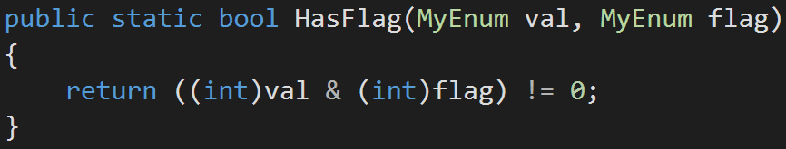
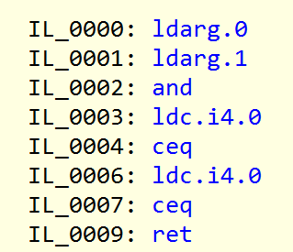
Notes:
8 IL instructions. It’s probably fewer x64 instructions.
Let’s see what it actually looks like…

Slide 43
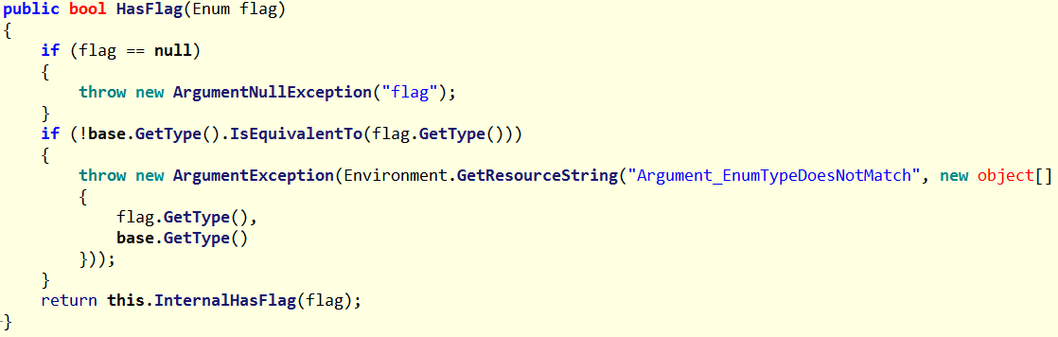
Notes:
Uh oh…. A call to some type functions…
Any guesses on how expensive this all is?

Slide 44
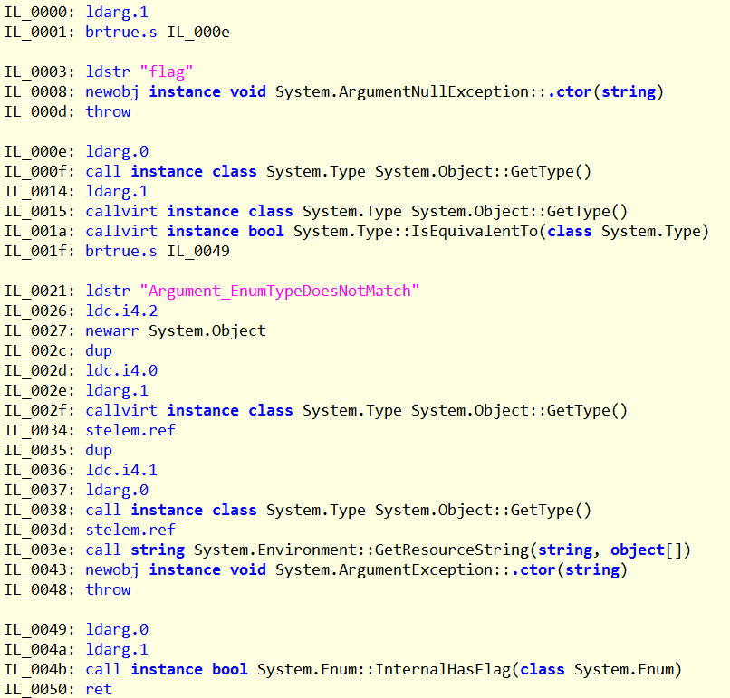
Notes:
Ignoring the exception throwing code, there are:
12 IL instructions, none of which actually compare the numeric values.
2 calls and 2 virtual calls
STORY: I discovered this after seeing it show up in a system profile—and I thought to myself, “How in the world is this possible, even if we’re calling it this much?”
This code is correct
It is more robust than my solution. It checks types, after all.
It is a general-purpose solution, with general-purpose performance.
BUT: In my app, I have more information. I can make assumptions about the types, and get better performance. I just have to implement it myself.

Slide 45
Read the Source
Notes:
There’s no getting around this. If performance is critical, you have to read the source of all the code you didn’t write.
Otherwise, you’ll be surprised when you start looking at profiles.
* One example of why its important to read the source: (NEXT SLIDE)

Slide 46
Default collection sizes
Notes:
Don’t assume these are anything other than 0.
Creating a collection and adding three items to it could result in three separate recreations of the underlying data structure, and copying of that data.
Pre-initialize the size whenever you can.

Slide 47
Quiz: How many different XML serialization options ship with .NET?

Slide 48
LINQ-to-XML
XmlTextReader
XmlValidatingReader
DataContractSerializer
XmlSerializer
XDocument
XPathNavigator
XPathDocument
Notes:
Each of these are different.
Lots of options, each with their own quirks and performance characteristics. You have to study them and decide which is best in your situation.
* (Someone in here knows some I’ve left out)

Slide 49
Methods that throw exceptions in normal conditions.
Notes:
Exceptions really are expensive. More expensive in .NET than normal Windows exceptions.
HttpWebRequest throws exceptions on non-200 responses.
All of the Int.Parse-style methods
Don’t let your methods be one of these!

Slide 50
Static analysis
Notes:
Since we’re in .NET we have a rich API for inspecting the IL in assemblies.
Using FxCop, we can block APIs, libraries, certain coding patterns

Slide 51
FxCop
Stupid String Tricks: ToLower, ToUpper, Format, Join
Notes:
Things you can block….

Slide 52
FxCop
Stupid String Tricks: ToLower, ToUpper, Format, Join
Large Static Allocations (>85K go on LOH)
Notes:
Things you can block….

Slide 53
FxCop
Stupid String Tricks: ToLower, ToUpper, Format, Join
Prevent finalizers
Large Static Allocations (>85K go on LOH)
Notes:
Things you can block….

Slide 54
FxCop
Stupid String Tricks: ToLower, ToUpper, Format, Join
Prevent finalizers
Force use of pooling APIs for some types
Large Static Allocations (>85K go on LOH)
Notes:
Things you can block….

Slide 55
FxCop
Stupid String Tricks: ToLower, ToUpper, Format, Join
Prevent finalizers
Warn against LINQ
Force use of pooling APIs for some types
Large Static Allocations (>85K go on LOH)
Notes:
Things you can block….

Slide 56
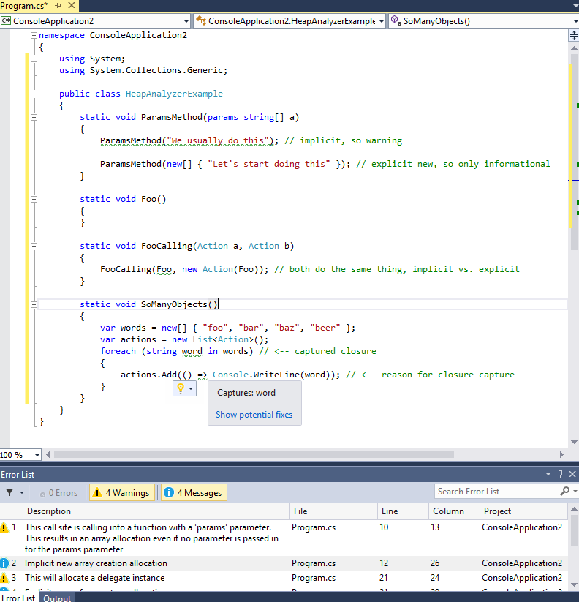

Projects like RoslynClrHeapAllocationAnalyzer
This is the future…
(note: Clippy not actually included)
It looks like you’re writing awful, poorly performing code. Would you like to stop already?
Notes:
Colleague in Bing
https://github.com/mjsabby/RoslynClrHeapAllocationAnalyzer

Slide 57

People Factors
(No, you can’t actually use a hammer and sword.)
Notes:
(TIME: @ -10 minutes)
Our final enemy
* Note that I am very carefully not saying that PEOPLE are the enemy

Slide 58

Notes:
For some reason, when good C++ programmers start using C#, something happens to their brains.
In C++, they come across a division by two and say to themselves, “I don’t trust the compiler, I better just bit shift this.”
Then they start using C# and…. (NEXT SLIDE)
Photo courtesy of Allan Ajifo, https://www.flickr.com/photos/125992663@N02/14599057094

Slide 59

Notes:
“Oh, I just need to do a string join, with a split, make it upper case, then pass it through a regex, and I’m good.”
No! What are you doing?
Some of the C++ performance rules are the same, but many of them are different.
BUT THERE ARE STILL RULES.
Even supposed experts will be tripped if they’re new to .NET
Even .NET experts will be tripped up if they don’t really understand the principles of performance engineering in .NET
STORY: foreach is such simple syntax that it gets used in completely wrong contexts. I recently looked at some random code, and saw a foreach over a dictionary. Inside the loop it dutifully checked the key for the one it wanted. Then it looked up that key in the dictionary it was currently iterating over. (Remember: you can’t actually se the hammer and sword…)

Slide 60

You must train people
Notes:
This feels obvious, but:
You have to train people.
Even people who already know .NET
Even senior people who really know their stuff.
Build up a small set of leaders who understand this stuff and work on it full-time.

Slide 61
Code does not exist in a vacuum
Notes:
We’ve had to teach people:
“You’re not writing C# code. You’re writing Bing code.”
There’s a huge difference.

Slide 62
Understand the Tradeoffs
Notes:
.NET features aren’t free, but you do get a lot for the cost.
Example: Unmanaged code doesn’t have garbage collection, but it can have problems with memory fragmentation, which can be a real problem in a high-performance, multi-threaded server.
Cost of allocations can skyrocket if you’re not careful.
.NET has extremely cheap allocations, much less fragmentation worry, but you have to pay for the GC.
Ask yourself: if I was using a different framework, what would I have to build to get these features.
When people criticize managed environments, they often focus on the costs and ignore the benefits. (NEXT SLIDE)

Slide 63
Understand the Tradeoffs
Benefits
Costs
Memory safety
Type safety
Fast allocations
Debugging is MUCH better
Better static code analysis
Code locality
JIT
Garbage Collection
Bounds checking, type checking
Training
Hidden code
Notes:
There are more items you can add on both sides of this
You have to decide the weight of each time.

Slide 64
It is impossible to build a low-latency, high-performance server without taking GC into account from the beginning.
Notes:
Remember this slide?
This implies a general principle (NEXT SLIDE)

Slide 65
Performance is a Feature
Notes:
The higher your expectations, the more work you should expect to do.
Must make performance a feature on-par with all of your other features.
If someone isn’t focusing on this, then everybody else who doesn’t care will destroy it.
Good performance never “just happens.”

Slide 66
GC
JIT
3rd Party Code
People Factors
Notes:
These enemies… (NEXT SLIDE)

Slide 67
Notes:
…just fade away. You win.
The castle stands proudly, resisting all enemies.

Slide 68
Want to know more?
.NET Performance Deep-Dive Workshop
Thursday, 9am, Garden A

Slide 69
Resources
Books
  Writing High-Performance .NET Code
    Book Site – Can get the following for free:
      Intro, Chapter 1 – general measurement guidelines, tools, how to use Windbg and PerfView (and others)
      Chapter 5 – Performance Considerations of Class Design and General Coding
  Advanced .NET Debugging by Mario Hewardt
Article: .NET memory allocation details

Slide 70
Resources
Vance Morrison’s CLR Inside Out columns on performance: Measure Early and Often for Performance, Parts 1 & 2
  http://msdn.microsoft.com/en-us/magazine/cc500596.aspx
  http://msdn.microsoft.com/en-us/magazine/cc507639.aspx
Interface Dispatch: http://blogs.msdn.com/b/vancem/archive/2006/03/13/550529.aspx
SOS command reference
  http://msdn.microsoft.com/en-us/library/bb190764.aspx
Windbg command reference
  http://windbg.info/doc/1-common-cmds.html

Slide 71
Tools
Reflector, ILSpy, ILDASM – tools to convert compiled binaries into readable code. Essential for understanding how 3rd-party code (including the FCL) works.
FxCop
  Performance rules are limited, but useful
  Warns about things like multiple casts, Equals() on value types, empty finalizers, etc.
  Lots of other style and correctness rules
  Get in the habit of running these as part of your build
    DON’T get in the habit of issuing exceptions for rule violations -- just fix the issue if possible

Slide 72
Tools
MeasureIt
  Small, simple tool for running microbenchmarks on the .Net framework
  http://blogs.msdn.com/b/vancem/archive/2009/02/06/measureit-update-tool-for-doing-microbenchmarks.aspx
PerfView
  ETW event analyzer with clever views (like a CPU profiler)
  Can analyze both CPU and memory events
  Can tell you who is allocating memory, who owns memory, who is allocating on the LOH
  How often are GCs? How long do they last?
  Exceptions being thrown and handled
  Jitting events
  Anything else that’s an ETW event (which is most things)

Slide 73
Tools
Windbg & SOS
  The best way in many cases to understand what’s really going on
  SOS is the managed debugging extensions
  Comes with CLR, already setup to work with WinDbg in PHX
  See http://msdn.microsoft.com/en-us/library/bb190764.aspx for SOS commands
  Getting started:
    Attach to your process
    .loadby sos clr
    !bpmd program.exe Namespace.Type.Method
    g
    !U @rip
    !ClrStack

