Slide 1
Optimal Pipeline Using Perforce, Jenkins & Puppet
Nitin Pathak
Works on Stuff @Perforce

Slide 2
Agenda
Overview of Continuous Delivery
Unified Best practices for success
SDLC – Powered by Helix
Demonstration
What’s new in Perforce Helix?
Perforce Community
Notes:
I’ll go over the basics of continuous delivery , cover best practices and some common tools and technologies before showing you how to use some of these tools with the perforce platform in a demo.

Slide 3
Continuous Delivery
Delivers functional product to end users
Every change (Commit) leads to a potential release
Empowers business with the option to release – what, when, why, and to whom
Continuous Delivery
Reqs
Dev
Test
Integrate
Deploy
PIPELINE
Notes:
Repeatable processes are key to success. The well-oiled eco system now delivers functional products to the end users. Developers and businesses are not worried about why the functionality works in Dev environment and not in QA or Stage.
This involves both culture and process change and affects all teams involved. If every change could lead to a potential release there needs to be a high level of trust between all parties involves.
All teams need to have a common goal of getting quality assured products to users faster.

Slide 4
User Data: Gaining Traction Fast
65% of software developers, managers and executives report that their organizations have started down the path to Continuous Delivery
At Least Some Projects
All Projects
Notes:
Our survey validates the analyst sentiment. More and more organizations are adopting continuous delivery.
65% have started using it. 28% use CD across all projects and teams. Another 37% are using it across at least one project/team.
This is across all types of business and both geographies.
Where are you in your adoption of continuous delivery practices?

Slide 5
Principles of Continuous Delivery
1
2
3
4
5
6
Repeatable process for release
If it hurts, do it more frequently
Build quality in
Done means released
Everybody is responsible
Continuous improvement
Reqs
Dev
Test
Integrate
Deploy
PIPELINE
Automate almost everything
Keep
everything in version control
Doc
Code
Libraries
Media
Scripts
Configs
Binaries
“Hardware”
(virtual)
Notes:
The question is – how do you get there? Experts have laid down a few key principles (6 in the case of this book, often considered as the Bible for Continuous Delivery).
Repeatable processes
More frequent checkins
Quality awareness
Frequent releases
Peer responsibility
Continuous feedback and iteration
Automation is achieved via the notion of a pipeline – a implementation of your release process that takes bits as soon as they are coded, and moves them through a set of stages that qualify them for a release, and then deploys them if appropriate. Every checkin can result in a deployment (in the extreme case).
To make this repeatable, your automation system needs to work against a version control system to obtain each change, each configuration, each test case, each machine image, the content necessary to make all of this actually work.

Slide 6
Exponential Complexity and Risk
1
1
0
1
0
0
1
0
Challenges
1
1
0
1
0
0
1
0
Productivity
Quality
Team Collaboration
IP Security
Time to Market
1
1
0
1
0
0
1
0
1
1
0
1
0
0
1
0
Data
1
1
0
1
0
0
1
0
Sites
1
1
0
1
0
0
1
0
1
1
0
1
0
0
1
0
Transactions
Size
1
1
0
1
0
0
1
0
Automation
1
1
0
1
0
0
1
0
1
1
0
1
0
0
1
0
Users
Load
Notes:
Alongside, the change in processes stresses your organization. Business wants predictability and value. Developers want flexibility and freedom to innovate. Collaboration and flexibility becomes critical for success.

Slide 7
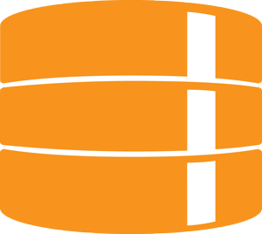
Key Requirements
Complete Visibility
Distributed Teams
Flexible Workflow
COORDINATE TEAMS
(design, dev, release, devops, etc.)
PIPELINE
COORDINATE ASSETS
(code, scripts, artwork, binaries, etc.)
Unified Repository
Universal Security
Scalability & Performance

Slide 8
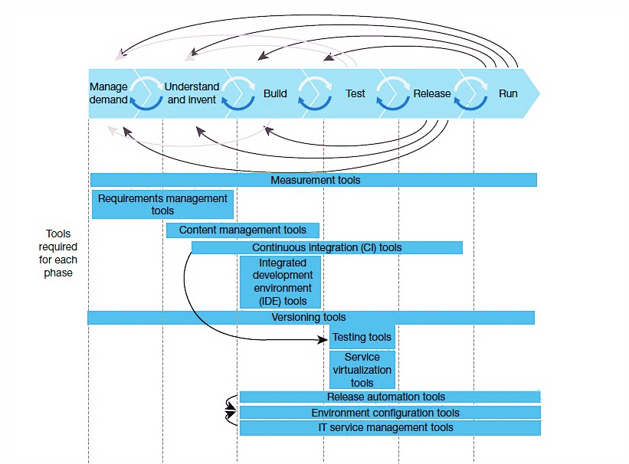
Supporting a Modern Product Lifecycle
Version Management is one of the only systems used throughout the entire product lifecycle.

Slide 9
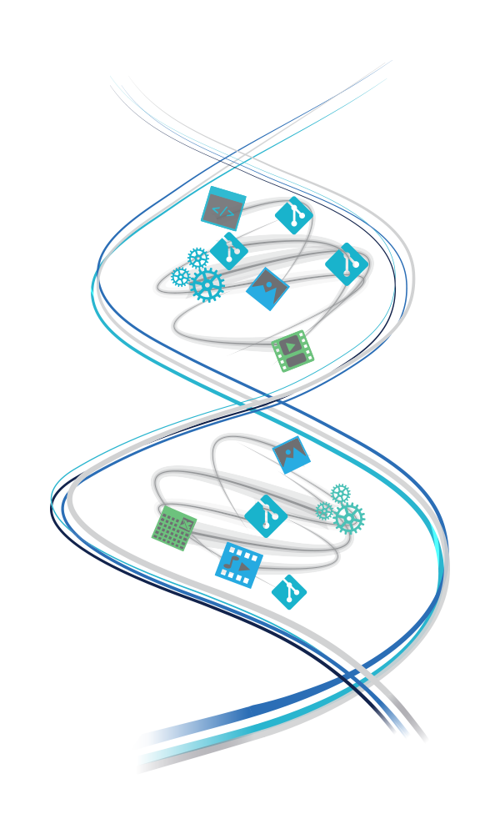
Perforce Helix
Hybrid Workflows
Distributed & Centralized Version control, code reviews, simple file sharing
Happy developers & contributors
Every File
Efficiently handles large, often binary, data
DevOps Stay Happy & Productive
A mainline source for all builds even with distributed development
All IP Safe & Secure
Granular permissions, theft risk monitoring
CONSUMERS
CONTRIBUTORS

Slide 10
Continuous Delivery Demo
Notes:
I’m now going to give you an overview of what we will show in the demo.

Slide 11
What’s New in Perforce Helix?

Slide 12
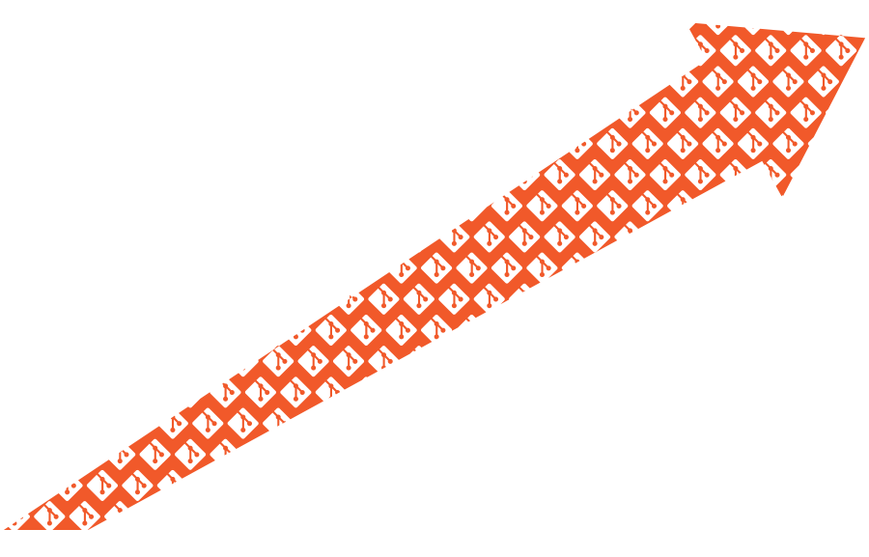
Git is a Very Popular 10-Year-Old
69.3%
of developers use Git
— 2015 Stack Overflow Developer Survey
2005
2015

Slide 13
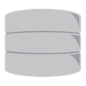
Hybrid Version Management

Slide 14
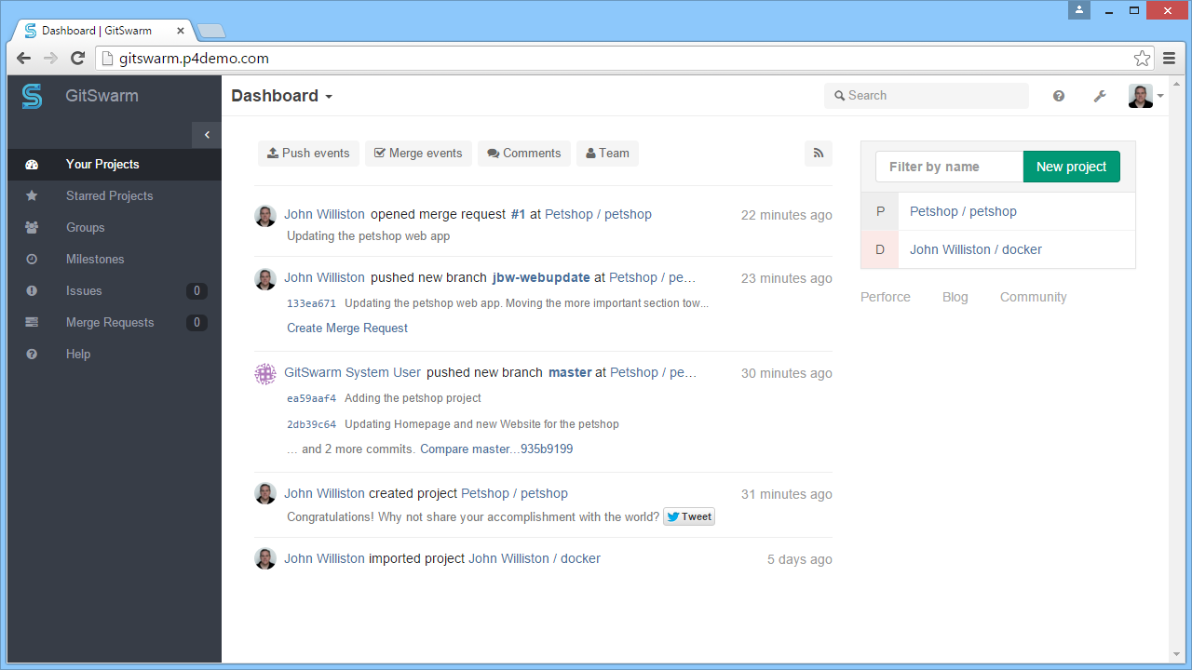
GitSwarm: Integrated Git Management
Self-service repos
Merge requests
Permissions
Issue tracking, etc.
Powered by GitLab

Slide 15
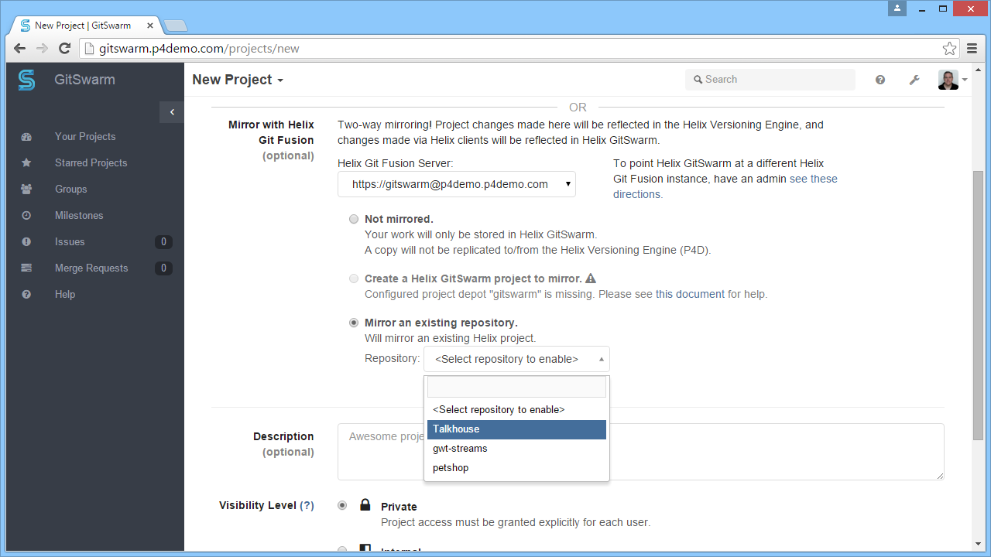
Mirrored to the Helix Versioning Engine
Automatic mirroring with the shared Helix server
Helix enforces security – traditional Perforce protection down to the file level, maintains immutable audit trail
Work with narrow clones from the Helix depot

Slide 16
Distributed Team Support
Each developer team working within its own GitSwarm ecosystem
Each team has controlled access to IP managed within Helix core
Team can access only what they need to do their job

Slide 17
Helix Threat Detection
Threats Detected in Real-Time & Scored by Risk
Threat Detection Engine
USER
INTERFACE
Logs with No Performance Impact
ANALYZE
DETECT THREATS
SCORE RISKS
Highest Risk Data
Highest Risk Devices
Highest Risk Activity
Highest Risk Users
Timestamp
User
Action (commit, sync, get, etc.)
Resource (folder, file, path, etc.)
AGGREGATE
REST API
Threat Detection Agent
Runs Hidden
Sends Metadata
No Device Impact
Delivers Predictive
Provides Investigation
Outputs in Plain Language
Scales to Thousands of Users
ONLINE
REPORTING
Notes:
This diagram describes the data flow (inputs and outputs and how things work). Helix Threat Detection has 3 components (Connector, Agent, and Engine).
Fine-grained user activity is fed through a Threat Detection Connector to the Threat Detection Engine. There are 5 elements that are used from the logs (as shown). A month (or more) of historical data can be loaded into the engine to be aggregated and analyzed to establish patterns of baseline behavior.
The Threat Detection Engine continuously monitors all IP-related interactions with the Helix environment, applies the behavioral analysis models and entity-based risk scores to detect anomalous behavior and potential threats. The Threat Detection Engine proactively surfaces the highest risk data, devices, activity, and accounts (it’s possible for user accounts to be taken over or compromised). It can process tens of millions of events across tens of thousands of users to generate a prioritized list of the highest-risk accounts, data, and projects.
A GUI interface clearly identifies threats in plain English and there is also online reporting (automatic generation of executive summary reports).
A REST API that allows you to interface to other systems, to a SIEM or Security Operations Center. For example, if someone is taking Perforce log data and putting it into a SIEM, you can take the data out of the SIEM. Can either take the data directly or through other tools.
The Threat Detection Agent is optional. Once threats have been identified, then it’s possible to load a threat detection agent to monitor offline activities on the endpoint, which is sent as metadata to the Threat Detection Engine. The agent runs hidden - it’s obfuscated - and is available for Mac and Windows desktops and laptops.

Slide 18
Data & risky behaviors
Log Data
Timestamp (Date/Time)
User
Resource (Folder Structure)
Action (Give/Take)
Item Number
Client
Size
Wandering
Accessing content that they don’t normally access
e.g.: It was unusual for John Smith to take from project 54
Sneaking
Active outside of their normal working times of day or days of week
e.g.: John Smith kept unusual working hours
Moocher
Taking unexpectedly large amounts of content, while contributing very little
e.g.: John Smith mooched from project 54
Hoarder
Taking more than expected, compared to self or others
e.g.: John Smith took a large amount compared to other people
Notes:
Helix Log Data drives the Helix Threat Detection Analytics.
- Helix log data enables the analytics engine to compute risk scores using the 4 components described earlier, and applying that concept with over 20 different analytical models
The behavioral categories are:
Wandering – accounts that are accessing surprising content that they don’t normally access
Sneaking – accounts that are active outside of their normal working patterns
Mooching – accounts that are taking unexpectedly large amounts of content, while contributing very little
Hoarding – accounts that are taking more than expected, compared to others similar to them
Each category of behavior has multiple behavioral models rolling up into it. For example, wandering models include multiple models that determine when users access from abnormal projects. And sneaking models monitor when it is unusual for someone to be working, whether it is an abnormal time of day, or an abnormal day of the week.
In addition to measuring behavior risk, Interset also measures entity risk. This is an important set of models that helps focus attention on the most significant risks.

Slide 19
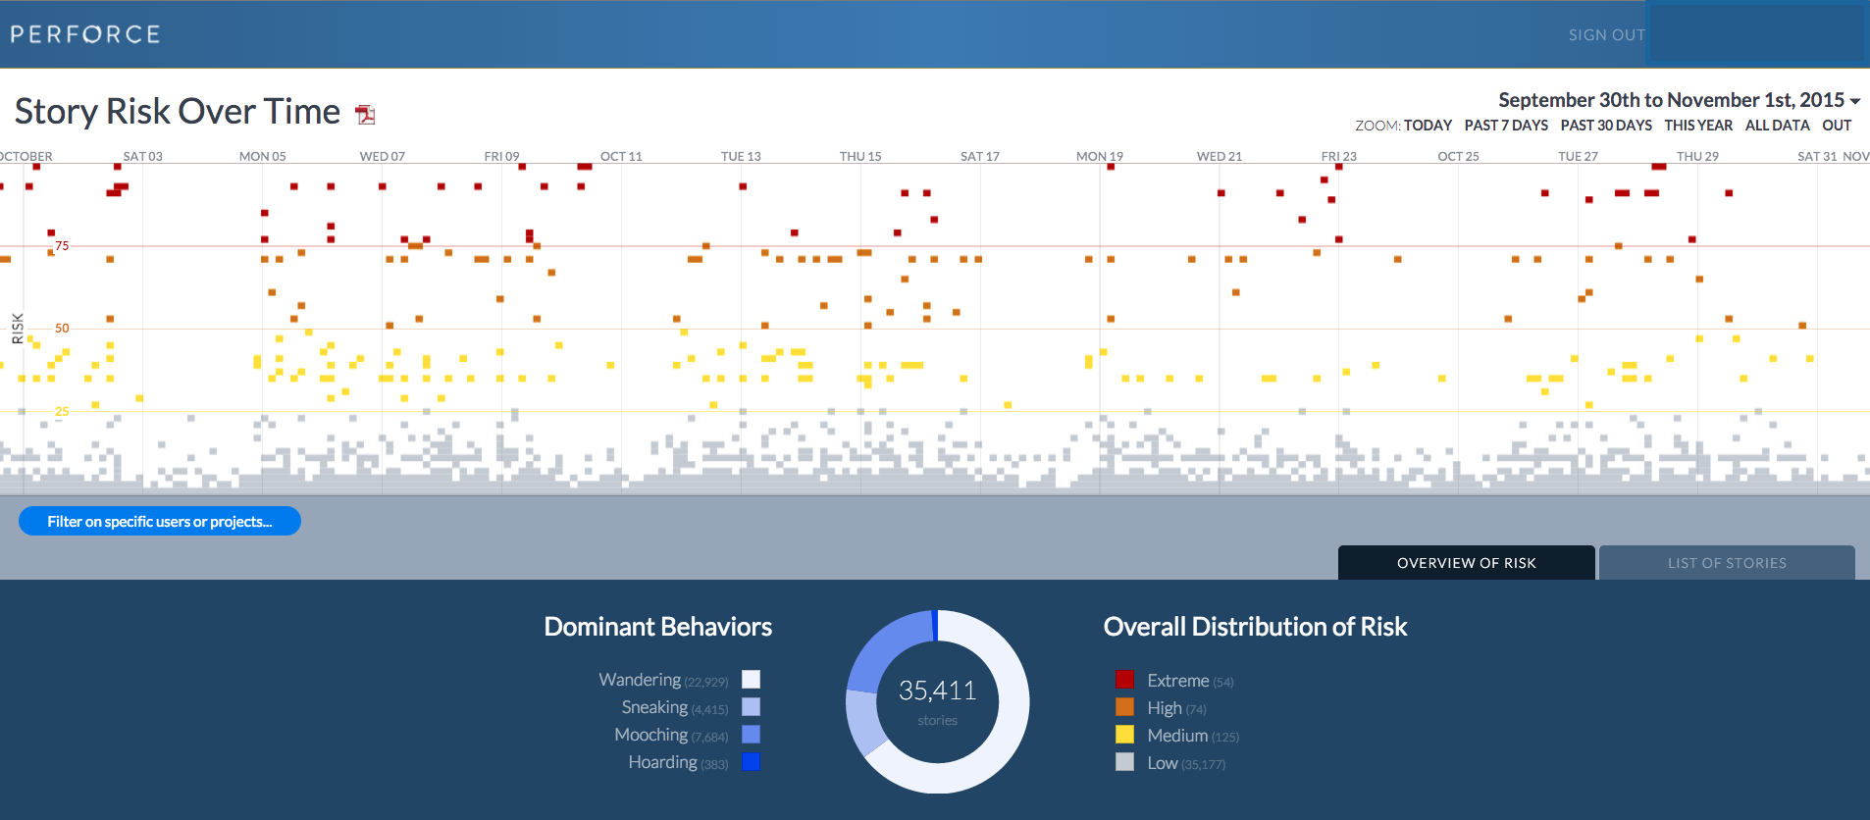
Data & risky behaviors - Dashboard
Notes:
Helix Log Data drives the Helix Threat Detection Analytics.
- Helix log data enables the analytics engine to compute risk scores using the 4 components described earlier, and applying that concept with over 20 different analytical models
The behavioral categories are:
Wandering – accounts that are accessing surprising content that they don’t normally access
Sneaking – accounts that are active outside of their normal working patterns
Mooching – accounts that are taking unexpectedly large amounts of content, while contributing very little
Hoarding – accounts that are taking more than expected, compared to others similar to them
Each category of behavior has multiple behavioral models rolling up into it. For example, wandering models include multiple models that determine when users access from abnormal projects. And sneaking models monitor when it is unusual for someone to be working, whether it is an abnormal time of day, or an abnormal day of the week.
In addition to measuring behavior risk, Interset also measures entity risk. This is an important set of models that helps focus attention on the most significant risks.

Slide 20
Example - Customer: $20B manufacturer
THREAT
DETECTION
X
1 YEAR
2 WEEKS
$1 million spent
Large security vendor failed to find anything
Found 3 additional users stealing data at HQ
2 engineers stole data
Easily identified the 2 remote engineers
Found 8 additional users stealing data from another global location
Notes:
Telling the story in a short version:
Company came to us after they found 2 engineers had stolen a large amount of very high value data
The company spent a year and over a million dollars working with a traditional security player and were unable to deploy a tool that would have detected these two engineers - traditional approaches failed.
They were a Perforce customer and approached Interset and Perforce to see if analytics could be the answer.
The company sent us 30 days of log data, including the theft by these users, to see if we could surface the attack – and it was easy. In two weeks, we had clearly defined the attacks of these two users. We also discovered 11 others that were stealing from them – they had no idea. Three in North America – action has been taken against them – and eight in China currently being investigated.
It is important to understand that the company was struggling with two problems
They had no visibility into the activities in their Perforce environment. They could not see if users were stealing data – or any risky activity
The company had over 20K developers – that means the 30 days of logs contained millions of events that occurred in the Perforce system.
Behavioral analytics was able to collect, correlate, analyze and score all of those events. The result – the users doing bad things scored the highest risk…. And were found.
We can solve the really hard threat problems – we can see things other tools cannot see. How? ...
Other Anecdotes:
Four engineers from a large company over a period of time stole a lot of data when they left the company and went to a competitor. It took this company almost nine months to determine what had happened afterwards. They found out from a 3rd party, a partner of both companies, that suddenly some of the things started looking the same. They were seeing some of the same design specs and the same training manuals were showing up. When they went back and looked, sure enough they found out that this attack had taken place.
Helix Threat Detection could have discovered this suspicious activity while it was happening, tell you exactly who to looked at what, and what to worry about. And you can dig in and look at the activity in terms of a time period, from a person, or from the perspective of a project or file folder structure, and prevent the data theft.
A large company kept inactive projects accessible for a long time. An insider breached the source code of these open projects, and this was undiscovered until many years later when a similar game was observed running and available in China.

Slide 21
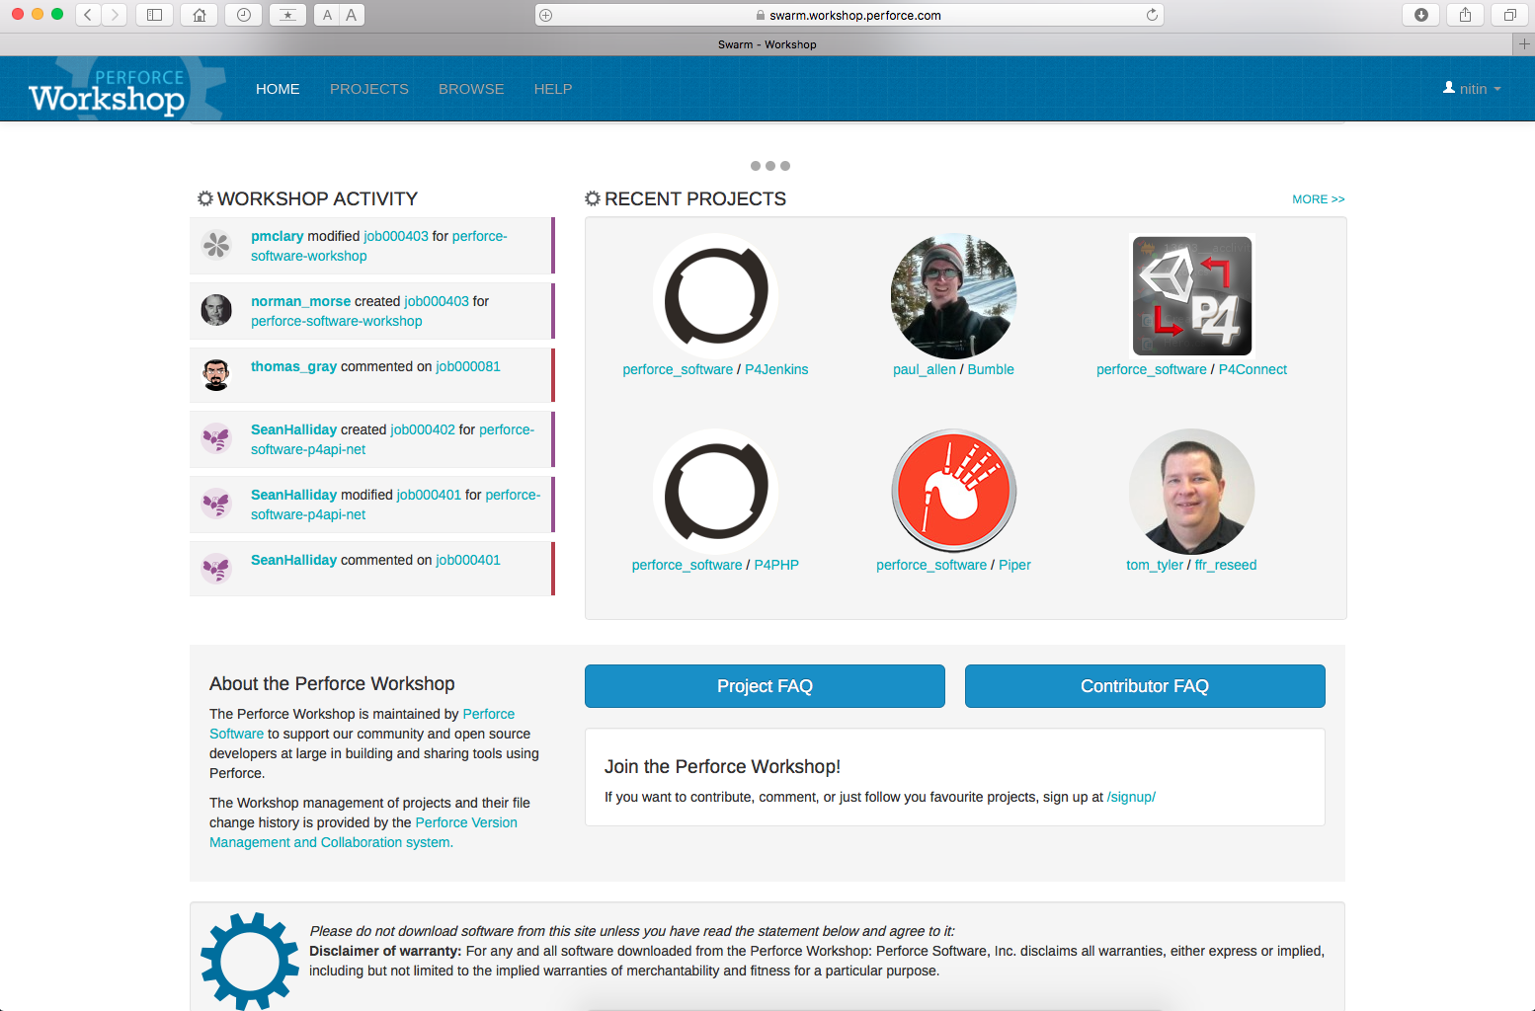
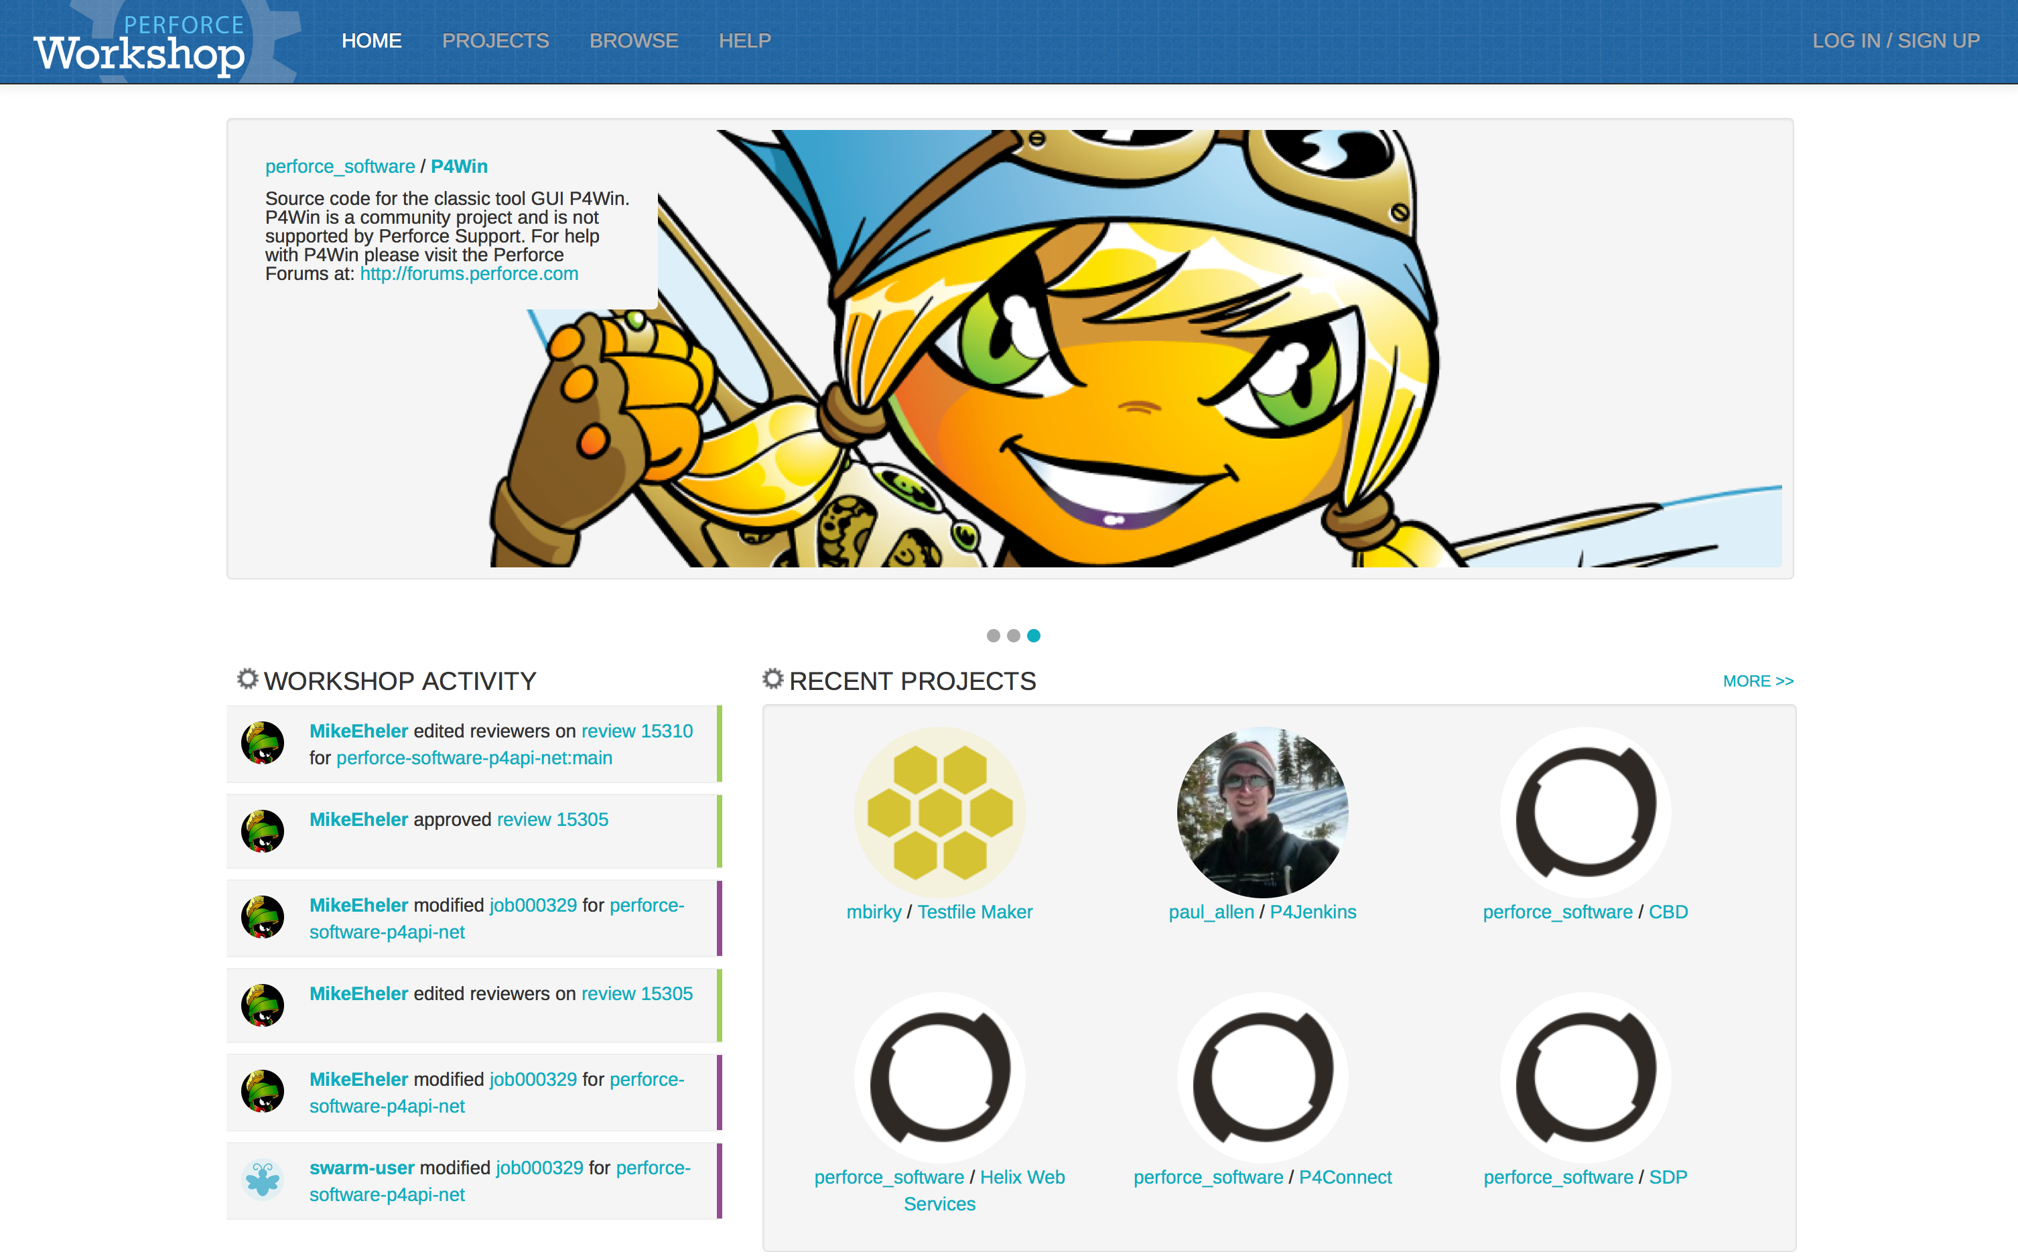
Perforce Community
workshop.perforce.com
Community forums and hangout
User-contributed code, integrations, plugins

Slide 22
Questions?

Slide 23
Thank You
Nitin Pathak
npathak@perforce.com

