Slide 1
The Lego Model of Machine Learning
Leah McGuire, PhD
Senior Member of Technical Staff

Slide 2
What I am going to talk about:
Blah blah blah. Blah
In case you are curious… or want to take a nap.
Machine learning use cases
How to build a machine learning workflow
The boring repetitive parts and what we can do about them
Abstractions around machine learning (with a Scala Spark focus)
Prediction IO
Spark ML
Keystone ML
What we used from these examples
What we added to these examples
Our machine learning platform with example interfaces
The important lessons from building our machine learning platform
z
z
z
Notes:
In case you are tired and doze off I will outline now so you can figure out what I’m babling on about

Slide 3
The magical panacea that is machine learning…
Or not.
Definition: Machine Learning
“Machine learning algorithms can figure out how to perform important tasks by generalizing from examples. This is often feasible and cost-effective where manual programing is not. As more data becomes available, more ambitious problems can be tackled. As a result, machine learning is widely used in computer science and other fields. However, developing successful machine learning applications requires a substantial amount of ‘black art’ that is hard to find in text books” – Pedro Domingos, U of Washington, A Few Useful Things to Know about Machine Learning.
ML is not magic, just statistics – generalizing examples
But what is this ‘black art’?
You cant just throw a ml algorithm at your raw data and expect good results
Different types of problems require different algorithms
Data needs to be: 1) cleaned so that ‘bad’ data is removed 2) manipulated so that the most predictive features are available 3) put into the correct format

Slide 4
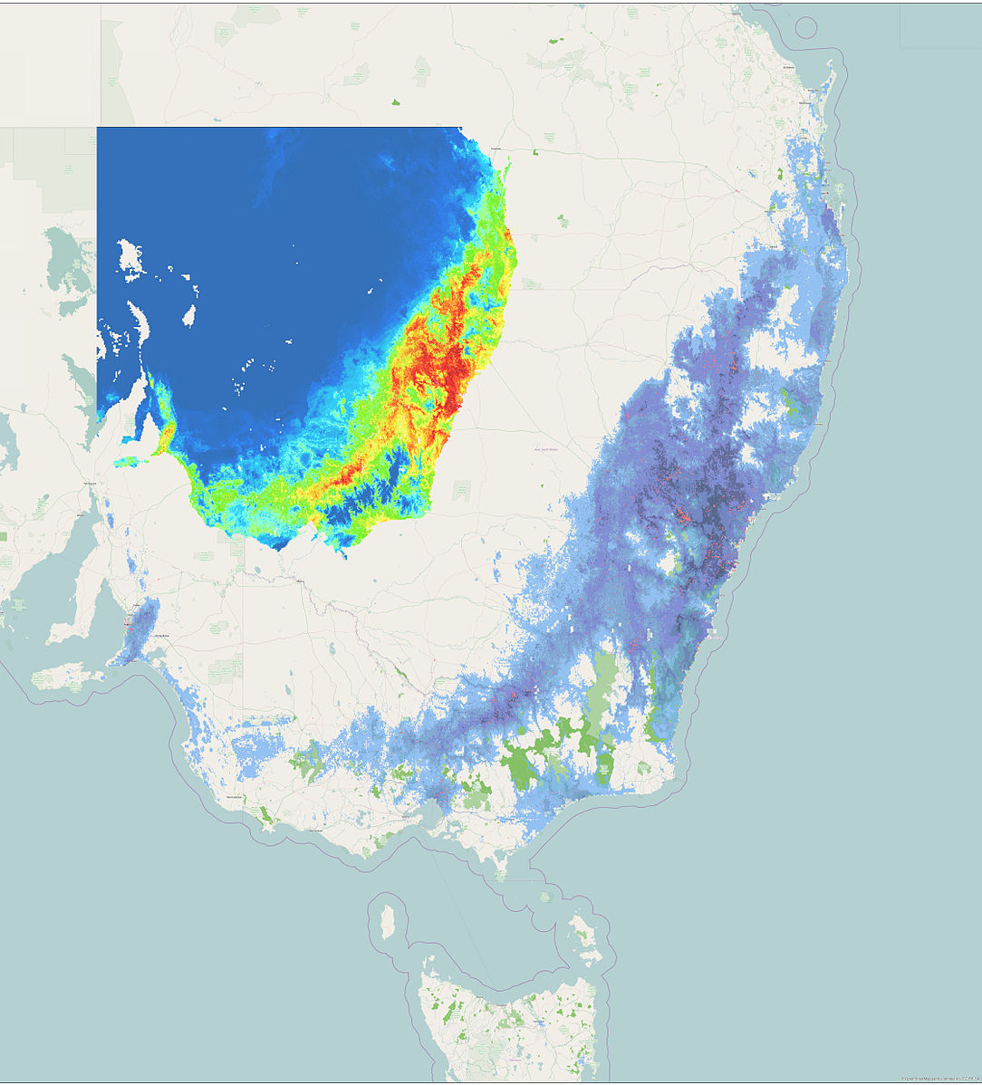
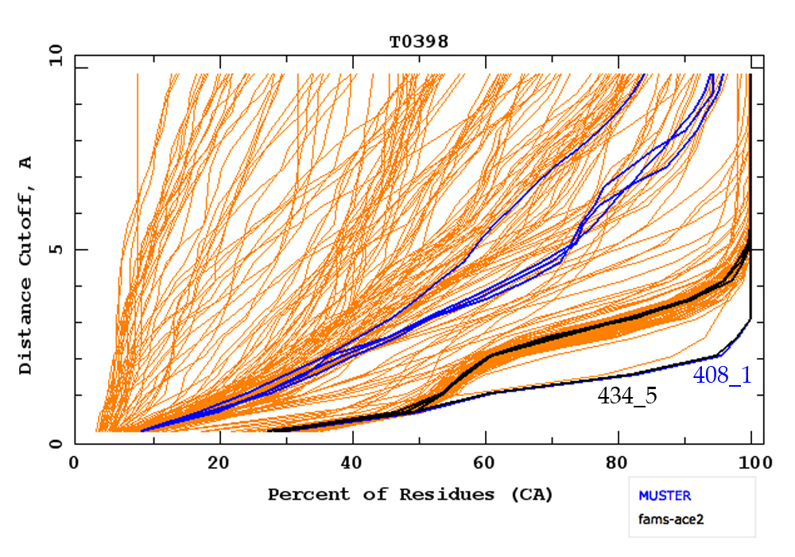
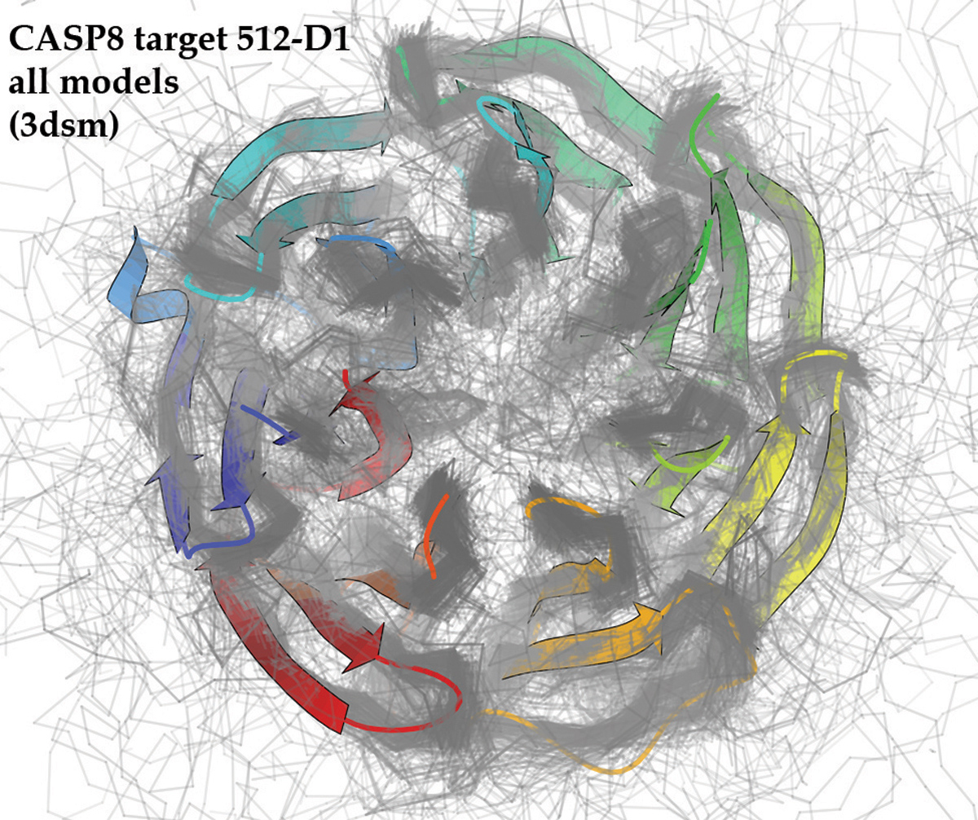
What you can do with machine learning
Predictive modeling
Notes:
Predict trends, 3d structure of protein from 1D sequence of Amino acids, predict the weather

Slide 5
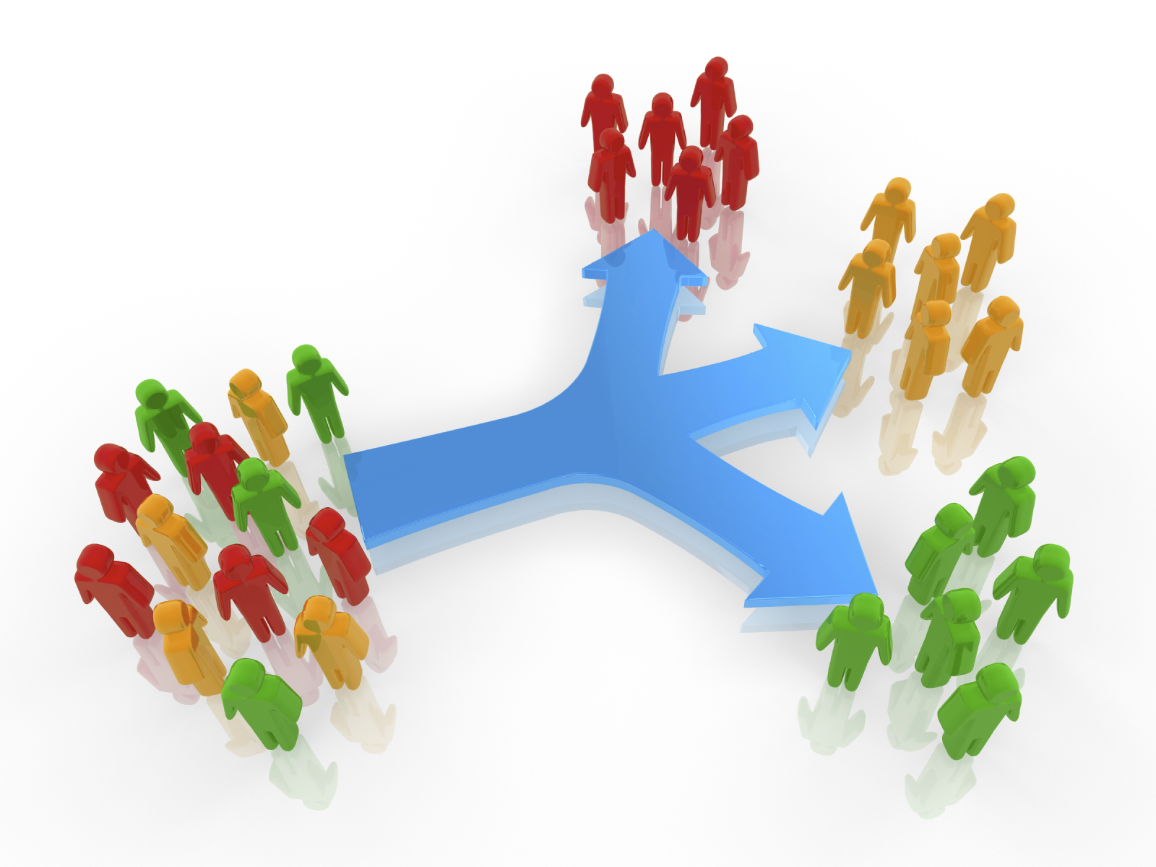
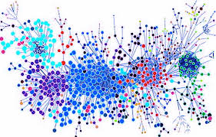
What you can do with machine learning
Intelligent segmentation
Notes:
Segment based on behavior to learn interesting things about your users
Divide networks into subgroups that encompass most interactions for easier computation

Slide 6
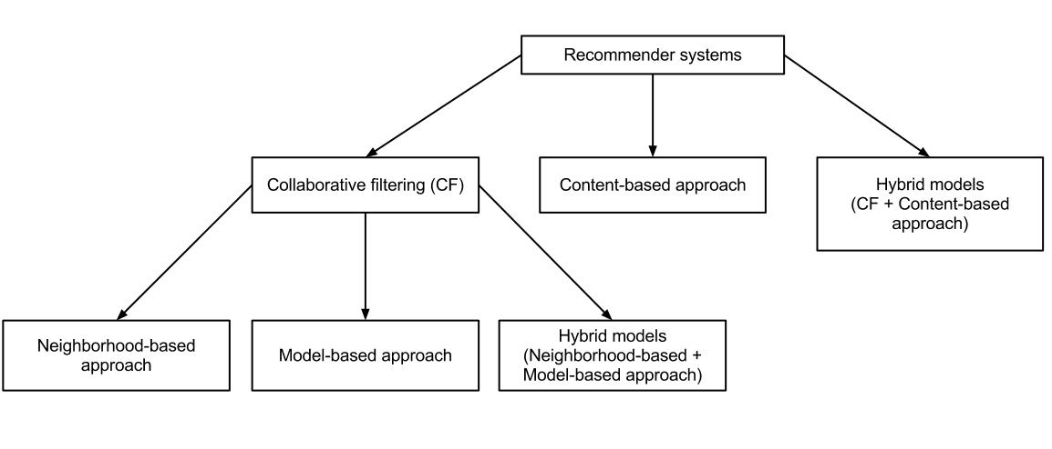
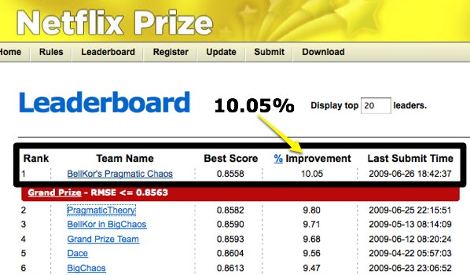
What you can do with machine learning
Personalization and Recommendations
Notes:
Personalization
Can use knowledge about what people liked and didn’t like
Use that knowlegde to make models based either on people with similar likes or information about the items or people to make personalized experience

Slide 7
Building a machine learning model
What Kaggle would lead us to believe
Model A
Data
Source
Feature Engineering
Evaluation
Model B
Model C

Slide 8
Building a machine learning model
The industry reality
Feature Engineering
Model Fitting
Evaluation 1
Data
ETL
Feature Trans-formations
Feature Extraction
Model A
Evaluation 2
Feature Engineering
Model B
Data
Source
Data
Source
Feature Engineering
Model C
Production-alization /
Scoring
Data
Source
Data
Source

Slide 9
Building a machine learning model
Over and over again
Data
Source
Data
Source
Data
Source
Data
Source
Source
Source

Slide 10
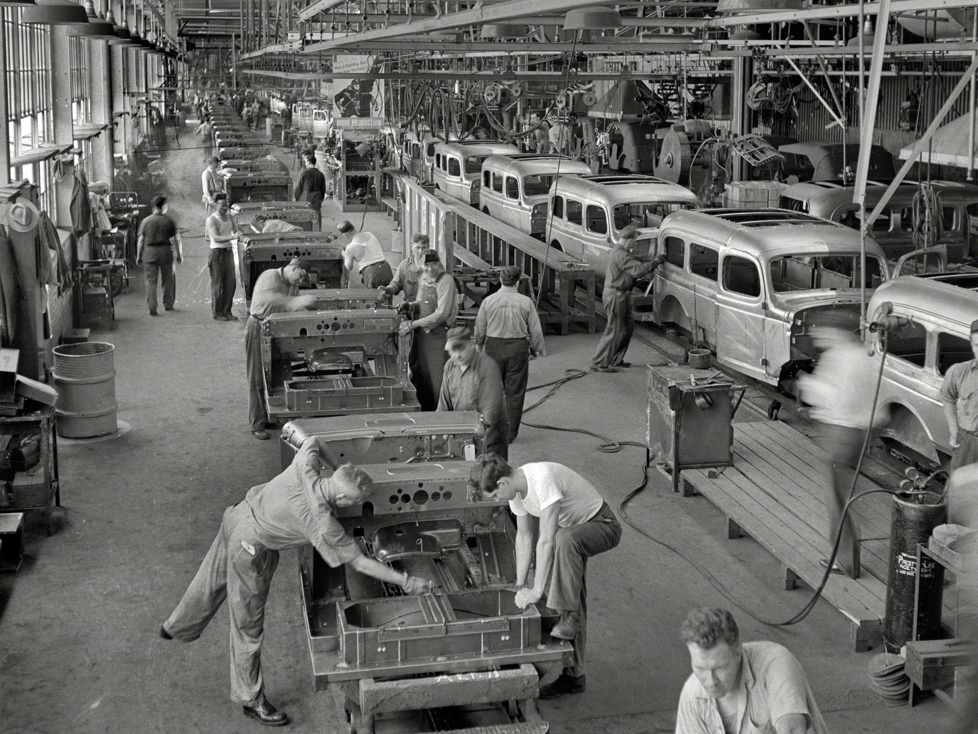
Building a machine learning model
Making the pieces reusable and minimizing time per model
Most of the time goes into data manipulation (80-95% depending on who you talk to)
Cleaning data
Changing the format
Combining and transforming features
So make as much of this as possible reusable
This means make each manipulation modular
More structure = more code re-use
Can make models and evaluation more utilitarian by wrapping them in interfaces that take a standard data input
Unless you are doing something super specialized hopefully you are not writing your own models

Slide 11
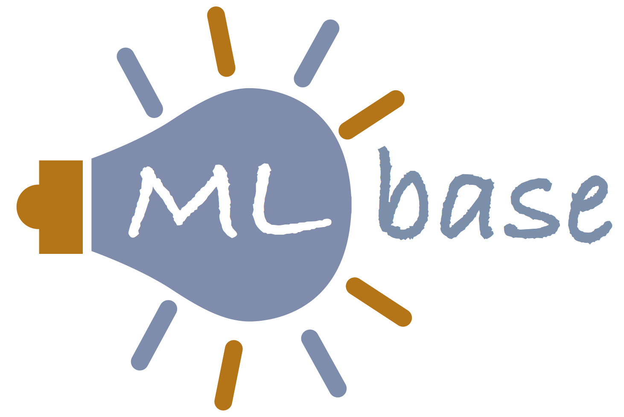
We are not the first people to think of this

Slide 12
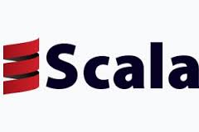
Choosing your tool set limits the options
We chose Spark and Scala. Because …
Spark is great
Map reduce has a lot of overhead for iterative processes, in memory with Spark is better
Has good ML libraries (MLlib, ML, KeystoneML, GraphX)
Simple to productionalize models if they are built in the same system they are used in
Scala and Java are the languages with the best spark support
Scala is WAY less verbose than Java
More fun to write
Functional is nice
Type safe makes life better (most of the time)

Slide 13
Even if you limit search to Spark there are options
Not personally a fan of re-inventing the wheel
ML
KeystoneML
Not MLlib – ML, build for constructing pipelines
Uniform set of high level APIs
Wraps MLlib models – though this is changing
Build on DataFrames not RDDs
Product of UCB AMP Lab
Similar design to Spark ML
Improvements in type safety and chaining
Has its own set of models included – cover different ground than spark MLlib
Machine learning server for building and deploying predictive applications
Uses “DASE” architecture – Data Source, Data Preparator, Algorithms, Serving, Evaluation
Compartmentalized so can swap algorithms

Slide 14
Spark ML
ML
The basics
Why not?
DataFrames are not quite there
Missing a lot of RDD functionality
Type system is meh
ML requires vector type which is not well integrated
Transformers are deterministic and limited in scope
Need exact schema expected
Really designed to append a column
Intended to string together sequentially
Does not deal with how you are getting your data in or out at all
Spark ML standardizes APIs for machine learning algorithms to make it easier to combine multiple algorithms into a single pipeline, or workflow.
DataFrame: Spark ML uses DataFrame from Spark SQL as an ML dataset, which can hold a variety of data types.
Transformer: A Transformer is an algorithm which can transform one DataFrame into another DataFrame.
Estimator: An Estimator is an algorithm which can be fit on a DataFrame to produce a Transformer.
Pipeline: A Pipeline chains multiple Transformers and Estimators together to specify an ML workflow.
Parameter: All Transformers and Estimators now share a common API for specifying parameters.

Slide 15
Keystone ML
KeystoneML
The basics
KeystoneML is a framework for building and deploying ml pipelines. It is built on several design principles: supporting end-to-end workflows, type safety, horizontal scalability, and composibility.
Nodes (Transformers and Estimators) - Transformers are nodes which provide a unary function interface for both single items and RDD of the same type of item, while an Estimator produces a Transformer based on some training data.
Pipelines - A dataflow that takes some input data and maps it to some output data through a series of nodes.
Data Loaders - The entry point for your data into a batch training pipeline.
Evaluators - Utilities for evaluating models once they’ve been trained.
Why not?
Still designed to chain together sequential transformations
The models included are less general than spark ML models (computer vision and language processing)
Still mostly focuses on the modeling without much on where data is from or going

Slide 16
Prediction IO
The basics
Open source machine learning server, installed as a full machine learning stack, to simplify and accelerate ml infrastructure management
Bundled with Apache Spark, MLlib, Hbase, Spray and Elasticsearch
Customizable templates for a quick start
Support machine learning and data processing libraries such as Spark MLlib and OpenNLP
Evaluate and tune multiple engine variants systematically
Simplify data infrastructure management with Event Server
Respond to dynamic queries in real-time once deployed as a web service
Why not?
Bundled with a lot of stuff
Nice if you are just starting off but what if you have your own infrastructure?
Hard to change and or remove the Event Server and Prediction Engine
Not simple to put in real feature engineering
Easy to end up rewriting all transformations for every workflow
Workflow development is constrained
The pieces can’t really be moved or changed

Slide 17
General lesions we will use
Very interesting…
So what have we learned?
Reusable pieces are VERY important
Figure out all your steps and make simple base classes according to that outline
Type safety is good
Model fitting returns an object that transforms the data by scoring
Uniform way of passing in parameters
Including evaluation makes life easier
Important to think about more than just the modeling, also need to interact with data in and out

Slide 18
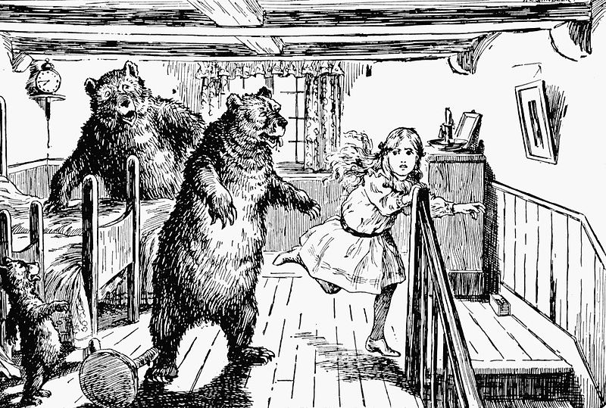
What we didn’t like or felt was missing
This porridge is too hot. This porridge is too cold. This porridge is just right!
Prefer RDDs to DataFrames
Want to be able to bundle transformations so don’t have to string them together
Want to be able to use a lot of model libraries if possible – avoid rewriting models
Its best if pieces can function outside the framework as well as inside
Try not to have too many pieces that cannot be changed or removed
Have in and out connectors that are general enough to take in data from many sources and spit out to different outputs

Slide 19
The pieces
ETL is not included…
Workflow
Feature Extractor
Transformation Plan
Feature engineering and manipulation
Model Selector
Data Writer
Put data in final format
Put data in final location
Data Reader
Feature Transformation
Preparator
Feature Aggregator
Sanity Check
or
Feature Getter
Fit Model

Slide 20
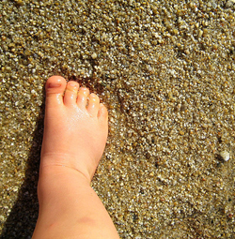
Feature Extractors
Feature Extractor
Data Reader
The first step in making each step re-usable is to put things in a standard format
Feature Aggregator
or
Extractors function as an interface between the data and our framework
They are generally defined one per data source
Multiple extractors can be used in a single workflow
Data going in can look like anything – data coming out must be in the format used in the framework
The data conversion is achieved in several stages
Data is read and a specific type of record is returned
Events are defined for that record type
Events are used to extract features for each row
Features are combined to give a single feature vector for each entity to be scored
Feature Getter
First Step

Slide 21
Feature Extractors
Feature Extractor
Data Reader
Data Readers
Really just want to load up the data here
Can do simple manipulations and joins
Ideally complex data joins and processing are done in separate ETL jobs
Data must contain the key for entity want to score when returned
Feature Aggregator
or
Feature Getter
/** * Reader for data files, * @tparam type of data records */
abstract class DataReader[T] extends Serializable {
def getPath(pathInfo: Map[String, String]): String def load(implicit params: WorkflowParams, sc: SparkContext): RDD[T]
}

Slide 22
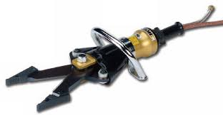
Feature Extractors
Feature Extractor
Data Reader
Feature Getters and Aggregators
Need to define how to turn the data from the record into our standardized feature types
For Getters that is really all there is to it – good for flat files
For Aggregators this is slightly complicated by the “aggregation”
Define timed events and filters to determine how things are combined
These are designed for daily, hourly, streamed, etc. records
Feature Aggregator
or
Feature Getter
/** * The base trait for feature getters and aggregators * @tparam I input * @tparam O output */ trait TransformerLike[-I, +O] extends Serializable { def transform(value: I)(implicit params: ExtractorParams): O }

Slide 23
Feature Extractors
Feature Extractor
Data Reader
Take the value for each feature in a row and put in our format
This all looks fairly standard, why are we doing it?
To make sure that all our data looks the same no matter where it came from!
Feature Aggregator
or
Feature Getter

Slide 24
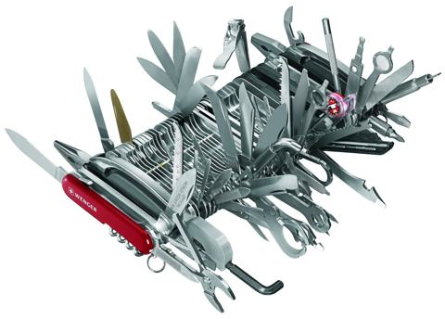
Feature Extractors
Feature Extractor
type Numeric = Double type NullableNumeric = Option[Double] type Categorical = Set[String] type Text = Option[String] type Binary = Option[Boolean] type DateList = Seq[Long] type KeyString = Map[String, String] type KeyNumeric = Map[String, Double]
Data Reader
The features
Feature Aggregator
or
Feature Getter
case class Feature[+T](name: FeatureName, value: T, settings: FeatureSettings = FeatureSettings()) extends Serializable
class KeyedFeatureVector(val key: String, val features: Map[FeatureName, Feature[_]]) _extends Serializable { def get[T](name: FeatureName) = getFeature[T](name).value def getFeature[T](name: FeatureName) = features(name).asInstanceOf[Feature[T]] def getFinalFeatures: Iterable[Feature[_]] = features.values.filter(_.settings.isFinal) def getFinalVector = KeyedFeatureVector.fromIterable(key, getFinalFeatures) }

Slide 25
The pieces
ETL is not included…
Workflow
Feature Extractor
Transformation Plan
Feature engineering and manipulation
Model Selector
Data Writer
Put data in final format
Put data in final location
Data Reader
Feature Transformation
Preparator
Feature Aggregator
Sanity Check
or
Feature Getter
Fit Model

Slide 26
Feature Transformers
Transformation Plan
Feature engineering and manipulation
Feature Transformation
Feature engineering is a large part of building a good model
There are many types of transformations that we may want to perform
Mathematical – Log, Normalize, Cap …
Expansion – Pivot, Bin, TFIDF …
Reduction – Hash, Minimum Requirements …
Combination – Interaction, Similarity …
Time – Days Since, Weeks Since, Occurred on ..
On the plus side these can be abstracted to be reusable
What we want is to be able to just map the features we want to transform to the transformations we want to make
Clicks -> Log
Date_Joined -> Days_Ago

Slide 27
Feature Transformers
Transformation Plan
Feature engineering and manipulation
Feature Transformation
Need to define these transformations in a generalizable way
Old feature goes in new feature, or sequence of features, comes out
Need a unique identifier for each transformation
Want to be able to chain these together arbitrarily, but run as efficiently as possible
Some are as simple as applying the same function to the feature value for each row
Some require full knowledge of all values for that features column
trait FeatureTransformer extends Serializable with Logging { val featureName: FeatureName val derivedFeatureName: FeatureName val inFinalOutput: Boolean _def key: FeatureName = s"$featureName to $derivedFeatureName” }

Slide 28
Feature Transformers
Transformation Plan
Feature engineering and manipulation
Feature Transformation
Need to define these transformations in a generalizable way
/** * Simple transformer is a transformation that passes only once over the data */ trait SimpleTransformer extends FeatureTransformer { protected def vectorGet[T](vector: KeyedFeatureVector, key: FeatureName) = vector.get[T](key) def transformVector(vector: KeyedFeatureVector): Seq[AnyFeature] }
/** * Aggregator transformers is a two stage transformer. The first stage performs an aggregation over the feature. Second -* stage is to combine the original feature with the result of the aggregation. * @tparam T type of original feature * @tparam U type of intermediate aggregation step * @tparam V type of the value to be combined with */ abstract class AggregatorTransformerBase[T: ClassTag, U: ClassTag, V: ClassTag] extends FeatureTransformer with Aggregator[T, U, V] { def combineFeaturesToMany(f1: Feature[T], f2: V): Seq[AnyFeature] def transformVector(vector: KeyedFeatureVector, broadcastMap: Broadcast[Map[FeatureName, Any]]): Seq[AnyFeature] = combineFeaturesToMany(vector.getFeature[T](featureName), broadcastMap.value(key).asInstanceOf[V]) }
Aggregator = Twitter Algebird:
prepare, reduce, present

Slide 29
Feature Transformers
Transformation Plan
Feature engineering and manipulation
Feature Transformation
Need to automatically execute these transformations correctly
Transformations:
Clicks -> Log
Opens -> Log
Opens + Sends -> Divide
Clicks + Sends -> Divide
SubjectLinesResponsedTo -> TFIDF
SubjectLinesNotRespondedTo -> TFIDF
SubjectLinesResponsedTo_TFIDF + SubjectLinesNotRespondedTo_TFIDF -> Similarity
Transformation Plan

Slide 30
Feature Transformers
Transformation Plan
Feature engineering and manipulation
Feature Transformation
Need to automatically execute these transformations correctly
object TransformationPlan extends Serializable { def fromTransformers(transformers: Seq[FeatureTransformer]): TransformationPlan = { val transformersMap = transformers.groupBy(_.featureName) def namesToStages(names: collection.Set[FeatureName]) = TransformationStage.fromTransformers(names.flatMap(transformersMap.get).toSeq.flatten) val edges = transformers.flatMap{ case t: BinaryDerivedTransformer[_, _] => Seq( Edge(t.featureName, t.derivedFeatureName), Edge(t.otherFeatureName, t.derivedFeatureName) ) case t => Seq(Edge(t.featureName, t.derivedFeatureName)) } val graph = Graph.fromEdgeList(edges) val stages = graph.topologicalClustering TransformationPlan(stages.flatMap(namesToStages)) } }

Slide 31
Feature Transformers
Transformation Plan
Feature engineering and manipulation
Feature Transformation
What you write and what you get
A sequence of transformations, generated by mapping over the features names that need that transformation
A brand new set of features that have been explicitly transformed (even if just with identity)
Key | Clicks | State
A | 0 | CA
B | 5 | NM
C | 1 | TX
Key | Clicks_Log | State_CA | State_NM
A | 0.0 | 1 | 0
B | 1.791759 | 0 | 1
C | 0.693147 | 0 | 0

Slide 32
The pieces
ETL is not included…
Workflow
Feature Extractor
Transformation Plan
Feature engineering and manipulation
Model Selector
Data Writer
Put data in final format
Put data in final location
Data Reader
Feature Transformation
Preparator
Feature Aggregator
Sanity Check
or
Feature Getter
Fit Model

Slide 33
Model Selectors
Model Selector
Preparator
Make a uniform interface for all machine learning models
Sanity Check
Want to be able to switch models easily
Need to get the data in the correct format for whatever library or model
Have to be able to store and load fit model for later use
Fit Model
/** * Wrapper around model fitting * @tparam ModelOut is the type of the output model * @tparam Data is the type of data the fit model will output */ trait ModelSelector[ModelOut <: FittedModel[_, Data], Data] extends Serializable with Logging { def prepareData(dataset: NumericTrainingData, checkData: Boolean = false) (implicit sc: SparkContext, params: WorkflowParams): PredictiveDataset def fit(dataset: NumericTrainingData) (implicit sc: SparkContext, params: WorkflowParams): ModelOut def loadModel(path: String)(sc: SparkContext, implicit params: WorkflowParams): ModelOut }

Slide 34
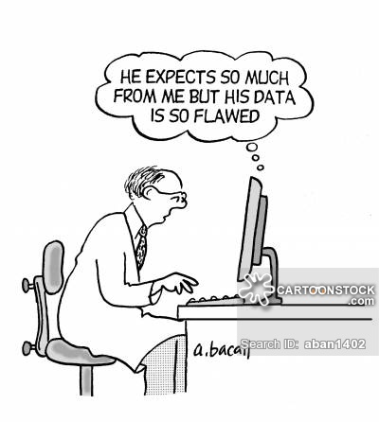
Model Selectors
Model Selector
Preparator
Nice things to have
Sanity Check
Preparator - If multiple models need the same data manipulation make the preparator its own class which can be shared
Sanity Checker - Its good to check your data before fitting the model
Make sure there is no label leakage
Make sure your features have the values / ranges you expect
This check can also be a re-usable class
Fit Model

Slide 35
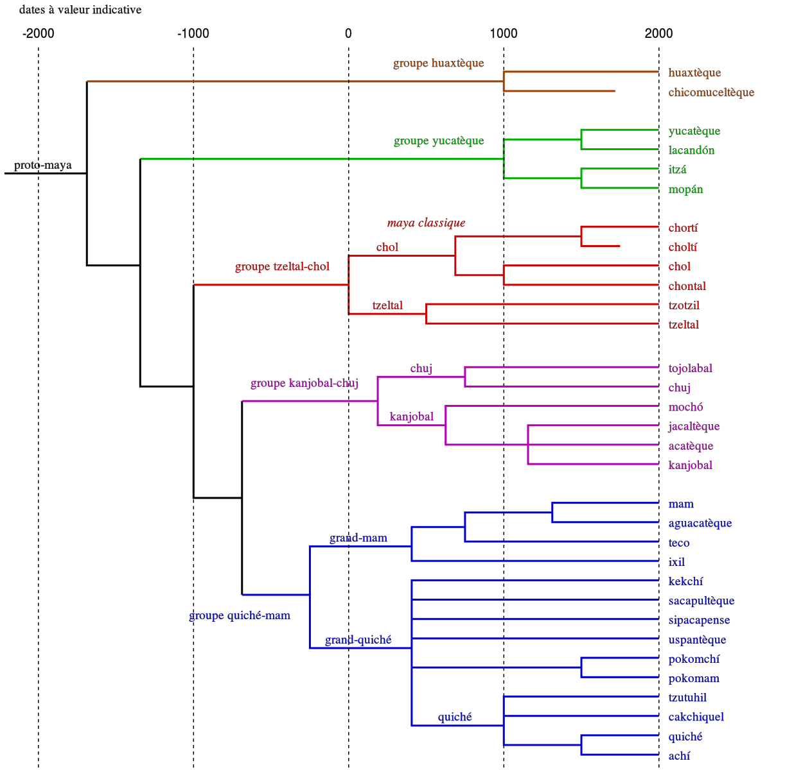
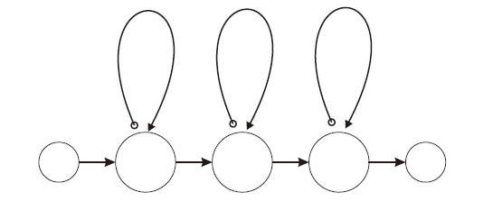
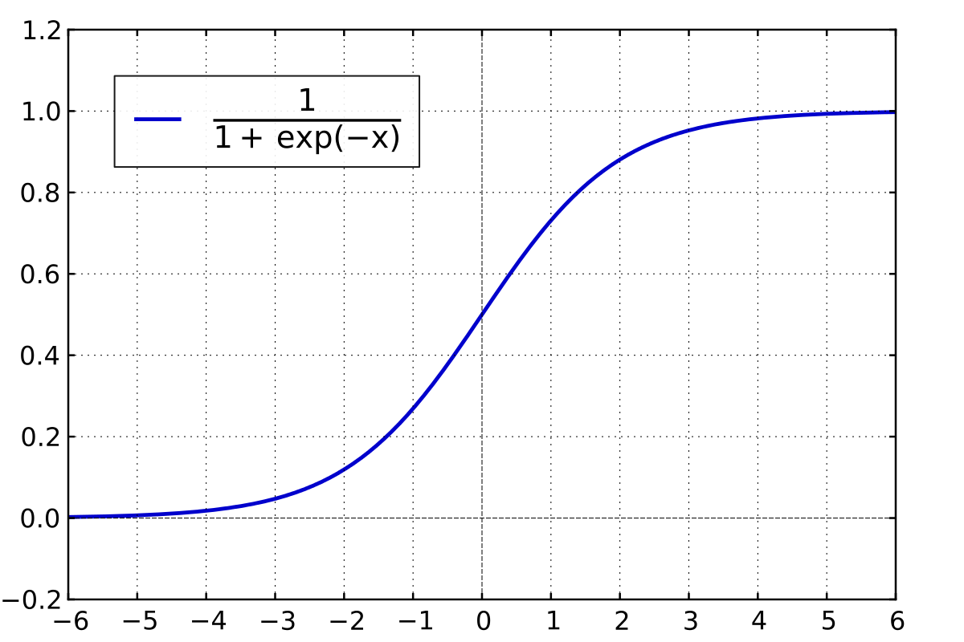
Model Selectors
Model Selector
Preparator
What you get out: the model
Sanity Check
/** * Wrapper for model after best model has been selected. * @param model Best model after fitting * @param featureNames Names of features used in model * @tparam Model Type parameter of model * @tparam Data Type of data output after transformAndSelect */ abstract class FittedModel[Model, Data](val model: Model, val featureNames: Array[String]) _extends Serializable with Logging { def transformAndSelect(dataIn: PredictiveDataset, keepObjective: Boolean = true) (implicit params: WorkflowParams, sc: SparkContext, sQLContext: SQLContext): Data def logMetrics(dataIn: Data)(implicit params: WorkflowParams): Unit = log.info("No metrics specified”) def saveModel(path: String)(implicit params: WorkflowParams, sc: SparkContext): Unit }
Fit Model

Slide 36
The pieces
ETL is not included…
Workflow
Feature Extractor
Transformation Plan
Feature engineering and manipulation
Model Selector
Data Writer
Put data in final format
Put data in final location
Data Reader
Feature Transformation
Preparator
Feature Aggregator
Sanity Check
or
Feature Getter
Fit Model

Slide 37
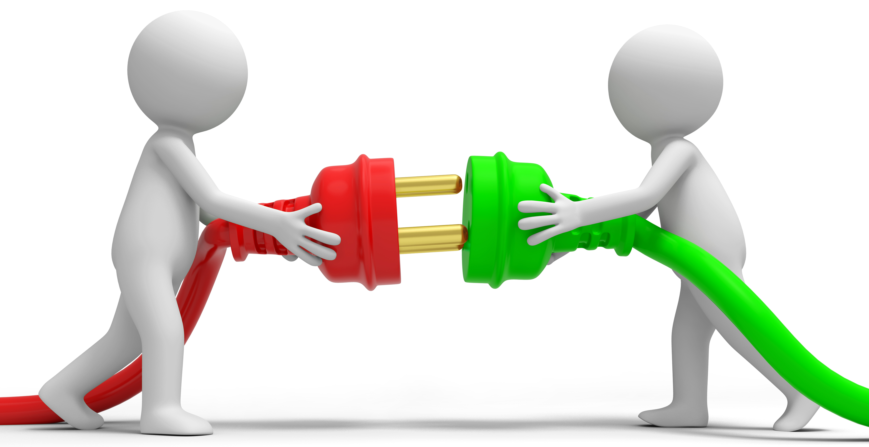
Data Writer
Data Writer
Put data in final format
Put data in final location
The last connector
Take in the scored data and the model
Put it wherever it needs to go for production
Lookup table of scores
API for online scoring
Etc.

Slide 38
The pieces
ETL is not included…
Workflow
Feature Extractor
Transformation Plan
Feature engineering and manipulation
Model Selector
Data Writer
Put data in final format
Put data in final location
Data Reader
Feature Transformation
Preparator
Feature Aggregator
Sanity Check
or
Feature Getter
Fit Model

Slide 39
Putting it all together
New data source?
Yes
The steps to build a model
No
Feature Extractor
The first time you write a machine learning pipeline you might have to write all the pieces
We have a lot of defaults for al of these pieces
For simple models and data even all new workflows can be less than 20 lines of code
Every time someone writes a new workflow all of the pieces they write are added to the library available!
Every new data source that is added can subsequently be used by everyone
Every new of data transformation written can subsequently by used by everyone
Every new model written can subsequently be used by everyone
New feature engineering?
Yes
No
Feature Transformer
New type of model?
Yes
No
Model Selector
New output location?
Yes
Data Writer

Slide 40
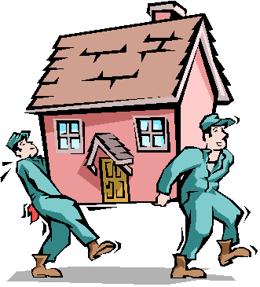
Take home
Designing a good interface in important for machine learning frameworks too
Most engineers and data scientists treat modeling like they are one time projects
The vast majority of modeling time is spent on data preparation
If you really think about all the work that is being repeated it is staggering
Both by individual data scientists and across companies
Think ahead and make your project pieces re-usable
Even if you don’t want to design your own frame work there are pretty good options out there (and we hope that this will one day be one of them)
http://learningradiology.com/misc/sitemap.htm

Slide 41
&
We are hiring ☺

