Slide 1
Hybrid DevOps for Containerized Microservices
Neelesh Pateriya (Innovation Architect)
Cloud Innovation Lab - CTO (Ken Owens)

Slide 2
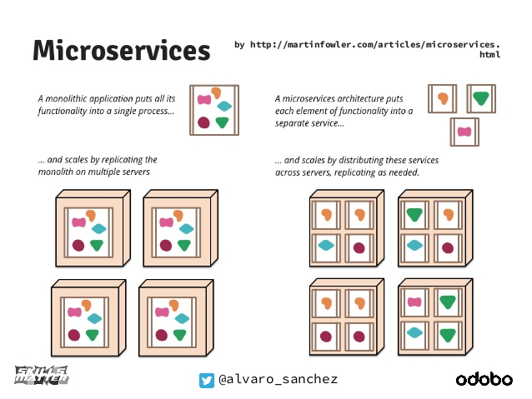
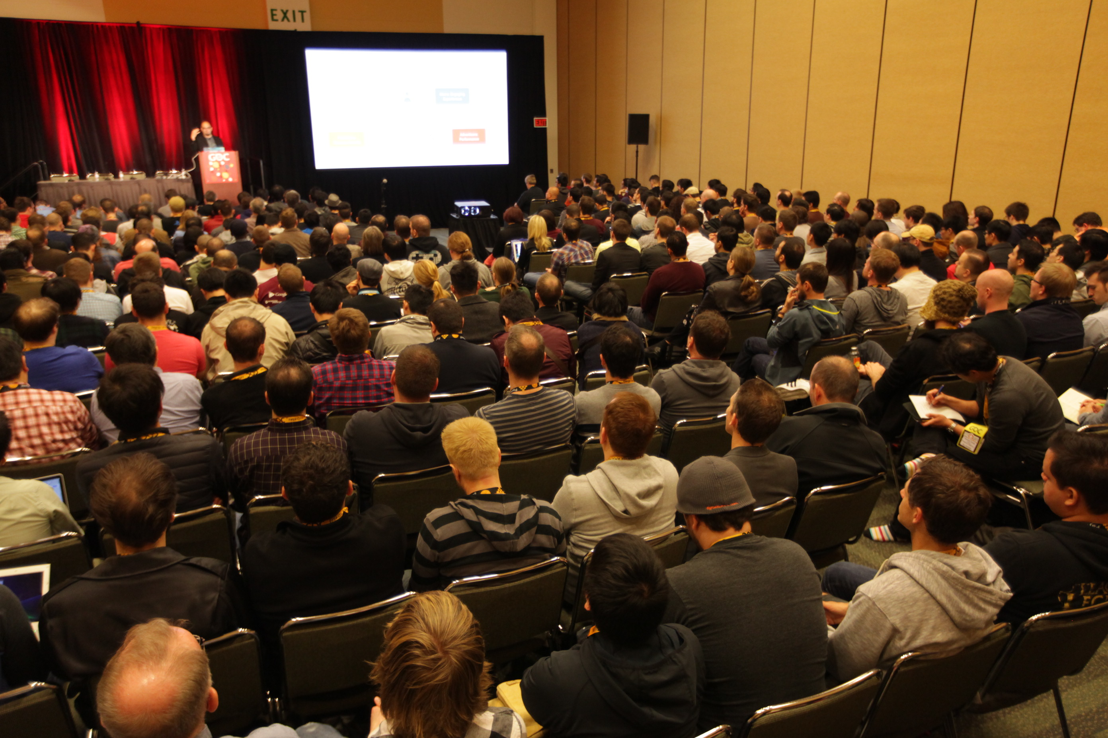
Microservices: Preferred Architecture
Software architecture style
complex applications are composed of small, independent processes communicating with each other using language-agnostic APIs.
Application services are small, highly decoupled and focus on doing a small task.
https://creativecommons.org/licenses/by-sa/2.0
https://www.flickr.com/photos/officialgdc/16698766901

Slide 3
Containers: Best suited for Microservices
Docker / Container
Virtual Machine
App
App
App
App
Bin/Libs
Bin/Libs
Bin/Libs
Bin/Libs
GuestOS
GuestOS
Docker Engine
Hypervisor
Host OS
Host OS
Server
Server
Docker / Containers
Build once run anywhere
Consistent packaging across language and platforms
Faster delivery and deployments of application.
Higher Density
https://creativecommons.org/licenses/by-sa/2.0
https://www.flickr.com/photos/officialgdc/16698766901
Notes:
Developer attends conferences and hear great success stories about Micoroservices.
If you attend Adrian’s Netflix story, by end of talk you will be likely to convinced to start evaluating Microservices, if not already doing.

Slide 4
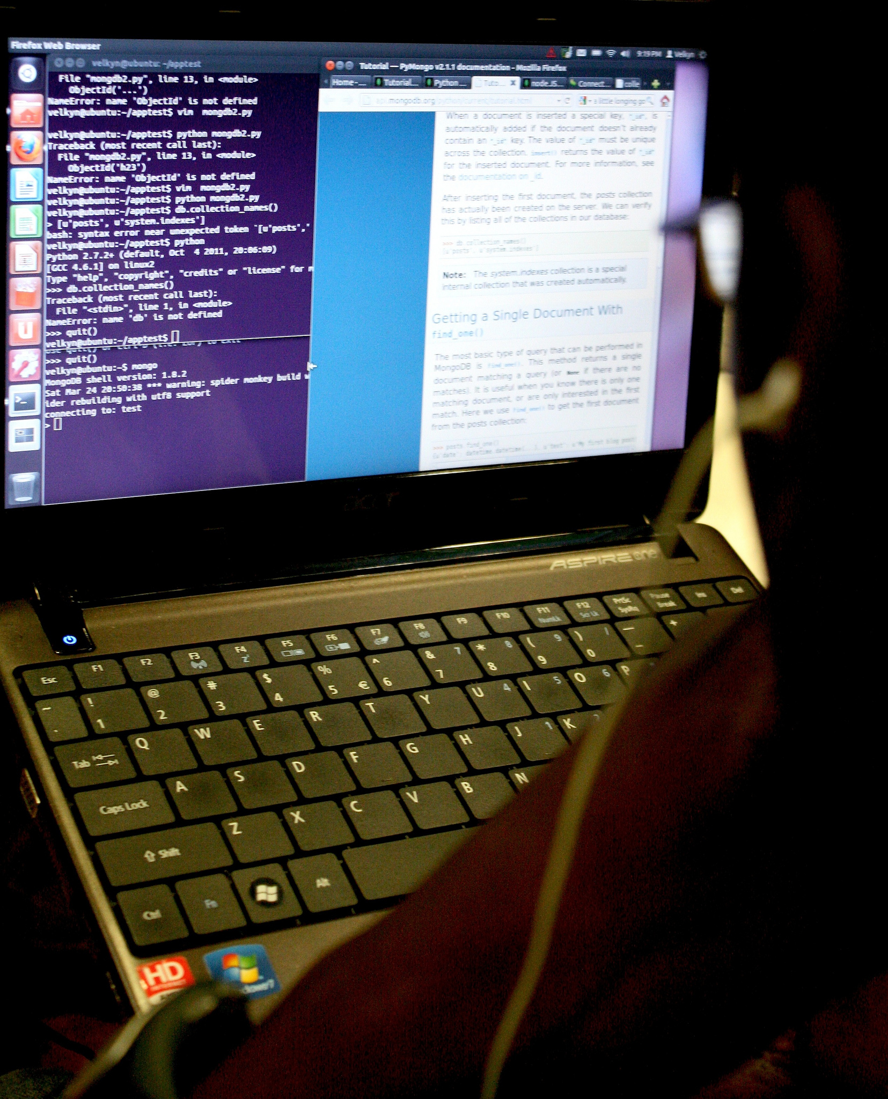
Oh Yeah !!! Found solution
Rewrite monolithic application to Microservices
Package and deploy Microservices as Containers
https://creativecommons.org/licenses/by-sa/2.0 https://www.flickr.com/photos/hackny/7036220249

Slide 5
Oh, No!!! Did I miss something?
https://creativecommons.org/licenses/by-sa/2.0
https://www.flickr.com/photos/slapbcn/2035854990

Slide 6
Microservices: Software Development Lifecycle Challenges
Develop
Build
Deploy
Run
App aware containers monitoring and log aggregation.
Develop
Laptop run multiple services
Multiple language /technology stack
Run multiple storage backend
Build
SDLC admin control CI flow bottleneck
Flexible/dynamic build slaves
Consistent packaging and version.
Deploy
Distributed systems, increased deployment complexity,
Service discovery and Internal load balancing
Run
Microservices response monitoring
App deploy intent based policy
Microservice continuous deployment
Multiple tech stack
App operational intent based policy.

Slide 7
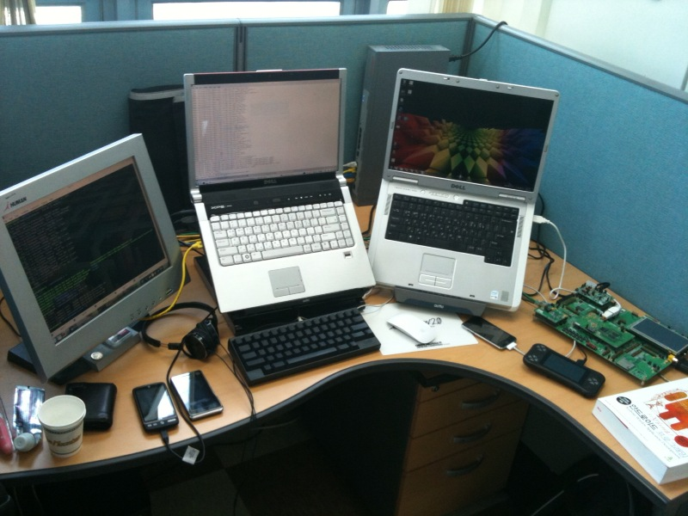
Challenge: Microservices on Laptop
Develop
Build
Deploy
Run
Developer need to run mini Microservices topology on laptop.
Challenges
Multiple language/technology stack.
Multiple backend.
Mini connected services topology.
https://creativecommons.org/licenses/by-sa/2.0
https://www.flickr.com/photos/segfault87/4605242395

Slide 8
Containerized services in VM Pattern
Develop
Build
Deploy
Run
Source Code
Vagrant, Virtual Box and Docker Compose based developer Sandbox.
Run Multiple Services, Multiple Languages/Technology stack and backend in Sandbox.
Developer application topology consistent with production.
Local
CI-CD
App1
Containers
App 2
Containers
DB1
Containers
DB2
Containers
Docker Compose
Shipped VM
Virtual Box-Vagrant

Slide 9
Challenge: Admin controlled CI pipeline
Develop
Build
Deploy
Run
Microservices team need to control and define CI pipeline.
Challenges
Flexible/dynamic build slaves
Microservice specific build and test scripts
Consistent packaging and version.
Multiple tech stack
https://creativecommons.org/licenses/by-sa/2.0 https://www.flickr.com/photos/plentyofants/683994728

Slide 10
Docker slaves, config in source Pattern
Develop
Build
Deploy
Run
Developer Defined Jobs
Dockerized slaves
Jenkins, Hudson
Go ..
Travis, CircleCI ..
DroneIO
Shippable..
Closely managed by Admin
Build config, slaves and pipeline hard to customize by developer.
Developer friendly Yaml or Json based build Config
Slaves configuration still managed by Admin.
Containerized slave and yaml based build config
Developer independently can fully customize CI Env.

Slide 11
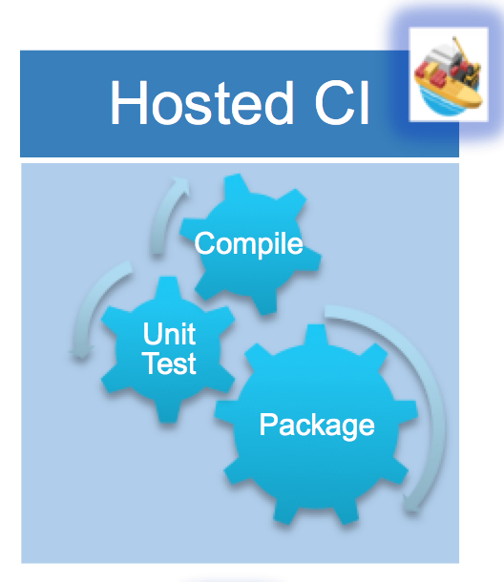
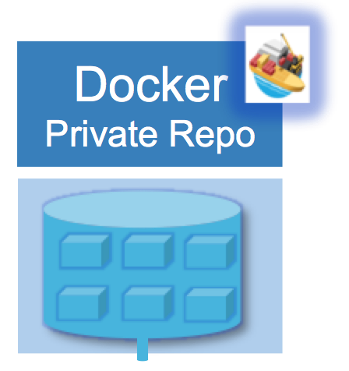
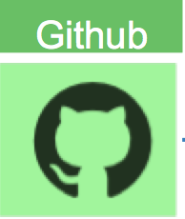
Docker slaves, config in source Pattern
Develop
Build
Deploy
Run
Build, test in CI executed in Docker Slave.
Developer customized slave images.
CI config store within source repository.
Docker image per Microservice tagged with commit-id pushed to private repo.

Slide 12
Challenge: Service Discovery
Develop
Build
Deploy
Run
How client find and connect to Service Instances.
Challenges
Instances with dynamically assigned host and port.
Instances can be added, removed or moved by scheduler
Service upgrades frequently.
https://creativecommons.org/licenses/by-sa/2.0 https://www.flickr.com/photos/glynlowe/10921732025

Slide 13
Service Discovery: 3rd party Registrator pattern
Develop
Build
Deploy
Run
Marathon-consul monitors marathon events
Marathon-consul adds docker instances host:port to service-name mapping to consul.
Consul exposes information via inbuilt DNS
Consult templates watches changes in Consul
HAProxy configuration is updated based on changes in consul
Namespace naming convention
environment.project.service.shipped.com
Deploy Env. (Staging)
(MS-Infra)
HAProxy
MicroService-1
MicroService-1
MicroService-1
MicroService-1
MicroService-1
(Github repo)
MicroService-2
(Github repo)
Consul
Template
Consul (DNS)
MicroService-1
MicroService-1
MicroService-1
MicroService-1
Dependency-1
(Marketplace App)
Dependency-2
(Marketplace App)
Marathon-Consul/
Registrator
Docker containers
Mesos – Marathon (MS-infra)
Mantl

Slide 14
Service Discovery: Scheduler aware LB Pattern
Develop
Build
Deploy
Run
Load-Balancer itself is aware of Scheduler generated events.
Can avoid couple of event driven configuration hops.
Deploy Env. (Staging)
MicroService-1
MicroService-1
MicroService-1
MicroService-1
MicroService-1
(Github repo)
MicroService-2
(Github repo)
MicroService-1
MicroService-1
MicroService-1
MicroService-1
(MS-Infra)
Dependency-1
(Marketplace App)
Dependency-2
(Marketplace App)
Traefik
LoadBalancer
Docker containers
Mesos – Marathon (MS-infra)
Mantl
Pattern Client-side discovery : option only if all clients willing to participate.

Slide 15
Challenge: Microservices monitoring
Develop
Build
Deploy
Run
Traditional monitoring solution not sufficient.
Challenges
Microservices instance added/removed more dynamically then VM
Monitoring CPU, memory system metric for container not sufficient.
Complex distributed monitoring.
VM
VM
VM
VM
DC/Region
DC/Region
VM
VM
VM
VM
DC/Region
DC/Region

Slide 16
Microservices monitoring
Develop
Build
Deploy
Run
Container scheduler will mostly try restart failing instances before operator.
Microservice response time and ratio of error requests key metrics
Auto detect/plot request route and identifying bottleneck service causing bad user experience is key.
Monitoring/metrics exposed by load balancer will become differentiator.
Request Route
Load-Balancer
Response Time
% Error Request
Microservice1
Microservice2
Microservice3
Microservice1
Microservice2
Microservice3

Slide 17
Microservices Logging
Develop
Build
Deploy
Run
Logs need to be service context aware
Challenges
Single container logs may not lead to right direction on debugging.
Number of instances increased so very less context info in logs.
External analytics system need to index logs with multiple context.
https://creativecommons.org/licenses/by-sa/2.0/
https://www.flickr.com/photos/glynlowe/10921732025

Slide 18
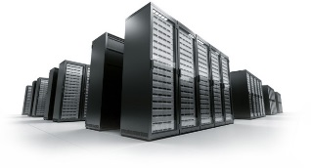
Monitoring/Logging Reference Architecture
Develop
Build
Deploy
Run
Real-time and batch processing, anomaly detection, visualization
Logs/metrics indexed with services, user, dc/region, host, containers to provide multiple views.
Shipped-Mantl
Clusters
Logstash
Collectd
cAdvisor
Metrics
Logs
SSL
Global Monitoring / Analytics Cluster (global, Texas-1)
Monitoring / Analytics Cluster (DC1)
SSL
Monitoring / Analytics Cluster (DC2 )
SSL
Monitoring / Analytics Cluster (DC3)

Slide 19
Developer implement Microservices DevOps patterns?

Slide 20
Shipped Hybrid DevOps platform enables developers to easily Build, Deploy and Run Containerized Microservices
Build your application the
way you always have
with the tools you always
use
Deploy your application across
A variety of internal, private, and
public clouds, developer,
Business Choice – No Lock-In
Mantl.io
Run your application
across multiple deployment
locations in a CI/CD &
Application Intent
Framework

Slide 21
Shipped 1.0
Build Packs
Eclipse
Vagrant
Docker
Mesos
Marathon
Consul
Consul
Kafka
Elasticsearch
InfluxDB
GitHub
GitHub
Drone
Terraform
Docker Images
GitHub
Project
Management
Developer
Tools
Source
Control
Continuous
Integration
Continuous
Deployment
Application
Orchestration
Service
Assurance
Issue
Management
Cisco Spark
Collaboration

Slide 22
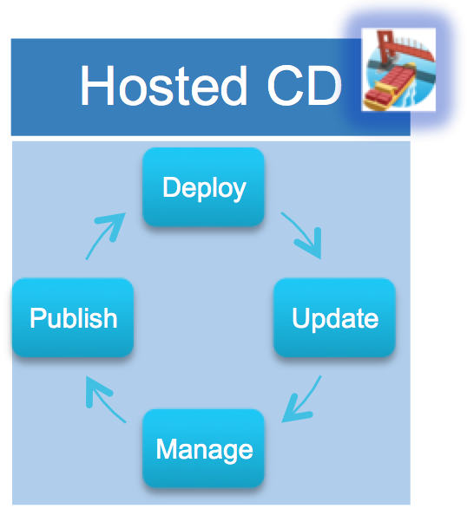
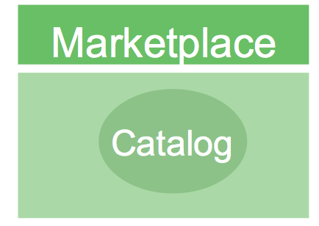
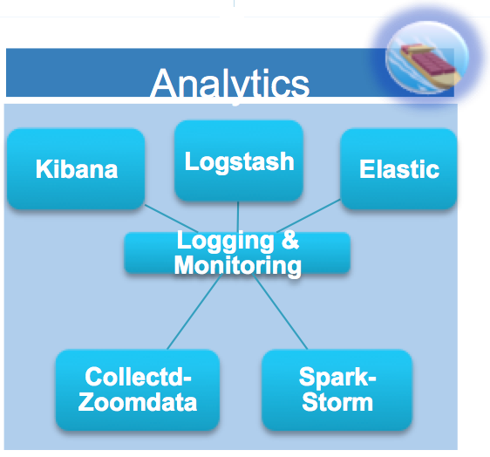
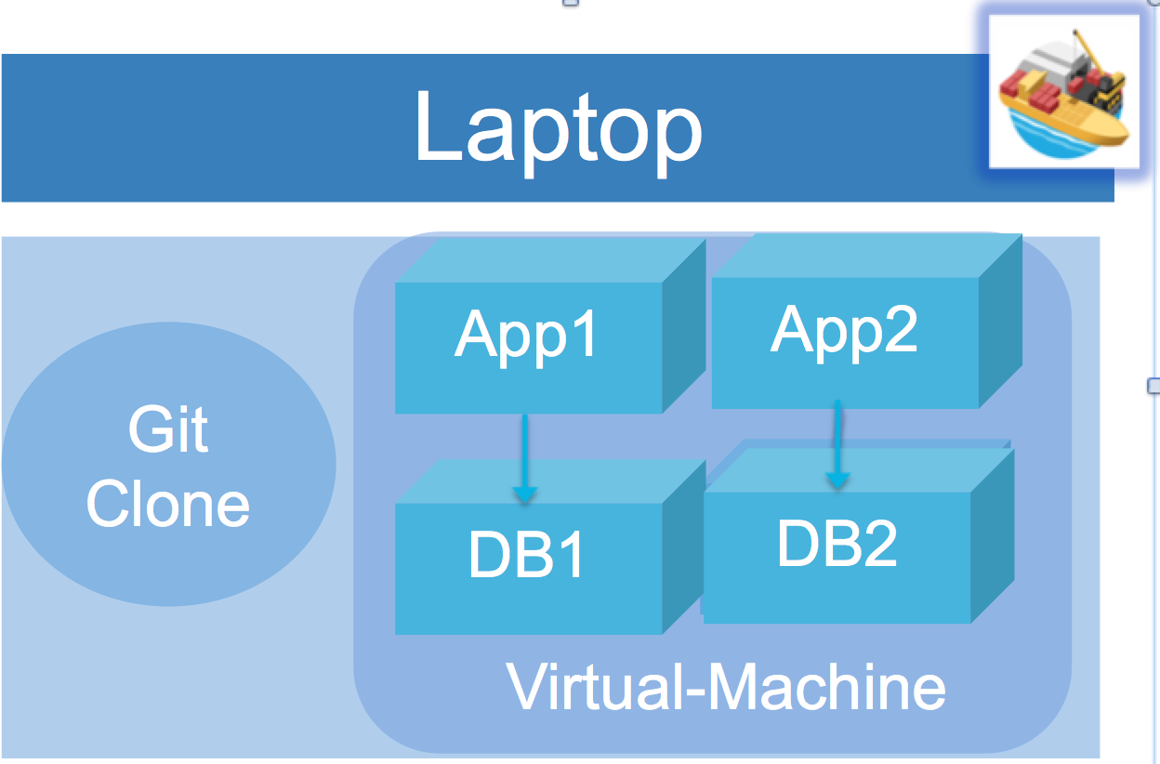
Shipped 10,000ft View
Create multi env dev, prod, stage etc.
Publish or rollback builds
Deploy to multiple public-private clouds
Application intent policy for deploy
Auto configure CI – Drone
Dockerized build slave
Multi Language Buildpacks
Developer defined build/test steps
Auto create Docker private repository
Repo Integrated with CICD
Tag image with commtid.
Auto create repository
Auto configure Callback hooks
Mesos-Marathon based Docker cluster manager
Consul base multi-dc service discovery
HAProxy base auto LB.
Integrated docker app logging and monitoring
Single command setup
Multiple Services and backend
Clean & consistent env every build
Multi-Language
Multiple public and private cloud support

Slide 23
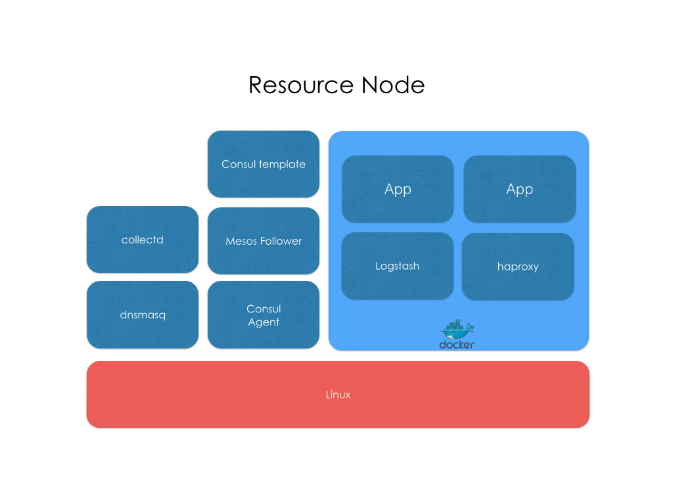
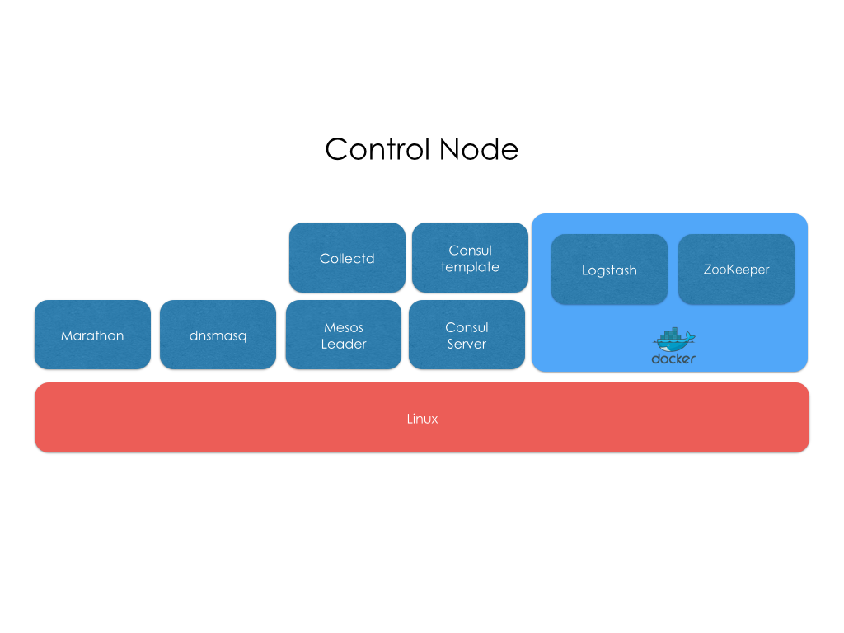
Mantl

Slide 24
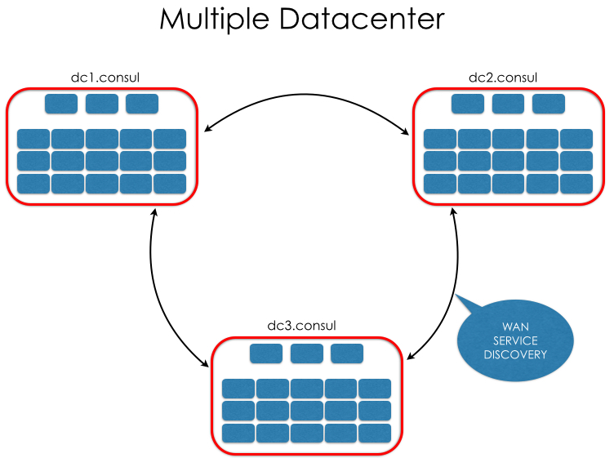
Mantl Multi Datacenter/Cloud

Slide 25
Shipped: Microservices Deployment Layout
Support Namespace aware ( Secure Isolation )
Deployments
Service Discovery and Wiring.
Load-Balancing
Deploy Env. (Prod2)
Deploy Env. (Prod1)
MicroService-1
MicroService-1
MicroService-1
MicroService-1
MicroService-1
(Github repo)
MicroService-2
(Github repo)
Deploy Env. (Staging)
MicroService-1
MicroService-1
MicroService-1
MicroService-1
MicroService-1
(Github repo)
MicroService-2
(Github repo)
Project
MicroService-1
MicroService-1
MicroService-1
MicroService-1
MicroService-1
(Github repo)
MicroService-2
(Github repo)
MicroService-1
MicroService-1
MicroService-1
MicroService-1
MicroService-1
(Github repo)
MicroService-2
(Github repo)
Dependency-1
(Marketplace App)
Dependency-2
(Marketplace App)
MicroService-1
MicroService-1
MicroService-1
MicroService-1
Dependency-1
(Marketplace App)
Dependency-2
(Marketplace App)
Release
[ Build Tag + Config Snapshot ]
MicroService-1
MicroService-1
MicroService-1
MicroService-1
Dependency-1
(Marketplace App)
Dependency-2
(Marketplace App)
Dependency-1
Dependency-2
Docker containers
Mesos – Marathon (MS-Infra)

Slide 26
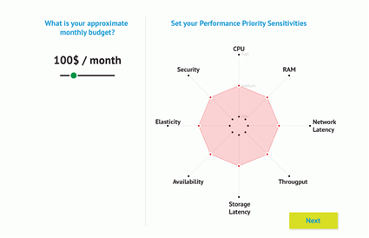
Shipped: Application Intent Policy
Business objectives of the developer by enabling a framework where the intent of the application can be selected (low to high)
Enforcement across the multiple deployment environments is handled by Mantl and Contiv
CPU, Ram, Network Latency, Throughput, Storage, Availability, Elasticity, and Security can be defined as an overall application policy

Slide 27
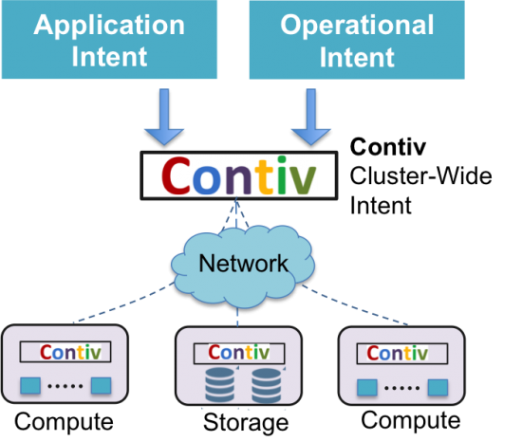
Contiv : Infrastructure operation Intent Policy
Security policies for applications for inbound/outbound as well as within application tiers.
Network services policies- integration of L4-L7 services (Load balancers, firewall, encryption, etc.).
Physical infrastructure policies around bandwidth limit/guarantee per container, latency requirements, etc.
IP allocation management policies.
Storage policies around persistence storage, volume allocation, snapshotting etc.
Compute policies around performance requirements and SLA etc.
Corporate and government compliance policies.

Slide 28
Demo ScreenCast

Slide 29
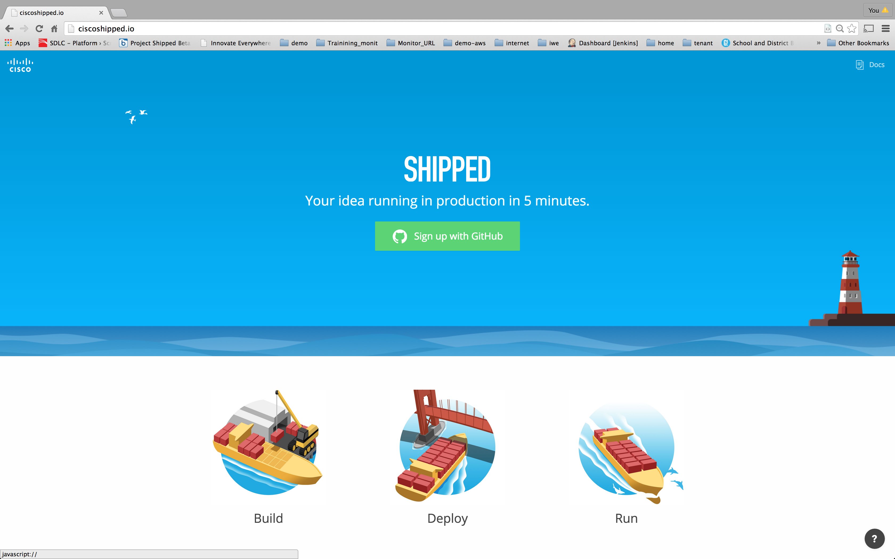

Slide 30
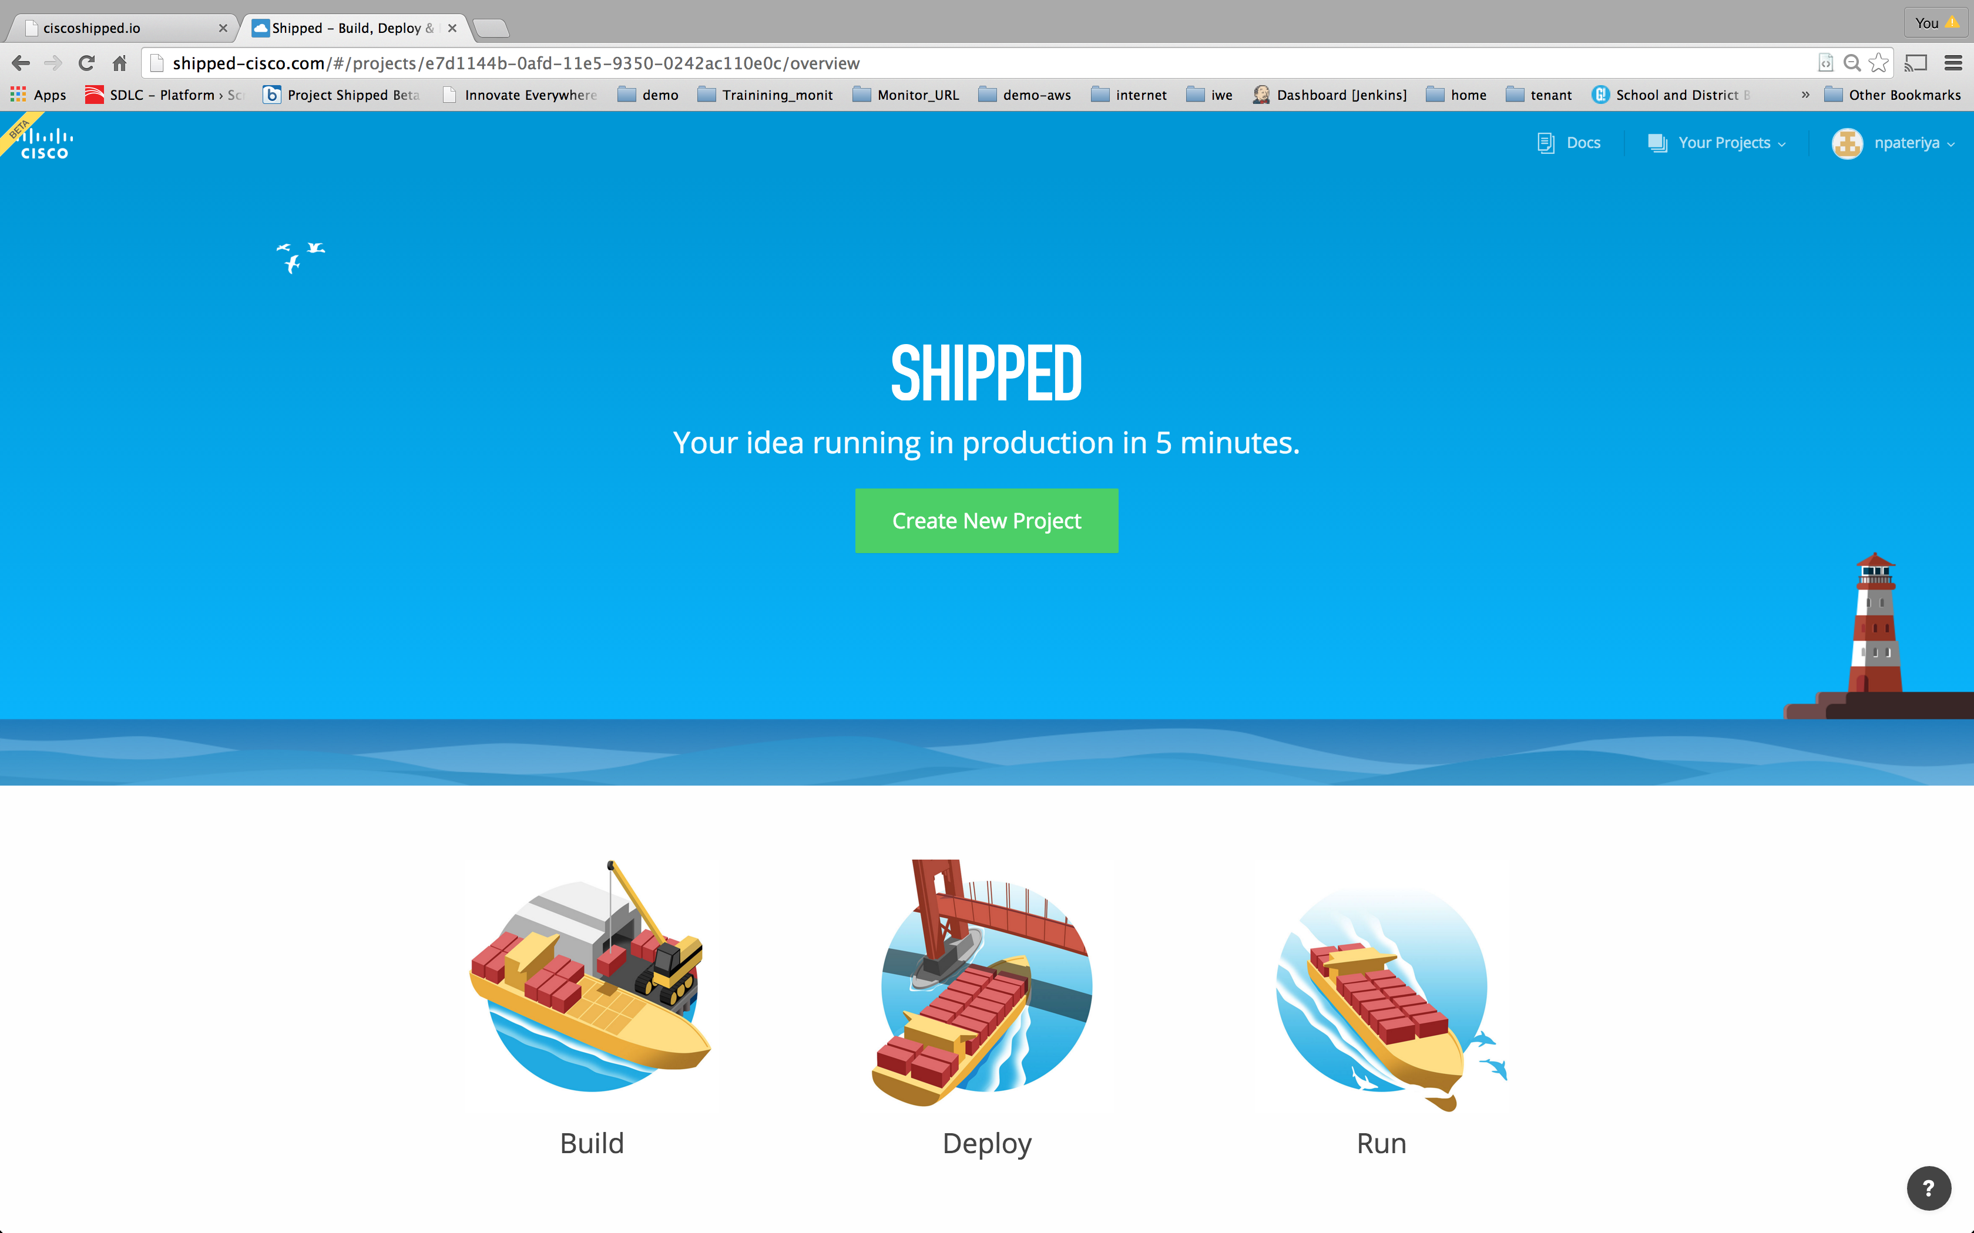

Slide 31
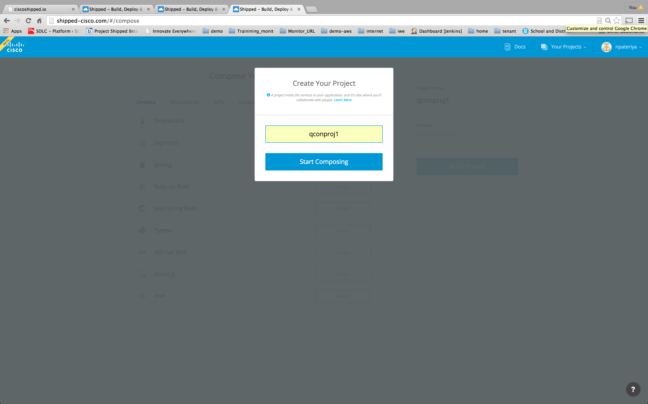

Slide 32
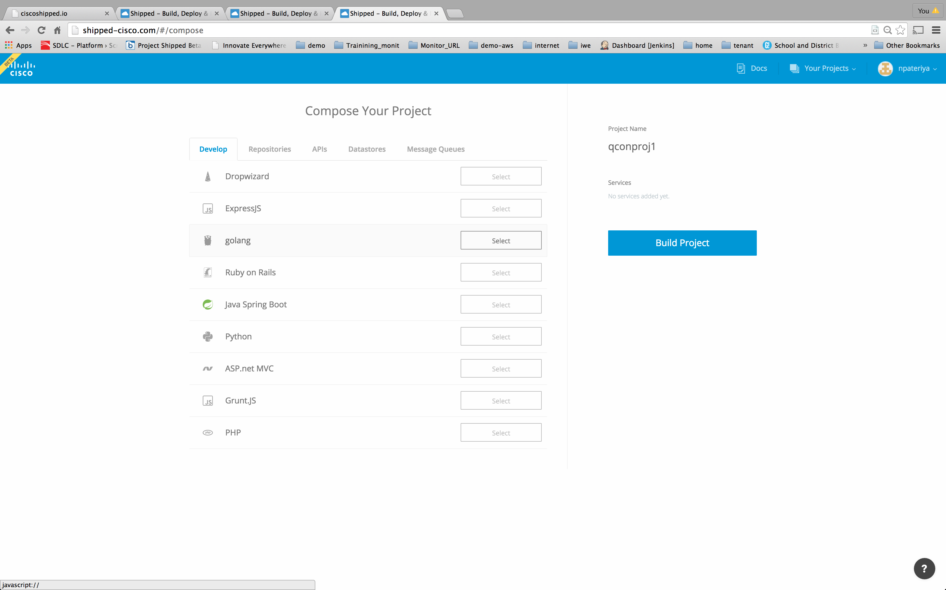

Slide 33
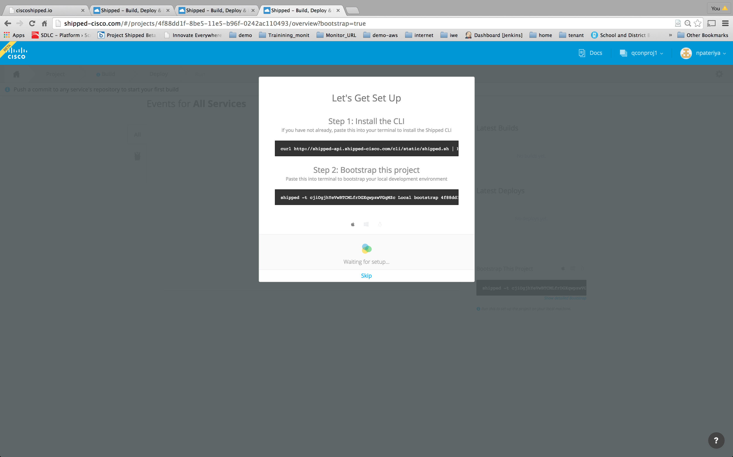

Slide 36
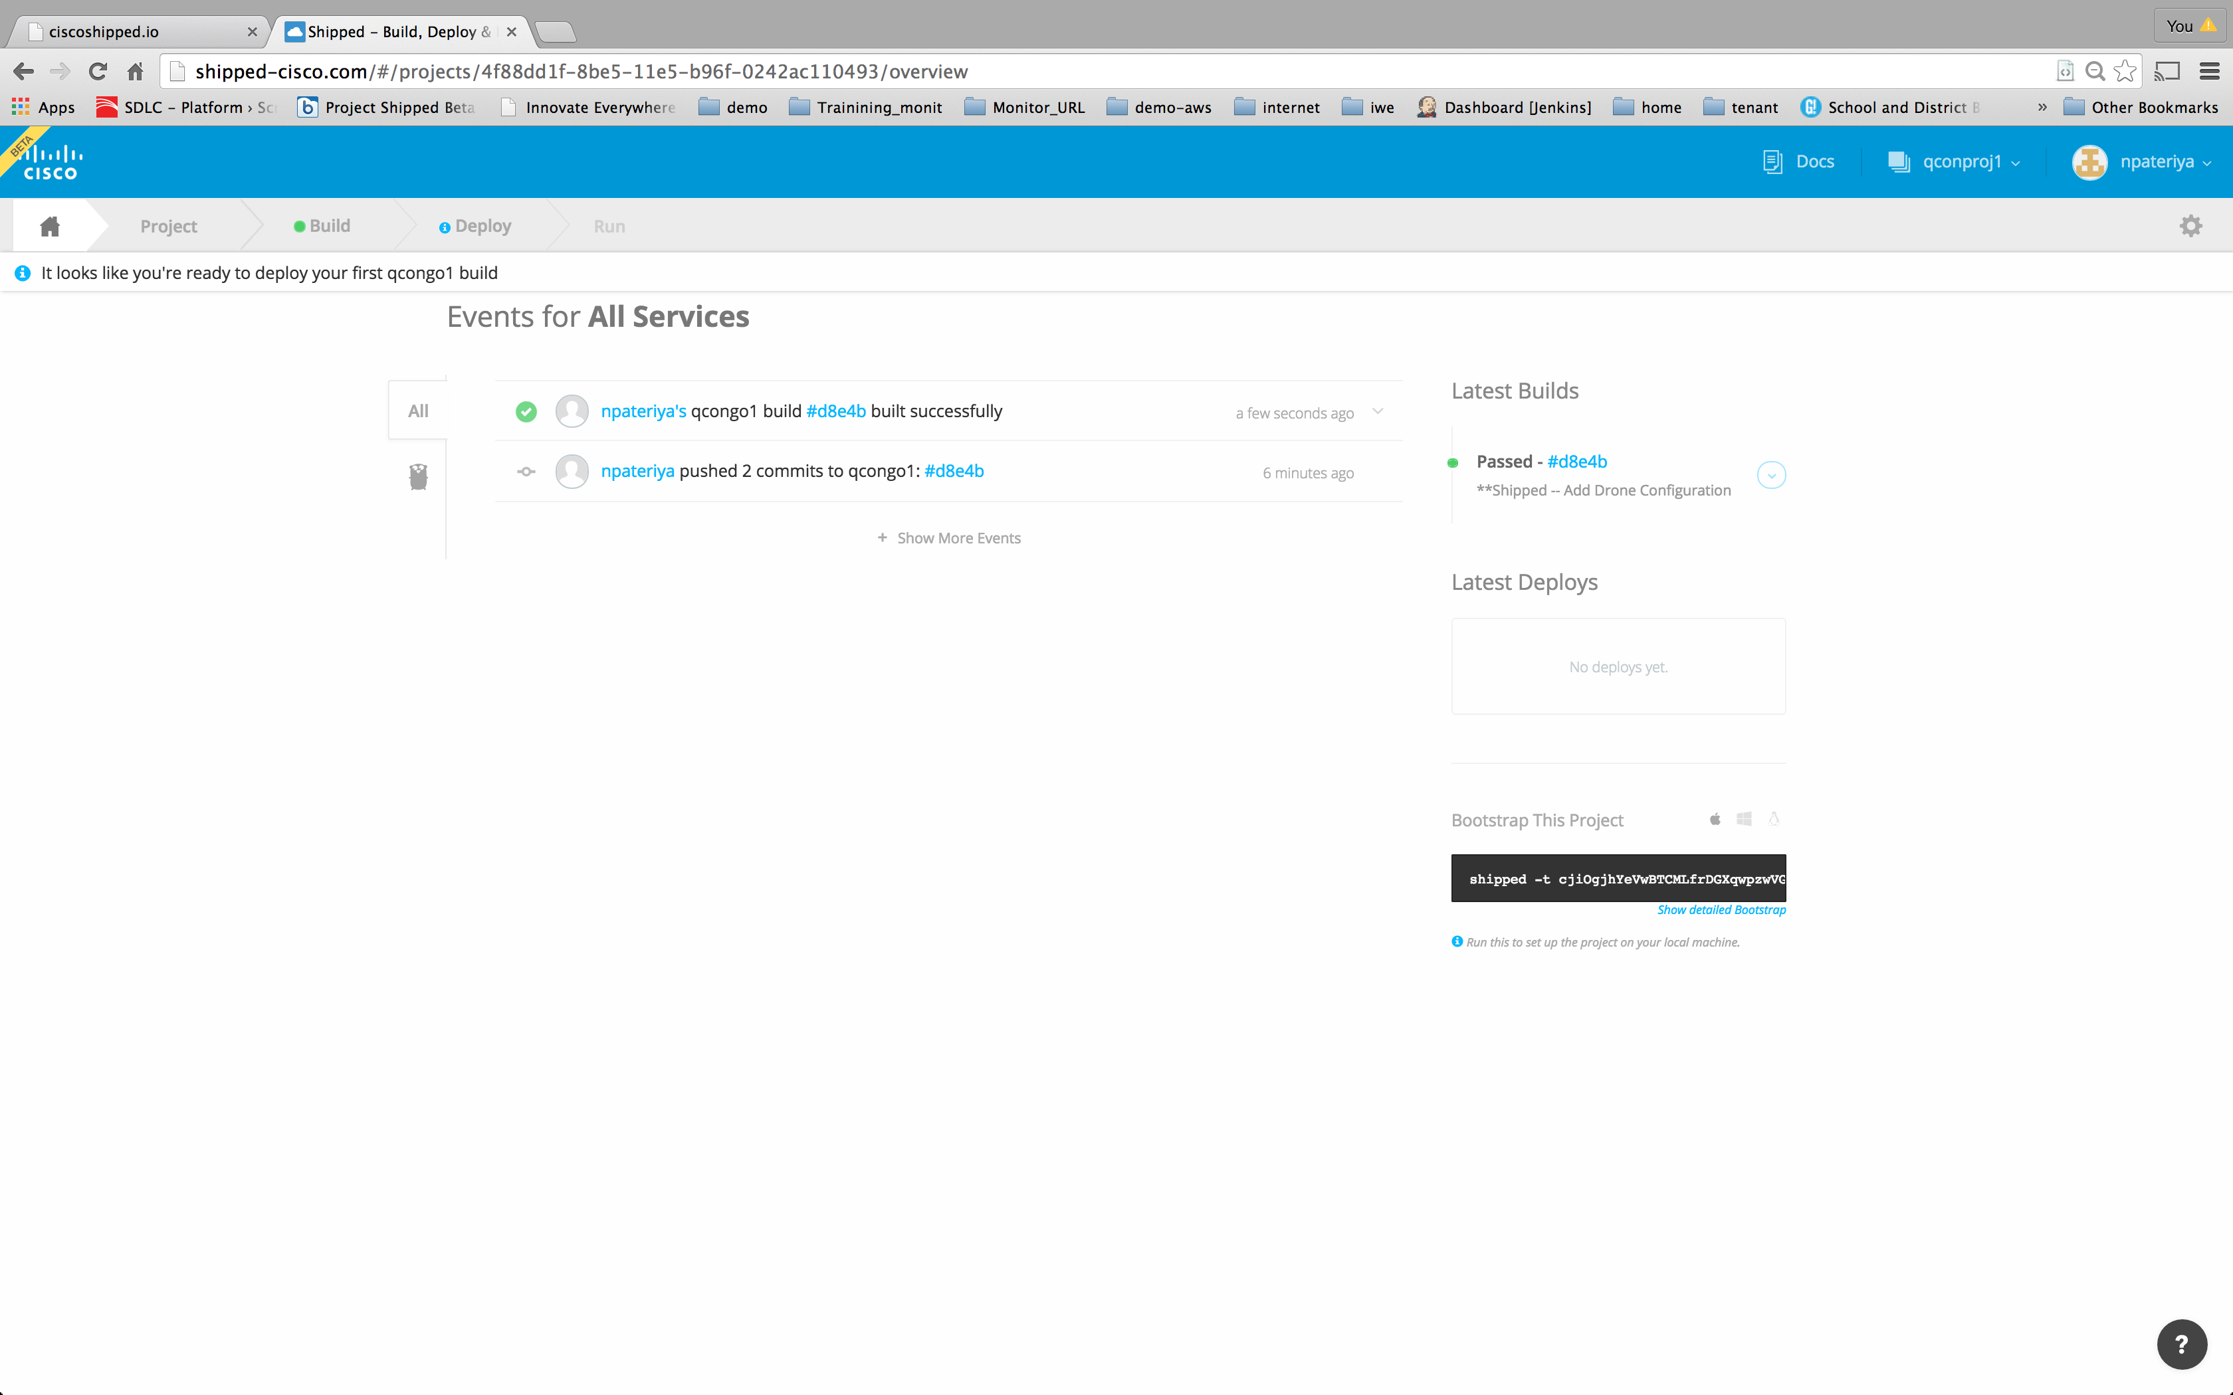

Slide 37
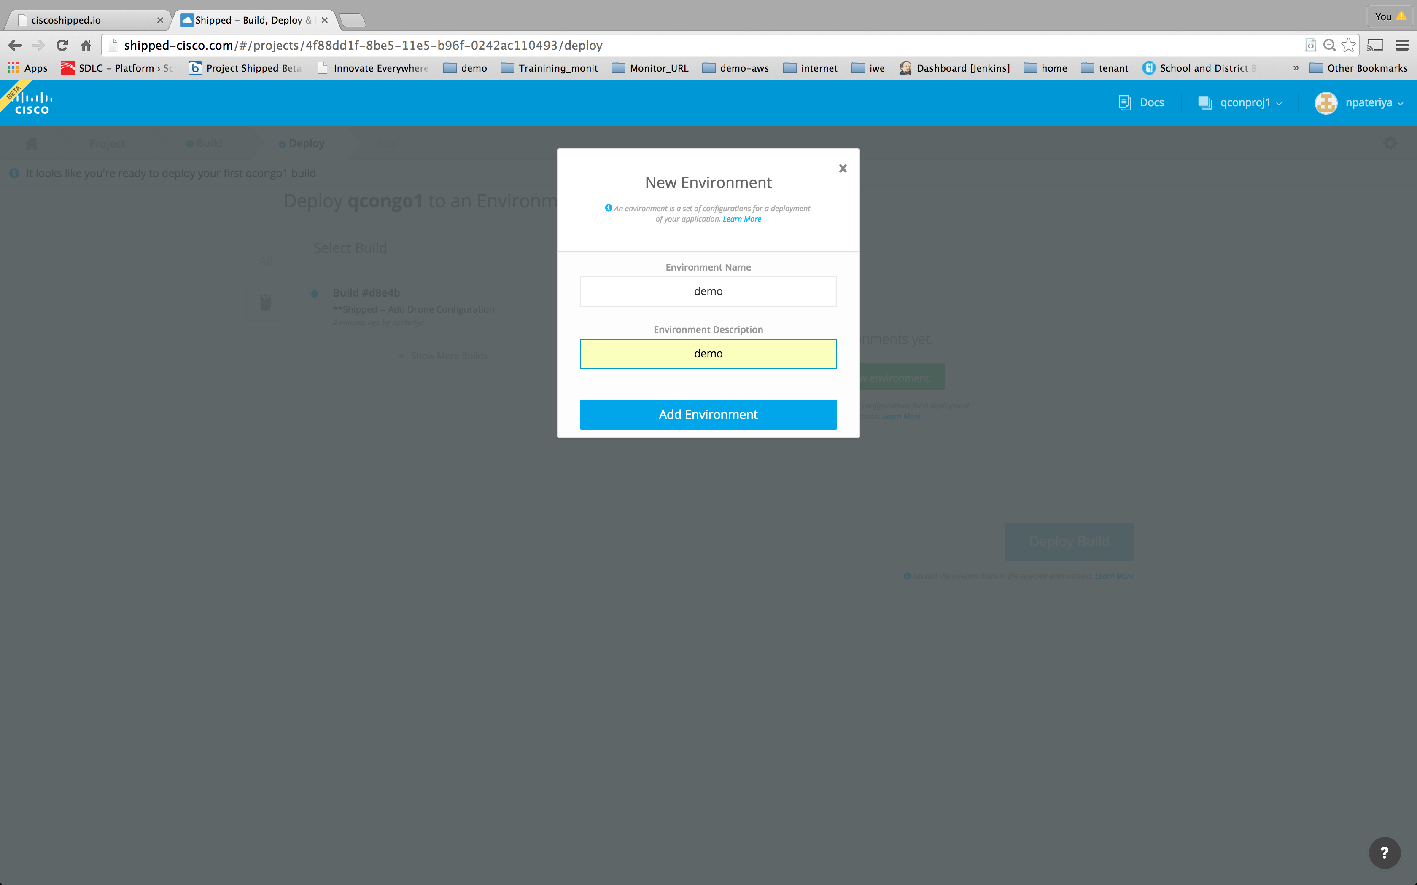

Slide 38
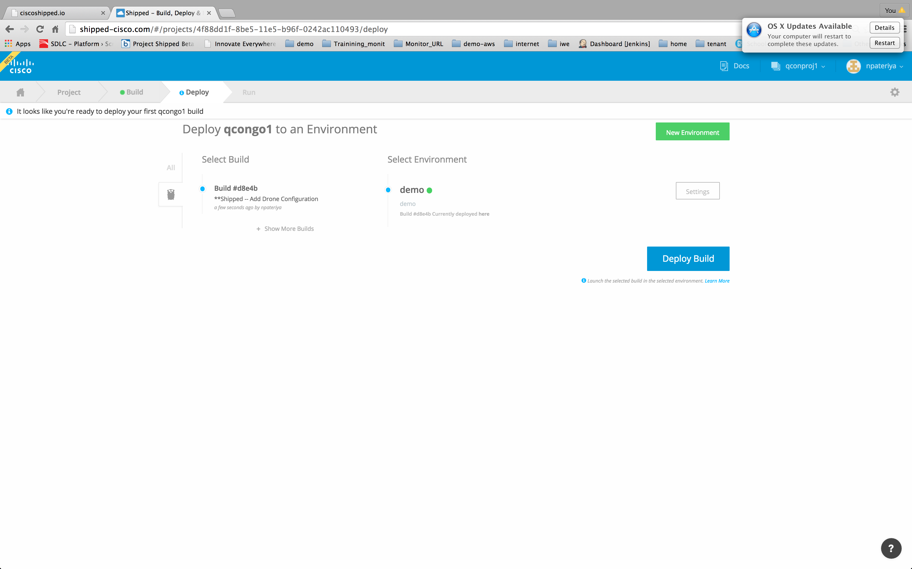

Slide 39
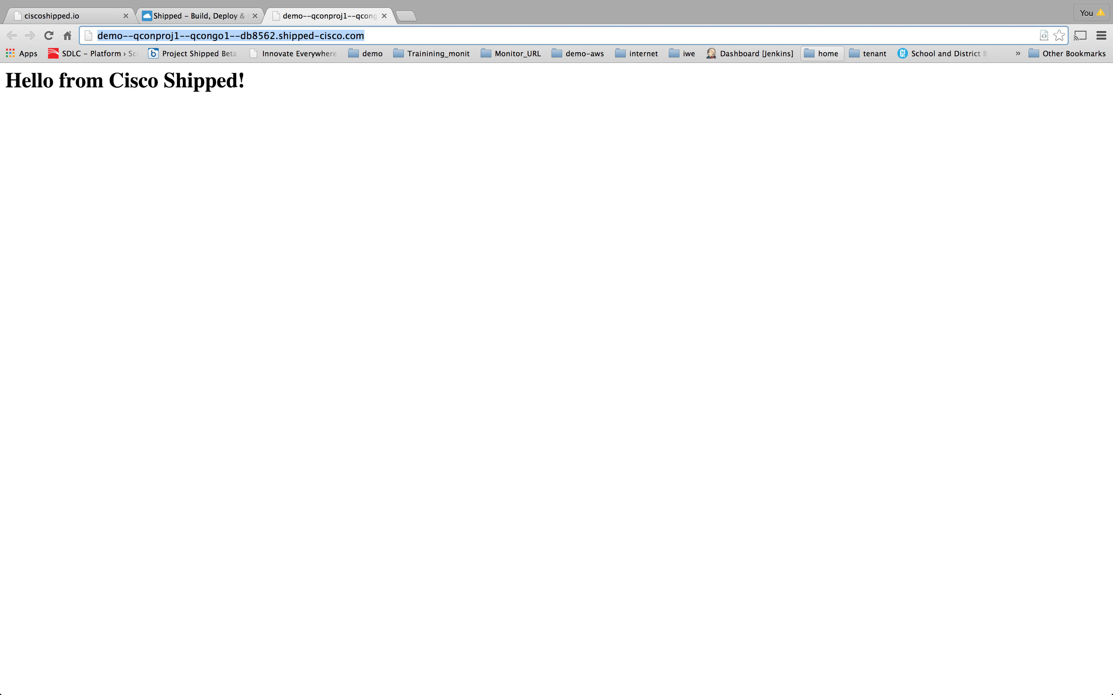

Slide 40
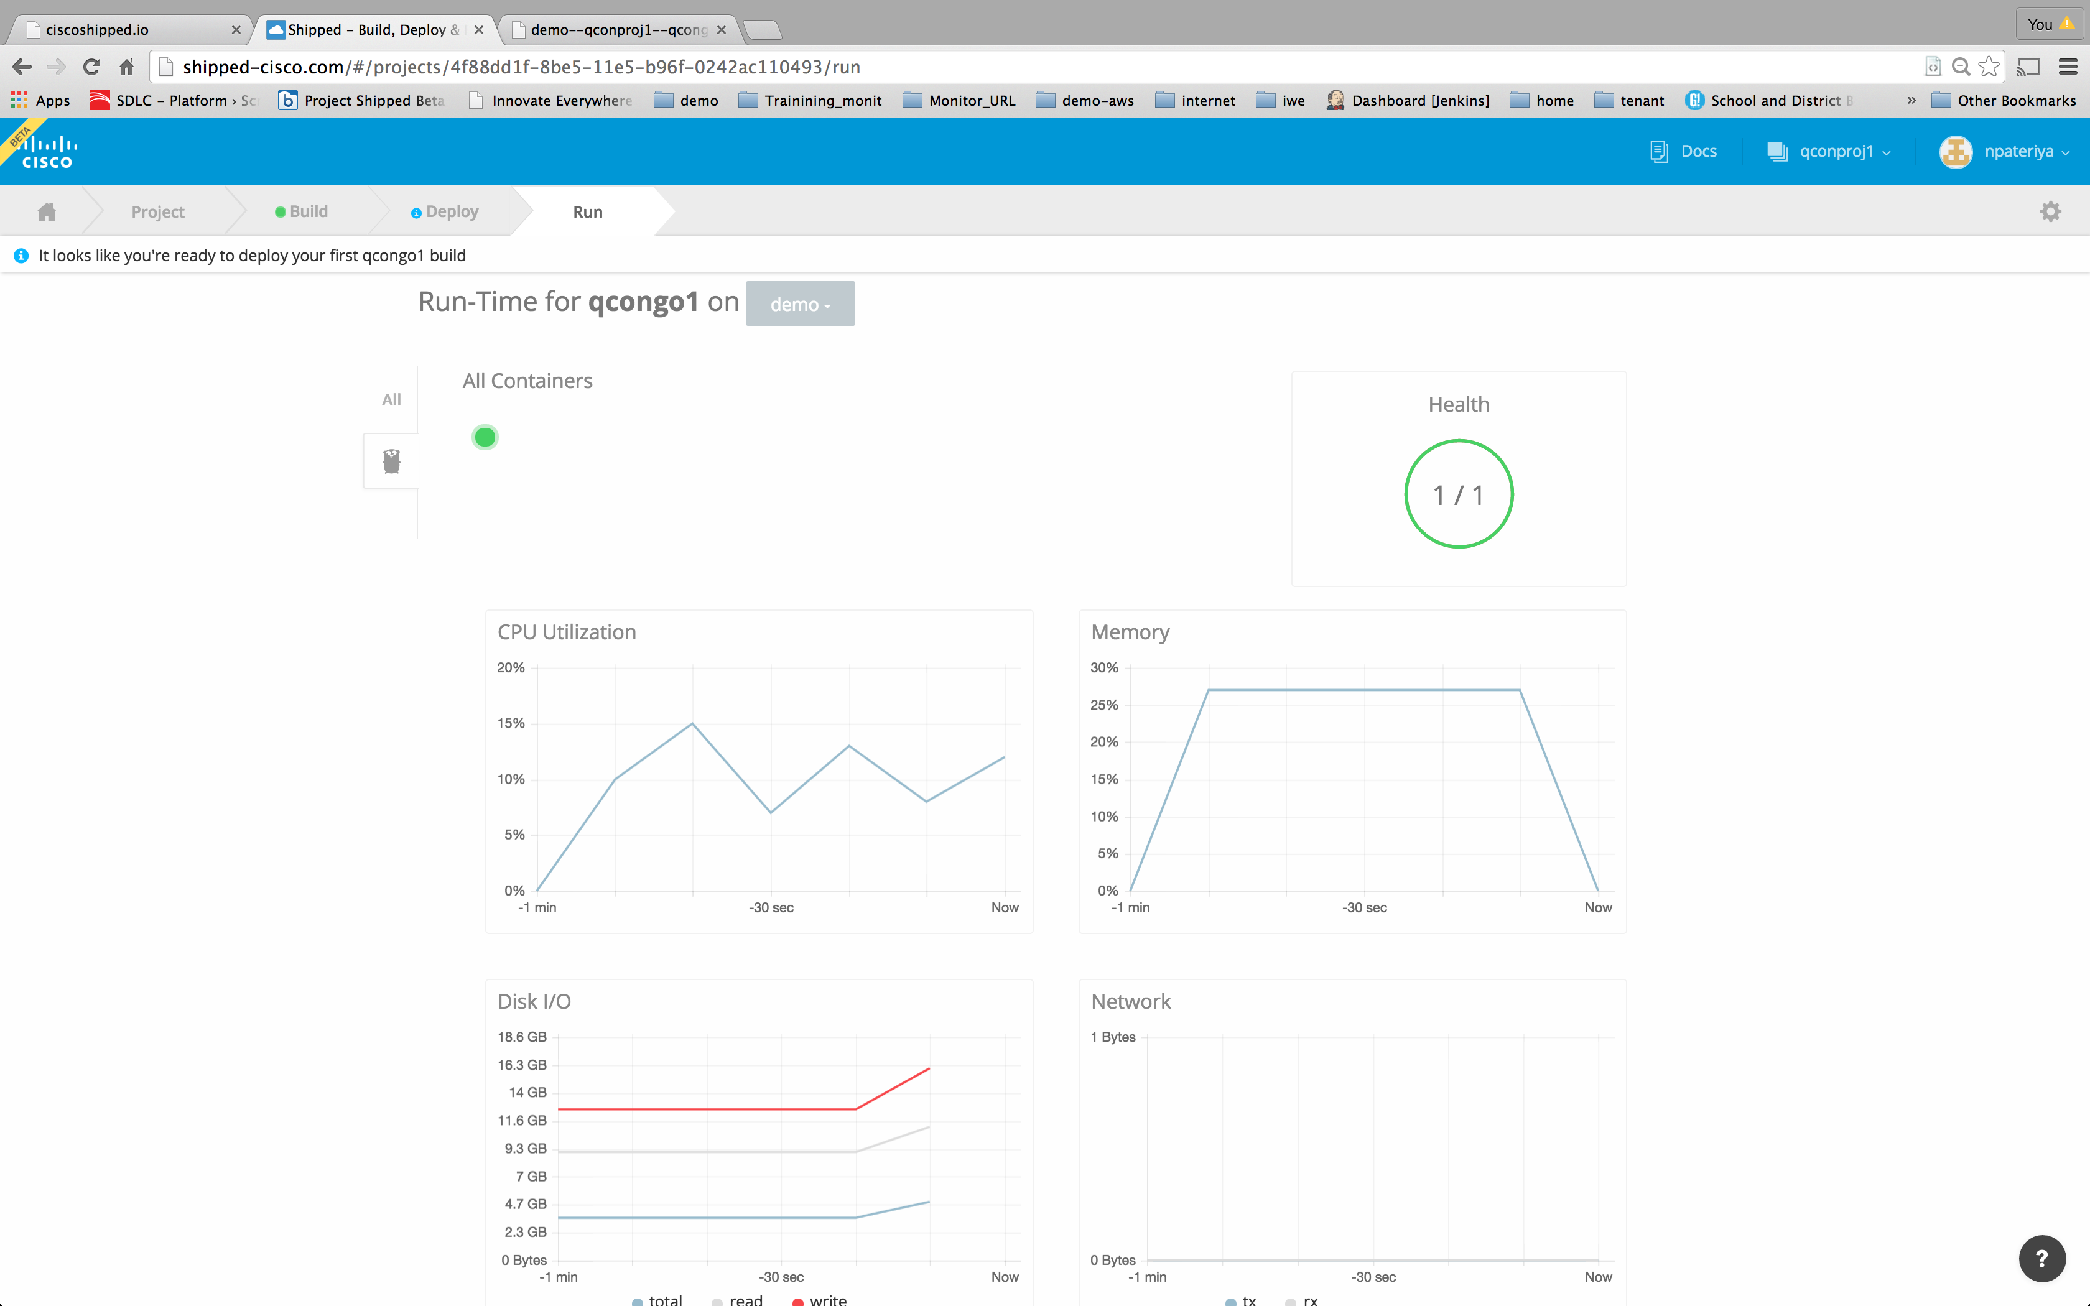

Slide 41
Thank You
http://ciscoshipped.io
http://MANTL.io
http://Github.com/CiscoCloud/microservices-infrastucture
Visit Cisco Booth

