Slide 1
Design Thinking –
what’s in it for me?
Jeanine Spence – Experience Strategist
Current Associates & The SFE Group
Seattle, Washington
Notes:
Jeanine Spence
Experience Strategist
Current Associates
www.currentassociates.com
jeanine@currentassociates.com
@jeaninespence
https://www.linkedin.com/in/jeaninespence
I would love to hear your feedback about the talk.
Try out the 5 try ideas, let me know what worked, where you have questions.
Did you try something else and to drive culture change?
The SFE Group
www.sfeinfo.com

Slide 2
Design

Slide 3
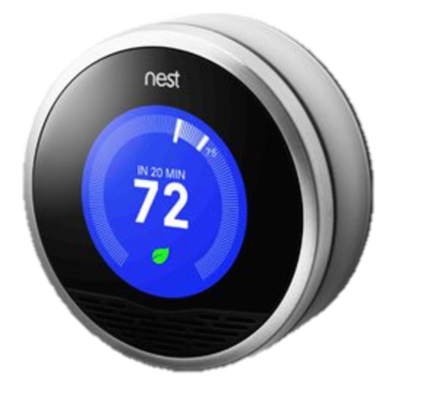
Notes:
shiny, pretty

Slide 4
Design
Thinking

Slide 5
Diverge
Converge
Create choices
Make choices

Slide 6
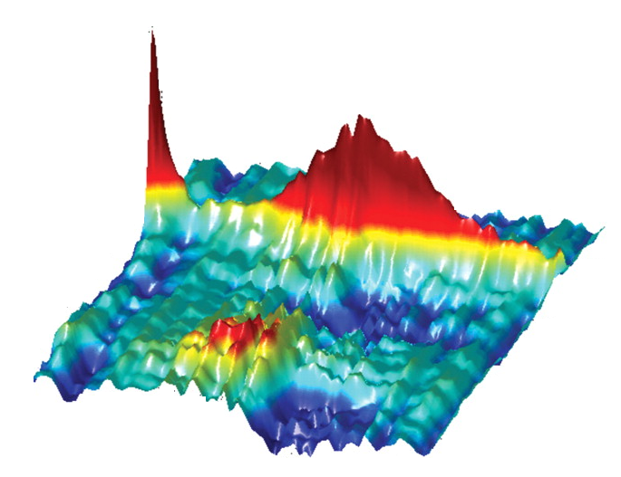
Global Maximum

Slide 7
How do we make product decisions?
Goal: bring it into balance (BXT)
technical
feasibility
eXperience
desirability
business viability
eXperience
desirability
Notes:
Content reference:
Scenario-Focused Engineering: A toolbox for innovation and customer-centricity (Developer Best Practices) December 24, 2014
by Austina De Bonte, Drew Fletcher
http://www.amazon.com/Scenario-Focused-Engineering-innovation-customer-centricity-Developer/dp/0735679339

Slide 8
Claudia Kotcha at Procter & Gamble VP Design Innovation and Strategy
https://vimeo.com/5203345
Start at 10:30

Slide 9
Tackling the issues of water transport and storage.
Watch The Ripple Effect in India, by IDEO and Acumen Fund by IDEO: https://vimeo.com/7329159
Notes:
The Ripple Effect project aims to improve access to safe drinking water for the world’s poorest and most under-served people; to stimulate innovation among local water providers; and to build the capacity for future development in the water sector.

Slide 10
Design Thinking in an Engineering Context
Notes:
Content reference:
Scenario-Focused Engineering: A toolbox for innovation and customer-centricity (Developer Best Practices) December 24, 2014
by Austina De Bonte, Drew Fletcher
http://www.amazon.com/Scenario-Focused-Engineering-innovation-customer-centricity-Developer/dp/0735679339

Slide 11
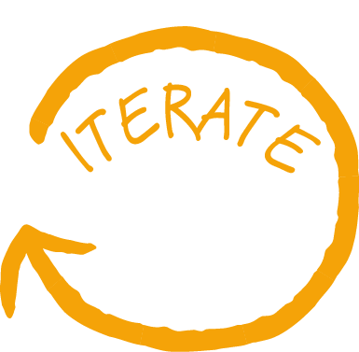
Design Thinking at QConSF
Developing Customer Empathy
Chris Witeck
TRY: Scenario Framing
Discover Key Customer Insights
Marianne Berkovich
Models of Innovation
Jon Madison
TRY: Quick Pulse
TRY: Parallel Iteration
TRY: Lateral Thinking
Prototyping for Optimal Learning
Diana Joseph
TRY: All in Collaboration
Notes:
QConSF 2015 talks
Design Thinking Track
11:50am - 12:40pm
by Jeanine Spence
User Experience Strategist
Design Thinking, what’s in it for me?
Design thinking - what does it really mean for engineers? This talk demystifies design thinking and explains how it differs from traditional approaches. Learn what it takes to put your customer at the center of your development process and up level your innovation capabilities. Discover five ways you can put these methods to work immediately on your team.
1:40pm - 2:30pm
by Chris Witeck
Principal Technology Strategist @Citrix
Developing Customer Empathy
Empathy is the key to finding out what your customers need and want. Discover true customer empathy mapping, an ongoing journey you share with your customers throughout the whole development process. Empathy mapping is so much more than a one time session of profiling your customer, showing off your idea, and collecting the feedback. Chris will cover key lessons learned by Citrix Labs as they tackle their goal of customer led innovation.
2:55pm - 3:45pm
by Diana Joseph
Director of the Innovation Enablement Team @Citrix
Prototyping for Optimal Learning
Prototyping is about working lean — using the tiniest possible amount of investment to generate the greatest possible amount of learning. You already use whiteboarding to decide how to build your idea. Does anyone want your idea in the first place? In this workshop you'll work with a team to come up with a brand new solution idea. You'll build and test a low-fideility concept prototype as a probe for understanding the desirability of that idea. You'll learn how to practice concept...
4:10pm - 5:00pm
by Marianne Berkovich
Staff User Experience Researcher @Google
Discover Key Customer Insights
How can you get the most out of your time when talking to users? Marianne will share how to crank up your interviewing skills and discover key insights that could lead you to the next big innovative “thing” your users need.
5:25pm - 6:15pm
by Jon Madison
Senior Software Engineer on the Mobile app team @Nordstrom
Models of Innovation
So you're an engineer and you've been introduced to Design Thinking. How's that matter to you? Jon will share his story around learning about and applying Design Thinking to his daily software development process, and talk about engineering practices through the lens of Design Thinking.
The following will be discussed from an engineering perspective:
Why are we buliding it?
Brainstorming
Logging ideas
Personal Kanban

Slide 12
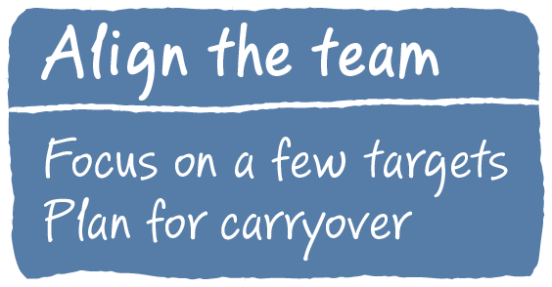
The Fast Feedback Cycle
Notes:
Content reference:
Scenario-Focused Engineering: A toolbox for innovation and customer-centricity (Developer Best Practices) December 24, 2014
by Austina De Bonte, Drew Fletcher
http://www.amazon.com/Scenario-Focused-Engineering-innovation-customer-centricity-Developer/dp/0735679339

Slide 13
Notes:
Example of carryover
Update to the new can opener pictures from the book

Slide 14
People who eat food
People with arthritis
People who eat food from cans
One-size-fits-all never wins.
Notes:
Believe that one-size-fits-all never wins
Find your customer’s unspoken needs & desires

Slide 15
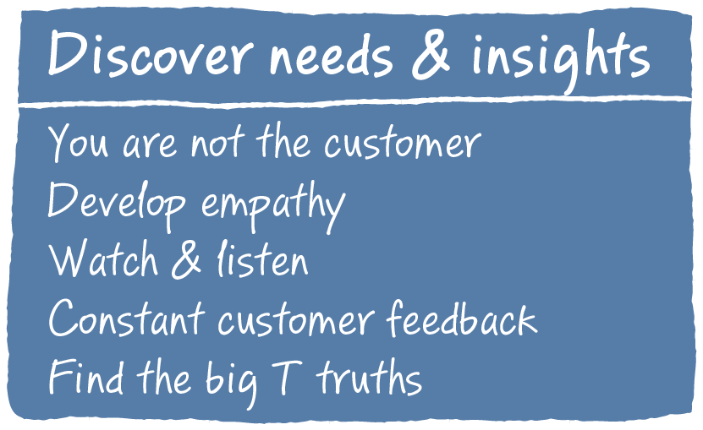
The Fast Feedback Cycle
Notes:
Content reference:
Scenario-Focused Engineering: A toolbox for innovation and customer-centricity (Developer Best Practices) December 24, 2014
by Austina De Bonte, Drew Fletcher
http://www.amazon.com/Scenario-Focused-Engineering-innovation-customer-centricity-Developer/dp/0735679339

Slide 16
 | Need (WHAT) | Insight (WHY)
Kindle | Read books anywhere | Books are heavy, and I can never decide which ones I will want later. I can carry all of my books with me wherever I go, so I always have lots of options.
Facebook | Share notes and pictures among friends | It makes me feel good when I am validated (“liked” or “commented” on). Secretly, I like to “spy” on people and compare my life with theirs.
Notes:
A few key examples by picture
Difference between needs & insights (what vs. WHY)

Slide 17
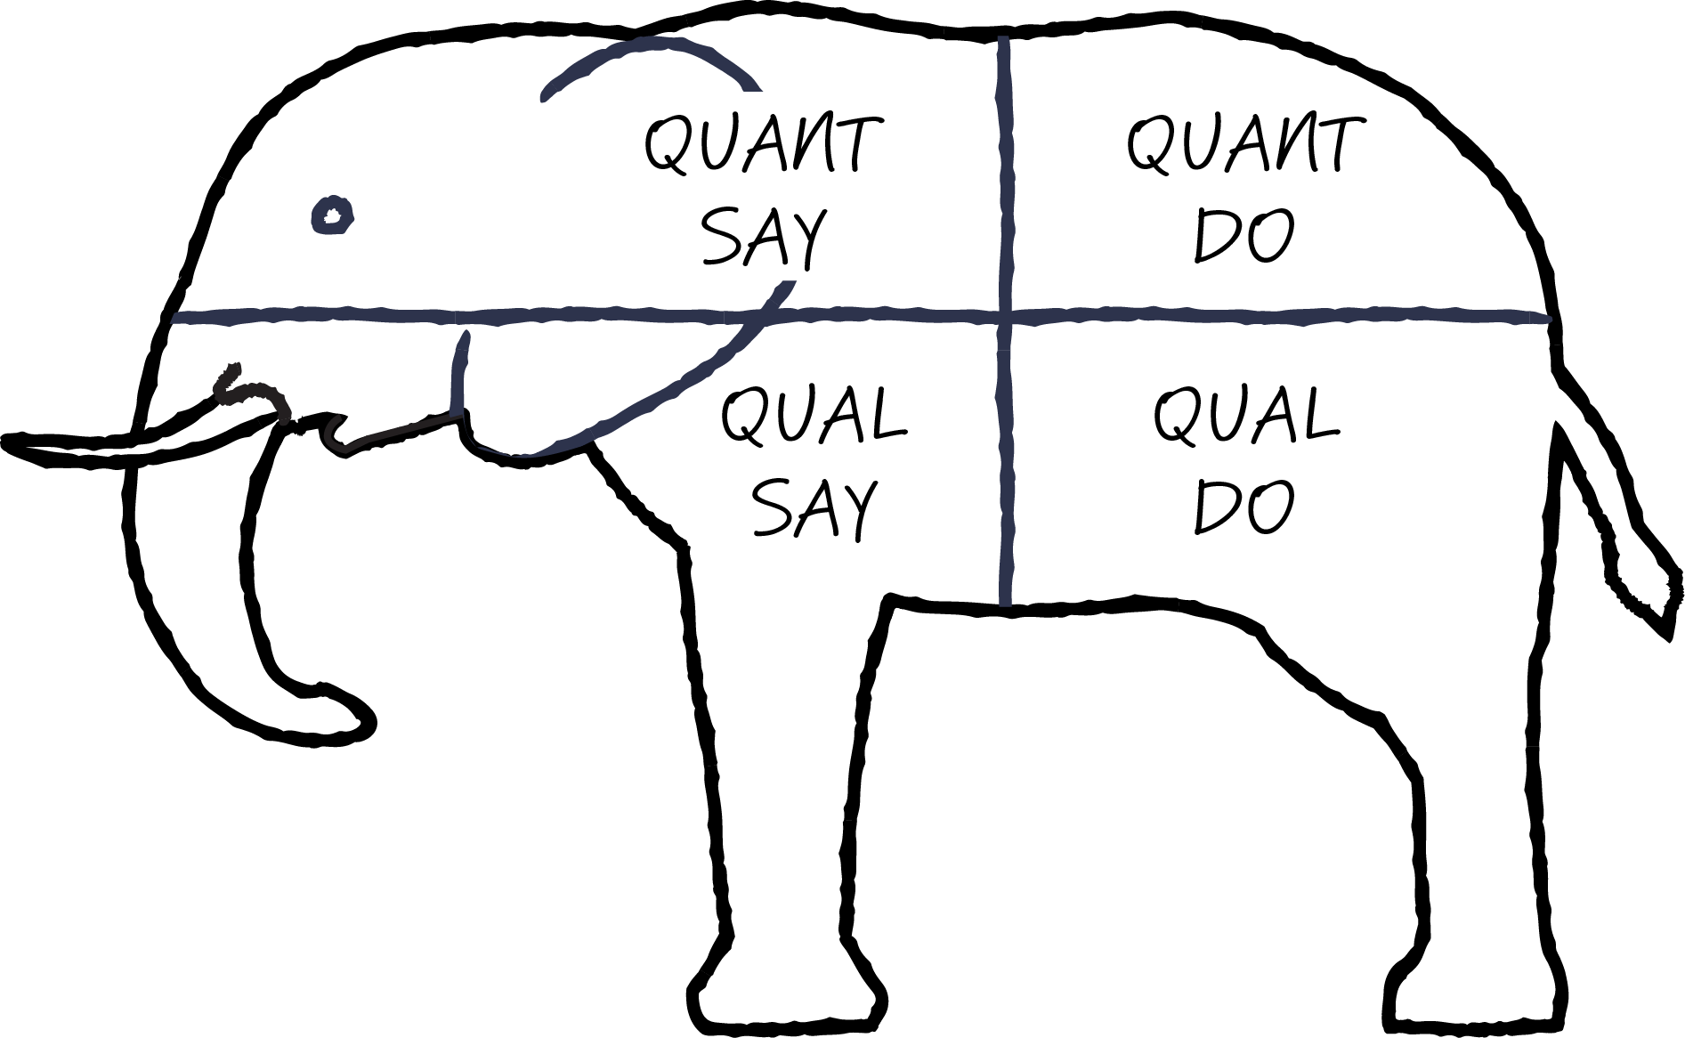
QUANT (quantitative)
taking measurements
DO (objective)
watching what customers do
SAY (subjective)
listening to what customers say
QUAL (qualitative)
unstructured, but full of insight
Notes:
Old story of the 4 blind men and the elephant… One felt the tusk, another the tail, another the skin, another the ear.
You need all of the perspectives to really understand the elephant. No one quadrant is enough.
Triangulating
How do you currently find out customer needs?
Debunk focus groups (& usability) – promote observation
Highlight particular methods that are very relevant for this company/group

Slide 18
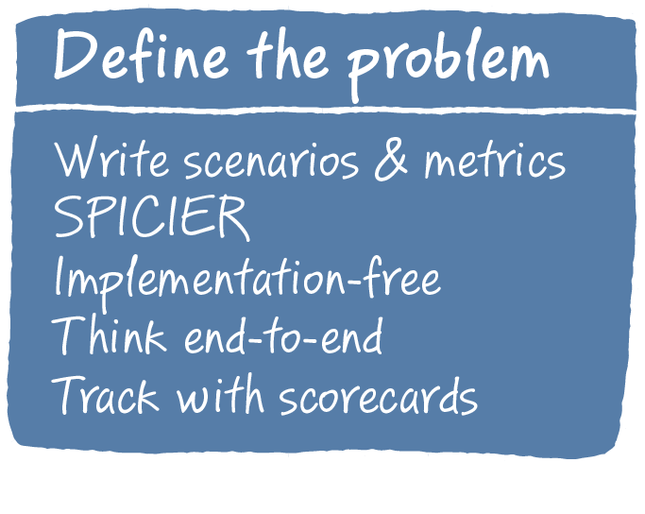
The Fast Feedback Cycle
Notes:
Content reference:
Scenario-Focused Engineering: A toolbox for innovation and customer-centricity (Developer Best Practices) December 24, 2014
by Austina De Bonte, Drew Fletcher
http://www.amazon.com/Scenario-Focused-Engineering-innovation-customer-centricity-Developer/dp/0735679339

Slide 19
Why bother framing?
What problem are you trying to solve?
What does success look like?
Align teams & partners
Unit to measure, track & iterate over the project
Resist the urge to jump to solutions!
Notes:
What problem are you trying to solve?
Aligning teams & partners
Unit of governance – measure, track & iterate over the course of the project
What does success look like?
Focus on the end to end experience, not features

Slide 20
"While we are a coffee company at heart, Starbucks provides much more than the best cup of coffee—we offer a community gathering place where people come together to connect and discover new things. Starbucks represents something beyond a cup of coffee.” Howard Schultz CEO

Slide 21
put photos on a website
automatically file share photos directory with grandparents
print photos and give to them
send directly from phone
John wants to share the latest kid pictures with grandparents
email pictures
easy to use kiosk in retail outlet
easy template for emailing
online slideshow
plug memory card directly into a printer
see pictures for people in my social network
email slideshow
print photos, books, cards
put photos on a CD
send photo via instant messaging
show pictures on TV screen
send photo via billboard
Notes:
Implementation free

Slide 22
put photos on a website
automatically file share photos directory with grandparents
print photos and give to them
send directly from phone
John wants to email the latest kid pictures to the grandparents
email pictures
easy to use kiosk in retail outlet
easy template for emailing
online slideshow
plug memory card directly into a printer
see pictures for people in my social network
email slideshow
print photos, books, cards
put photos on a CD
send photo via instant messaging
show pictures on TV screen
send photo via billboard
Notes:
Implementation free

Slide 23
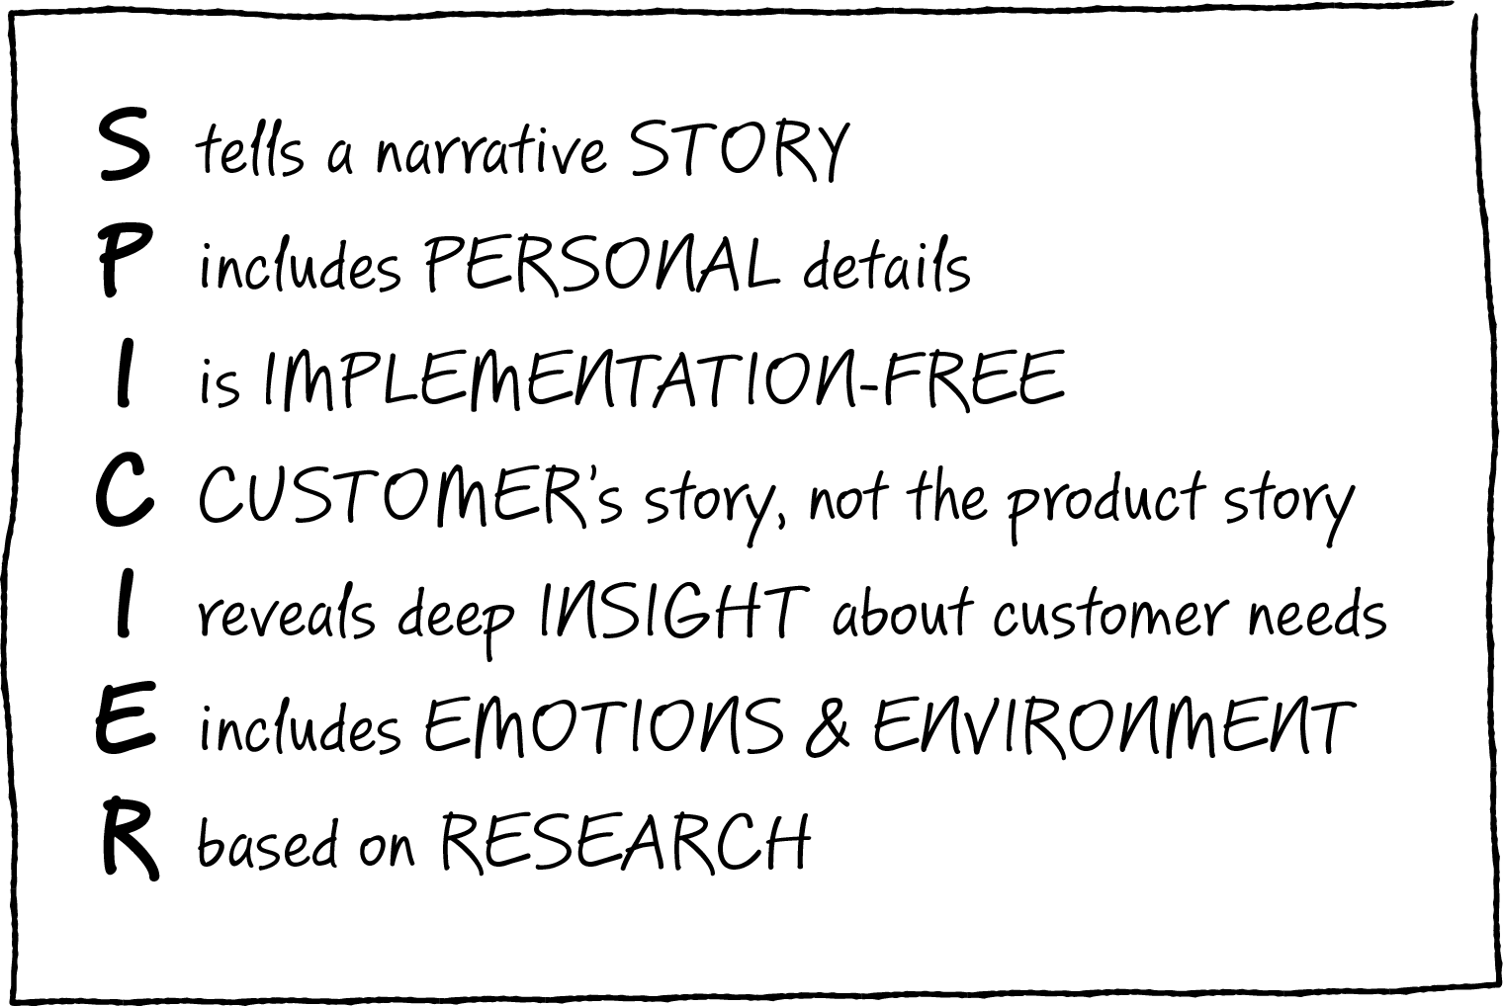
TRY: Scenario formula
Notes:
SPICIER

Slide 24
TRY: Scenario formula
One-line headline
Introduction: Who is the customer? What motivates them?
Situation: What is the specific real world situation? What problem needs to be solved?
<magic happens>
Outcomes: What does the customer accomplish? What are the success metrics? How would you know if you came up with a good solution?
Notes:
One-line headline
Introdution: who is the customer, what motivates them?
Situation: what is the specific, real-world situation?
<Magic happens>
Outcomes: with specific outcomes has the customer accomplished? What are the key metrics for success?

Slide 25
Jessica conquers international formats
Jessica is a sales specialist at a small European company that sells wind turbines internationally. One of her main responsibilities is collecting sales leads and sending out about 500 sales circulars per month to prospects and her boss doesn’t understand why it takes so long. Her information comes from multiple sources: some leads she finds on her own via the web, others are provided to her by outside services and given to her in Excel files, and some come from other employees via individual emails. Each source uses different country formats, conventions, and layouts – who knew there were that many different ways of formatting an address and phone number! She is frustrated that this busy work causes her to fall behind on her leads generation work.
Jessica can easily get 500 international mailing addresses compiled into one place and standardized into a consistent format, ready to print mailing labels, without any manual editing, and in under 10 minutes. Even better, she is able to repeat this task quickly in the future. Jessica is relieved that she no longer has to spend countless hours manually editing her data, freeing her up to spend more time acquiring greater quantity and quality of leads.
<magic happens>

Slide 26
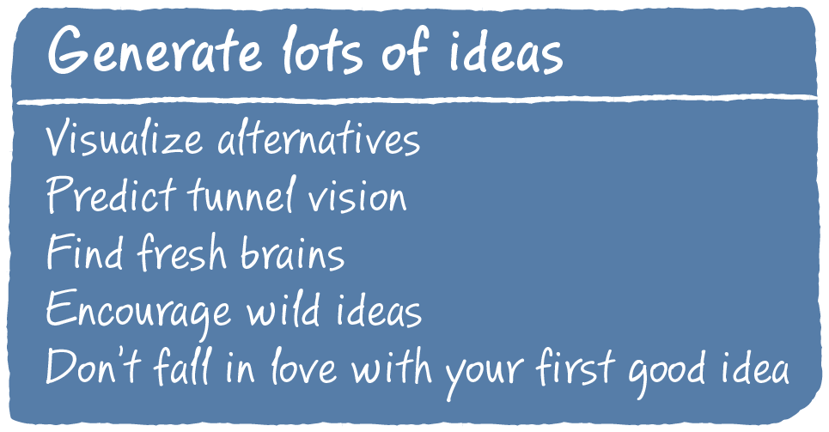
The Fast Feedback Cycle
Notes:
Content reference:
Scenario-Focused Engineering: A toolbox for innovation and customer-centricity (Developer Best Practices) December 24, 2014
by Austina De Bonte, Drew Fletcher
http://www.amazon.com/Scenario-Focused-Engineering-innovation-customer-centricity-Developer/dp/0735679339

Slide 27
TUNNELVISION
Notes:
Have you ever been in a situation where you had a plan worked out…
But you had this niggling feeling like there must be a better way
And so you sit yourself down
And you can’t manage to come up with a single new idea
That’s tunnelvision
You are not alone, and thinking about it harder isn’t going to help.
See the reason WHY….

Slide 28
It is not just luck, think laterally
Generate ideas: wishful thinking, reversal
Challenge with why: new look at everyday
Broaden where you look for ideas: new math
Structure time and place
Harvest carefully to get more value from idea generating output
Introduce real-world constraints
Edward DeBono Lateral Thinking

Slide 29
Lateral Thinking with New Math
Soccer + Battery + Kids
"Our first prototype was a hamster ball with shake-to-touch torch inside [a torch that stores charge when shaken.] We rolled it around and when we switched on the torch the light came on, so we thought this could work," Silverman said.
"We then moved to a ball with a bladder that had a light fitted into it. But the model being tested at the 2010 World Cup is the Soccket 2.0, which has a DC jack. So any appliances that have a compatible plug would work.”
Julia Silverman, one of 4 co-inventors, Harvard students. "Soccket" ball

Slide 30
TRY: Lateral thinking
Set up a structured session with dedicated facilitator
Establish the topic in advance, based on business need
Select 2-3 techniques
Time box
5 minutes set rules and topic
2 minutes warm up
15 minutes technique 1
Assess progress
15 minutes technique 2
Discuss results
Define areas to investigate
Hint: When you start, don’t have managers/leadership participate.

Slide 31
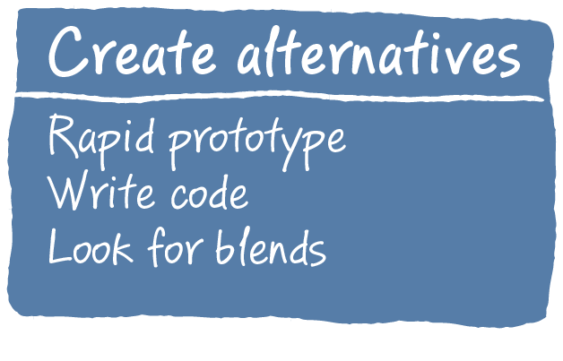
The Fast Feedback Cycle
Notes:
Content reference:
Scenario-Focused Engineering: A toolbox for innovation and customer-centricity (Developer Best Practices) December 24, 2014
by Austina De Bonte, Drew Fletcher
http://www.amazon.com/Scenario-Focused-Engineering-innovation-customer-centricity-Developer/dp/0735679339

Slide 32
Many types of sketches
Notes:
Lots of pictures that build – both storyboards of UI, storyboards of stick figures, and flow charts
Fast forward icon

Slide 33
Rapid prototypes
Notes:
Paper prototype – show the video?
Server paper prototype -> PPT toolkit UI
Mobile prototype - using POP
Flow chart example – create
Doing a skit for process flow – make a picture???
Prototyping an API: write the docs, read this code tell me what it does, open book close book…

Slide 34
The Fast Feedback Cycle
Notes:
Content reference:
Scenario-Focused Engineering: A toolbox for innovation and customer-centricity (Developer Best Practices) December 24, 2014
by Austina De Bonte, Drew Fletcher
http://www.amazon.com/Scenario-Focused-Engineering-innovation-customer-centricity-Developer/dp/0735679339

Slide 35
Feedback with Quick Pulse
keep the customers coming through
Notes:
Example
Visual Studio Application Tools Team set up weekly customers
Anyone can sign up
Informal way to get feedback at any time
TFS, BING – Quick pulse studies
Run by researcher
Then set up company wide
Researcher: Miki Kanno

Slide 36
TRY: Quick Pulse Feedback
Rules
Set up the process
Select the tools
Create a customer pipeline
Keep it really simple
Train qualified teammates
Best time
Get team hooked early
Run every week, without fail
User research sets it up and lets go
Miki Kanno

Slide 37
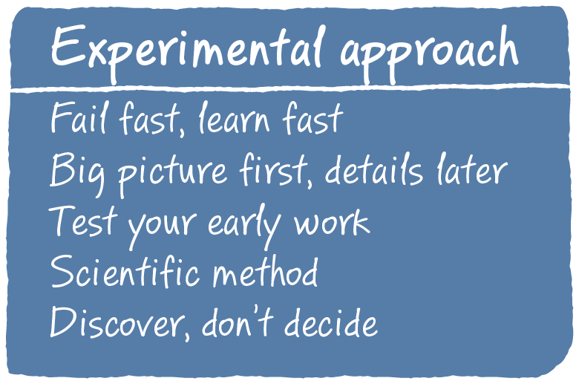
The Fast Feedback Cycle
Notes:
Content reference:
Scenario-Focused Engineering: A toolbox for innovation and customer-centricity (Developer Best Practices) December 24, 2014
by Austina De Bonte, Drew Fletcher
http://www.amazon.com/Scenario-Focused-Engineering-innovation-customer-centricity-Developer/dp/0735679339

Slide 38
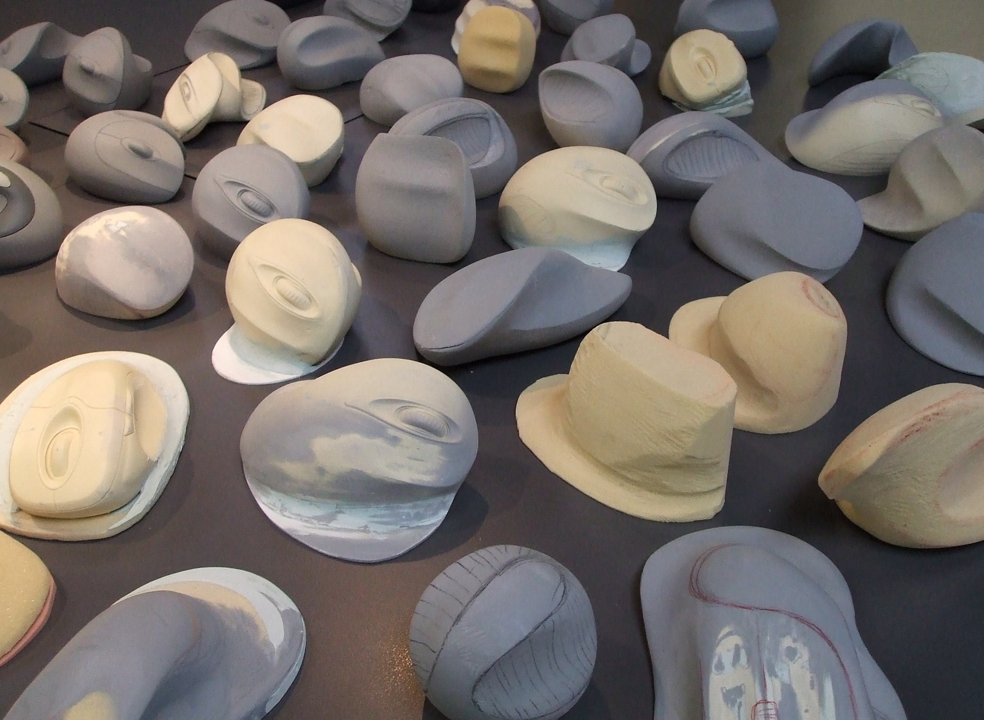
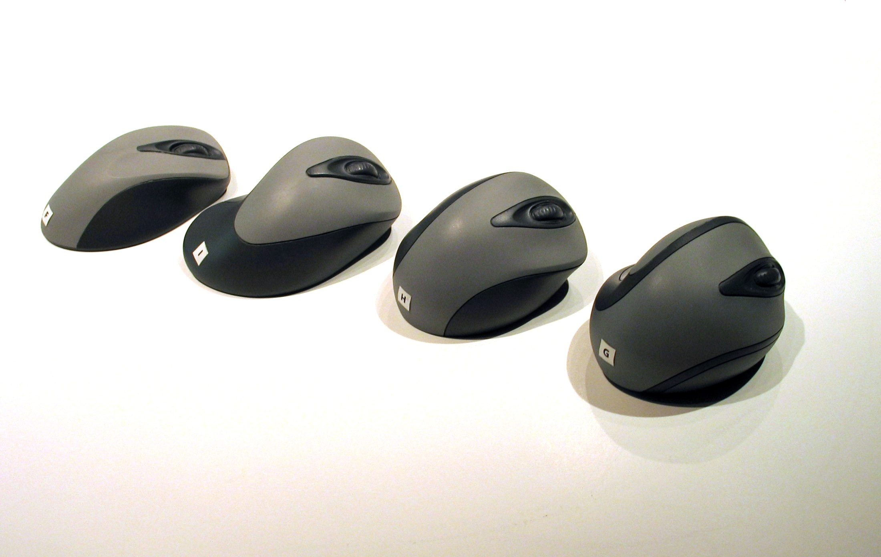
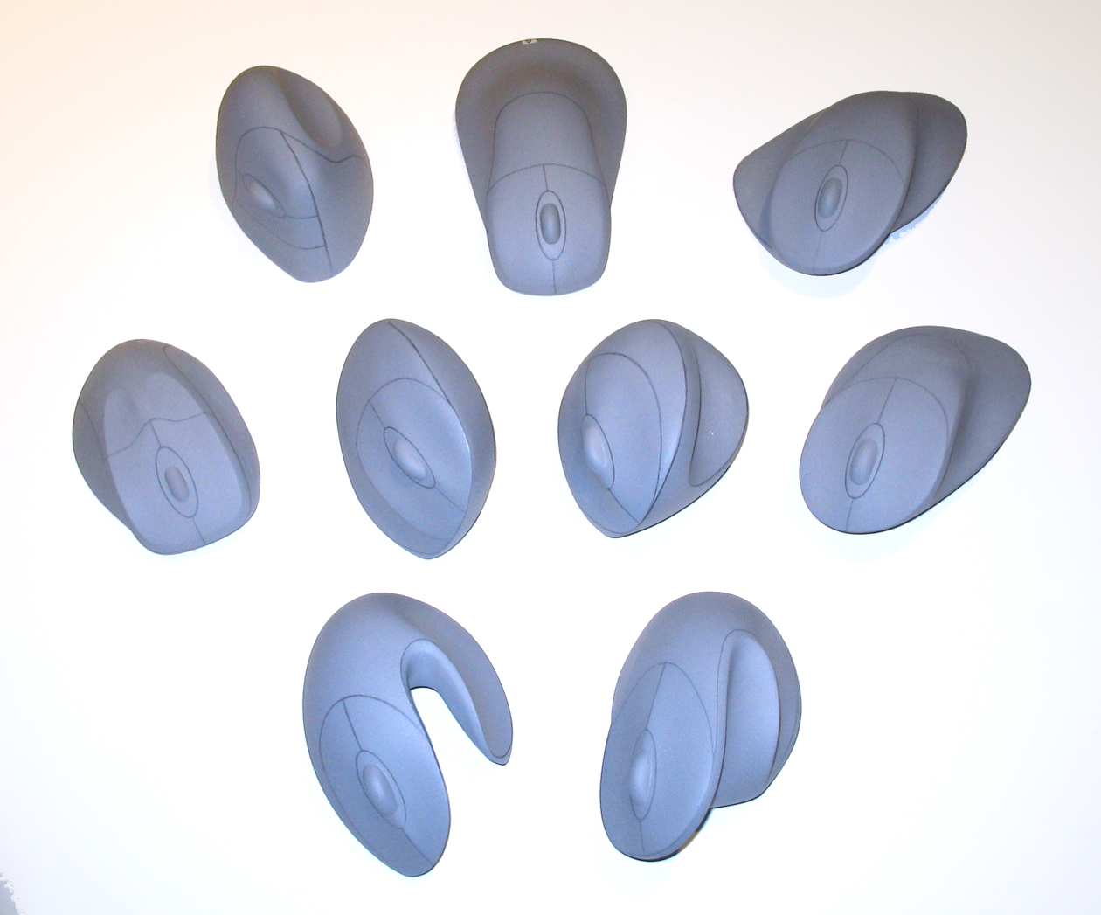
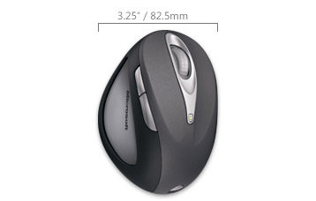
Notes:
Content reference:
Scenario-Focused Engineering: A toolbox for innovation and customer-centricity (Developer Best Practices) December 24, 2014
by Austina De Bonte, Drew Fletcher
http://www.amazon.com/Scenario-Focused-Engineering-innovation-customer-centricity-Developer/dp/0735679339

Slide 39
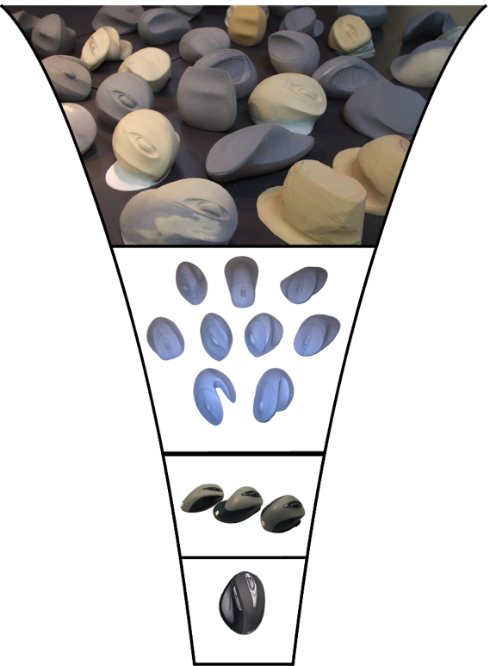
Notes:
Mice in the funnel shape
Pages fig 10-1
Mice build up,
Then into funnel

Slide 40
Which funnel do you want?
Notes:
Bad funnels
Fig 10-2 (add E reverse funnel dotted lines at end)
Add an E that is neverending brainstorming that never converges, horizontal line

Slide 41
TRY: Parallel Iteration
Set out 3 distinct solutions
Test with customers
Work low-fi, work fast
Take best parts, combine
Repeat
Paula Bach: Fast Iterative Prototyping
http://www.hcde.washington.edu/521/win12/mar16
Notes:
Call out to Bill Buxton
Sketching User Experiences: Getting the Design Right and the Right Design (Interactive Technologies) 1st Edition
http://www.amazon.com/dp/0123740371/?tag=mh0b-20&hvadid=3482640548&hvqmt=b&hvbmt=bb&hvdev=c&ref=pd_sl_7hm544ipqe_b

Slide 42
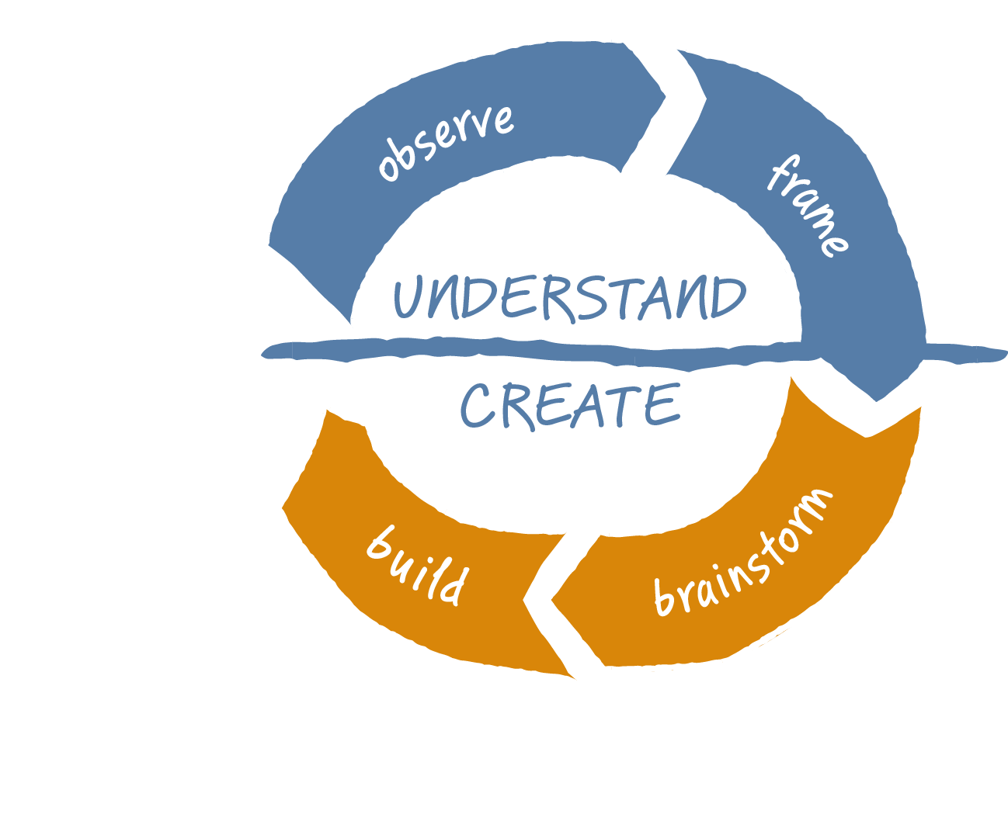
Understand - Create
Notes:
Let’s go back to the Fast Feedback Cycle
Unpack it
There are some hidden patterns that are important to be aware of

Slide 43
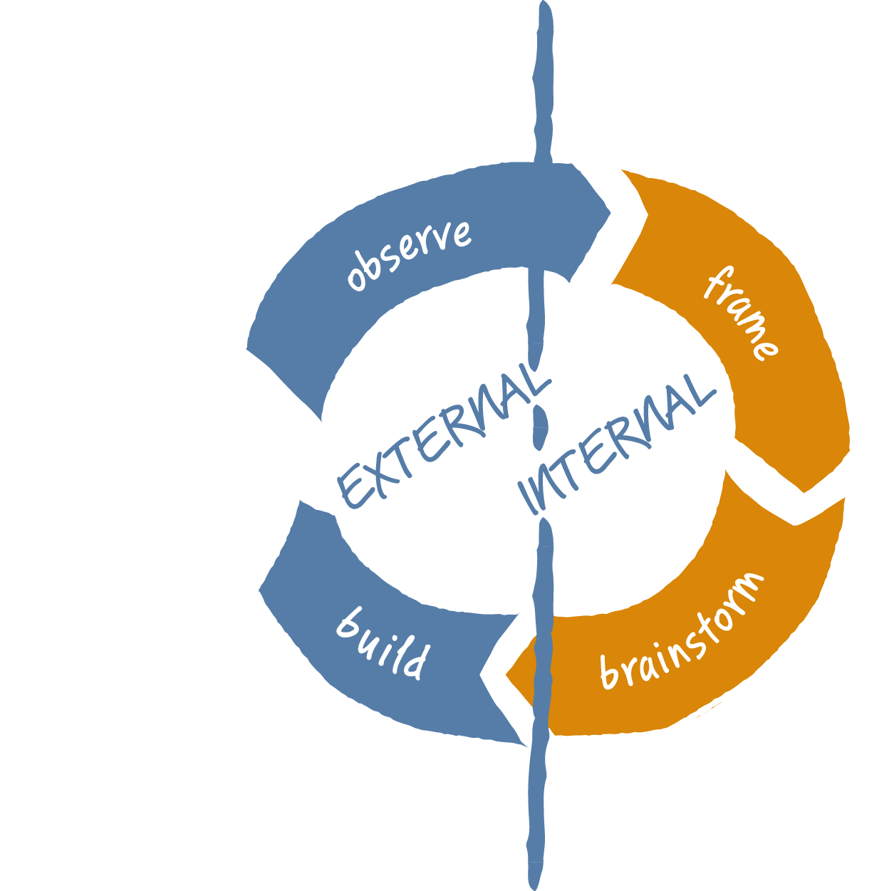
External - Internal

Slide 44
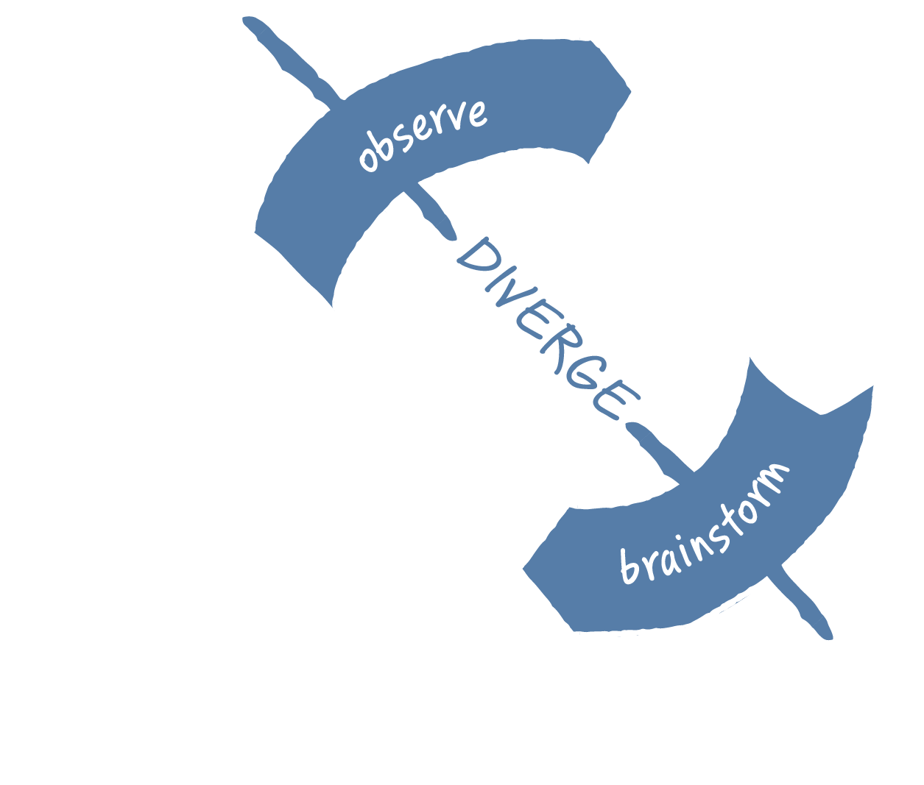
Diverge – create options
Notes:
Let’s go back to the Fast Feedback Cycle
Unpack it
There are some hidden patterns that are important to be aware of

Slide 45
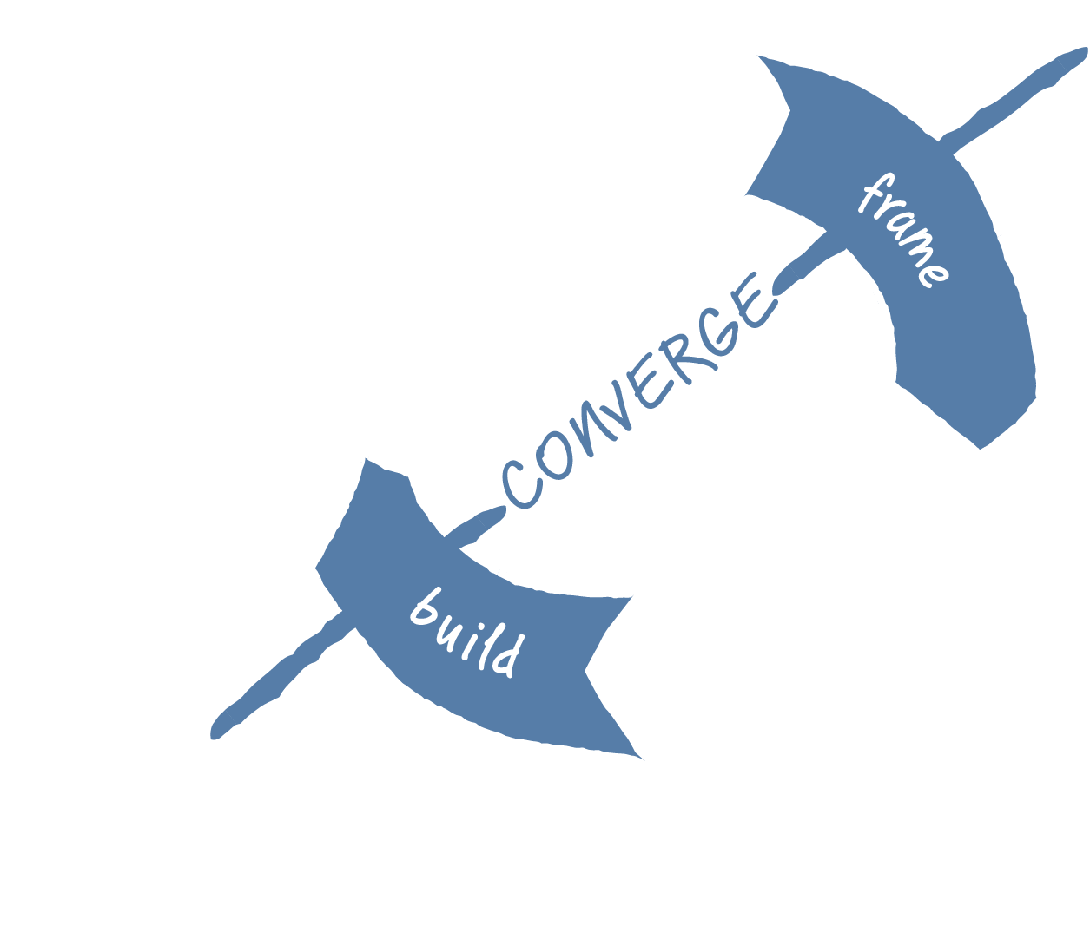
Converge – make decisions
Notes:
Let’s go back to the Fast Feedback Cycle
Unpack it
There are some hidden patterns that are important to be aware of

Slide 46
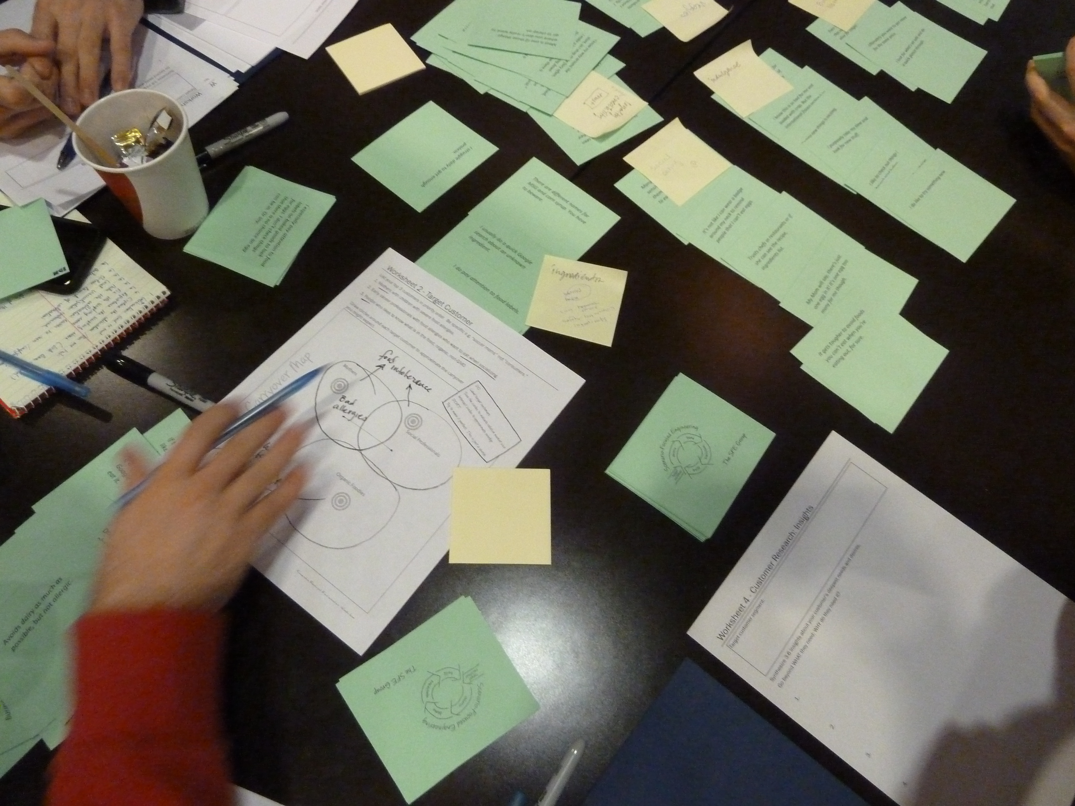
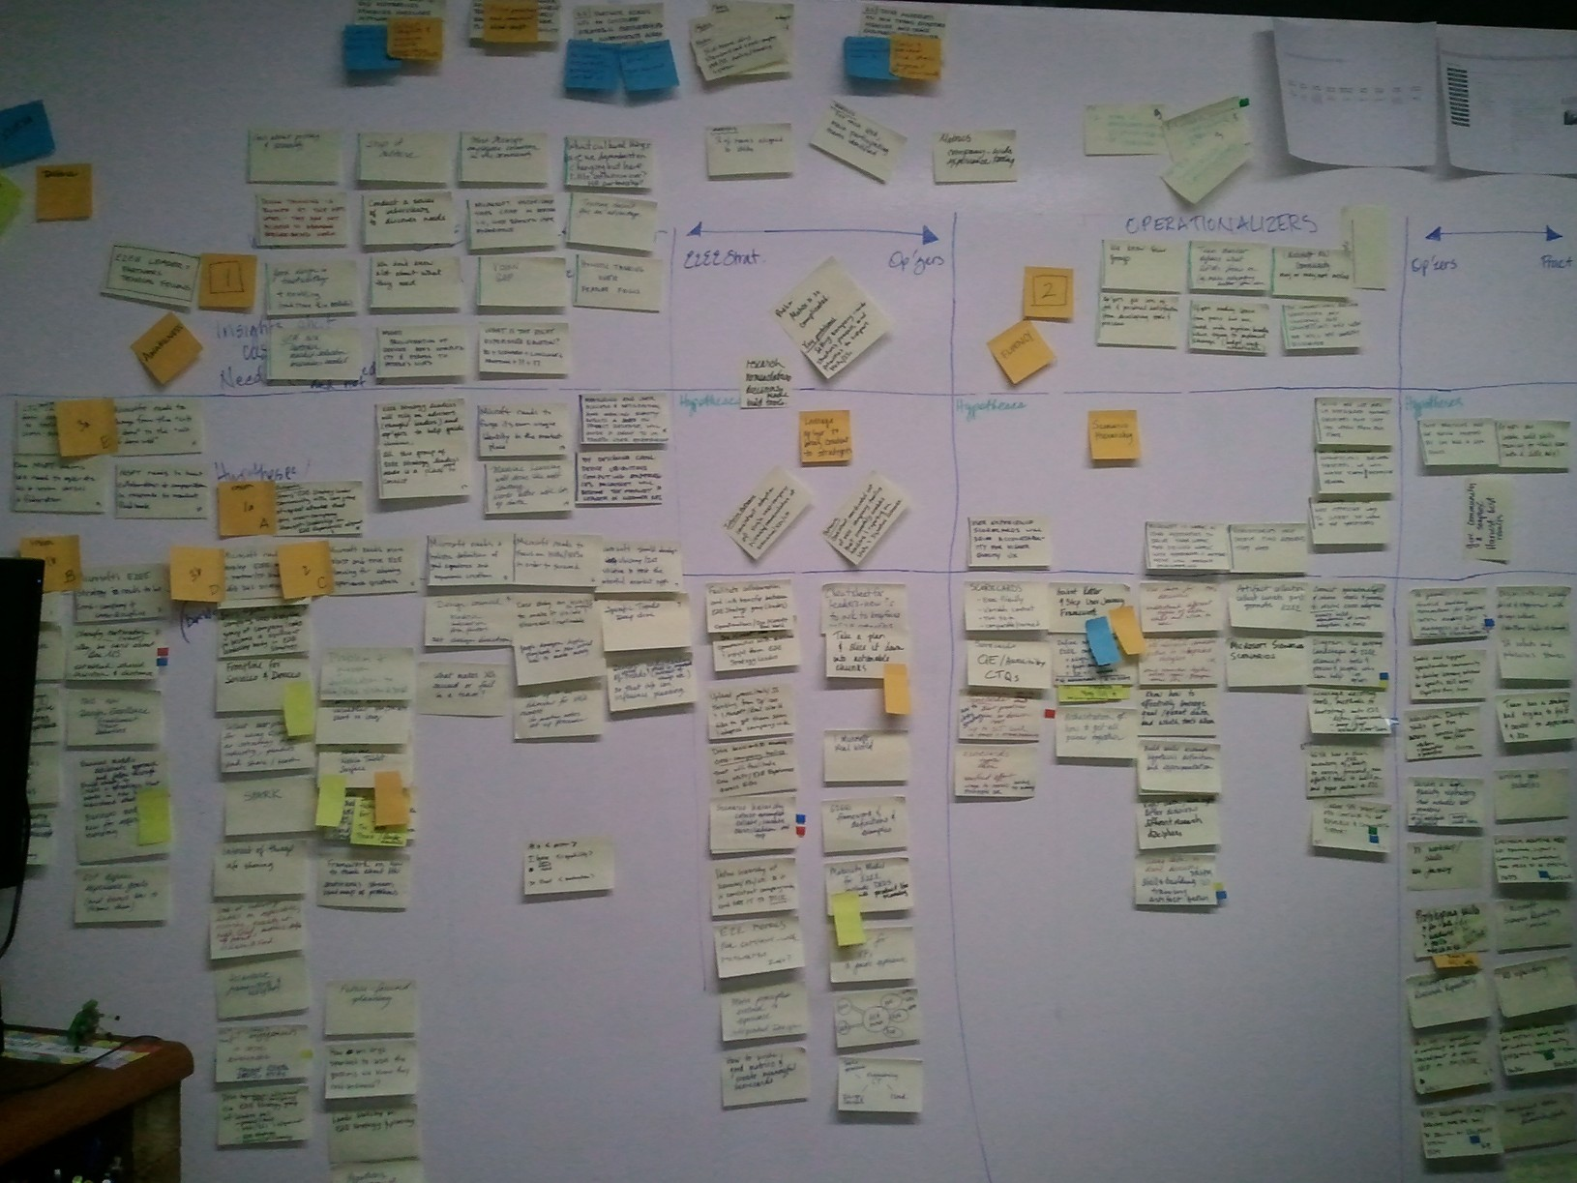
TRY: All in Collaboration
It’s a team sport
Include all disciplines
Deliberately work to build trust
Work outloud
Change early deliverables
Define team objectives, not individual ones

Slide 47
Why design thinking?
Takes us out of our rut.
Broadens our perspective.

Slide 48
Focus on needs of humans
Learning through building
Active participation of community
Focus on systems not objects
Opens to bigger impact

Slide 49
Outputs of design thinking:
New marketing
New business models
New products
New team culture

Slide 50
Your biggest risk is building the wrong thing.
Your best insurance policy is to:
Believe that one-size-fits-all never wins
Find your customer’s unspoken needs & desires
Diverge while your brain is fresh
Experiment with multiple ideas
Leverage the brainpower of your entire team

Slide 51
But…
It’s awkward
Uncomfortable to stay longer in unknown
Early deliverables are really different
Already have great ideas
Converging muscle is too strong
Effective diverging requires new skills
“Its not in my job description, not why I get paid.”
“Just decide and get on with it.”

Slide 52
"Organizations resist change because they're made up of individuals who are working at what has always worked."
Roger Martin, Rotman School of Management

Slide 53
Start
Start small, pick a specific experience to try.
Start with customer research.
Time box diverging activities like brainstorming.
It takes time to build trust.
Make it a team sport
Involve all disciplines
Converge carefully, follow the funnel.
Write team objectives, team status reports instead of individual.

Slide 54
Scenario-Focused Engineering
Save 40% at The Microsoft Press Store
Code SFE40
Expires January 31, 2016
Thank you
Jeanine Spence
Experience Strategist
Current Associates
www.linkedin.com/in/jeaninespence
jeanine@currentassociates.com
The SFE Group
www.sfeinfo.com
Design Thinking for Engineers
Scenario-Focused Engineering Workshop
Customer Experience as Your Strategic Advantage
Writing Effective Scenarios Workshop
Notes:
The SFE Group
Works directly with organizations large and small to transform how teams work. We guide, coach and train engineers on how to incorporate design thinking into engineering practices.
Contact: http://www.sfeinfo.com/#!contact/cce3
About The SFE Group
We think there is a better way to engineer software.
That innovation and creativity can be taught, and
that there is science behind it, not just art.
We are engineers, who together have more than 35 years of experience designing, building, and shipping software products and online services.
We figured out how to explain the non-analytical principles of innovation and design to a hard-core analytical engineering audience, which in many cases led to some significant change in the ways teams think and work.
Over the past 6 years we got it down to a science. Now we are taking SFE on the road, as we think these ideas are just as powerful for the rest of the industry.
*Scenario-Focused Engineering Workshop*
We think there is a better way to engineer software. We believe that innovation and creativity can be taught, and that there is science behind it, not just an art. This workshop bridges the gap between the power of analytical, deductive reasoning and the seemingly unstructured world of creativity, innovation, and customer delight. We present both the methods (things you do) and the mindsets (attitudes and points of view) that have been proven over time to be effective tools for creating innovative products customers love.
Through a series of hands on exercises we explore the cultural and process implications of putting the customer first. Along the way we’ll teach you techniques like writing scenarios, brainstorming, iteration, and how to get frequent feedback so that your team can create innovative end-to-end solutions that solve customer’s real life problems.
Whether you work in software, hardware, or operations, you will learn:
-Why delighting customers matters
-The importance of end-to-end experiences
-How to solve customer's real-world problems
-How to align disparate teams around customer needs & insights
-How to use iteration to rapidly test innovative ideas
-How to assess your team’s customer-centric capabilities
-Strategies for integrating SFE methods & mindsets in your own organization

Slide 56
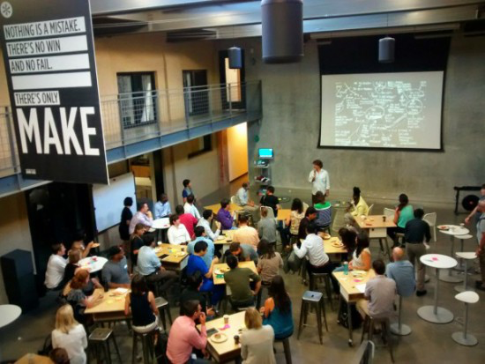
Continuing the discussion
Scenario-Focused Engineering: a toolbox for innovation and customer centricity by Austina De Bonte, Drew Fletcher
http://www.amazon.com/Scenario-Focused-Engineering-innovation-customer-centricity-Developer/dp/0735679339
Stanford d.school’s Virtual Crash Course
http://dschool.stanford.edu/dgift/
Tim Brown : IDEO
http://designthinking.ideo.com
Roger Martin: Rotman School of Management University of Toronto
https://www.rotman.utoronto.ca/FacultyAndResearch/EducationCentres/DesignWorks/About%20DW.aspx
Harvard Business Review – Design Thinking
https://hbr.org/2008/06/design-thinking&cm_sp=Article-_-Links-_-Top%20of%20Page%20Recirculation
Notes:
Explore on your own.
Try out these resources.

