Slide 1
Creating a Debt Aware Culture
Aaratee Rao
Nov 18th 2015
QCon, San Francisco

Slide 2
My Professional Experience

Slide 3
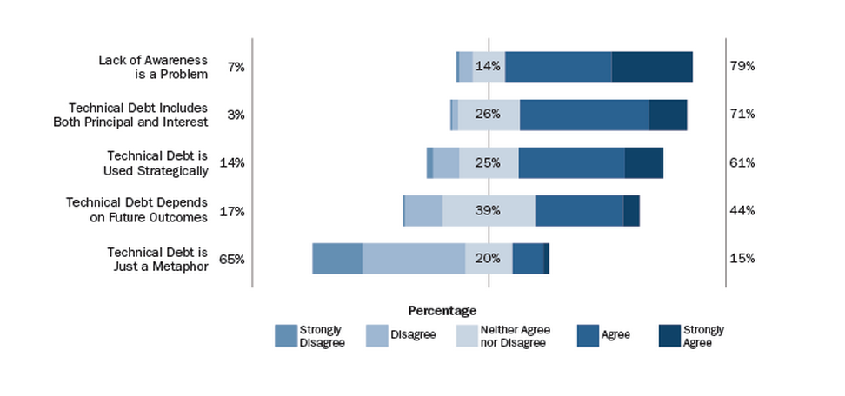
Technical Debt Awareness
https://insights.sei.cmu.edu/sei_blog/2015/07/a-field-study-of-technical-debt.html
reference :SEI

Slide 4
Awareness amongst Senior Management
http://www.ambysoft.com/surveys/agile2015Q1.html

Slide 5
Outline
What, Why and Who?
Identify & Evaluate
Payment strategy
Case study
Q & A

Slide 6
Little History
(1974) "Increasing Complexity" — as a system evolves, its complexity increases unless work is done to maintain or reduce it
(1996) "Declining Quality" — the quality of a system will appear to be declining unless it is rigorously maintained and adapted to operational environment changes
Meir Manny Lehman

Slide 7
"Shipping first time code is like going into debt.”
"A little debt speeds development so long as it is paid back promptly with a rewrite... The danger occurs when the debt is not repaid.”
Every minute spent on not-quite-right code counts as interest on that debt.
Ward Cunningham

Slide 8
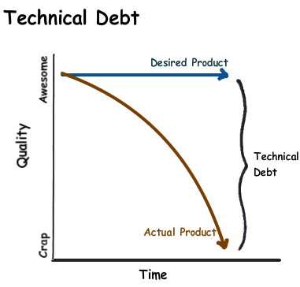
Many have explained the debt metaphor and confused it with the idea that you could write code poorly with the intention of doing a good job later.
— Ward Cunningham, 1992

Slide 9
Benefits
Useful Tool
Opportunity Cost
Productivity

Slide 10
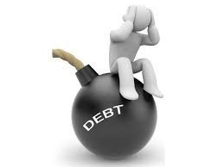
Costs
Interest
Risk
Real Financial Cost

Slide 11
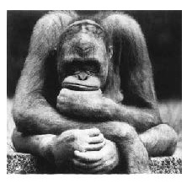
Morale Killer!

Slide 12
PRODUCT
MANAGEMENT
CUSTOMER
SUPPORT
DEVELOPER
OPERATIONS

Slide 13
Poor Designed Architecture
Time Crunch
Defects
Outdated Documents
Complexity
Incomplete Test Coverage
Technical Debt
Poor Coding Habits
Environment

Slide 14
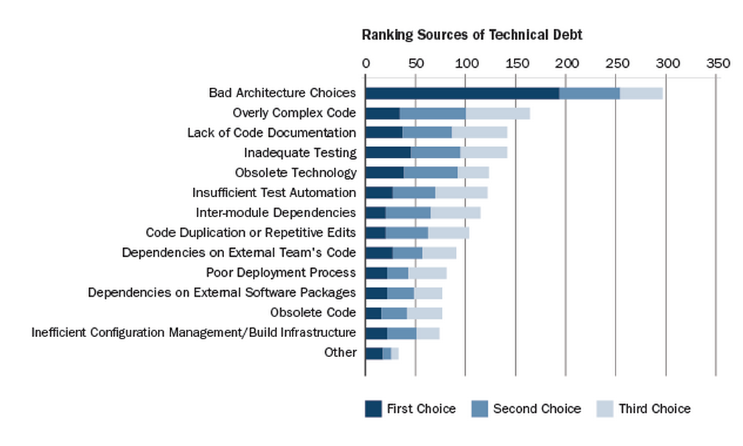
Sources of Technical Debt
https://insights.sei.cmu.edu/sei_blog/2015/07/a-field-study-of-technical-debt.html
reference :SEI

Slide 15
Common Behaviors
Production Issues
Velocity
Bugs
Morale
Stress
Single point of failure
Customer complaints

Slide 16
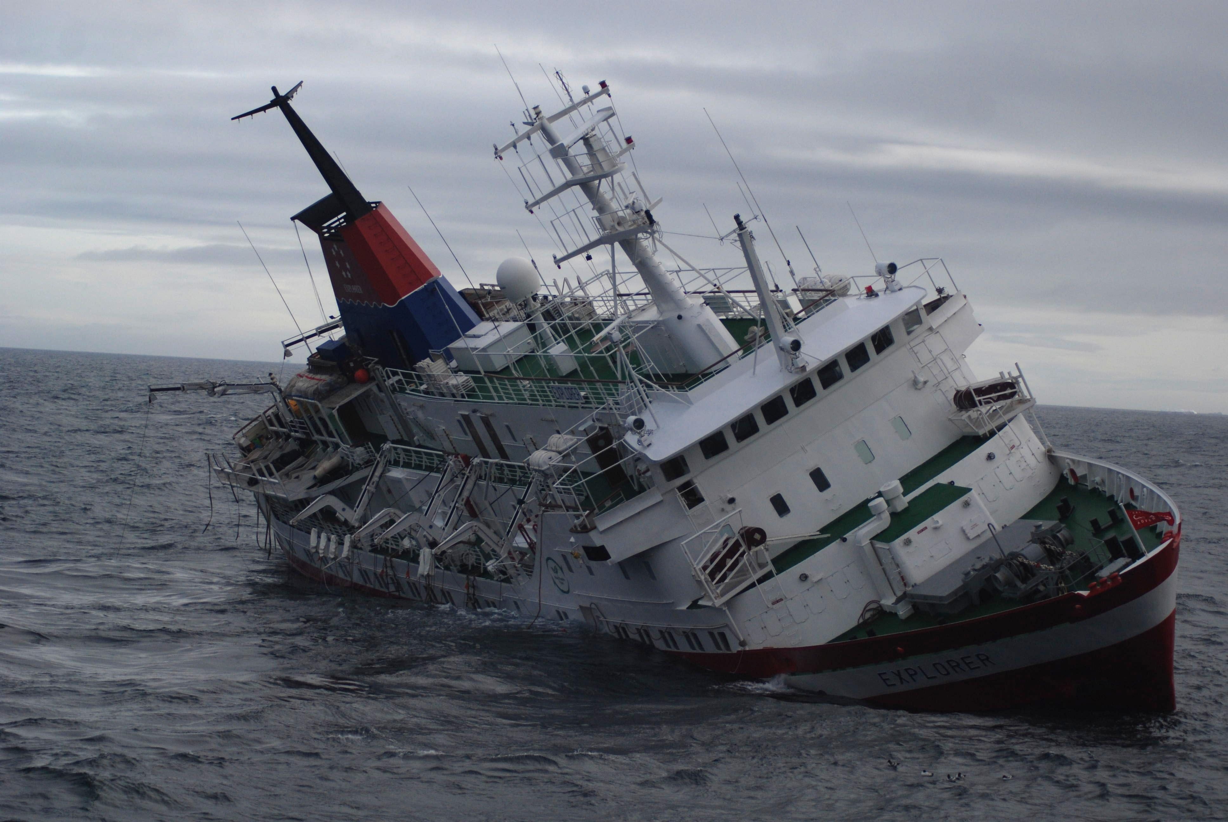
Case Study A
New product launch with intentional technical debt

Slide 17
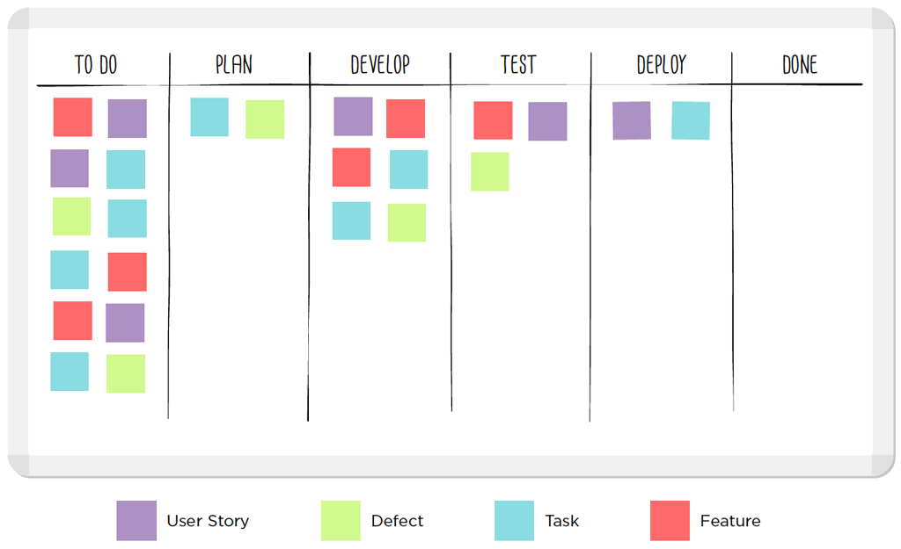
Managing Technical Debt
Separate TD backlog
Prioritize
Amortize debt payment
Boy’s scout rule

Slide 18
Case Study B
Technical Debt incurred by hypergrowth and outsourcing

Slide 19
Training
Rewards
Relevant process

Slide 20
Definition of DONE
Design Review
Tests
Code Reviews
Integration
Documentation
Approved
Monitoring

Slide 21
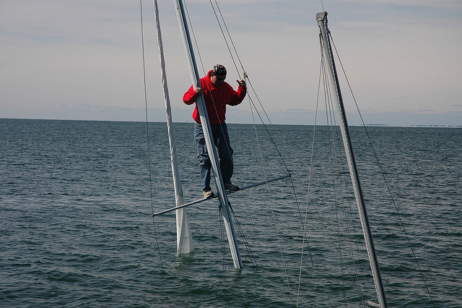
Case Study C
Technical Debt incurred due to acquisition of a startup

Slide 22
Payment Strategy
Estimated Principal
Estimated Interest Amount
Estimated Interest Probability

Slide 23
Final Thoughts
“Avoid being a perfectionist in a world of finite resources”
- Forest Shell
"Stop perfecting, start experimenting"

Slide 24
aaratee@uber.com

