Slide 1
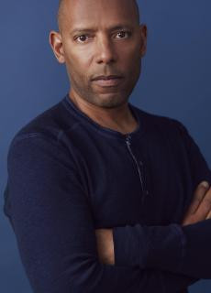
Bias in BigData/AI and ML
Leslie Miley
Engineering Leadership, previously of Slack, Google, & Apple

