Slide 1
Scale @ Reddit
Tripling The Team Size
Without Losing Control

Slide 2
Nick Caldwell
Reddit, Inc. VP of Engineering
Microsoft, Power BI General Manager
MIT ’03
Berkeley Haas ‘15
Nick Caldwell Reddit | VP Eng
Notes:
Experienced starting teams across a multitude of technologies and different sizes
Machine learning, nlp SWAT projects
Statistical Spellchecker, back in 2004, works in more than 100 languages, 10 people
Bunch of teams in Office including the Mailbox intelligence pipeline for Exchange that does text analytics and ML on about a trillion mails per yea
InfoNavigator
Natural language Q&A system for datasets, kicked off by Bill Gates, 30 people
Power BI general manager
Started with about 10 people and grew to more than 500 over the course of 3 years
Last year reached the millionth subscriber and took the leadership spot in the garner magic quadrant

Slide 3
What is reddit
Reddit is the frontpage of the internet
A social network where there are tens of thousands of communities around whatever passions or interests you might have
It’s where people converse about the things that are most important to them
Notes:
Reddit is the frontpage of the internet
A social network where there are tens of thousands of communities around whatever passions or interests you might have
It’s where people converse about the things that are most important to them

Slide 4
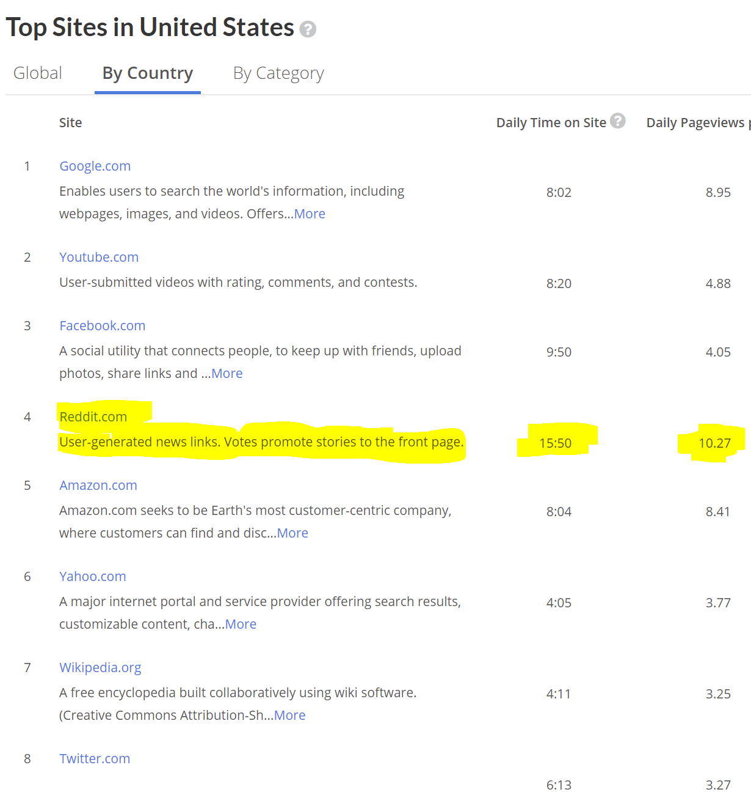
Engagement

Slide 5
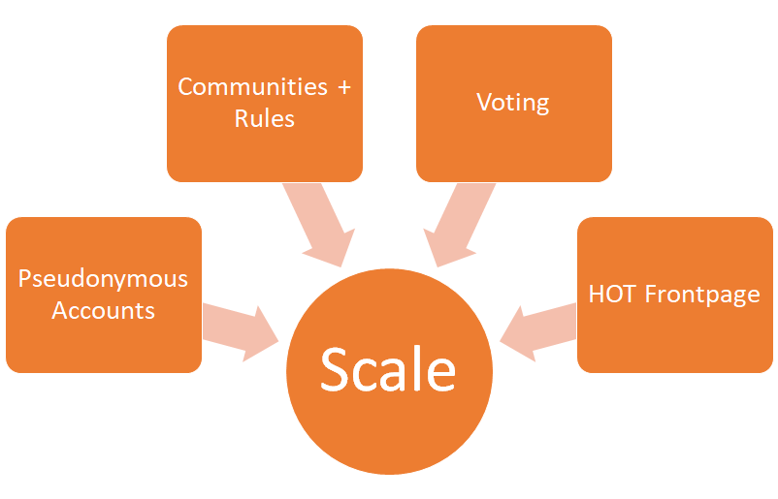
How Reddit Works
SCALE
ENDLESS CONTENT ENDLESS CONTENT ENDLESS CONTENT ENDLESS CONTENT ENDLESS CONTENT ENDLESS CONTENT ENDLESS CONTENT ENDLESS CONTENT ENDLESS CONTENT ENDLESS CONTENT ENDLESS CONTENT ENDLESS CONTENT ENDLESS CONTENT ENDLESS CONTENT ENDLESS CONTENT ENDLESS CONTENT ENDLESS CONTENT

Slide 6
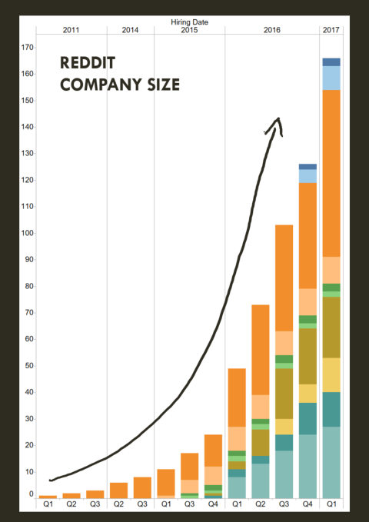
Reddit SCALE
REDDIT COMPANY SIZE
BY THE NUMBERS
Quick Stats
4th largest web site in the United States (Alexa)
325M monthly users
1.1M communities
What’s new?
Executive team
Product vision: make the site more welcoming
Rapid hiring! Grew 40 to 130 engineers this year
Notes:
Now I work at Reddit (reddit logo with stats)
Reddit is a site the revolves around hundreds of thousands of communities
8th largest site in the world, 300 million monthly active users
This same rapid expansion is now happening at reddit (reddit logo with expanding arrows, growth chart)
New executive team
Dramatically new product vision
Rapid expansion
80% of the company has < 1 year of tenure
Expanding from 40 engineers to about 120 this year

Slide 7
STARTUP Genome Report
Within 3 years, 92% of startups fail...
… of those, 43% fail due to issues with SCALE!
Notes:
Startup genome report
Topic of my presentation is tripling the team size without losing control
Why is that important
Startup genome report, which is a survey of several hundred startups concluded that
92% of startups fail, and
when the then looked into why, about half were due to issues with scale
So my hope with this talk is to give you some practical tips for how you can grow your engineering organization rapidly.

Slide 8
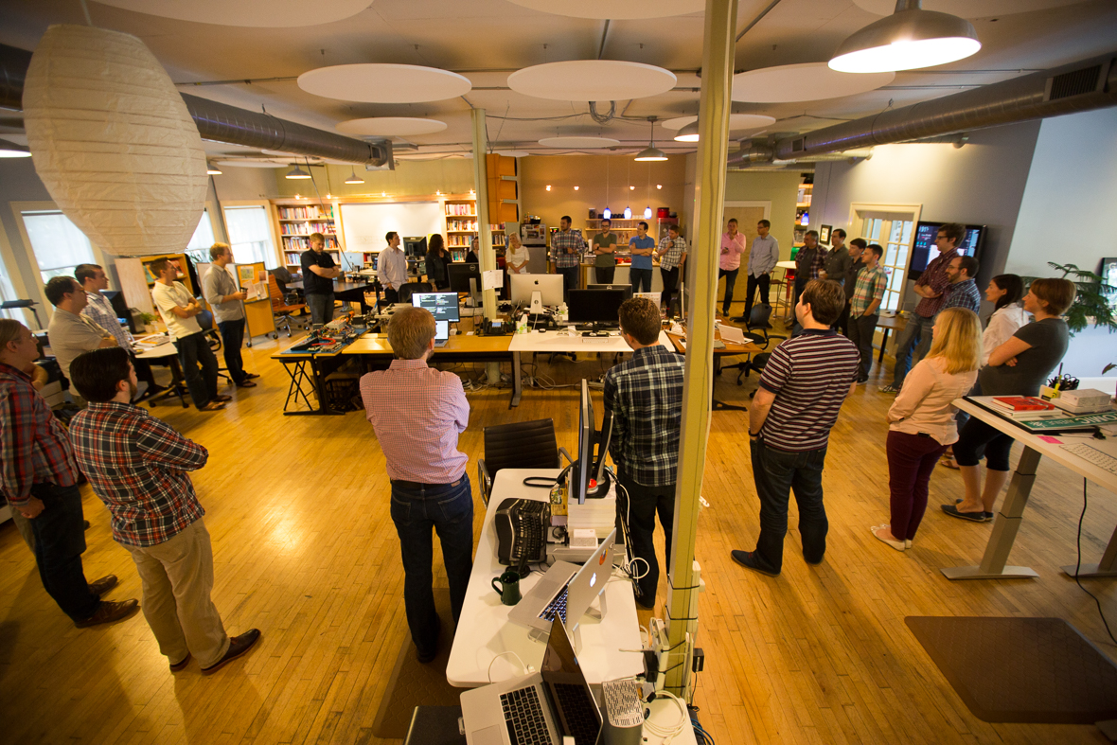
My first week at Reddit
WOAH!
30+ person standups
Google Slide tracking tools
Many “tech leads” but no real org chart
Sloooooow delivery pace
Urgent work to do! Also need to hire 100 people!
Super-size Daily Standups
Notes:
My first week at Reddit
As I mentioned, I spent most of my career at Microsoft, a big, well established, 2000 person enterprise software company
So my first week at reddit was a bit surprising. The easiest way to sum it up is that we had a 50 person organization still using the techniques of a single, maybe 5-person, engineering team.
Gigantic standup meetings
Reporting progress through google slides (not even google sheets)
Lots of tech leads but no one managing
No org-chart, so lots of confusion about what was responsible for what
Ton of work to do! High expectations.
I'm going to tell the story of what I did at Reddit, roles and responsibilities, organization, people, engineering execution

Slide 9
1. Roles + Responsibilities
Growth
Market ing
Engineers
Product
Data
Internationalization
Tech Founder
Product
Founder
Quality
Design
Usability
Sales
BD
Legal
Notes:
Wear many hats. In a small team everyone can do everything.
This is good in the sense that it maximizes agility and freedom. You also feel incredibly empowered because you DO have a lot of power. The company's success literally depends on your ability to do anything necessary to get the job done.
Classic example of this is having the CTO or an engineer pitching on design or even sales calls.
But as your team expands and you want to optimize you will be able to bring in domain experts
Missy's (brilliant legal council) Reddit story about legal policy through consensus. No actual lawyers in the room but the feeling was that through the combined wisdom of several engineers and a designer we might produce something that would simulate the output of a harvard lawschool graduate
Clear roles will begin to emerge
Product managers, engineers, designers, quality, marketing, sales, and leadership roles
How can you get to agreed-upon definition?

Slide 10
R.A.C.I.
Advantages
Clear ownership outcomes
Notes:
Common solution that gets used at a lot of places is a RACI chart.
RACI is a tool where tyou list all the organizations activities and then list them out, and then say "Joe is reponsible for X, Bob is reponsible for Y" etc etc.
Everyone agrees to get together and define their place in the organization
Advantages is you will get to a solution

Slide 11
Product vs Program vs Engineering Managers
Program Manager
Product Manager
Customer (who)
Vision (what)
Strategy (why)
Eng. Manager
Engineers (who)
Architecture (how)
Execution (when)
Notes:
Older program manager role needed to be teased apart into two sets of responsibilities
So initially we did that split
Product managers are going to spend their time talking to customers
Engineering Managers are going to spend their time manager engineers

Slide 12
Voight-Kampff Test for Eng Managers
What do you care about more, people or architecture?
What are your thoughts on shipping towards a deadline?
Your PM goes to two of your direct reports and tells them to immediately start working on a feature, what do you do?
You spend one full day a week fishing LinkedIn or working with recruiting, how do you feel?
ENG MANAGER
TECH LEAD
ARCHITECT / IC
Notes:
So the first problem I had was 40 engineers and no manager. I had a ton of people calling themselves "tech leads“
What is a tech lead? I remember asking my manager this same question 15 years ago and he said "Nobody knows". Today I've learned a lot, gotten to an executive position, and now people ask me "what is a tech lead" and of course I tell them "nobody knows“
For the purposes of this conversation, let's call tech leads proto-managers. People who are technically adept and mimicking some management behaviors, but not actually granted real management authority, much more interested in coding than management
So the first thing I did was get rid of tech leads and decide to take a bet on a few of them as real managers.
But how to decide?
So I devised this test. It is skewed to my particular style of management
What do you care about more, people or architecture?
What are your thoughts on shipping towards a deadline?
Your PM goes to two of your direct reports and tells them to immediately start working on a feature, what do you do?
You spend one full day a week fishing LinkedIn or working with recruiting, how do you feel?

Slide 13
R.A.C.I.
Disadvantages
Inflexibility
Does not directly address deeper issues
You can’t scale without trust!
Notes:
Disadvantage is now there's less flexibility, maybe you genuinely did have some people who could contribute in multiple areas and now that's going to be harder to do. But fine.
Th real problem with his charts is that they don't address the actual problem lack of trust
To scale you are going to have to trust each other!

Slide 14
Organizational Trust
Low
High
People manipulate or distort facts
People withhold and hoard information
Getting the credit is very important
People spin the truth to their advantage
New ideas are resisted and stifled
Mistakes are covered up or covered over
There are numerous “meetings after the meetings”
There are many “undiscussables”
People tend to over-promise and under-deliver
Low energy level
People are candid and authentic
Information is shared openly
People are willing to share credit
Transparency is a practiced value
New ideas are welcome
Mistakes are tolerated as a way of learning
There are few “meetings after the meetings”
People talk straight and confront real issues
There is a high degree of accountability
High energy level
Taken from: Speed of Trust
Notes:
There is a great book called the speed of trust and I'm not going to read all of this.
To summarize it, lack of trust means you hide information, don't generate ideas, maybe even lie.
Wasting time and energy. Find yourself filling out RACI charts instead of shipping software
When you trust each other you generate ideas, there's less follow up, you can tackle problems candidly. You can move faster and accomplish more

Slide 15
Trust (but verify)
People feel okay to say, “that’s not my job” …
… when they can also say “the person we hired to do it is amazing!”
Notes:
Want to get to a place where you can say "that's not my job but I trust the person we hired to do it"
I’m not going to lie, we did have executive offsites with a trust counselor to make this happen at Reddit
Quick tip
When you hire a new person don't force them to build trust / credibility with you.
Give them the benefit of the doubt, give them responsibility. Then measure what they accomplish
Trust but verify, give them a shot
Transition
After you've decided who is responsible for what you are only halfway through the battle because you need to get organized.

Slide 16
2. (re)ORGS
The most terrifying and important part of successfully growing a product team is the org chart…
Notes:
Scariest part of growing an organization is the org chart.
No one likes getting new managers, everyone is a little afraid of taking on new responsibilities.
But you have to do this if you want to scale.

Slide 17
3. (Re) Organization
“Organizations which design systems are constrained to produce designs which are copies of the communication structures of these organization.” -Conway’s Law
You will eventually ship your org chart. -Translation
Notes:
There are many ways to choose how your team is structured and don't want to spend all day enumerating them
Conway's Law: organizations which design systems ... are constrained to produce designs which are copies of the communication structures of these organizations."
Conway’s law is going to get you whether you like it or not. So rather than “Don’t ship the org chart”, I think the takeaway is “Do ship the org chart, but make sure you have the right one.”

Slide 18
Your organization should reflect your company's most immediate goals and the best people for each goal should be continually moved to where they are most needed…
… ideally
Notes:
Your organization should reflect your company's most immediate goals and the best people for each goal should be continually moved to where they are most needed
That’s a simple thing to say but a hard thing to implement
This is going to mean the beginning of the dreaded reorgs

Slide 19
REORGANIZATIONS
suck
SUCK (LESS)
Relationships with key people change or get further apart
Hurt feelings over projects getting defunded
Scary instability as the ground shifts beneath you
Surfaces leaders who are okay with uncertainty and discomfort
Prevent empire building behaviors
Creates new opportunities for people who want to grow skills
Get the right people to where they need to be to urgently achieve changing business goals
Notes:
Why reorgs are painful
Relationships with key people change or get further apart
Hurt feelings over projects getting defunded
Instability as the ground shifts beneath you
Reddit is still grappling with this as most of the executive team has never had to perform a reorg
Reddit. Completely flat org structure until about a year ago. No org chart, so we finally decided to move someone
Wanted to move one person between teams, he was one of our best engineers and we needed him on an urgent project. it resulted in about a week of deep soul searching, existential, conversation about the meaning of manager relationships. The HR department suggested we call his wife to get her input.
You laugh but it's not uncommon. I have seen grown men break down in tears because of reorgs. People are afraid of change
Despite all that I'm going to tell you now that I strongly believe reorganizing and purposefully, no matter how big your company gets, is a great thing
You want to find people who are okay with uncertainty and discomfort
As business goals change, you get the right people to where they need to be
Prevent empire building behaviors
Creates new opportunities for people who want to grow and take risks
Going back to the story: that engineer got a promotion and is now one of our strongest technical leaders.

Slide 20
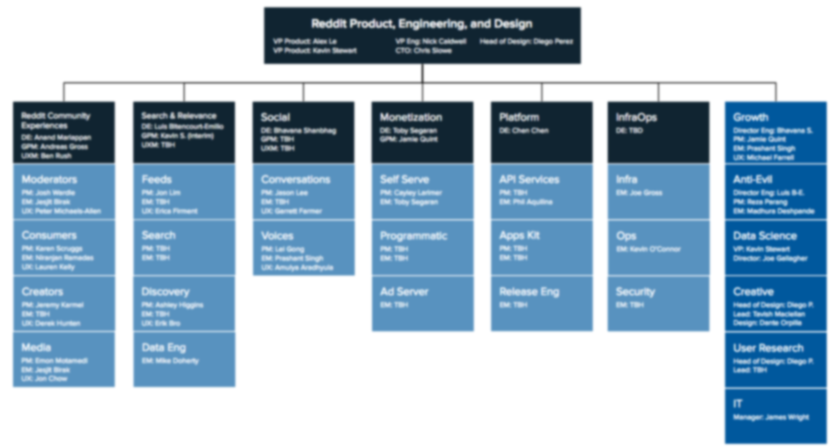
Do ship the org chart, but make sure you have the right one! - Conway’s Law (revised)
Reddit’s 2017 Org Chart
Groups of teams for every product. Minimize dependencies and maximize focus on user needs.
“Shared” teams, to provide cross-organizational support needs.
Clear, time-bounded, mission statement for every box in the chart
Notes:
Took about 6 months but we eventually got to an org chart

Slide 21
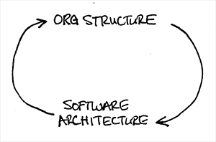
What’s next?
“The design which occurs first is almost never the best possible, the prevailing system may need to change. Therefore, flexibility of organization is important to effective design.” — Mel Conway
Notes:
One other thing Mel Conway said that a lot of people don't know about is that it's hard to get the right organization structure and the needs of a business change over time
Your organization has to be flexible
Rather than the org chart defining the product architecture, what if it were possible for the product architecture to define the org chart?

Slide 22
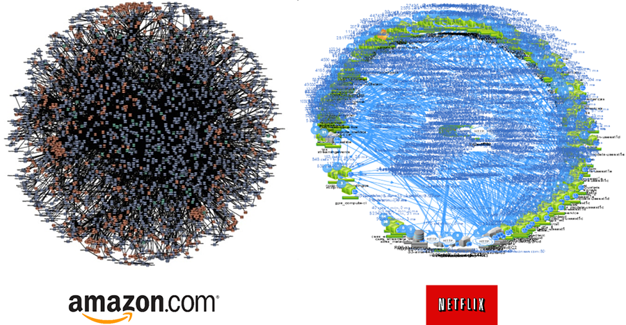
Reverse Conway’s law
Microservices change how we think about organization!
In the highly-networked and flexible teams of the future, the value of mission, culture, and relationships will dominate that of organization
“Death Star” Architectures
Notes:
Reddit is heading toward a microsservice architecture where teams own many small services and collaborate through them. Here are some examples from Amazon and Netflix
It’s no surprise that both Amazon and Netflix are notorious for having some of the strongest engineering cultures
small, independent teams that are focused on services
Amazon uses the term “pizza box sized teams”
Netflix says “we’re a sports team”
Both of these companies have culture handbooks that are about an inch thick if you print them out

Slide 23
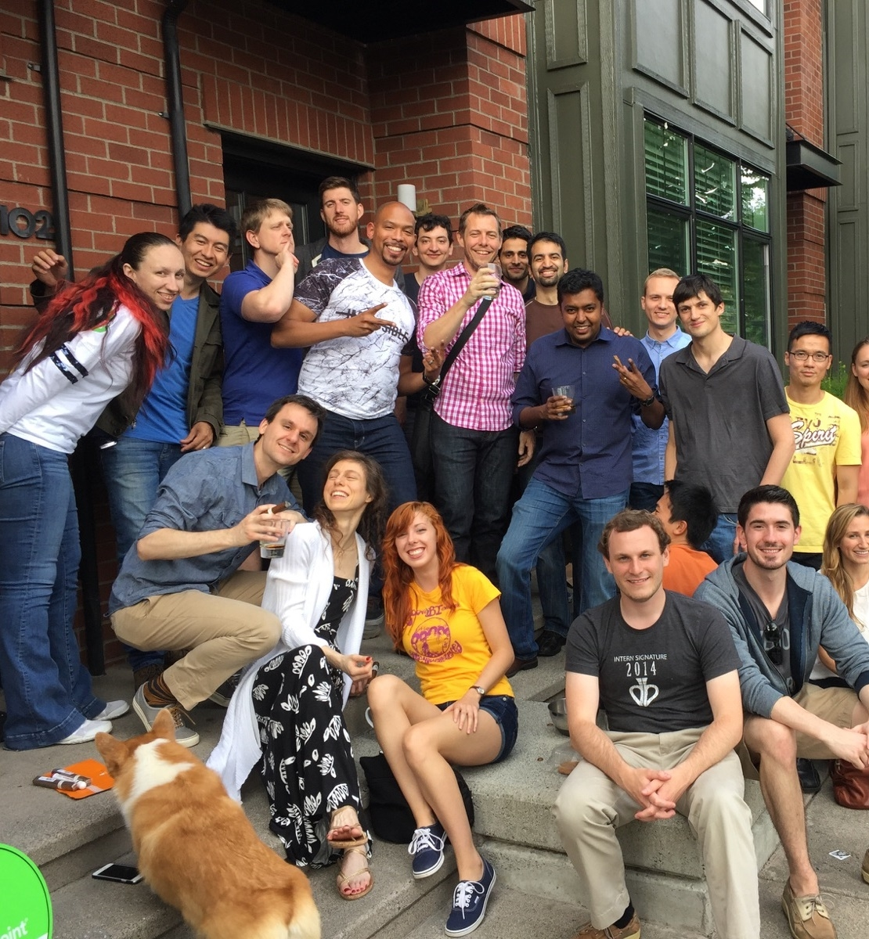
3. So many People
How can it be that the more people we have the more disconnected we feel?
Notes:
A small team feels like family. Top left photo is a picture of one of my first engineering teams, you can see we are all huddled up on a porch. That's my porch! I know every single person on the team.
This next photo is a year and a half later, and it isn't even the entire team. I know maybe 25% of the people in that photo
Ironically as more people join your organization the more isolated and disconnected from the team you can feel
Reddit is starting to get this big now. A few weeks back I had my first elevator moment

Slide 24
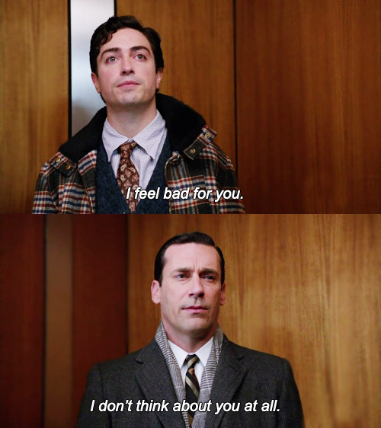
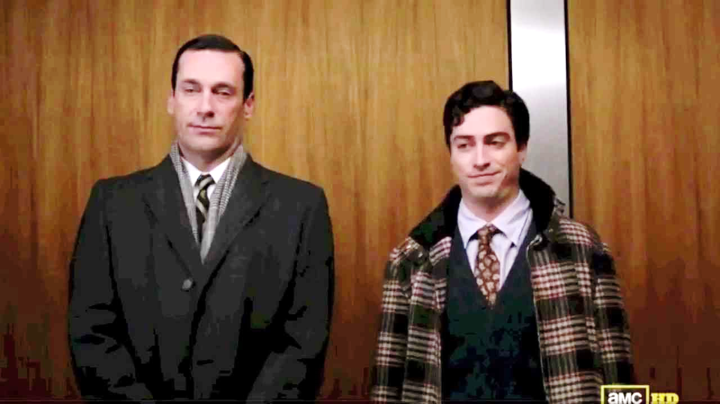
Elevator moment
Notes:
A fI pulled back to just spending quality time with my 6 or 7 direct employees, and a few months later I had my first elevator moment. The elevator moment is the point in time in your company's history where you introduce yourself to someone in the elevator or a meeting without realizing that you have already introduced yourself to them before.

Slide 25
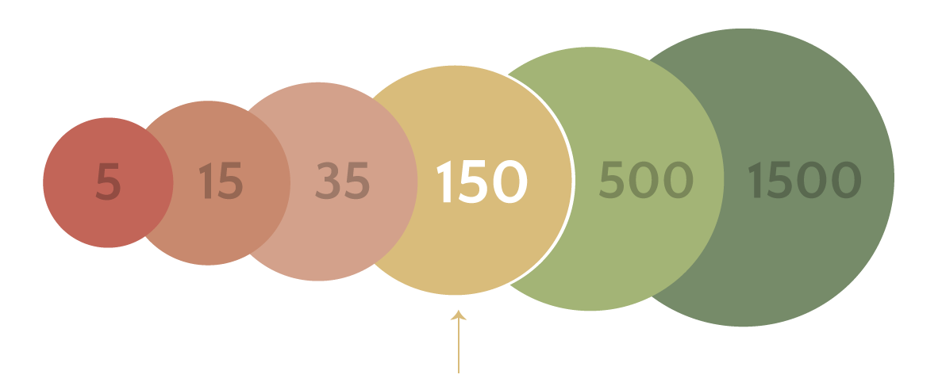
How many people can you know?
Dunbar’s Number
What is the MonkeySphere
Notes:
You can't feel bad about this. Your brain simply isn't wired to know THAT many people
Dunbar used an analysis to determine the maximum number of people any one person can know
That number is 150

Slide 26
You don’t need to know everyone at the party to have a good time!
Assume that diverse subcultures will form
Technology guilds, affinity groups, are all great ways to continue feeling connected
Don’t let anyone ruin the party! Make sure your core values are strong
Reddit’s solutions
Guilds
Weekly All-hands broadcast
Company mega-events

Slide 27
what about Communication?
WARNING: none of these methods work*
newsletters, team syncs, company meetings, interest groups, documentation, regular 1:1s, posters, onboarding, press releases, offsite, Slack, Email, Wikis, dashboards
*Alone. At scale, you have to use all of them!
Notes:
I predict that in my lifetime I will get to see self driving cars, drones will deliver my pizza, stem cells will cure every diseas. I will see all this in my lifetime But it is up to future generations solve the problem of how to get two teams to communicate effectively when they are further than 50 feet apart.
You can try each of these methods I've listed here. None of them will work.
When there are more people it is easier to be misinterpreted and misunderstood.
When there are more people there is most stuff for you to not care about

Slide 28
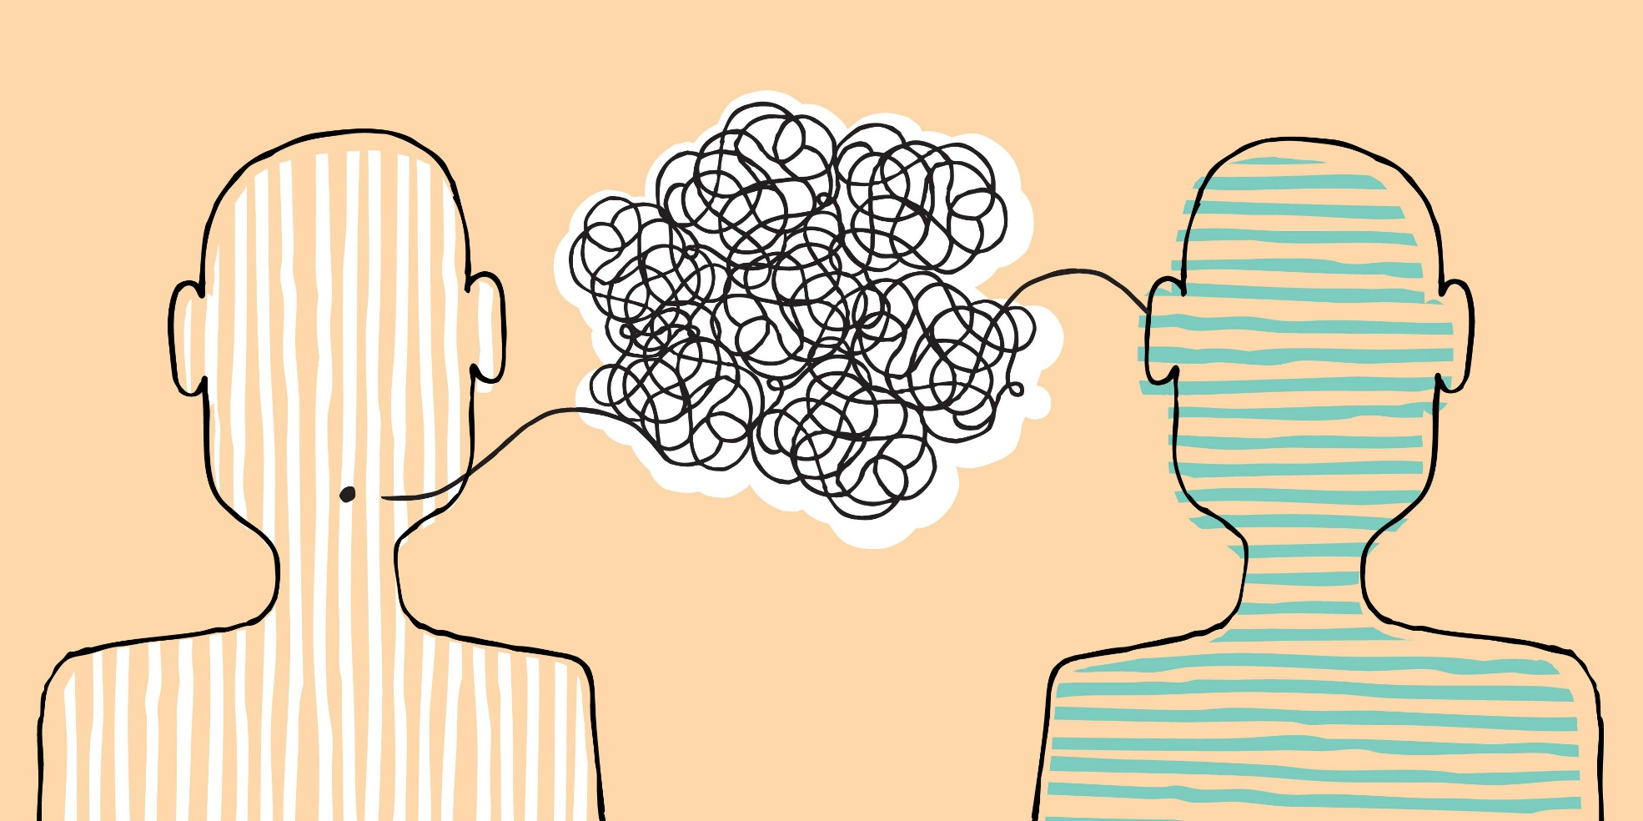
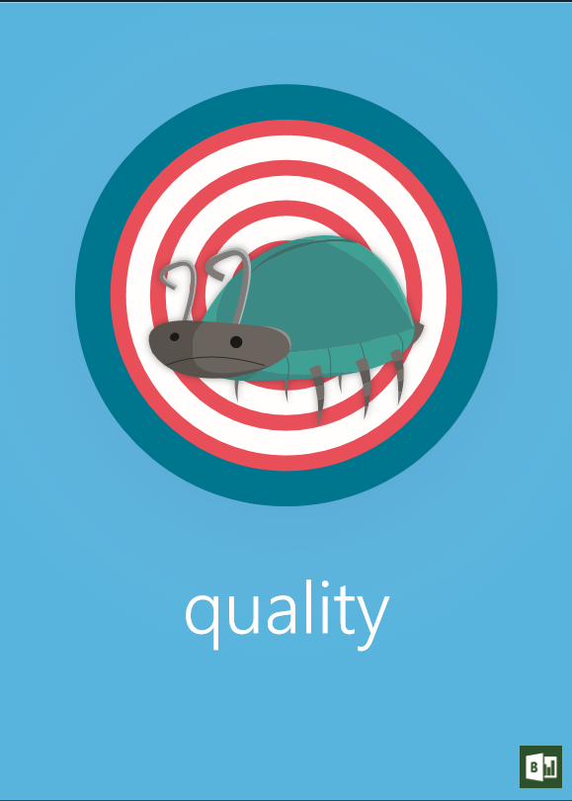
BEAT THE TELEPHONE GAME
message with extreme clarity
broadcast for everyone
repeat and reinforce
overcommunicate
Notes:
We haven’t solved this but here are some tips
How leaders communicate differently at scale
Regular cadence
Extreme clarity
Extreme sensitivity, people want to feel like they are remembered
Overcommunicate with simple and repetitive messages
Story about how long lectures about poor product quality resulted in single word posters being hung in the hallway.

Slide 29
4. Engineering at scale, what gets harder
Awareness
Everyone wants to know what everyone else is doing
Coordination
Here comes PROCESS: managers, tools, meetings
Bottlenecks
Missed dependencies can cripple your production roadmap
Notes:
Your job as product leaders is to deliver quality experiences to you users in a predictable fashion, which gets much harder with more people.
What is everyone doing?
Risk of working on the same thing
Dependencies
People don't want to communicate
There is too much to know!
More moving parts so now we need managers and tools.
We're all adults here, can't we just trust each other to do the right thing?
We don't need managers, if we hire smart people, the right things will just work themselves out!
Favorite: I don't ship to deadlines, my code is done when it's done
Bottlenecks get much worse because a problem in one part of the organiztion can kill productivity across the entire company

Slide 30
Why?
Efficiency Curve Scope Output
Surely, with more people we can just get more done! Right? Wrong!
For every 1 engineer you hire, add to backlog 1.1 engineers worth of work
Eventually, coordination costs and scope overcome your ability to deliver reliably.
You will need a process change or reorg to keep scaling up.
# PEOPLE
Notes:
More people means greater ambition but also greater communication and process overhead
Remember efficiency. A rule of thumb I use is that for every 1 additional engineer you add to a team, 1.1 engineers worth of work is added to the product roadmap.
You will need either a reorg or process change to continue scaling
We already talked about reorganizaing, but Reddit had to work on process

Slide 31
Reddit’s First Project tracker
Notes:
2 hand crafted slides that nobody could figure out how to keep up to date
Idea was that every week you'd copy past links to JIRA (if you used it) into this slide, and then also copy past the appropriate icon next to your text
Fun through, check out the cool aquaman and batgirl images!
But obviously this makes it impossible to know what is going on with any real accuracy
Using the tools of a 5 person team, scaled up to 40 or 50 people.

Slide 32
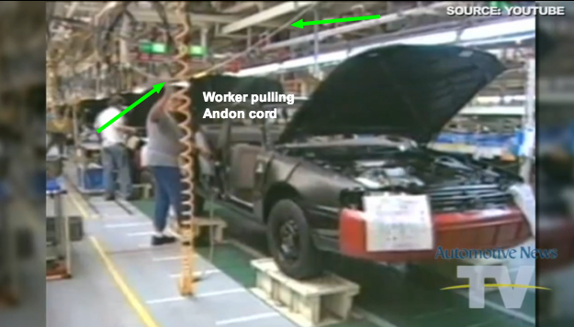
Process Advice and Caution
Avoid process junkies and boilerplate solutions. Evolve something that works for your team.
Some variants of Agile promote intra-team coordination more than actually shipping code
Original Toyota Kanban “Kaizen”: minimal processes created from bottom up
Toyota production system
Process becomes culture over time
Notes:
There is no silver bullet fix to this and there are lots of books you can read on how to scale up an agile team. I'll just leave you with a few tips
Worst mistake was we hired an agile coach to come in and run one of our teams. It is incredibly ironic to me that some people can get so dogmatic and rigid about agile processes.
More focussed on following the rules or on intra-team coordination than on shipping software
Original kanban paper: andon cord
Descend from Manager heaven, only then would process be added. This meant that process was created organically from the bottom’s up and you got only the processes you need for the problem you were trying to solve.
I like that flexibility, and I’ll also caution that process becomes culture over time, so if you are aiming to stay fast moving then choose processes that will allow for it

Slide 33
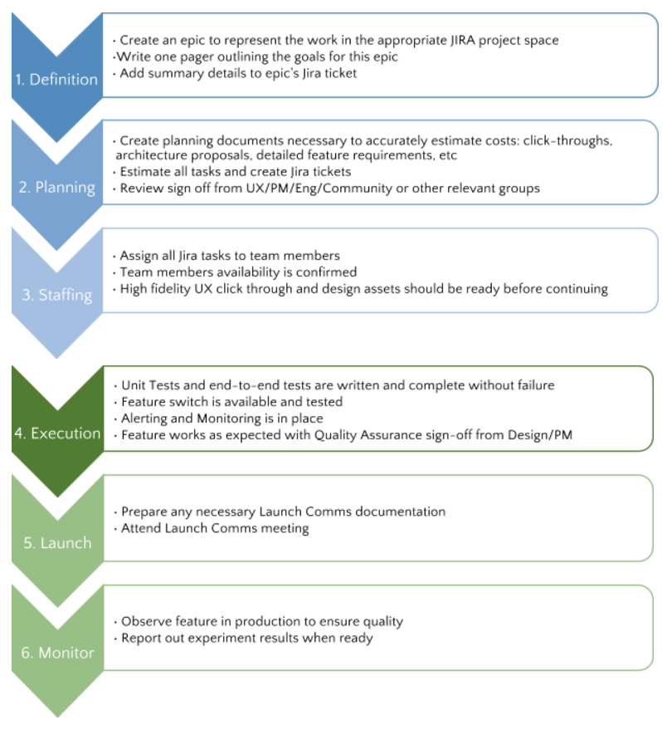
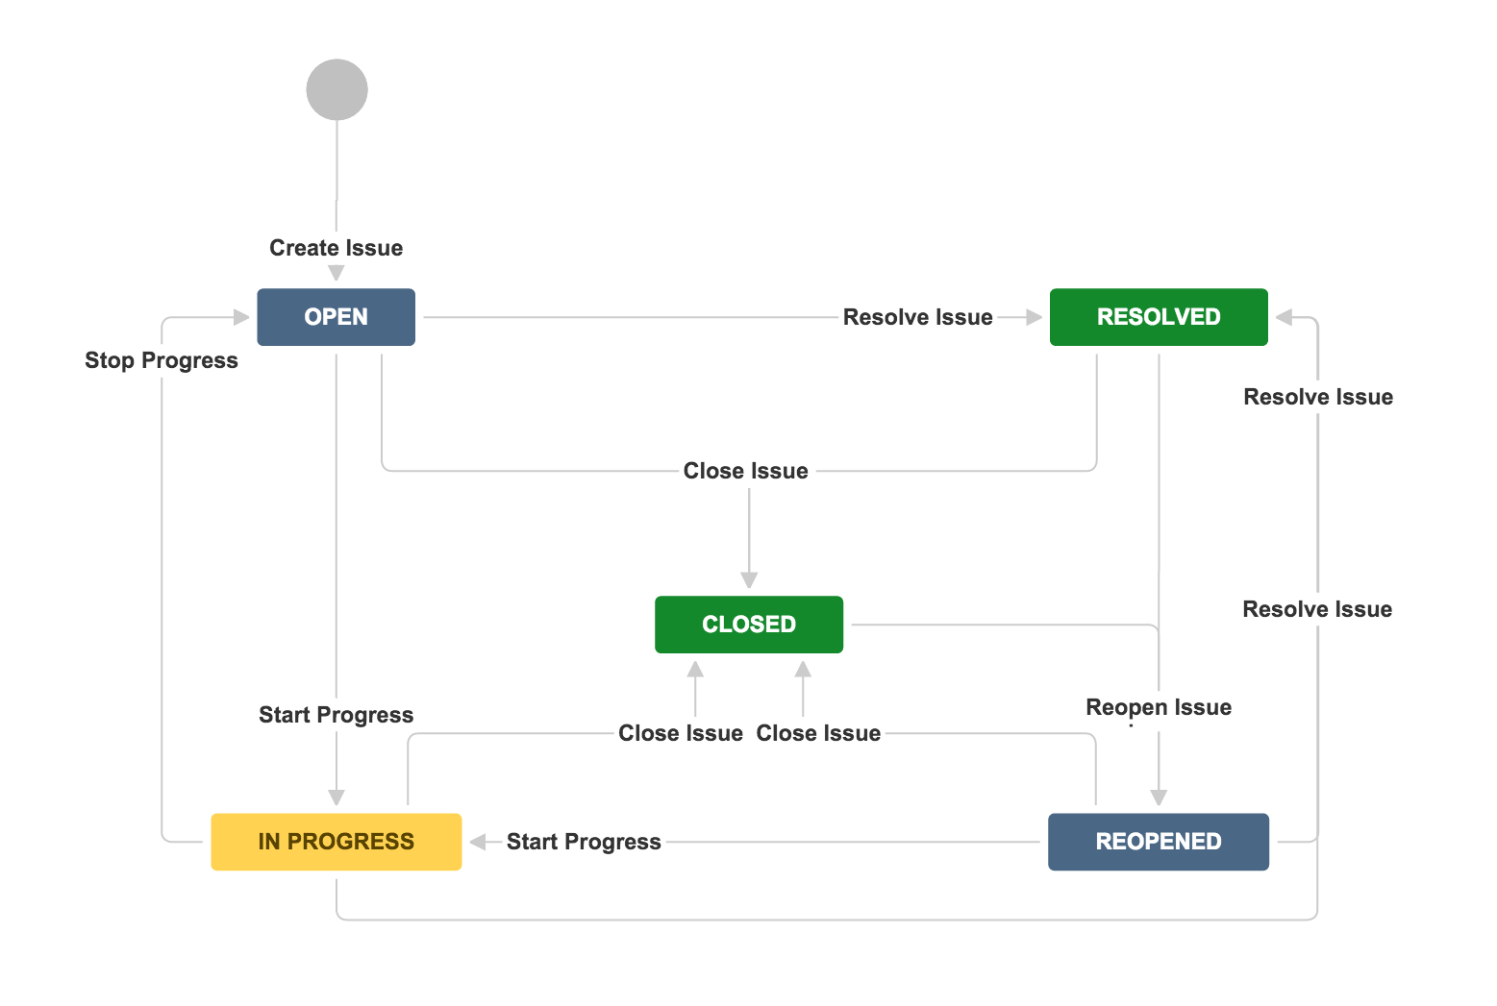
Reddit’s jira evolution
Notes:
Our IT guy was a huge fan and advocate and he was trying to convince me to get the entire company using it
I sat down with him for an hour and described my ideal engineering workflow, which is in this slide deck
Definition, planning, staffing, execution, launch, monitor
The next day he had translated it into a complete JIRA workflow

Slide 34
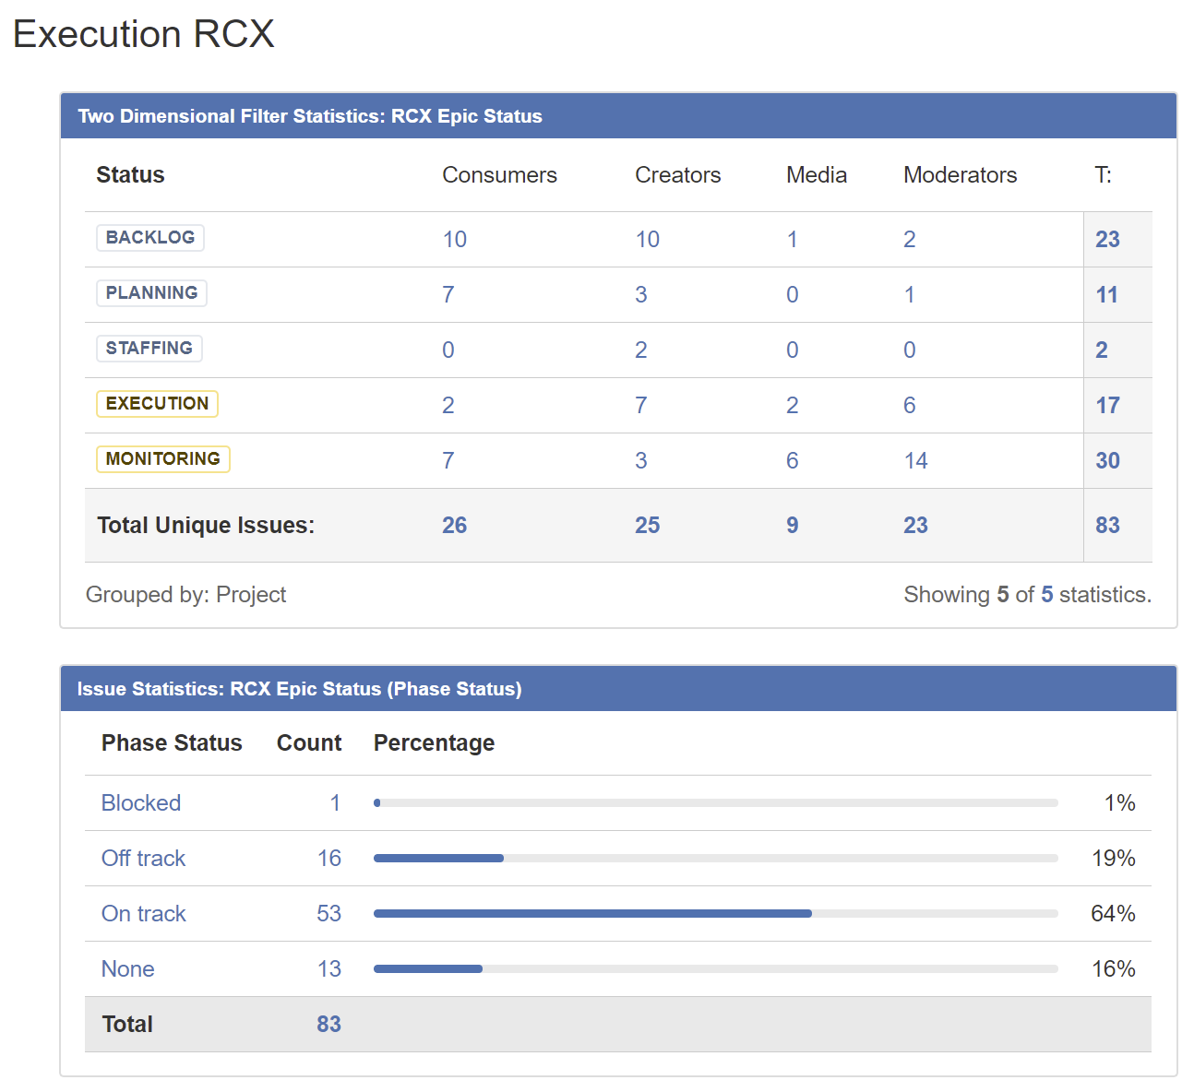
Team Dashboards
Now we can see all the work…
… but this isn’t useful for daily standups

Slide 35
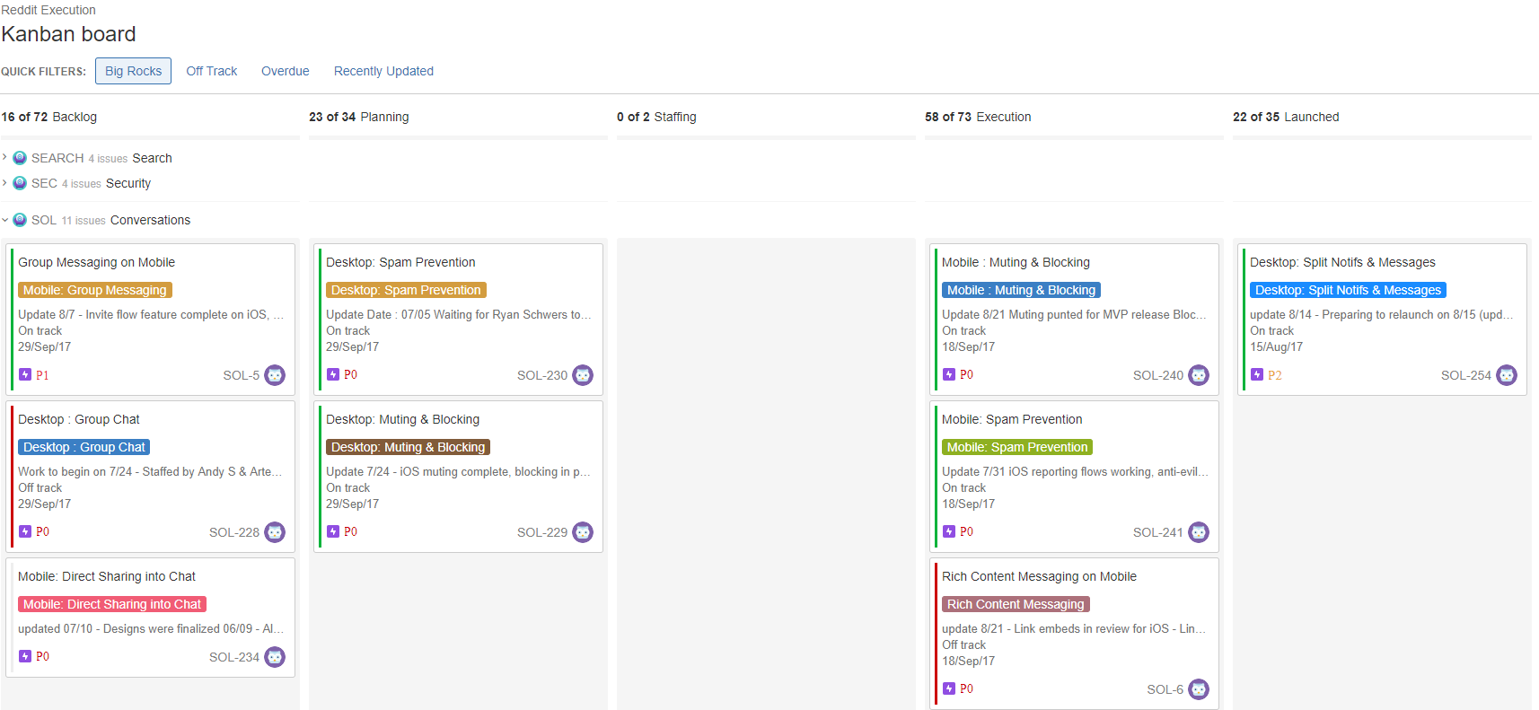
Kanban boards
Great for standups …
… but what about reporting status to the rest of the product team?

Slide 36
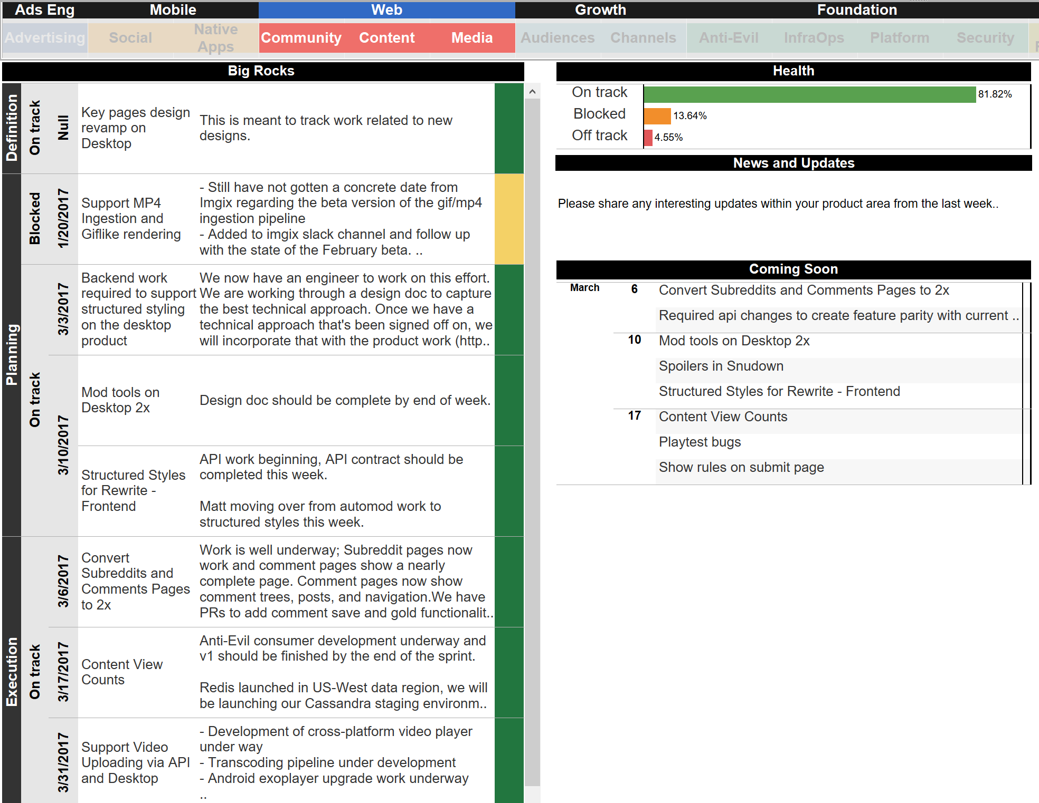
Jira + Tableau
Great for directors team, but…
…too much detail for the execs and company-wide communications
Engineering Execution Dashboard

Slide 37
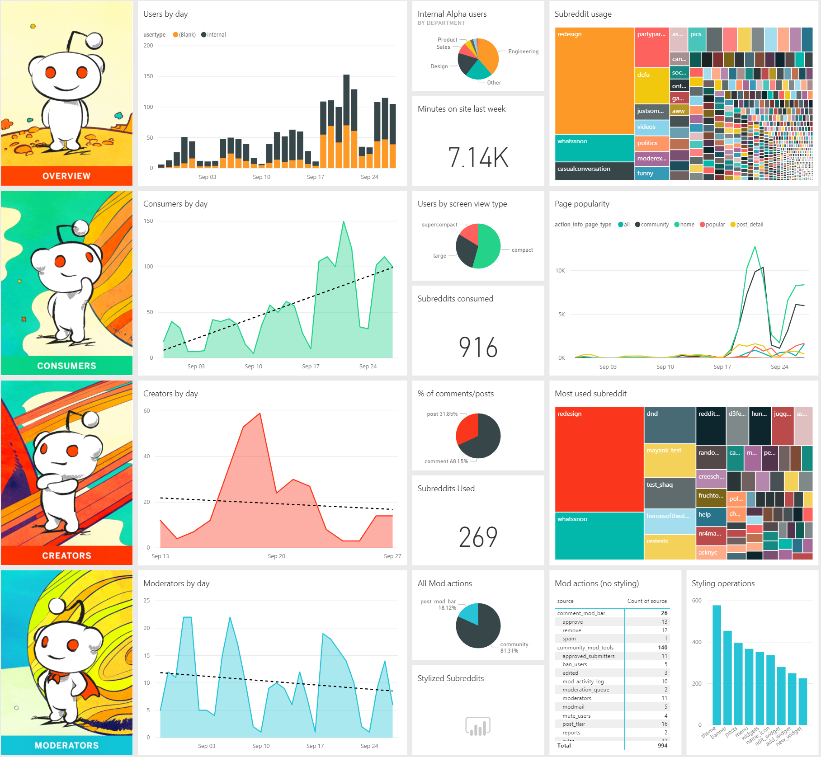
Executive Dashboards
Realtime executive dashboard…
… AND the cartoons are back so everyone is happy!
Notes:
Most important thing is that our cartoons are back

Slide 38
Results
2017 Major Reddit Releases
Feb. New Moderator Mail
Mar. Launch of Profile Pages
Mar. Self-serve Ad Platform
May. International Reddit
Aug. New Video Platform
Sep. New Search Platform
Sep. New Chat Platform
???? Complete site-redesign

Slide 39
3 quick Career Tips for scaling

Slide 40
1. Get comfortable being uncomfortable
There is opportunity in change. Comfort is the enemy of progress.
Notes:
4 new javascript frameworks have been released during this talk alone

Slide 41
2. Follow the investments
If you understand the where and why of a reorganization, then you understand the priorities of your leadership team
Notes:
Simple time for growing your career is to work on projects that matter to your leadership. As an IC you are boudn to hear a lot of lip service from your own manager about the importance of your work, but nothing is more telling than where people get moved to during a reorganization

Slide 42
3. Be a process pilot
If process becomes culture over time, then take the lead and help define the future of your engineering organization

Slide 43
Final Thoughts Scaling Fast @ Reddit
2 opportunities
1 challenge

Slide 44
Diversity and inclusion
Diverse and Inclusive Teams:
make better products
are more fun to work in
Like any cultural aspect, it will be extremely hard to “fix” later
Make D&I part of your company DNA before you expand!
Notes:
There are bunch of stats that say diverse teams produce better software.
Diverse teams are just more fun to work in
Tech is a modern day goldrush, everyone should have access
Critical to get this right while you are growing because it is incredibly hard to fix later on. You will WANT to hire as many people as possible. You have to stop yourself and be patient.

Slide 45
Diversity & Inclusion
Don’t
DO
Hire a "head of diversity" and expect them to fix everything
Assume that diverse employees care about this issue deeply
Complain about the hiring pipeline
Aim for “diversity of thought” or ever say, “we don’t see gender or color”
Get executive support.
Create or invite inclusiveness groups to interact with your company
Build a new pipeline
Be intentional, patient and persistent.

Slide 46
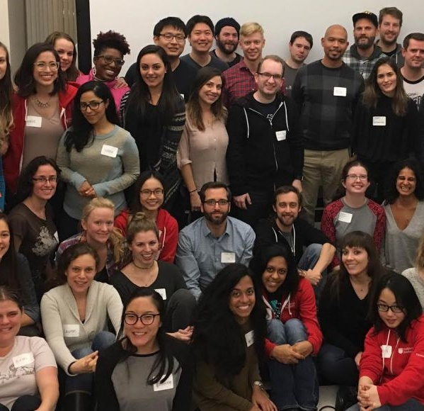
Social Impact @ SCALE
Your company’s value to the world can be more than the products you ship.
Notes:
When we talk about impact we usually assume we're talking about that satisfying feeling you get when you launch a product into the world.
From left to rigth
Reddit hosting hackbright which is a coding bootcamp for women who want to career switch into technology
Team reddit extralife is an event where we raise money for charities by playing video games all day
On the right is one of our directors of engineering, teaching students in Uganda about coding
When I talk about impact, I'm not just talking about products and customers.
Don't forget social responsibility
Don't forget to give back
But I will be totally honest. In my career I've shipped a lot of software and in retrospect the proudest moments I've had are all about connections with people.

Slide 47
Managers:
As your team grows your connection to individuals will lessen. It will become easy to think of people as numbers or resources in your tracking tools…
…remember that people are the most valuable part of your organization and the best part of being a manager.
Notes:
Talk about the transition from IC, to manager, to director need to approah problems differently
Many years ago before I was a director…
Kurt Del Bene story
Managers: Don't forget about people
Have fun! Don't be afraid, this is the best part of the ride.

Slide 48
Calls to Action
Reddit is hiring! http://about.reddit.com
Follow me!
Reddit https://www.reddit.com/user/nickcald
Twitter https://twitter.com/nickcald
Medium https://medium.com/@nickcaldwell
LinkedIn https://www.linkedin.com/in/nickcaldwell/
Color Code Fund http://colorcode.fund

Slide 49
Thanks
Questions?

