Slide 1
A/B Testing at Scale with Open Source Proctor
Ketan Gangatirkar
ketan@indeed.com
Indeed Engineering — Job Seeker

Slide 2
1
Yes, Indeed
2
Experiments
3
How to experiment
4
A mathematical tangent
5
What is Proctor even?
6
Advanced techniques
7
Best practices

Slide 4
60 countries
30 languages
200M unique visitors
20M jobs

Slide 5
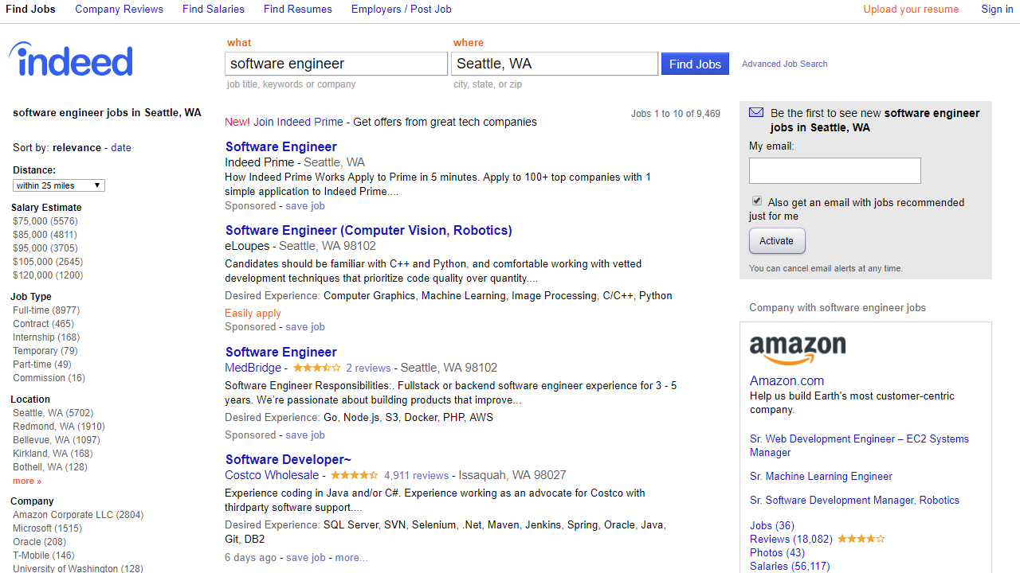

Slide 6
Indeed is more than keyword search

Slide 8
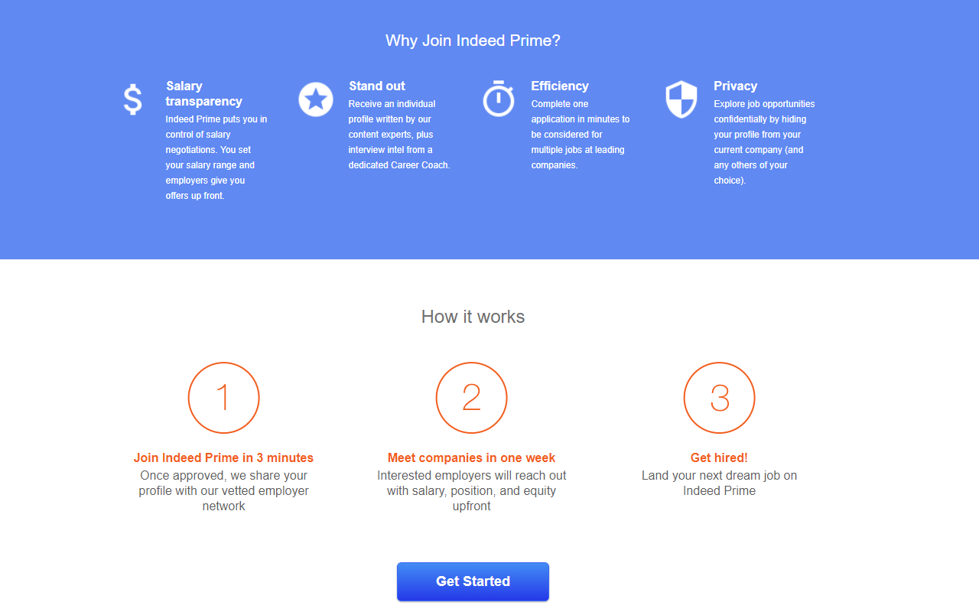

Slide 9
We bring jobs to you

Slide 10
How do job seekers discover Prime?

Slide 11
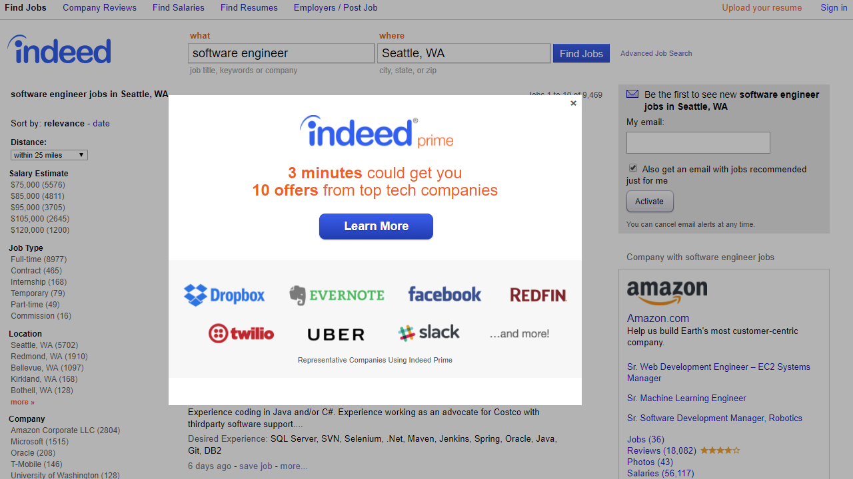

Slide 13
Prime
signups
Job
clicks
-
> 0 ?

Slide 14
Is this the right thing for job seekers?

Slide 15
Which is better?
A
B

Slide 16
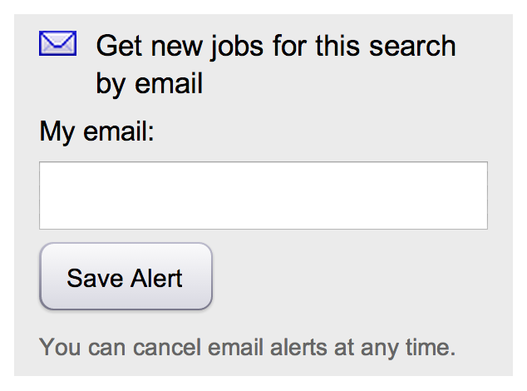
We have other ideas to try
A
B
Save Alert

Slide 17
Running a pharmaceutical trial

Slide 18
Who

Slide 19
What

Slide 20
How

Slide 21
Why

Slide 22
Problems with running trials

Slide 23
Insufficient Data

Slide 24
Collect large samples

Slide 25
External effects

Slide 26
Simultaneous control and test groups

Slide 27
Wrong sample

Slide 28
Sample from your target population

Slide 29
Biased sample
Source: http://www.scmp.com/week-asia/society/article/2085110/even-thais-mourn-land-smiles-attracts-worlds-clowns

Slide 30
Select representative groups

Slide 31
Product experiment requirements

Slide 32
Fast

Slide 33
Consistent

Slide 34
Unbiased

Slide 35
Other requirements

Slide 36
First, do no harm

Slide 37
Segment precisely

Slide 38
Iterate rapidly

Slide 39
Isolate

Slide 40
Minimize state

Slide 41
Implementation options

Slide 42
Multiple software versions

Slide 43
Good
Maximum performance
Independent
Consistent
Easy to understand
Stateless
Multiple software versions

Slide 44
Good
Maximum performance
Independent
Consistent
Easy to understand
Stateless
Bad
Management overhead
Can only run one test at a time
No precise segmentation
Poor isolation
Slow iteration
Multiple software versions

Slide 45
Roll the dice every time

Slide 46
Good
High performance
Independent
Easy to understand
Stateless
Roll the dice every time

Slide 47
Good
High performance
Independent
Easy to understand
Stateless
Bad
Inconsistent across requests
Roll the dice every time

Slide 48
Server sessions

Slide 49
Good
Independent
Server sessions

Slide 50
Good
Independent
Server sessions
Bad
Stateful
May add dependency
Possibly slow performance
Inconsistent across sessions

Slide 51
Persistent storage

Slide 52
Good
Independent
Consistent
Server storage

Slide 53
Good
Independent
Consistent
Bad
Stateful, but even more so
Another dependency
Possibly slow performance
Server storage

Slide 54
Client-side storage

Slide 55
Good
High performance
Independent
Consistent
Client-side storage

Slide 56
Good
High performance
Independent
Consistent
Bad
State can get out of date
Can be manipulated
Client-side storage

Slide 57
Just enough cryptography

Slide 58
Hash function
“... a mathematical algorithm that maps data of arbitrary size to a [large number]... which is designed to also be a one-way function, that is, a function which is infeasible to invert.”
https://en.wikipedia.org/wiki/Cryptographic_hash_function

Slide 59
Biased inputs, uniformly distributed outputs

Slide 60
Same input, same output
$ echo "One Search. All Jobs." | shasum -a 512224
5749569aac2b3ae8ff54cd41657861a57112b247b0d4f8188d837ac5
$ echo "One Search. All Jobs." | shasum -a 512224
5749569aac2b3ae8ff54cd41657861a57112b247b0d4f8188d837ac5

Slide 61
Similar inputs, very different outputs
$ echo "One Search. All Jobs." | shasum -a 512224
5749569aac2b3ae8ff54cd41657861a57112b247b0d4f8188d837ac5
$ echo "One Search: All Jobs." | shasum -a 512224
aefc203f8fd599b9fa8be7569c8013336aa95a07cb686d5427462b4b
$ echo "One Search, All Jobs." | shasum -a 512224
a51bf48129368a9b0037598aa40412a533d26a55ee78afc0d0c7afc6

Slide 62
Hashing for experiments

Slide 63
Account ID
Email address
Start with an identifier
Unique cookie
etc.

Slide 64
Control (existing behavior)
Test (new behavior)
Save Alert

Slide 65
Map groups to the number line
control (0)
test (1)
MIN_INT
0
MAX_INT

Slide 66
Assigning Alice to a group
V_{a} = hash (alice@example.com) mod 2³²
control
test
MIN_INT
0
MAX_INT
V_{a}

Slide 67
Assigning Babu to a group
V_{b} = hash (babu@example.com) mod 2³²
control
test
MIN_INT
0
MAX_INT
V_{b}
V_{a}

Slide 68
Assigning Chen to a group
V_{c} = hash (chen@example.com) mod 2³²
control
test
MIN_INT
0
MAX_INT
V_{b}
V_{a}
V_{c}

Slide 69
Assigning Diu to a group
V_{d} = hash (diu@example.com) mod 2³²
control
test
MIN_INT
0
MAX_INT
V_{b}
V_{d}
V_{a}
V_{c}

Slide 70
Email address | Experiment 1
alice@example.com | 1
babu@example.com | 0
chen@example.com | 1
diu@example.com | 0
esteban@example.com | 1
fatima@example.com | 1
galina@example.com | 0
hadassah@example.com | 0
Assigning groups to multiple users

Slide 71
Multiple experiments at once?
Email address | Experiment 1 | Experiment 2 | Experiment 3
alice@example.com | 1
babu@example.com | 0
chen@example.com | 1
diu@example.com | 0
esteban@example.com | 1
fatima@example.com | 1
galina@example.com | 0
hadassah@example.com | 0

Slide 72
Email address | Experiment 1 | Experiment 2 | Experiment 3
alice@example.com | 1 | 1 | 1
babu@example.com | 0 | 0 | 0
chen@example.com | 1 | 1 | 1
diu@example.com | 0 | 0 | 0
esteban@example.com | 1 | 1 | 1
fatima@example.com | 1 | 1 | 1
galina@example.com | 0 | 0 | 0
hadassah@example.com | 0 | 0 | 0

Slide 73
Oops
Email address | Experiment 1 | Experiment 2 | Experiment 3
alice@example.com | 1 | 1 | 1
babu@example.com | 0 | 0 | 0
chen@example.com | 1 | 1 | 1
diu@example.com | 0 | 0 | 0
esteban@example.com | 1 | 1 | 1
fatima@example.com | 1 | 1 | 1
galina@example.com | 0 | 0 | 0
hadassah@example.com | 0 | 0 | 0
This is one experiment

Slide 74
Add salt to taste

Slide 75
“...a salt is random data that is used as an additional input to a one-way function that ‘hashes’ a password or passphrase.”
https://en.wikipedia.org/wiki/Salt_(cryptography)

Slide 76
Salted hashing
$ echo "One Search. All Jobs.0" | shasum -a 512224
9f16a15dbf70cb41f1201c37bbc0ac81a3db174c13783d233cc996e7
$ echo "One Search. All Jobs.1" | shasum -a 512224
517ba504a094ce93e4a906ec484d4df26fef4a7ed88f327ee85fdcc8
$ echo "One Search. All Jobs.2" | shasum -a 512224
4d02b7f1cd5a28039080cd6e26aae5fab757d586f7ebd1ab9ae0ba18
$ echo "One Search. All Jobs.3" | shasum -a 512224
e834f9bda41daa61c5c4b27a072e03c23cdac834bef96a8a5c28c39d

Slide 77
V' = hash (email + salt) mod 2³²

Slide 78
Each experiment gets its own salt
Experiment 1 | Experiment 2 | Experiment 3
pep | pepa | pepper

Slide 79
Assigning groups with different salts
Email address | salt=pep | salt=pepa | salt=pepper
alice@example.com | 1 | 1 | 1
babu@example.com | 0 | 1 | 0
chen@example.com | 1 | 0 | 1
diu@example.com | 1 | 1 | 1
esteban@example.com | 0 | 1 | 0
fatima@example.com | 1 | 0 | 0
galina@example.com | 0 | 1 | 0
hadassah@example.com | 0 | 1 | 0

Slide 80
Remember the ID
Recompute the groups

Slide 81
Good
Good performance
Independent
Consistent
Stateless
Remember the ID
Recompute the groups

Slide 82
Good
Good performance
Independent
Consistent
Stateless
Bad
Not so easy to understand
Remember the ID
Recompute the groups

Slide 83
A-B-C-D-E-F-G…

Slide 84
Multiple treatments at once
Experiment 1
control
test
Experiment 2
control
test1
test2
Experiment 3
control
test1
test2
test3
MIN_INT
0
MAX_INT

Slide 85
Multiple users and multiple experiments
Email address | salt=pep | salt=pepa | salt=pepper
alice@example.com | 2 | 0 | 2
babu@example.com | 3 | 1 | 3
chen@example.com | 0 | 2 | 0
diu@example.com | 0 | 2 | 2
esteban@example.com | 3 | 3 | 1
fatima@example.com | 2 | 3 | 1
galina@example.com | 1 | 2 | 1
hadassah@example.com | 1 | 3 | 3

Slide 86
As many as you want
A
B
C
D
E
F
G
H
I
J
K
L
M
N
O
P
Q
MIN_INT
0
MAX_INT

Slide 87
Proctor

Slide 88
Open source A/B testing library + more

Slide 89
Put in parameters, get test group assignments

Slide 90
You implement your own features

Slide 91
Pipet

Slide 92
Proctor as a service

Slide 93
No Java or JVM required

Slide 94
Use any platform that speaks HTTP + JSON

Slide 95
Use cases

Slide 96
Appearance
A
B
Save Alert

Slide 97
Layout
A
B
Save Alert
Save Alert

Slide 98
Workflow
A
B

Slide 99
New features

Slide 100
Algorithm changes
1
Lead Developer - Core Engine
Seattle, WA
Senior Software Engineer - Mobile
Seattle, WA
1
2
Development Architect
Bellevue, WA
Lead Developer - Core Engine
Seattle, WA
2
3
Principal Software Engineer
Redmond, WA
Principal Software Engineer
Redmond, WA
3
4
Senior Software Engineer - Mobile
Seattle, WA
Principal Software Engineer
Kirkland, WA
4
5
Principal Software Engineer
Kirkland, WA
Development Architect
Bellevue, WA
5

Slide 101
Toggle/kill switch

Slide 102
Results

Slide 103
5+ years in production

Slide 104
Thousands of experiments completed

Slide 105
~634 A/B experiments active on Indeed

Slide 106
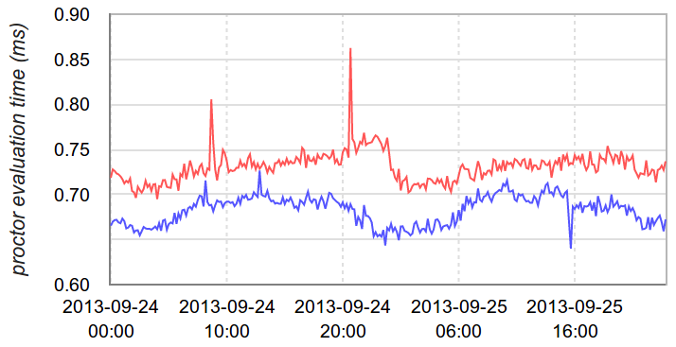
Proctor is fast enough
Resume editor
Resume search
0.90
0.85
0.80
0.75
0.70
0.65
0.60

Slide 107
Web
We use it on everything
Native mobile
Email

Slide 108
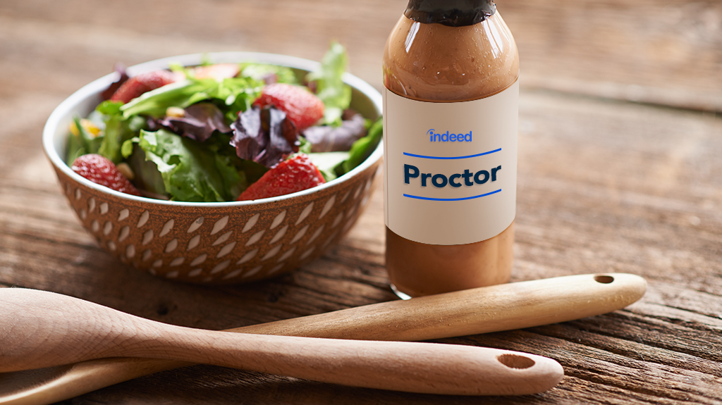

Slide 109
Limitations

Slide 110
You have to implement your own features

Slide 111
You have to modify your deployable

Slide 112
You have to manage the test data

Slide 113
You have to do your own logging and analysis

Slide 114
Advanced features

Slide 115
Segmentation

Slide 116
Logged-in users
Francophone
In France or Canada
Who is eligible for an experiment?
Android users
Users with resumes
Mobile users on wifi

Slide 117
Simple rules
user.isLoggedIn
language == 'fr'
proctor:contains(['CA', 'FR'], country)
device.os == 'android'
user.hasResume
device.network == 'wifi'

Slide 118
Boolean expressions
Rules language is powerful
Comparisons
Extensible function library

Slide 119
Loops
But not too powerful
Inline functions
Variables

Slide 120
Complex targeting
Logged-in Francophone Android users in France or Canada with resumes using wifi

Slide 121
Complex rules
user.isLoggedIn
&& user.hasResume
&& ((language == 'fr') && proctor:contains(['CA', 'FR'], country))
&& (device.os == 'android')
&& (device.network == 'wifi')

Slide 122
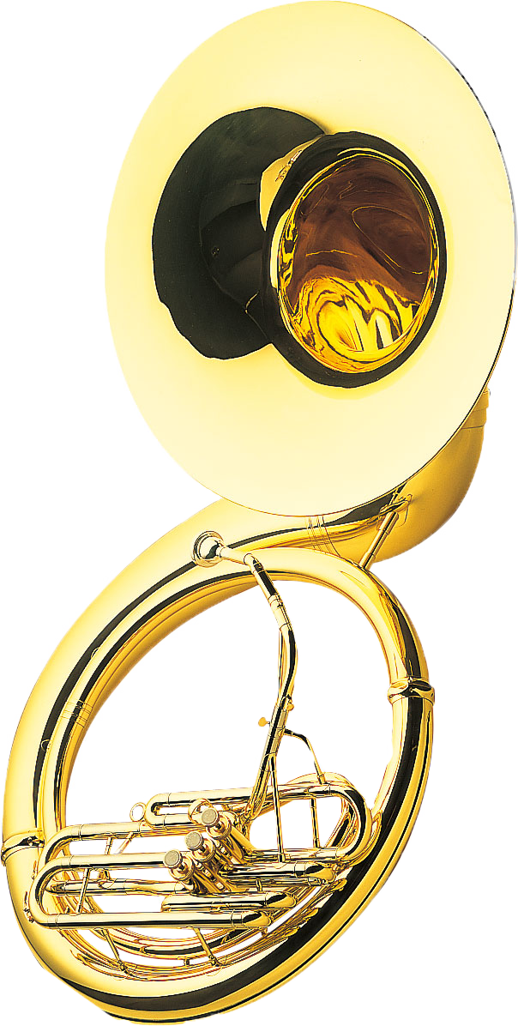
Add Lusophones in Brazil or Portugal
user.isLoggedIn
&& user.hasResume
&& (((language == 'fr') && proctor:contains(['CA', 'FR'], country))
|| ((language == 'pt') && proctor:contains(['PT', 'BR'], country)))
&& (device.os == 'android')
&& (device.network == 'wifi')
Source: Yamaha Music Europe, https://commons.wikimedia.org/wiki/File:Yamaha_Sousaphone_YSH-411.jpg

Slide 123
Write rules based on whatever parameters you want
Browser
Display size
Time of day
Favorite color
If your code knows it, Proctor can use it
Arbitrary input parameters

Slide 124
Control sample size
US desktop Web
10%
10%
Brazil mobile
25%
25%
Everywhere else
50%
50%

Slide 125
Payloads

Slide 126
What if you want to test 99 colors?

Slide 127
String bgColor;
if (groups.isBgColorControl() {
bgColor = "C0C0C0";
} else if (groups.isBgColorTst1()) {
bgColor = "067F03";
} else if (groups.isBgColorTst2()) {
bgColor = "7F8A23";
} else if (groups.isBgColorTst3()) {
bgColor = "935AB2";
} else if (groups.isBgColorTst4()) {
/* … blah blah blah … */
} else if (groups.isBgColorTst99()) {
bgColor = "4A3400";
}

Slide 128
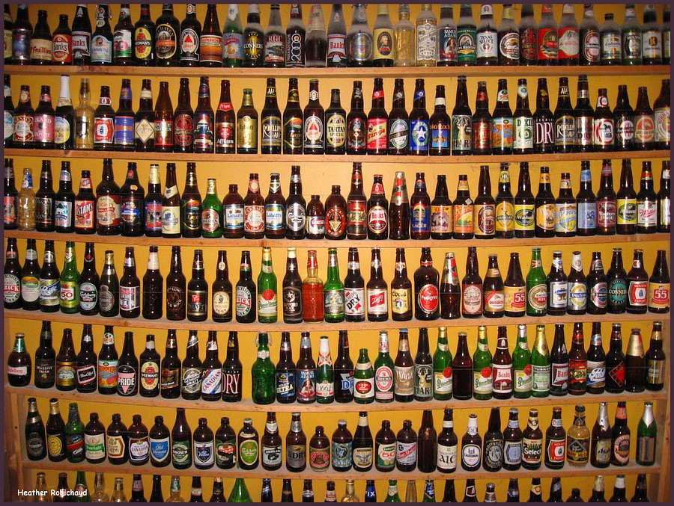

Slide 129
String bgColor;
if (groups.isBgColorControl() {
bgColor = "C0C0C0";
} else if (groups.isBgColorTst1()) {
bgColor = "067F03";
} else if (groups.isBgColorTst2()) {
bgColor = "7F8A23";
} else if (groups.isBgColorTst3()) {
bgColor = "935AB2";
} else if (groups.isBgColorTst4()) {
/* … blah blah blah … */
} else if (groups.isBgColorTst99()) {
bgColor = "4A3400";
}
String bgColor = groups.getBgColorTstPayload();

Slide 130
Forcing group membership

Slide 131
Activate your experimental features

Slide 132
?prforceGroups=abctst1,deftonestst4

Slide 133
Cross-product tests

Slide 134
Many products can opt into the same test

Slide 135
Same users, same groups

Slide 136
Easily coordinate experiments across products
Warning: Proctor is not a real-time or CA or CP system

Slide 137
A
B
☄
☄
❄
❄
❄
❄
☃
☃
☃
☃
☃
☃

Slide 138
Manipulating salts

Slide 139
Synchronizing different experiments

Slide 140
Reset experiments by reallocating groups
Email address | salt=pepa |  | salt=oregano
alice@example.com | 1 |  | 0
babu@example.com | 1 |  | 1
chen@example.com | 0 |  | 0
diu@example.com | 1 |  | 1
esteban@example.com | 1 |  | 0
fatima@example.com | 0 |  | 1
galina@example.com | 1 |  | 0
hadassah@example.com | 1 |  | 1

Slide 141
Managing tests via Proctor webapp

Slide 142
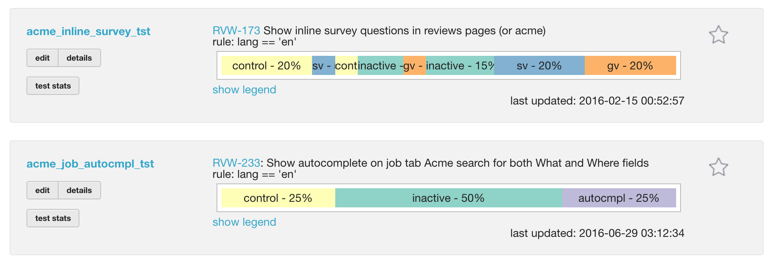
Summary view
Notes:
SO about 6 months later we build Proctor webapp.

Slide 143
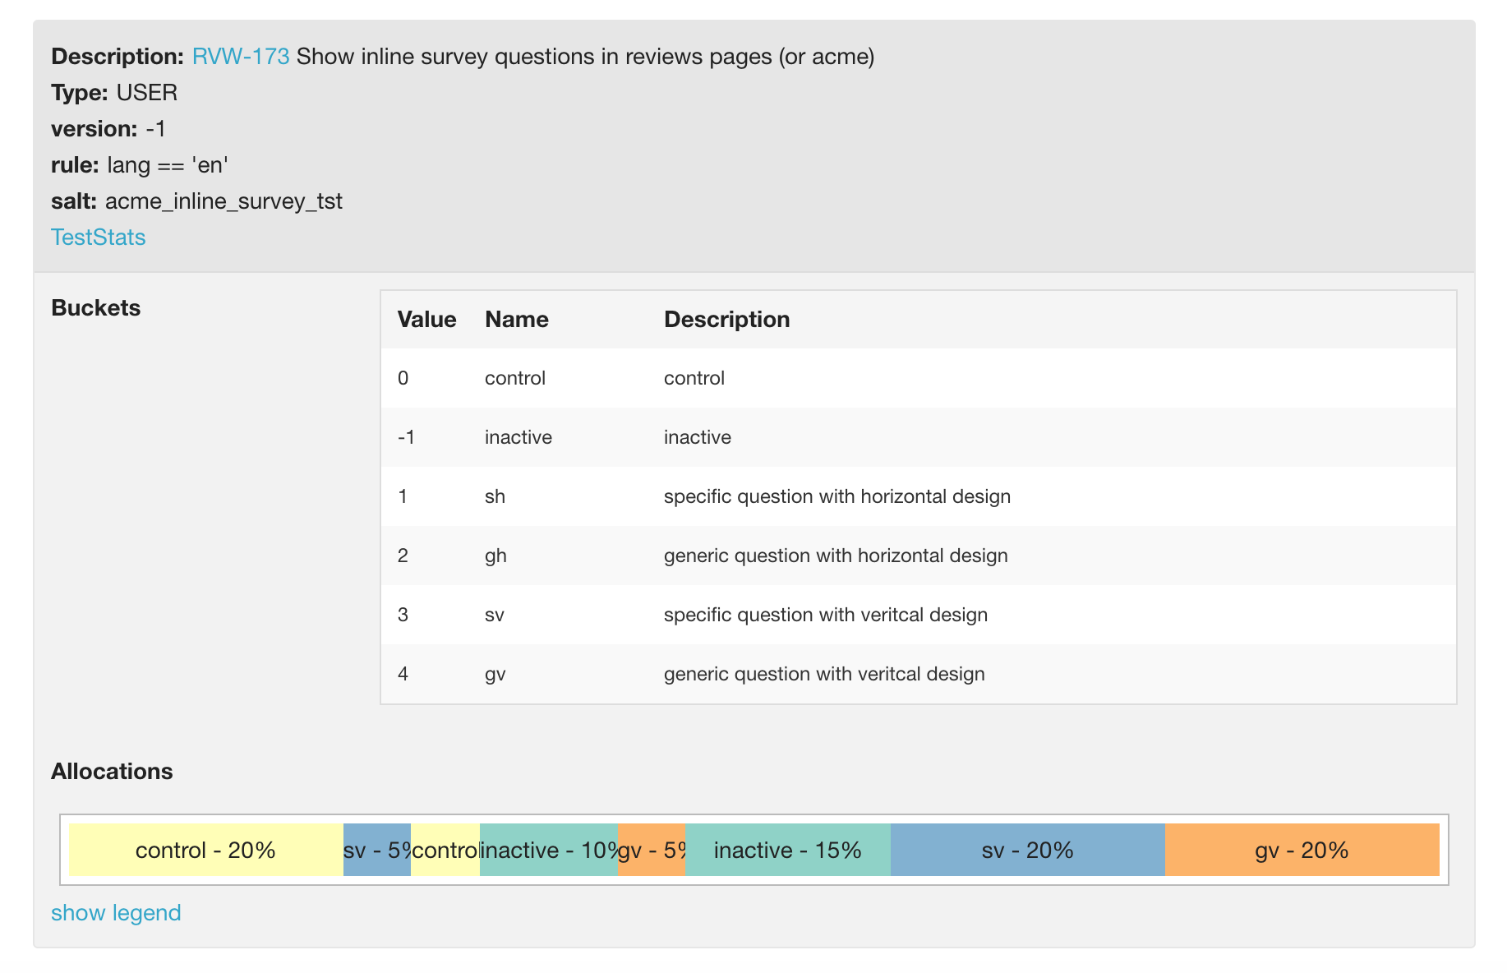
Detail view
Notes:
SO about 6 months later we build Proctor webapp.

Slide 144
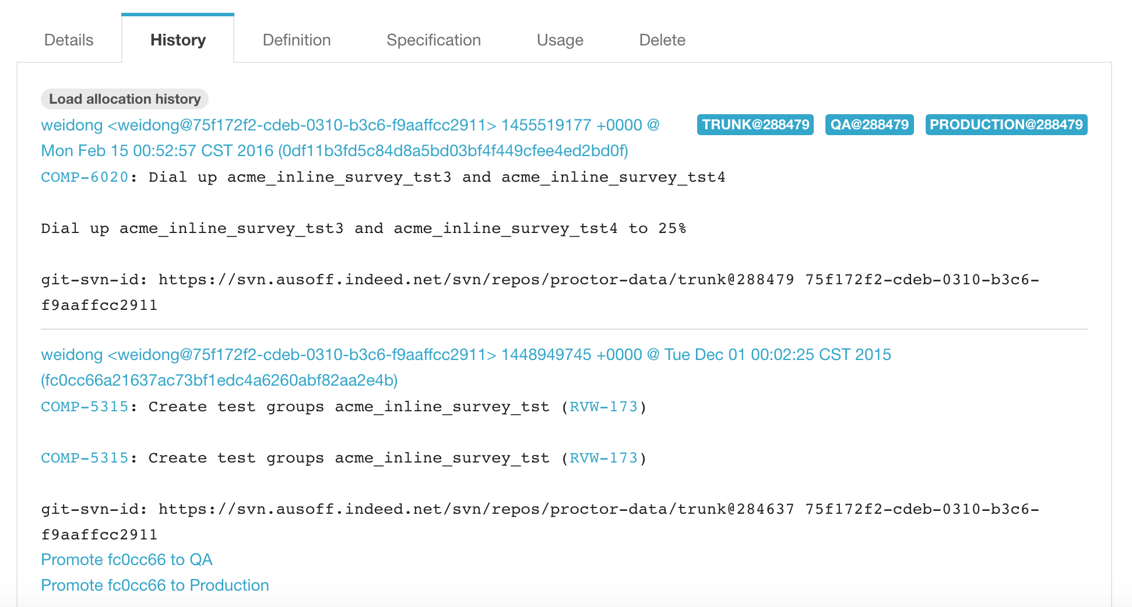
History
Notes:
SO about 6 months later we build Proctor webapp.

Slide 145
Edit experiment details
Notes:
SO about 6 months later we build Proctor webapp.

Slide 146
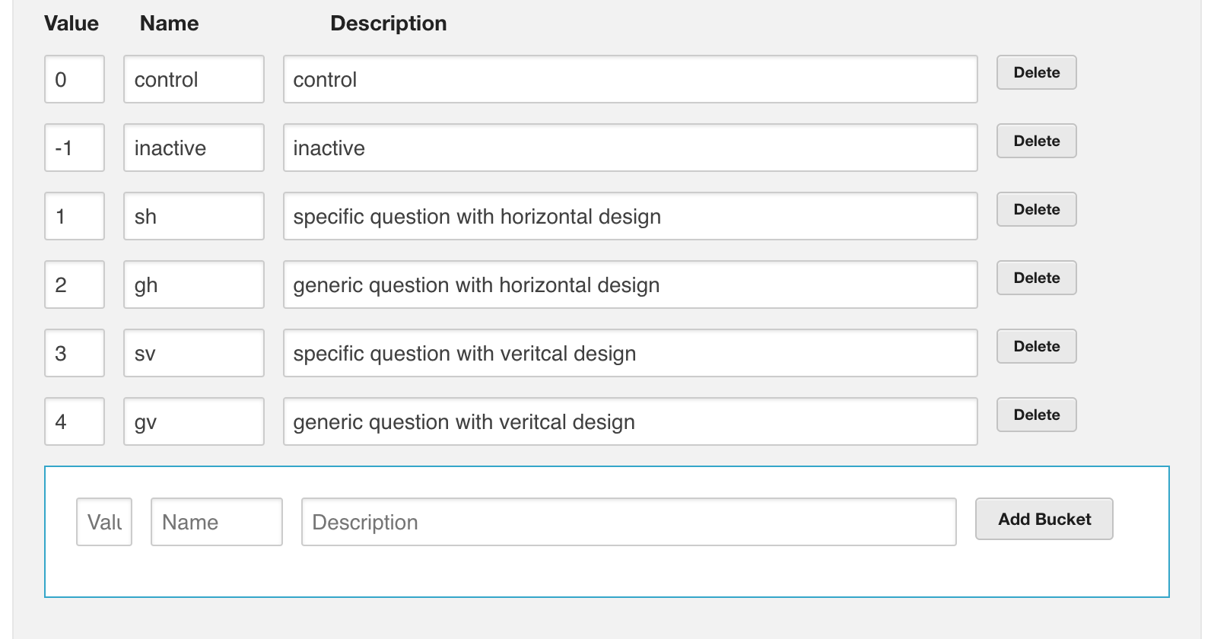
Edit test groups
Notes:
SO about 6 months later we build Proctor webapp.

Slide 147
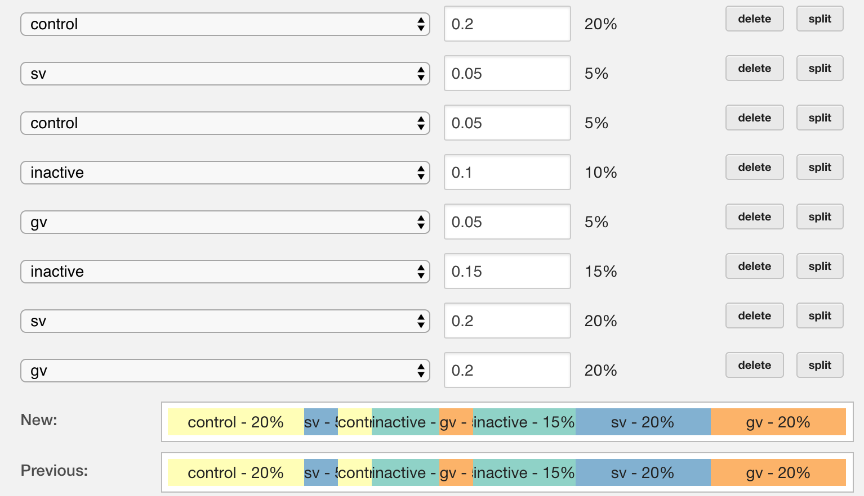
Adjust experiment size
Notes:
SO about 6 months later we build Proctor webapp.

Slide 148
Best practices

Slide 149
Request life cycle

Slide 150
Assign groups on every request

Slide 151
Assign groups at start of request processing

Slide 152
Avoid caching group assignments

Slide 153
Log group assignments, not treatment

Slide 154
Expanding experiment groups

Slide 155
Start with 10% test
0
1
(inactive)
10%

Slide 156
Naively expand to 25%
0
1
(inactive)
0
1
(inactive)

Slide 157
Expand to 50%
0
1
(inactive)
0
1
(inactive)
0
1

Slide 158
Roll out new behavior to 100%
0
1
(inactive)
0
1
(inactive)
0
1
1

Slide 159
Monday
Save Alert

Slide 160
Monday
Tuesday
Wednesday
Save Alert

Slide 161
Monday
Tuesday
Wednesday
Thursday
Save Alert
Save Alert

Slide 162
Monday
Tuesday
Wednesday
Thursday
Friday
Save Alert
Save Alert

Slide 163
Start from the ends
0
(inactive)
1
10%
10%

Slide 164
Expand to 25%
0
(inactive)
1
0
(inactive)
1

Slide 165
Expand to 50%
0
(inactive)
1
0
(inactive)
1
0
1

Slide 166
Roll out at 100%
0
(inactive)
1
0
(inactive)
1
0
1
1

Slide 167
Different test selection criteria

Slide 168
Different tests assign based on different types of ID

Slide 169
Anonymous cookie
Email address
Authenticated account
Department

Slide 170
Run them all on one user
Email | UID cookie | Account | Department
diu@example.com | asdfh8h2hvasd03 | 239145 | Marketing
emailcliptst0 emailsubjecttst4 | bluelinktst3 srchranktst2 Infinitescrolltst2 | logintst1 verifytst4 | workflowtst5

Slide 171
You can use Proctor too

Slide 172
Proctor is open source
github.com/indeedeng/proctor
github.com/indeedeng/proctor-pipet

Slide 173
Proctor is documented!
indeedeng.github.io/proctor

Slide 174
Source
github.com/indeedeng/proctor
github.com/indeedeng/proctor-pipet
Docs
indeedeng.github.io/proctor
Email
indeedeng-proctor-users@googlegroups.com
Me
ketan@indeed.com
Q&A

