Slide 1
Expedia’s Journey Toward Site Resilience
Sahar Samiei (@saharsamiei)
Senior Technical Product Manager
Willie Wheeler (@williewheeler)
Principal Applications Engineer
Copyright (c) 2017 Expedia, Inc. All rights reserved.
Notes:
By FEMA/Joselyne Augustino - https://share.sandia.gov/news/resources/news_releases/images/2013/fema.jpg, Public Domain, https://commons.wikimedia.org/w/index.php?curid=27401730

Slide 2
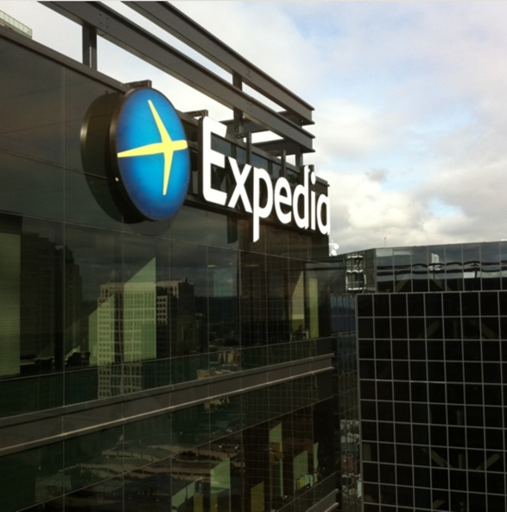
In 2016, Expedia was the 11th-largest Internet company by revenue at $8.77B.
`
Source: https://en.wikipedia.org/wiki/List_of_largest_Internet_companies

Slide 3
The Price of Downtime:
A Back-of-the-Envelope Calculation
Uptime | Downtime | Potential Revenue Loss
99% | 3.65 days | $87.7M
99.9% | 8.76 hours | $8.77M
99.99% | 52.56 minutes | $877K

Slide 4
So keeping our site up protects tens of millions of dollars of revenue per year.

Slide 5
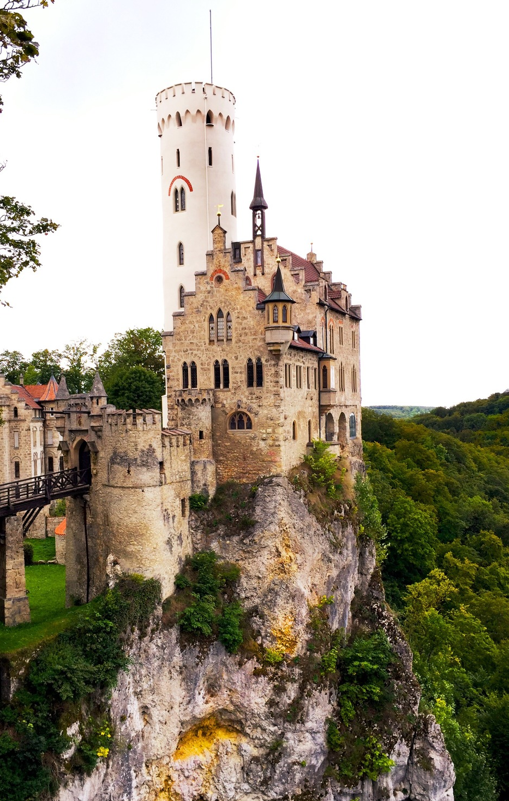
Resilience Challenges
Expedia’s Strategy
Technical Approach
Results to Date
Q & A
OVERVIEW
Notes:
https://www.trover.com/li/giuT/1dDXb

Slide 6
Resilience Challenges

Slide 7
Resilience is not always treated like a first-class citizen.

Slide 8
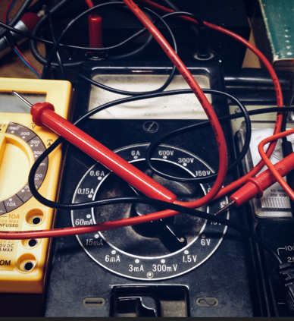
In Expedia we have a test-and-learn culture.

Slide 9
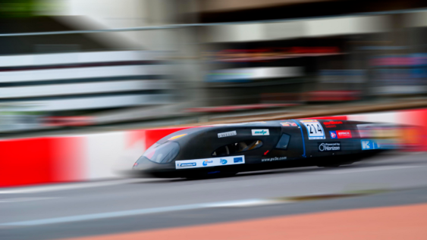
Innovation at Expedia is about constantly iterating its products and features.

Slide 10
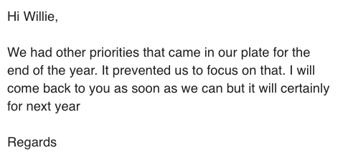
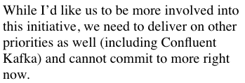
Resilience is an uphill battle.

Slide 11
Too many competing priorities.

Slide 12
There are major misconceptions about resilience.

Slide 13
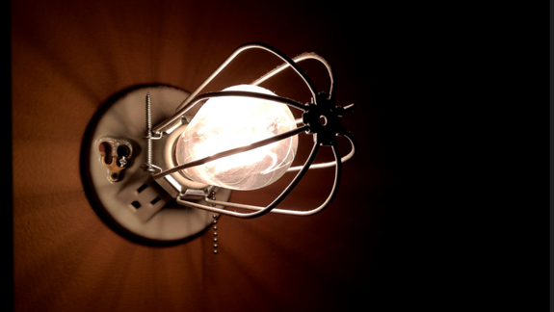
Myth:
By migrating to AWS your service will be resilient.

Slide 14
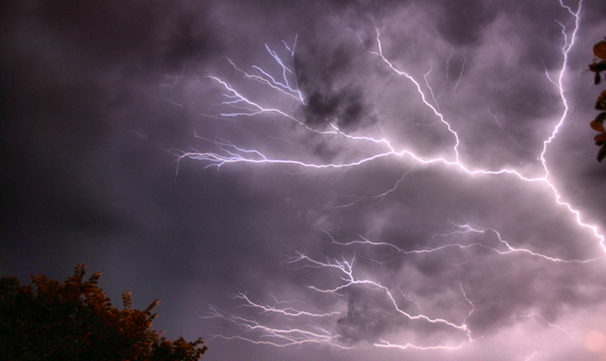
Myth:
We can’t do anything when S3 has an outage.

Slide 15
Myth:
Can’t build resilient services on flaky infrastructure.

Slide 16
Team Autonomy

Slide 17
Team autonomy is one of Expedia’s core beliefs. It’s great to have latitude to establish your own practices, tools and processes but it could add complexity.

Slide 18
We are still learning.

Slide 19
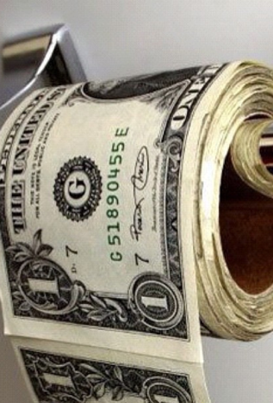
Resilience is not free.

Slide 20
Expedia Strategy

Slide 21
We put travelers at the heart of our thinking. To organize ourselves to ensure maximum availability of our websites – even during odd conditions – we started an initiative called “Perceived Zero Downtime”.

Slide 22
We make incremental improvements.

Slide 23
We empower teams by providing tools & best practices
We are not biased
We humbly listen to different approaches
We are open to other teams’ suggestions

Slide 24
We embrace team autonomy.
We set up a forum to bring teams from different brands together to share ideas, tools and best practices.

Slide 25
We create a shared learning space.

Slide 26
Introduce resilience champions.

Slide 27
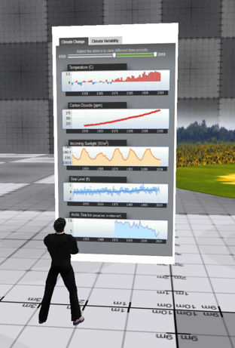
We invest lots of time to gather and present data.

Slide 28
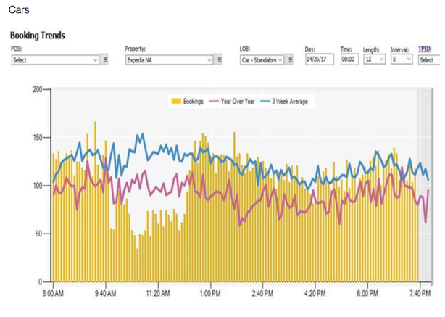
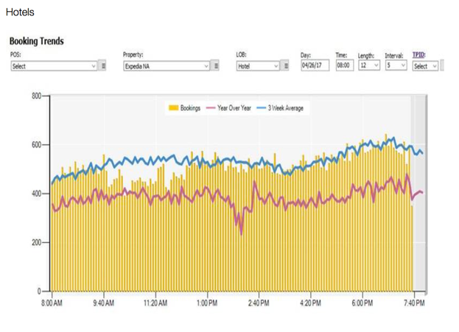
Tier 1 dependency failure
Product without a fallback
Product with a fallback

Slide 29
Pursue small wins by going after low-hanging fruit.

Slide 30
We are partnering with teams.

Slide 31
Technical Approach
Photo: Hans Splinter
Notes:
https://www.flickr.com/photos/archeon/4942358910
[KA] General notes:
- Consider using "experiment" instead of "test"
- Consider using "chaos" instead of "resilience"
- E.g. "chaos experiment" instead of "resilience test"

Slide 32
Lots of teams.
Lots of tools.
Notes:
[KA] Great slide. Please use Gremlin logo with name "Gremlin" here. Kolton will provide the logo.

Slide 33
How do we pull it all together?

Slide 34
Resilience Engineering Lifecycle
Service
Service
Service
Service
Service
Service
Service
Service
Service
Service
Database
Database
3rd-party
service
3rd-party
service
Notes:
https://www.trover.com/li/gikL/W4IU

Slide 35
Resilience Engineering Lifecycle
Service
Service
Service
Service
Service
Service
Service
Service
Service
Service
Database
Database
3rd-party
service
3rd-party
service
Prioritize Services
Notes:
https://www.trover.com/li/gikL/W4IU

Slide 36
Resilience Engineering Lifecycle
Service
Service
Service
Service
Service
Service
Service
Service
Service
Service
Database
Database
3rd-party
service
3rd-party
service
Prioritize Services
Investigate Vulnerabilities
Notes:
https://www.trover.com/li/gikL/W4IU

Slide 37
Resilience Engineering Lifecycle
Service
Service
Database
3rd-party
service
Prioritize Services
Investigate Vulnerabilities
Apply Resilience Patterns
Notes:
https://www.trover.com/li/gikL/W4IU

Slide 38
Resilience Engineering Lifecycle
Service
Service
Database
3rd-party
service
Prioritize Services
Investigate Vulnerabilities
Apply Resilience Patterns
Experiments in Test
Notes:
https://www.trover.com/li/gikL/W4IU

Slide 39
Resilience Engineering Lifecycle
Service
Service
Database
3rd-party
service
Prioritize Services
Investigate Vulnerabilities
Apply Resilience Patterns
Experiments in Test
Experiments in Production
Notes:
https://www.trover.com/li/gikL/W4IU

Slide 40
Let’s take a closer look…

Slide 41
1. Prioritize Services
Service Tiering
Scorecards & Reporting
Notes:
https://www.flaticon.com/free-icon/pyramid-chart_129532#term=pyramid&page=1&position=4
https://www.flaticon.com/free-icon/checklist_189067#term=checklist&page=1&position=2

Slide 42
1. Prioritize Services Service Tiering
Tier 1 – Essential
Tier 2 – Important
Tier 3 – Nice to have
T1: Bookings
T2: Reviews
T3: Urgency,
ads
Notes:
[KA] Explain how we know what's tier 1. Define that.
[SS] Examples:
- Bookings are tier 1
- Reviews are tier 2
- Ads and urgency messaging are tier 3

Slide 43
1. Prioritize Services Scorecards & Reporting
Incidents
Availability
Resilience
Notes:
[KA] Nice distinction between availability and resilience. Go into more detail on this.

Slide 44
1. Prioritize Services Resilience Scorecard
Resilience Alerts
Your app failed a Chaos Monkey experiment. Chaos Monkey terminated an EC2 instance, causing an outage.
To resolve this, please use EC2 Auto Scaling Groups.

Slide 45
Focus areas: identified.
What are the vulnerabilities?

Slide 46
2. Investigate Vulnerabilities
Resilience Maturity Model
(analytic)
Interactive Experiments
(empirical)

Slide 47
2. Investigate Vulnerabilities Resilience Maturity Model
Survive instance loss
Survive dependency loss
Survive AZ loss
Survive region loss
And so forth…

Slide 48
2. Investigate Vulnerabilities Interactive Experiments
Interactive attack tools
Discover vulnerabilities
Surprises await!
Notes:
[KA] The latency/load balancer example is interesting. Go into more detail, including explaining how we were preparing for a demo.

Slide 49
Now we understand some vulnerabilities.
How do we address them?

Slide 50
3. Apply Resilience Patterns
Auto-Scaling
Rate Limiting
Circuit Breakers
Multi-Geo
Database Failover
Bulkheads
Notes:
[KA]
- Find a better circuit breaker icon.
- Add the bulkhead pattern.

Slide 51
Defend your app with Hystrix
UI
An open source circuit breaker implementation by Netflix:
Start closed
Trip (open) when downstream is unhealthy
Close when downstream is healthy again
API
Database
External API
Notes:
[KA] Explain the value of defining a fallback. This will come up again in the city example.

Slide 52
Defend your app with Bulkheads
No bulkheads
Isolate resources to avoid unintended interactions between apps
Avoid "tragedy of the commons"
Bulkheads
Notes:
[KA] Explain the value of defining a fallback. This will come up again in the city example.

Slide 53
“
“
On our side, it is not a production incident because no client started to use this new platform.

Slide 54
Now we need to test our defenses.

Slide 55
4. Experiments in Test
perf
tests
deploy
to test
build
resilience
tests
deploy
to prod
release
to prod
security
scan

Slide 56
Attack
& validate
Retreat
& validate
Generate
load
Establish
baseline
Record
test results
Anatomy of a resilience test
Notes:
[DONE] [KA]
- Change "attack and test" to "attack and validate", and "retreat and test" to "retreat and validate".
- Change "log test results" to something that doesn't use "log"—that sounds like log file.

Slide 57
4. Experiments in Test
Baseline →
$ python test3.py
Baseline city count is 8.
Response during attack returned a city count of 1.
Response after attack returned a city count of 8.
********* Test success. *********
← Fallback
← Recovery

Slide 58
Pipeline tests are great.
But we do the real thing in prod.

Slide 59
5. Production-Based Experiments
Randomized Attacks
Health Checks

Slide 60
5. Production-Based Experiments Randomized Attacks
Netflix Simian Army
Self-service whitelist (autonomous teams)

Slide 61
5. Production-Based Experiments Health Checks
Pre-, during and post-attack
Pluggable checks
Notes:
[DONE] [KA] Explain how the health checks work. The API/plug-in thing and how we tell whether a service is actually healthy.

Slide 62
Recap
Service
Service
Service
Development
Test
Production

Slide 63
Results to Date
Photo: Mycatkins
Notes:
https://www.flickr.com/photos/bigmikeyeah/5751406027

Slide 64
We've had a good start over the past year.

Slide 65
Chaos Monkey running daily
in production since May 15
Added resilience tests to four Tier 1 service pipelines
Results to Date
Increased organizational awareness
Established resilience community of practice

Slide 67
Dev team engagement has been a struggle:
Limited team capacity
Product > resilience
Results to Date
Notes:
https://www.flaticon.com/free-icon/monkey_194301#term=monkey&page=1&position=35
https://www.flaticon.com/free-icon/chat_126500#term=community&page=1&position=6

Slide 68
Pivot for 2018: Automation
Proxy-based resilience
Test by discovery
Visibility
Reduce the cost of resilience engineering through automation

Slide 69
Resilience has a cost!
Teams have multiple competing prioritizes
Reduce friction
What did we learn?
There are major misconceptions
Prepare for early effort

Slide 70
Start with low-hanging fruit
Represent metrics
Add complexity incrementally
Make adoption easy
What did work well?
Try multiple technical approaches
Drive for experiments in production
Notes:
https://www.flickr.com/photos/kennysarmy/16366891047/

Slide 71
Questions & Answers

