Slide 1

Herding Nulls
and other C# stories from the future
Mads Torgersen, C# Lead Designer

Slide 2
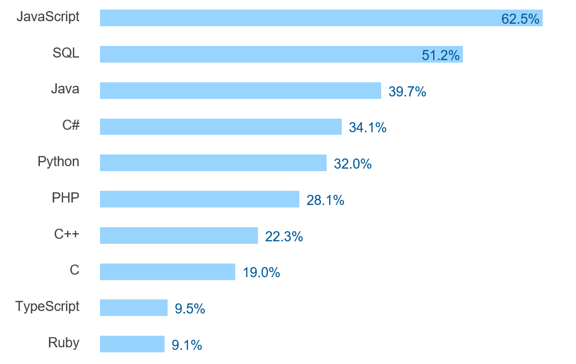

Stack Overflow - most popular technologies
stackoverflow.com/insights/survey/2017#most-popular-technologies

Slide 3
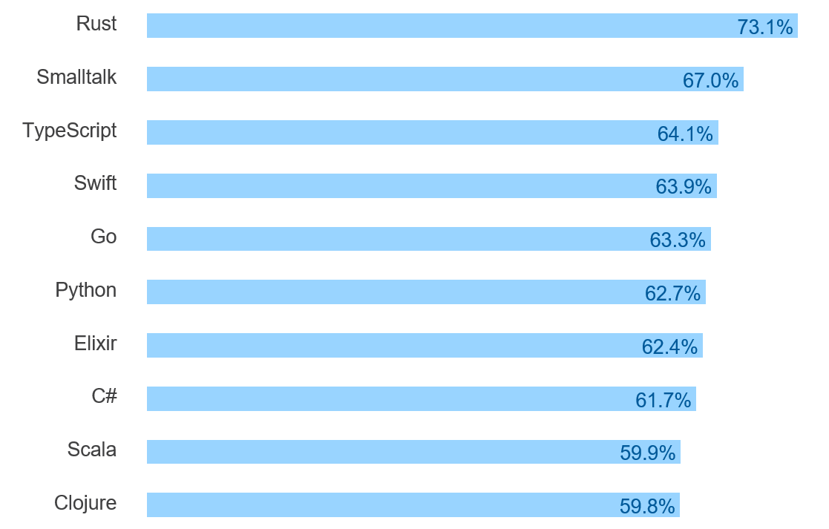
Stack Overflow - most loved technologies
stackoverflow.com/insights/survey/2017#most-loved-dreaded-and-wanted

Slide 4
Herding nulls – the problem
Every reference type allows null!
  Code must be defensive about it
  C# shares this with most object oriented languages
Not all languages have this problem
  Differentiate between nullable and non-nullable
  Use pattern matching or similar to conditionally “unpack” nullables
Components of a solution
  Expression of intent (nullable or not?)
  Enforcement of intent (regulate assignment and dereference)
Within an existing language!
  There are billions of lines of C# code, many of them well-tested against null

Slide 5
Herding nulls – expression of intent
public class Person
{
public string FirstName { get; set; }
public string MiddleName { get; set; }
public string LastName { get; set; }
}

Slide 6
Herding nulls – expression of intent
public class Person
{
public string! FirstName { get; set; }
public string? MiddleName { get; set; }
public string! LastName { get; set; }
}
☹

Slide 7
Herding nulls – expression of intent
public class Person
{
public string FirstName { get; set; }
public string? MiddleName { get; set; }
public string LastName { get; set; }
}
☺

Slide 8
Herding nulls – enforcement
Protect non-null types from nulls
Protect nulls from dereference
Must be optional
  Turn it on when you’re ready to know
  Can’t affect semantics - warnings, not errors
Must do a good job with existing code
  Can’t force you to rewrite good code
  Recognize existing ways of ensuring null safety (checks and assignments)
Can’t be exhaustive
  Tradeoff between completeness and convenience

Slide 9
Extension everything – new members
extension Student extends Person
{
// static field
static Dictionary<Person, Professor> enrollees = new Dictionary<Person, Professor>();
// instance method
public void Enroll(Professor supervisor) { enrollees[this] = supervisor; }
// instance property
public Professor? Supervisor => enrollees.TryGetValue(this, out var supervisor) ? supervisor : null;
// static property
public static ICollection<Person> Students => enrollees.Keys;
// instance constructor
public Person(string name, Professor supervisor) : this(name) { this.Enroll(supervisor); }
}

Slide 10
Extension everything – new members
extension Student extends Person
{
static Dictionary<Person, Professor> enrollees = new Dictionary<Person, Professor>();
public void Enroll(Professor supervisor) { enrollees[this] = supervisor; }
public Professor? Supervisor => enrollees.TryGetValue(this, out var supervisor) ? supervisor : null;
public static ICollection<Person> Students => enrollees.Keys;
public Person(string name, Professor supervisor) : this(name) { this.Enroll(supervisor); }
}
Person mads = new Person("Mads Torgersen", tonyHoare);
WriteLine(mads.Supervisor);
var tonysStudents =
from s in Person.Students
where s.Supervisor == tonyHoare
select s.Name;

Slide 11
Extension everything – interfaces
extension Student extends Person
{
static Dictionary<Person, Professor> enrollees = new Dictionary<Person, Professor>();
public void Enroll(Professor supervisor) { enrollees[this] = supervisor; }
public Professor? Supervisor => enrollees.TryGetValue(this, out var supervisor) ? supervisor : null;
public static ICollection<Person> Students => enrollees.Keys;
public Person(string name, Professor supervisor) : this(name) { this.Enroll(supervisor); }
}
class Professor { … }
interface IStudent
{
string Name { get; }
Professor? Supervisor { get; }
void Enroll(Professor supervisor);
}

Slide 12
Extension everything – interfaces
extension Student extends Person : IStudent
{
static Dictionary<Person, Professor> enrollees = new Dictionary<Person, Professor>();
public void Enroll(Professor supervisor) { enrollees[this] = supervisor; }
public Professor? Supervisor => enrollees.TryGetValue(this, out var supervisor) ? supervisor : null;
public static ICollection<Person> Students => enrollees.Keys;
public Person(string name, Professor supervisor) : this(name) { this.Enroll(supervisor); }
}
class Professor { … }
interface IStudent
{
string Name { get; }
Professor? Supervisor { get; }
void Enroll(Professor supervisor);
}

Slide 13
Extension everything – interfaces as type classes
interface IGroup<T>
{
static T Zero { get; }
static T operator +(T t1, T t2);
}
extension IntGroup extends int : IGroup<int>
{
public static int T Zero => 0;
}
public static T AddAll<T>(T[] ts) where T : IGroup<T>
{
T result = T.Zero;
foreach (T t in ts) { result += t; }
return result;
}
int sixtyThree = AddAll(new [] { 1, 2, 4, 8, 16, 32 });

Slide 14
Async streams – getting rid of callbacks

Slide 15
Records
class Person(string First, string Last);
class Person : IEquatable<Person>
{
public string First { get; }
public string Last { get; }
public Person(string First, string Last) => (this.First, this.Last) = (First, Last);
public void Deconstruct(out string First, out string Last)
=> (First, Last) = (this.First, this.Last);
public bool Equals(Person other)
=> other != null && First == other.First && Last == other.Last;
public override bool Equals(object obj) => obj is Person other ? Equals(other) : false;
public override int GetHashCode() => GreatHashFunction(First, Last);
…
}

Slide 16
Resources
  github.com/dotnet/csharplang
  blogs.msdn.microsoft.com/dotnet

