Slide 1

Cloud Native Infrastructure
with Kubicorn
Kris Nova

Slide 2
About Me

Slide 3
Kris Nova

Slide 4

Kris Nova

Slide 5
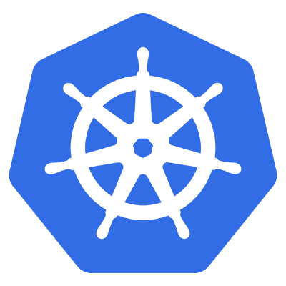
Kris Nova

Slide 6
Kris Nova

Slide 7

Kris Nova

Slide 8
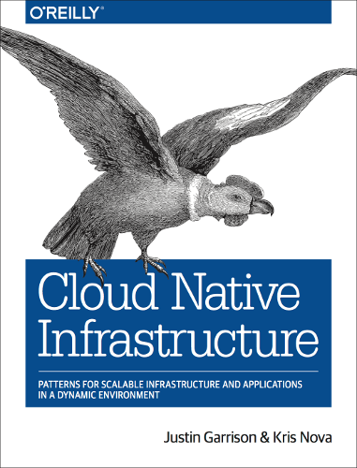
Kris Nova

Slide 9
What is Cloud Native Infrastructure?

Slide 10
Infrastructure

Slide 11
Infrastructure
All the things you don’t want to deal with

Slide 12
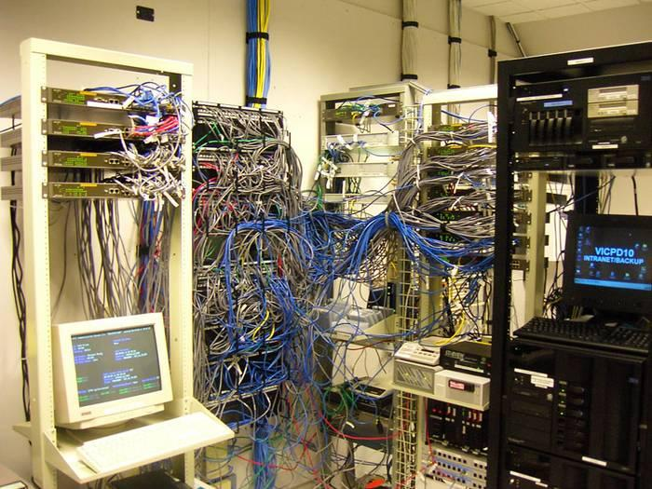
Infrastructure

Slide 13
The OSI Reference Model
Application
Presentation
Session
Transport
Network
Data link
Physical

Slide 14
The NEW OSI Reference Model
Software
Software
Software
Software
Software
Software
Physical

Slide 15
Cloud Native

Slide 16
Cloud Native
Offloading workloads to a cloud

Slide 17
Cloud Native
Offloading workloads to a cloud… via HTTP(s)

Slide 18
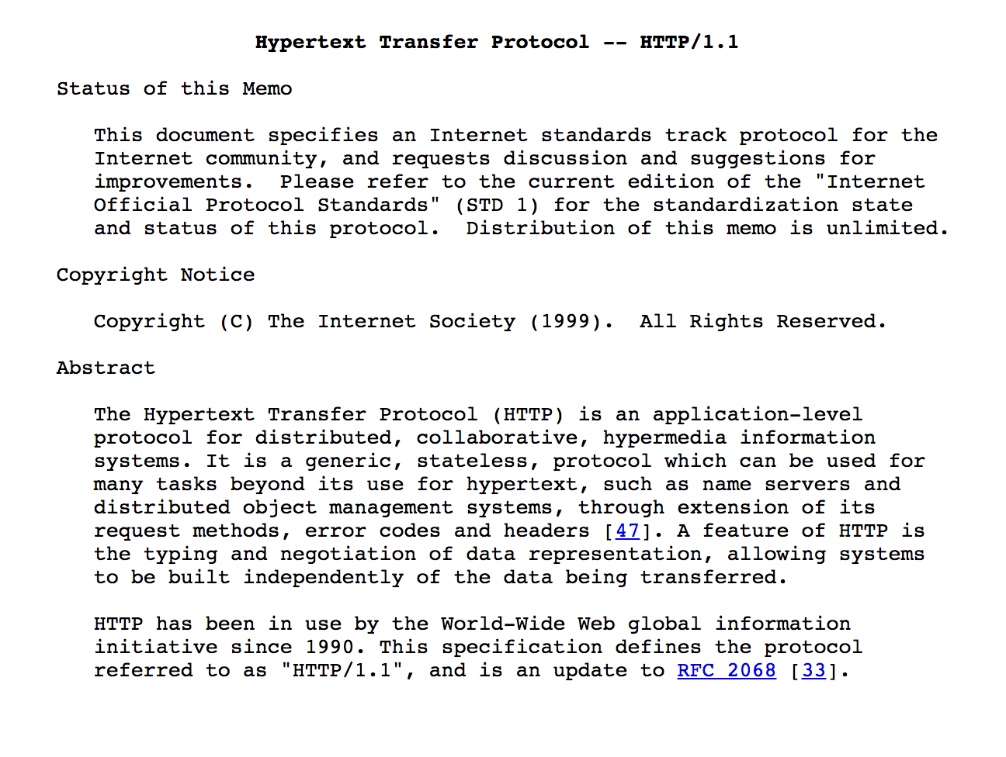
Cloud Native

Slide 19
Cloud Native Infrastructure
+

Slide 20
Managing Cloud Native Infrastructure…?

Slide 21

Managing Cloud Native Infrastructure

Slide 22
What is Kubicorn?

Slide 23
What is Kubicorn?
Kubernetes Infrastructure Management

Slide 24
How does it work?
Resource
Kubicorn API
Reconciler
Resource
Resource

Slide 25
Where did it come from?

Slide 26
The History of Kubicorn
Terraform

Slide 27
The History of Kubicorn
Kubernetes Kops

Slide 28
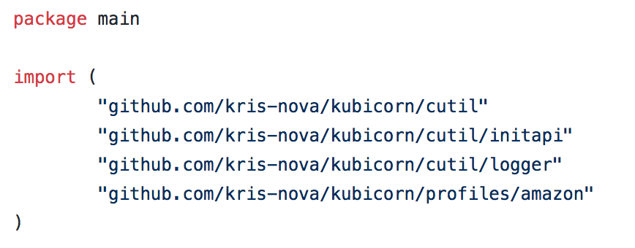
The History of Kubicorn
I wanted a library

Slide 29
The History of Kubicorn
I wanted a controller

Slide 30
The History of Kubicorn
I wanted out of core

Slide 31


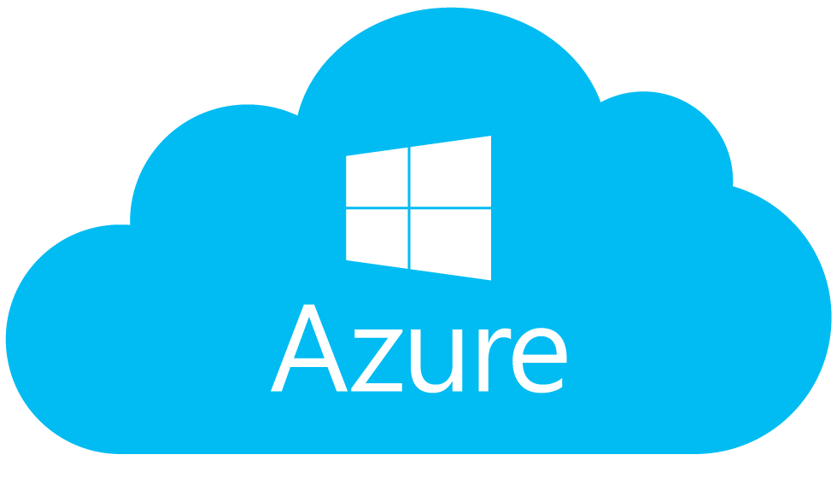

I wanted all the clouds

Slide 32
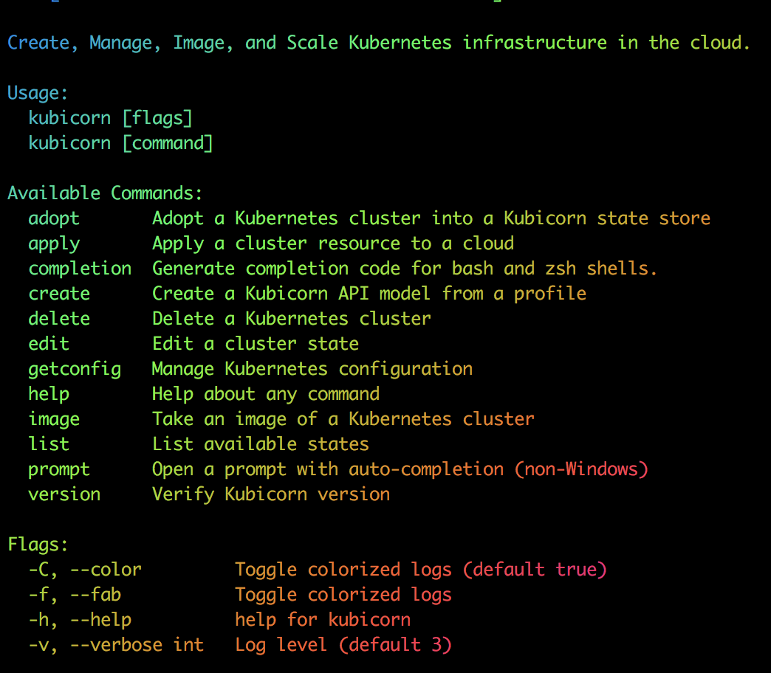
I wanted it to be pretty

Slide 33
I was afraid to open source it

Slide 34
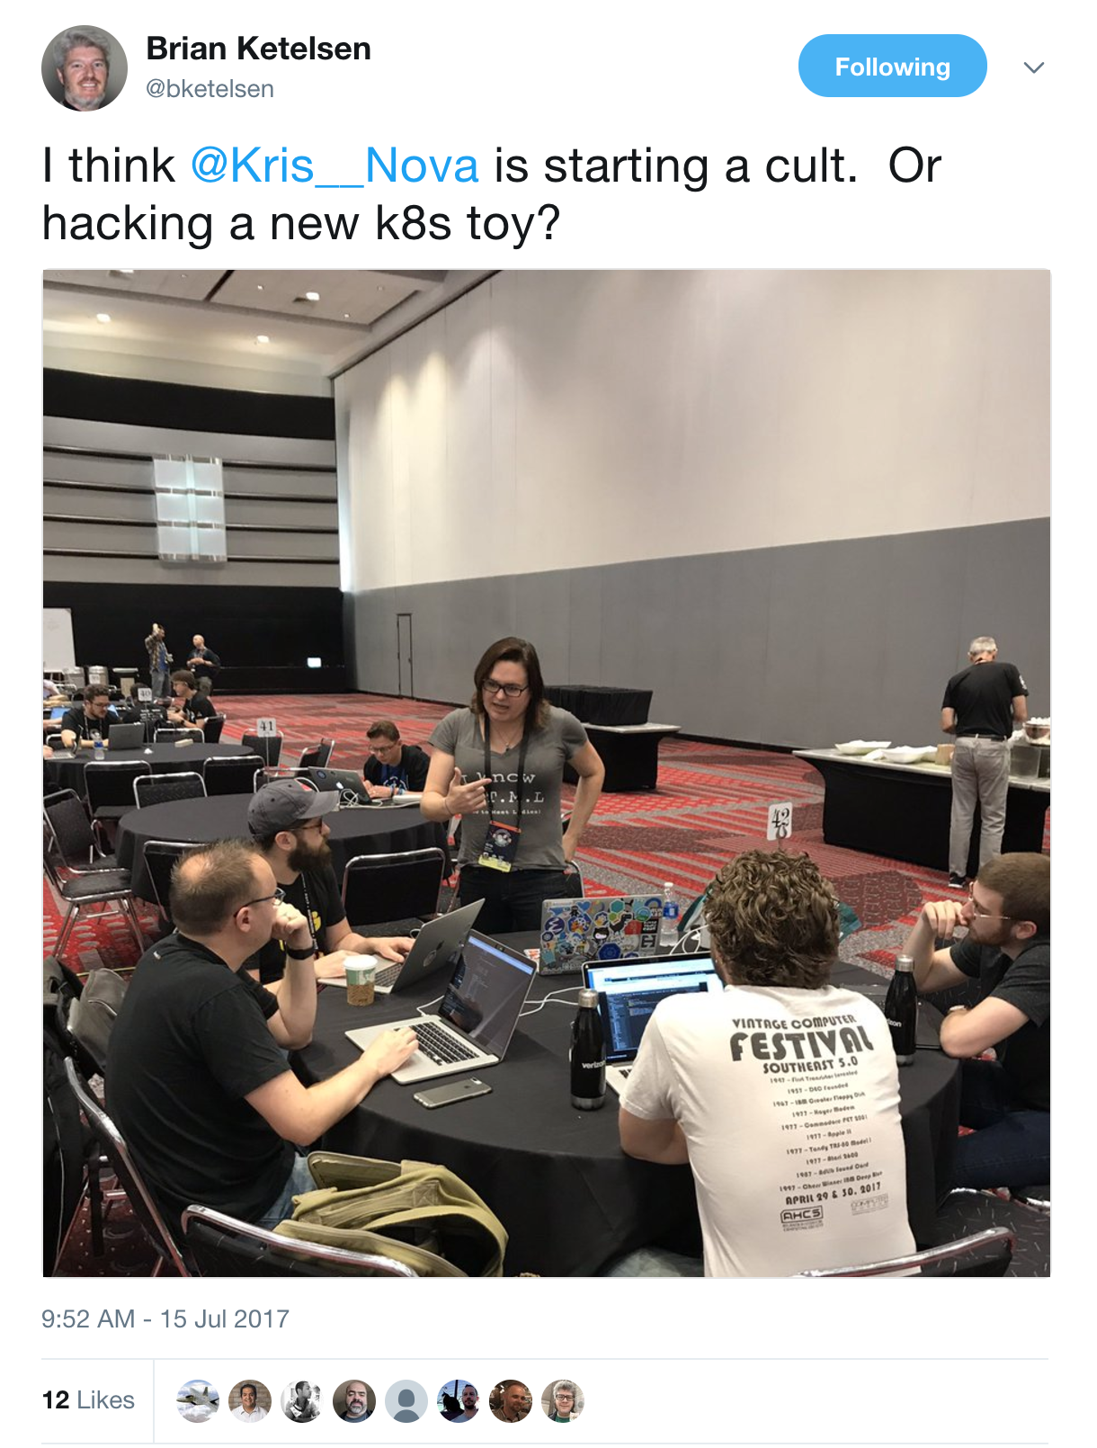
GopherCon 2017

Slide 35
I was number 1 on GitHub!

Slide 36
Deep Dive

Slide 37
Kubicorn API

Slide 38
Kubicorn API
State

Slide 39
Kubicorn API
State
Reconciler

Slide 40
Kubicorn API
State
Resource
Reconciler

Slide 41
Kubicorn API
State
Bootstrap
Resource
Reconciler
Resource

Slide 42
The API
Key: Value

Slide 43
The API
Data structure that represents a cluster

Slide 44
The API
Going to demo the “new” API at Kubecon

Slide 45
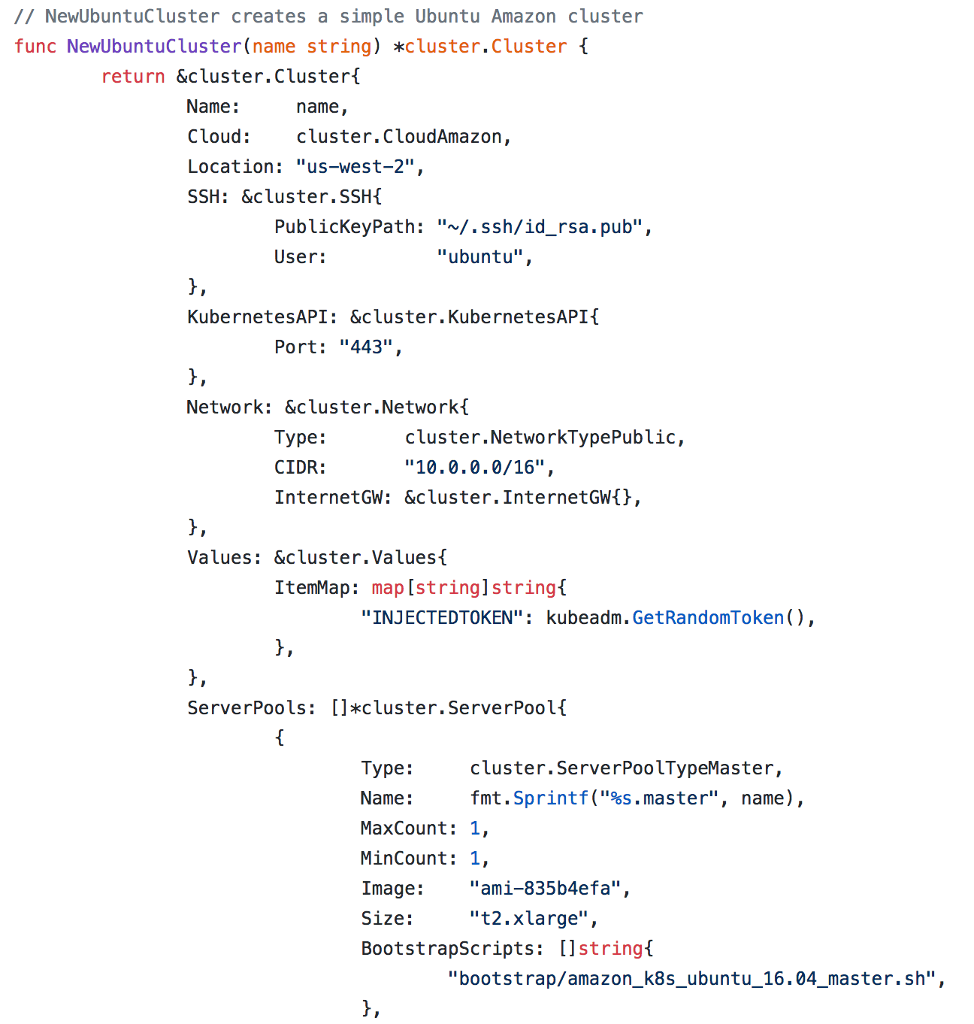

Slide 46
The Reconciler Pattern
Resource
API
Reconciler
Resource
Resource

Slide 47
The Reconciler Pattern
GetActual()
GetExpected()
Reconcile(actual, expected)
Destroy(actual)

Slide 48
The Resource Model
Resource
Kubicorn API
Resource
Resource

Slide 49
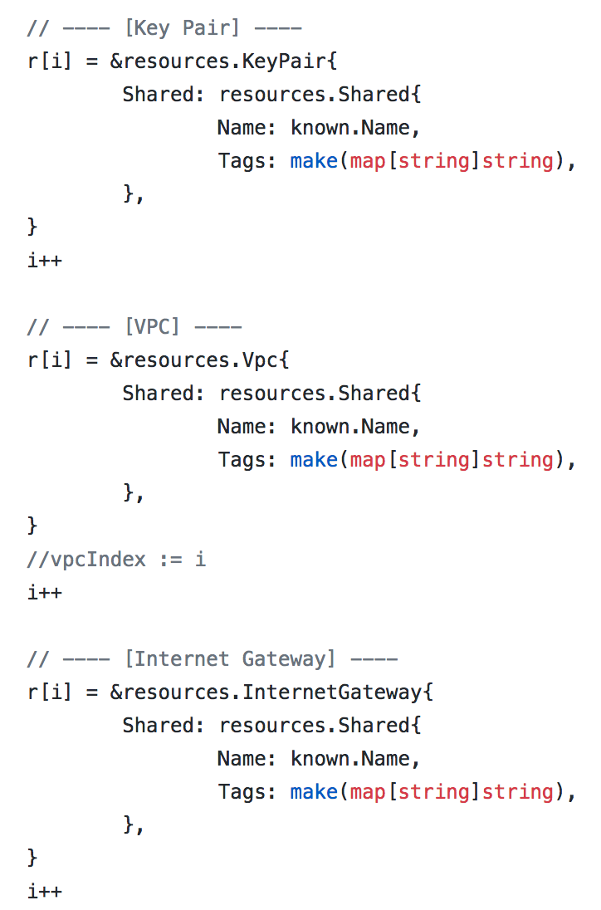
The Resource Model

Slide 50
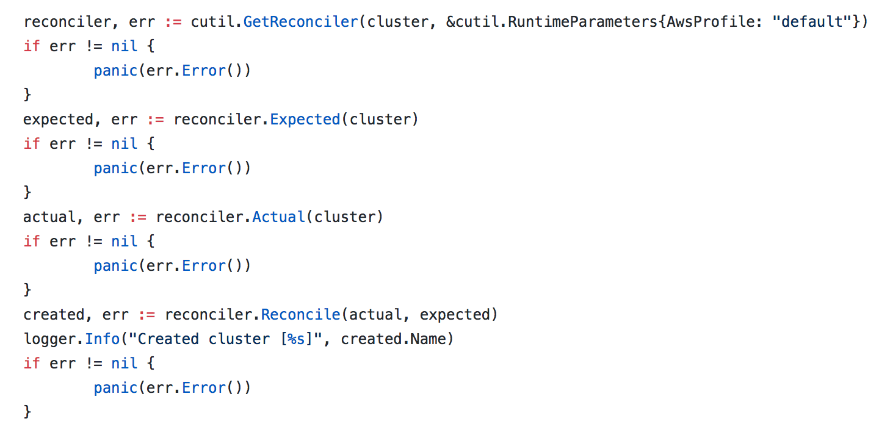
The Reconciler

Slide 51
Bootstrap Scripts
Cloud Init
cat API to disk /etc/kubicorn
No templating!
No bindata!

Slide 52
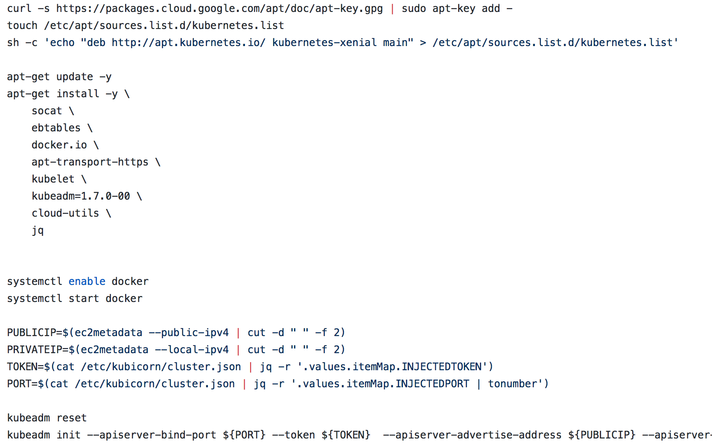
Bootstrap Scripts

Slide 53
The Kubernetes Stack
Apps
Components
Infrastructure

Slide 54
The Kubernetes Stack
Kubernetes
Kubeadm
Kubicorn

Slide 55
Go Interfaces

Slide 56
The Pattern
Implementation
Interface
Implementation
Implementation

Slide 57
Cloud Example
AWS
Cloud
Digital Ocean
Google

Slide 58
The Future

Slide 59
Cloud Native Applications
Orchestrator
Container
My Application

Slide 60
Kubernetes Controller
Runs in a container
Loops indefinitely
Reconciles something

Slide 61
Reconcile Infrastructure with a Controller
for {
// Reconcile loop
}

Slide 62
Running Kubicorn as a controller
CLI
Cluster

Slide 63
Running Kubicorn as a controller
CLI
Cluster
Kubicorn Controller

Slide 64
Running Kubicorn as a controller
Cluster
Kubicorn Controller

Slide 65
Running Kubicorn as a controller
Cluster
Kubicorn Controller
Kubicorn API
Client

Slide 66
Questions?

Slide 67
Demo!

Slide 68
Thank You
Kris Nova
@kris__nova

