Slide 1
Solving Performance Bottlenecks for Spark Developers
Kirk A. Lewis
Field Engineer

Slide 2
Productivity Tip #1
The Stranger Things soundtrack is not the best focus music.

Slide 3
Agenda
Overview of developer focused solutions from Pepperdata
3 Examples of Identifying Spark Application Bottlenecks and Resolving Failures
Okay But… Make It Easier!
Q and A

Slide 4
Big Data Performance Expertise
>20
Thousand
Production
Nodes
~100
Million
Jobs/Year
~400
Trillion
Performance
Data Points

Slide 5
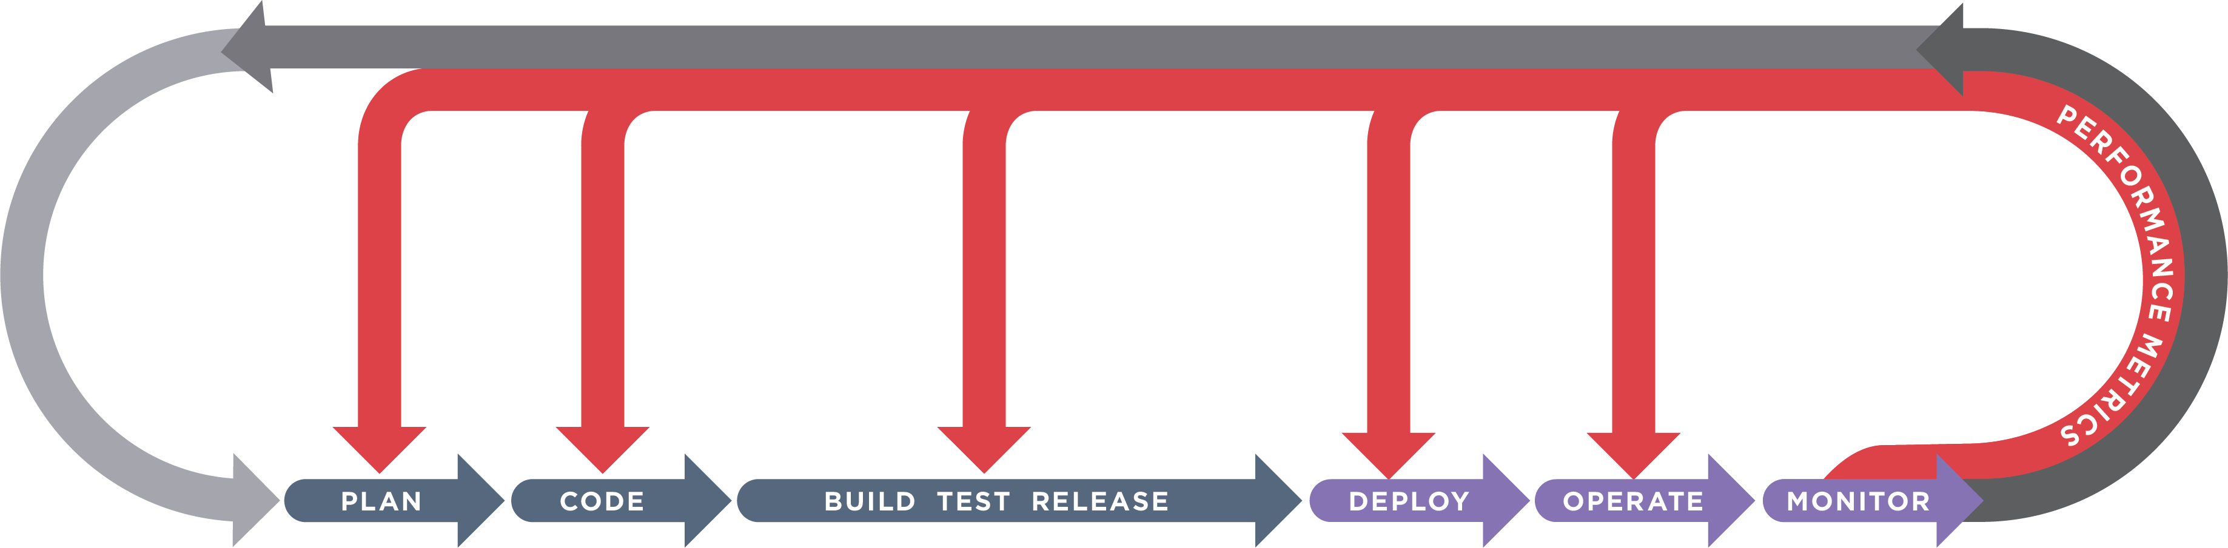
Big Data Performance Solutions
DEV
OPS
Code Analyzer
for Apache Spark
Application Profiler
Cluster Analyzer
Capacity Optimizer

Slide 6
Developer Focused Products
Code Analyzer for Apache Spark
Line of Code level resource utilization to uncover bottlenecks
Diagnosis of Spark app failures
Timelines and charts showing the impact on resource consumption
Diagnostic
Application Profiler
Looks at all Spark and MR apps & tells you which need tuning
It looks at the entire run of each application
Recommends modifications per application
Prescriptive

Slide 7
3 Use Cases:
Identifying Bottlenecks and Resolving Failures

Slide 8
Use Case 1:
Reading the Tea Leaves of Garbage Collection

Slide 9
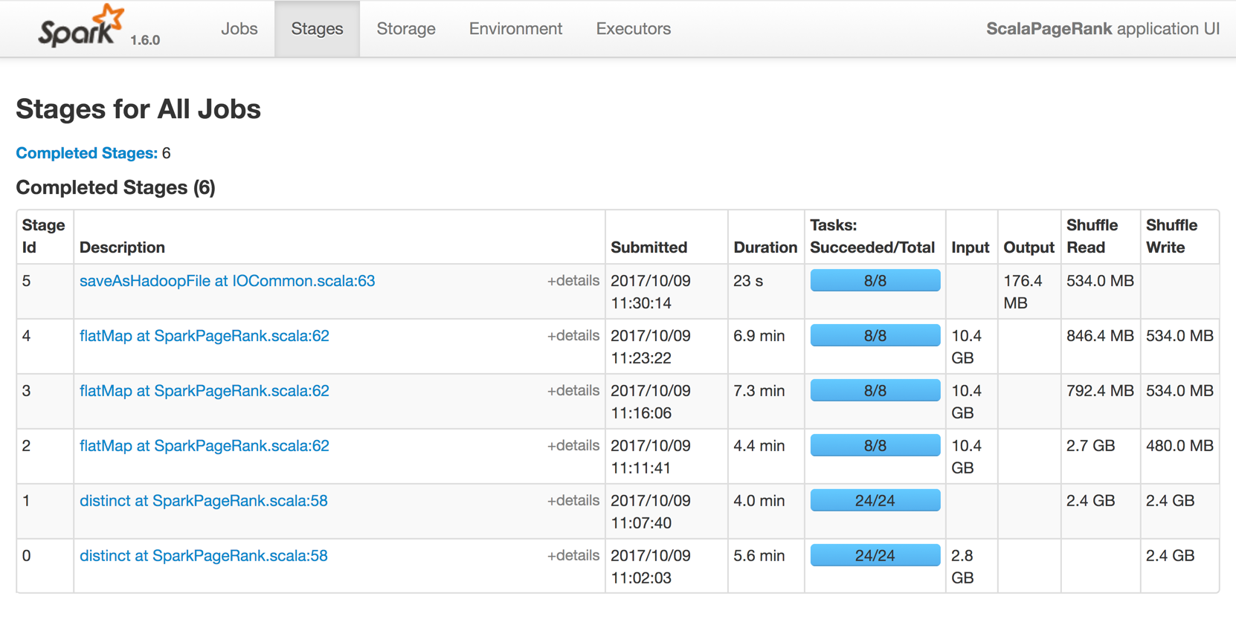
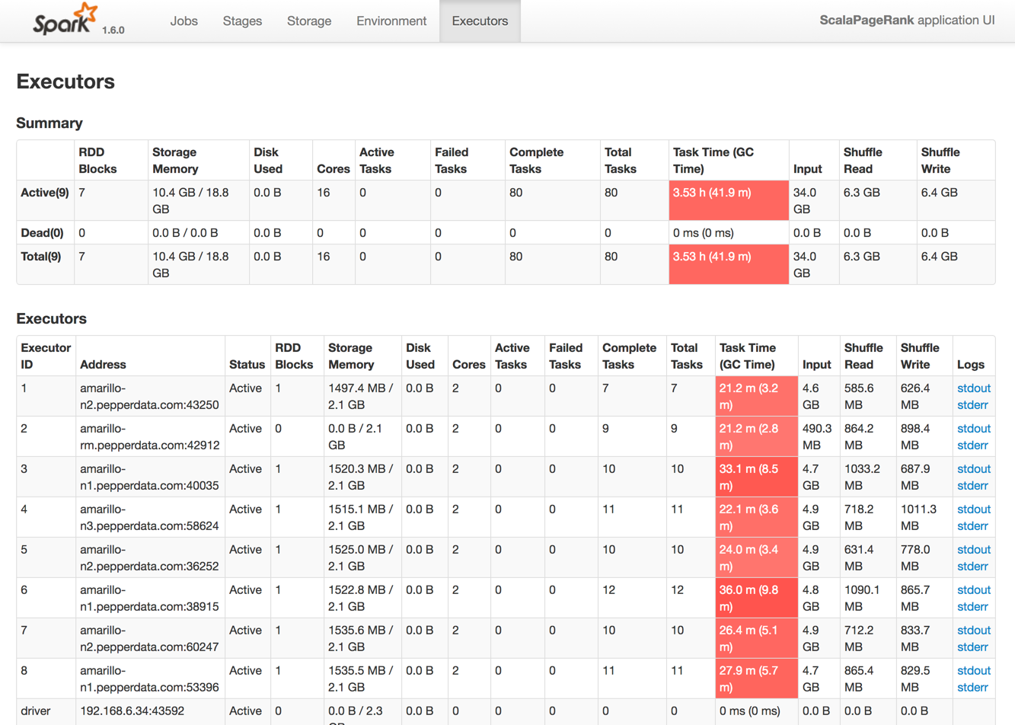
Spark Web UI indicates a GC issue

Slide 10
Time Series Data:
Tells you Where to Focus Your Attention

Slide 11
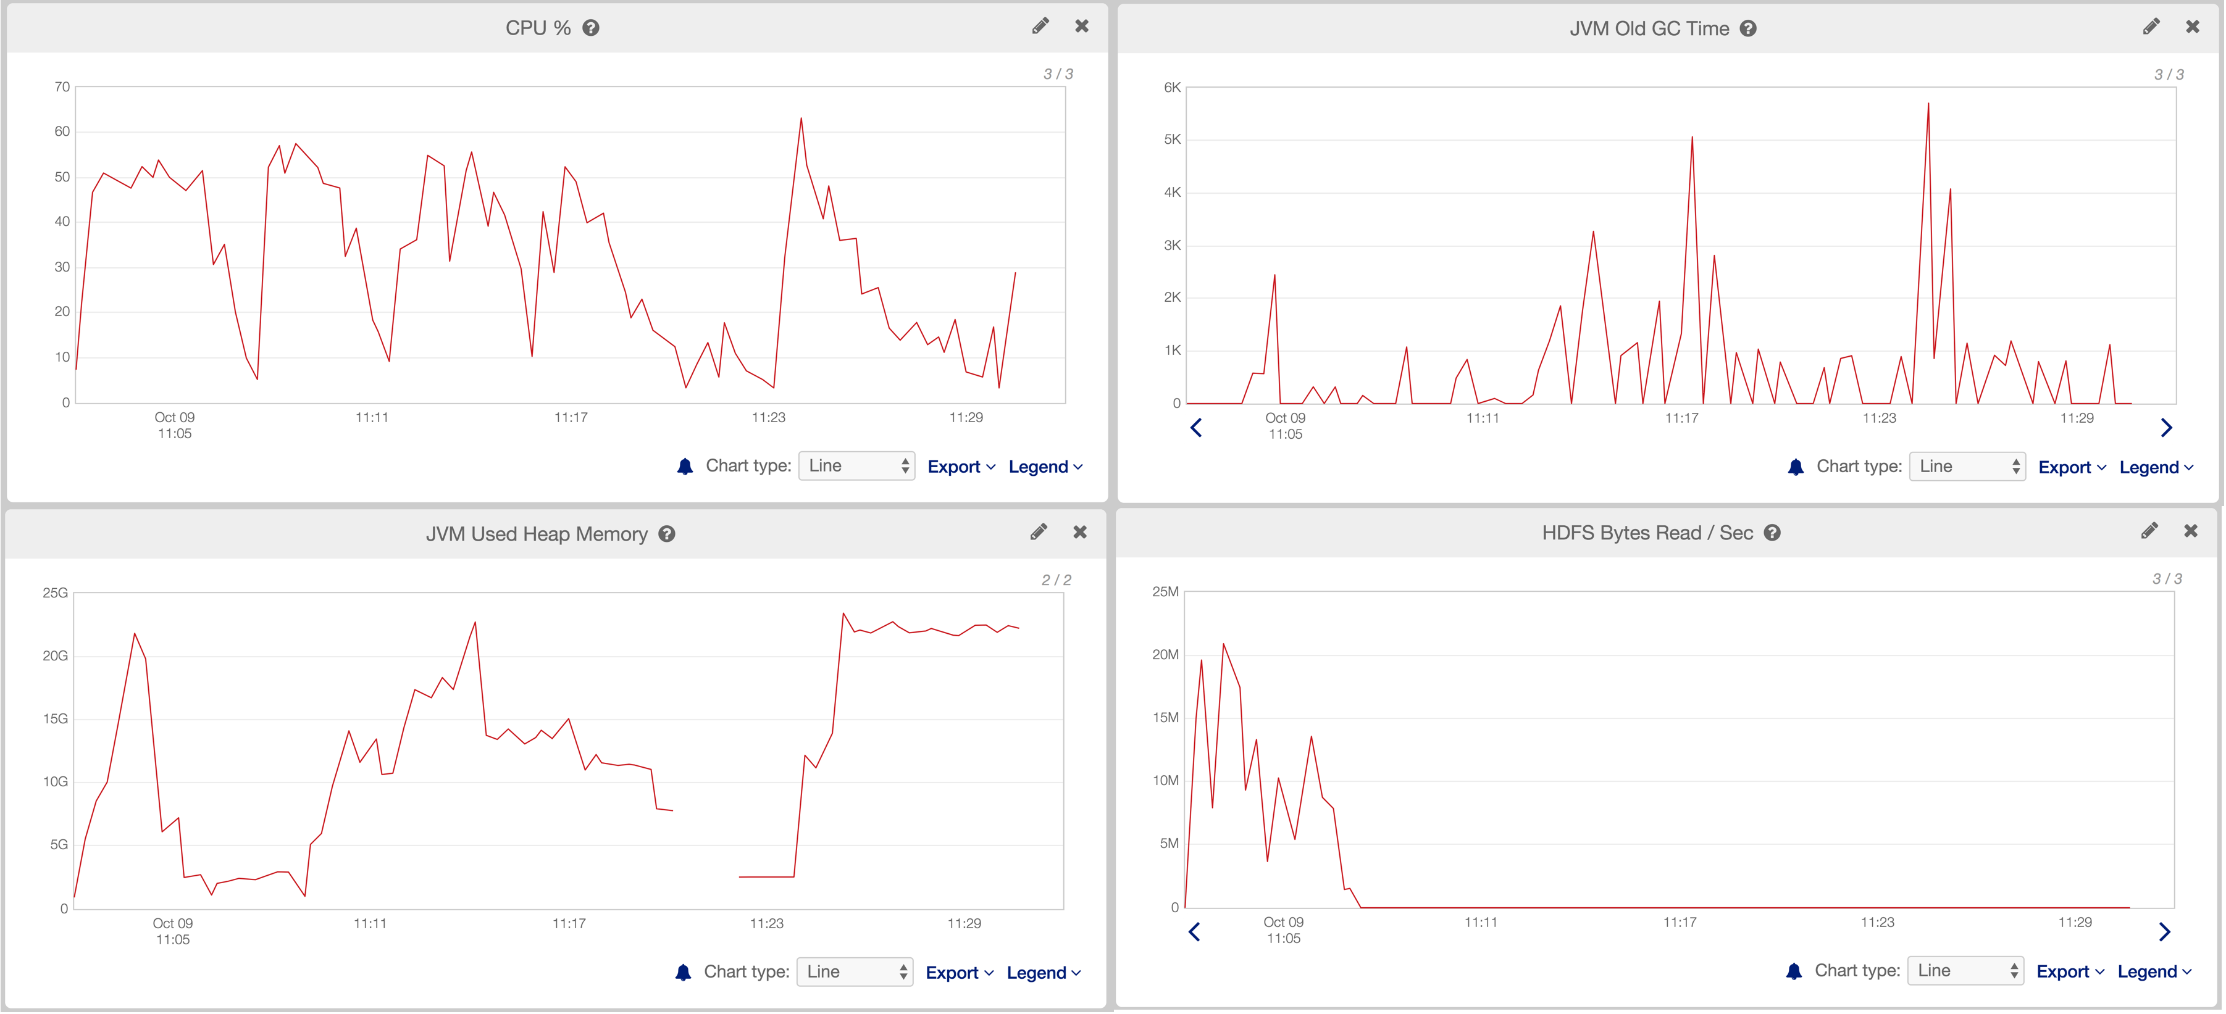
Time series view of the App

Slide 12
Code Analyzer for Apache Spark:
Execution Plan + Time Series

Slide 13
Three Data Elements Paint a Complete Picture of Spark Application Performance
Code execution plan
  Indicates which block of code is being executed
Time series view
  Visualize resource consumption by the application
  Outliers in resource usage are easy to spot
Cluster weather
  A view of all applications running on the cluster

Slide 14
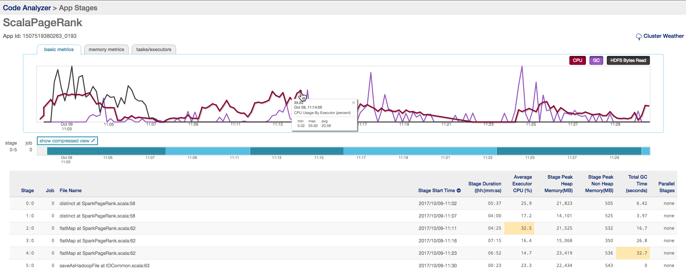
Code Analyzer = Execution Plan + Time Series

Slide 15
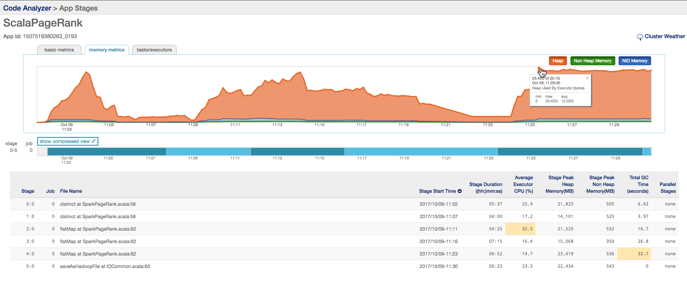
Code Analyzer = Execution Plan + Time Series

Slide 16
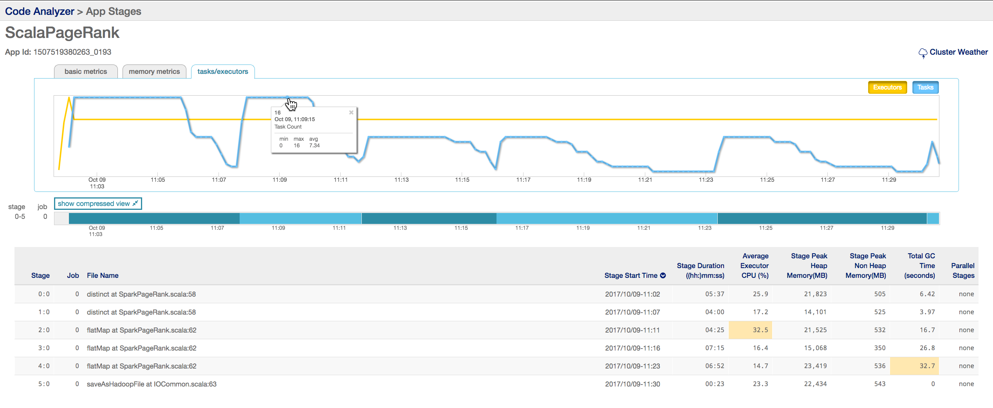
Code Analyzer = Execution Plan + Time Series

Slide 17
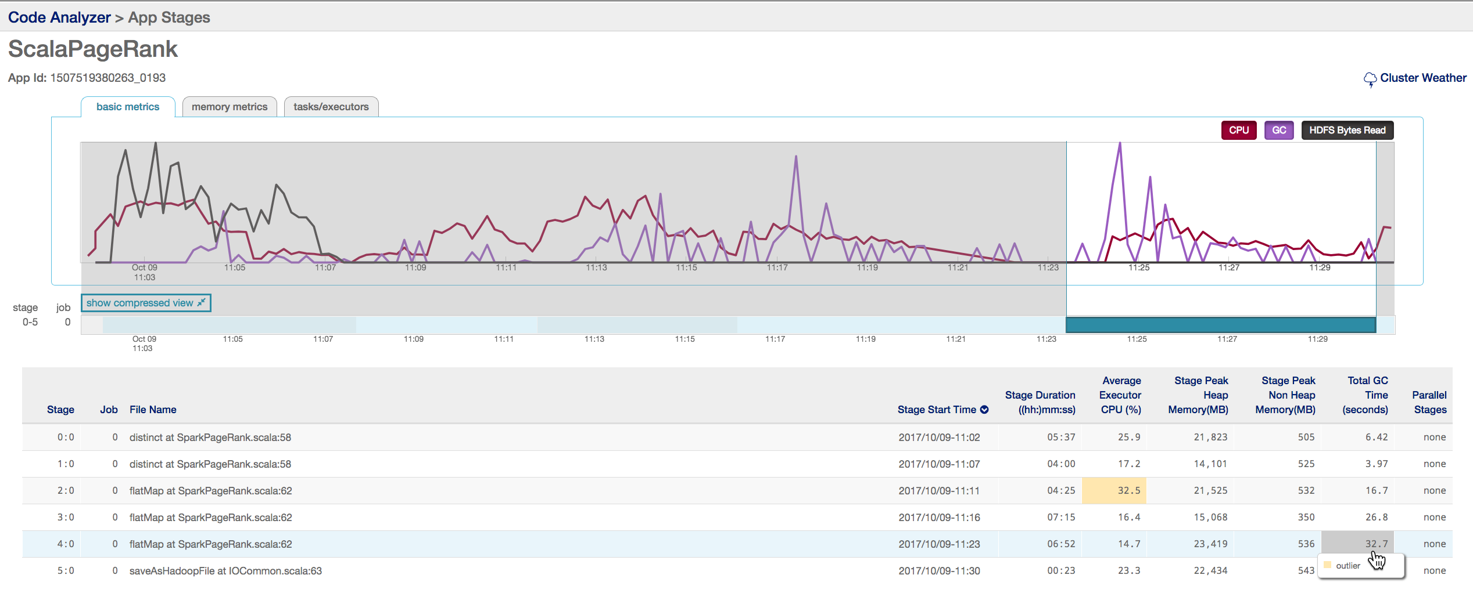
Drill down into Stage 4 to investigate GC

Slide 18
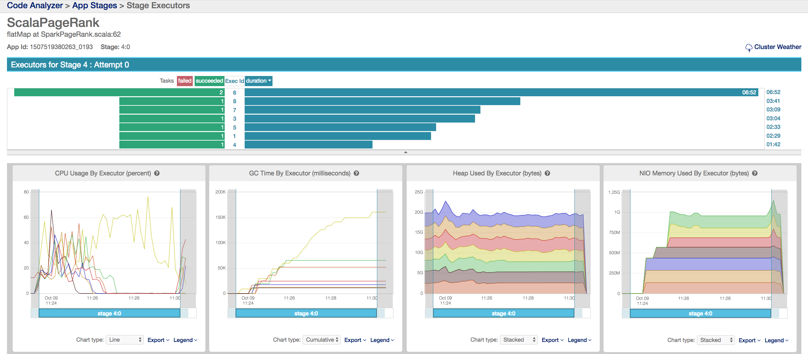
Executor skew increased Stage duration 3x

Slide 19
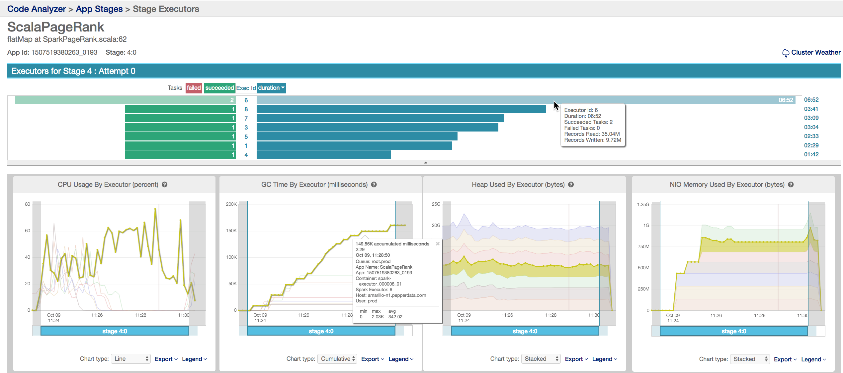
Executor skew increased Stage duration 3x

Slide 20
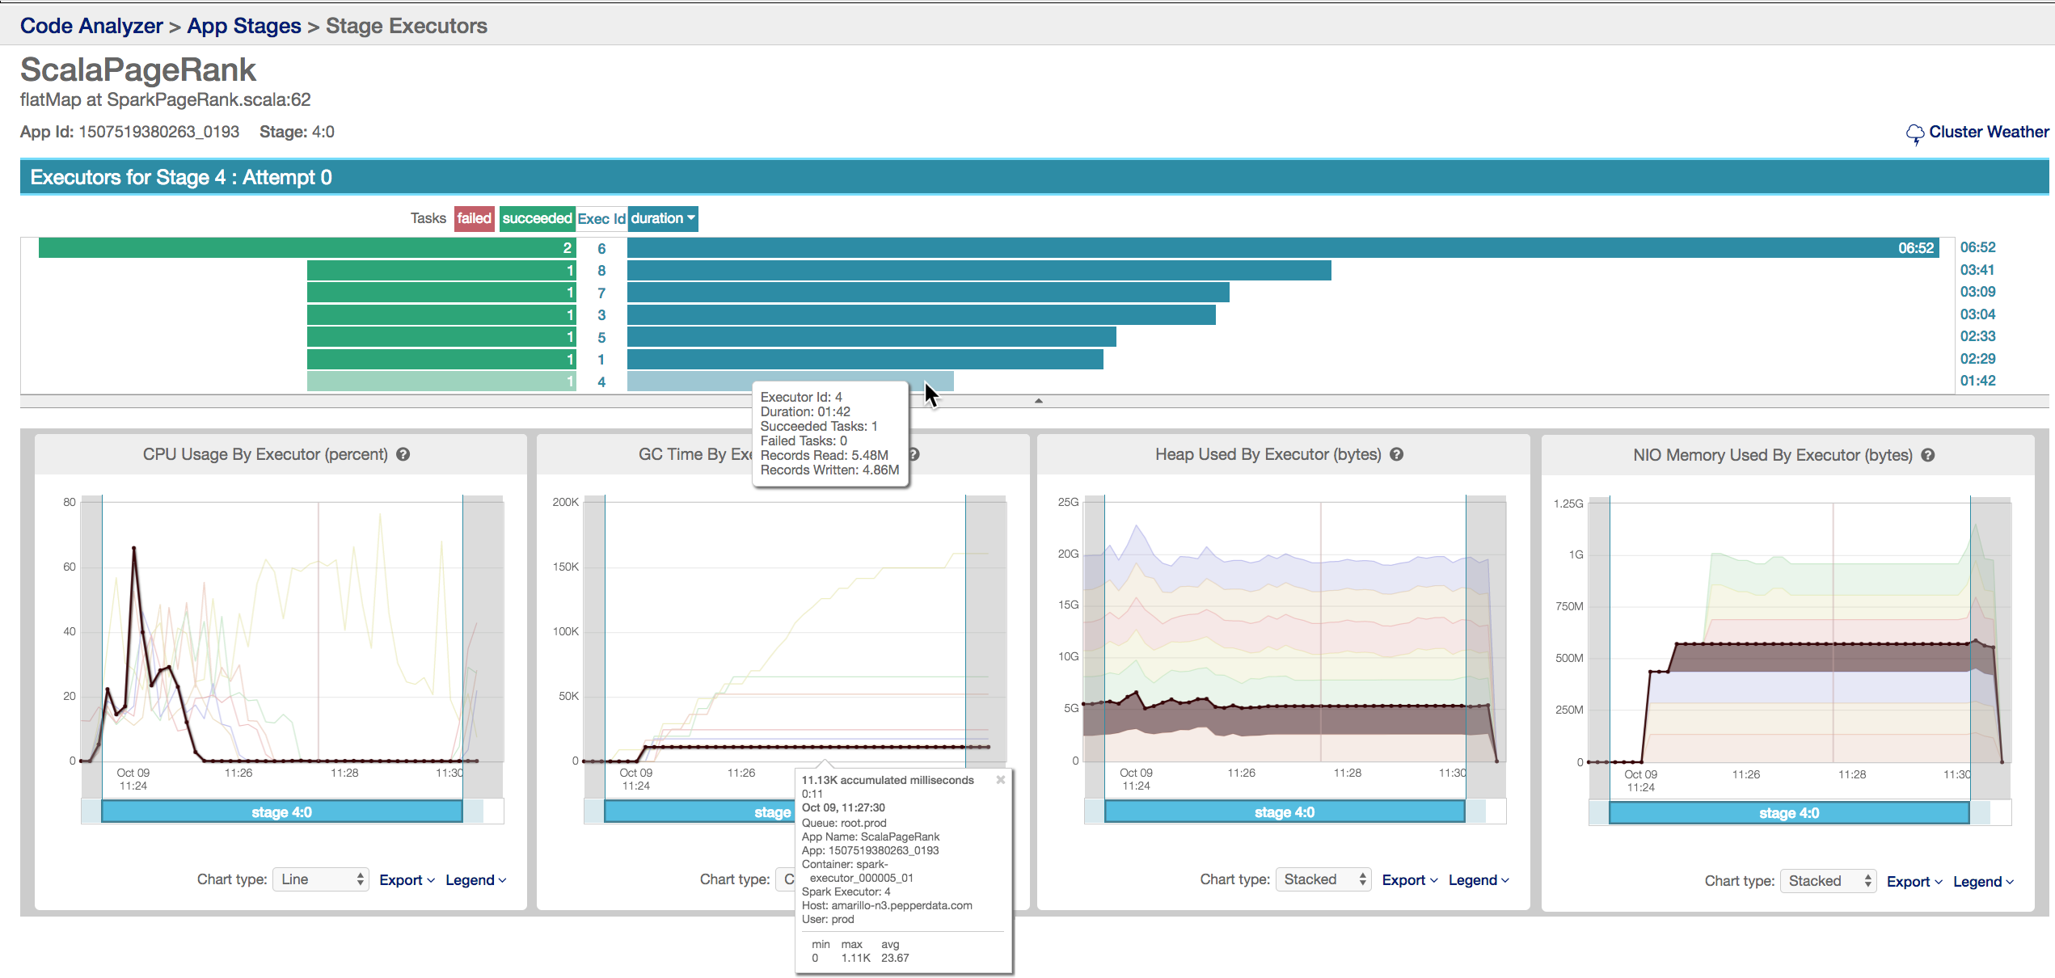
Executor skew increased Stage duration 3x

Slide 21
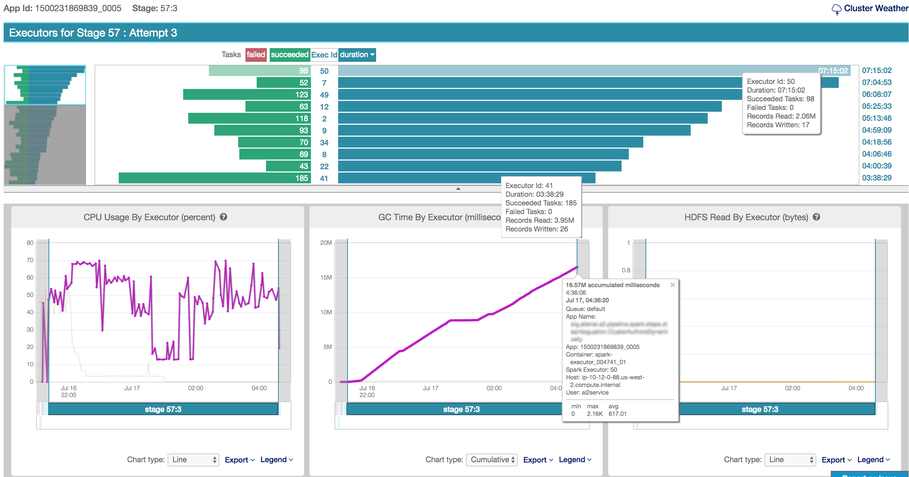
GC as Indicator of Insufficient Memory (EMR)

Slide 22
Use Case 2:
The Tyranny of Defaults

Slide 23
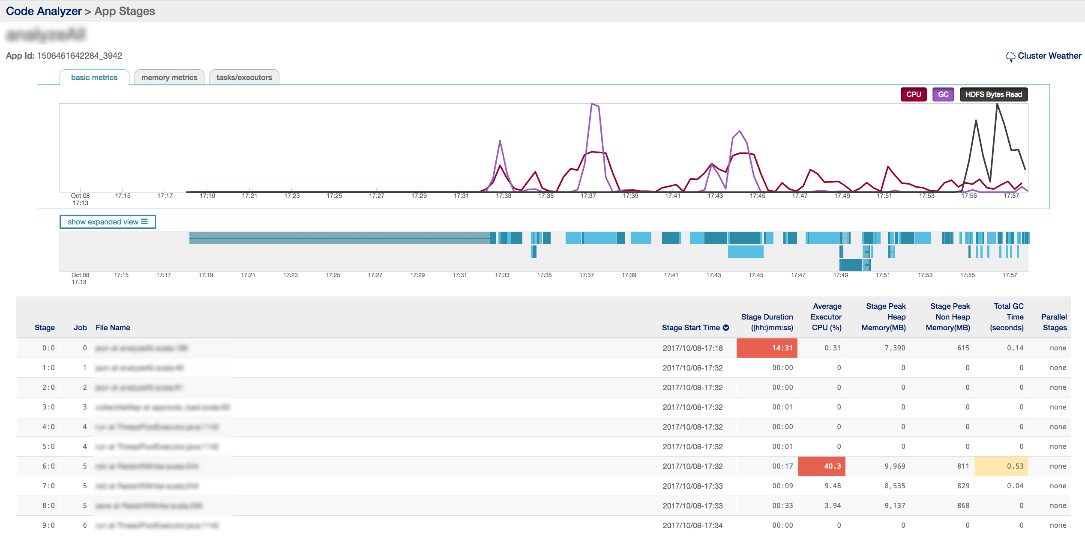
How can cluster weather impact your app ?

Slide 24
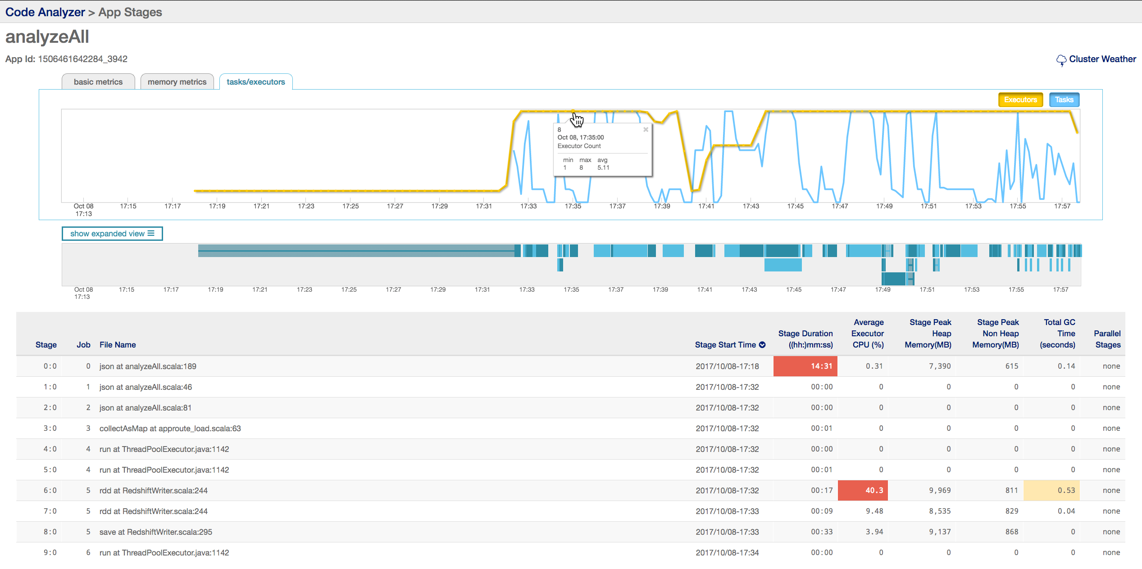
How can cluster weather impact your app ?

Slide 25
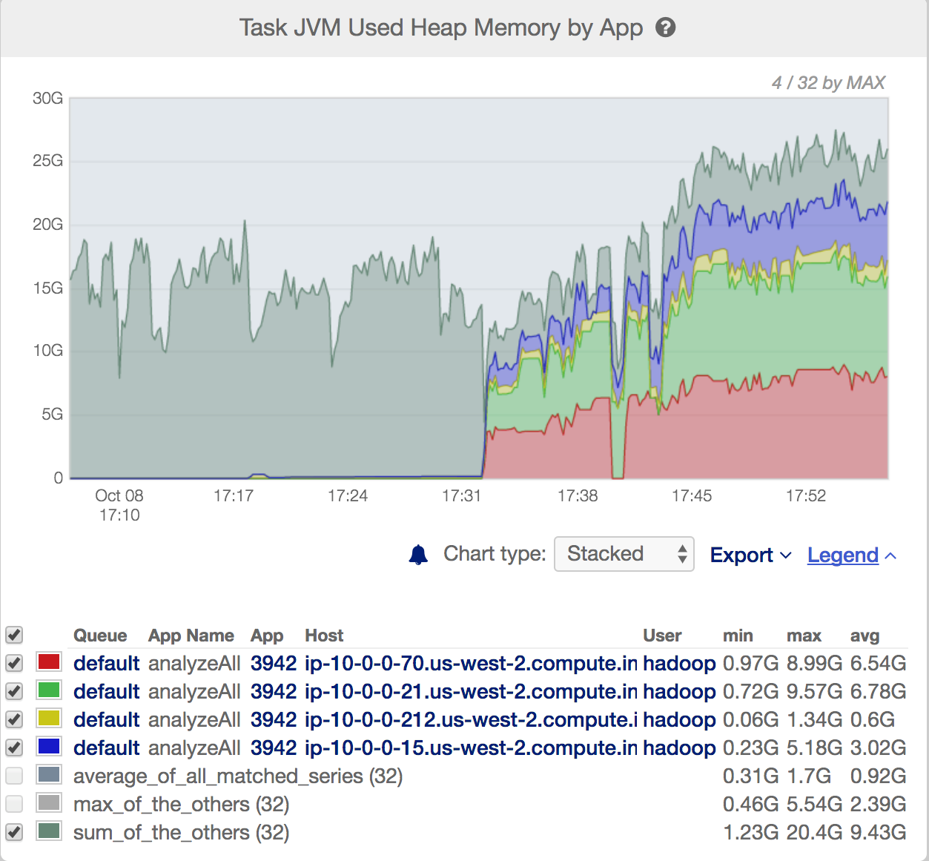
App waiting for memory to free up
Other Apps on cluster using memory
Memory now available for our App

Slide 26
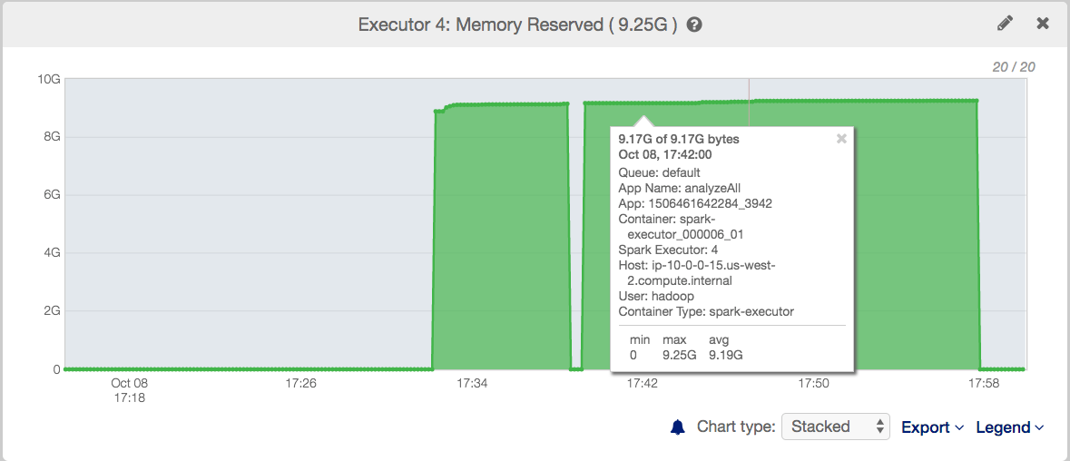
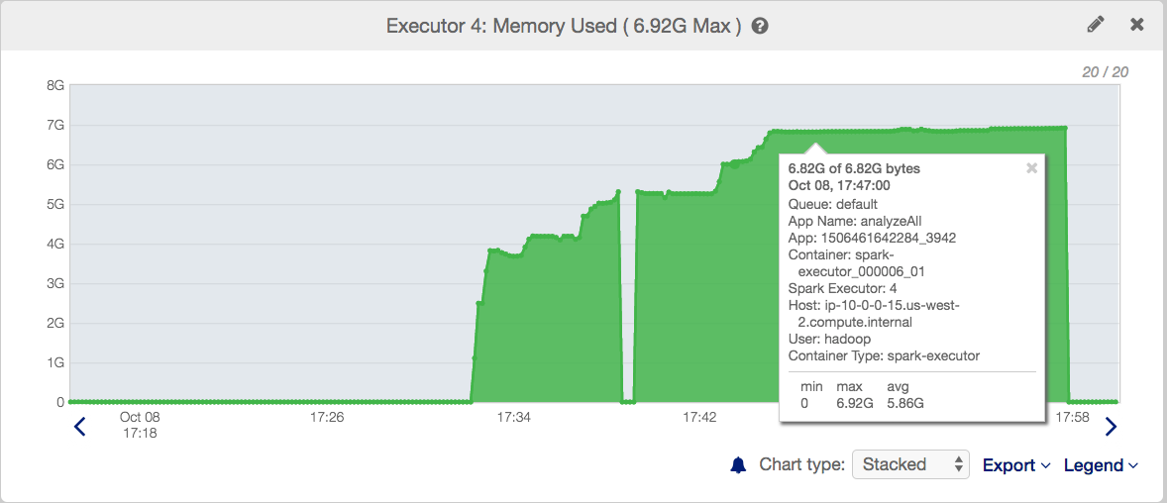
Bottleneck: 25% of memory unused per executor

Slide 27
Use Case 3:
In English Please!!

Slide 28
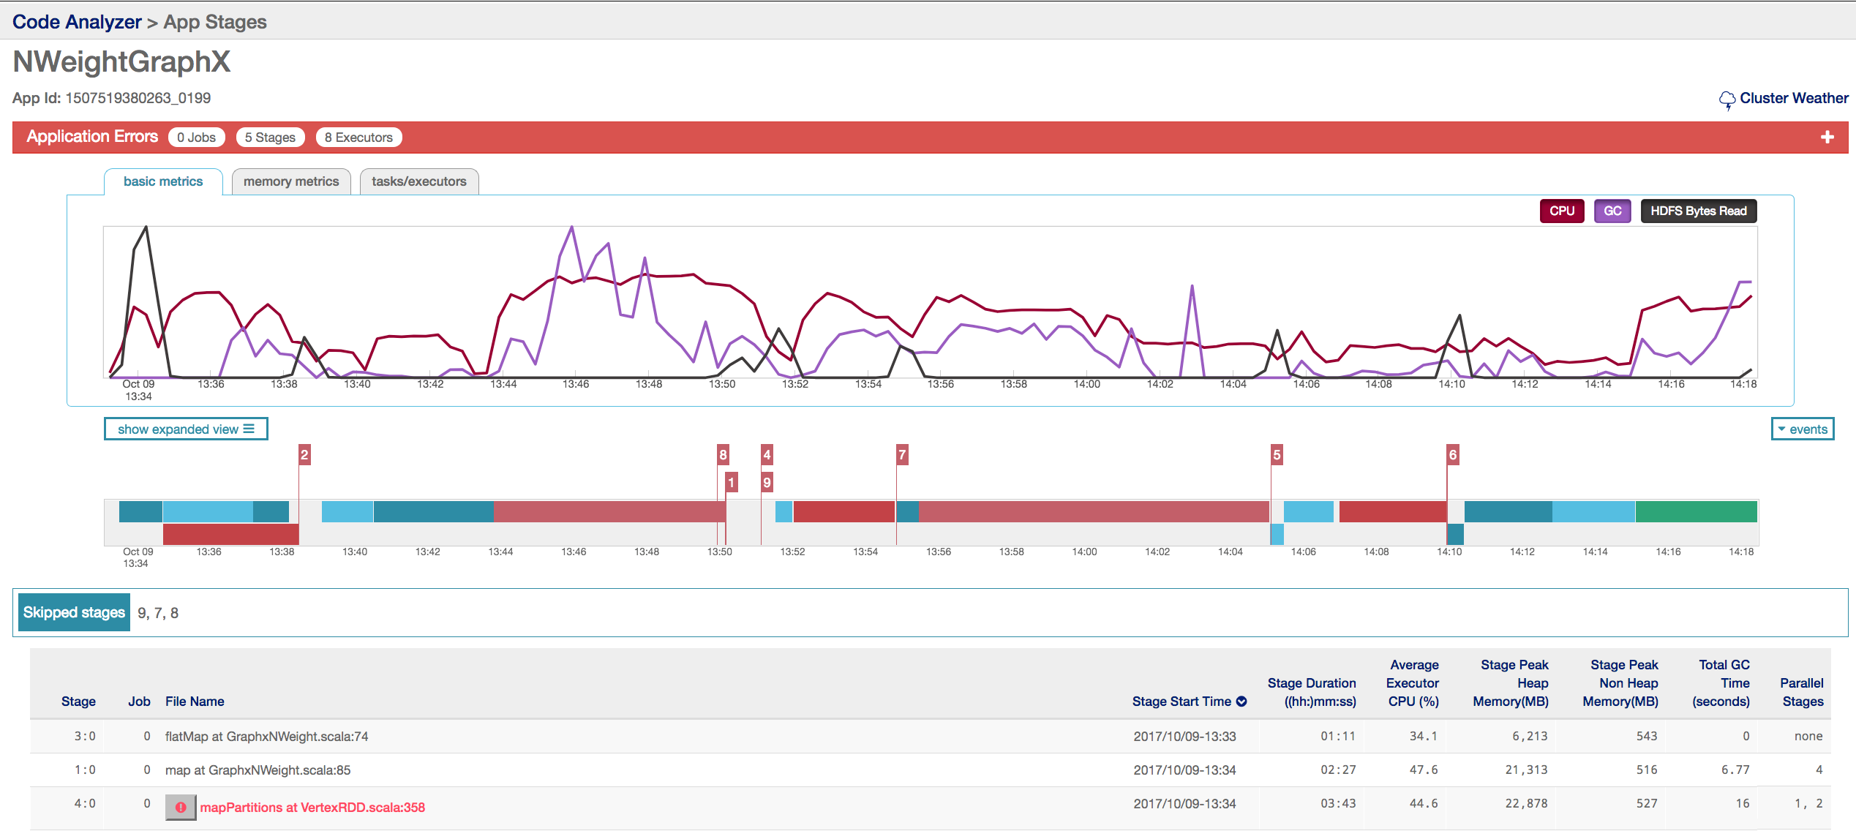
Root Cause Analysis of Spark App Failures

Slide 29
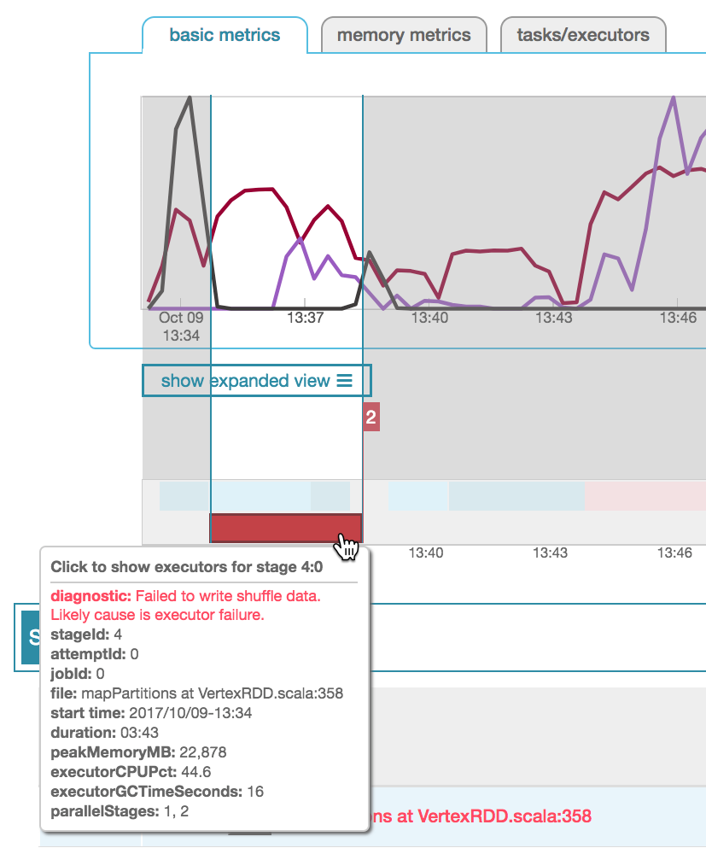
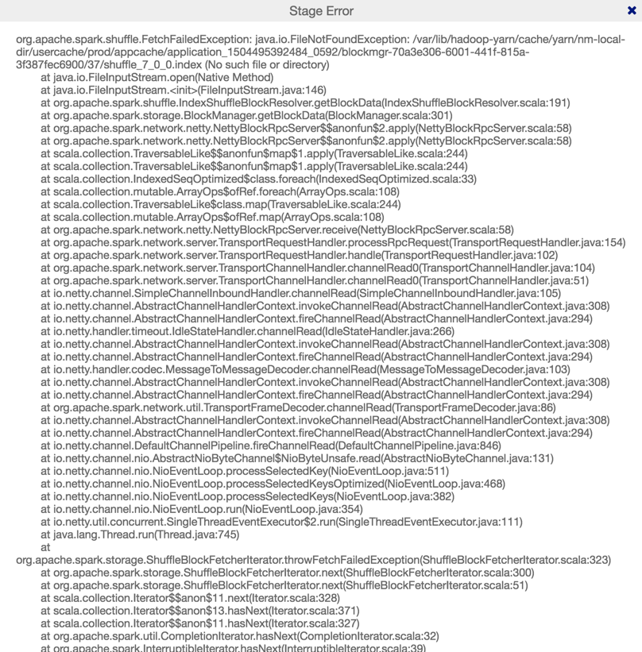
Spark Error to Plain English

Slide 30
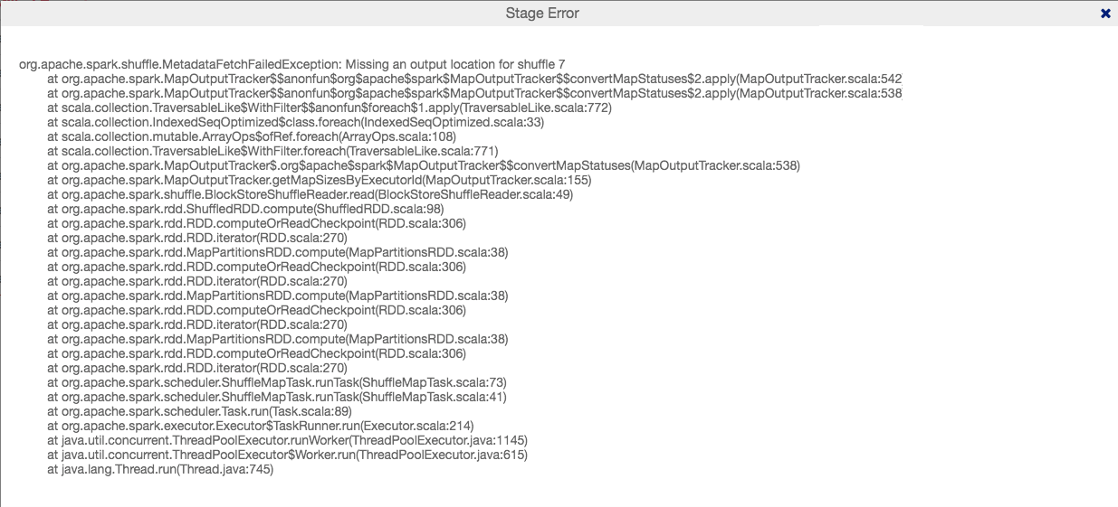
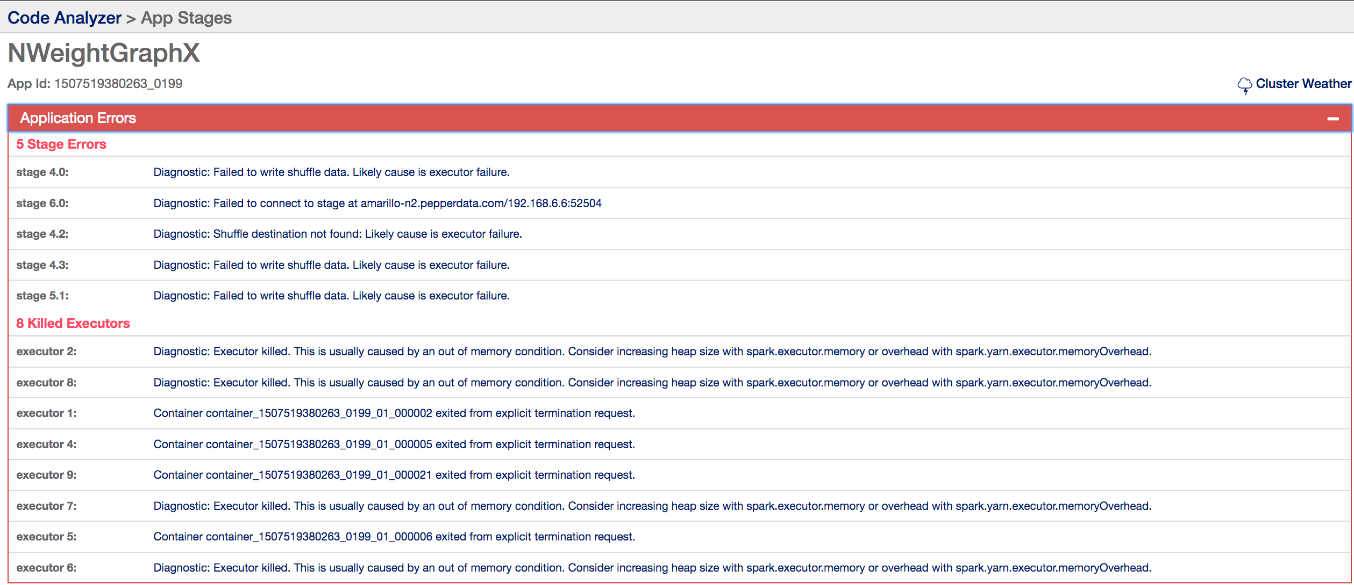
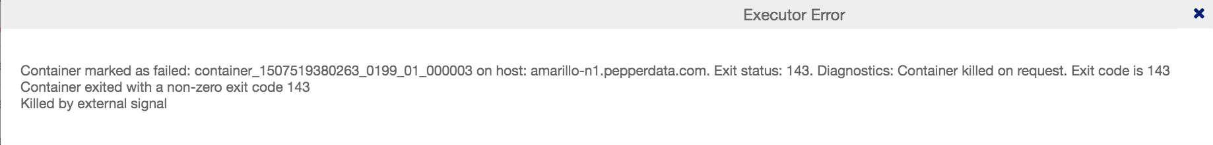
Chronological Error Stack with Translations

Slide 31
Productivity Tip #2
Two threads are better than one.

Slide 32
“Can you make it even easier?”

Slide 33
“Can You Make It Even Easier?”
We know what application problems look like in the performance data
We know what data is most important to Developers
Can we just GIVE the developers the answers to why the app is slow or not working?

Slide 34
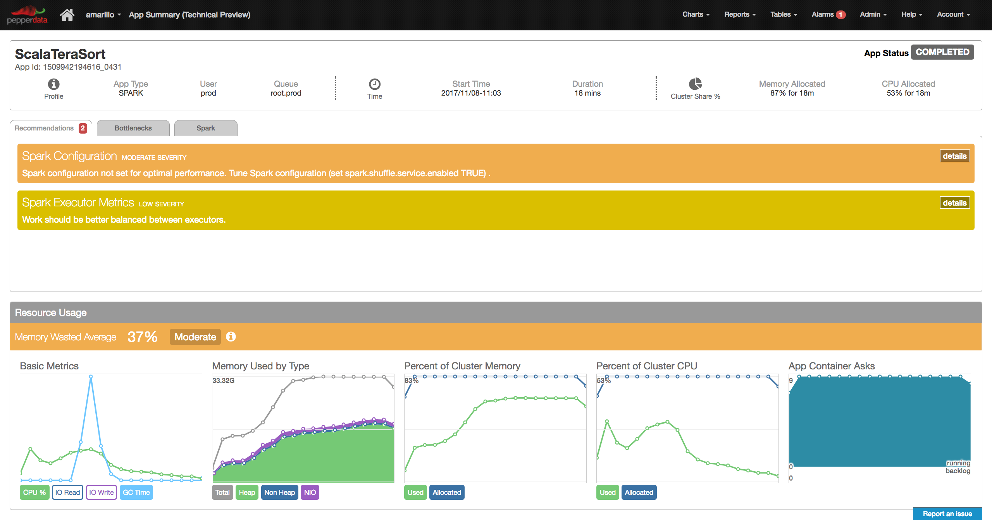
Application Summary Page

Slide 35
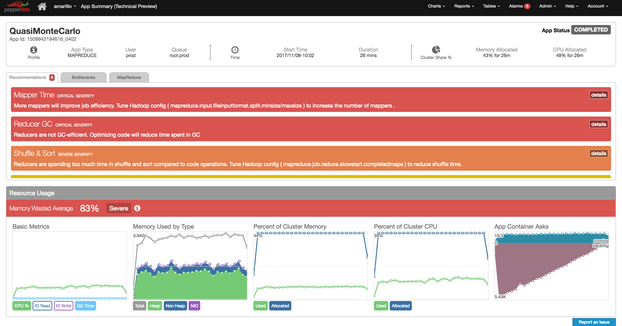
Application Summary Page

Slide 36
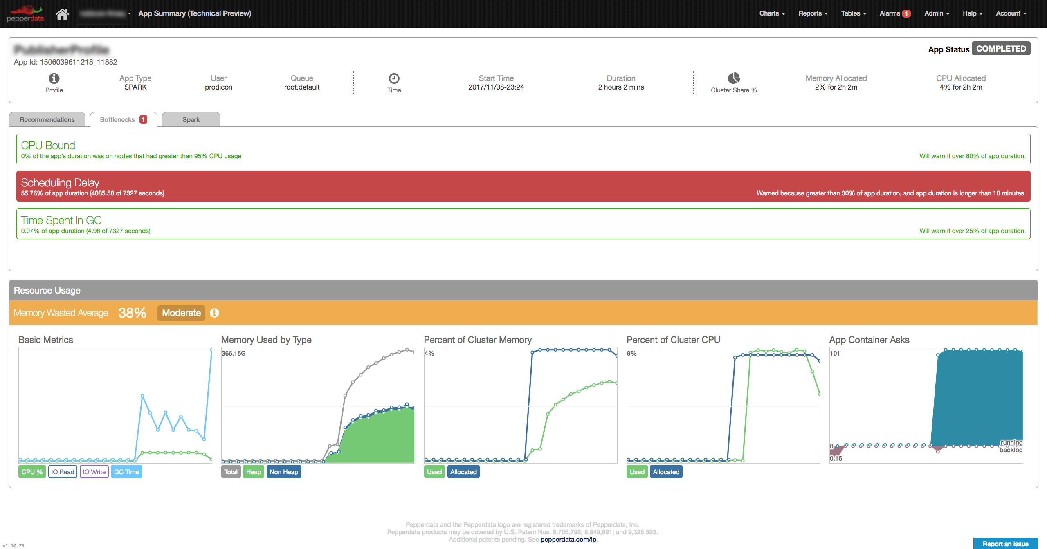
Application Summary Page

Slide 37
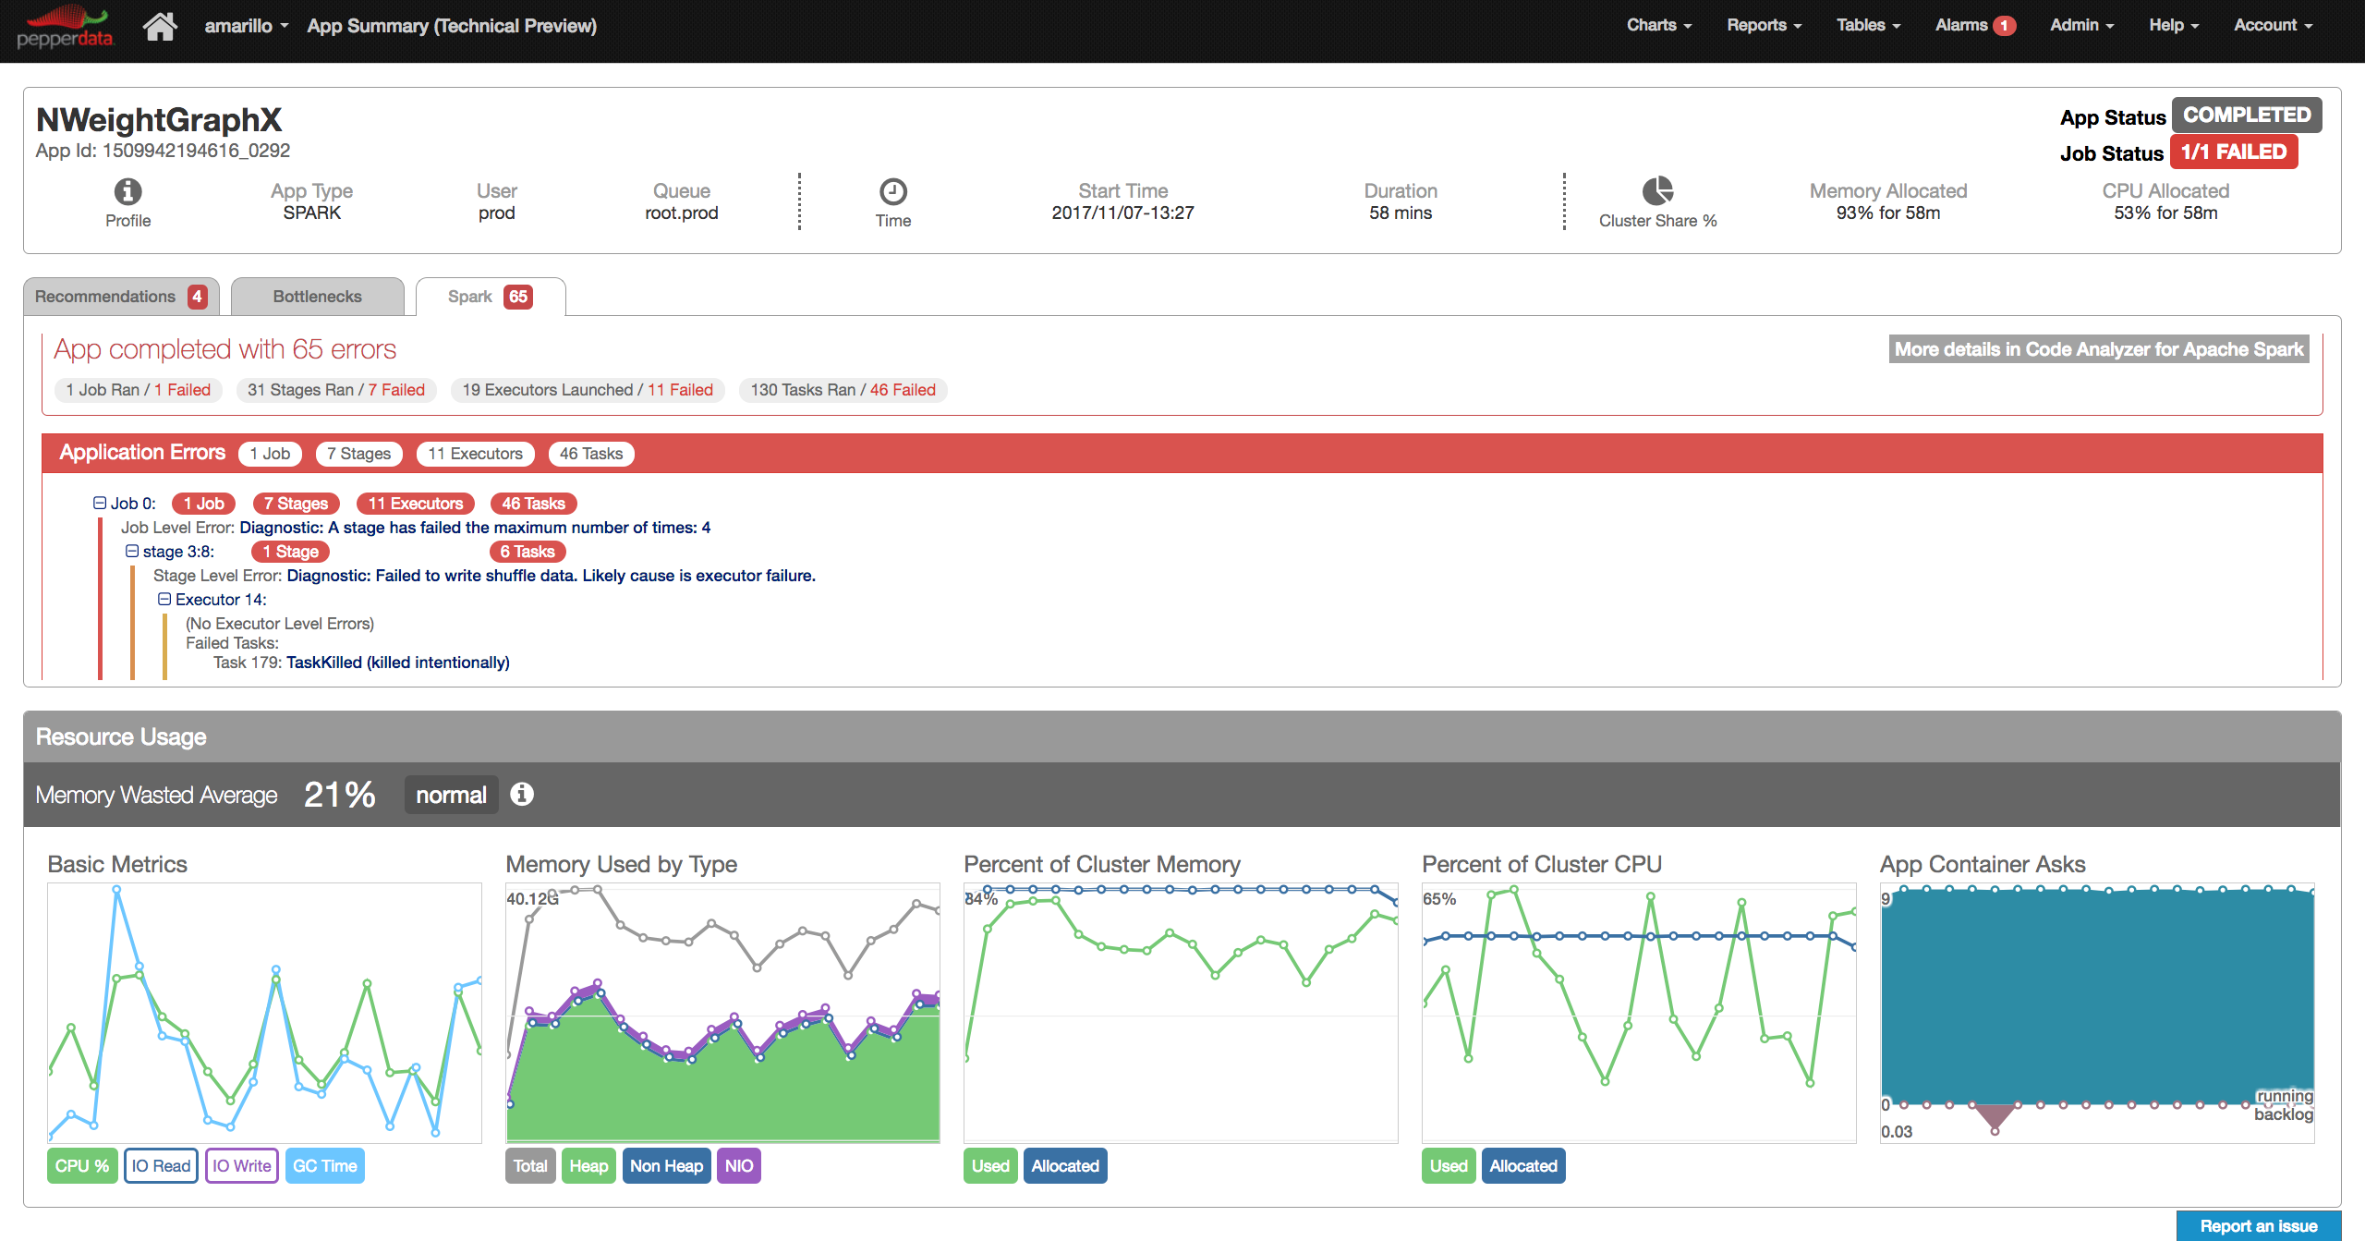
Application Summary Page

Slide 38
Focus Areas for Pepperdata Developer Solutions
Continued improvement on Root Cause Analysis of App errors & failures
More and better diagnosis and prescription
Inspection of RDDs inflight
Support for Spark SQL – what part of your SQL query is the most expensive?
FREE during POC
www.pepperdata.com

Slide 39
Recap
How performance data is visualized is important
Time series shines a Spotlight on problems inside your application
Knowing cluster weather can identifying bottlenecks outside your application
Root Cause Analysis of failures based on multiple data points is a must
Just give them the answers based on what we’ve learned

Slide 40
Thank You

