Slide 1
From Chaos to Clarity
Git at Scale

Slide 2
Introduction
Paul Allen
  Professional Services Consultant
    DevOps workflows around versioning
    Configuring Integrations (CI, Build, Deployment)
  Senior Integration Engineer
    Develop Integrations for DevOps tools: Jenkins, Puppet, Slack
    Plugins for IDEs: Eclipse, MathWorks, Visual Studio

Slide 3

Introduction
Perforce Helix
  Version Control & Repo Management
  Developer Collaboration
  On-Prem and Cloud Solutions

Slide 4

Introduction
Agile Project Management
  Mixed-Mode Project Management
  Requirements and Test Case Management
  Integrated Issue Management

Slide 5
Content
1
4
What Challenges
Do We Face?
How to Scale
With Multi Repos
2
5
The Evolution of Versioning
How to Blend Mixed Repos
3
6
How to Scale Your VCS
Performance at Scale
Notes:
The version management problems we all face today – looking at the specific industry challenges
How we got into the mess – a quick walk through of versioning history
How to scale your Mono repo and how to scale with Git
How you can blend Helix with Git
Finaly code management

Slide 6
Imagine a Repo With No Limits...
What would you store? What would you share?

Slide 7

EATON:
...We have top men working on it
right now.
INDY:
Who?
EATON:
Top men.
Notes:
Some SCM systems can look a bit like this...
Lots of individually boxed up projects, no organization, generally what goes in is never going out!
Who remembered which film this scene is from...

Slide 8
What Challenges Do We Face?
Growth challenges across the industry.
Notes:
Lets look at four generalised industries, Semiconductor, Games, Software and Regulatory
To some extent your industry will share some of the same or similar issues

Slide 9
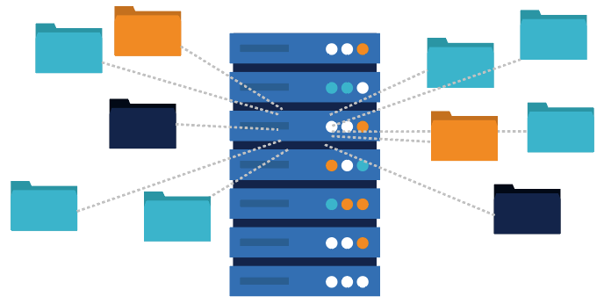
Specific Industry Challenges
Semiconductor
  Large number of files
  Frequent changes
  Long term support
  Different release rates
Notes:
We would always be fixing not only our own software bugs, but working around bugs in the hardware.

Slide 10

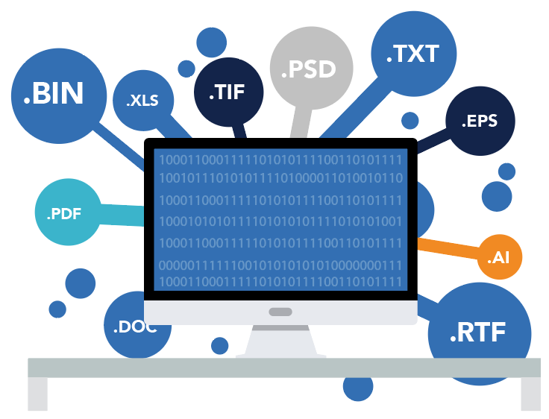
Specific Industry Challenges
Games
  Mono project
  Large binary assets
  Distributed studios
  Fixed release deadlines
Notes:
It always seemed like a contest as to who has checked in the biggest file...
Scouting the team goes out shoots video, photos, records audio – all gets checked in.

Slide 11

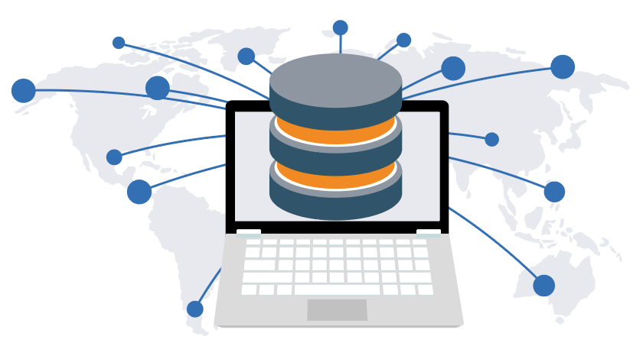
Specific Industry Challenges
Software and Technology
  Large teams
  Distributed offices
  Remote and offline workers
  Merge and integration challenges
Notes:
Remote workers – where were you when you checked that in...

Slide 12


Specific Industry Challenges
Regulatory
  Code changes traceability
  Security controls
  Quality – code review stages
  Audit – changes, issues, and releases

Slide 13
The Evolution of Versioning
How versioning has helped us.
Notes:
Having seen the problems faces by industry, how has Version control addressed them over the years.

Slide 14
Evolution of Repositories
CVS
SVN
GIT
Helix
Version the individual file, but no connection to the change.
Version the changes, but no file tracking.
Version the diff and change, but isolated.
Version the whole.
Notes:
CVS – don’t version binary files
helped us track versions and labeled releases
SVN – better binary support, but nothing too big (backup!)
no per file history (slow to build history)
no variant management
GIT – silo
- no large files or lots of files

Slide 15

Birth of a Repository
release 0.1
release 0.2
Trunk-Based Development
One Developer, Releasing From Desktop
Notes:
So what as a developer do we want?

Slide 16
Growth of Repository
release 1.0
release 1.1
Small Team, Trunk-Based Dev With Artefact Store
Build Server & Continuous Integration (CI)
Notes:
We grow and add more people

Slide 17
Growth of Branches
r1.0
r1.1
comX
comY
More Teams (Modules/Products)
  Feature branches
  Integration branches
Notes:
We grow and divide the project – still a mono repo

Slide 18
Multiple Repos
r1.0
r2.0
X:1.0
Y:1.0
X:1.1
Y:2.0
prod
comX
comY
More Teams (Divide the Code)
  Multiple repositories
  Dependency management
Notes:
If we reach the limit of the repo developers start spinning up new repos to divide the project – enter the would of the multi repo!

Slide 19
Explosion of Artefacts
Independent Releases
  Previously we had 1 : many
Sharing Components
  many : many
r1.15
r1.16
projA
r3.0
r3.1
projB
comW
comX
comY
comZ

Slide 20
Release Branches
LTS 1.16.x
LTS 1.17.x
projA
X:1.1
comX
Long-Term Stable Releases
  Back ports on components in a repository

Slide 21
Explosion of Multiple Repositories
?
1000’s
internal repos
1000’s artefacts from different providers
1000’s
external repos
More Repos, Other Teams, Modules, 3rd Parties

Slide 22
How to Scale Your VCS
Using Perforce Helix Core.

Slide 23

Version Everything
Helix Core
  Source code & artefacts
  Config data & binary assets
  Even Git repos!
Notes:
I had one customer that versioned his tools...
- Visual Studio, Perl, ToolChains, etc...
- branched then for each release
Patch request for a 5 year old project, no problem here is my full dev environment

Slide 24

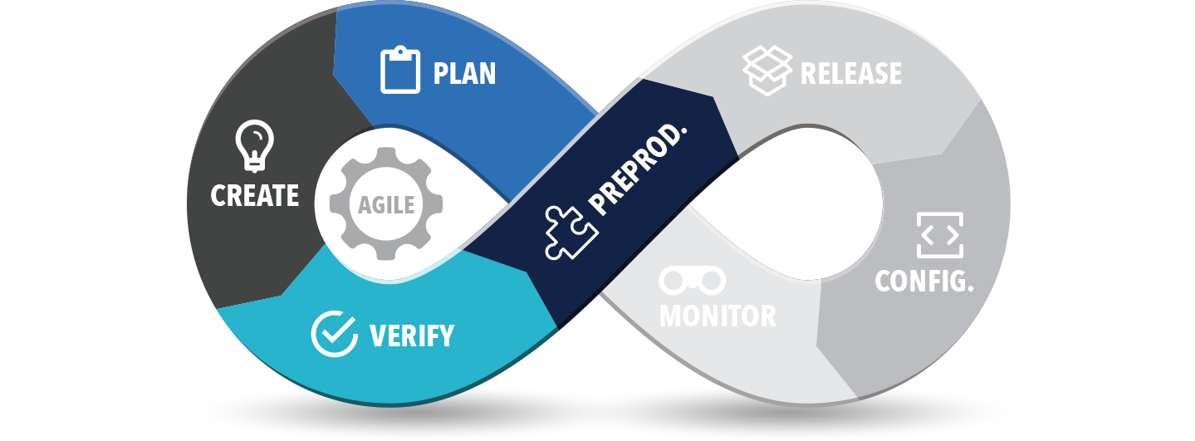







Helix Platform
DevOps Ready – Version everything from plans to release

Slide 25



Federation Architecture
Work As If You Are Local
  Replication and proxies
  DVCS for offline work
Enterprise Scaling
  Tens of thousands of users
  Millions of transactions per day
Single Source of Truth
Notes:
Ok so we don’t have anyone coding offline in the moon, but some of our consultants do like to travel...
Some of my best coding is at 39,000 feet

Slide 26
Federation Architecture
Build Replica
Data Centre Federation
Commit Server
Edge Server
Build farm
Developers
Forwarding Replica
Proxy Servers
Designers
Designers
Render farm

Slide 27
Helix Depots
Helix Workspaces
  Map any part of a depot with any other
  Pin a path by label or change
Client: pallen.ace.ws
Root: /Users/pallen/Demos/ace
View:
//projects/main/ace/... //proj.ws/...
//components/r1.0/p4java/src/... //proj.ws/p4java/...
//components/r1.1/p4rest/src/... //proj.ws/p4rest/...
ChangeView:
//components/r1.0/p4java/src/...@r1.0.2
//components/r1.0/p4rest/src/...@1548111
Notes:
Who here knows about Perforce Workspaces?
Did you know about the ChangeView field?

Slide 28
Helix Depots
Helix Streams
  Import code
  from another Stream or depot
  Share code
  to child streams
  Isolate code
  to limit the flow of change
  Workspaces
  managed client workspaces
Notes:
Streams are very powerful and even create the workspace for you...

Slide 29
How to Scale With Multi Repos
Using graph depots in Perforce.
Notes:
So far I have talked about the merits of the mono repo, but there are lots of Git users out there that still want Git. So how can we help scale their would too?

Slide 30
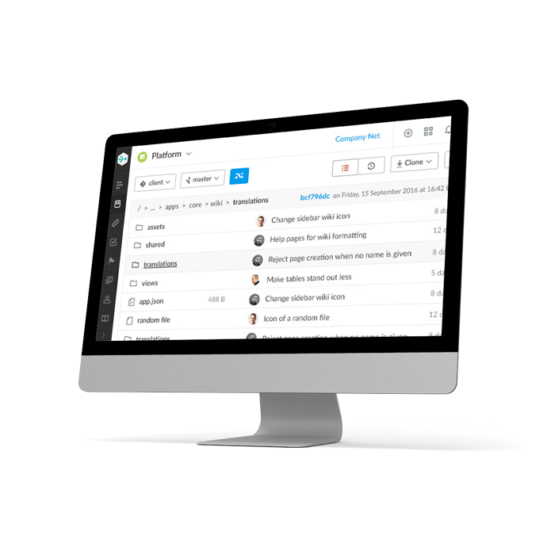


Helix TeamHub
Team-based collaboration
  Code review
  Issue management
Cloud and on-prem solutions
  Project administration
  Multi repo management

Slide 31



Mixed Repos
Manage your Git sprawl
Single source of truth
Scaling & Global replication
Breakdown silos
Helix Clients
Any Git Tool
Notes:
Helix can mange any number of Git repositories and store their whole history. This breaks down the silo of traditional Git storage; so files from one Git repository can be mapped with files from another Git repository, Perforce Stream or Workspace.
Internally we use a Graph based data model similar to Git.
The data model allows Git clients to work against the Perforce server, without even knowing the repository is actually in Perforce.

Slide 32
Clone From Helix
git clone https://localhost:4443/plugins/p4-plugin
Cloning into 'p4-plugin'...
remote: Counting objects: 8343, done.
remote: Compressing objects: 100% (2641/2641), done.
remote: Total 8343 (delta 3242), reused 8343 (delta 3242)
Receiving objects: 100% (8343/8343), 33.51 MiB | 61.46 MiB/s, done.
Resolving deltas: 100% (3242/3242), done.
Any Git Tool
Notes:
You can use Helix with any Git command.
For example; a simple Git clone…
(this is mapped to localhost for my docker example, but in production you would run this on a server with a fully qualified domain name.)

Slide 33
Perforce Graph
p4 repos
//plugins/p4-plugin admin 2017/08/10 14:16:26 Automatically created by the initial push.
//plugins/scm-api-plugin gconn-user 2017/08/10 14:02:34 Mirror of https://github.com/jenkinsci/scm-api-plugin.git
p4 files //plugins/p4-plugin/*
//plugins/p4/.gitignore
//plugins/p4/GRAPH.md
//plugins/p4/Jenkinsfile
//plugins/p4/LICENSE.txt
//plugins/p4/NOTES.md
//plugins/p4/P4GROOVY.md
//plugins/p4/README.md
//plugins/p4/RELEASE.md
//plugins/p4/SETUP.md
//plugins/p4/WORKFLOW.md
//plugins/p4/pom.xml
Helix Clients
Notes:
You can access the same Git content using Perforce commands… for example `p4 files`
We have added a new command `p4 repos` to list your Git repos.
(the `p4 repos` output has two repos one was mirrored from GitHub and the other an initial push)

Slide 34
Adding From OpenSource
git clone https://github.com/p4paul/jenkins-demo.git
Cloning into 'jenkins-demo'...
remote: Counting objects: 94, done.
remote: Compressing objects: 100% (49/49), done.
remote: Total 94 (delta 31), reused 94 (delta 31), pack-reused 0
Unpacking objects: 100% (94/94), done.
cd p4-plugin/
git remote add helix https://localhost:4443/plugins/demo.git
git push -u helix master
Counting objects: 8132, done.
Delta compression using up to 8 threads.
Compressing objects: 100% (2531/2531), done.
Writing objects: 100% (8132/8132), 33.50 MiB | 0 bytes/s, done.
Total 8132 (delta 3200), reused 8132 (delta 3200)
To https://localhost:4443/plugins/demo.git
* [new branch] master -> master
Branch master set up to track remote branch master from helix.
Notes:
You can add Git content with a simple `git push`.
This example clones some content from GitHub,
adds a new remote,
then pushes it into Helix.

Slide 35
WebHooks and Mirrors
gconn --mirrorhooks add plugins/scm-api-plugin \
https://github.com/jenkinsci/scm-api-plugin.git
Mirroring configured for:
Upstream repo: https://github.com/jenkinsci/scm-api-plugin.git
Downstream repo: //plugins/scm-api-plugin.git
Webhook URL: /mirrorhooks
Webhook secret token: 476b5d58-61fa-478f-950d-53887d3222d0
Notes:
Helix also provides mirroring from a third party site, keeping the changes up-to-date.

Slide 36
How to Blend Mixed Repos
Using Git and Perforce repositories in your projects.
Notes:
Now that you have Git content in Perforce, how can you use it? You can blend Git repositories into your Projects, using Streams or Workspace Views; even slicing up a Git repository, down to the individual file.

Slide 37
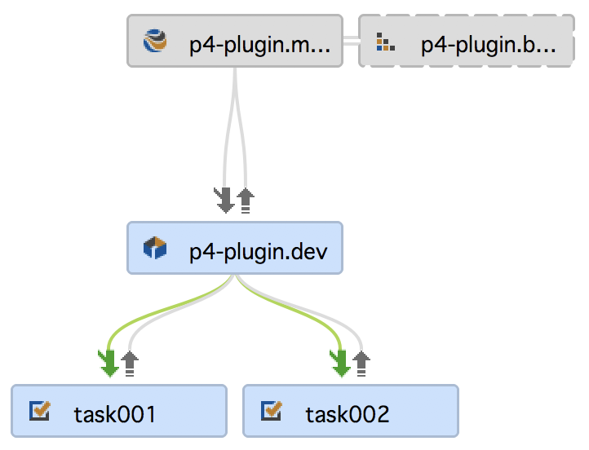
Git in Streams
scm-api-plugin
credentials-plugin
p4-plugin
//projects/p4-plugin.main
//p4java/main
Notes:
Take these Git and Perforce sources, you can map them into a parent stream,
then share them between other child streams.

Slide 38
Git in Streams
Stream: //projects/p4-plugin.main
Parent: none
Type: mainline
Paths:
share ...
import p4java/... //p4java/main/p4-java/com.perforce.p4java/...
import p4-plugin/... //plugins/p4-plugin.git/...@master
import scm-api-plugin/... //plugins/scm-api-plugin.git/...@scm-api-2.0.2
import credentials-plugin/... //plugins/credentials-plugin.git/...@credentials-2.1.11
Notes:
Here is a typical view:
The share … inherits everything from the parent branch.
The first import is a Perforce depot path, but you wouldn't know that...
the only way to distinguish it would be to know the depot type (that //p4java is a Perforce depot and //p4plugin is a Graph depot).
The other three imports are from Graph depots and contain Git content (in fact some of the Git content used by the p4-plugin)
The @master and @scm-api tags are Git references to particular versions, but can now be manage by the Stream.

Slide 39
Git in Workspaces
Client: proj.ws
Root: /Users/pallen/Demos/jenkins-demo/test
Stream: //projects/p4-plugin.main
View:
//projects/p4-plugin.main/... //proj.ws/...
//p4java/main/p4-java/com.perforce.p4java/... //proj.ws/p4java/...
//plugins/credentials-plugin/... //proj.ws/credentials-plugin/...
//plugins/p4-plugin/... //proj.ws/p4-plugin/...
//plugins/scm-api-plugin/... //proj.ws/scm-api-plugin/...
ChangeView:
//plugins/p4-plugin.git@master
//plugins/scm-api-plugin.git@scm-api-2.0.2
//plugins/credentials-plugin.git@credentials-2.1.11
Notes:
For completeness here is the corresponding Workspace view,
you can see the ChangeView field is used to control the history.

Slide 40
Performance at Scale
For users and CI Tooling.

Slide 41
How We Scale
Shallow Clone of Linux Kernel
  40-80% Faster Builds
  All tests use:
    1 Gbps link
    4 parallel threads of p4 sync
  WAN test:
    200 ms round trip latency
Git Clone
P4 Sync
47 (s)
43 (s)
Sync/Clone time (seconds)
25 (s)
13 (s)
Sync Linux kernel head revision over LAN
Sync Linux kernel head revision over WAN
Notes:
Our Performance Lab gets all the new shiny servers and storage arrays...

Slide 42
How We Scale
Reduced Sync Size
  Huge benefit for CI builds
  18% Less Storage
  Perforce has records stored server-side
Git clone
796MB
P4 sync
650MB

Slide 43
How We Scale
Shallow Clone of Full Android Build
150
Git clone
66GB
Repo sync
67GB
28
36
17
14
23
P4 sync
50GB
Sync over LAN
(1100 repos)
Sync over WAN
(1100 repos, 200ms latency)
Resulting sync sizes
Git Clone
Android Repo Sync
P4 Sync

Slide 44
Summary
Use a federated version control system to version everything…
...even multiple Git repositories.
Scale with Perforce across your enterprise.
Access content globally as if it were local.
Version every aspect of DevOps.

Slide 45
Thank you
Questions?

