Slide 1
Practical Microservices
Jonathan Schabowsky, Sr. Architect, Office of the CTO

Slide 2
What are Microservices?
Small in Size, Single in Purpose
Communicate using technology-agnostic protocols
Independently Deployable
Released via Automated Processes

Slide 3
Microservice Architecture Desires
Scalable:
Horizontal – Services must scale in order to meet demand
Dynamic Scaling – Change number of running instances based on actual demand
Shock Absorption – Properly deal with irregular bursts of utilization
Fault tolerant:
In case of failure or exception unit of work should be retried
Resilient to unexpected IaaS/DC outages
Performant:
User experience dictates that applications do not take a long time to return
Service execution must not exceed planned processing/response time
Manageable:
Visibility into application performance and/or bottlenecks
Secure:
Communications between Services need to be encrypted when using Public Clouds

Slide 4
The Event:
Dalmore King Alexander III is Amazing!
Wonder if I can buy it in Utah?!

Slide 5
The Problem:
Department of Alcohol Control
AKA: The State Liquor store
WebApps:
OnlinePriceList
InventoryQuery

Slide 6
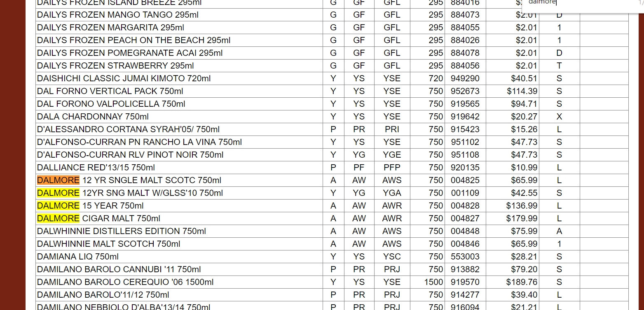
OnlinePriceList Data (16,172 Products):

Slide 7
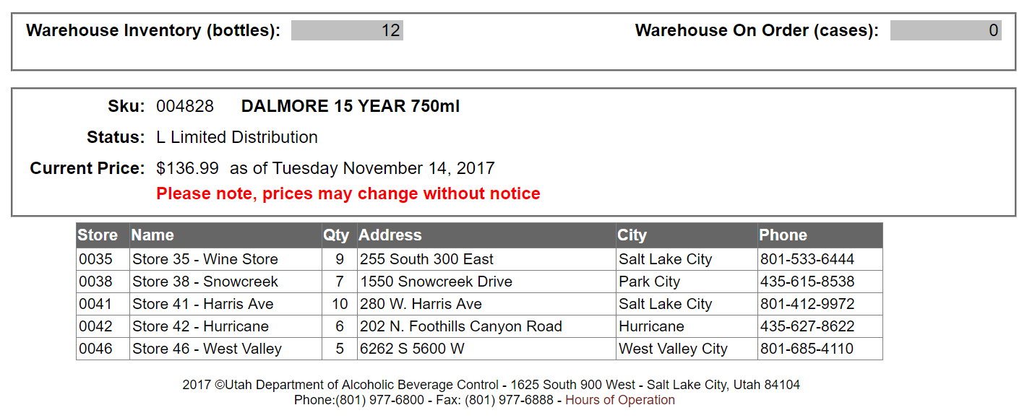
InventoryQuery Data:

Slide 8
The Outcome:
Department of Alcohol Control
AKA: The State Liquor store
WebApps:
OnlinePriceList
InventoryQuery
Wouldn’t it be great if I could:
see when it was last in-stock
be notified when in-stock

Slide 9
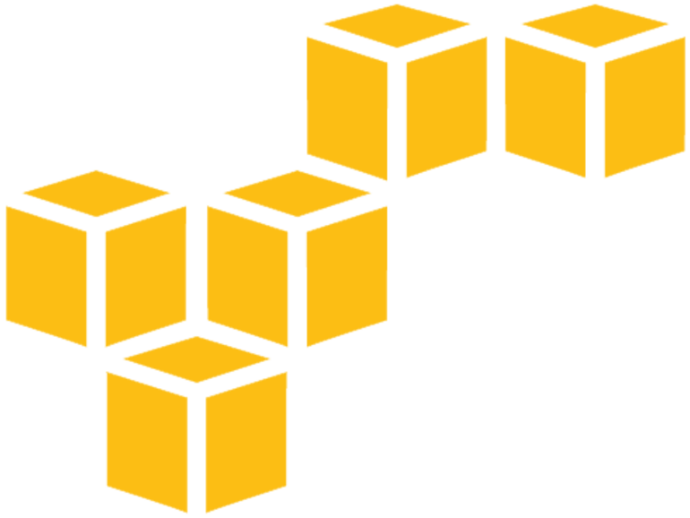
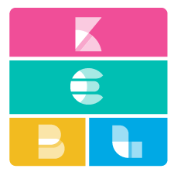
amazon web services
Elastic Stack
Utah Department of
Alcohol Control
OnlinePriceList
InventoryQuery
On Premise Environment
On Premise Environment
Notes:
Deployment problem

Slide 10
Application Iteration#1:
Department of Alcohol Control
AKA: The State Liquor store
AWS
Data Lake
WebApps:
OnlinePriceList
InventoryQuery
http POST
Elastic Stack
UtahDABC-Client
http POST
UtahDABC-Inventory
http REST POST
Spring RestServices
Business Logic
http REST POST
Business Logic
SpringRestTemplate
SpringRestTemplate

Slide 11
Application Iteration#1 Issues:
Tight Coupling:
What if I want those events to also go to ELK?
Department of Alcohol Control
AKA: The State Liquor store
AWS
Data Lake
Service Discovery: How do I know where ELK is?
The Client’s Processing time is dependent on all downstream services!
WebApps:
OnlinePriceList
InventoryQuery
http POST
Elastic Stack
Tight Coupling:
What if Inventory Service is Slow? Or down?
UtahDABC-Client
http POST
UtahDABC-Inventory
http REST POST
Spring RestServices
Business Logic
http REST POST
Performing Query for non Whiskey Products!
Business Logic
SpringRestTemplate
SpringRestTemplate

Slide 12
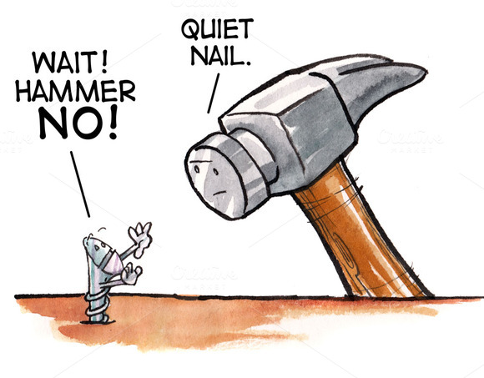
When holding Hammer…
REST is a Hammer
Not everything is a Nail
Good for:
Synchronous Interactions
Externally facing APIs
Baggage it brings:
Blocking
Service Coupling
Complex Failure Scenarios – Responsibility

Slide 13
Think Event Driven
Microservices have inputs and outputs
Inputs and outputs can be “events”
So what is an Event?
an event is an action or occurrence recognized by software, often originating asynchronously from the external environment, that may be handled by the software
Stop thinking about services INVOKING services!
Instead our services emit events!
What/where do we emit these events to?
Messaging (preferability Solace!)

Slide 14
Why Solace? Technical Characteristics http://dev.solace.com/
Open APIs (AMQP1.0, MQTT, REST, JMS)
Native APIs (JMS, Java, .NET, Node.js, JS, C#)
Extensive Spring Support
Native integration to all Clouds, PaaS, IaaS
WAN routing & optimization
Broad 3rd party app integrations
Performance
80K guaranteed msgs/sec P2P
>600K guaranteed msgs/sec fanout
Scalability
100K IoT connections – can scale to billions
Robustness
Security
Rich Management

Slide 15
Messaging Terminology
Topic
In Solace, a Topic is a property of a message.” That’s it!
It’s just a text string published in the message header
It’s completely dynamic
Supports hierarchies using the ‘/’ delimiter
Supports wildcard subscriptions
‘*” replaces any part or whole level identifier
“>” replaces any number of level identifiers
Queue
Can have topic subscriptions to “attract” messages
Exclusivity – Like Dating
Exclusive – Only one connection gets all messages
Non-Exclusive – Round Robin messages across ALL connections
Durability – Will hold messages even if there are no active consumers
Enforce TTL – can expire messages

Slide 16
OnlinePriceList Data (16,172 Products):
Topic Hierarchy!

Slide 17
The Better Way Demo:
Department of Alcohol Control
AKA: The State Liquor store
AWS
Data Lake
WebApps:
OnlinePriceList
InventoryQuery
http REST POST
Elastic Stack
http POST
PCF Tile
RDP
UtahDABC-Client
RDP
UtahDABC-Inventory
http POST
Queues:
-productQforInventory
Topic Sub: product/A/W/>
-toELK-Inventory
Topic Sub: inventory/>
Spring MessageListenerContainer
Business Logic
JMS – topic:
product/X/Y/Z
Business Logic
SpringJmsTemplate
JMS – topic:
inventory/X/Y/Z
SpringJmsTemplate

Slide 18
Data Flow:
amazon web services
http REST POST
JMS
Elastic Stack
JMS
Utah Department of
Alcohol Control
Solutions:
Legacy-to-cloud
Cloud-to-Cloud
PaaS Support
Cloud network outbound cost?
OnlinePriceList
InventoryQuery
On Premise Environment
On Premise Environment
Notes:
Deployment problem

Slide 19
Utilizing Compression:
amazon web services
http REST POST
Compression
<Bridge>
JMS
Elastic Stack
JMS
Utah Department of
Alcohol Control
Reduces Network Cost! (80%+ Savings on Bandwidth Utilization)
OnlinePriceList
InventoryQuery
On Premise Environment
On Premise Environment
Notes:
Deployment problem

Slide 20
Event Driven Interaction Considerations
Benefits
Limited service to service coupling (excludes data level)
No impact service upgrades
Easy to create new services and fail fast
Resilient to service failures
Generally more resource efficient
Enables fine grained service scaling
Challenges:
Not as Natural – Many architects and developers think in a “synchronous” way. Design pattern education is required.
Correlation – Services must be able to correlate different events since they occur asynchronously

