Slide 1


Production Debugging in a Serverless World

Slide 2

About Me
Co-founder – OverOps (God mode in Production Code).
Co-founder – VisualTao (acquired by Autodesk).
Director, AutoCAD Web & Mobile.
Software Architect at IAI Aerospace.
Coding for the past 16 years - C++, Delphi, .NET, Java.
Focus on real-time, scalable systems.
Blogs at blog.takipi.com

Slide 3
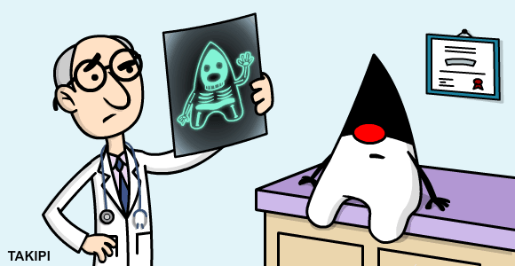
Overview
Microservices and Serverless and Lambda architectures open up a whole world of opportunity for app development.
The enable easy of use while deploying and operating at scale.
But with that comes loss of control over the JVM and lessened run-time introspection capabilities.

Slide 4
JVM Debugging in a Serverless World
Unavailable Capabilities | Available Capabilities
Global Exception Handlers | Logging
jstack | Metrics
Java Agent / VM API | Proprietary (AWS-Xray )
Btrace
JVMTI
HSDB

Slide 5
Global Exception Handlers
Your last line of defense - critical to pick up on unhandled exceptions.
Setting the callback:
This is where thread Name + TLS are critical as the only surviving state.
public static void Thread.setDefaultUncaughtExceptionHandler(UncaughtExceptionHandler eh)
void UncaughtExceptionHandler.uncaughtException(Thread t, Throwable e) {
logger.error(“Uncaught error in thread “ + t, e);
}

Slide 6

Preemptive jstack
A production debugging foundation.
Presents two issues –
  Activated only in retrospect.
  No state: does not provide any variable state.
Let’s see how we can overcome these with preemptive jstacks.
github.com/takipi/jstack

Slide 7
Part1: Stateful Thread Names
Thread name is a mutable property.
Can be set to hold transaction specific state in tandem with jstack. Can be automated.
At code entry point:
  Thread.currentThread().setName(Context, TID, Params, Time,..)
”pool-1-thread-25 MsgID: AB5CAD, type: Analyze, queue: ACTIVE_PROD, TID: 5678956, TS: 11/8/20014 18:34 "
#17 prio=5 os_prio=31 tid=0x00007f9d620c9800 nid=0x6d03 in Object.wait() [0x000000013ebcc000]
"pool-1-thread-1" #17 prio=5 os_prio=31 tid=0x00007f9d620c9800 nid=0x6d03 in Object.wait() [0x000000013ebcc000]

Slide 8
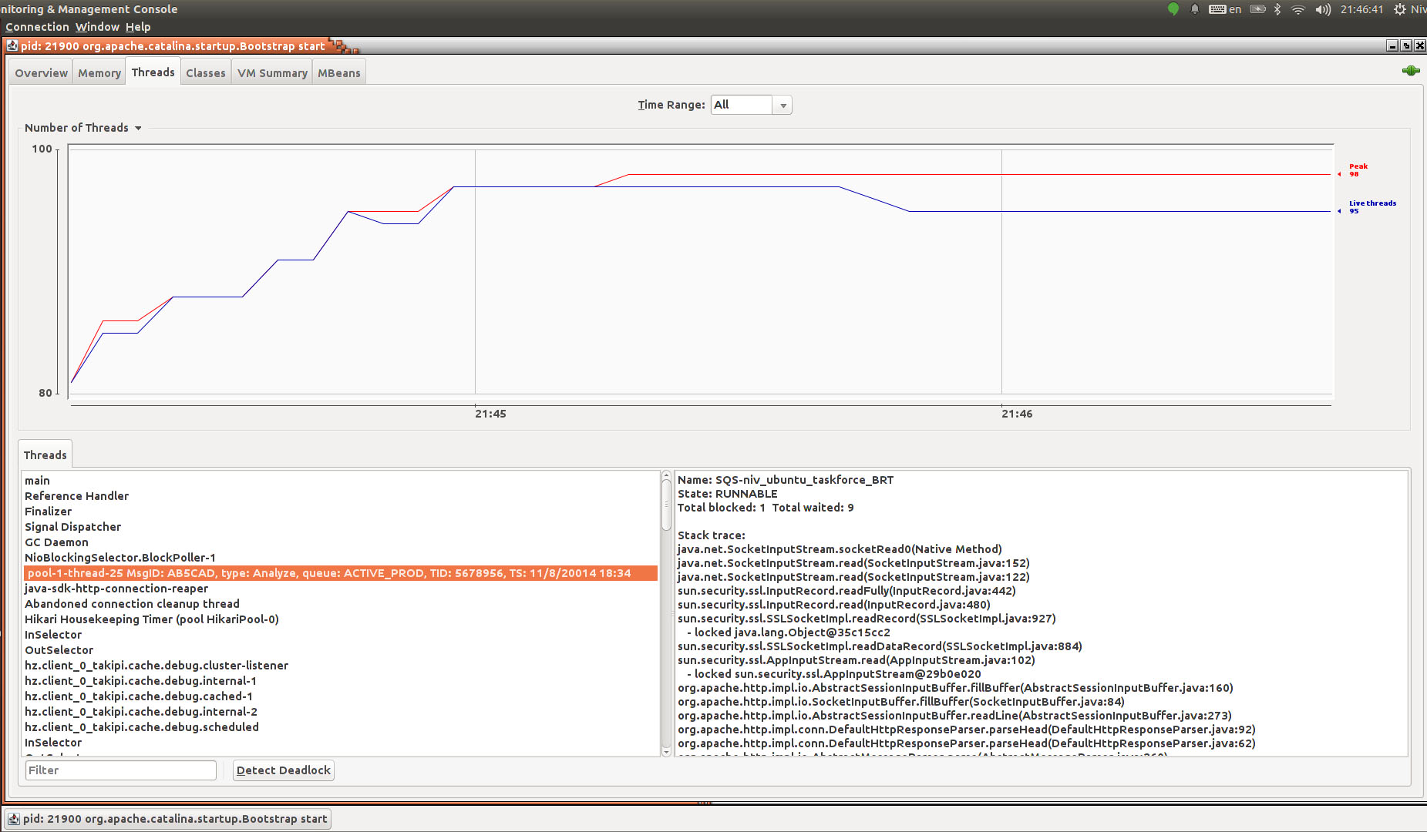

Slide 9
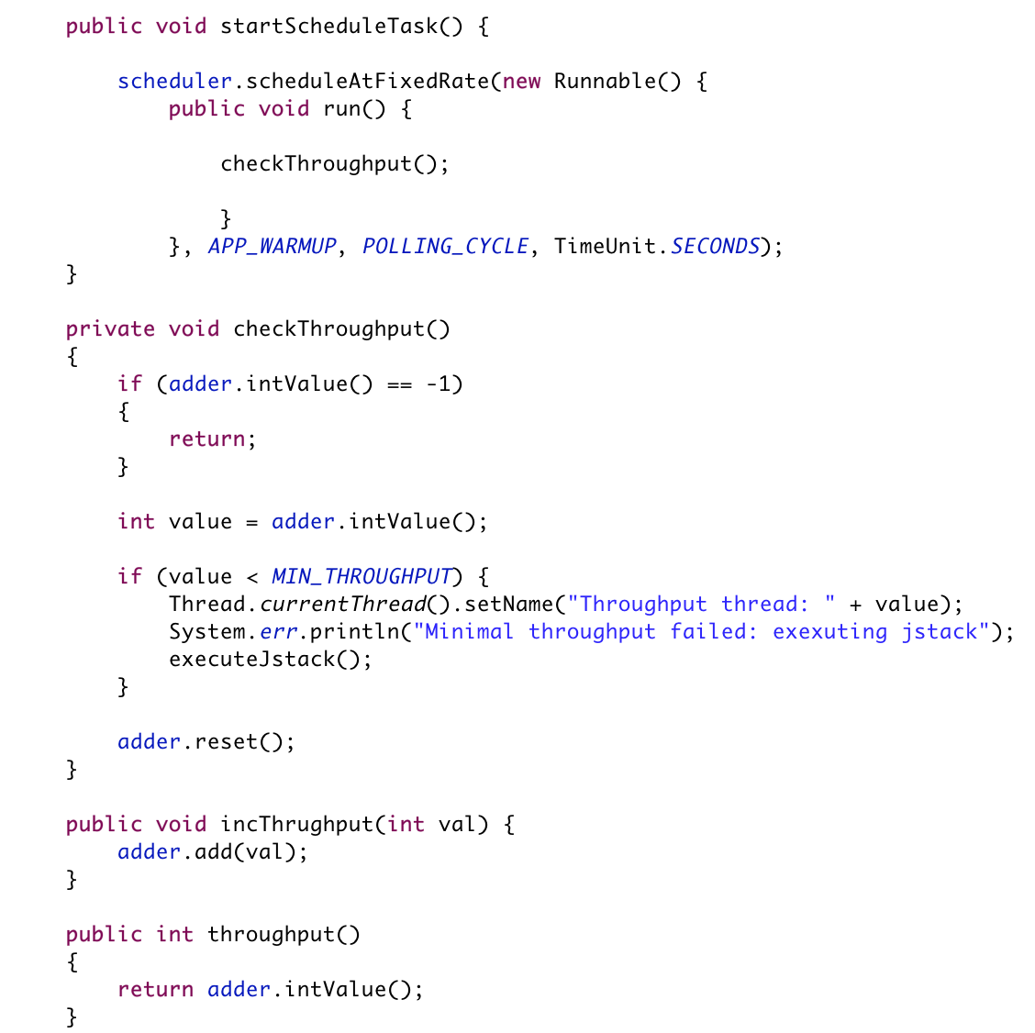
60-100% /performance
(LongAdder: 60-100% > Atomics)

Slide 10
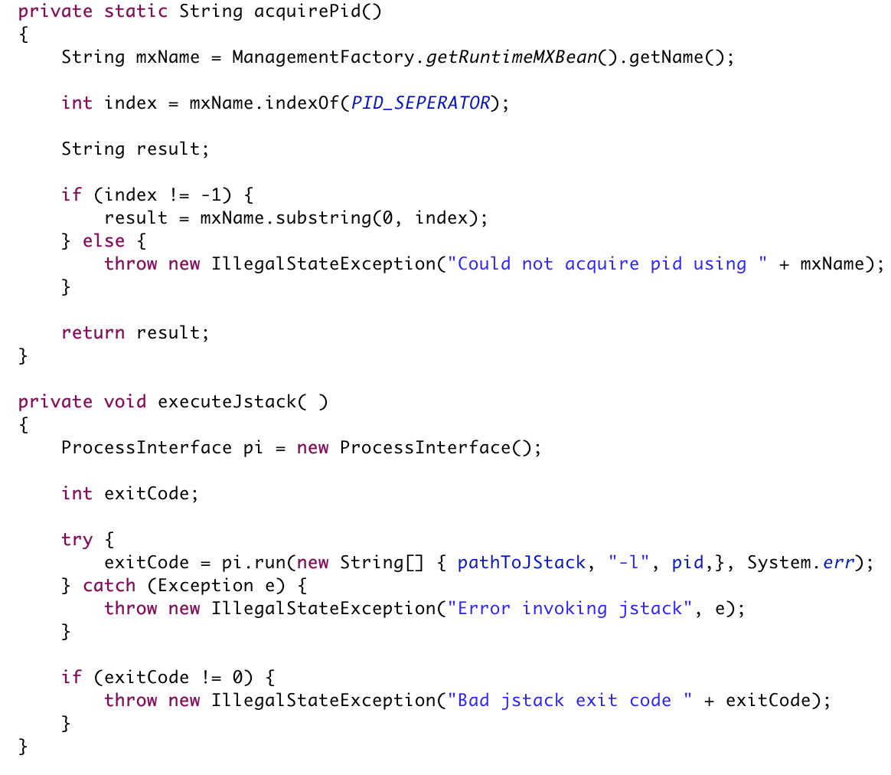
Native frames, monitors
60-100% /performance

Slide 11
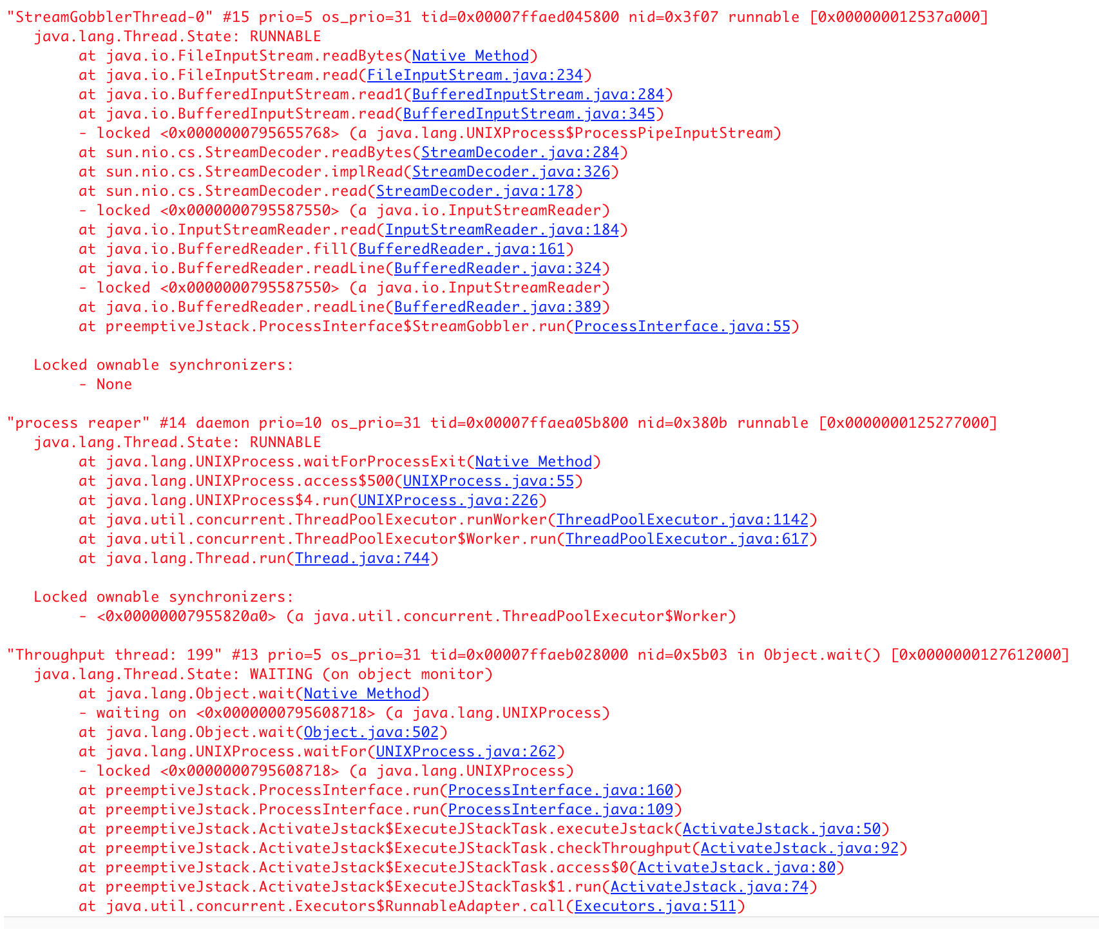

Slide 12
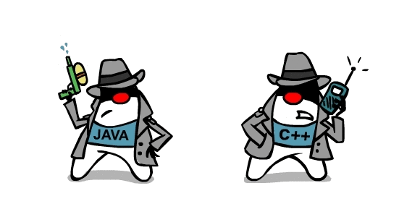
Custom Java Agents
An advanced technique for instrumenting code dynamically.
The foundation for most profiling / debugging tools.
Two types of agents: Java and Native.
Pros: extremely powerful technique to collect state from a live app.
Cons: requires knowledge of creating verifiable bytecode.
github.com/takipi/debugAgent
github.com/takipi/profiling-agent

Slide 13

BTrace
An advanced open-source tool for extracting state from a live JVM.
Uses a Java agent and a meta-scripting language to capture state.
Pros: Lets you probe variable state without modifying / restarting the JVM.
Cons: read-only querying using a custom syntax and libraries.
github.com/btraceio/btrace

Slide 14
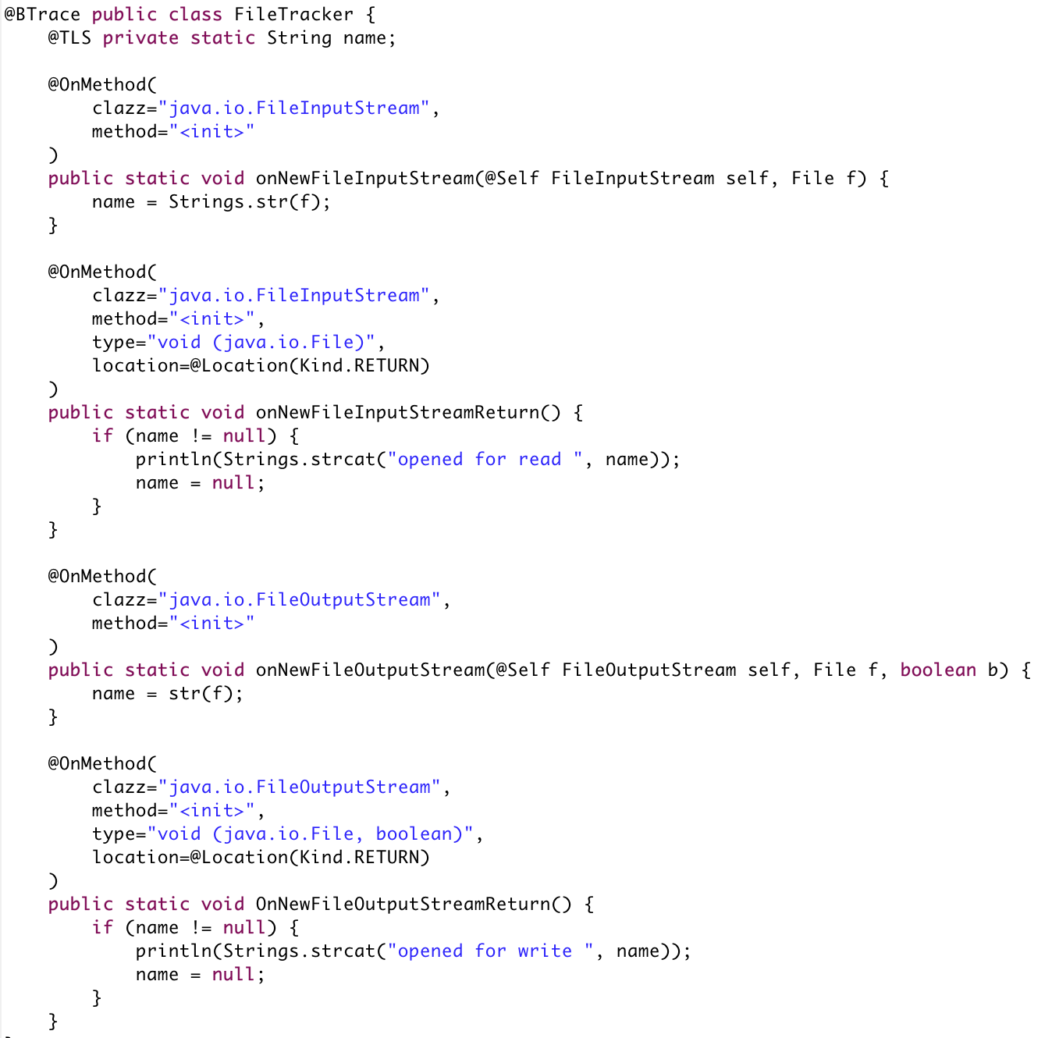

Slide 15
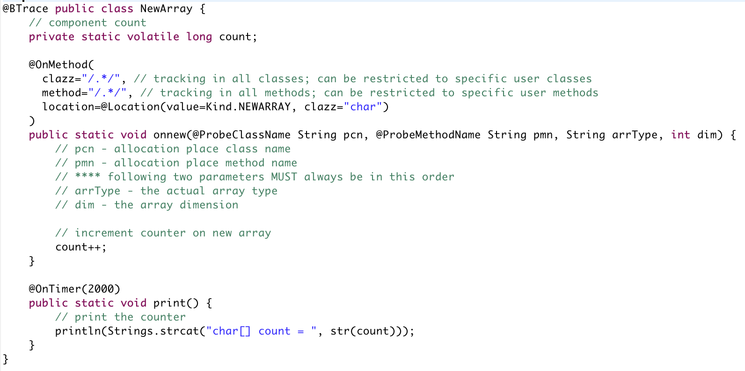

Slide 16
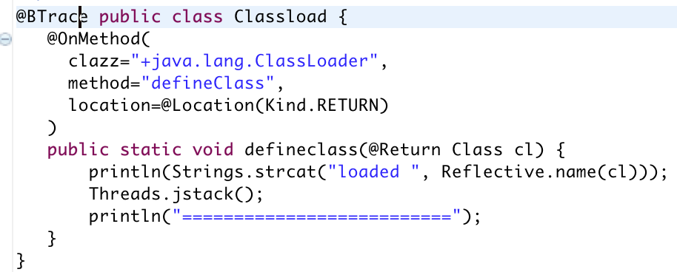

Slide 17
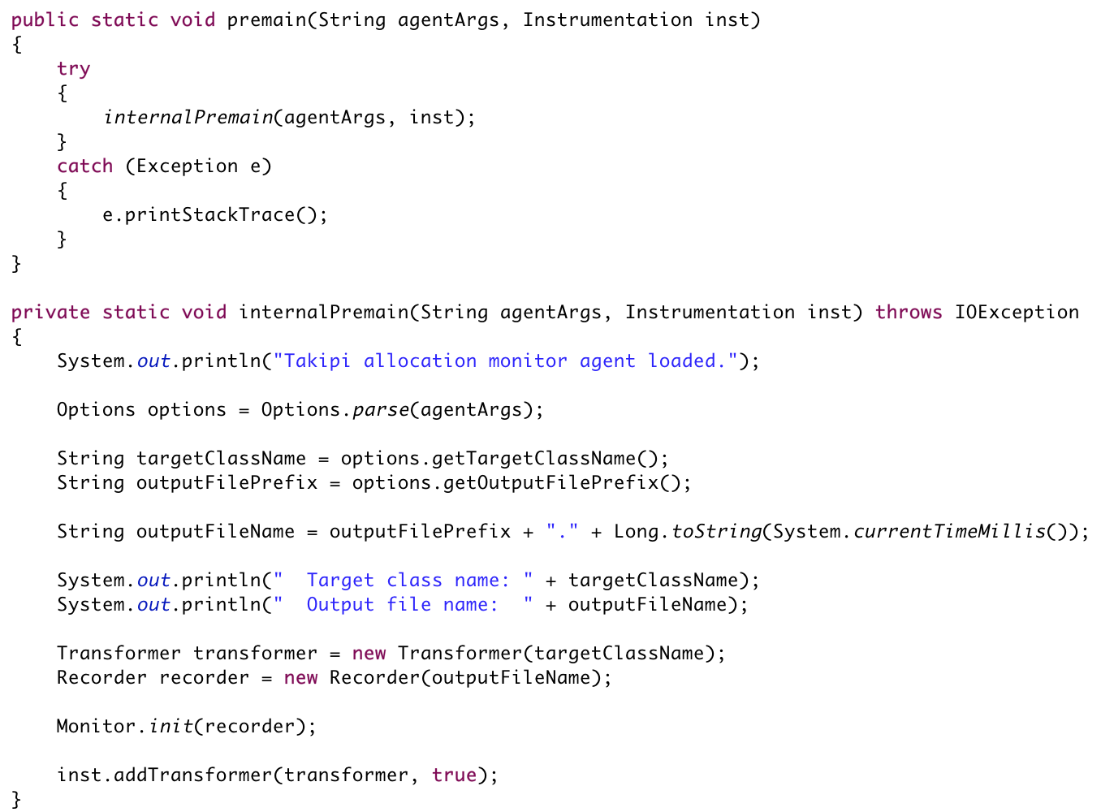

Slide 18
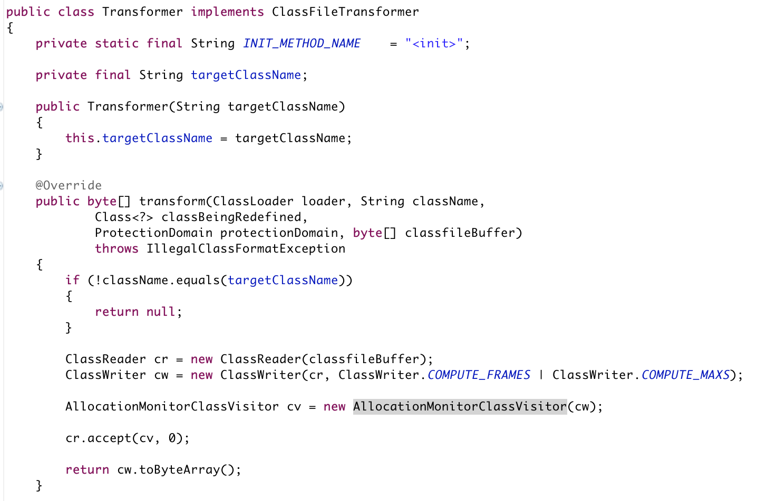
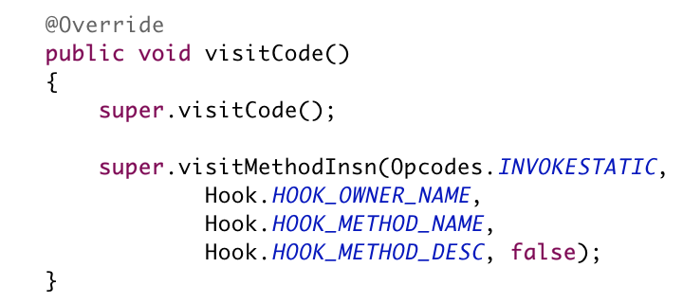

Slide 19
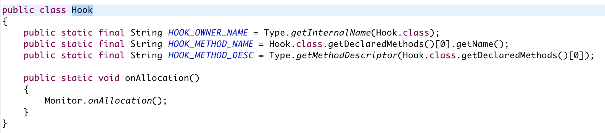
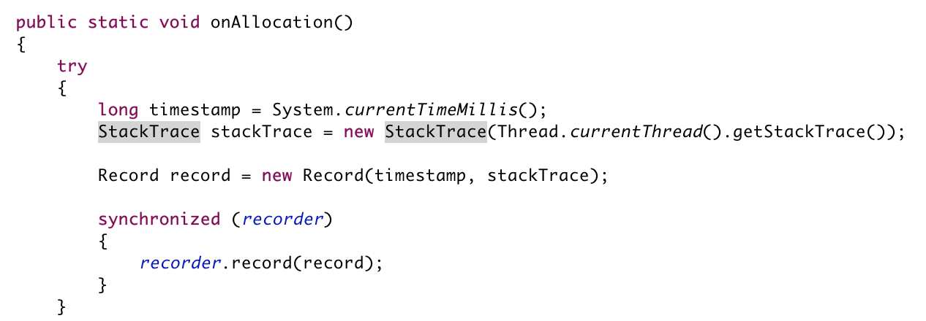

Slide 20
Native Agents
Java agents are written in Java. Have access to the Instrumentation API.
Native agents – written in C++.
Have access to JVMTI – the JVM’s low-level set of APIs and capabilities.
  JIT compilation, GC, Monitor, Exception, breakpoints, ..
More complex to write. Capability performance impact.
Platform dependent.
docs.oracle.com/javase/8/docs/platform/jvmti/jvmti.html

Slide 21
HSDB / Serviceability API
A powerful backdoor into the Hotspot JVM.
Complete access into discrete internal JVM classes from within the JVM or externally.
Requires intimate understanding of the JVM.
The most powerful way to introspect the state of the JVM.
Can be run externally or from within the JVM.

Slide 22
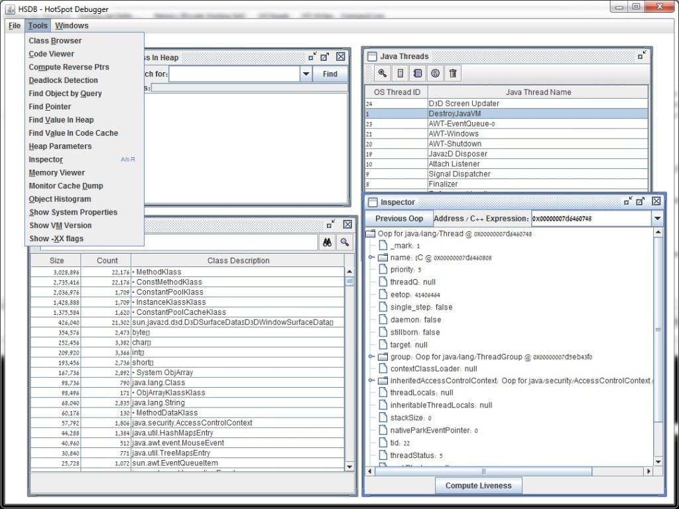

Slide 23
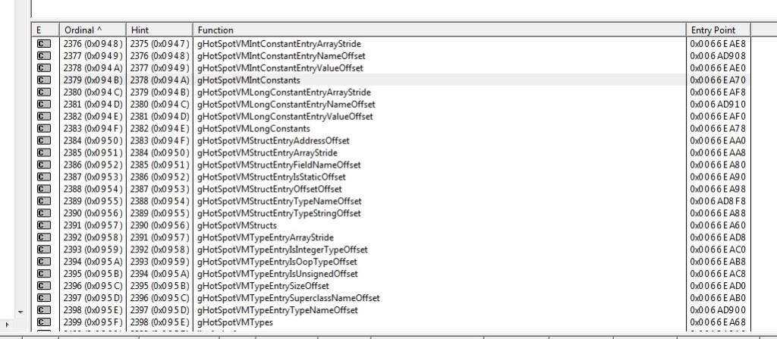

Slide 24
JVM Debugging in a Serverless World
Unavailable Capabilities | Available Capabilities
Global Exception Handlers | Logging
jstack | Metrics
Java Agent / VM API | Proprietary (AWS-Xray )
Btrace
JVMTI
HSDB

Slide 25
AWS Lambdas: X-Ray
A distributed framework for tracing distributed workflows.
Pros: out-of-the-box, scalable, wired into AWS.
Cons: proprietary, manual code instrumentation, less capable than agents, requires continuous connectivity to AWS.

Slide 26
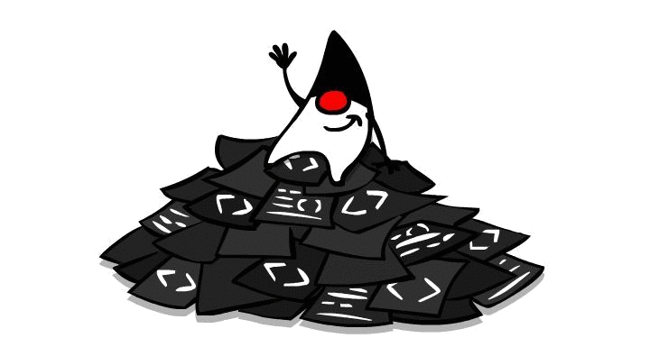
Lambda Logging Best Practices
Logging has become increasingly more important in the age of Microservices and now Lambda functions.
Make sure these are baked into your logging context –
Transaction ID (for distributed tracing).
Distributed DEBUG-level log throttling.
Handle inner / fatal and timeouts.

Slide 27
Distributed Transaction ID
Logging is usually a multi–threaded / process affair.
Generate a UUID at every thread entry point into your app – the transaction ID.
Should have sample-able attributes. Must be persistent.
Append the ID into each log entry.
Try to maintain it across machines – critical for distributed / async debugging.

Slide 28
Serverless Lambdas – Guardian Angel
A template framework to apply the following techniques within an AWS lambda:
Stateful thread naming
Global exception handling
Preemptive jstack
Timeout and critical failure state capture
Considerations: consistent across distributed flows,
Throttles at scale, minimal code change.

