Slide 1

Good Abstractions Help
Developers Write Good Crypto
Isaac Potoczny-Jones
ijones@tozny.com
https://tozny.com
Proprietary Information

Slide 2
Imagine Headlines From
An Alternate Past…

Slide 7
How many of you prefer
The fake headlines about security?

Slide 8
What is the reality
behind this fantasy?

Slide 9
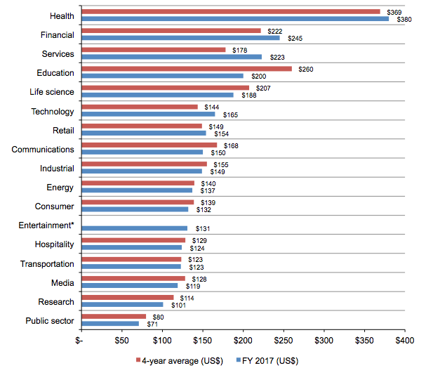
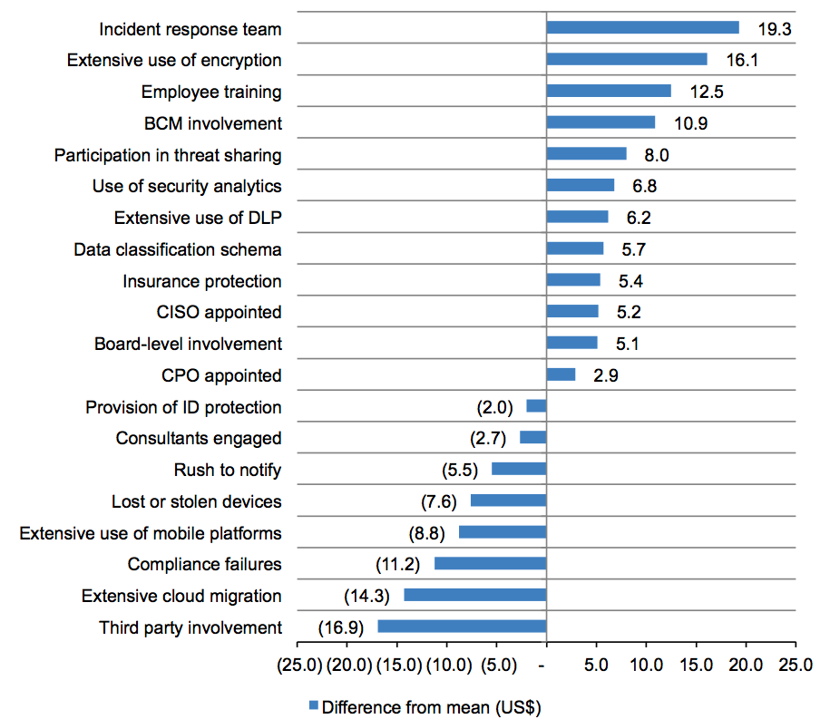
Good Crypto Makes Data Breaches Not Matter
Crypto Matters
Costs
Solutions
$ per Record
Ponemon - http://www-03.ibm.com/security/infographics/data-breach/
Notes:
http://www-03.ibm.com/security/infographics/data-breach/

Slide 10
EU Privacy Law Creates New Cost
General Data Privacy Regulation (GDPR)
  Violation hits 4% of annual revenue or €20M, whichever is greater
  Global in impact if you manage data of EU citizens, including IP addr
Encryption is required for GDPR
  €10M / 2% fine is waived if leaked data is encrypted
  Notification is not required if leaked data is encrypted
Proprietary Information

Slide 11
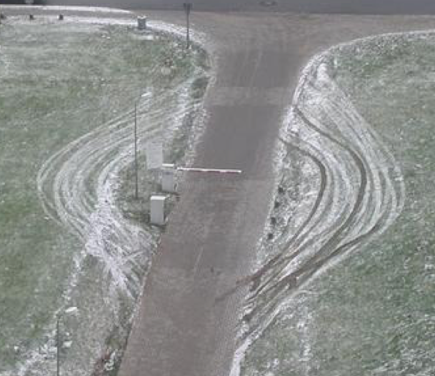
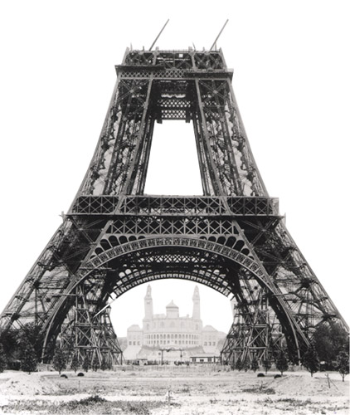
Let’s Face it: Privacy Gets in the Way
We all could do more with data…
If Privacy was not a problem.
But privacy matters…
Think of it as a foundation, not a gate.
Do more with data by doing right with data.

Slide 12
Mistake 1
Not Using Crypto

Slide 13
Why Encrypt
Why Not
Reduces the cost of a breach
Protects intellectual property
It protects the users
It’s the right thing to do
Access control is good enough
It causes overhead
We can’t query encrypted data
It’s hard to implement

Slide 14
It’s True, Encryption is Hard
But Why?

Slide 15
Introduction: Isaac Potoczny-Jones
Computer Science, Cybersecurity, CEO
ijones@tozny.com

Slide 16
There’s a good chance you use our crypto
Tozny Android AES Library – More on this later…
  Tens of millions of end-user installs
  Fortune 500 companies
  Open source projects
Debian / Ubuntu package integrity
  Developed by Tozny CEO prior to company in 2003
  Most common server OS
  Millions of server and desktop installs
  Our team has had a huge impact on open source crypto
Proprietary Information

Slide 17
Takeaways
Security defense continues to be a disaster
  The massive advantage goes to the attacker
Crypto is the recognized solution
    The last line of defense when access control falls down
More crypto is getting written
  By developers without training, in organizations without incentives
So developers are getting it wrong
  Because the crypto community is not giving us good interfaces

Slide 18
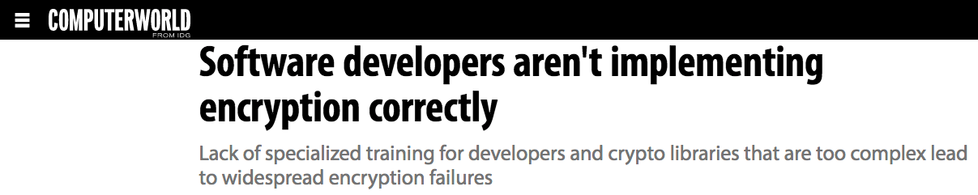
“Cryptographic issues ranked higher than
cross-site scripting, SQL injection and directory traversal.”
“Developers are adding a lot of crypto …
but they're doing it poorly.”
- Veracode CTO Chris Wysopal.
Notes:
Developers don’t know how to use crypto. http://www.computerworld.com/article/2941412/encryption/software-developers-arent-implementing-encryption-correctly.html

Slide 19
What you’ll get from this talk
Understand how typical devs approach crypto
What’s the root cause of the problem
Understand how you should approach crypto

Slide 20
It’s True, Encryption is Hard
But Why?

Slide 21
Two Negative Examples
Three Positive Examples

Slide 22
How Programmers Approach Encryption
“Encryption feels like a function
that inputs plaintext and outputs ciphertext.”

Slide 23
String encrypt (String plaintext) {…}
// A nice, stateless function

Slide 24
byte [] encrypt (byte[] plaintext) {…}
// Well, obviously it’s bytes not strings…

Slide 25
byte [] encrypt (byte[] plaintext,
byte [] key) {…}
// Of course, I need a key…

Slide 26
byte [] encrypt (byte[] plaintext,
byte [] key,
byte [] iv,
String algorithm,
String mode) {…}
// I don’t know what those are, but how hard can it be?

Slide 27
Negative Example 1: Encrypting Strings in Java
Selecting an Algorithm and Mode
  Symmetric vs. Asymmetric, AES, RSA, ECC
  Symmetric modes: ECB, GCM, CBC, etc.
  Hashing (where applicable): MD5, SHA1, SHA2
Managing Keys
  Generated randomly, generated from passwords
  How to store, register, and communicate keys
  Key size, key trust
  User identification (passwords, biometrics, etc.)
Miscellaneous
  How to generate, store, and communicate: Initialization vector (IV), salt, nonce
  Padding, encoding, serializing, signing
  How to communicate all these decisions to the other party

Slide 28
Let’s ask Google and Stack Overflow
Wrong
Wrong
Wrong
Our Library
Proprietary Information

Slide 29
Bad code looks completely reasonable
Insecure Key Generation
Insecure Encryption
Programmer Response
Might Destroy Your Data

Slide 30
What’s the result of this?
“65% of Android applications that use cryptography were found to use the default, insecure ECB mode for AES encryption.”
- 2013 “An empirical study of cryptographic misuse in Android applications.

Slide 31
Concept:
The abstraction stack of building crypto
The left side is completely generic and can be used for anything.
The right side is specific and can only be used for one thing.
This always happens with abstractions.
Proprietary Information

Slide 32
Mistakes creep into the gaps between layers
Proprietary Information

Slide 33
Mistake 2
Directly using low-level primitives like AES.

Slide 34
This is how you should imagine the attacker
A strong cryptographic attack model ignores “access control”
They can read all the encrypted data and plain text data
  But they can’t decrypt it
They can change all the encrypted data and plain text data
  But digital signatures should be able to catch it
They can choose example plain text data to encrypt
  For instance by creating an account with known values
They know the algorithm and the format of the data
  But not necessarily the keys

Slide 35
Mistake 3
Using a weak attack model.

Slide 36
Key Generation and Management
Randomly generated keys: High security, hard to manage
  Need to store the key, introducing new attack vectors.
  Bad: Storing the key next to the ciphertext.
  Bad: Not using a cryptographically secure RNG.
  Good: Use an HSM, keychain, or other kind of KMS.
Password-based keys: No “management” but weaker security
  Bad: Using the password as the AES key: Wrong size, easy to crack.
  Bad: Using password.getBytes() as a seed to RNG
  Good: Use an approved password-based key derivation function “PBKDF”.

Slide 37
Mistake 4
Broken key management or
No key management strategy.

Slide 38
Security Problems of Bad Crypto
Losing Confidentiality and Integrity

Slide 39
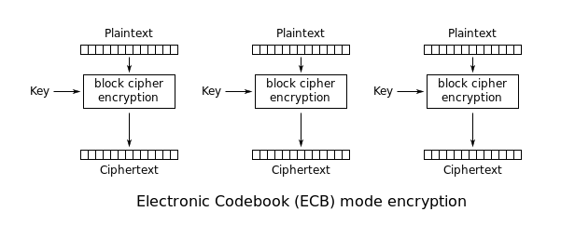
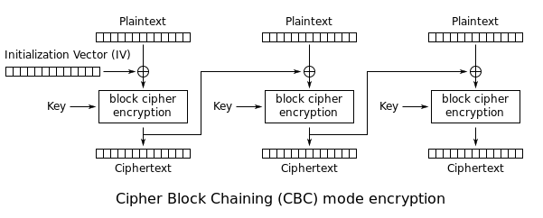
AES Modes - ECB vs CBC (Encrypt)

Slide 40
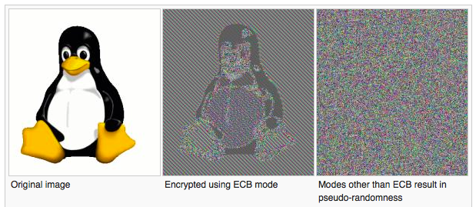
AES Modes: ECB loses confidentiality
Gotchas: In Java, ECB is the default mode for AES
Password manager: I can tell which sites have the same password
Images: I can see the shape of the image
What to do instead:
  Use CBC or GCM
  Depends on what’s available

Slide 41
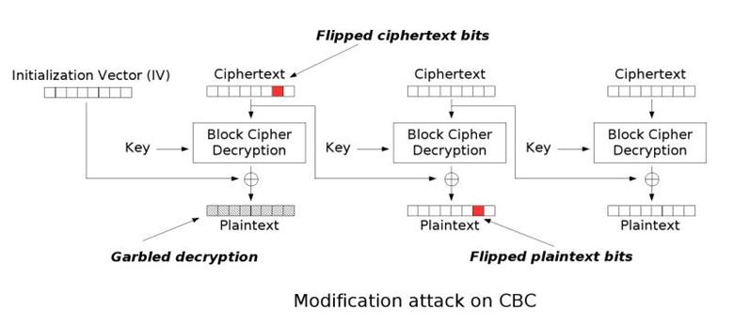
Integrity: ECB and CBC don’t provide it
Gotchas: Relying on integrity
  You can change the ciphertext and still decrypt it
  Sometimes it matters, sometimes it doesn’t
  ECB can be broken up by blocks
  CBC is harder
What to do instead
  Use GCM
  Add your own integrity

Slide 42
How to Break Security
of Bad Crypto

Slide 43
ECB Has Weak Confidentiality
Input Data – Winner = Bob (Orange)
user=Isaac | action=vote | user=Alice
user=Alice | action=vote | user=Bob
user=Bob | action=vote | user=Bob
user=Alice | action=change_addr | addr=123 Main
user=Bob | action=change_addr | addr=123 Main
I know that I voted for Alice (green) and I didn’t change my address…
user=Isaac | action=vote | user=Alice
user=Alice | action=vote | user=Bob
user=Bob | action=vote | user=Bob
user=Alice | action=change_addr | addr=123 Main
user=Bob | action=change_addr | addr=123 Main
3 Users.
Two actions.

Slide 44
ECB Has Weak Integrity
Starting State – Winner = Bob (Orange)
user=Isaac | action=vote | user=Alice
user=Alice | action=vote | user=Bob
user=Bob | action=vote | user=Bob
user=Alice | action=change_addr | addr=123 Main
user=Bob | action=change_addr | addr=123 Main
Attacker can mix and match records and make Alice (Green) win
user=Isaac | action=vote | user=Alice
user=Alice | action=vote | user=Alice
user=Bob | action=vote | user=Alice
user=Alice | action=change_addr | addr=123 Main
user=Bob | action=change_addr | addr=123 Main

Slide 45
Getting crypto right
Preserves confidentiality and Integrity

Slide 46
Negative Example 2: Client-Side Certs in Curl
Google:
“PHP curl send client-side certificate”

Slide 47
Top hit – Looks reasonable…

Slide 48
Top hit disables server verification!
Bad
What we want

Slide 49
First comment at the bottom of curl docs

Slide 50
PHP Docs for Curl
How many key-related options are there to curl in PHP – CURLOPT_
  SSLCERT, SSLCERTPASSWD, SSLCERTTYPE, SSLKEY, SSLKEYPASSWD, SSLKEYTYPE, SSH_HOST_PUBLIC_KEY_MD5, SSH_PUBLIC_KEYFILE, SSH_PRIVATE_KEYFILE, PINNEDPUBLICKEY, CERTINFO, SSL_VERIFYPEER, CAINFO, CAPATH
Documentation:
  CERTINFO: TRUE to output SSL certification information to STDERR on secure transfers.
  SSLCERT: The name of a file containing a PEM formatted certificate.
  SSLKEY: The name of a file containing a private SSL key.

Slide 51
Man page for --cert

Slide 52
It’s not that curl is bad!
It’s just that it’s too low-level…

Slide 53
Mistake 5
Trusting crypto code examples
without professional guidance.

Slide 54
Mistakes to watch out for
Not using crypto is the biggest mistake!
Directly using low-level primitives like AES
Letting a weak attack model undermine the correctness goal
Ask about the key management strategy
Trusting crypto code examples without professional guidance
Watch for “old or broken” stuff: DES, MD4, MD5, SHA1, RC4, (RSA)

Slide 55
But… I have a saying:
"Don’t blame users for security problems.”
e.g. You didn’t get hacked because you had a bad password, you got hacked because a programmer forgot to check for SQL injection vulnerabilities.

Slide 56
Likewise…
"Don’t blame developers for crypto problems.”
… What can the crypto community do better?

Slide 57
Solutions
A world with better security

Slide 58
The Abstraction Gap
Proprietary Information

Slide 59
The abstraction stack of building crypto
The left side is completely generic and can be used for anything.
The right side is specific and can only be used for one thing.
This always happens with abstractions.
Proprietary Information

Slide 60
Mistakes creep into the gaps between layers
Proprietary Information

Slide 61
In Crypto, there are very few tools in this gap
Proprietary Information

Slide 62
That big gap is an opportunity for improvement
Proprietary Information

Slide 63
Positive Example 1: Our Java AES Library
Let’s dig in…
Proprietary Information

Slide 64
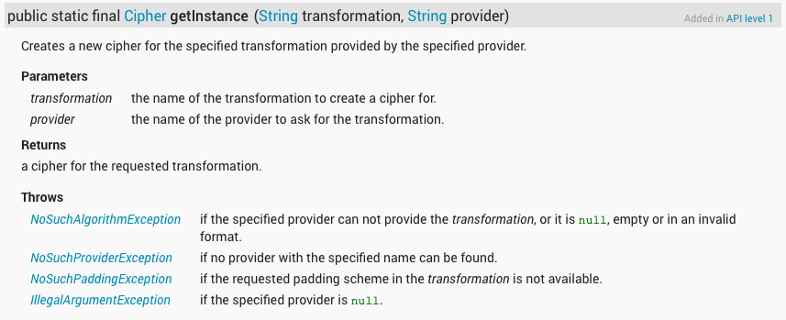
What Java Provides (the problem)
javax.crypto functions are: getInstance(), init(), doFinal()

Slide 65
Experience: What Our Library Provides

Slide 66
System Properties
We realize that people want simple copy-paste code.
Works for Strings: Operates as a stream cipher, base64 encoding.
Algorithm & Mode: AES 128, CBC.
Secure IV generation and handling.
Secure key generation for random or password-based keys.
Integrity – add a SHA256 HMAC, we handle the keys.
Pull requests welcome!
  https://github.com/tozny/java-aes-crypto

Slide 67
How does this Bridge the Gap
It’s opinionated; it makes a LOT of choices for you
That means it’s not perfect for everything
  It encrypts only strings, not any object of your choosing
  It’s for data at rest, not transit
  It generates keys, IVs, etc., all in the way we choose
  It’s not transparent database encryption
For-instance on performance
  10k rounds of password-based key generation isn’t fast on all platforms

Slide 68
Positive Example 2: Signal Protocol
Proprietary Information

Slide 69
End-to-end Crypto in Brief
Encrypt data as soon as it’s created
Decrypt it only when you need it
Distribute keys to the systems that need it
No intermediate systems get the data
Proprietary Information

Slide 70
Signal: An end-to-end secure chat protocol
Open Whisper Systems specified the protocol publically
Signal: Their secure chat app
WhatsApp, Facebook, and others have implemented it
It solves a specific problem and solves it well!

Slide 71
Positive Example 3: libSodium
A higher-level crypto library
We love it and use it all the time
Proprietary Information

Slide 72
libSodium: Use it if there’s no protocol library
Pros: Higher-level than ciphers
  Makes lots of choices for you
  Combines authenticated symmetric and asymmetric crypto
Cons: Lower level than protocols
  Its choices are somewhat odd - Doesn’t use the NIST ciphers
  Documentation is still a little weak

Slide 73
End-to-end beyond chat (Bonus Example 4)
We’ve launched a much more complete commercial product.
We used this Java AES project to verify the need
It was wildly successful, but the problem is much bigger than Java AES
Come chat with me if you’re curious

Slide 74
What you can do
In your day job…

Slide 75
How to get it right
If you have the expertise, build Tools in this gap:
Proprietary Information

Slide 76
For the rest of us
Decide on your security and privacy goals
Plan for a strong attacker
Use a tool that’s close to your abstraction layer or libSodium
Ideally, use a trained cryptographer to implement your approach
Otherwise, get training and have a cryptographer check your work
Remember: crypto is there for when “access control” fails

Slide 77
Thank You!
Isaac Potoczny-Jones
ijones@tozny.com
https://tozny.com

