Slide 1
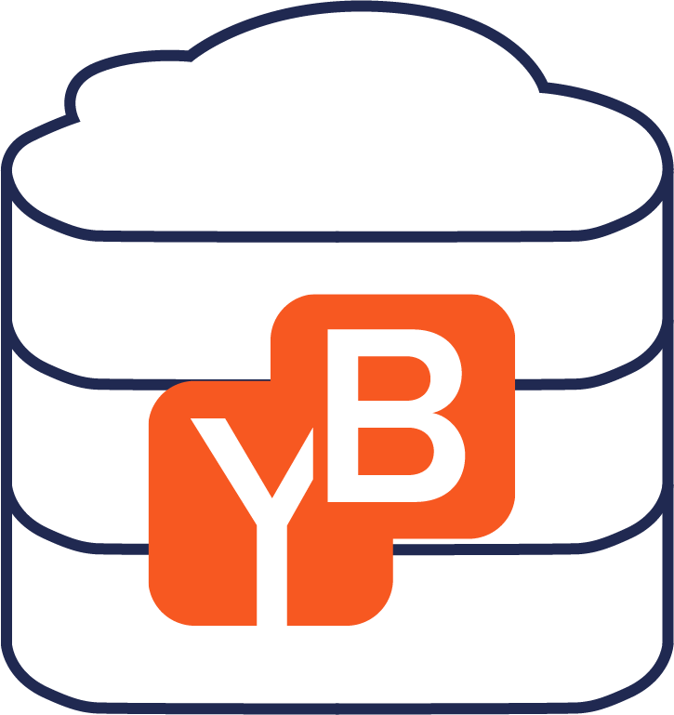
Introducing YugaByte DB
Karthik Ranganathan
Co-Founder & CTO
November 13, 2017

Slide 2
Mission
Simplify Mission-Critical Data

Slide 3
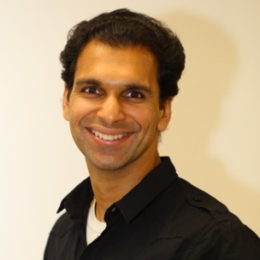
About Us
Founders
Kannan Muthukkaruppan, CEO
Nutanix ♦ Facebook ♦ Oracle
IIT-Madras, University of California-Berkeley
Built Facebook’s NoSQL platform powered by Apache HBase
Scaled the platform to serve ~10 mission-critical use cases
Messages (OLTP)
Operational Data Store (Time Series)
Reassembled the same Facebook team at YugaByte along with engineers from Oracle, Google, Nutanix and LinkedIn
Hands-on with Apache HBase, Apache Cassandra, Oracle, RocksDB
Karthik Ranganathan, CTO
Nutanix ♦ Facebook ♦ Microsoft
IIT-Madras, University of Texas-Austin
Mikhail Bautin, Software Architect
Clear Story Data ♦ Facebook ♦ D.E.Shaw
Nizhny Novgorod State University, Stony Brook
Investors
Ravi Mhatre
Founding Investor at Nutanix ♦ AppDynamics ♦ Mulesoft
Lightspeed Venture Partners
Jeff Rothschild
Former VP, Infrastructure Software at Facebook
.. and prominent angels

Slide 4
What?
Converge operational database needs of
mission-critical apps into a cloud-native platform

Slide 5
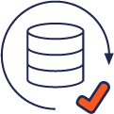
Cloud-Native, Mission-Critical, Open-Source
Consistent & Partition-tolerant (CP)
Highly available when majority replicas available
Apache 2.0 licensed core
Enterprise offering as upgrade
Highly reliable
Open source
MISSION-CRITICAL
OPEN ECOSYSTEM
Redis
Apache Cassandra
SQL
(coming soon)
Built ground-up in C++
3x read throughput of traditional NoSQL
High performance
Polyglot persistence with open APIs
CLOUD-NATIVE
Linear read & write scalability
Reconfigurable with zero downtime
Cloud-agnostic, no lock-in
Sync replication (default)
Async replication (optional)
Elastic, reconfigurable & portable
Multi-cloud & Multi-datacenter

Slide 6
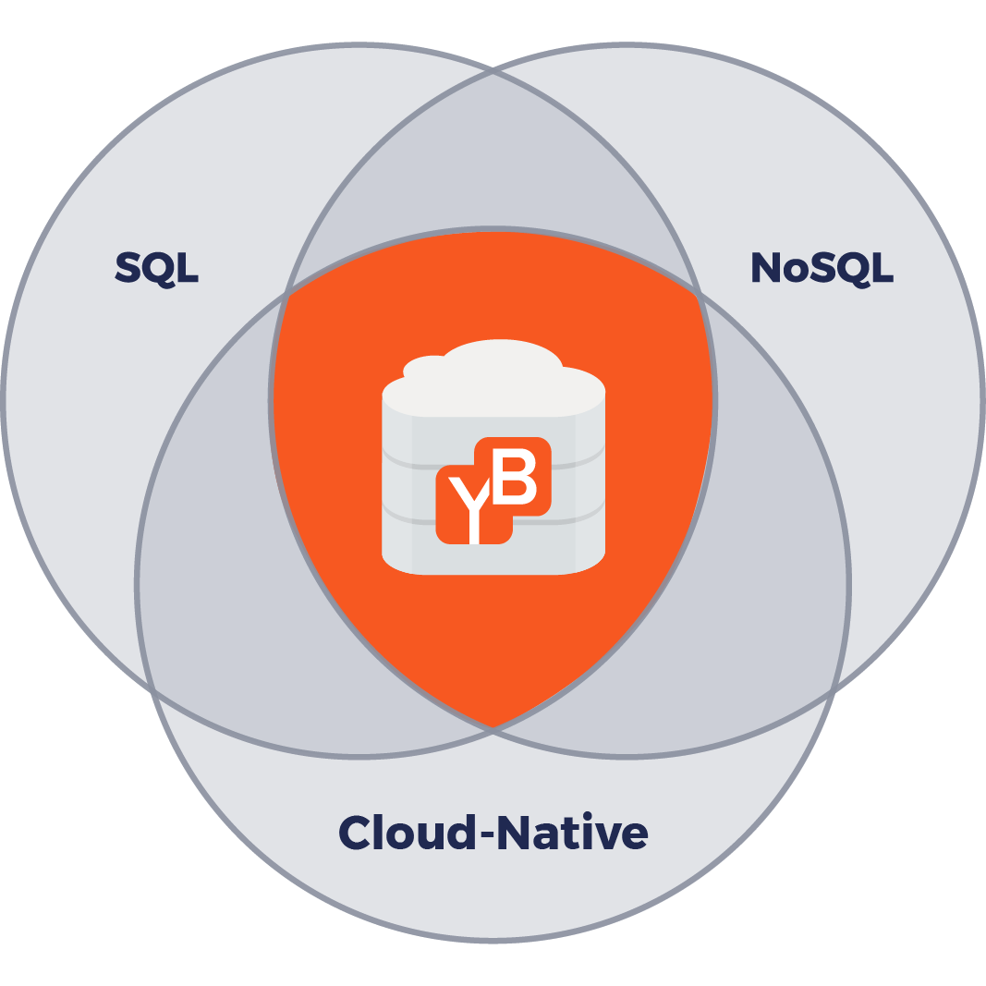
Breaking Barriers
A unified, cloud-native platform for mission-critical data
SQL DB
Reliable, strongly consistent core
Relational data model & ACID txns
Low-latency reads & writes
NoSQL DB
Available across multi-datacenters
Multi-model
High throughput writes, low-latency reads
Native integration w/ Analytics & Streaming infrastructure (e.g. Apache Spark/Kafka)
Cloud-Native Infrastructure
Elastic and geo-distributed fault-tolerance
Reconfigurable with zero downtime
Cloud-agnostic, portable across clouds

Slide 7
Cloud-Based Mission-Critical Apps Today
SQL for OLTP data
Manual sharding
Cost: dev team
Stateless microservices
NoSQL for other data
App aware of data silo
Cost: dev team
Cache for low latency
App does caching
Cost: dev team
Manual replication
Manual failover
Cost: ops team
SQL Master
SQL Slave
Data inconsistency/loss
Fragile infra
Hours of debugging
Cost: dev + ops team
Datacenter 1
Datacenter 2

Slide 8
Cloud-Based Mission-Critical Apps with YugaByte
Automatic Sharding
Automatic Failover
Cost: dev team
Stateless microservices
No data silos
Cost: dev team
Transparent caching
Cost: dev team
Build better apps
Lower total cost
High agility
Datacenter 1
Datacenter 2

Slide 9
Architecture – 3 Node Cluster
n1
n3
YB-Master
Manage shard metadata & coordinate cluster-wide ops
yb-master1
yb-master2
n2
yb-master3
Automated Sharding
Scale to large data sets & high throughput ops
yb-tserver1
yb-tserver2
YB-TServer
Host & serve user data
tablet1-leader
tablet1-follower
tablet 1’
tablet 1’
tablet2-follower
Raft Consensus Replication
Highly resilient, used for both data replication & leader election
tablet2-leader
tablet3-follower
tablet3-follower
…
yb-tserver3
…
tablet1-follower
tablet 1’
tablet2-follower
DocDB LSM Storage Engine
Built for storing ever-growing data, based on a heavily customized version of RocksDB
tablet3-leader
…

Slide 10
Powering Mission-Critical Use Cases
Consistency
Zero data loss persistence
yb-master1
yb-master2
YB-Master
Manage shard metadata & coordinate system-wide ops
master-follower
yb-master3
master-follower
master-leader
2
Get latest tablet-leader locations and send to client for future caching
yb-tserver1
yb-tserver2
1
Update record in tablet3
YB-TServer
Host & serve user data
tablet1-leader
Redirect to current tablet3-leader
3
tablet1-follower
tablet 1’
tablet 1’
tablet2-follower
tablet2-leader
tablet3-follower
tablet3-follower
5
…
yb-tserver3
…
tablet1-follower
Wait for majority replicas to commit
Commit to local DocDB
Ack client after local commit
tablet 1’
tablet2-follower
Sync update follower replicas via Raft
4
tablet3-leader
4
Sync update follower replicas via Raft
…

Slide 11
Powering Mission-Critical Use Cases
Availability
Resilient under any failure
yb-master1
yb-master2
YB-Master
Manage shard metadata & coordinate system-wide ops
master-follower
yb-master3
master-follower
master-leader
2
Get latest tablet-leader locations and cache for future
yb-tserver1
yb-tserver2
Update record in tablet3, see node unreachable
1
YB-TServer
Host & serve user data
tablet1-leader
tablet 1’
tablet 1’
tablet2-leader
Update via current tablet3-leader
3
tablet3-follower
…
yb-tserver3
…
tablet1-follower
tablet 1’
tablet2-follower
5
Wait for majority replicas to commit
Commit to local DocDB
Ack client after local commit
Sync update follower replicas via Raft
4
tablet3-leader
…

Slide 12
Powering Mission-Critical Use Cases
Performance
No quorum reads ➔ 3x throughput of traditional quorum-based NoSQL
yb-master1
yb-master2
YB-Master
Manage shard metadata & coordinate system-wide ops
master-follower
yb-master3
master-follower
master-leader
yb-tserver1
yb-tserver2
Read record in tablet3
(BOUNDED STALENESS or SESSION read consistency level)
1
YB-TServer
Host & serve user data
tablet1-leader
tablet1-follower
tablet 1’
tablet 1’
tablet2-follower
tablet2-leader
tablet3-follower
tablet3-follower
…
yb-tserver3
…
tablet1-follower
tablet 1’
tablet2-follower
tablet3-leader
…
1
Read record in tablet3 (default: STRONG read consistency level)

Slide 13
… With Cloud-Native Agility
Reconfigure [hardware | AZ | region |cloud] with zero downtime
YugaByte Admin Console
n1
n3
n4
n6
YB-Master
Manage shard metadata & coordinate system-wide ops
yb-master1
yb-master2
yb-master4
yb-master6
master-follower
n2
master-follower
master-follower
n5
master-follower
yb-master3
yb-master5
yb-tserver1
master-leader
yb-tserver2
yb-tserver4
master-leader
yb-tserver6
YB-TServer
Host & serve user data
tablet1-leader
tablet1-follower
tablet1-leader
tablet1-follower
tablet1-leader
tablet 1’
tablet 1’
tablet 1’
yb-tserver3
tablet 1’
yb-tserver5
tablet2-leader
tablet2-leader
tablet2-follower
tablet2-leader
tablet2-follower
tablet1-follower
tablet3-follower
tablet1-follower
tablet3-follower
tablet3-follower
tablet 1’
tablet3-follower
tablet 1’
tablet2-follower
…
tablet2-follower
…
…
…
…
…
tablet3-leader
tablet3-leader
tablet3-leader
…
…
…
Old infrastructure
New infrastructure

Slide 14
Business Value Proposition
Consistent CX
Lower TCO
Increase Agility

Slide 15
Case Study #1 - User Identity Login, change password, view profile
Current State
1. MySQL master-slave replication
2. Cassandra cross-DC queue for cache updates
3. Per-DC Couchbase for caching

Slide 16
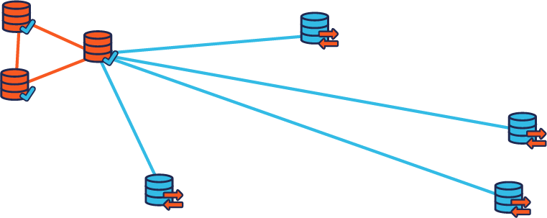
Case Study #1 - User Identity Login, change password, view profile
One click deploy of sync and async replication
With YugaByte EE
Unified platform
Zero data loss even on DC failures
Add new DCs with ease

Slide 17
Case Study #2 - Financial Data Service
On-premises only, would like to run hybrid/public cloud deployments
DB
Current State
Redis cluster for low latency reads
Fragile (manually sharded & load balanced)
Expensive (entire dataset in memory)

Slide 18
Case Study #2 - Financial Data Service
With YugaByte EE
One click deploy of unified Redis cluster + DB
Develop more business use cases
Only hot data in memory, auto-sharding and load balancing
Hybrid cloud deployment and ability to burst

Slide 19
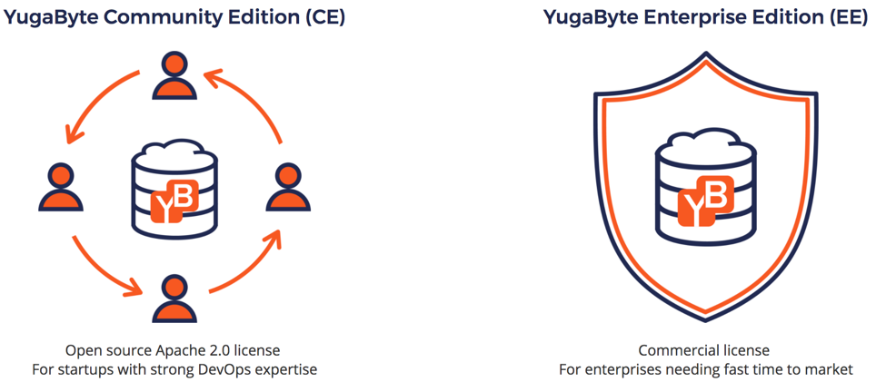
Product editions

Slide 20
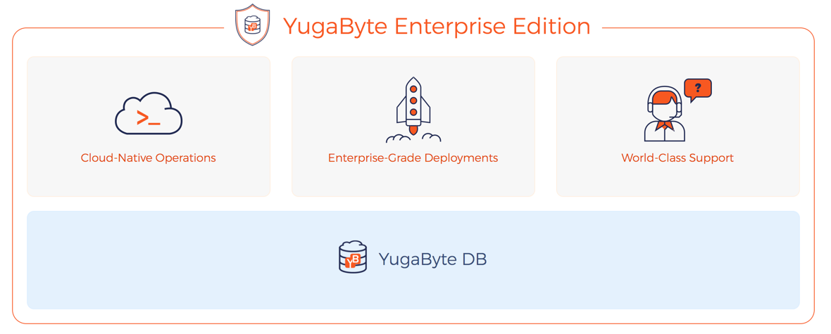
The simplest way to run YugaByte DB in production
Multi-Cloud Cluster Orchestration
Deep Public Cloud Integration
Monitoring & Alerting
Highly Reliable Admin Console
Async Replication
Preferred Leader Placement
Distributed Backups/Restore
Tiered Storage
24/7/365 Web & Phone Support
Emergency Patches

Slide 21
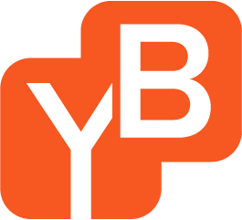
Simplify Mission-Critical Data
Converging Operational DBMS …
Graph, Full-text Search, Large Object Store …
SQL API w/ Distributed ACID txns
Apache Cassandra & Redis APIs w/ Single Row ACID txns
Scale-out, Transactional, Cloud-Native Data Fabric
ROADMAP
TODAY

Slide 22
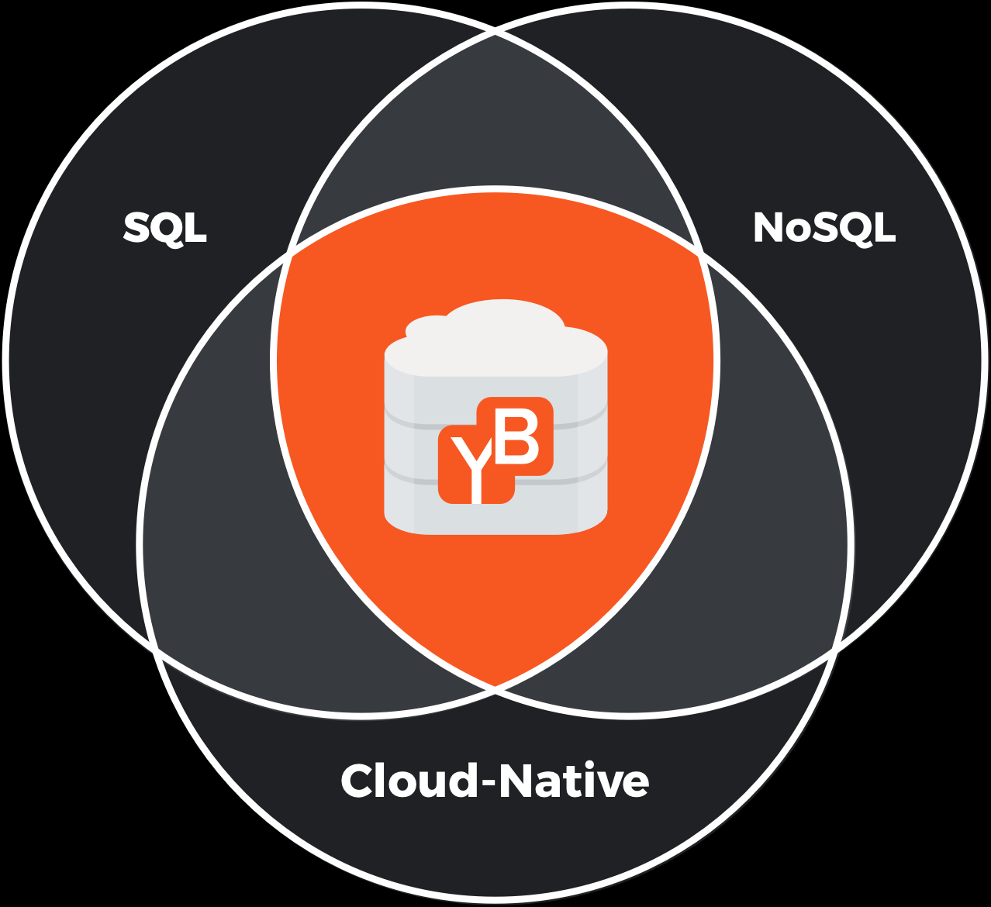
Demo

Slide 23
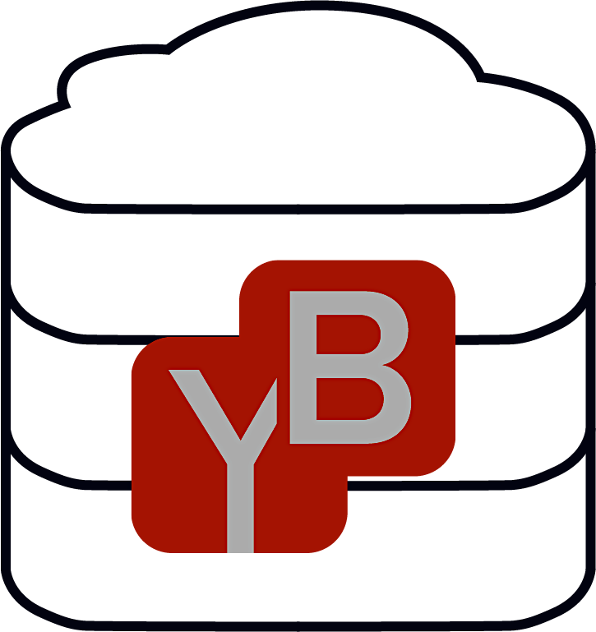
Questions?
yugabyte.com/community/
@YugaByte

