Slide 1
How To: Community Driven Career Growth for Developers
Georgiy Mogelashvili
Booking.com

Slide 2
“Change is disturbing when it is done to us, exhilarating when it is done by us.”
Rosabeth Moss Kanter, Harward School of Business

Slide 3
…
…
Manager
Principal
Team Lead
Senior
core contributor

Slide 4
…
…
Manager
Principal
Team Lead
Senior
core contributor

Slide 5
…
…
Manager
Principal
Team Lead
Senior
core contributor

Slide 6
Senior is a recognition, not a promotion

Slide 7
Being Senior means
More community impact
More responsibility and ownership
Higher input, impact on department and company levels
Perfect communication and collaboration
Role model

Slide 8
Senior – not only skills and knowledge, it’s also a behaviour

Slide 9
Behaviour can’t be taught

Slide 10
But you can create an environment, where behavior will show up

Slide 11
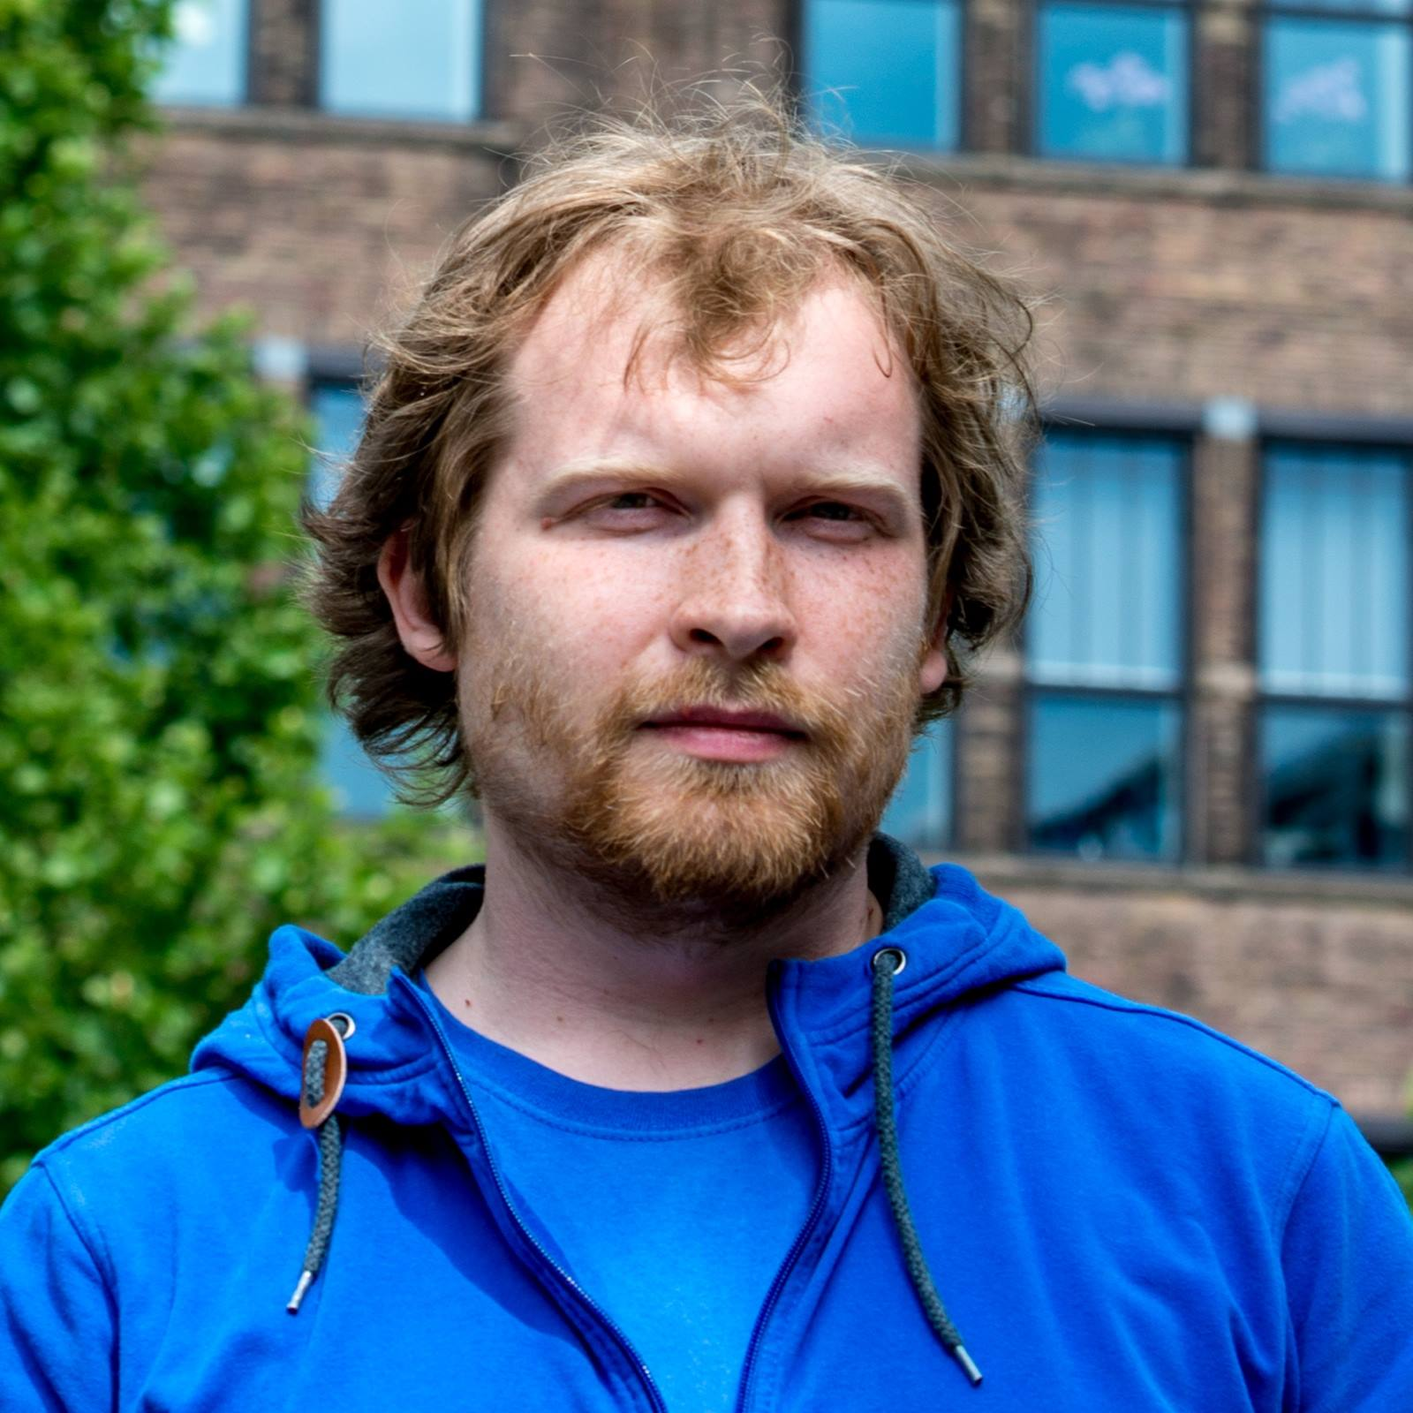
Idea
Denis Yakunin
coffee together, generated an idea, discussed the concept

Slide 12
1. Marathon
2 weeks, new task every day
Goal – create a habit
2. Work in groups
Goal – learn from and through others
3. Online
Goal – learn at your own pace

Slide 13
Game of Roles
Opportunity to be in a different role for a while

Slide 14
Being a Senior means playing the role. To become a Senior you have to try playing* it! * don’t forget to stay yourself though

Slide 15
Experiment & Fail fast
Idea to MVP as quick as possible
Pilot on a limited group
Collect feedback
Repeat

Slide 16
Idea is born
Day 0
Discuss details
Day 5
Public announcement
Day 10
Final polishing
Day 12
Launch
Day 14

Slide 17
2 weeks
training
preparation
2 weeks

Slide 18
Format
Completely online in Workplace by Facebook

Slide 19
1. Marathon
2 weeks, 10 tasks
Publish a task evening before
2. Online
Workplace or any similar platform
3. Rules
What is expected and what is not
Code of Conduct

Slide 20
Code of Conduct
Trust. Everything we discuss in the group regarding private topics should stay in the group.
Privacy. If you have to share something related to a person from outside of this group, please don’t mention that person’s name.
Safety. Don’t judge or blame others. Instead, try to listen and provide feedback and/or suggestions. If you want to give feedback, follow BIO model.
Be open to receive feedback. Think of it as a opportunity to grow rather than something wrong with you.
These are the top rules we need to follow, however most important one is - use common sense. We are all here to help each other to grow, so respect this. There will be group moderators, who will take care of code of conduct as well, but we hope they won’t be involved.

Slide 21
Groups

Slide 22
1. Small
15 people
More control, better focus
More people? Add one more group.
2. Closed
Only participants and moderators
No managers, HR and any other spectators

Slide 23
Tasks
Clear – no time to clarify each task
Simple – estimated completion time within 1 hour
Relevant – should reflect what Senior work/role is about
Solution – separate post per participant in Facebook

Slide 24
1. Hard skills / tech
Go beyond immediate area of responsibility
Have impact
Master technical skills
Example:
Fix some errors in another person’s code
Describe and draw a diagram of your project

Slide 25
2. Self-reflection – the key to growth
Make people think and understand themselves better
Easy to accomplish, but extremely valuable for self development
Produce a lot of ground base for future coaching
Examples:
What are your strengths? Weaknesses? What do you miss right now as a Senior?
Describe what tasks do you like and don’t like to do. Why?

Slide 26
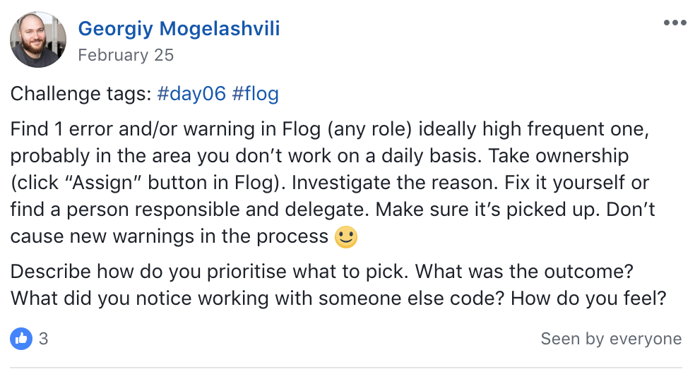

Slide 28
Moderators
Experiences – preferably Seniors
Monitor group activity, answer questions
Can ask questions, coach

Slide 29
Coaching
Fully “unlock” each answer and a person
Make participants think more
Dig deeper
Make them think of solutions, rather then offer them

Slide 30
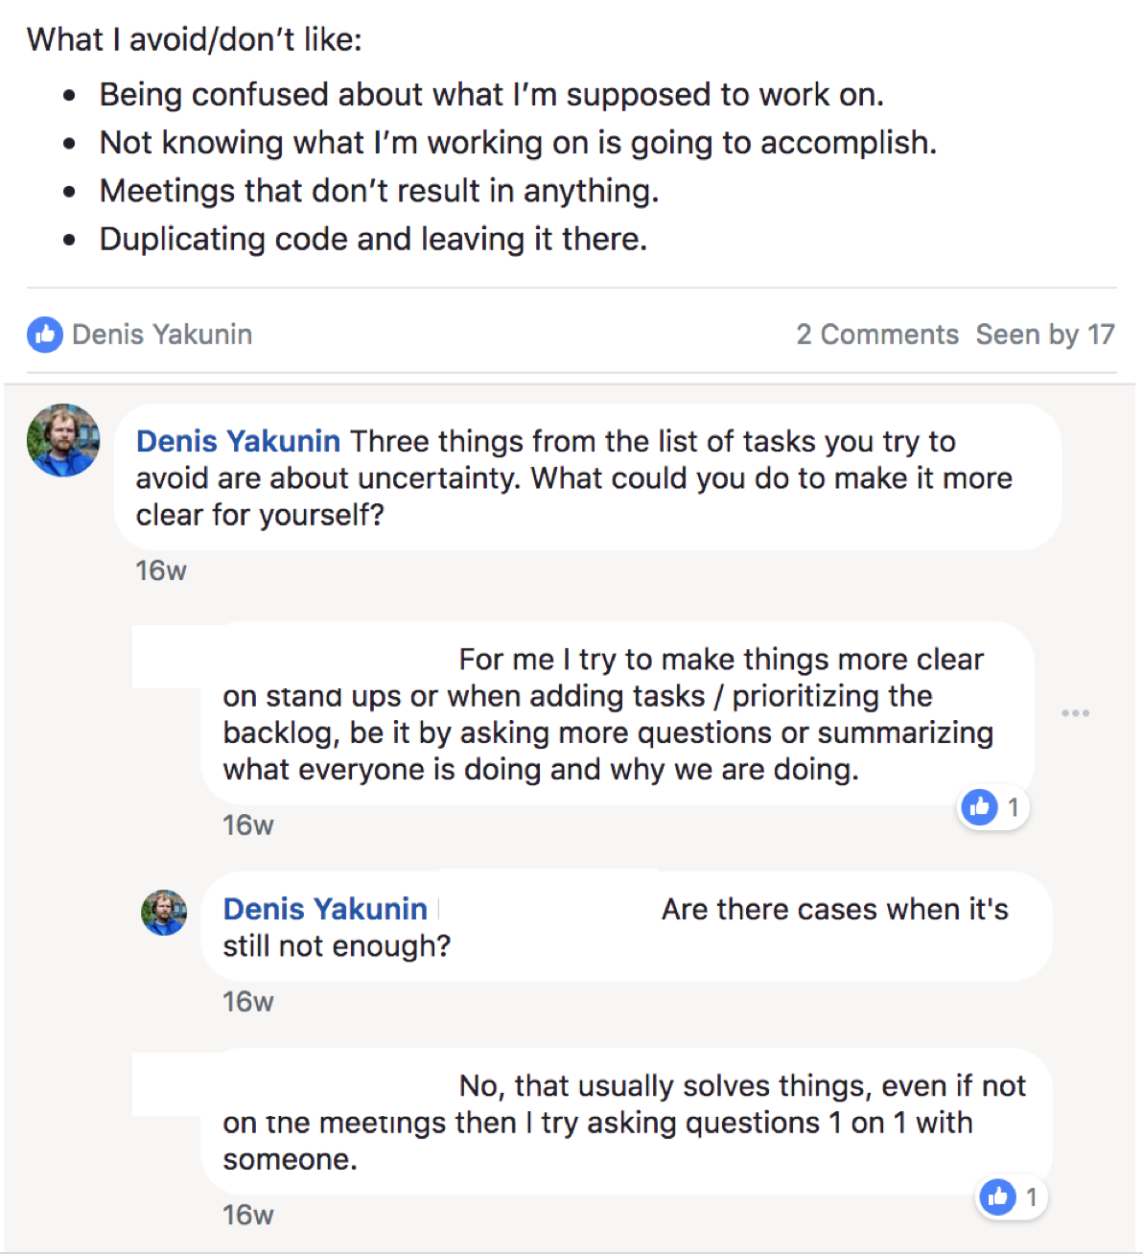

Slide 32
Feedback + AMA
Ask Me Anything – opportunity to ask other Seniors anything they’d like
Collect feedback (keep it agile)

Slide 33
What did we learn?

Slide 34
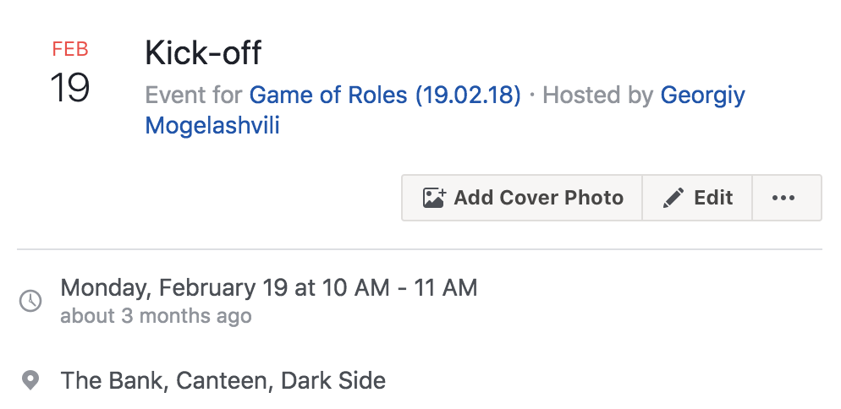
Lesson 1. Meet in real life before each training start

Slide 35
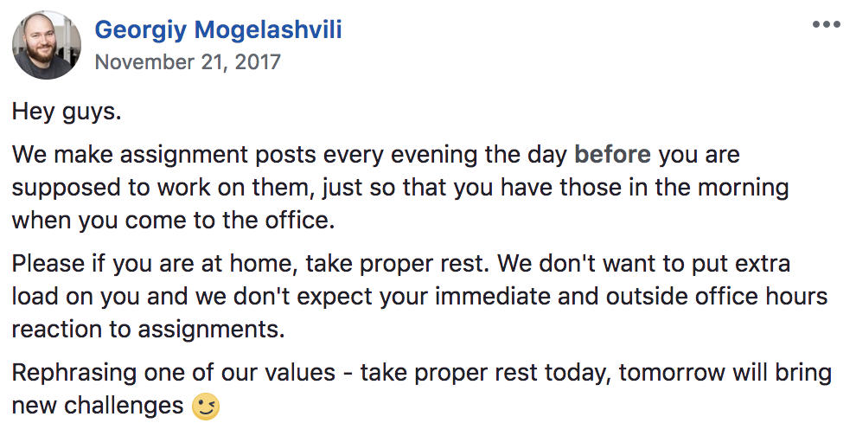
Lesson 2. Think of WLB – publish tasks in the morning of same day, not in the evening

Slide 36
Lesson 3. Give some time off in between. Friday became a catch-up day

Slide 37
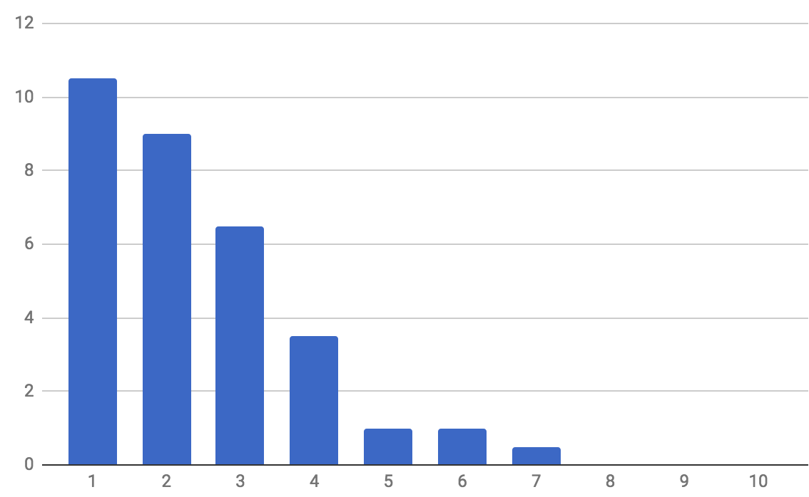
Before having catch-up days
participants
Tasks completed

Slide 38
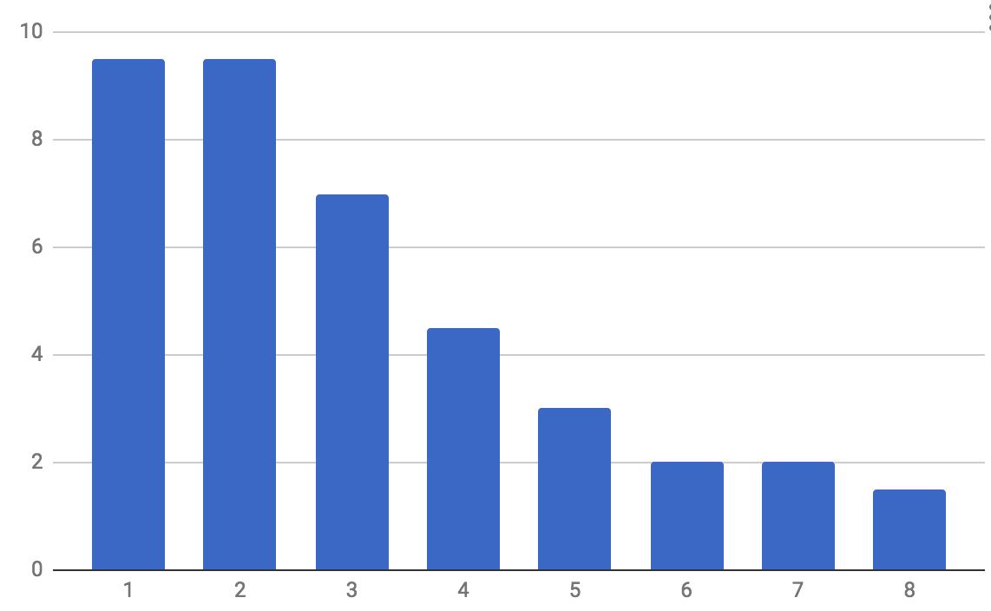
After having catch-up days
participants
Tasks completed

Slide 39
Lesson 4. Introduce OKRs Objective & Key Results Set clear expectations Extra motivation

Slide 40
After having catch-up days
participants
Tasks completed

Slide 41
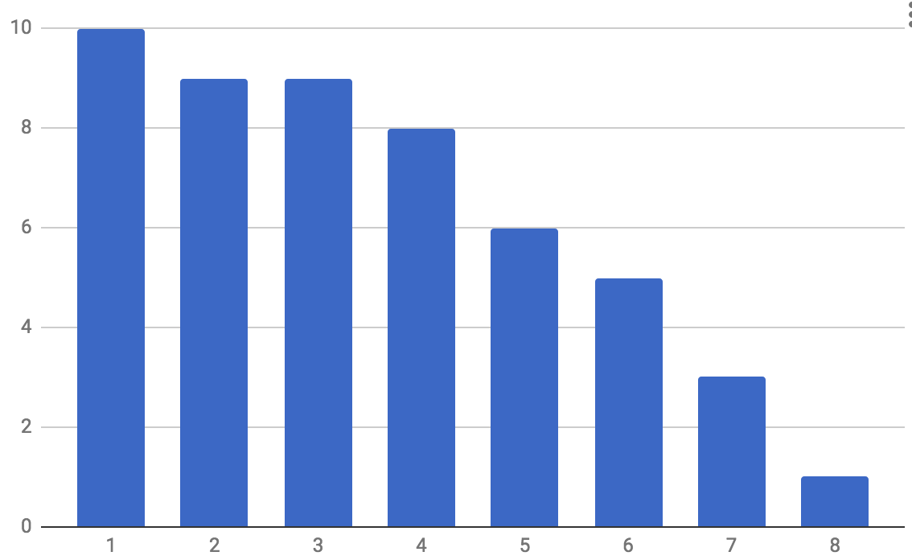
After having OKRs
participants
Tasks completed

Slide 42
Lessons 5, 6, 7 … Collect feedback after each run Improve, improve, improve

Slide 43
Can we measure value?
How to understand that the training is successful?
Did participants learn anything?
Should we continue?

Slide 44
In short term – we can’t!
We provide space for growth, not skills and knowledge
Have to wait long before first results

Slide 45
Feedback is the king
Reviews and feedback is the main indicator of success
Collect feedback online and in person
Collect feedback again after 2-3 months after the finish

Slide 46
“I think the most important insight I got from the Game of Roles (Senior Edition) is that there is no checklist or roadmap to become a senior. It is not about the number of programming languages you've learned or the number of dev tools you know.
Senior is the way of thinking and solving issues, the way of sharing your knowledge with the community.”

Slide 47
“I liked the environment we had in a Workplace group, which made it easy to share experiences and support others.
It also helped a lot to learn about other people and different issues and challenges in the everyday life at work.”

Slide 48
“It motivated me to do things that I would otherwise postpone forever”

Slide 49
Results
We had 3 runs, 80 people in total (10% of developers), 50+ in the waiting list
Highly positive feedback
Support from Talent Development department

Slide 50
What’s next?

Slide 51
“Most of the tasks and questions given seem like they would apply to other senior roles as well, not just backend devs. Any thoughts of opening it up to everyone and give people the opportunity to interact with people in other roles?”

Slide 52
«Franchise»
Currently running:
Team Lead edition
Discussing:
Senior Designer edition
Senior Front End

Slide 53
Game of Roles: Team Lead edition
Framework doesn’t change
Marathon
Online
Group
Tasks are different
Relevant for TL role
More offline activities

Slide 54
Summary

Slide 55
“Change is disturbing when it is done to us, exhilarating when it is done by us.”
Rosabeth Moss Kanter, Harward School of Business

Slide 56
Don’t wait for someone. Act, change!

Slide 57
If set up right, people are able to help themselves together
Community is always stronger then an individual

Slide 58
How to create Game of Roles
Find a partner!
Go online (Facebook or similar platform)
Marathon (every day during 2 weeks)
Groups (up to 20 people)
Find moderators
Small practical and self-reflecting tasks
Don’t ask for 100% completion, but for participation
Give time to rest and catch-up
Constant two-way feedback

Slide 59
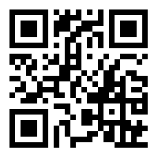
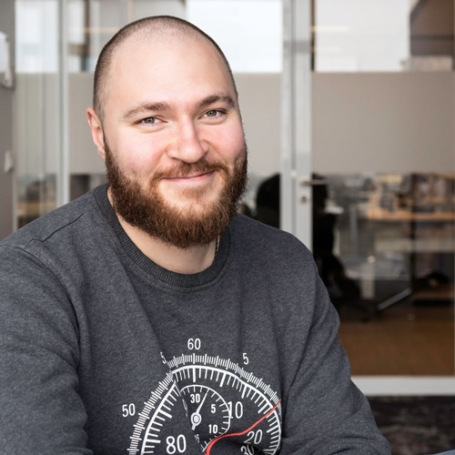
Questions?
Georgiy Mogelashvili
glamcoder.org
fb.com/glamcoder
@glamcoder
Tasks:
https://goo.gl/pkuwdQ

