Slide 1
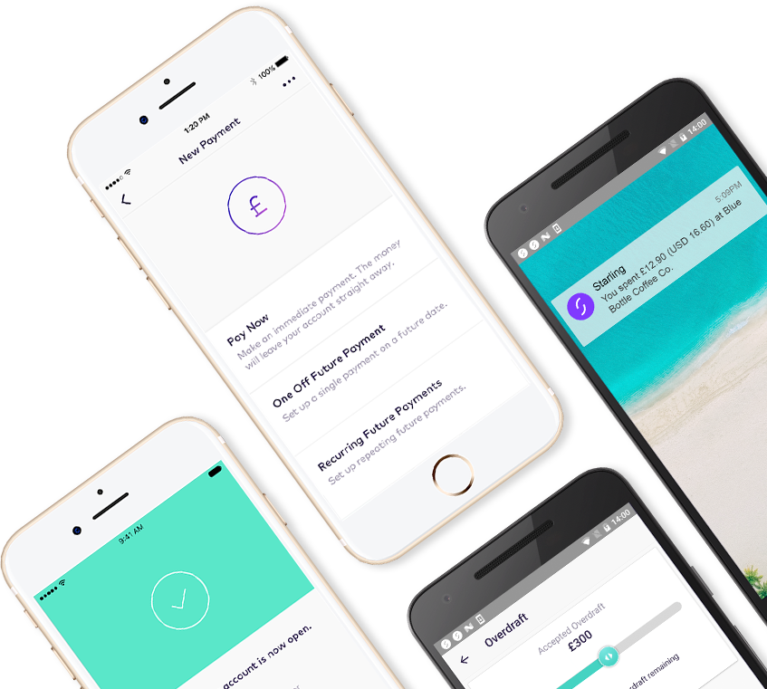
BUILDING A RELIABLE CLOUD BASED BANK IN JAVA
Jason Maude - Senior Engineer
@jasonmaude
Notes:
Introduce me
The reliability vs speed of delivery trade-off is a false dichotomy (as mentioned in Monday morning keynote)
How do you architect your system to remove this trade off?
Why is Java a good language to help you achieve this?

Slide 2
THE PROBLEM WITH BANKING
Notes:
What is the crux of the problem with IT in banking?

Slide 3
“Move fast and break things. Unless you are breaking stuff you are not moving fast enough.”
Mark Zuckerberg
Notes:
The unofficial motto of Facebook (at least it was for time)
It is better to build fast, introduce some bugs, and learn, than to have guaranteed stability
Epitomises the tech start-up culture

Slide 4
“Gringotts was the safest place in the world for something you wanted to hide”
Harry Potter and the Philosopher's Stone by J K Rowling
Notes:
Why is banking so behind when it comes to software?
People are very conservative when it comes to banking, they prioritise security and reliability
Hence the sloooooooowwww nature of releases, slow pace of change
But banking IT is not immune to failure, their failures are just more spectacular
Nor do consumers not want change

Slide 5
A tale of banking woe
Notes:
The story of the major high street bank that botched a rollback...

Slide 6
If you develop, you break things
Notes:
Any change carries with it the possibility of failure, the more complex the system, the more this possibility appears
Once you accept this and build that idea into your software then you can develop with speed and reliability

Slide 7
WHO ARE STARLING BANK?
Notes:
A brief introduction to Starling

Slide 8
Who are Starling Bank?
Tech start-up with a banking licence
~100% cloud-based, mobile-only
Mastercard debit card
DDs and faster payments
Location-enriched transaction feed
ApplePay, GooglePay, FitBitPay...
Spending insights
Granular card control
Open APIs & developer platform
Notes:
We’re a tech start up with a banking license
Almost 100% cloud based bank only on mobile
All the standard features you’d expect in a bank, plus a few more
An open API

Slide 9
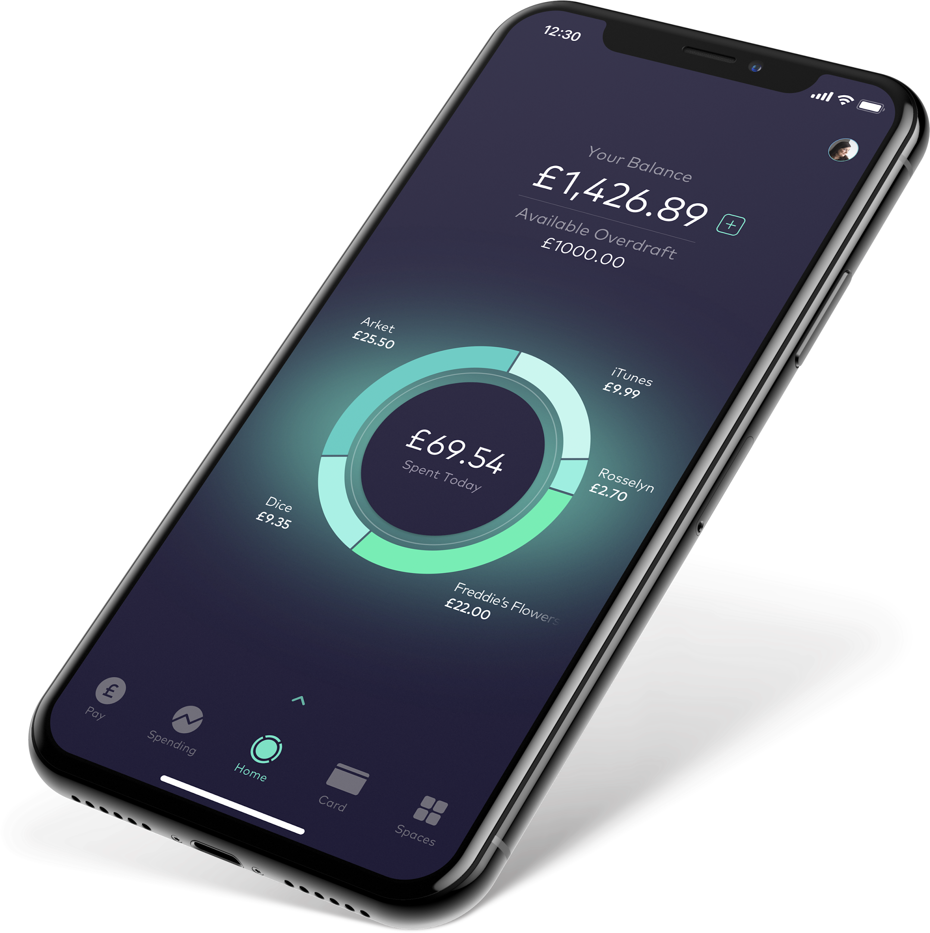
We built a bank in a year
Jan 2014 - Founded by Anne Boden
Jun 2014 - Kick-off with Regulators
Sep 2015 - Technical prototypes
Jul 2016 - Granted a partial banking license
Nov 2016 - Launching the alpha app
Feb 2017 - Launching the beta app
Apr 2017 - Granted a full banking license
May 2017 - Public launch
Mar 2018 - Awarded Best British Bank
Notes:
We started developing the bank in around July 2016 and launched in May 2017
In March 2018 we were awarded the Best British Bank at the British Banking Awards
So how did we do this...

Slide 10
BUILDING RELIABLE ARCHITECTURE

Slide 11
Self-contained systems
http://scs-architecture.org
Notes:
Rather than the traditional banking monolith or microservices we decided to take an approach in-between these two
Self contained systems are systems designed to do a particular job that have:
Their own data
Their own logic
Their own APIs
Examples include:
A system to process card payments
A system to send out payments to other banks
A system to maintain the ledger
We don’t fully follow the SCS architecture, but we take a reasonable amount from it.
These are not microservices (more micro-liths)

Slide 12
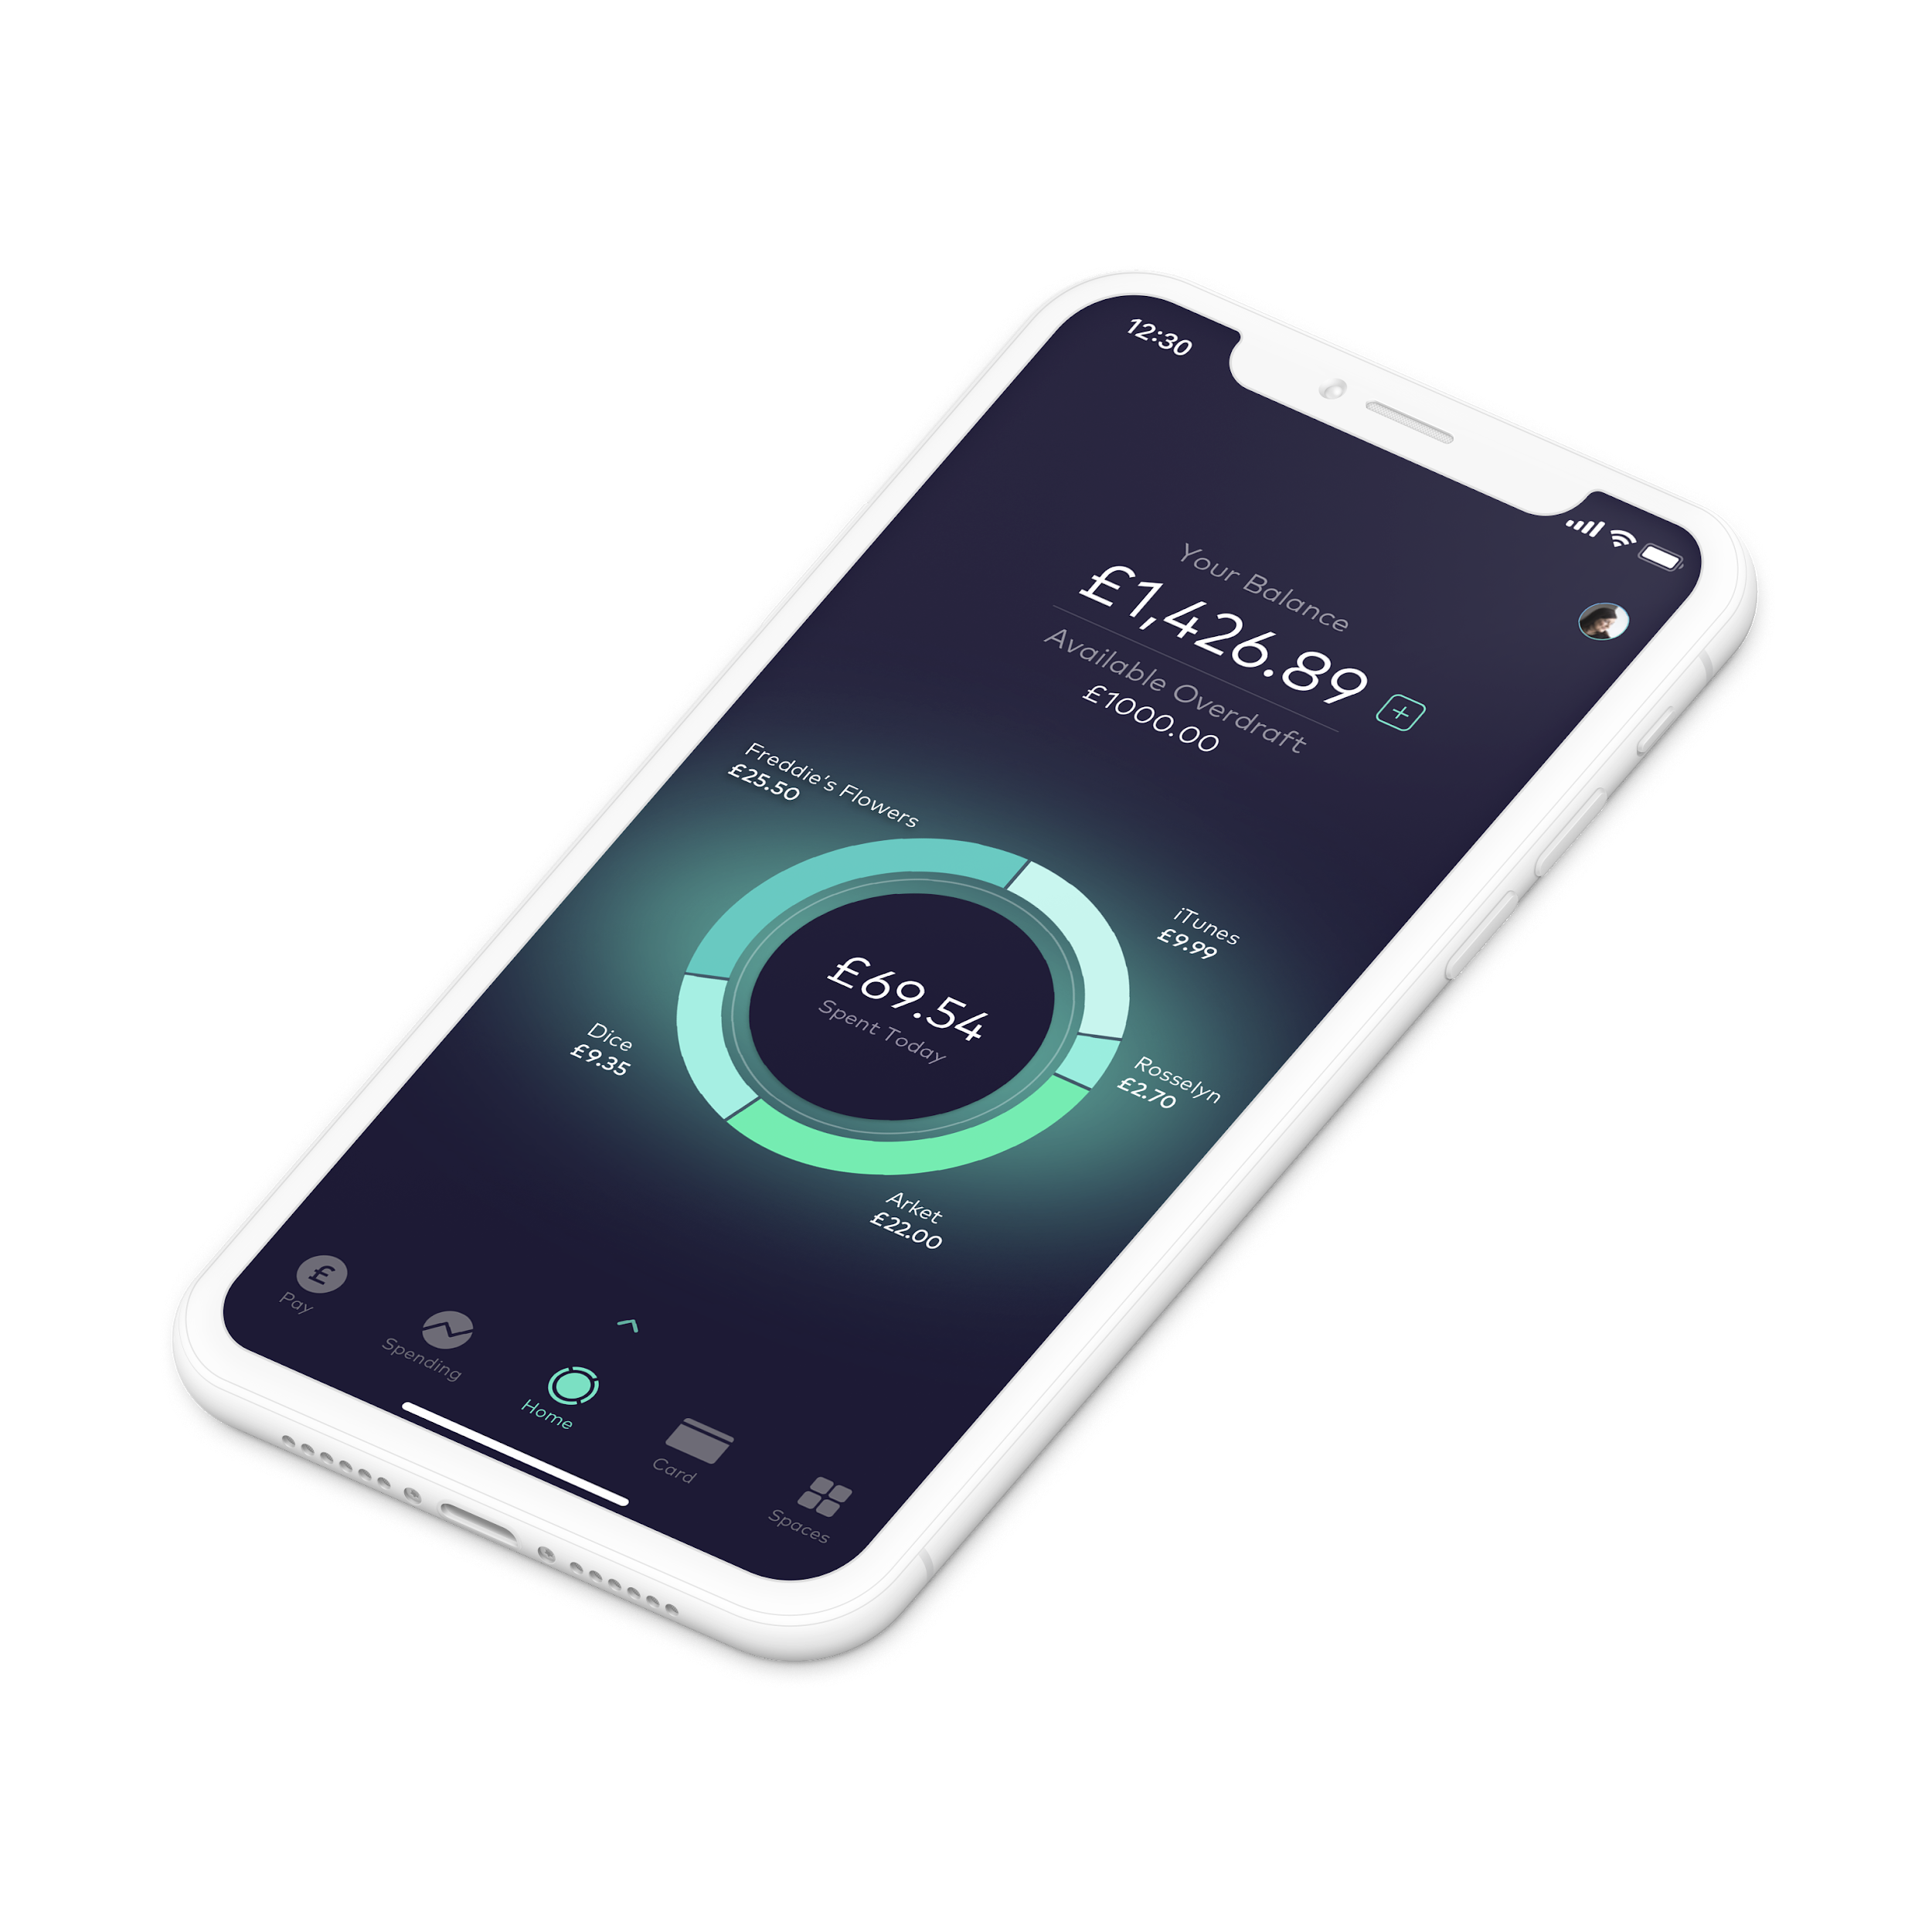
Self-contained systems
Notes:
Multiple instances of each service running in EC2 instances
All services have their own Postgres database run in an RDS instance
Inter-service comms is async (mostly) via a REST API
Mobile & management layers integrates data from different services
No distributed transactions
No start-up dependencies

Slide 13
Recovery in distributed architectures
Notes:
Hypothetically if you have two systems...
The usual problem with recovery in distributed architectures is that the systems are too trusting (in the business logic sense)
When one system goes rogue with a bug or is compromised, all the other systems can be infected
You want the systems to be mistrusting and automatically recover

Slide 14
L.O.A.S.C.T.T.D.I.T.T.E.O.
Notes:
Lots Of Autonomous Services Continually Trying To Do Idempotent Things To Each Other
Explain idempotency here

Slide 15
DITTO architecture
(do idempotent things to others)
Notes:
We shortened this to: Do Idempotent Things To Others
Thanks to Adrian Cockcroft from AWS for this suggestion

Slide 16
DITTO architecture
Do everything at least once and at most once
Retry (at least once)
Idempotency (at most once)
Work towards correctness, eventual consistency
Reduce synchronicity to a minimum
Save all requests to the database first
Keep the smarts in the services, not in the pipes
No distributed transactions
Do not trust other services
Notes:
“At least once” and “At most once” may suggest just “once”, but the difference is that it highlights the two error cases that you must avoid
Systems all trying to work towards eventual consistency
All requests are saved to the db first so that they can be caught up later if needed
The smarts are in the services, the pipes between them are dumb
There are no distributed transactions, therefore you must anticipate any particular process failing half-way through
Above all mistrust other services

Slide 17
DITTO in action
customer
payment
bank
POST
Make a payment
201 Created {uuid}
PUT {uuid}
202 Accepted
PUT {uuid}
202 Accepted
Notes:
An example of DITTO architecture in action
A customer is making a payment from their bank account to bank account in another bank.
The whole action requires many individual steps including:
Changing the balance
Sending the payment to FPS
Recording the payment in the ledger
At each stage the amount of synchronous processing is as low as possible, the request is validated and logged, then processed
The processing is farmed out to a different thread

Slide 18
customer
payment
bank
POST
201 Created {uuid}
PUT {uuid}
retry
Retry provides “at least once”
PUT {uuid}
202 Accepted
PUT {uuid}
retry
PUT {uuid}
Idempotency provides “at most once”
202 Accepted
Notes:
That was the good path, this is the bad path.
The first problem to solve is the “at least once” problem
Customer tries to contact payment, but payment isn’t there
Customer waits 5 minutes, then retries
This keeps happening until payment comes back and returns a 200 response
The second problem to solve is the “at most once” problem
Payment contacts bank, but gets not response
… but bank has actually processed
Payment contacts bank 5 minutes later
Bank acknowledges the request as successful, but does nothing - idempotency

Slide 19
Catch-up processing
Catch Up Processor
RC
RC
RC
Notes:
This DITTO architecture is implemented with two key concepts, coded as interfaces:
The recoverable command is an idempotent command that processes a single work item and then marked it as processed in the db
The catch up processor finds unprocessed items and farms them out to different threads that can be processed

Slide 20
But why Java?
Exceptions are noisy and difficult to ignore
Reliable ecosystem (user base, tooling, job market, etc)
Integrations with legacy third parties (SOAP etc)
Notes:
Why Java as the language of choice?
Exceptions are noisy, difficult to ignore - this is good for us as a problem, bug in the system will be clearly highlighted (repeatedly)
We don’t leave on-call floating in the wind, we rally round them
Reliable ecosystem in terms of the user base, tooling, jobs, etc (more on this later) - reliability in the long term as well as per transaction
Integrations with legacy 3rd parties easier
We can experience problems there, but most of them have a basic level of idempotency built in

Slide 21
THE BENEFITS
OF DITTO
ARCHITECTURE

Slide 22
Instance termination is safe
Notes:
You can lose an instance and the system will automatically recover, this has many benefits
This even applies to the databases, since the first action of most interactions with a service is to save the request to the db

Slide 23
Continual delivery of back-end
Continual deployment to non-prod, sign-off into prod
Auto build, dockerise, test, scan, deploy < 1h
Code released to production up to 5 times a day
Notes:
You can deliver fast
Since you can safely kill instances at any time and still catch up with where you were, you can deploy code regularly
We still get sign off to go to production, regulators require this
But that doesn’t stop us deploying usually once or twice a day (once up to 5 times)

Slide 24
Bi-modal banking IT
Incumbent banks operate:
legacy backends that move at glacial pace
… and try to iterate the customer experience faster
We release the backend at 10x the rate of the mobile apps
1-5 backend software releases per day
1-2 infrastructure releases per day
mobile apps released weekly or fortnightly
Notes:
Consultants invented this term to try and justify the glacial pace of back end server releases
Releasing twice a day may not seem like a big thing, but in banking it is huge
The traditional model has back end server code being release once in a blue moon, and the UI trying to give the customers what they need without it changing
Usually at Starling the mobiles are the ones playing catch up

Slide 25
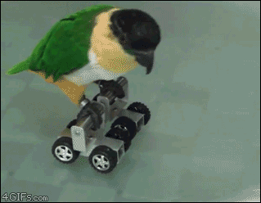
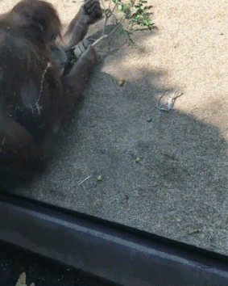
The “rolling” giphy
Our auditors loved this one
Yes it’s in our release documentation
Clear signal in engineering channel that is release in progress
Notes:
We’re a regulated bank, so we have to let the organisation know when a back-end release is happening
So we created the rolling gif

Slide 26
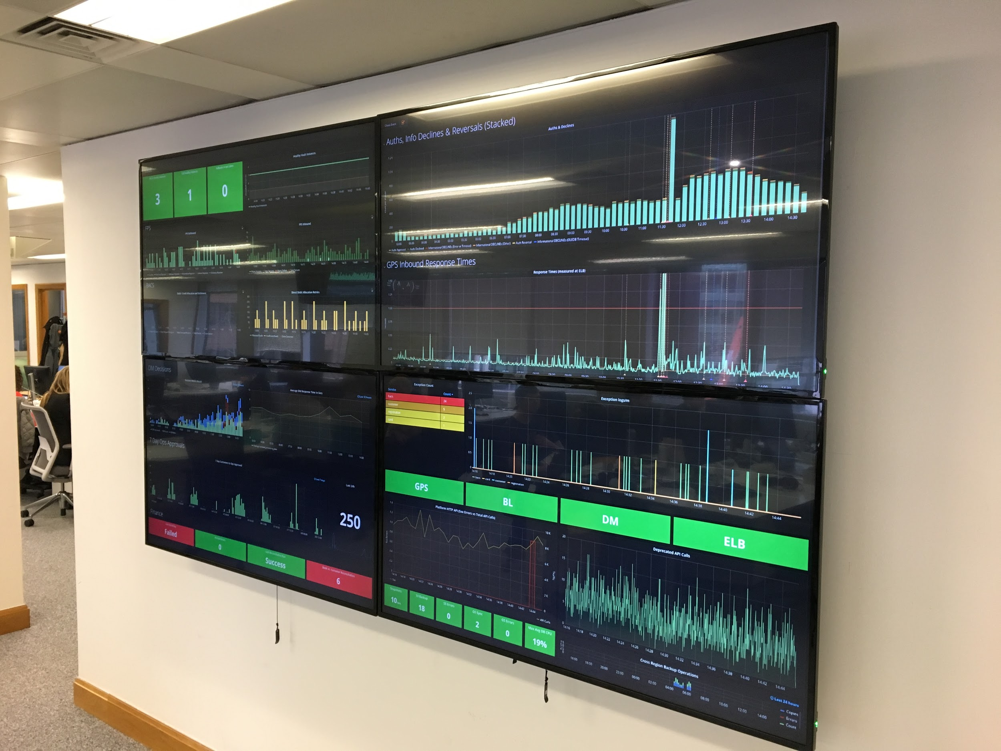
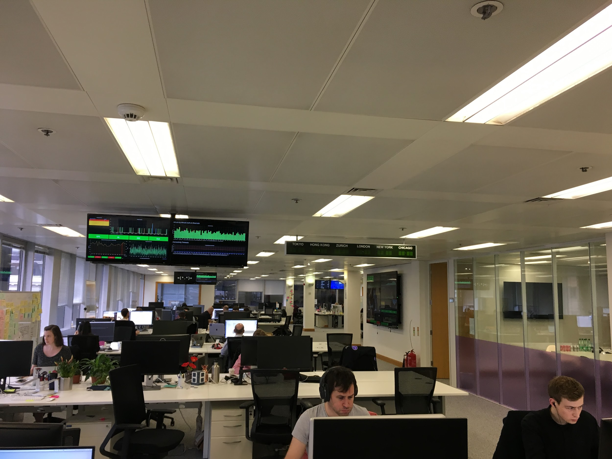
… and if something goes wrong...
Notes:
Make it visible and obvious that something is going wrong so that it can be fixed
When you do fix it, then the system catches up again and you can see the errors go away

Slide 27
Testing
Chat-ops via Slack
Available to all developers
Notes:
You can test losing instances through chat ops

Slide 28
Chaos
Notes:
… and we even employ a much simplified version of the Simian Army in production, to kill instances at random
We test RDS failover in demo (though not yet regularly in prod).

Slide 29
THE FUTURE
Notes:
So what next? Two topics: scale and the JVM

Slide 30
DITTO at scale: Self DOS
Catch Up Processor
Notes:
A broken item can cause a catch up processor in one service to spam another
Solution: work queue management system

Slide 31
DITTO at scale: Racing to work
Notes:
The duplicate work queue problem
Two instances both pick the same item at the same time
Idempotency checks don’t stop the problem, because both instances find that the item hasn’t been processed
Still maintaining the principle of the smarts in the services, not in the pipes.

Slide 32
The future of the JVM
Java as an ecosystem
Is the upgrade to Java 9/10/11 worth it?
Could someone else steal the crown?
Notes:
Java (like other languages) has managed to build up an ecosystem of a talent pool, tools, libraries, etc that make it easy to use
A lot of this build up was due to Java’s ability to be backwards compatible, code written in 6 could be run in 7 etc.
However 9+ has changed the visibility of many objects in core Java that were being depended on, so a whole load of dependencies need upgrading.
Encountering problems upgrading to Java 9+, will this be the end of Java’s crown?

Slide 33
SOME
IMPORTANT
TAKEAWAYS

Slide 34
Design software to be skeptical
Notes:
The cloud has abstracted us away from hardware, but that doesn’t mean you can stop thinking about failure.
The software is still going to be the biggest source of failure.

Slide 35
Give EVERYTHING a UUID
Notes:
UUIDs help idempotency no end

Slide 36
Fire alarms are good
Notes:
Repeated noisy failures are a guarantee of reliability, think long and hard before squashing

Slide 37
You can do anything you can undo

Slide 38
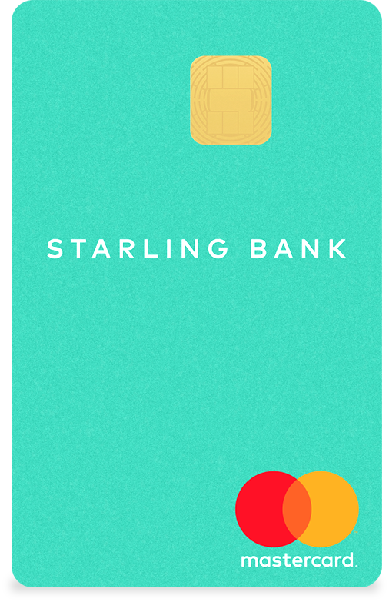
Thank you!
Check out the Starling Developer Podcast!
https://developer.starlingbank.com
@jasonmaude

